Slide 1
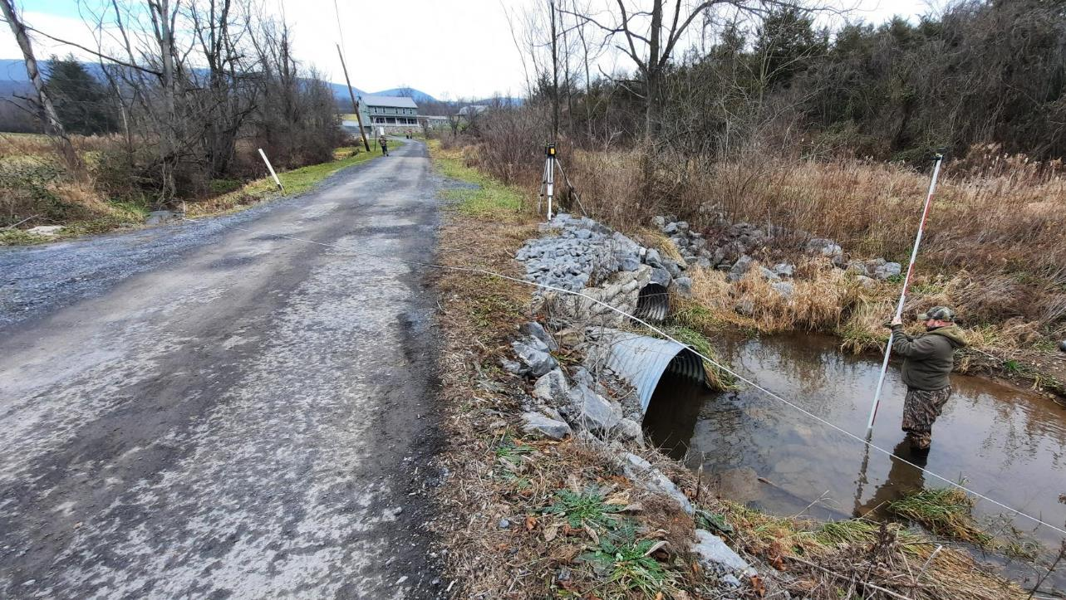
Dirt Gravel and Low Volume Road Program
WEBINAR
5/20/22
Starts 9am
DGLVR Approvals: May 2022 SCC Mtg
CDGRS
Steve Bloser
smb201@psu.edu
SCC
Roy Richardson
rrichardso@ps.gov
If you are reading this, then you are successfully seeing the webinar video. Webinar audio should be automatic through your computer (or click “join audio”), and options can be accessed in the “audio options” button on the bottom left. If your computer audio is not working, you can listen on your phone by dialing 646-876-9923.

Slide 2
DGLVR Actions from May SCC Meeting
Purpose
Provide General Overview and answer questions on DGLVR approvals from May SCC Mtg
CD Allocations
DSA Changes
Stream Crossing Documents
Admin Manual Changes
Note this will not be a “deep dive” into the stream documents, we are planning separate webinars for that
www.dirtandgravelroads.org

Slide 3
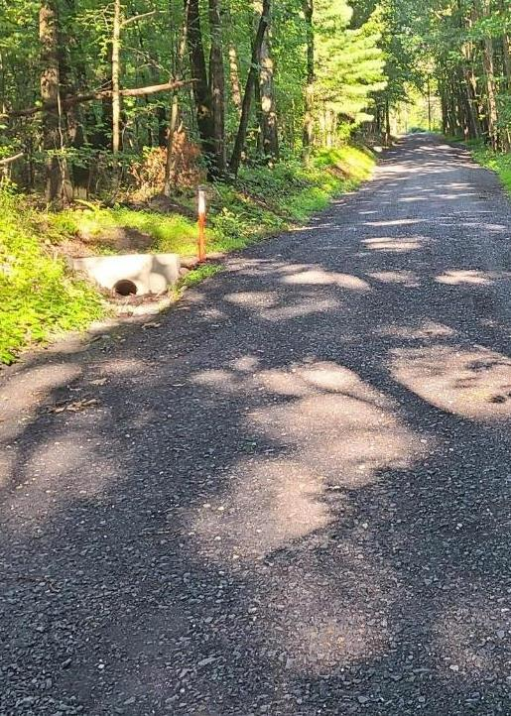
DGLVR Items Approved at May SCC Mtg
Proposed FY 2022-23 DGLVR Conservation District Allocations (A)
Proposed Changes to DGLVR Driving Surface Aggregate (DSA) Standard (A)
Proposed DGLVR Stream Crossing Documents (A)
Policy – revised
Standard – new
Technical Manual – new
Proposed Changes to DGLVR Administrative Manual (A)

Slide 4
Conservation District Allocations
Conservation District DGLVR Allocations – pending state budget approval
DGR ($20M) and LVR ($8M) allocated separately
Allocations are formula driven
No changes to either formula for FY 2022-23
Minor changes in allocations due to:
Difference in # of counties eligible for allocations
Changes in base data used in formulas
www.dirtandgravelroads.org

Slide 5
Conservation District Allocations
Dirt and Gravel ($20M) Allocations– pending state budget approval
Based on miles of unpaved road, miles of potential project site, HQ/EV watersheds, and cost of limestone
No changes to Formula
On average: ~3% decrease for 22-23 (more counties eligible this year versus 21-22)
Largest increase 20% ($22K) for Lehigh (identified new worksites)
Largest decrease 6% ($23K) for Washington (decrease in limestone cost)
www.dirtandgravelroads.org

Slide 6
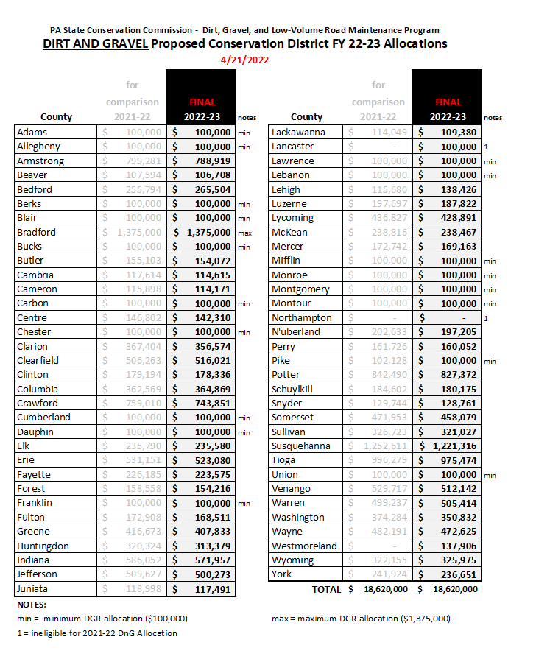
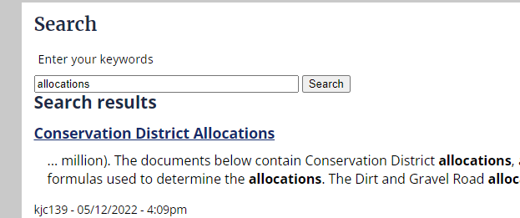
Conservation District Allocations
Dirt and Gravel ($20M) Allocations
Allocations provided in SCC handout for May meeting
Allocations available on CDGRS website, just search “allocations”
Pending State Budget approval
www.dirtandgravelroads.org

Slide 7
Conservation District Allocations
Paved Low Volume ($8M) Allocations– pending state budget approval
Based on miles potential Low Volume Roads, weighted based on proximity to stream and urban/rural classification
No Changes to Formula
Changes to base data
2020 Census data: updated “urban area” designation
Roads: updated layer with updated pavement status
Streams: minor updates to stream layer
www.dirtandgravelroads.org

Slide 8
Conservation District Allocations
Paved Low Volume ($8M) Allocations– pending state budget approval
Based on miles potential Low Volume Roads, weighted based on proximity to stream and urban/rural classification
No Changes to Formula
Changes to base data
2020 Census data: updated “urban area” designation
Roads: updated layer with updated pavement status
Streams: minor updates to stream layer
Allegheny Example
www.dirtandgravelroads.org

Slide 9
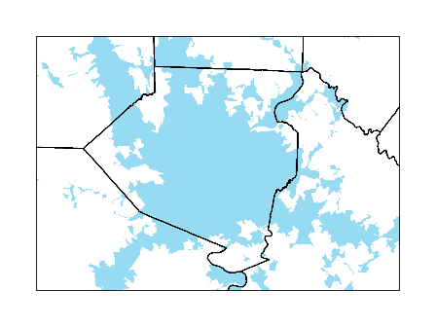
Conservation District Allocations
Paved Low Volume ($8M) Allocations– pending state budget approval
2020 Census data: updated “urban area” designation
Allegheny Example
2018 “Urban Areas”
www.dirtandgravelroads.org

Slide 10
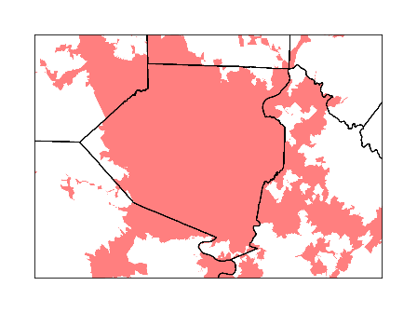
Conservation District Allocations
Paved Low Volume ($8M) Allocations– pending state budget approval
2020 Census data: updated “urban area” designation
Allegheny Example
2018 “Urban Areas”
2020 “Urban Areas”
www.dirtandgravelroads.org

Slide 11
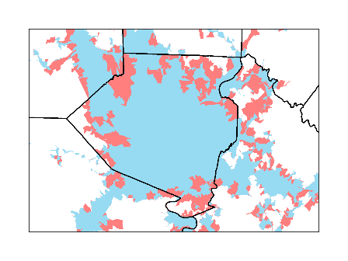
Conservation District Allocations
Paved Low Volume ($8M) Allocations– pending state budget approval
2020 Census data: updated “urban area” designation
Result:
- Allegheny County had 235 miles of LVR change from “rural” to “urban”
- Urban roads weighted less, led to 5% ($14K) allocation reduction
Allegheny Example
Pink = areas changed from “rural” to “urban”
2018 “Urban Areas”
2020 “Urban Areas”
www.dirtandgravelroads.org

Slide 12
Conservation District Allocations
Paved Low Volume ($8M) Allocations– pending state budget approval
Based on miles potential Low Volume Roads, weighted based on proximity to stream and urban/rural classification
No Changes to Formula
Changes to base data
2020 Census data: updated “urban area” designation
Roads: updated layer with updated pavement status
Streams: minor updates to stream layer
On average: + 7% allocation change for all districts
One exception, an increase of 20% ($21K) for Greene (roads reclassified as paved)
www.dirtandgravelroads.org

Slide 13
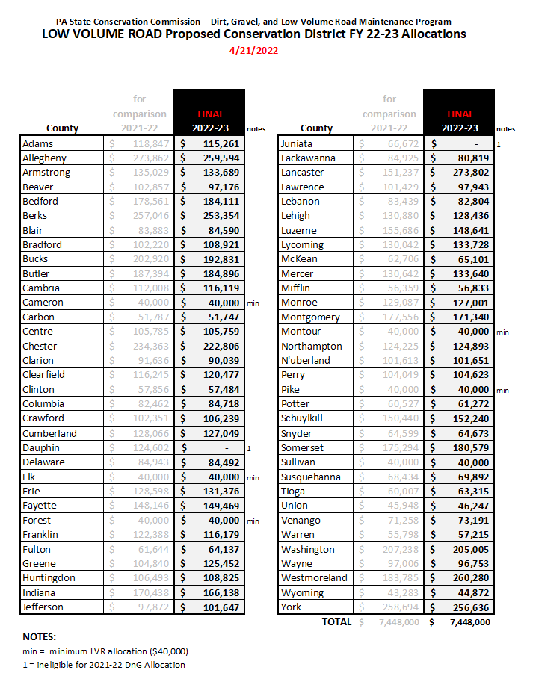
Conservation District Allocations
Low Volume Road ($8M) Allocations
Allocations provided in SCC handout for May meeting
Allocations available on CDGRS website, just search “allocations”
Pending State Budget approval
www.dirtandgravelroads.org

Slide 14
DGLVR Items Approved at May SCC Mtg
Proposed FY 2022-23 DGLVR Conservation District Allocations (A)
Proposed Changes to DGLVR Driving Surface Aggregate (DSA) Standard (A)
Proposed DGLVR Stream Crossing Documents (A)
Policy – revised
Standard – new
Technical Manual – new
Proposed Changes to DGLVR Administrative Manual (A)

Slide 15
Stream Crossing Documents
Note: Changes effective 7/1/22
Contracts signed before 7/1/22 must follow existing DSA standard
www.dirtandgravelroads.org

Slide 16
Driving Surface Aggregate
Driving Surface Aggregate
Two changes for 2022:
Abrasion Resistance (LA Abrasion)
Increase minimum from 40 to 45 (this is a loosening of spec)
Done to be consistent with PennDOT specifications
Paver placement requirement: Decrease threshold where paver is required from current 1,000 tons to proposed 500 tons. Require carbide tipped grader blades for placements under 500 tons that are not paver placed.
Effective July 1, 2022
www.dirtandgravelroads.org

Slide 17
DGLVR Items Approved at May SCC Mtg
Proposed FY 2022-23 DGLVR Conservation District Allocations (A)
Proposed Changes to DGLVR Driving Surface Aggregate (DSA) Standard (A)
Proposed DGLVR Stream Crossing Documents (A)
Policy – revised
Standard – new
Technical Manual – new
Proposed Changes to DGLVR Administrative Manual (A)

Slide 18
Stream Crossing Documents
Note: Changes effective 7/1/22
Contracts signed before 7/1/22 must follow existing policy, not required to follow standard.
Use of standard and new guidance is ENCOURAGED for contracts signed before 7/1/22.
May require amendments to existing contracts.
www.dirtandgravelroads.org

Slide 19
Stream Crossing Documents
Effective July 1, 2022
Stream Crossing Documents
Note this will NOT be a “deep dive” into the documents
Three separate webinars scheduled for next week, will be recorded:
Policy: 5/25, 9am
Standard: 5/26, 9am
Technical Manual: 5/27, 9am
These will also serve as “primers” for stream trainings.
www.dirtandgravelroads.org

Slide 20
Stream Crossing Documents
Effective July 1, 2022
POLICY
Eligibility Policy: UNCHANGED Crossings must be undersized (75% or less of bankfull channel width) to qualify for funding.
Replacement Structures:
Have a structure width at least equal to bankfull width (100 percent ratio).
Be properly aligned with the channel when possible.
Consider additional floodplain connectivity when possible.
Be designed and constructed to accommodate the passage of aquatic organisms through the structure.
Must follow (NEW) DGLVR Stream Crossing Replacement Standard
More CD involvement: initial site assesment, site meetings, plan review, inspection during installation, CD training requirement
Exemptions for smaller channels or special circumstances.
Example: small spring seep
Example: steep channel with natural AOP barriers
www.dirtandgravelroads.org

Slide 21
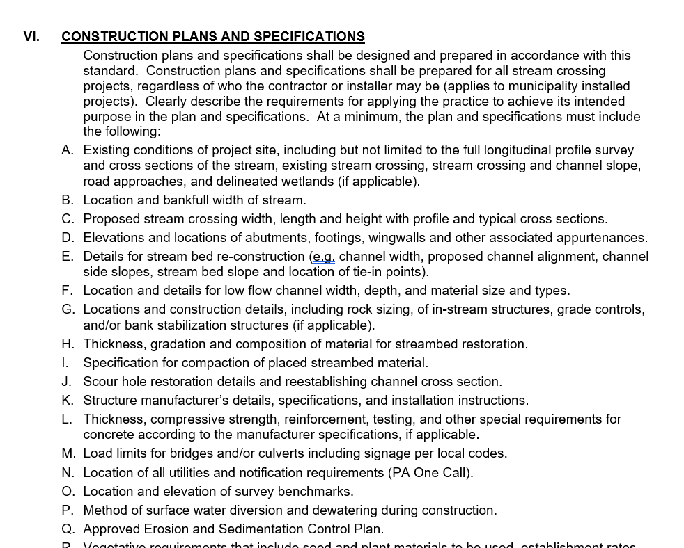
Stream Crossing Documents
STANDARD (new)
Increase minimum structure width from 100% to 125% bankfull channel
Require added streambed depth in structures, and low-flow channels
Require longitudinal profile survey with goal of stream continuity
Require bottomless structures over certain slopes (4%)
Require CDs to review permit plan and bid package
Construction design plan requirements for engineers
Increased oversight and inspection from engineers
Engineer certification
Effective July 1, 2022
www.dirtandgravelroads.org

Slide 22
Stream Crossing Documents
Effective July 1, 2022
TECHNICAL MANUAL (new)
Introduction
Understanding the standard
Initial Site Assessment
Longitudinal Profile Survey
Grant Application (Material Selection & Cost Estimation)
QAB Ranking & Review
Writing a Contract
From Contract to Construction
Installation and Constructions Inspection (active project oversight)
Final Inspection & As-built Notes
Maintenance
Engineering Design, Permitting, and Bidding a Stream Crossing
Technical Manual does not contain additional requirements not already specified in Policy or Standard.
Chapters 1 & 2 are background and spec detail
Chapters 3-11 in chronological order and directed at CDs
Chapter 12 directed at engineers
www.dirtandgravelroads.org

Slide 23
Stream Crossing Documents
Stream Crossing Trainings
Had “internal” test run of trainings this week.
6 Regional trainings Scheduled June through December.
Each training consists of 4 virtual and 2 in-field sessions over two weeks.
www.dirtandgravelroads.org

Slide 24
Stream Crossing Documents
Stream Crossing Trainings
Had “internal” test run of trainings this week.
6 Regional trainings Scheduled June through December.
Each training consists of 4 virtual and 2 in-field sessions over two weeks.
Week #1
Session #1 - Virtual – Initial Site Assessment / Stream Morphology / Admin Manual & Stream Standard Requirements
Session #2 – Field – Initial Site Assessment / Stream Evaluation Form / Waivers / Longitudinal Profile Survey / Cross Sections / Reference Reach / Field Measurement Data Entry
Session #3 - Virtual – Developing Project Recommendations for Grant Estimation / Stream Crossing Notification Requirements
Week #2
Session #4- Virtual - Request for Proposal Template / Pre-Design Meeting / Draft Permit & Construction Plan Review for DGLVR Program Consistency
Session #5 – Virtual -Bid Documents & Shop Drawing reviews for DGLVR Program Consistency / Municipal Bid Site Showings
Session #6 - Field – Pre-Construction Meeting / Project Implementation & Construction Inspection / Engineer Certification / Project Completion Reporting
www.dirtandgravelroads.org

Slide 25
Stream Crossing Documents
Stream Crossing Trainings
Trainings taken this year WILL COUNT for certification requirement that goes into place 7/1/2023 (currently a 3-year certification).
Full Details online, registration is open, limited to 15 per session. (NW is full)
www.dirtandgravelroads.org

Slide 26
DGLVR Items Approved at May SCC Mtg
Proposed FY 2022-23 DGLVR Conservation District Allocations (A)
Proposed Changes to DGLVR Driving Surface Aggregate (DSA) Standard (A)
Proposed DGLVR Stream Crossing Documents (A)
Policy – revised
Standard – new
Technical Manual – new
Proposed Changes to DGLVR Administrative Manual (A)

Slide 27
DGLVR Administrative Manual
DGLVR Administrative Manual
Current version July 2020
Significant Changes
DSA Standard Changes (already covered)
Stream Crossing Replacement Policy (already covered)
Stream Crossing Replacement Standard (already covered)
Most other changes minor clarifications
Effective July 1, 2022
www.dirtandgravelroads.org

Slide 28
DGLVR Administrative Manual
DGLVR Administrative Manual
Notable changes:
3.4.2 – Clarification on Cost Allocation Methodology, administrative and education expenses
3.5.3 – Increased threshold for amendments from 20% to 40% of original contract amount
3.7.4 – Clarification on when headwalls and end walls must be used
3.7.4 – Increased maximum allowed for engineering costs from 10% to 20% of contract amount with a $25,000 cap
7.2.3 – Fill exemption for DSA: changed from requiring a minimum of 12 inches of road fill including the thickness of the driving surface to a minimum of 12 inches not including the driving surface
Appendices added or updated:
Appendix E – New appendix to show examples of cost allocation methods
Appendix F – The DSA Standard and Specification with the proposed new changes
Appendix G – The proposed new Stream Crossing Replacement Standard
Appendix H – Stream Crossing Replacement evaluation
Appendix I – Exemptions from Stream Crossing Standard
Effective July 1, 2022
www.dirtandgravelroads.org

