Slide 1
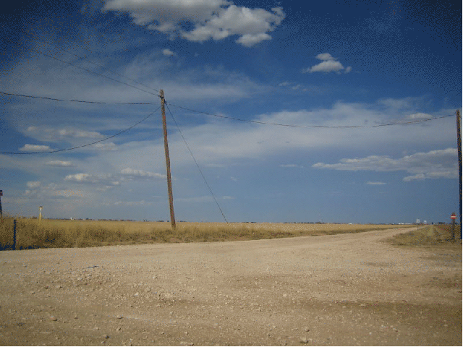

DGLVR Webinar
DGLVR
Municipal Bidding
4/14/20
Starts at 9am
If you are reading this, then you are successfully seeing the webinar video. Webinar audio should be automatic through your computer, and options can be accessed in the “audio options” button on the bottom left. If your computer audio is not working, you can listen on your phone by dialing 646-876-9923.

Slide 2
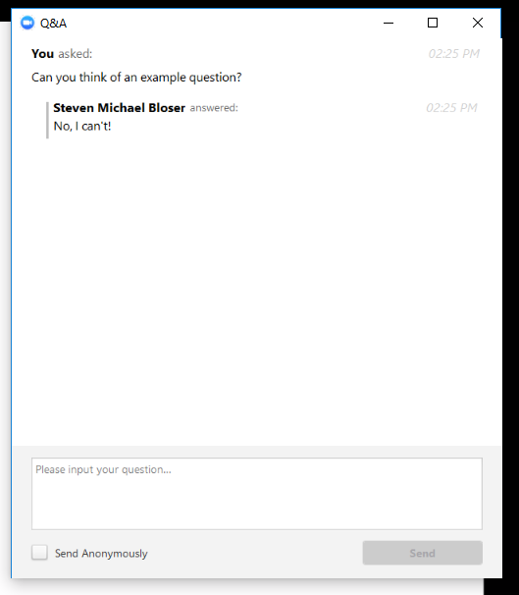
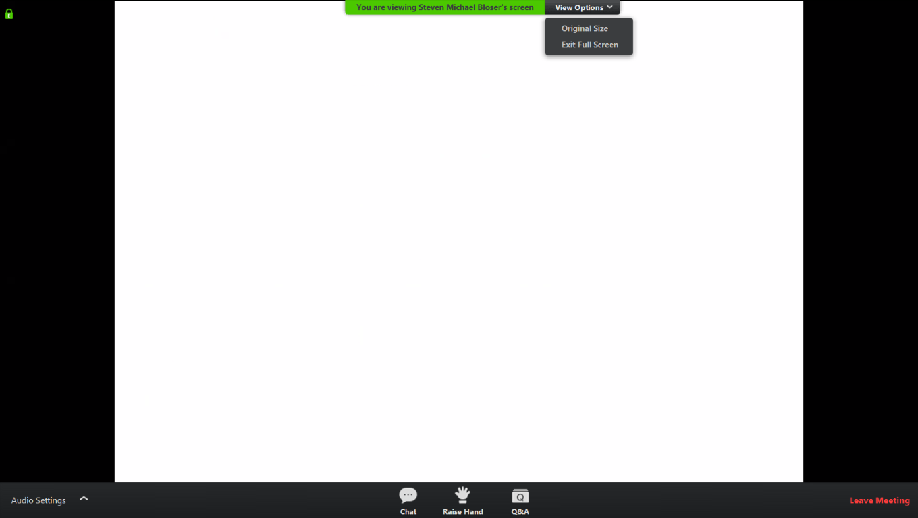
Q&A
Note you can ask a question anonymously
Q&A
For audio via phone: 646-876-9923
Slide #

Slide 3
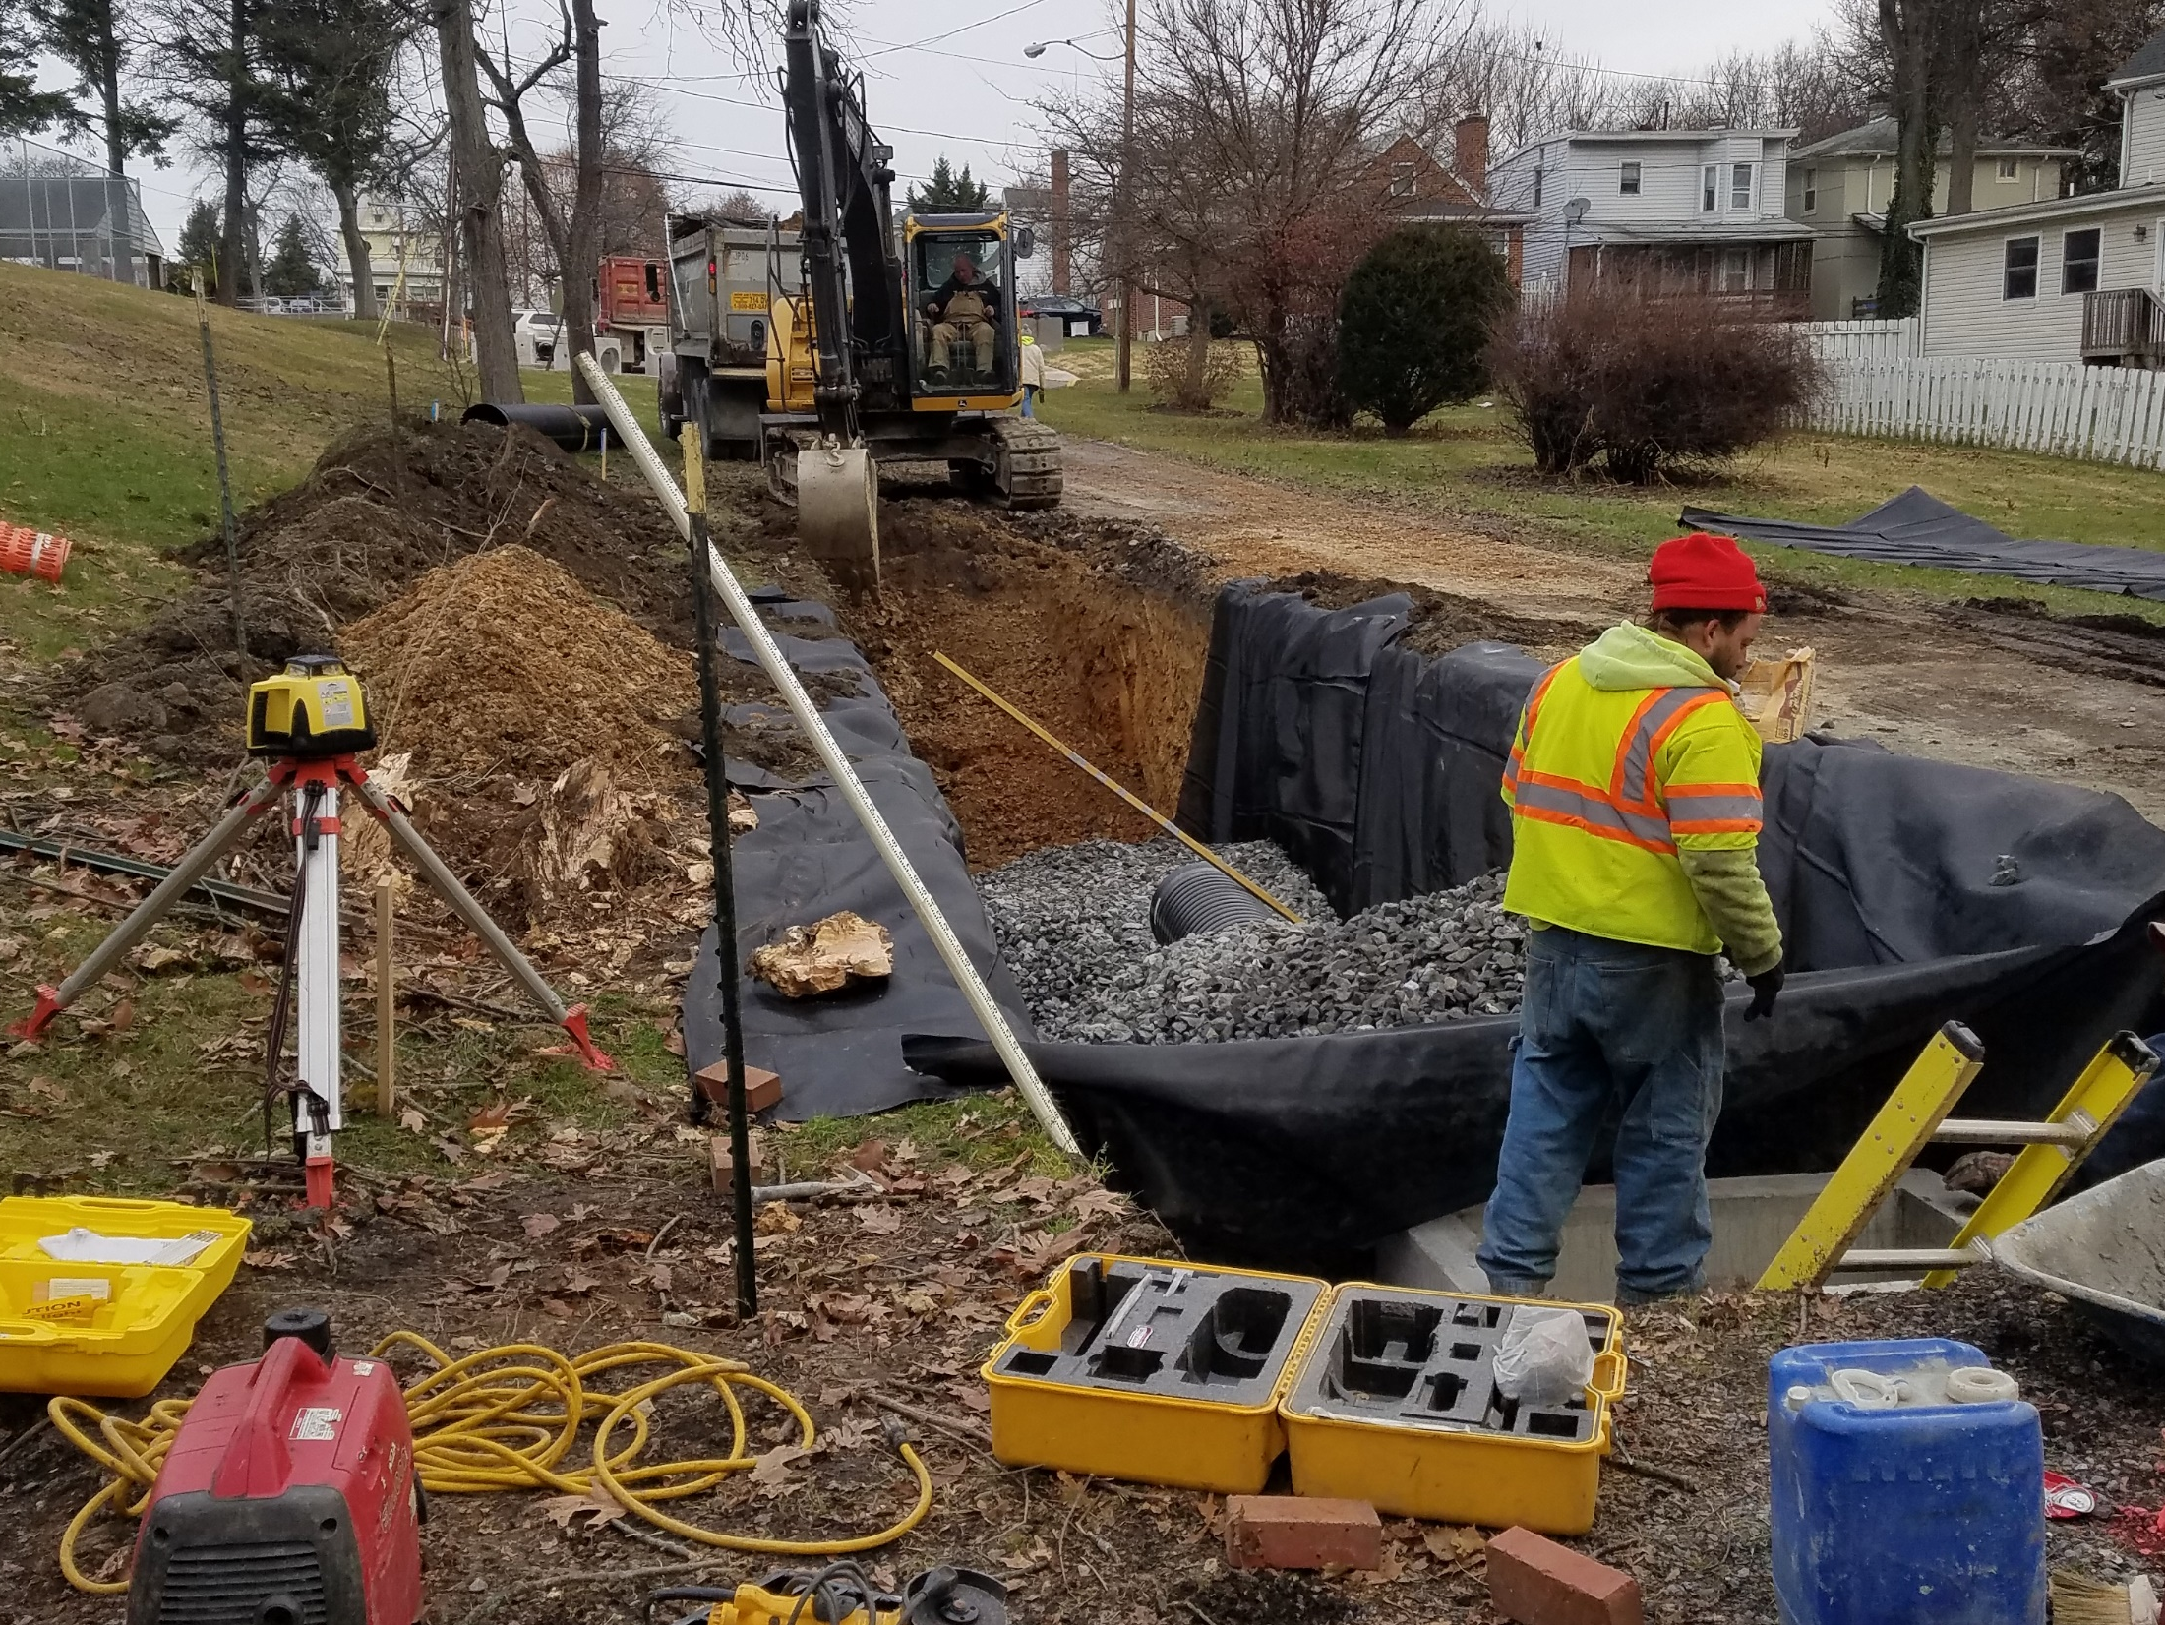
DGLVR Municipal Bidding

Slide 4
DGLVR Municipal Bidding
Why is Project Bidding Important?
Quality bidding documents are vital to successful projects
Clear and concise plans and information is required for contractor to understand the project scope and goals.
Contractual agreement – needs to be well planned to avoid conflict, confusion, & delay during the construction process.
For audio via phone: 646-876-9923

Slide 5
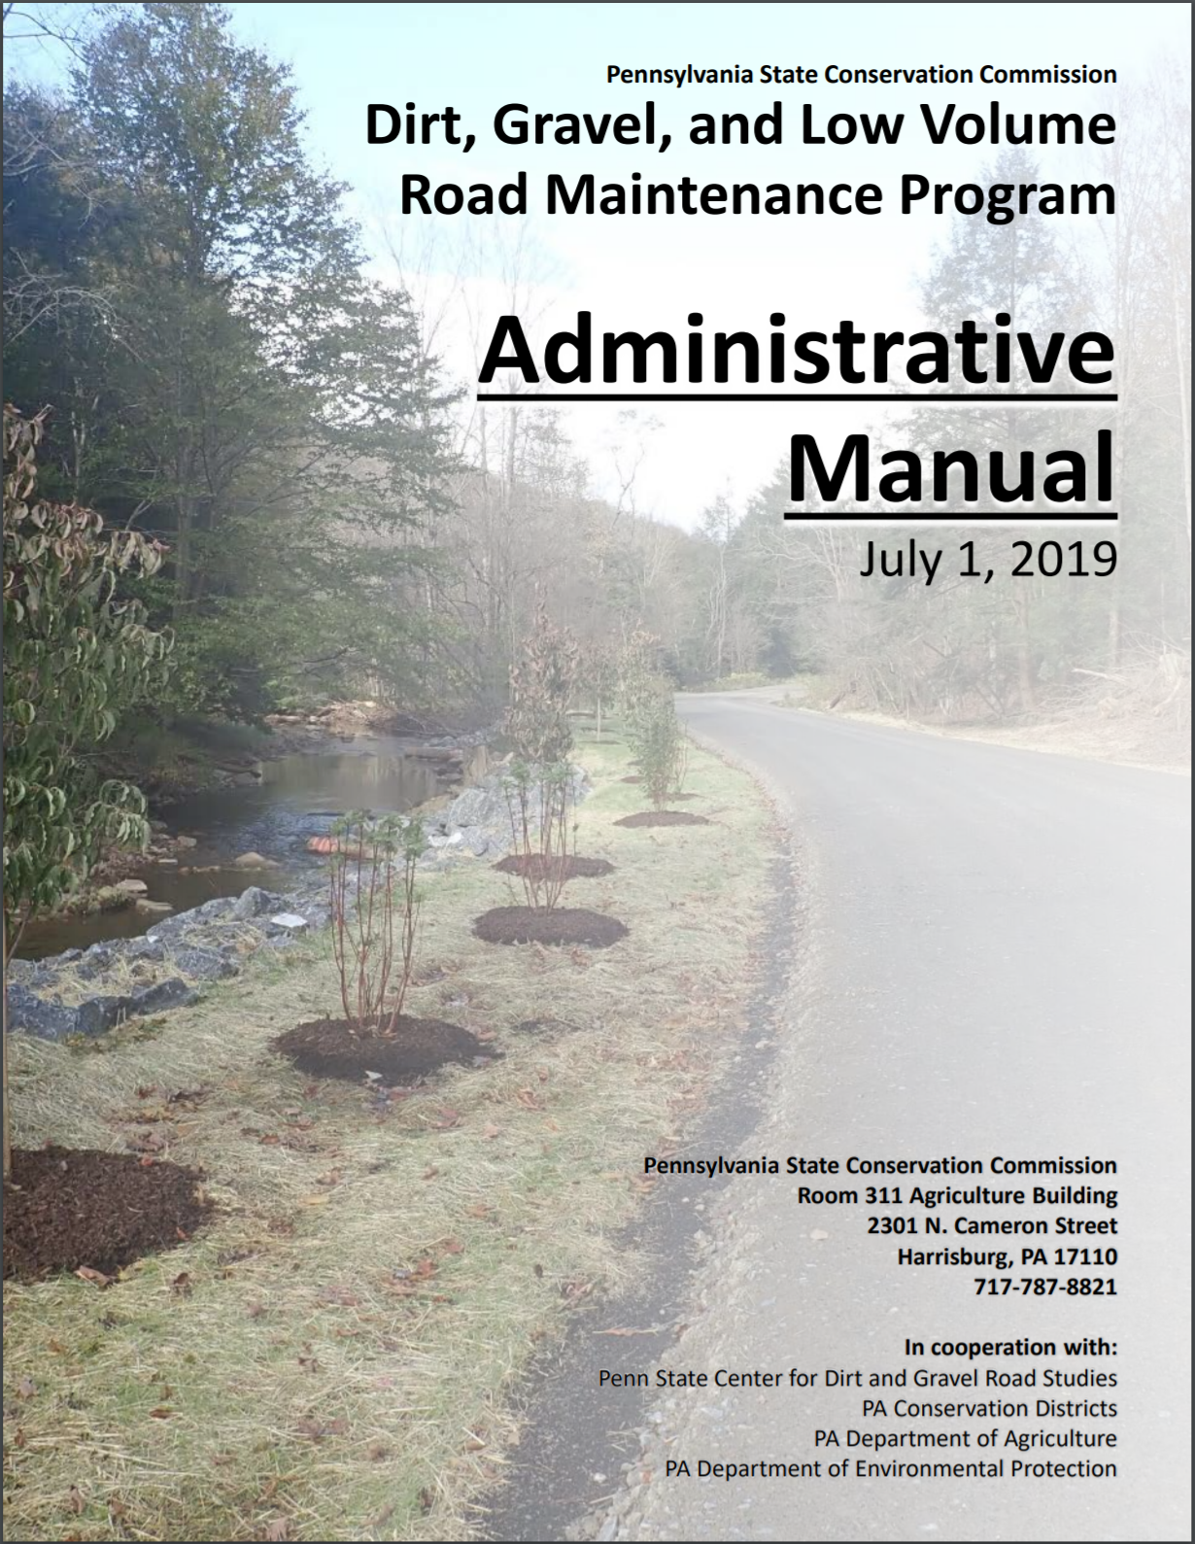
DGLVR Municipal Bidding
DISCLAIMER
CD’s are responsible for ensuring program policy is met.
CD’s going above & beyond, involved in bidding process – HELPS produce BETTER PROJECTS

Slide 6
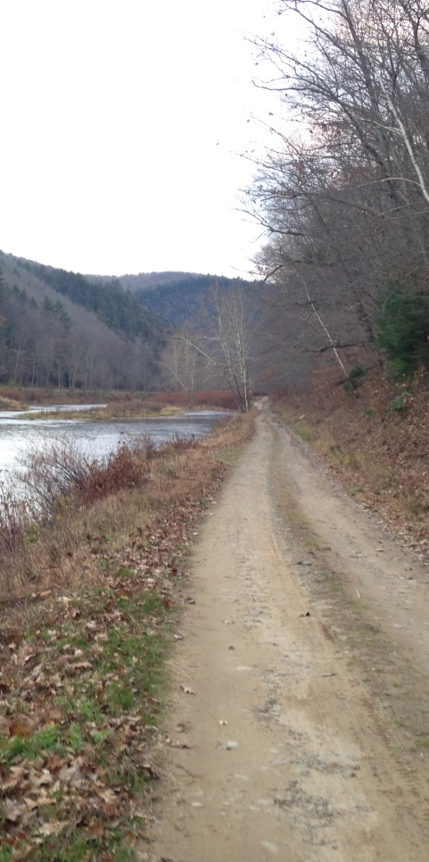
Municipalities
Bidding Thresholds
Requirements
Exemptions
Prevailing Wages
Bid Templates
Bid Bonds
Process of Bidding
Common Oversights
DGLVR Resources

Slide 7
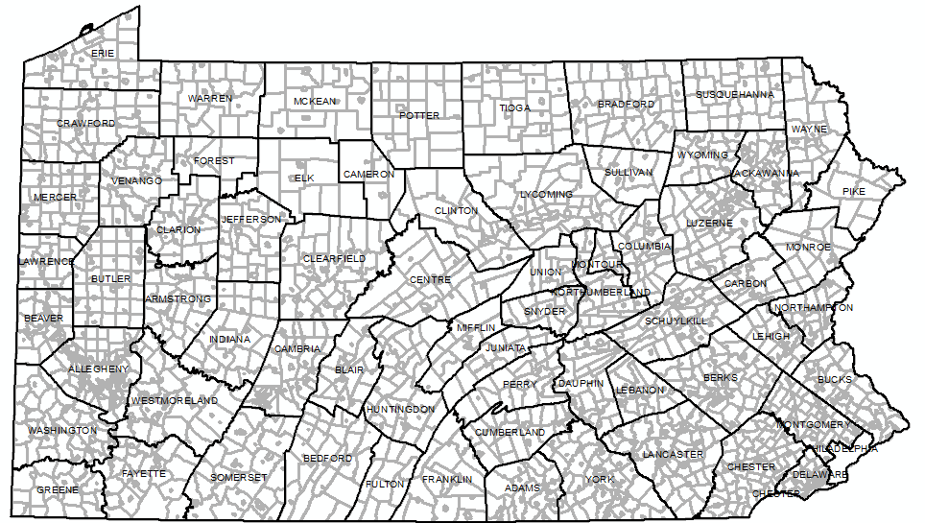
Municipalities
PA consist of over 2,500 municipalities!
Townships, Boroughs, Cities & 1 Town

Slide 8
Municipalities
PA consist of over 2,500 municipalities!
Each level of municipal government is different and governed in differing ways.
Different levels of municipalities have different requirements for
Bidding
Contracting
Bonding

Slide 9
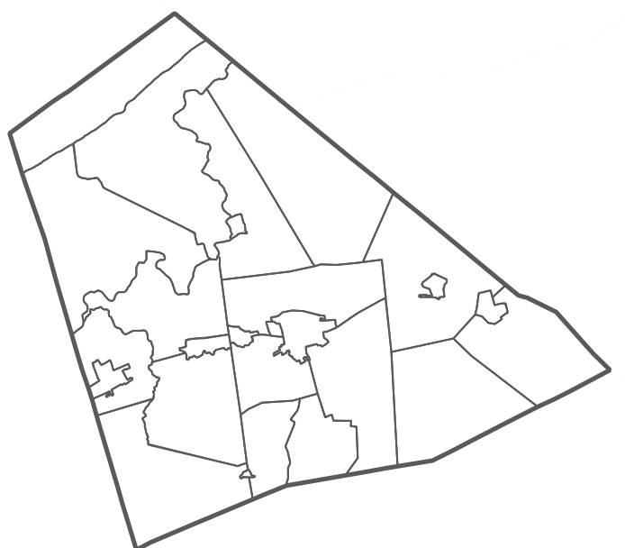
Municipalities
Townships
1st & 2nd Class Townships
  Class is dependent on population
  Governed by Board of Supervisors/Commissioners
  Follow Municipal Township Code

Slide 10
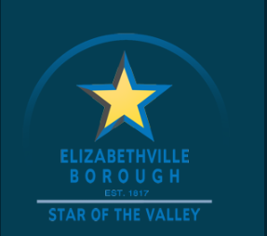
Municipalities
Boroughs
Typically smaller than cities
Governed by Borough Council
  Weak Mayor System
  Vote to break tie
Follow Municipal Borough Code

Slide 11
Municipalities
Cities
  4 Classes depending on population
  Governed by City Council
  Strong Mayor System
    Vote to break tie
  Follow Municipal City Code

Slide 12
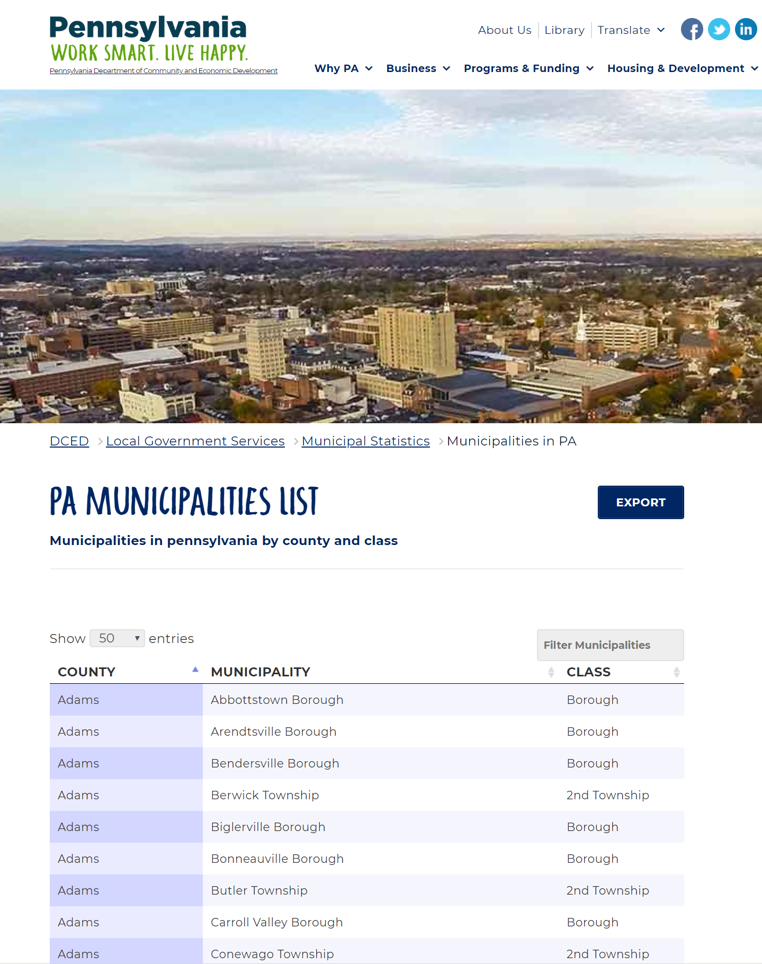
Municipalities
https://dced.pa.gov/local-government/municipal-statistics/municipalities/

Slide 13
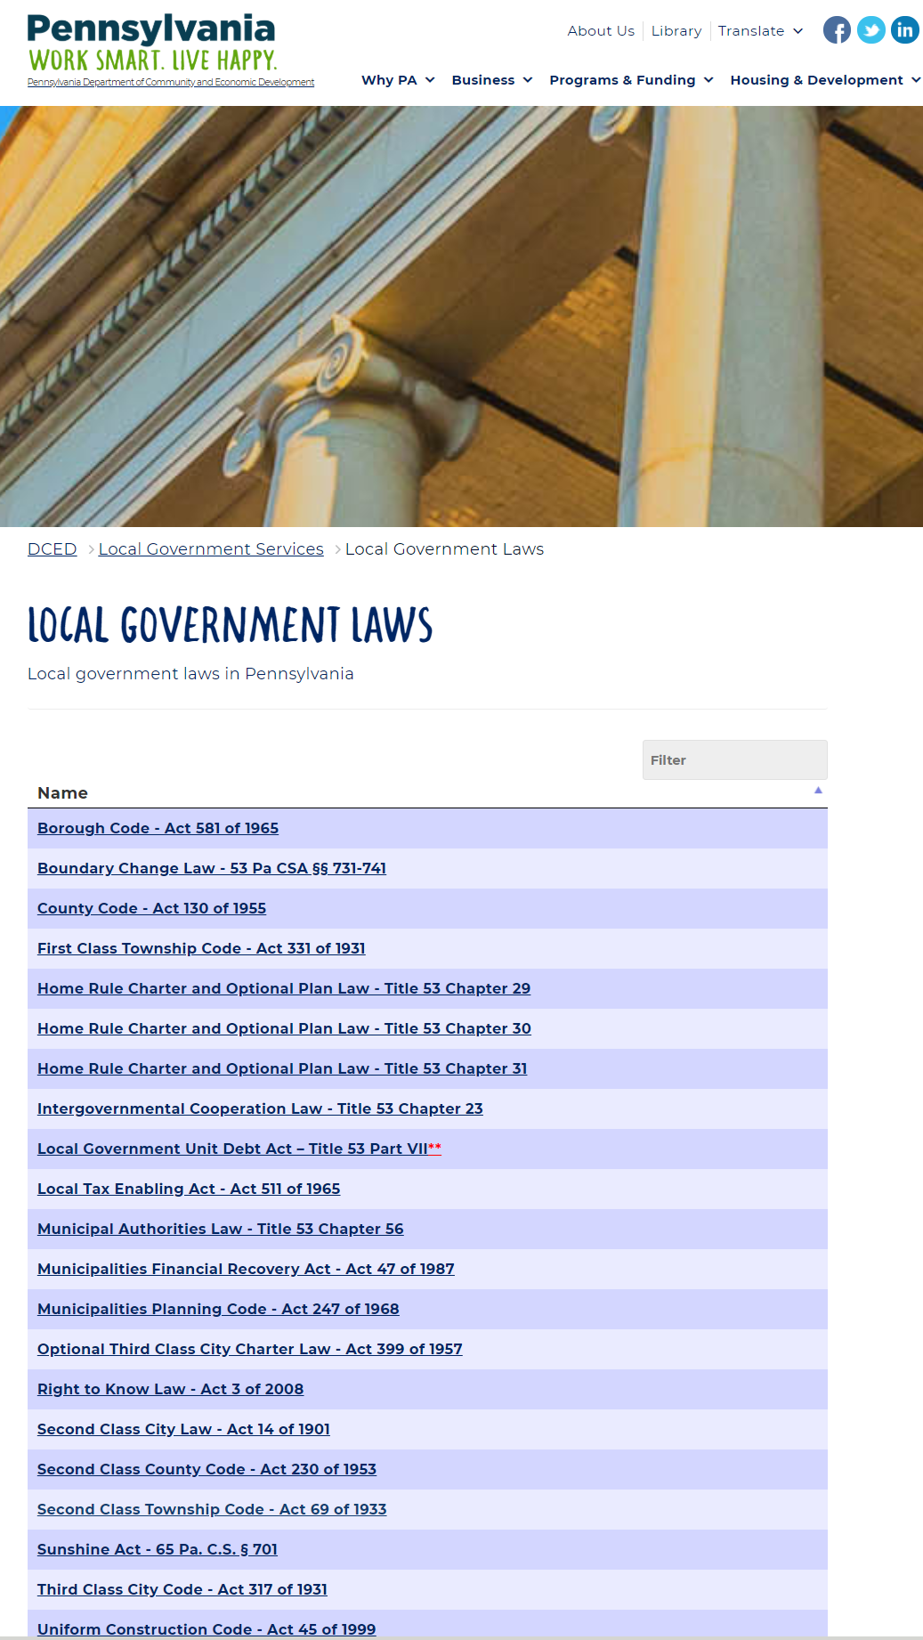
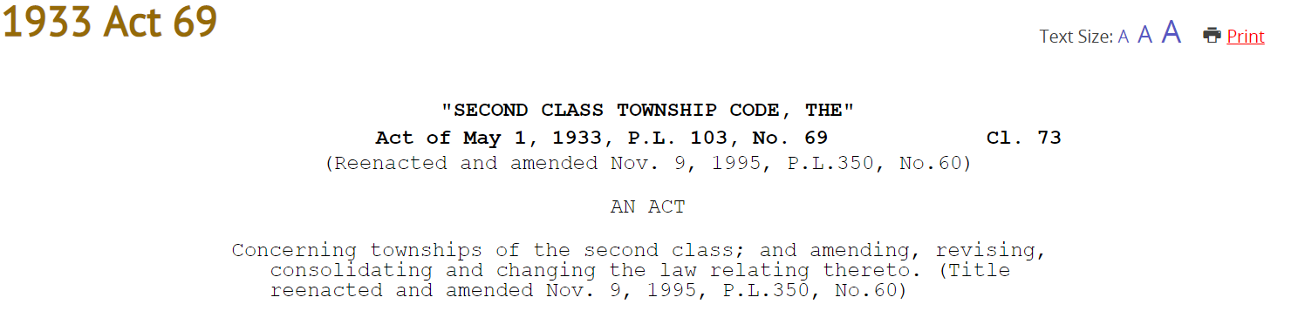
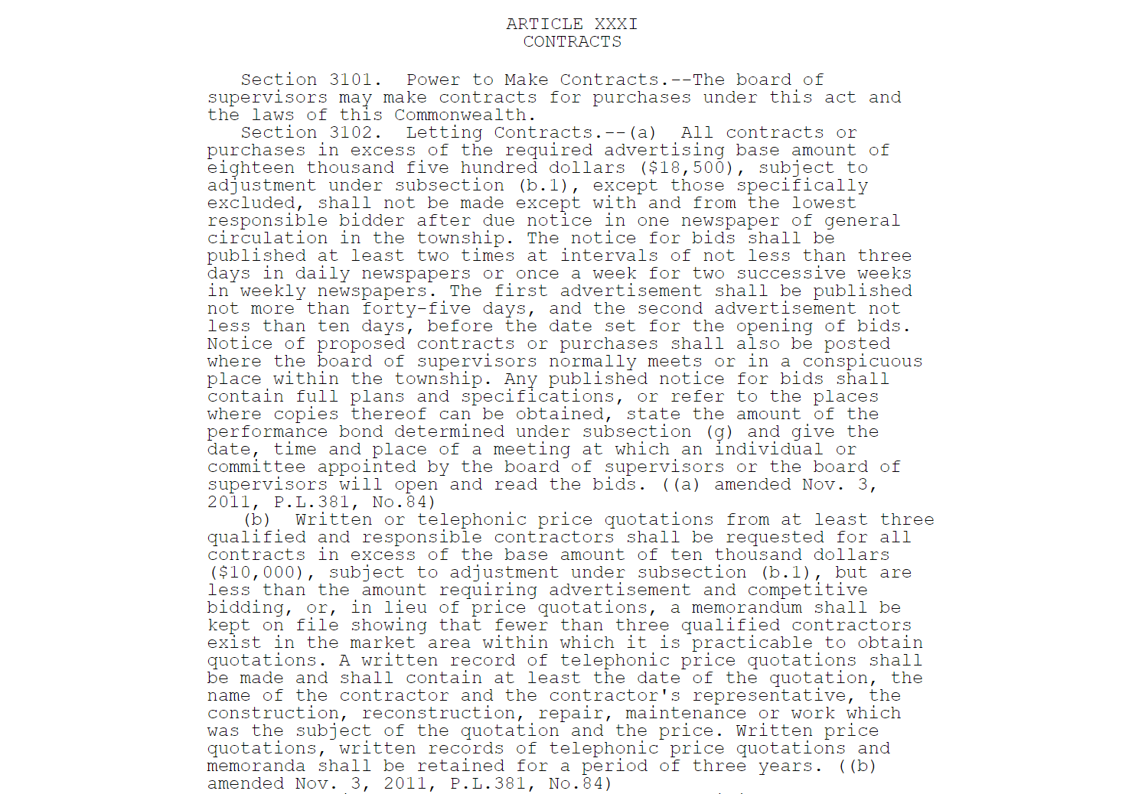
Municipalities
https://dced.pa.gov/local-government/local-government-laws/

Slide 14
Municipalities
Municipal Code Contract Sections
First Class Township Code – Article XVIII
Second Class Township Code – Article XXXI
Borough Code – Chapter 14
3rd Class Cities Code – Chapter 119
County Code – Article XVIII
2nd Class County Code – Article XX
Home Rule Charter – Specific to Charter

Slide 15
Municipalities
Bidding Thresholds
Requirements
Exemptions
Prevailing Wages
Bid Templates
Bid Bonds
Process of Bidding
Common Oversights
DGLVR Resources

Slide 16
Bidding Thresholds
Bidding Requirements as of January 1, 2020 (PA Bulletin):
  Purchases & Contracts below $11,300
    No formal bidding or written/telephone quotes
  Purchases & Contracts from $11,300 & $21,000:
    3 written or telephone quotes
  Purchases & Contracts greater than >$21,000:
    Formal Competitive Bidding Required

Slide 17
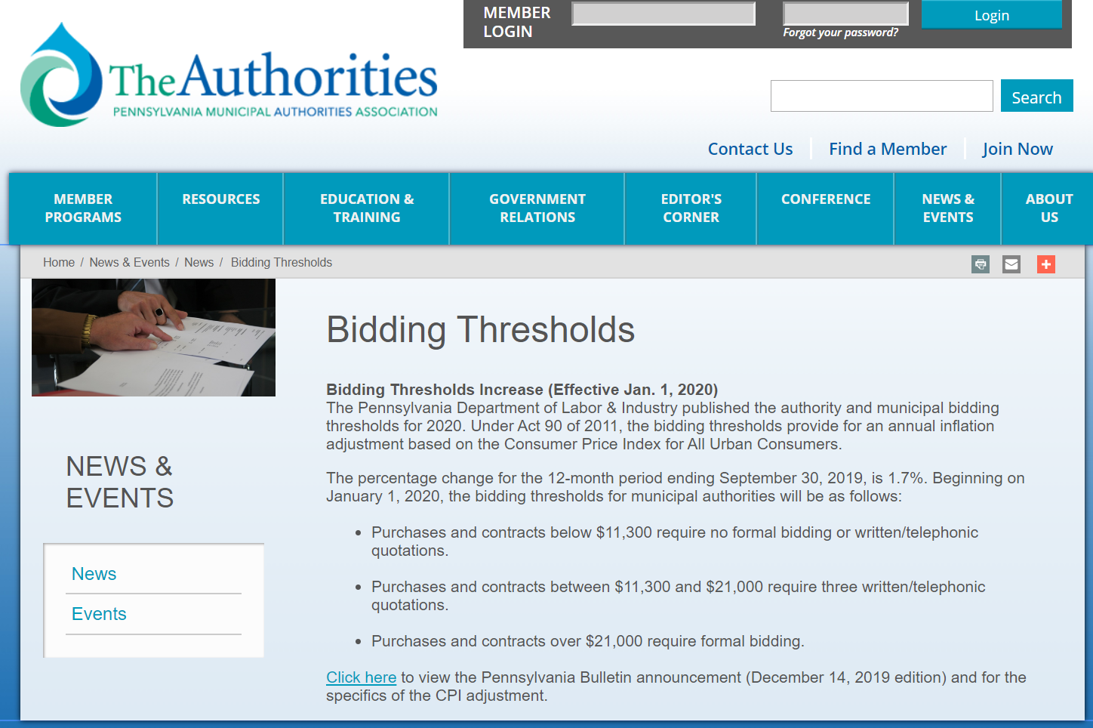
Municipal Bidding
Bidding Thresholds
PA Department of Labor & Industry publishes the thresholds for bidding.
Bidding thresholds provide for annual inflation adjustment (since 2011).
Last year there was a 1.7% increase.

Slide 18
Municipalities
Bidding Thresholds
Requirements
Exemptions
Prevailing Wages
Bid Templates
Bid Bonds
Process of Bidding
Common Oversights
DGLVR Resources

Slide 19
Requirements
Bidding requirements apply to:
  County
  First Class Township
  Second Class Township
  Boroughs
  Town
  Cities

Slide 20
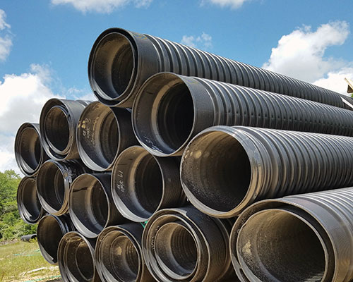
Requirements - Avoidance
Piecemeal purchases cannot be used to avoid bidding requirements when “in the exercise of reasonable discretion and prudence” the purchases could have been made together.
    Example:
      DGLVR Project is contracted to install 40 cross pipes at one time. Cannot pay the contractor to install 10 cross pipes, then 10 more, etc. to avoid bidding requirements.

Slide 21
Requirements - Avoidance
What happens if bidding required but not performed?
Municipalities may be subject to a surcharge
  Could be 10% of the full amount of contract to purchase.
  Lawsuits
  Evasion of bidding requirements is a misdemeanor of the 3rd degree.

Slide 22
Municipalities
Bidding Thresholds
Requirements
Exemptions
Prevailing Wages
Bid Templates
Bid Bonds
Process of Bidding
Common Oversights
DGLVR Resources

Slide 23
Exemptions
9 Exemptions from Public Bidding:
Maintenance, repairs or replacements for water, electric light, or other public works if they are not new additions.
Improvements, repairs, & maintenance of any kind made or provided by the municipality through its own employees. However, all materials used for street improvement, maintenance, and/or construction projects that cost in excess of $21,000 are subject to the bidding requirements.
Purchases where particular types, models, or pieces of equipment, articles, apparatus, appliances, vehicles, or parts thereof are patented and manufactured or copyrighted products.
Purchases of any insurance policies or surety company bonds and contracts made for public utility service, electricity, natural gas, or tele-communications service.
Purchases of any public utility service under tariffs on file with the Pennsylvania Public Utility Commission.
Intergovernmental contracts made with another political subdivision or county, the state or federal government or any of their agencies, or any municipal authority. (Example: COSTARS)
Contracts for purchase of personal or professional services, including, but not limited to, those provided by lawyers, engineers, auditors, and accountants.
Purchases of real estate are negotiable.
County contracts with non-profit cooperative hospital service associations for county homes or hospitals.

Slide 24
Exemptions
9 Exemptions from Public Bidding:
Only Exemptions #1, #2 and #6 may apply to DGLVR Projects.
1 -
2 -
6 -
Maintenance, repairs or replacements for water, electric light, or other public works if they are not new additions.
Improvements, repairs, & maintenance of any kind made or provided by the municipality through its own employees. However, all materials used for street improvement, maintenance, and/or construction projects that cost in excess of $20,100 are subject to the bidding requirements.
Intergovernmental contracts made with another political subdivision or county, the state or federal government or any of their agencies, or any municipal authority. (Example: COSTARS)
COSTARS – Pipe (Structural Plate & Plastic)

Slide 25

COSTARS
WHAT IS COSTARS?
COSTARS is Commonwealth’s cooperative purchasing program.
Municipalities purchase items through negotiated contracts for competitive pricing.
Buying Power of the State vs. Buying Power of One

Slide 26
Exemptions
Maintenance is defined as:
“the repair of existing facilities when the size, type or extent of such facilities is not thereby changed or increased.”
Maintenance work also occurs when a facility, once in usable condition, was restored to that condition by being partially overhauled or patched.

Slide 27
Exemptions
Maintenance or Construction?
L&I Determination .
Repaving Construction
Widening Construction
Shoulder Upgrades Construction
Cleaning Drainage Maintenance
Features
Repair or Replacement of Construction
Drainage Features

Slide 28
Municipalities
Bidding Thresholds
Requirements
Exemptions
Prevailing Wages
Bid Templates
Bid Bonds
Process of Bidding
Common Oversights
DGLVR Resources

Slide 29
Prevailing Wage
Prevailing Wage Applies when:
Construction projects (construction, reconstruction, demolition, alteration and or repair work other than maintenance work) financed by a public body where the total estimated cost is at least $25,000 & work is contracted.

Slide 30
Prevailing Wage
Prevailing Wage Applies when Estimated Cost Exceeds $25,000:
Prevailing Wage applies when the entire project is contracted, or if part of the work is contracted (e.g. DSA placement, etc.).
Prevailing Wage does not apply if a municipality does all the work.
If any portion is contracted out, then Prevailing applies to that part of the contract.
Material Delivery is exempt.

Slide 31
Prevailing Wage
Prevailing Wage Rates:
Municipality is responsible for obtaining prevailing wage rates from the Commonwealth, Department of Labor & Industry.
The public body must include Pennsylvania prevailing wage rates in the contracts, notice for bids and advertisements.

Slide 32
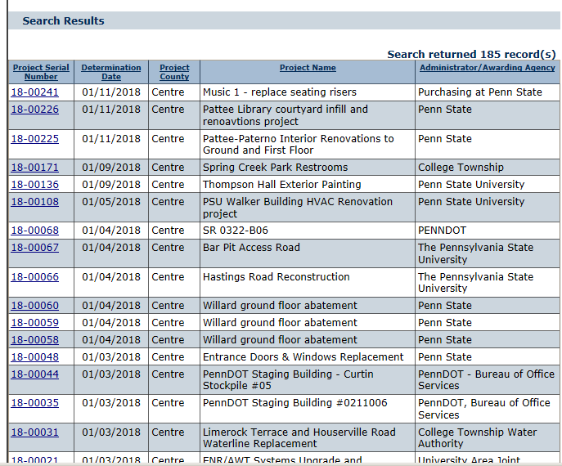
Prevailing Wage
Prevailing Wage Rates:
Wage Rate Form can be obtained online at the PA Department of Labor & Industry website.
Site will also list all prevailing jobs (easy way to confirm prevailing wage is being followed).
http://www.dli.pa.gov

Slide 33
Prevailing Wage
Prevailing Wage Rates:
Prevailing Wage Rate Form must be in the bid package.
Lists hourly rate for each applicable job
Contractors use these rates when calculating their costs

Slide 34
Prevailing Wage
Prevailing Wage – Program Forms:
Districts must use the DGLVR Prevailing Wage Notification Forms & keep them in the project files.

Slide 35
Municipalities
Bidding Thresholds
Requirements
Exemptions
Prevailing Wages
Bid Templates
Bid Bonds
Process of Bidding
Common Oversights
DGLVR Resources

Slide 36
Bid Templates
Bid Documents
PennDOT MS-944
Standardized PennDOT Bidding Forms
Used for Liquid Fuels Funds
Completed by Municipality or Penn DOT Field Rep.
Advertisement, Bidding & Completion of Contract
MasterSpec ($)
Guide for preparing construction bidding documents.
Industry standard for Engineers, Architects, Landscape Architects.
Template Forms that are modified as needed to fit the project.

Slide 37
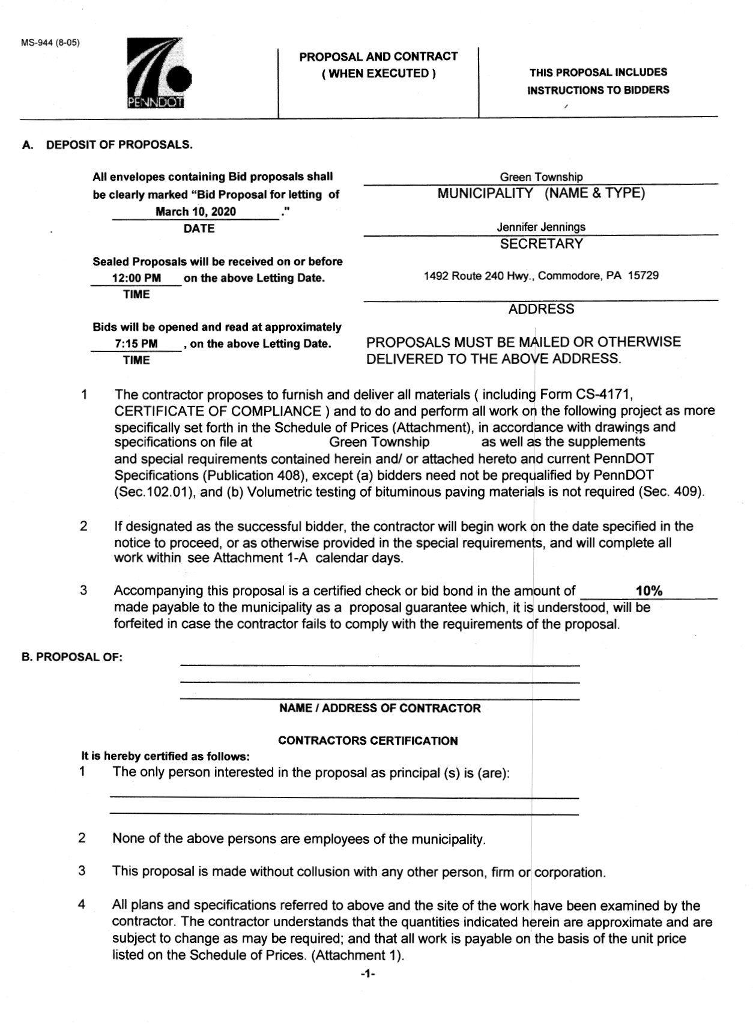
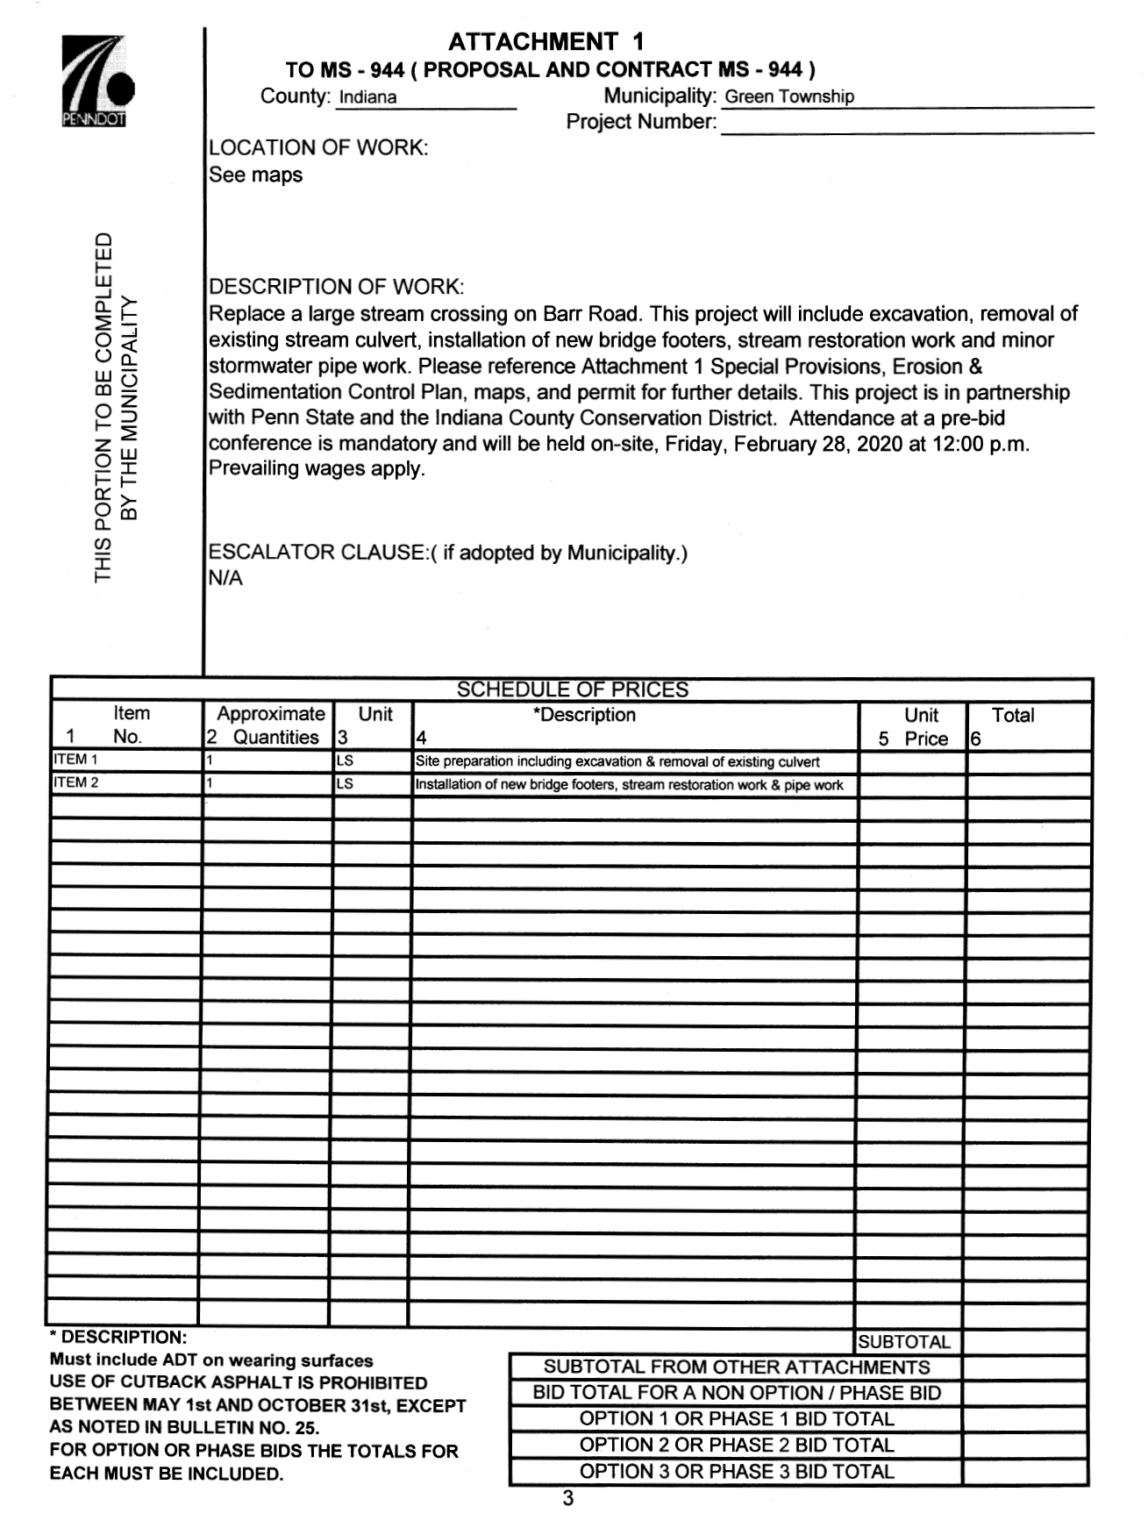
Bid Templates
PennDOT MS-944

Slide 38
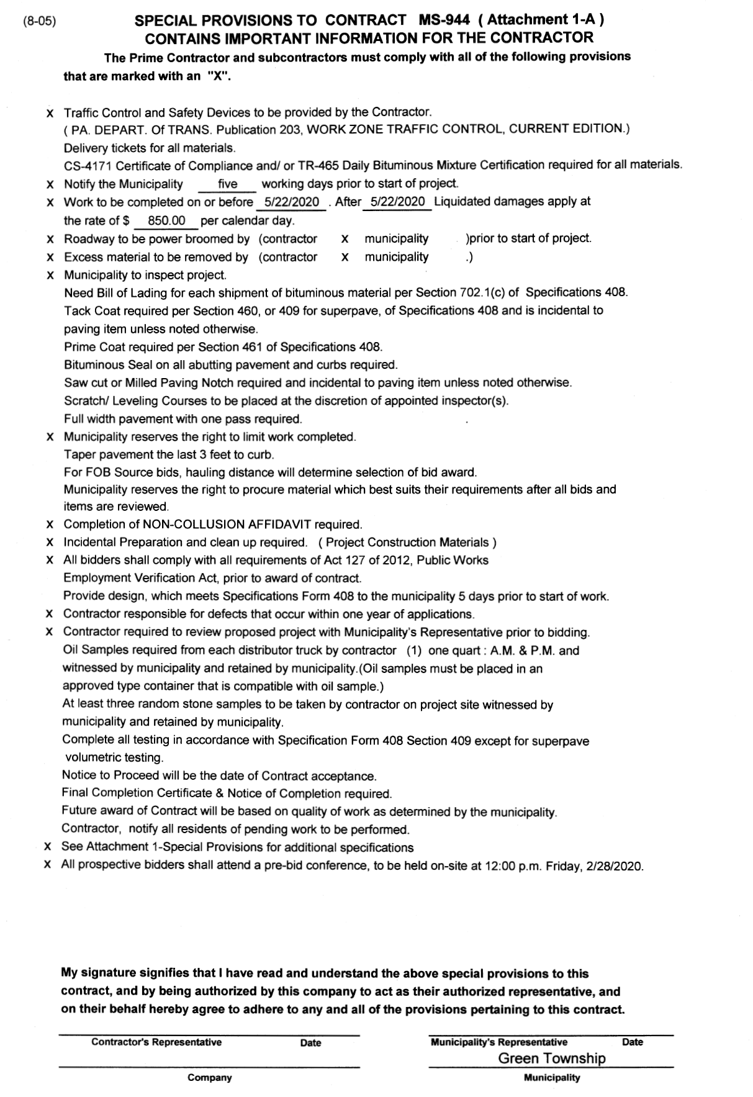
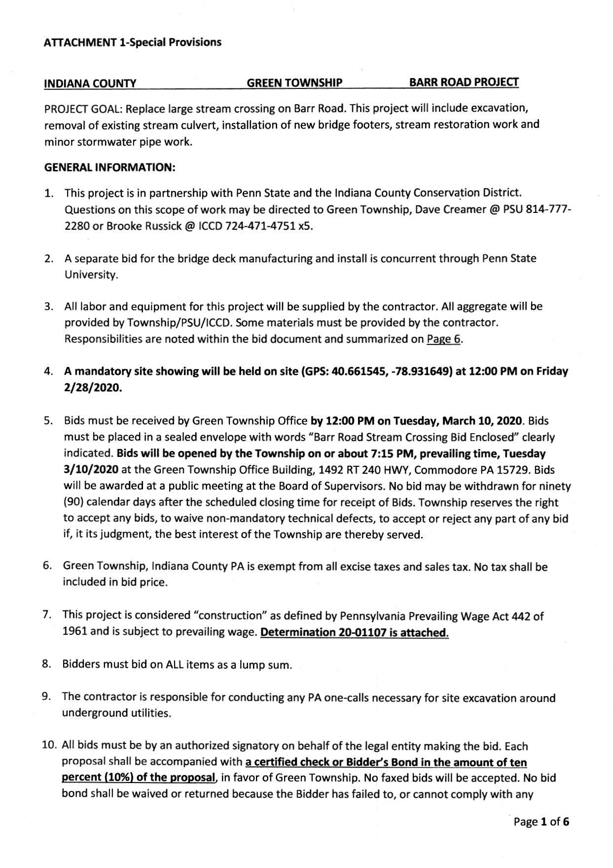
Bid Templates
PennDOT MS-944

Slide 39
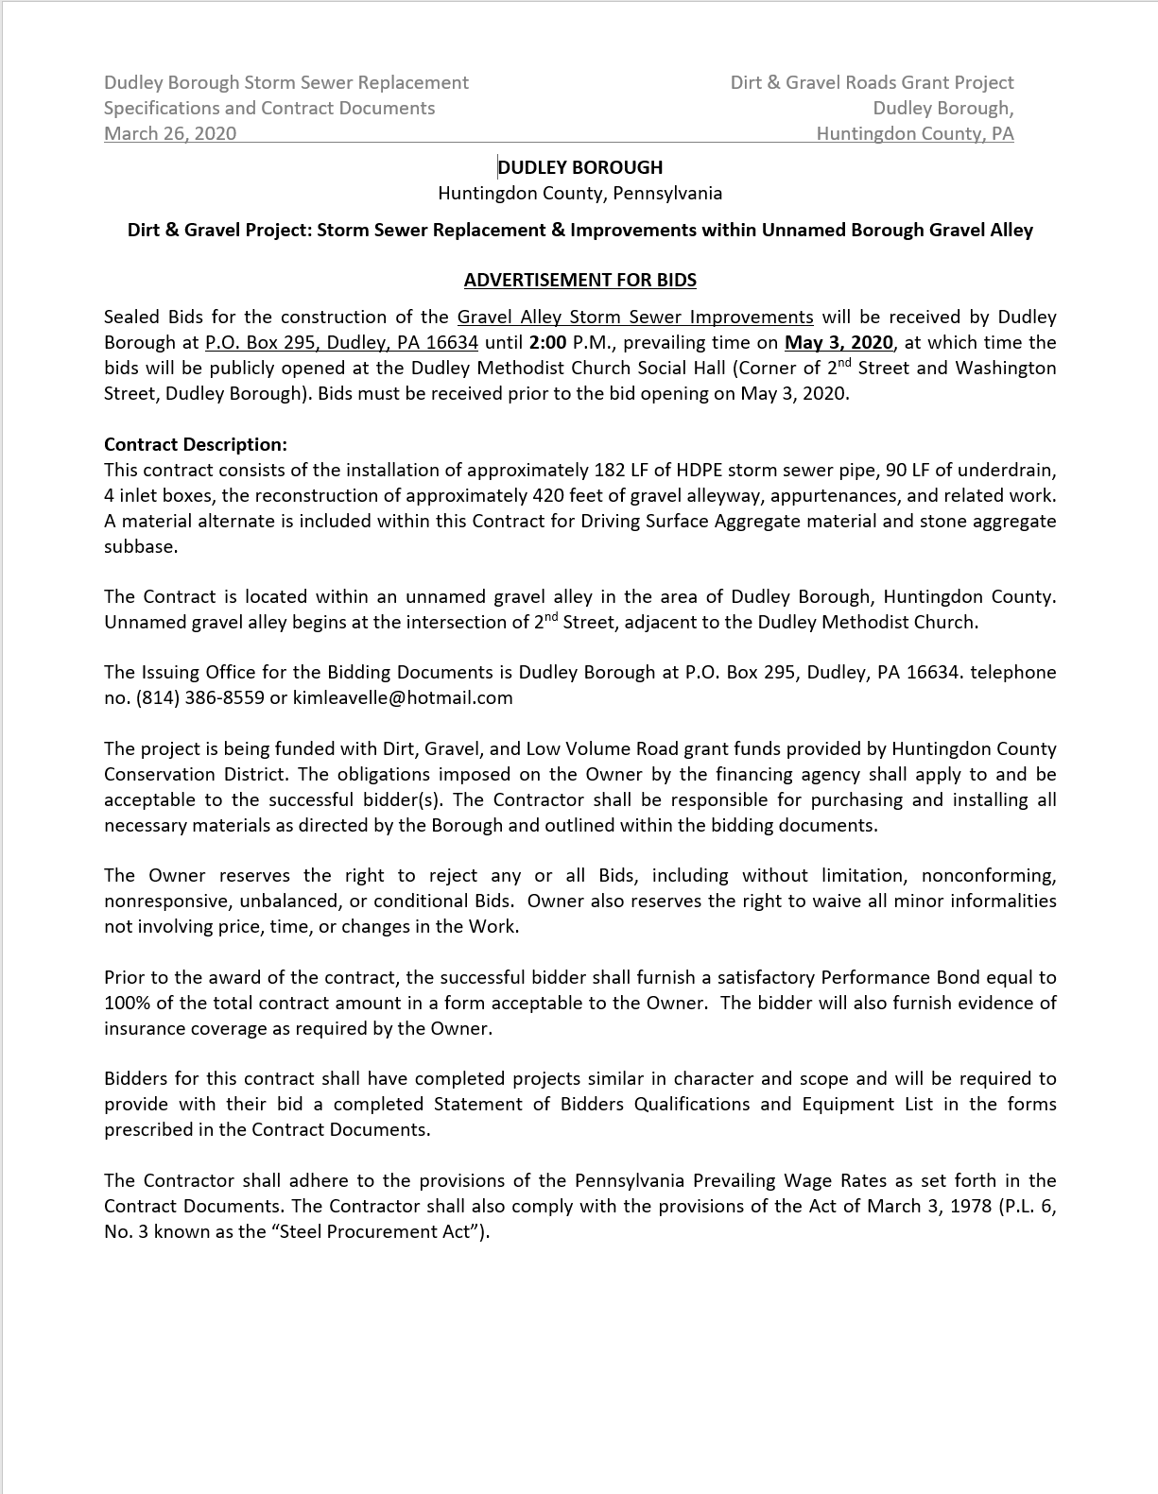
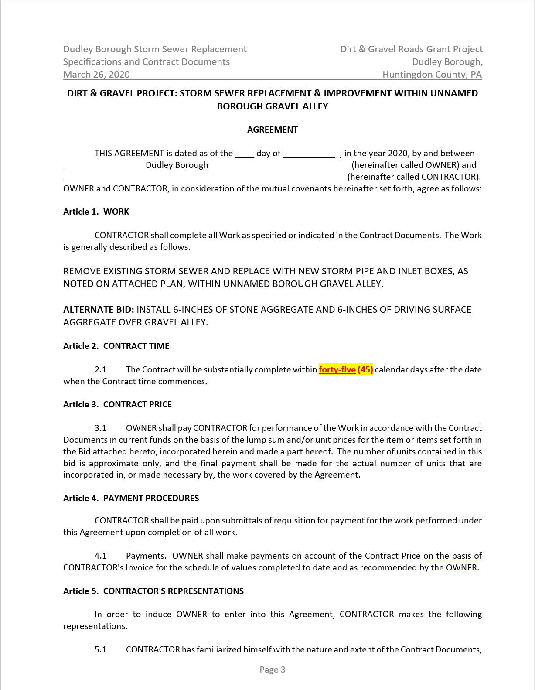
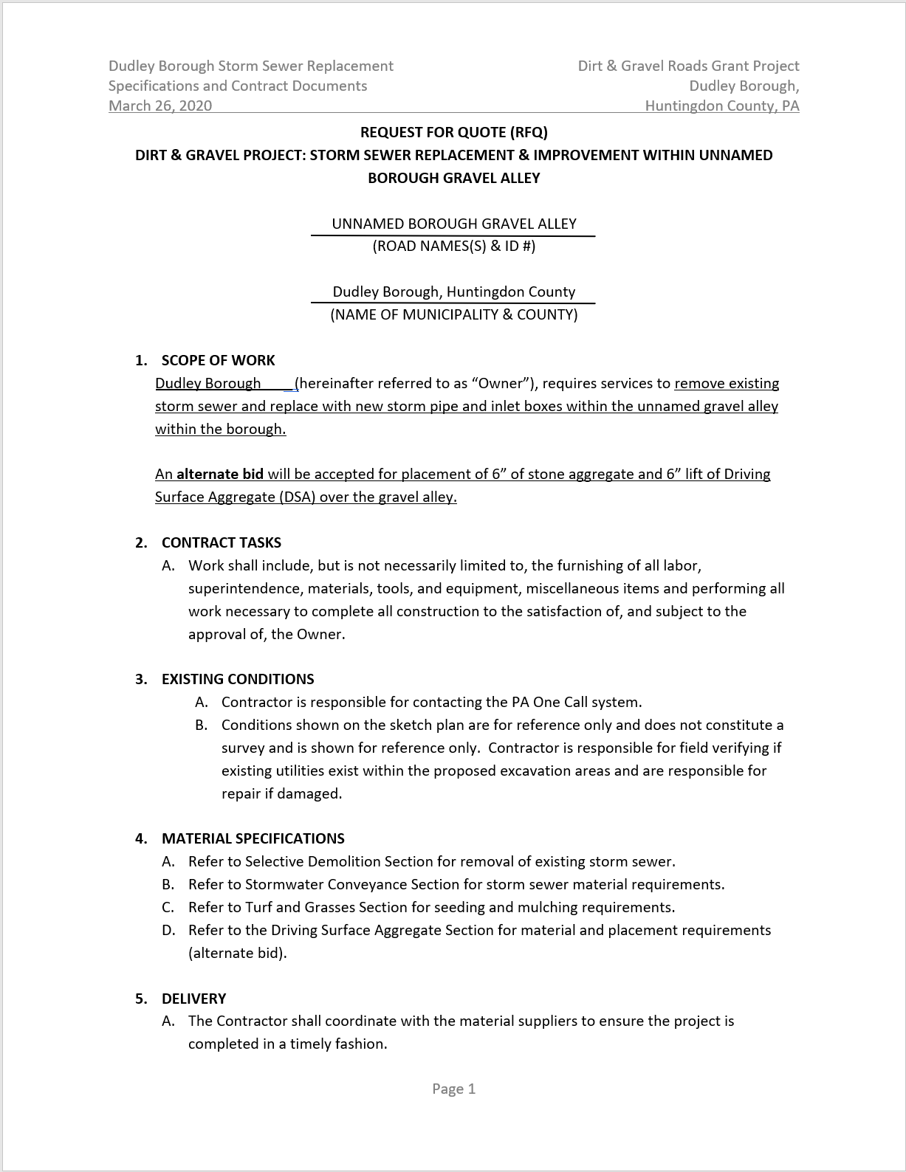
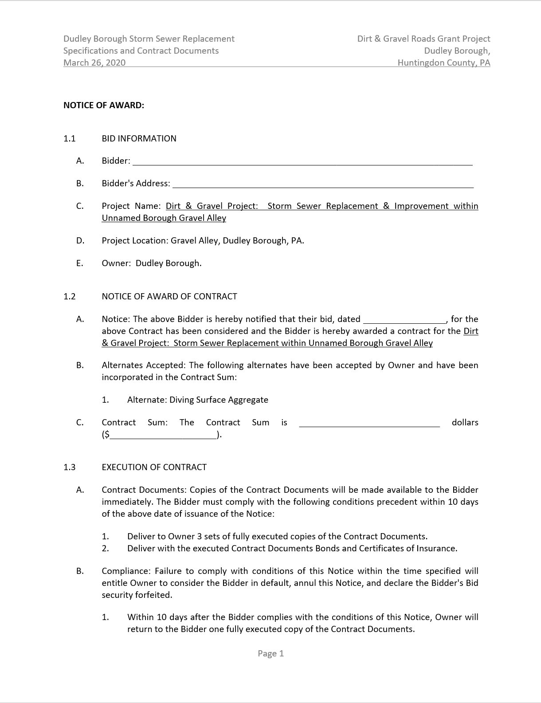
Bid Templates
MasterSpec

Slide 40
Bid Templates
“Front End” Forms
Instructions to Bidders & Contract Forms
  Request for Bid
  Prevailing Wage Forms
  Bid Agreement Forms
  Non-Collusion Form
  Notice of Award
Construction Specifications
What & how to install improvements
  Selective Demolition
  Storm Sewer
  DSA Specification
  Turf & Grasses
What is being constructed & how should be it installed?

Slide 41
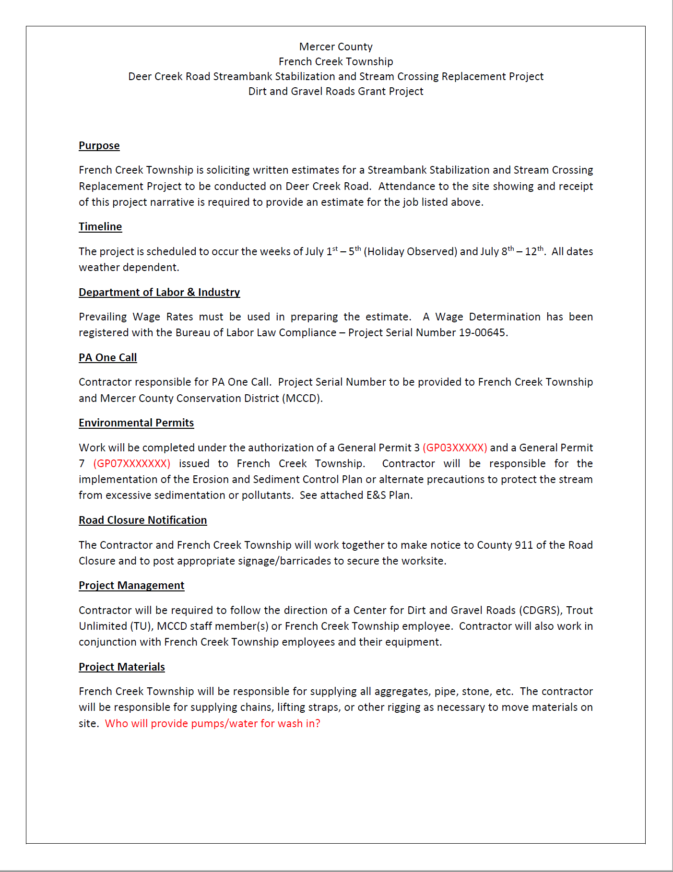
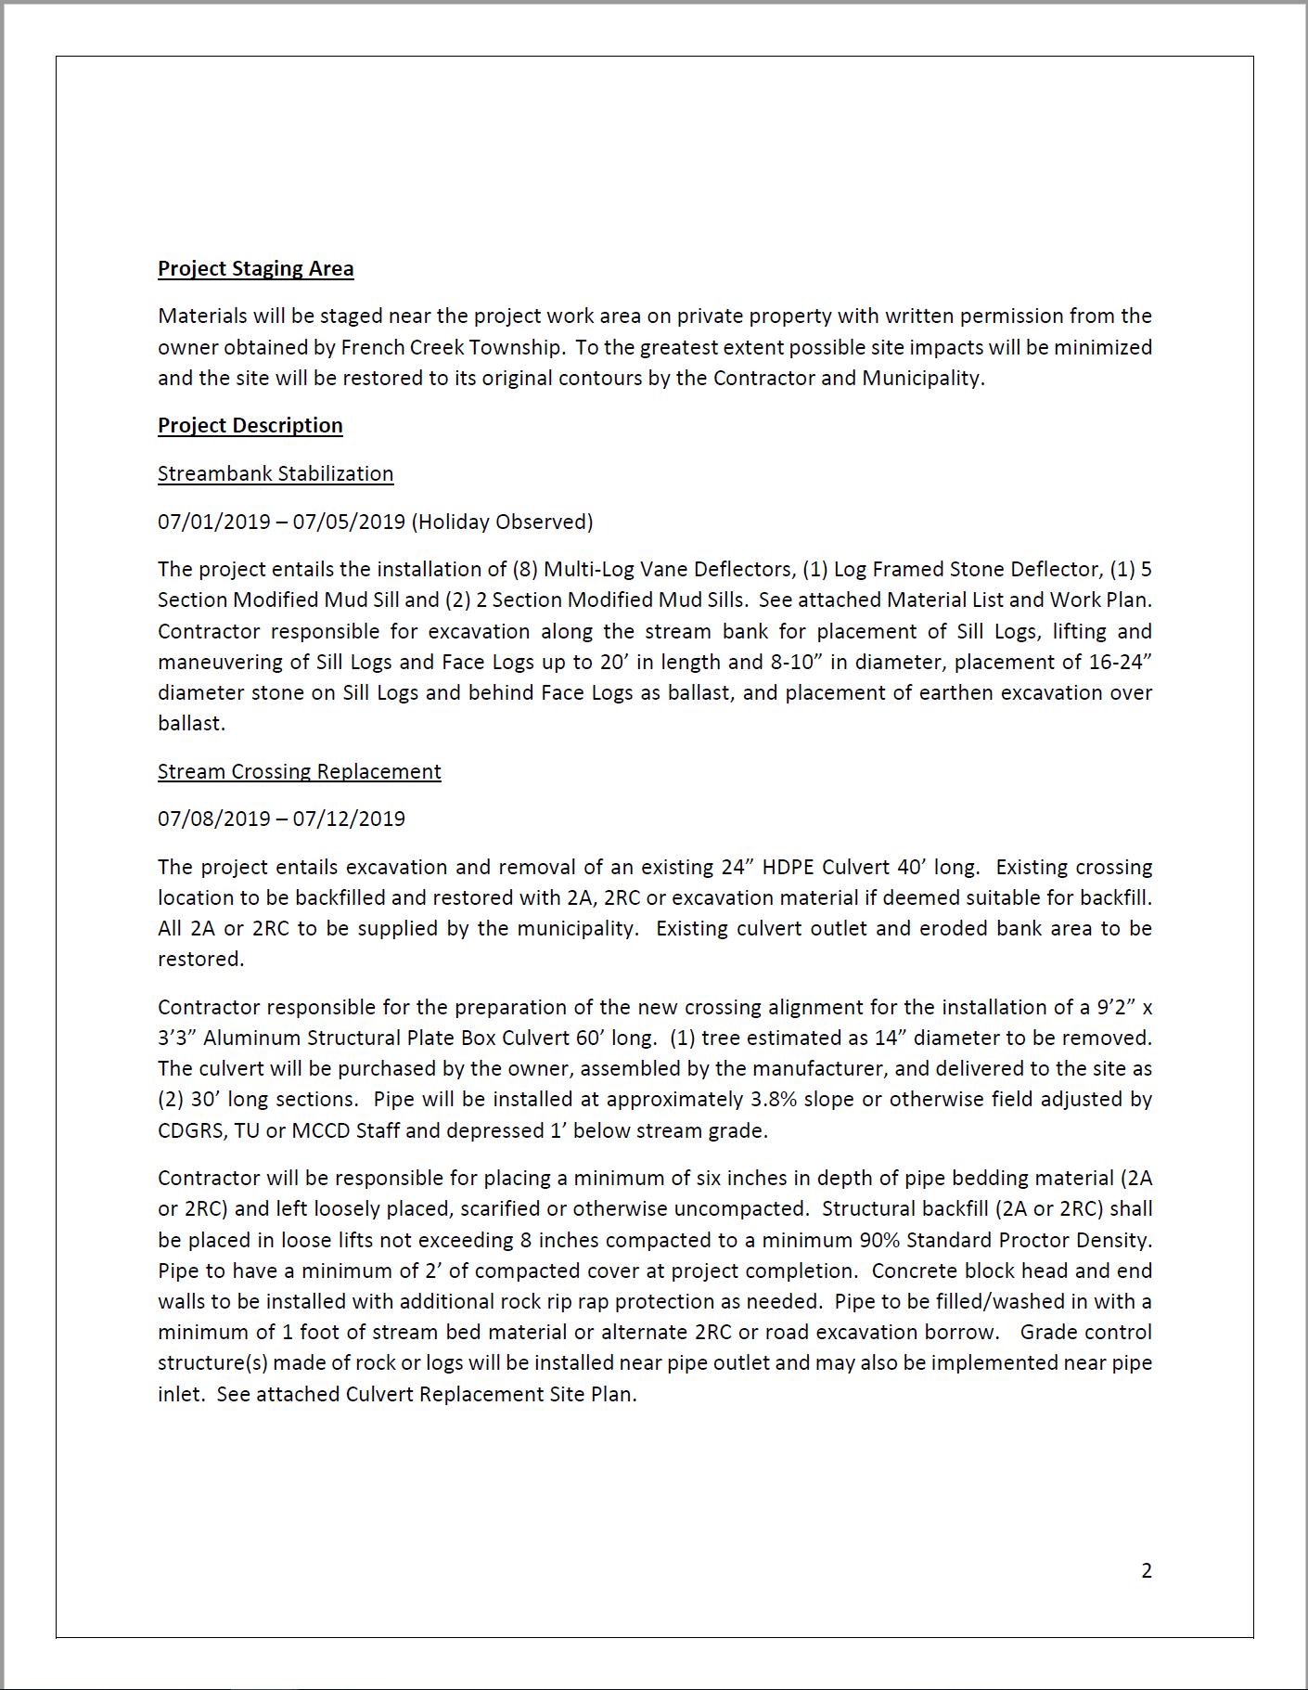
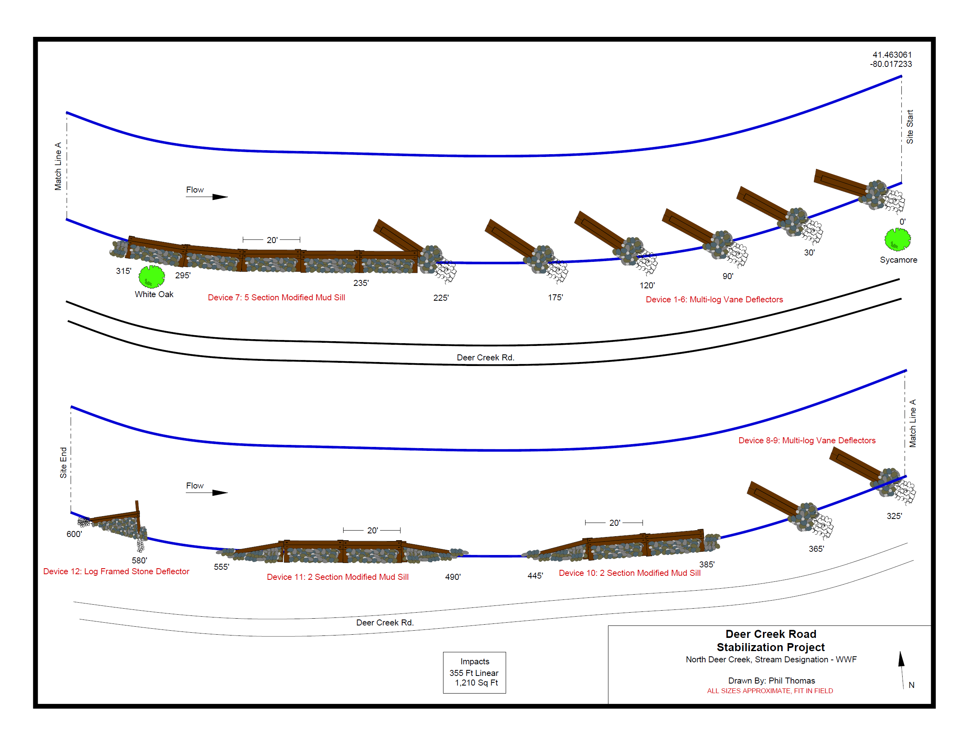
Bid Estimate
  Purchases & Contracts from $11,300 & $21,000:
    3 written or telephone quotes

Slide 42
Municipalities
Bidding Thresholds
Requirements
Exemptions
Prevailing Wages
Bid Templates
Bid Bonds
Process of Bidding
Common Oversights
DGLVR Resources

Slide 43

Bid Bonds
Bid bond: issued by the contractor to the owner, to guarantee that the winning bidder will undertake the contract under the terms at which they bid.
Payment Bond: Bond posted by a contractor to guarantee that all contractors, sub-contractors and material suppliers will be paid.
Performance Bond: Bond issued by financial institution guaranteeing fulfillment of a contract.
The municipal codes includes
requirements on each bond type.

Slide 44
Municipalities
Bidding Thresholds
Requirements
Exemptions
Prevailing Wages
Bid Templates
Bid Bonds
Process of Bidding
Common Oversights
DGLVR Resources

Slide 45

Process - Advertising
Advertising
Refer to municipal code. Varies depending upon municipality class. Advertisement must be in a publicly viewed publication.
Where to Advertise?
Local newspapers
Municipal website
Contractor websites
More Advertising = More Bidders

Slide 46
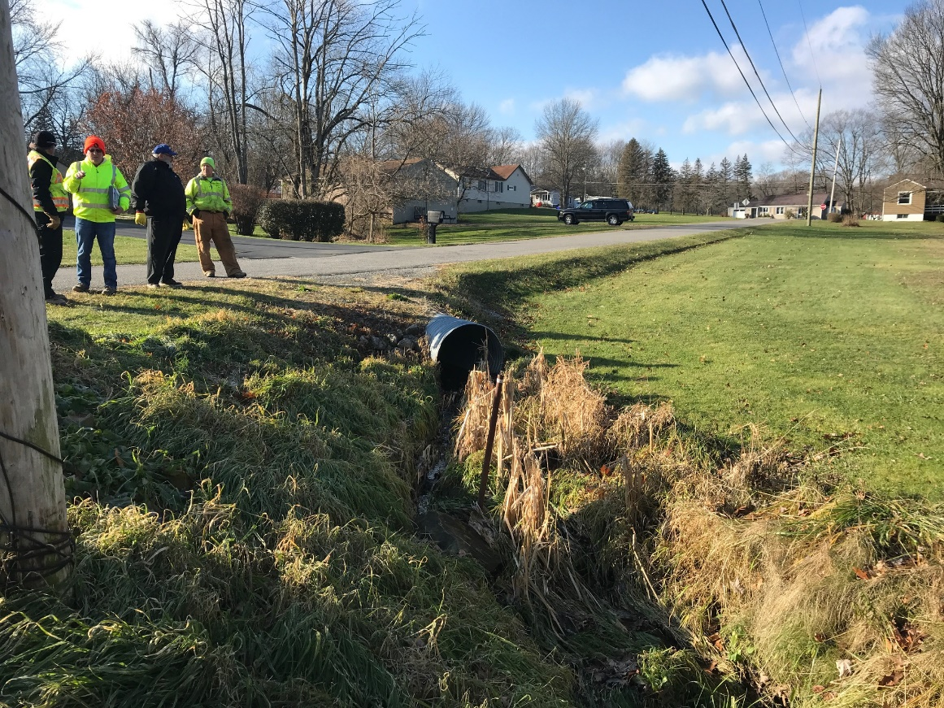
Process – Site Showing
Site Showing
A gathering of potential bidders to review the proposed work site and bid packet details.
Often require attendance to submit a bid.
Helps obtain accurate, competitive bids.
District attendance is recommended.

Slide 47
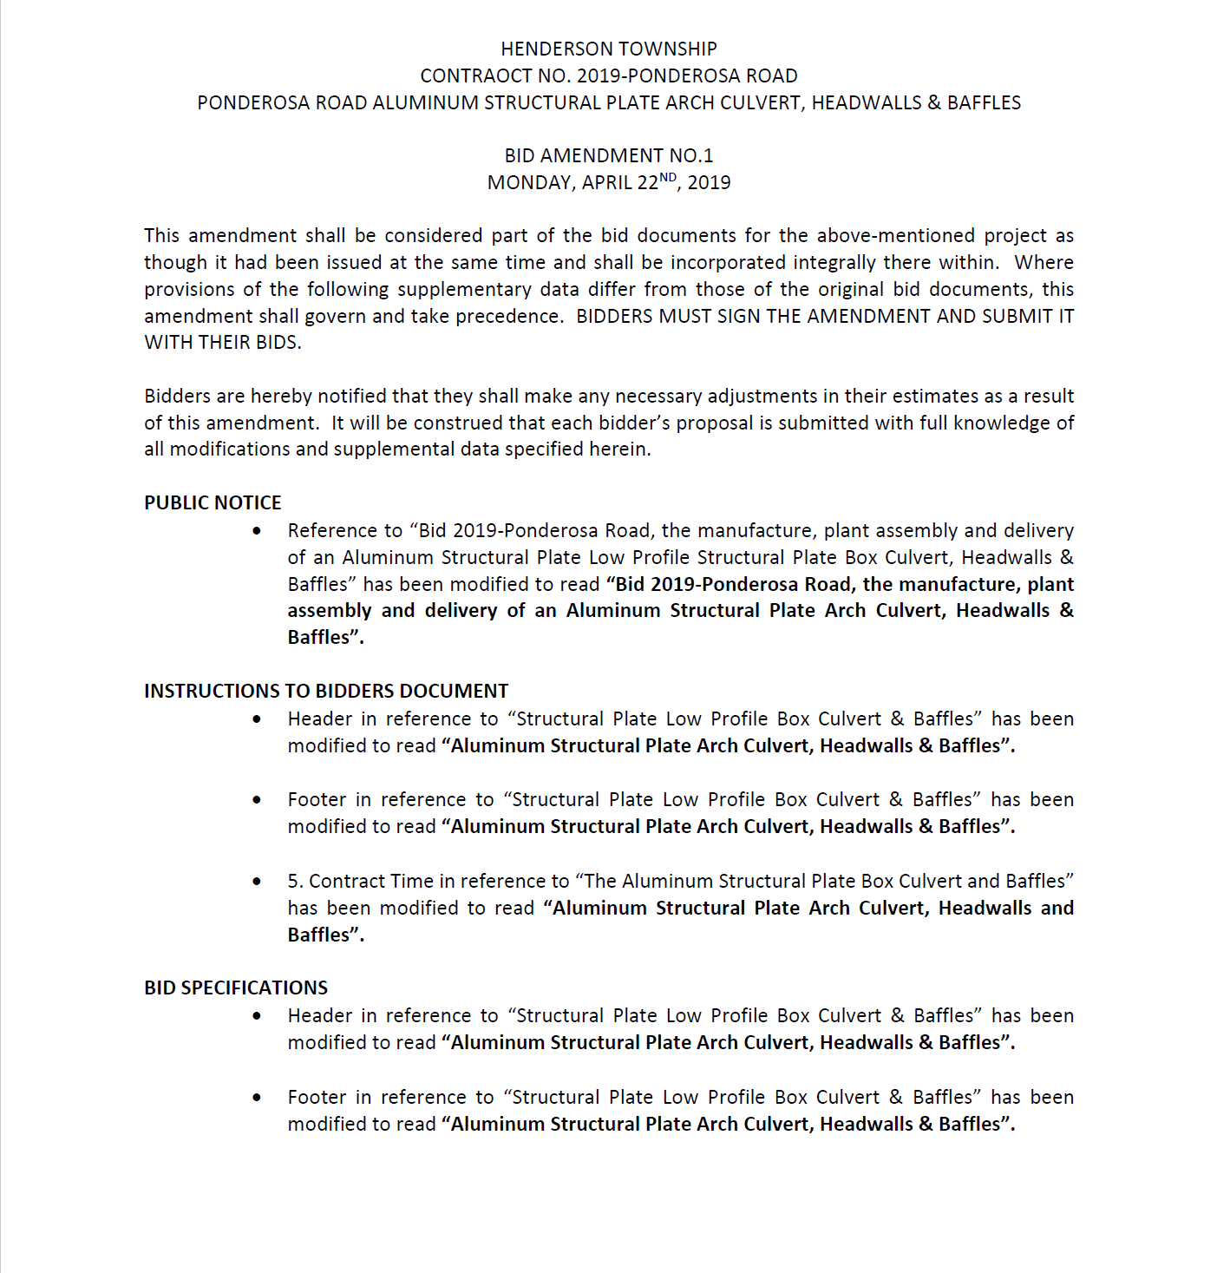
Process - Addendums
Addendums
Written information adding to, clarifying or modifying the bidding documents during the bidding process.
Site Showings often produce questions
or revisions that need to be
addressed in an addendum.
Provide any clarifications to ALL
bidders in written form.

Slide 48
Process – Submittal, Opening & Award
Submittal
Bids submitted in writing by a specified date, time & location. Submitted in sealed envelope.
Bid Opening
Bid opening date, time and location included in advertisement.
Public proceeding - May have an audience for opening.
Award
Bid Opening & Award may be held at the same time or at separate meetings.
Lowest qualified bidder.

Slide 49
Municipalities
Bidding Thresholds
Requirements
Exemptions
Prevailing Wages
Bid Templates
Bid Bonds
Process of Bidding
Common Oversights
DGLVR Resources

Slide 50
Common Oversights
Oversights & Issues
No indication of a DGLVR funded project & program specific requirements (e.g. – stream crossings & stream substrate replacement for AOP)
Construction Deadlines
Project Scheduling
Indication of CD Inspection Role
  Recommend the Project Owner use the terms “Owner or Owner’s Designee” in the bid package.

Slide 51
Common Oversights
Oversights & Issues
DSA Specifications
  DSA Request for Quote Form
Limitations imposed by MS944 bid form – Only State Approved Materials as written. Important for large fill projects.
Over complicated bid packets
  MasterSpec can become large very easily.
  Keep clear & concise.

Slide 52
Common Oversights
Oversights & Issues
No Pre-Bid Site Showing
  HIGHLY Recommended
    Provides Contractors the chance to review the site and ask questions
    Contractors may bring up issues that were missed from a design stand point.
No Pre-Construction Meeting
  Pre-Construction meetings set expectations.
  Define inspectors (CD, Township, Engineer)

Slide 53
Common Oversights
Oversights & Issues
Use of Roads – Large fill and DSA projects. Road bonding issues.
Disposal of Waste Products
Road Closure Notifications & Traffic Control
PA One Call
Prevailing Wage

Slide 54
Common Oversights
Oversights & Issues
Borrow Sites
Clear delineation of who is providing what to the job when mixing municipal and contracted equipment and labor.
Clear specifications of materials (e.g. fill, woven or non- woven geofabric, etc.)
  These are to be covered in the specification within the bid package.
  Product Submittals

Slide 55
Municipalities
Bidding Thresholds
Requirements
Exemptions
Prevailing Wages
Bid Templates
Bid Bonds
Process of Bidding
Common Oversights
DGLVR Resources

Slide 56
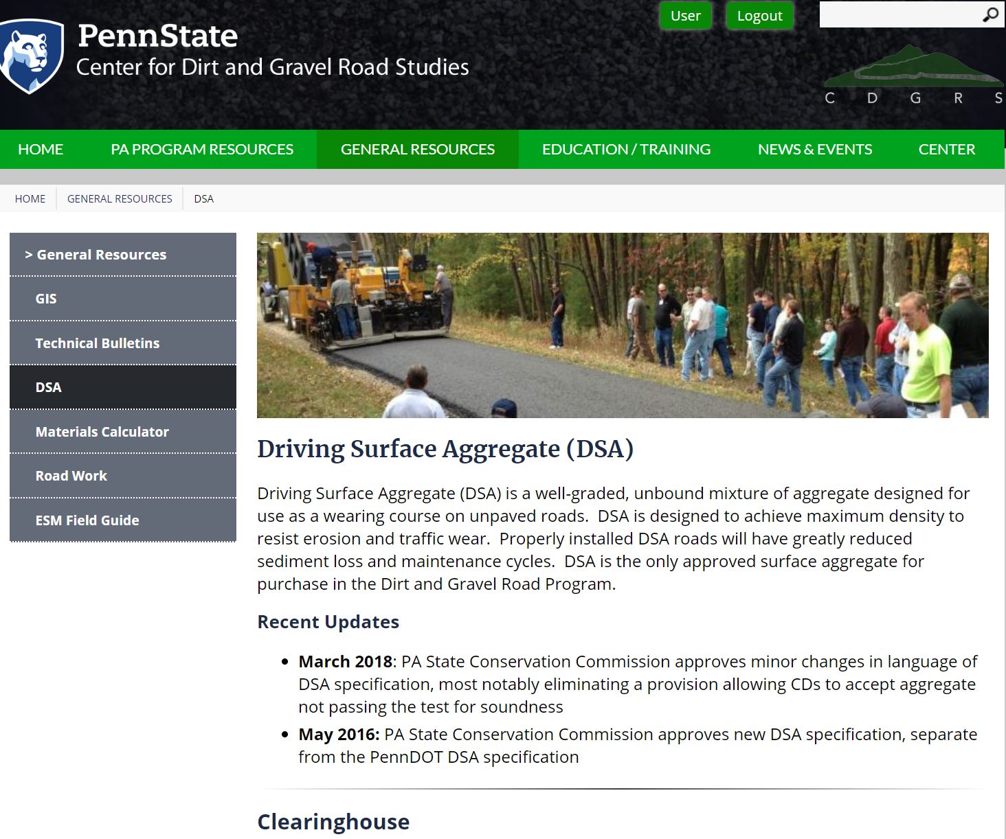
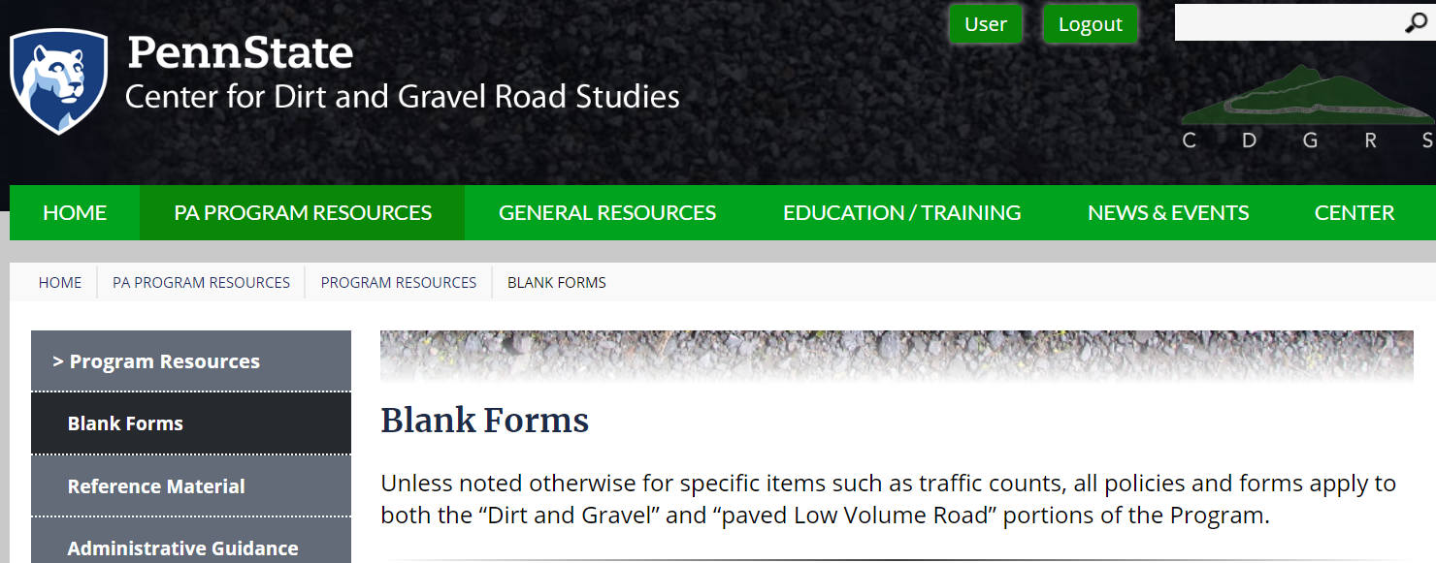
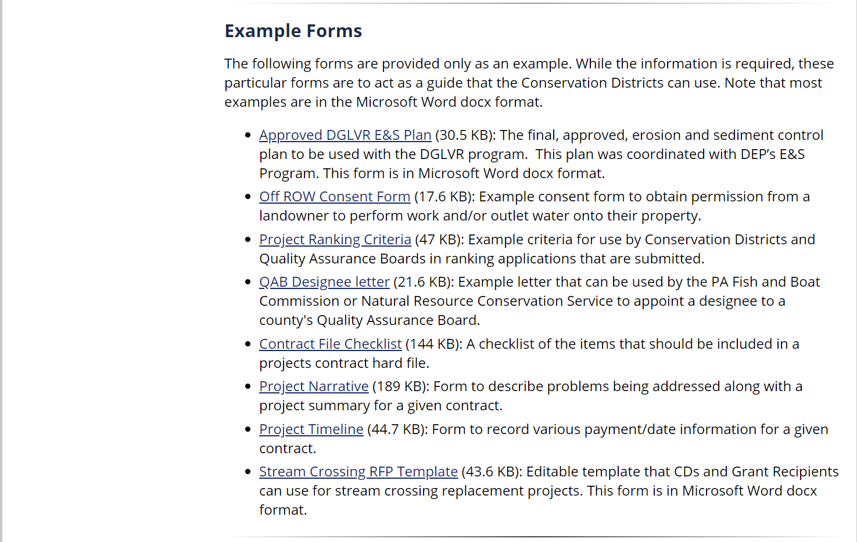
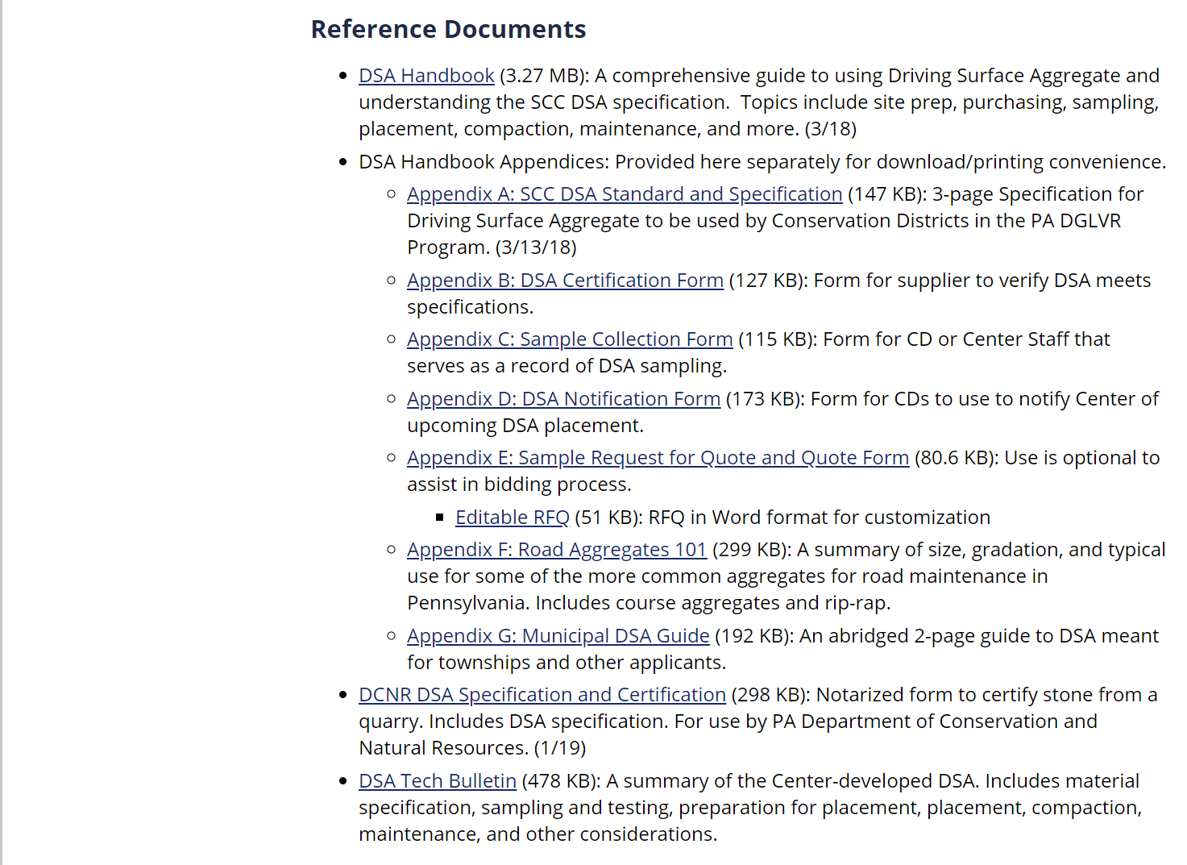
DGLVR Resources
DSA RFQ & Stream Crossing RFP

Slide 57
Municipal Bidding
Summary: QUESTIONS?
Thresholds: < $11,300 no bids, $11,300 to $21,000 three written/phone bids, >$21,000 formal bids.
Review of Bid Packet: Suggest CD review packet prior to advertisement.
Site Showing: Strongly recommended. Can make attendance a condition of submitting bid.
Pre-Construction Meeting: Strongly recommended. An hour on site before the project can save you headaches.
Bonding: Consider how you get equipment and materials to the project site.
Construction: L&I will consider almost all DGLVR projects as “construction” and bidding exemptions do not apply.
Keep Bidding Simple: Don’t over complicate the packet, be clear, concise and provide specifications for materials.

