Slide 1
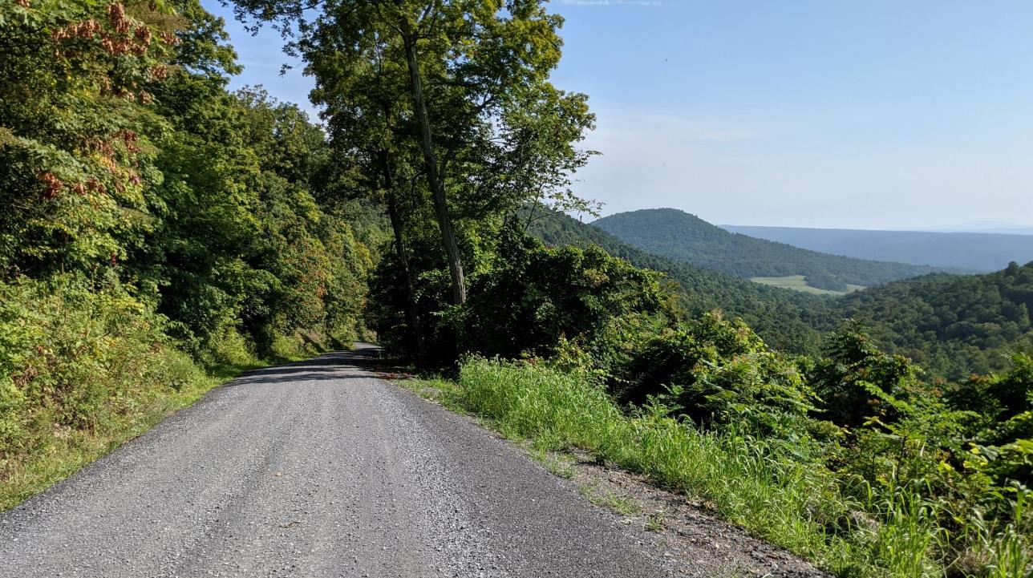


Dirt Gravel and Low Volume Road Program
FY 2022-23 DGLVR Updates
7/7/2022
Ken Corradini
kjc139@psu.edu
Roy Richardson: SCC
rrichardso@pa.gov
Steve Bloser: CDGRS
smb201@psu.edu
If you are reading this, then you are successfully seeing the webinar video. Webinar audio should be automatic through your computer (or click “join audio”), and options can be accessed in the “audio options” button on the bottom left. If your computer audio is not working, you can listen on your phone by dialing 646-876-9923.

Slide 2
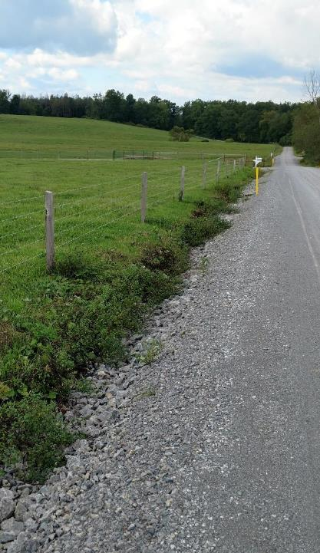
FY 2022-23 Updates
Website Update
  Website Update
  Login Changes: must reset password
  GIS Updates
Policies Update
  Stream Crossing Policy and Standard
  DSA Spec Update
  Other Policy Changes
Miscellaneous Update
  Workshop
  ESM Trainings
  Stream Trainings
  CD Allocations

Slide 3
FY 2022-23 Updates
Website Updates
  Redesigned
    Necessitated due to Penn State IT requirements
    Flexibility:
      Accommodates various devices much better than the old site
      Will allow for greater usage of various media tools
    All forms and buttons are active
    Will be small formatting changes over the next few weeks
  Security Requirements
    Migration to new database resulted in all passwords to be reset
    First time login requires the password to be reset
    You are allowed to use your old password
      For weak passwords, you are required to perform an extra step to allow it.
      Strongly recommended to create a stronger password

Slide 4
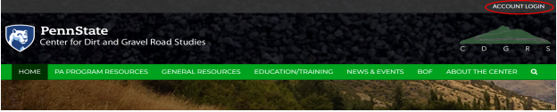
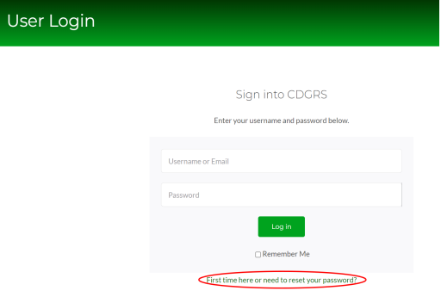
FY 2022-23 Updates
Website Updates: Resetting Your Password
  Step 1: Click the Account Login link in the
  upper right corner. Note: you may have to
  scroll to the top of the page to see the link.
  Step 2: Click the First time here… link at the
  bottom of the User Login page.

Slide 5
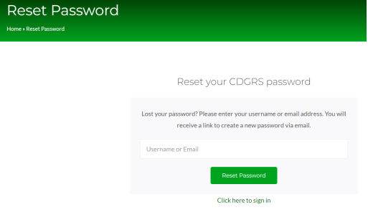
FY 2022-23 Updates
Website Updates: Resetting Your Password
  Step 3: Enter either your username or email and
  click the Reset Password button. Note: If you are
  unsure what email is associated with your
  username, then enter your username.
  Step 4: You will be notified than an email has been
  sent. Open that email and click the link that is
  provided.

Slide 6
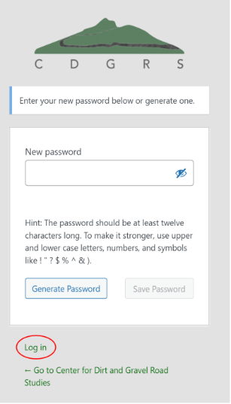
FY 2022-23 Updates
Website Updates: Resetting Your Password
  Step 5: Upon completing Step 4, the New Password page
  will open. Enter your password and click Log in. Note: you
  can use your previous password. But if it is too weak, you
  will have to confirm you want to use that password. Please
  try to avoid weak passwords for obvious reasons.

Slide 7
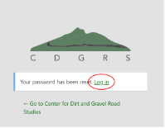
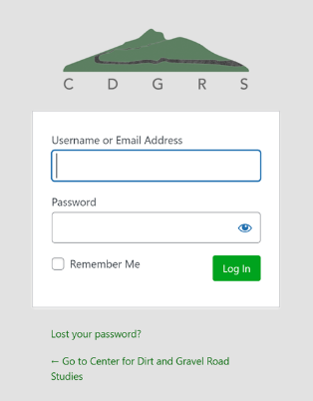
FY 2022-23 Updates
Website Updates: Resetting Your Password
  Step 6: Your password is now reset. Click Log in to be taken to
  the Sign In page.
  Step 7: Enter your username and new password and click the
  Log In button. You’ll then be taken to your User Page where
  you can access the GIS, Stream Crossing Notification Form and
  any other authorized tools.

Slide 8
FY 2022-23 Updates
GIS Updates
  Quarterly Reports: Budget Tool
    Helps with simple budgeting
    Resets after each quarter but has a tool to
    import the previous quarter’s values
    Important to have the income and expenses
    current in order for the budget to be
    accurate

Slide 9
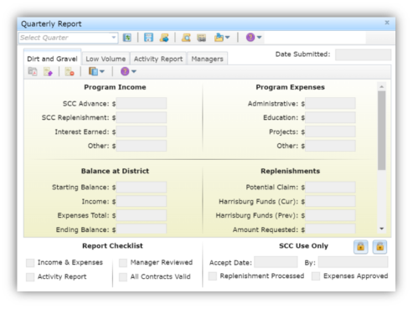
FY 2022-23 Updates
GIS Updates
Quarterly Report & Expired Contracts
“All Contracts Valid” must be checked in order to be able to submit the Quarterly Report
If it is unchecked, then there are expired contracts
Refer to the March 4, 2022 webinar for details

Slide 10
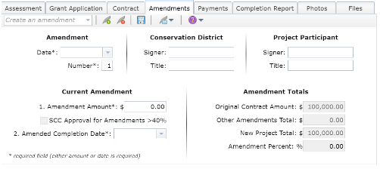
FY 2022-23 Updates
GIS Updates
  Amendments
    Increased to 40% or greater with SCC Approval
    If >40% the following steps must be followed to create
    the amendment
      Complete and submit the Approval Request form
        An email confirmation of the request will be sent
        Check the status by opening up the approval request
        Another amendment cannot be created while a request
        is pending. Withdraw the request if needed.
      A representative from the SCC will approve or reject the request
      Once approved, the amendment can be created
        The amount is fixed and cannot be changed
        The SCC Approval checkbox will automatically be checked
        An attachment document will be included with the printed
        amendment. This document must be signed by the
        Conservation District representative.

Slide 11
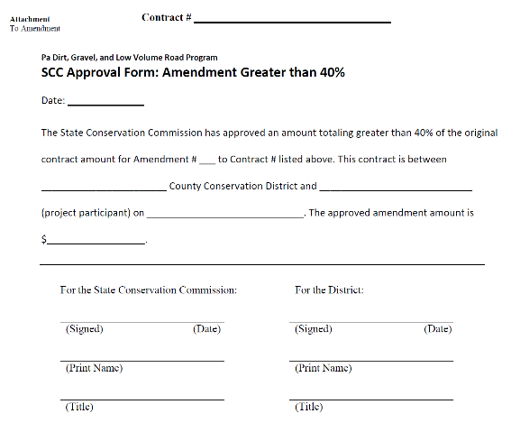
FY 2022-23 Updates
GIS Updates
  Amendments Approval Attachment

Slide 12
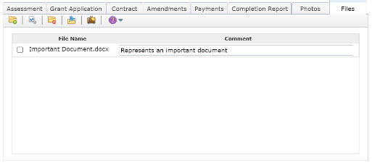
FY 2022-23 Updates
GIS Updates
  Contract File Manager
    Can upload any supporting documents
    Documents cannot be edited once uploaded
    Comments are auto-saved after entering
    Select one or more file(s) to delete or to download
      Downloaded files are in zipped in a single zip file
    Can also download all files associated with a Contract
    with the Download Contract button.
      Contains all uploaded documents, picture, and all created
      contract pdfs.
      Note that depending on the number of files, the download could
      have a large file size

Slide 13
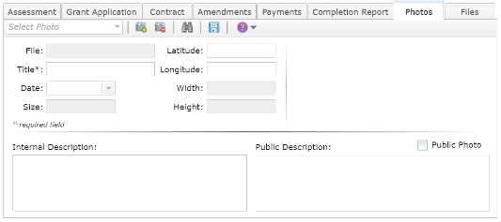
FY 2022-23 Updates
GIS Updates
  Contract Photos
    Can upload any images
    Must provide a title at the minimum
    Will soon be able to read photo metadata
    Photo can be marked as public
      Public photos will be viewable with the Public Viewer
      For public photos, the Public Description will also be provided
    Photos are saved by their uploaded filename.
      Prior to July 6, 2022, any uploaded photos have a custom
      filename, which cannot be changed. Delete and upload the
      photo to change its name
    A Grant Application’s Site Sketch will also soon be able
    to be uploaded

Slide 14
FY 2022-23 Updates
GIS Demo

Slide 15
FY 2022-23 Updates
Website Update
  Website Update
  Login Changes: must reset password
  GIS Updates
Policies Update
  Stream Crossing Policy and Standard
  DSA Spec Update
  Other Policy Changes
Miscellaneous Update
  Workshop
  ESM Trainings
  Stream Trainings
  CD Allocations

Slide 16
FY 2022-23 Updates
All Policy Changes: Stream Crossing, DSA, and others
Effective on any contracts signed on or after July 1, 2022.

Slide 17
FY 2022-23 Updates
Stream Crossing Changes
  POLICY
    Must follow (NEW) DGLVR Stream Crossing Replacement Standard
    More CD involvement: initial site assessment, site meetings, plan review, inspection during installation, CD training requirement
    Exemptions for smaller channels or special circumstances.
  STANDARD
    Increase minimum structure width from 100% to width needed to construct low flow channels with stable bank margins and 100 year hydraulic capacity (125% bankfull channel minimum)
    Require added streambed depth in structures, and low-flow channels, bottomless structures over (4%)
    Require longitudinal profile survey with goal of stream continuity
    Require CDs to review permit plan and bid package
    Construction design plan requirements for engineers
    Increased oversight and inspection from engineers
    Engineer certification
  TECHNICAL MANUAL
Detailed webinars recorded in June
Documents printed, will be sent to CDS
Website had been updated

Slide 18
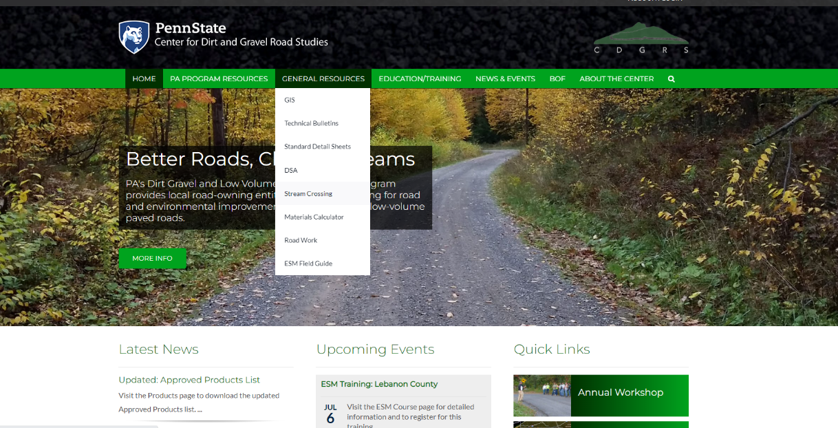
FY 2022-23 Updates
Documents printed, will be sent to CDS
Website had been updated

Slide 19
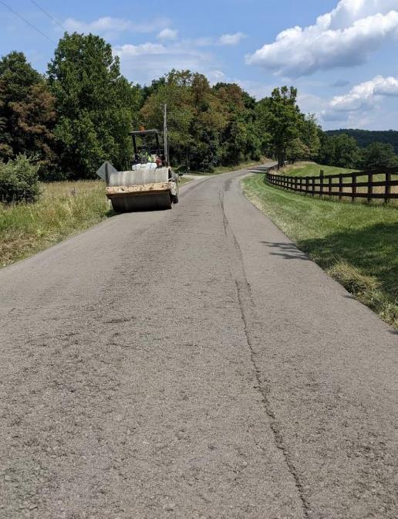
FY 2022-23 Updates
DSA Changes
  Abrasion Resistance: increased from 40 to 45 (loosening of spec)
  Placement:
    Paver placement required over 500 tons (formerly 1,000)
    Grader and carbide blade required if not using paver

Slide 20
FY 2022-23 Updates
Other Policy Changes
3.4.2 – Clarification on Cost Allocation Methodology, administrative and education expenses
3.5.3 – Increased threshold for amendments from 20% to 40% of original contract amount
3.7.4 – Clarification on when headwalls and end walls must be used
3.7.4 – Increased maximum allowed for engineering costs from 10% to 20% of contract amount
with a $25,000 cap
7.2.3 – Fill exemption for DSA: changed from requiring a minimum of 12 inches of road fill
including the thickness of the driving surface to a minimum of 12 inches not including the driving surface
Appendices added or updated:
  Appendix E – New appendix to show examples of cost allocation methods
  Appendix F – The DSA Standard and Specification with the new changes
  Appendix G – The new Stream Crossing Replacement Standard
  Appendix H – Stream Crossing Replacement evaluation
  Appendix I – Exemptions from Stream Crossing Standard
Not all inclusive: 6/2/22 recorded webinar goes over changes in detail

Slide 21
FY 2022-23 Updates
Website Update
  Website Update
  Login Changes: must reset password
  GIS Updates
Policies Update
  Stream Crossing Policy and Standard
  DSA Spec Update
  Other Policy Changes
Miscellaneous Update
  Workshop
  ESM Trainings
  Stream Trainings
  CD Allocations

Slide 22
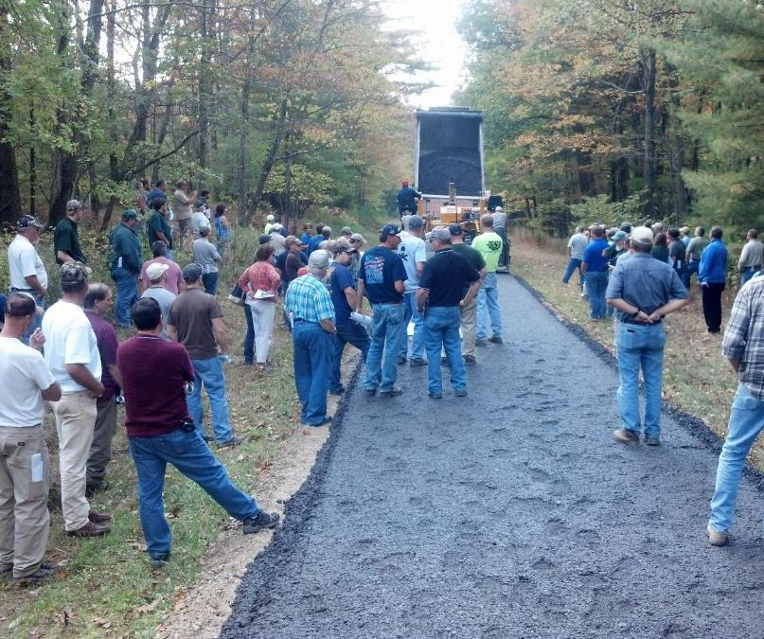
FY 2022-23 Updates
2022 DGLVR Workshop
  September 27-28, State College, PA
  Tue AM: Optional “Surveying 101” class
  Tue PM:
    Lunch 11:30, workshop starts at 12:30
    Concurrent Classes in afternoon
    Vendor Reception and Dinner
  Wed:
    2-3 repeated field trips, AM and PM
  2022 Theme: “Back to Basics”

Slide 23
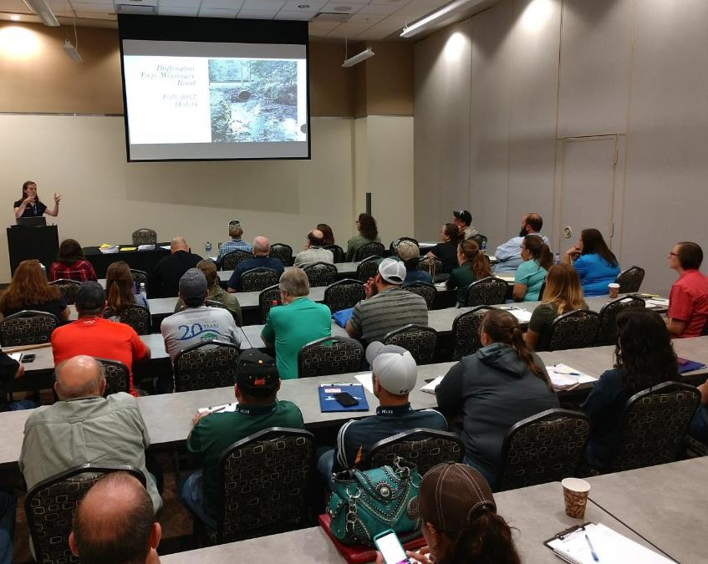
FY 2022-23 Updates
2022 ESM Trainings
  Virtual
    1/18-19 38 sites attending, ~90 attendees
    2/15-16 51 sites attending, ~90 attendees
    3/15-16 68 sites attending, ~210 attendees
  In-Person
    5/11-12 Bedford 32 attendees
    6/12-16 Venango 53 attendees
    7/6-7 Lebanon 42 attendees
  Future
  ??? TBD. Would like to keep old model of 2-day in-person. “Effectiveness over convenience”. Will be topic of discussion this fall/winter.

Slide 24
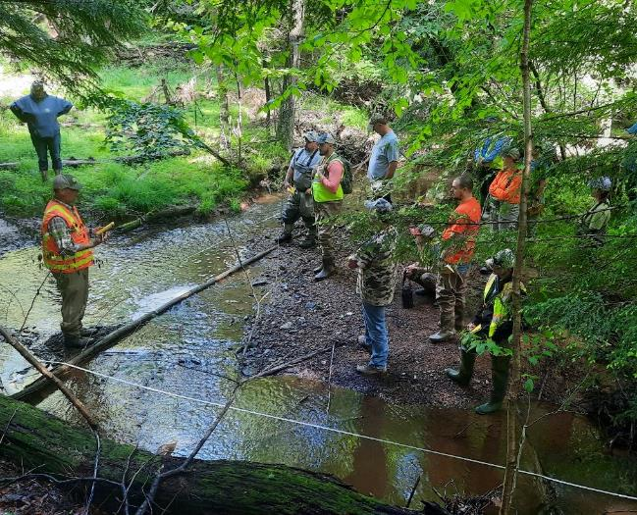
FY 2022-23 Updates
2022 Stream Crossing Replacement Certification Trainings
  One Completed:
  Indiana in June
  Remaining Schedule and Openings:
  NW in July full
  NC in August 5 left
  NE in October 8 left
  SC in November full
  SE in December 6 left
  Required by July 2023

Slide 25
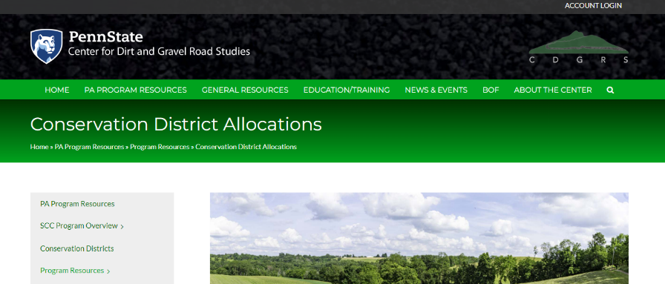
FY 2022-23 Updates
2022-23 CD Allocations
  Approved in May and on CDGRS website
  “Paperwork” is done and pending State Budget Approval
  “Rumors” are state budget will be approved soon, but further delay might slow allocation advances

Slide 26
Dirt Gravel and Low Volume Road Program
FY 2022-23 DGLVR Updates
7/7/2022
Ken Corradini
kjc139@psu.edu
Roy Richardson: SCC
rrichardso@pa.gov
Steve Bloser: CDGRS
smb201@psu.edu
You will need to reset your password to log into the CDGRS website and GIS system
All Policy Changes: Stream Crossing, DSA, and others are effective on any contracts signed on or after July 1, 2022.

