Slide 1
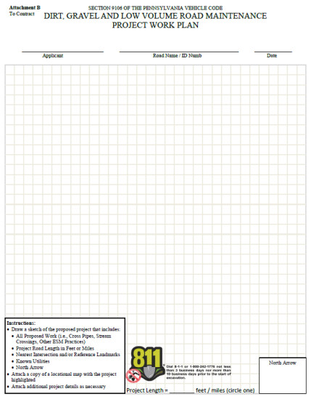
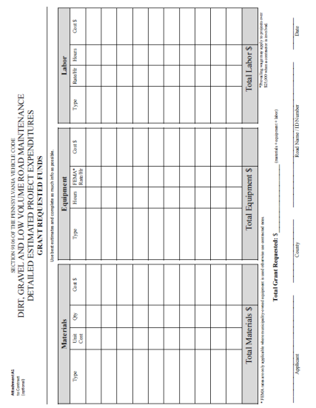
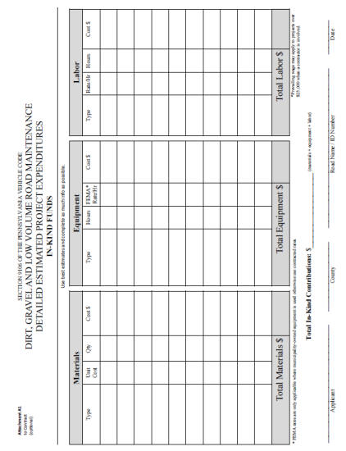
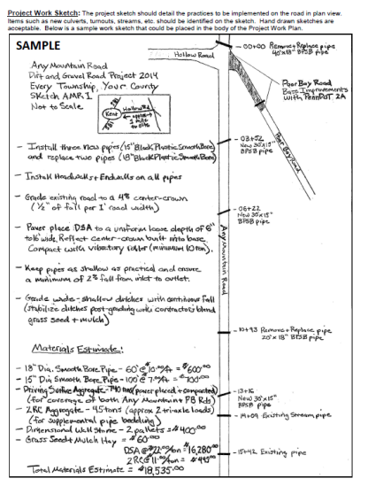
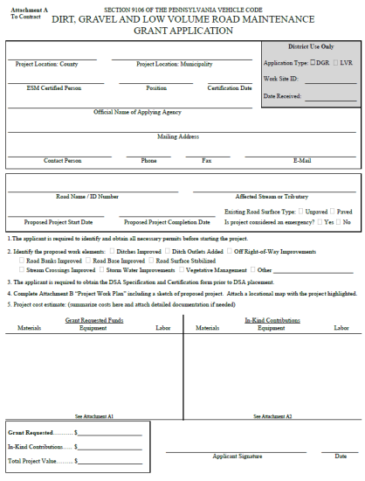
DGLVR Forms Update
12/17/2014
Toggle Fullscreen
mode with this button
above
Use Chat box to ask Questions
http://metrocount.com
If you are reading this, then you are successfully seeing the webinar video. In addition to audio on the webinar, we have opened a phone conference line to allow attendees to listen and ask questions directly: 866-823-7699. Please use either the webinar audio or conference line, but not both (will produce feedback)
Audio also available via phone: 866-823-7699
For assistance, call: 814-865-5355

Slide 2
Toggle Fullscreen
mode with this button
above
Use Chat box to ask Questions
Participant phone lines will be muted until after initial presentation
http://metrocount.com
Audio also available via phone: 866-823-7699
For assistance, call: 814-865-5355

Slide 3
Forms Update
Webinar, including Q&A, will be recorded and available later. www.dirtandgravelroads.org
Audio also available via phone: 866-823-7699
For assistance, call: 814-865-5355

Slide 4
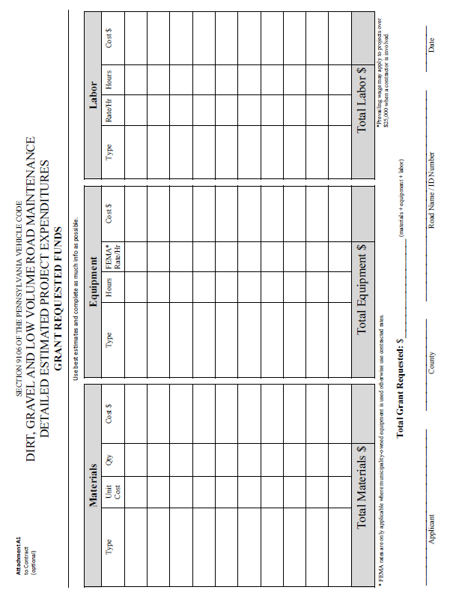
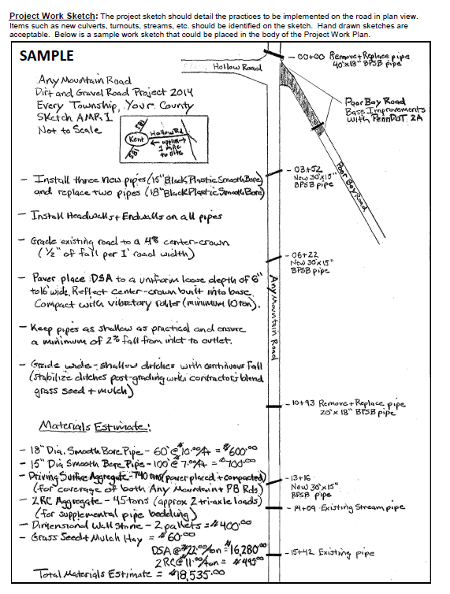
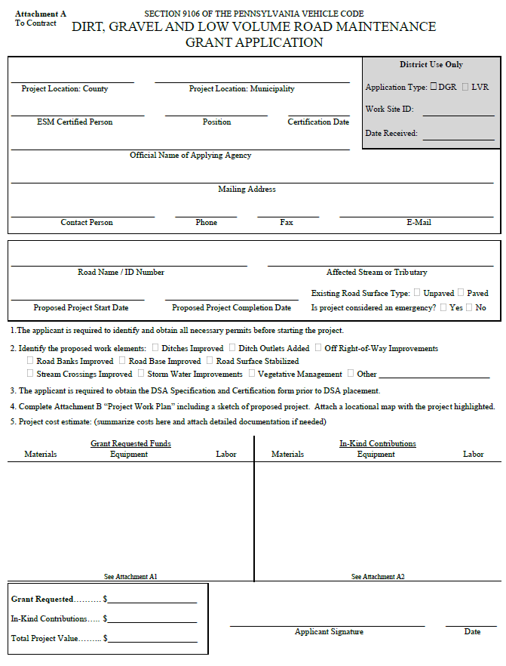
Introduction
Program Forms Update
Background
Overview of Admin Manual
Walkthrough of forms

Slide 5
Background
Forms Update
Program Administrative Manual approved in November
As part of manual:
Many REVISED forms
Several NEW forms

Slide 6
Background
Forms Update
Program Administrative Manual approved in November
As part of manual:
Many REVISED forms
Several NEW forms
Purpose: Provide OVERVIEW of manual structure and forms with focus on what is new and revised.
Will not have time to go over every blank in every form.
Will not have time to get into policy details

Slide 7
E. Grant App, Work plan, Instructions
Forms Update
When do I start using the new forms…?

Slide 8
E. Grant App, Work plan, Instructions
Forms Update
When do I start using the new forms…?
NOW!
Finish out current contracts with old forms, use new forms for 2015 projects.

Slide 9
Introduction
Program Forms Update
Background
Overview of Admin Manual
Walkthrough of forms

Slide 10
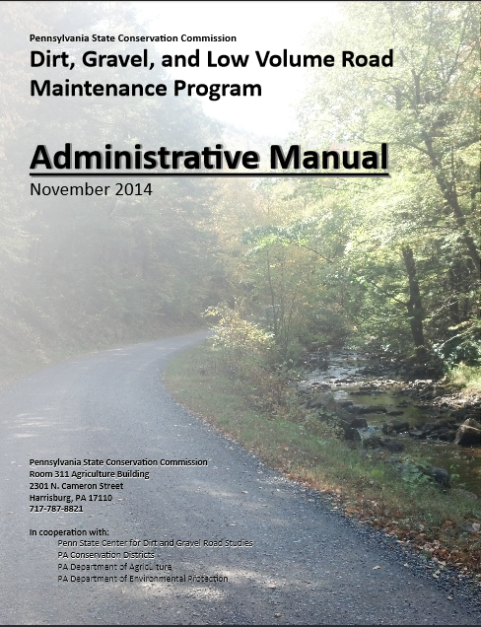
Background
Forms Update
DG&LVR Administrative Manual
Approved by SCC 11/12/14
Introduction
SCC Role
Conservation District Role
Quality Assurance Board Role
Applicant Role
Center for Dirt and Gravel Roads
Additional Policies
Permits and Other Requirements
Appendices
Available online.
Hard Copies being printed for CDs.

Slide 11
Poll
How familiar are you with the NEW
Program Admin Manual?
http://metrocount.com

Slide 12
Admin Manual
Forms Update
DG&LVR Administrative Manual
Approved by SCC 11/12/14
Introduction
SCC Role
Conservation District Role
Quality Assurance Board Role
Applicant Role
Center for Dirt and Gravel Roads
Additional Policies
Permits and Other Requirements
Appendices
Available online.
Hard Copies being printed for CDs.
Introduction
3-page “Abstract” of the Program and the rest of the manual.
Program Structure
Program History
ESM Overview

Slide 13
Admin Manual
Forms Update
DG&LVR Administrative Manual
Approved by SCC 11/12/14
Introduction
SCC Role
Conservation District Role
Quality Assurance Board Role
Applicant Role
Center for Dirt and Gravel Roads
Additional Policies
Permits and Other Requirements
Appendices
Available online.
Hard Copies being printed for CDs.
SCC Role
3-page summary of SCC role
SCC Structure
Program Administration
QAQC

Slide 14
Admin Manual
Forms Update
DG&LVR Administrative Manual
Approved by SCC 11/12/14
Introduction
SCC Role
Conservation District Role
Quality Assurance Board Role
Applicant Role
Center for Dirt and Gravel Roads
Additional Policies
Permits and Other Requirements
Appendices
Available online.
Hard Copies being printed for CDs.
3) District Role
Over ½ of manual
Receiving Funds
Accounting for Funds
Dispersing Funds to Grantees
CD Educational Opportunities
Program Eligibility
3.8 Administering Projects
GIS system
Annual Reports

Slide 15
Admin Manual
Forms Update
DG&LVR Administrative Manual
Approved by SCC 11/12/14
Introduction
SCC Role
Conservation District Role
Quality Assurance Board Role
Applicant Role
Center for Dirt and Gravel Roads
Additional Policies
Permits and Other Requirements
Appendices
Available online.
Hard Copies being printed for CDs.
4) QAB Role
Defines composition and function of QAB
Composition
Meeting Requirements
QAB Role in Projects
QAB Role in Policy

Slide 16
Admin Manual
Forms Update
DG&LVR Administrative Manual
Approved by SCC 11/12/14
Introduction
SCC Role
Conservation District Role
Quality Assurance Board Role
Applicant Role
Center for Dirt and Gravel Roads
Additional Policies
Permits and Other Requirements
Appendices
Available online.
Hard Copies being printed for CDs.
5) Applicant Role
Intentionally repeats previous material
Written “to” the applicant audience
Intended to be standalone to give to applicants.

Slide 17
Admin Manual
Forms Update
DG&LVR Administrative Manual
Approved by SCC 11/12/14
Introduction
SCC Role
Conservation District Role
Quality Assurance Board Role
Applicant Role
Center for Dirt and Gravel Roads
Additional Policies
Permits and Other Requirements
Appendices
Available online.
Hard Copies being printed for CDs.
6) Center Role
3-page overview of Center role and available services
Education
Outreach
Technical Assistance
Documentation

Slide 18
Admin Manual
Forms Update
DG&LVR Administrative Manual
Approved by SCC 11/12/14
Introduction
SCC Role
Conservation District Role
Quality Assurance Board Role
Applicant Role
Center for Dirt and Gravel Roads
Additional Policies
Permits and Other Requirements
Appendices
Available online.
Hard Copies being printed for CDs.
7) Additional Policies
Policies that apply to certain circumstances:
Stream Crossing Replacement
Driving Surface Aggregate
Paved LVR-Specific Policies

Slide 19
Admin Manual
Forms Update
DG&LVR Administrative Manual
Approved by SCC 11/12/14
Introduction
SCC Role
Conservation District Role
Quality Assurance Board Role
Applicant Role
Center for Dirt and Gravel Roads
Additional Policies
Permits and Other Requirements
Appendices
Available online.
Hard Copies being printed for CDs.
8) Permits
Brief overview of permit issues related to Program projects.

Slide 20
Admin Manual
Forms Update
DG&LVR Administrative Manual
Approved by SCC 11/12/14
Introduction
SCC Role
Conservation District Role
Quality Assurance Board Role
Applicant Role
Center for Dirt and Gravel Roads
Additional Policies
Permits and Other Requirements
Appendices
Available online.
Hard Copies being printed for CDs.
Appendices
Program forms and policies
Will be focus of the rest of this webinar.

Slide 21
Introduction
Program Forms Update
Background
Overview of Admin Manual
Walkthrough of forms

Slide 22
A. Dirt Gravel, And Low Volume Road Program Law 9106
B. Commission Statement Of Policy
C. 5 Year Agreement Between Districts And Commission
D. New-hire Program Guide revised
E. Grant Application, Work Plan & Instructions revised
F. Contract & Instructions revised
G. General Contract Provisions
H. Contract Amendment & Instructions revised
I. Schedule Of Payments
J. Project Completion Report And Instructions revised
K. Replenishment Request Form revised
L. Traffic Count Validation/Instructions new
M. Stream Crossing Evaluation/Instructions new
N. DSA Specification And Certification
O. Off Row Consent Form new
P. QAQC Documents
Q. Project Ranking Criteria
R. Allocation Formula Details
S. Definitions
T. Contact Information
Manual Appendices

Slide 23
A. Dirt Gravel, And Low Volume Road Program Law 9106
B. Commission Statement Of Policy
C. 5 Year Agreement Between Districts And Commission
D. New-hire Program Guide revised
E. Grant Application, Work Plan & Instructions revised
F. Contract & Instructions revised
G. General Contract Provisions
H. Contract Amendment & Instructions revised
I. Schedule Of Payments
J. Project Completion Report And Instructions revised
K. Replenishment Request Form revised
L. Traffic Count Validation/Instructions new
M. Stream Crossing Evaluation/Instructions new
N. DSA Specification And Certification
O. Off Row Consent Form new
P. QAQC Documents
Q. Project Ranking Criteria
R. Allocation Formula Details
S. Definitions
T. Contact Information
Manual Appendices
Not reviewing unchanged forms

Slide 24
Appendices
Forms Update
Manual Appendices
D. New-hire Program Guide revised
E. Grant Application, Work Plan & Instructions revised
F. Contract & Instructions revised
G. General Contract Provisions
H. Contract Amendment & Instructions revised
I. Schedule Of Payments
J. Project Completion Report And Instructions revised
K. Replenishment Request Form revised
L. Traffic Count Validation/Instructions new
M.Stream Crossing Evaluation/Instructions new
O. Off Row Consent Form new
Project
Forms

Slide 25
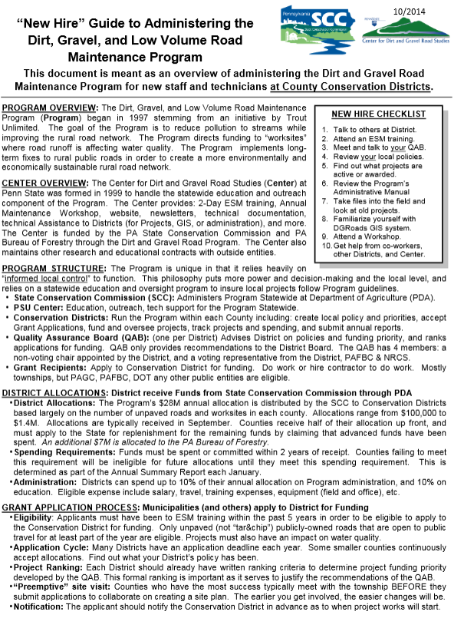
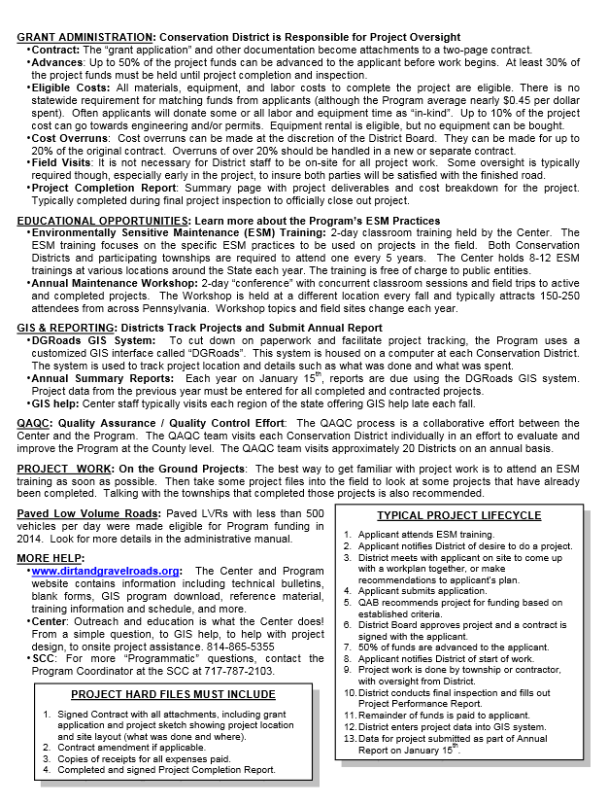
D. New Hire Guide
Forms Update
2 page “cheat sheet” for new CD hires.
Minor Changes

Slide 26
Appendices
Forms Update
D. New-hire Program Guide revised
E. Grant Application, Work Plan & Instructions revised
F. Contract & Instructions revised
G. General Contract Provisions
H. Contract Amendment & Instructions revised
I. Schedule Of Payments
J. Project Completion Report And Instructions revised
K. Replenishment Request Form revised
L. Traffic Count Validation/Instructions new
M.Stream Crossing Evaluation/Instructions new
O. Off Row Consent Form new
Project
Forms

Slide 27
E. Grant App, Work plan, Instructions
Forms Update
Grant app and forms used to apply to CD
Revised project-specific Grant Application
NEW optional cost summary forms
Revised Project Sketch (back of grant app)
New Instructions for all forms

Slide 28
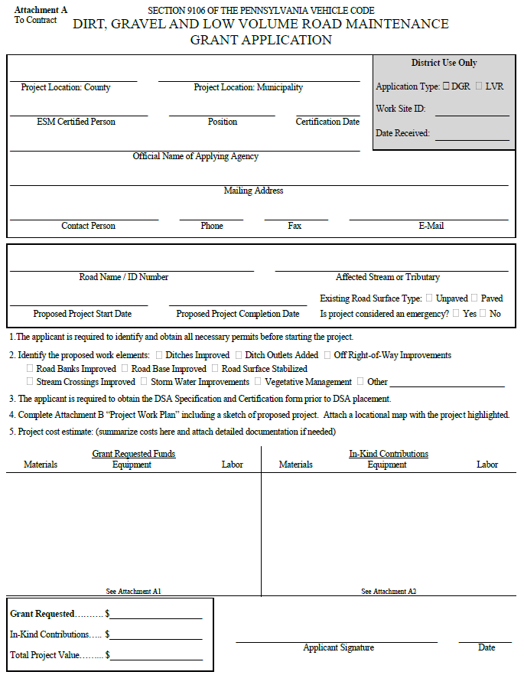
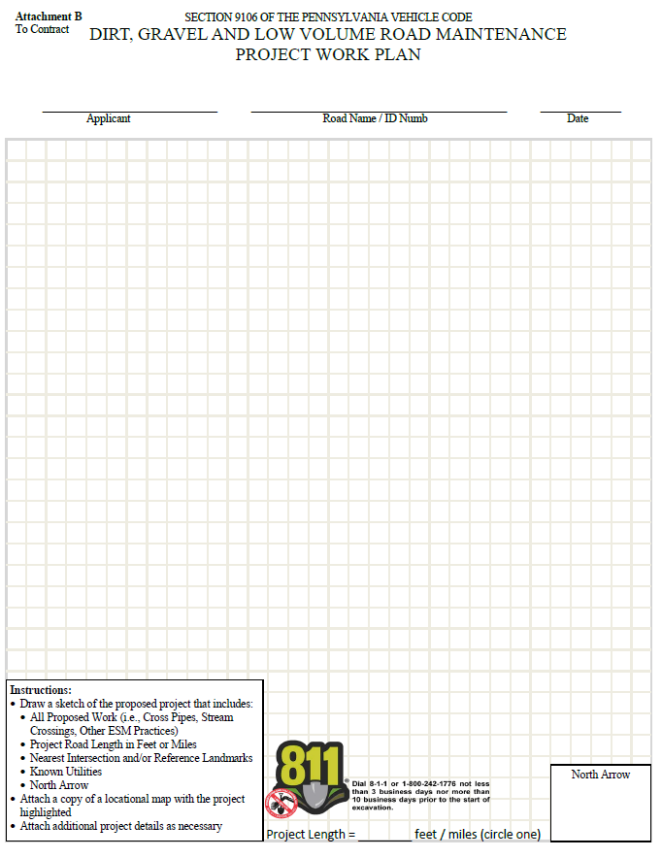
E. Grant App, Work plan, Instructions
Forms Update
Grant Application (front)
Project Sketch
(back)
2 page “cheat sheet” for new CD hires.

Slide 29
E. Grant App, Work plan, Instructions
Forms Update
Grant App - Top
NEW District Use Only Box
2 page “cheat sheet” for new CD hires.
Applicant Info
Project Info

Slide 30
E. Grant App, Work plan, Instructions
Forms Update
Grant App - Bottom
Questions changed slightly
2 page “cheat sheet” for new CD hires.
Additional Cost Sheets Available
Cost Summary

Slide 31
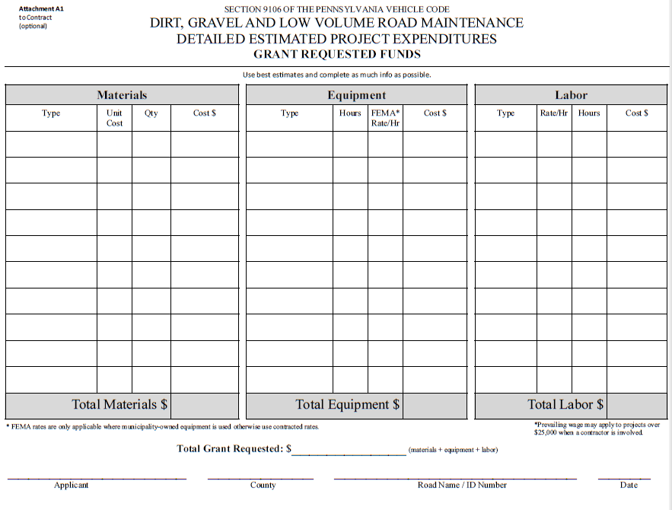
E. Grant App, Work plan, Instructions
Forms Update
NEW OPTIONAL Form
2 page “cheat sheet” for new CD hires.

Slide 32
E. Grant App, Work plan, Instructions
Forms Update
NEW OPTIONAL Form
Bottom of Grant Application
2 page “cheat sheet” for new CD hires.

Slide 33
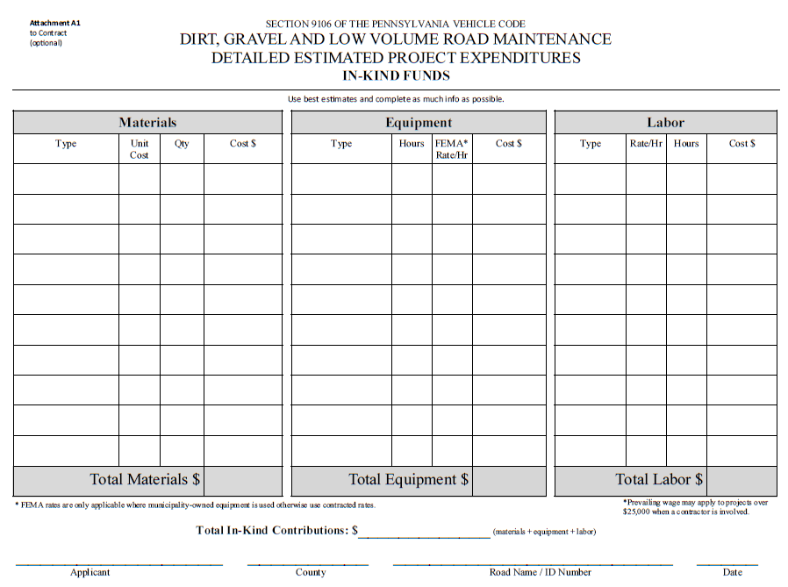
E. Grant App, Work plan, Instructions
Forms Update
NEW OPTIONAL Form
2 page “cheat sheet” for new CD hires.

Slide 34
E. Grant App, Work plan, Instructions
Forms Update
NEW OPTIONAL Form
Bottom of Grant Application
2 page “cheat sheet” for new CD hires.

Slide 35
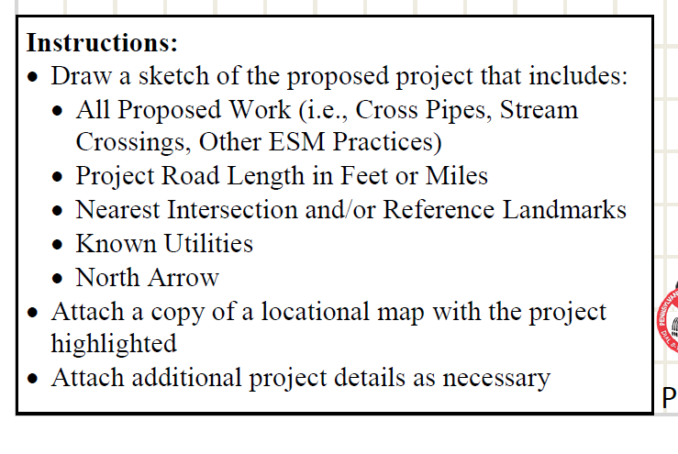
E. Grant App, Work plan, Instructions
Forms Update
Project Sketch
(back of grant app)
2 page “cheat sheet” for new CD hires.

Slide 36
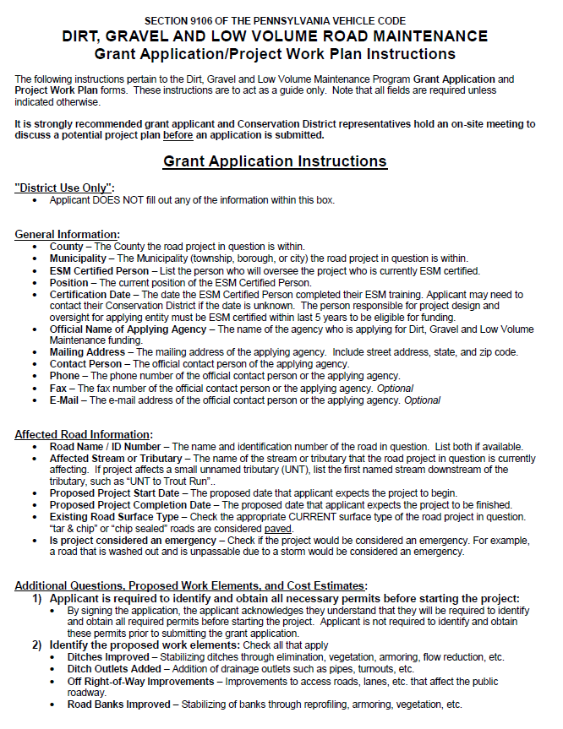
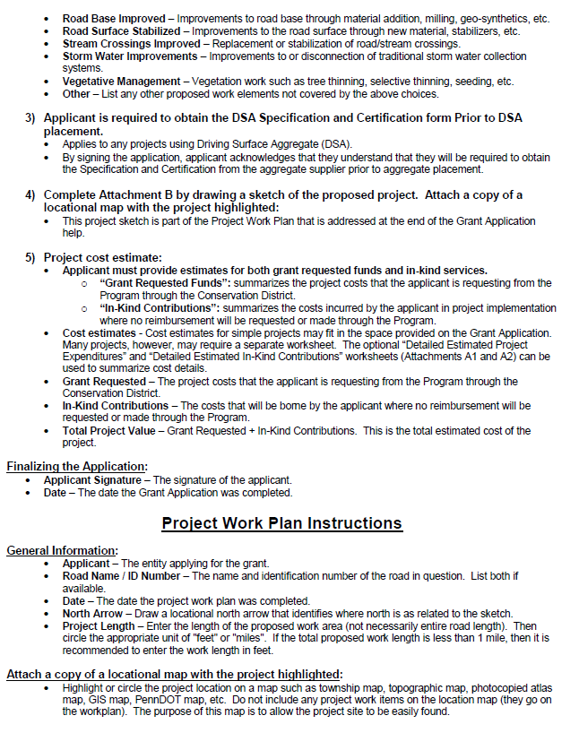
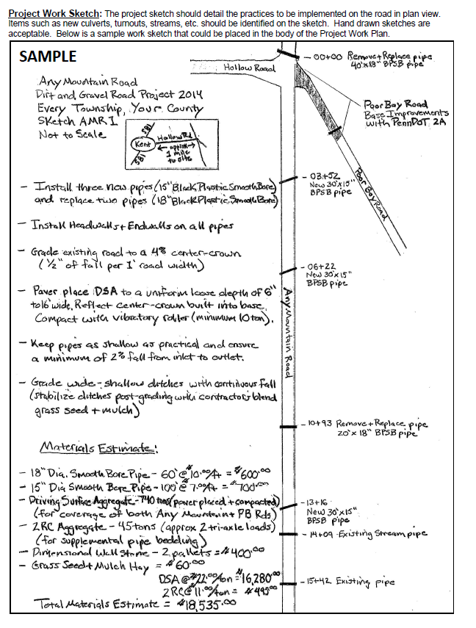
E. Grant App, Work plan, Instructions
Forms Update
Grant App Instructions, Sample Sketch
2 page “cheat sheet” for new CD hires.

Slide 37
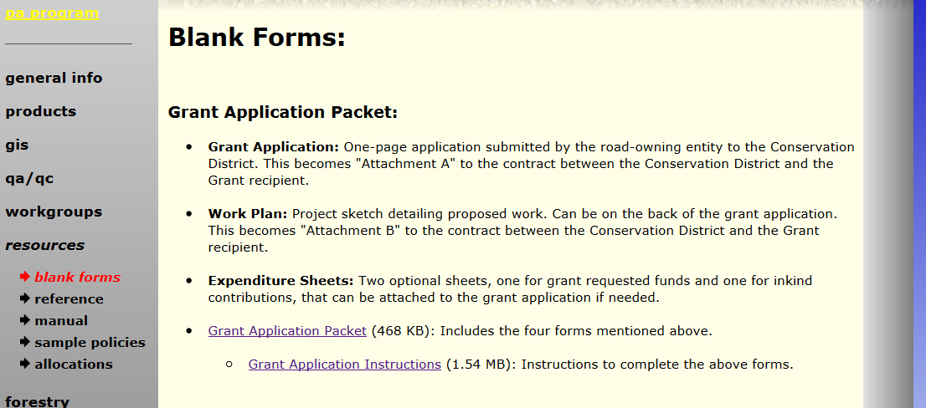
E. Grant App, Work plan, Instructions
Forms Update
New forms and instructions available online
Will provide link at end

Slide 38
Appendices
Forms Update
D. New-hire Program Guide revised
E. Grant Application, Work Plan & Instructions revised
F. Contract & Instructions revised
G. General Contract Provisions
H. Contract Amendment & Instructions revised
I. Schedule Of Payments
J. Project Completion Report And Instructions revised
K. Replenishment Request Form revised
L. Traffic Count Validation/Instructions new
M.Stream Crossing Evaluation/Instructions new
O. Off Row Consent Form new
Project
Forms

Slide 39
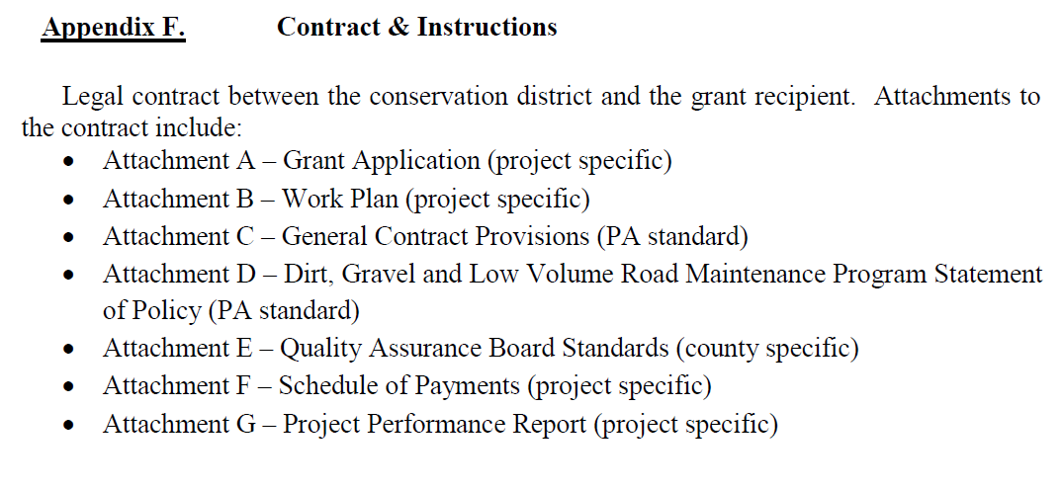
E. Contract
Forms Update
2-page contract between CD and grantee
Minor changes
CDs can add provisions

Slide 40
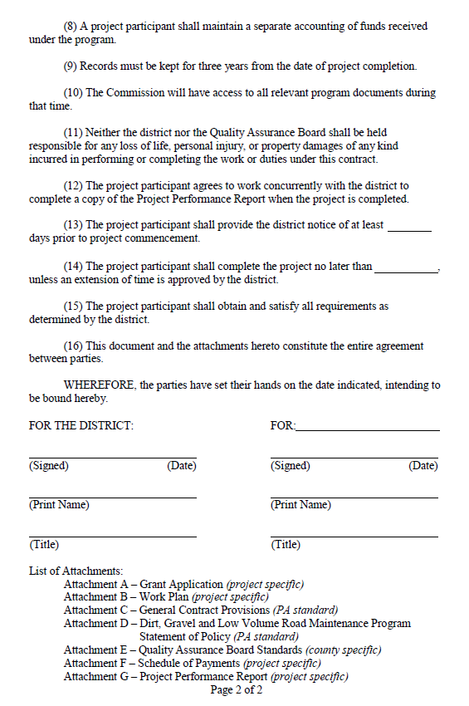
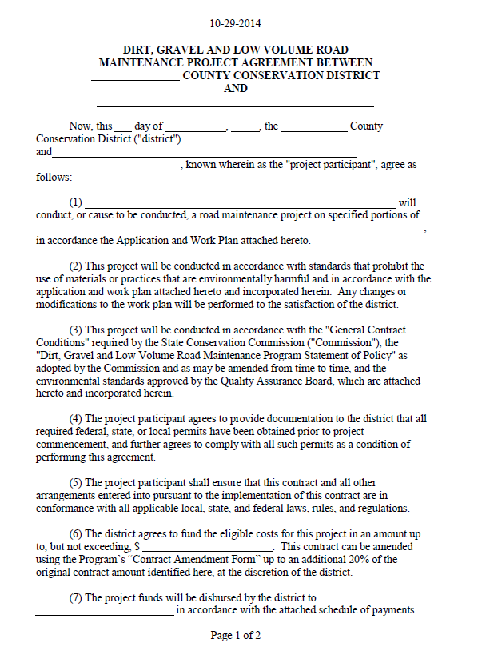
E. Contract
Grant App Instructions, Sample Sketch
Forms Update
2 page “cheat sheet” for new CD hires.

Slide 41
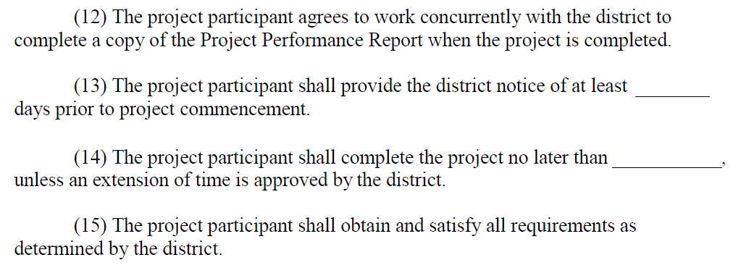
E. Contract
Grant App Instructions, Sample Sketch
Forms Update
2 page “cheat sheet” for new CD hires.

Slide 42
E. Contract
Forms Update
2-page contract between CD and grantee
CDs can add provisions to contract
Need to be approved by your solicitor.
Need to notify SCC.

Slide 43
Appendices
Forms Update
D. New-hire Program Guide revised
E. Grant Application, Work Plan & Instructions revised
F. Contract & Instructions revised
G. General Contract Provisions
H. Contract Amendment & Instructions revised
I. Schedule Of Payments
J. Project Completion Report And Instructions revised
K. Replenishment Request Form revised
L. Traffic Count Validation/Instructions new
M.Stream Crossing Evaluation/Instructions new
O. Off Row Consent Form new
Project
Forms

Slide 44
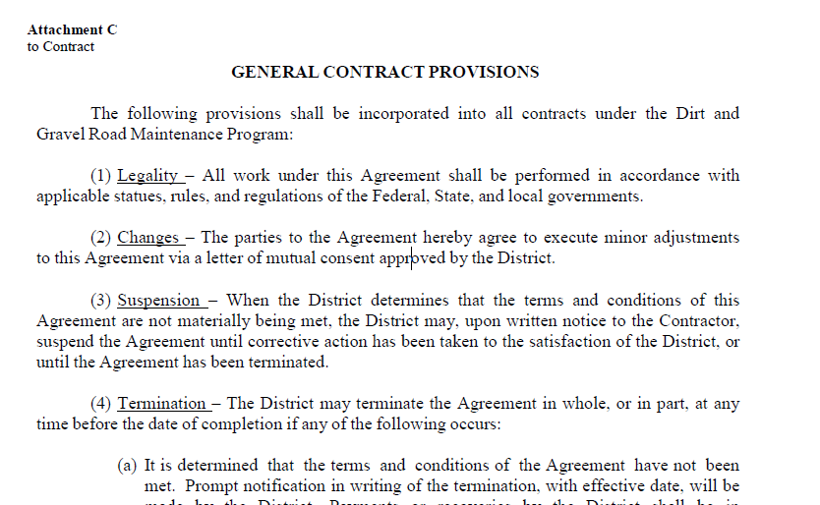
F. General Contract Provisions
Forms Update
2 pages of legal provisions that attach to contract
NO changes

Slide 45
Appendices
Forms Update
D. New-hire Program Guide revised
E. Grant Application, Work Plan & Instructions revised
F. Contract & Instructions revised
G. General Contract Provisions
H. Contract Amendment & Instructions revised
I. Schedule Of Payments
J. Project Completion Report And Instructions revised
K. Replenishment Request Form revised
L. Traffic Count Validation/Instructions new
M.Stream Crossing Evaluation/Instructions new
O. Off Row Consent Form new
Project
Forms

Slide 46
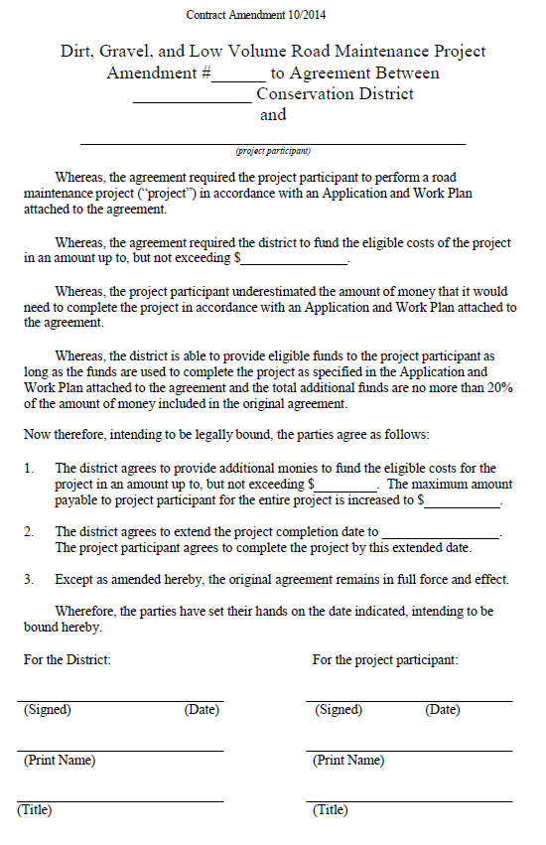
H. Contract Amendment
Forms Update
One-page amendment to contract between CD and grantee.
Minor changes

Slide 47
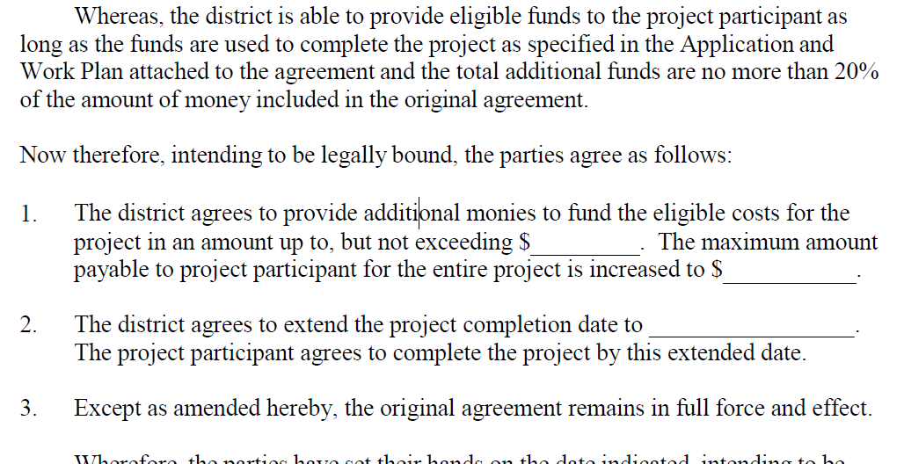
H. Contract Amendment
Forms Update
Limit increased from 10% to 20% of contract
Can now be used to extend completion date.

Slide 48
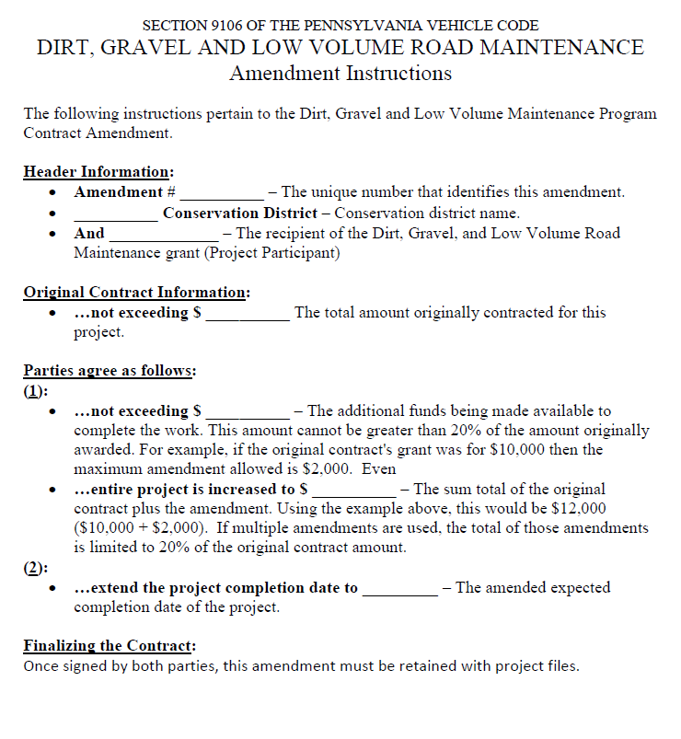
H. Contract Amendment
Forms Update
NEW Amendment Instructions
Can now be used to extend completion date.

Slide 49
Appendices
Forms Update
D. New-hire Program Guide revised
E. Grant Application, Work Plan & Instructions revised
F. Contract & Instructions revised
G. General Contract Provisions
H. Contract Amendment & Instructions revised
I. Schedule Of Payments
J. Project Completion Report And Instructions revised
K. Replenishment Request Form revised
L. Traffic Count Validation/Instructions new
M.Stream Crossing Evaluation/Instructions new
O. Off Row Consent Form new
Project
Forms

Slide 50
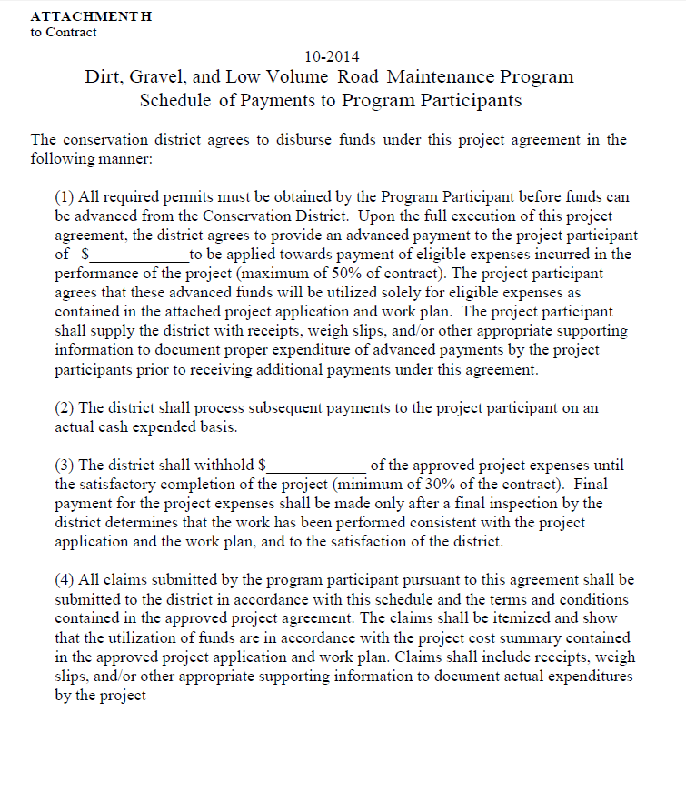
I. Schedule of Payments
Forms Update
Schedule of payments
Outlines payment plan with grantee
NO Change
Can now be used to extend completion date.

Slide 51
Appendices
Forms Update
D. New-hire Program Guide revised
E. Grant Application, Work Plan & Instructions revised
F. Contract & Instructions revised
G. General Contract Provisions
H. Contract Amendment & Instructions revised
I. Schedule Of Payments
J. Project Completion Report And Instructions revised
K. Replenishment Request Form revised
L. Traffic Count Validation/Instructions new
M.Stream Crossing Evaluation/Instructions new
O. Off Row Consent Form new
Project
Forms

Slide 52
J. Project Completion Report
Forms Update
Project Completion Report
Closeout summary of individual project
Encourage joint CD/grantee completion at final inspection.
Summarizes funding
Summarizes work
Signed by CD and grantee
Significant Changes

Slide 53
J. Project Completion Report
Forms Update
Significant Changes - Why?
Old Form: ineffective summaries
Vegetation Management ______Sq Ft
Road Surface Stabilized _______Sq Ft
Ditch Stabilized ________ Sq Ft
New form allows for better ESMP tracking.

Slide 54
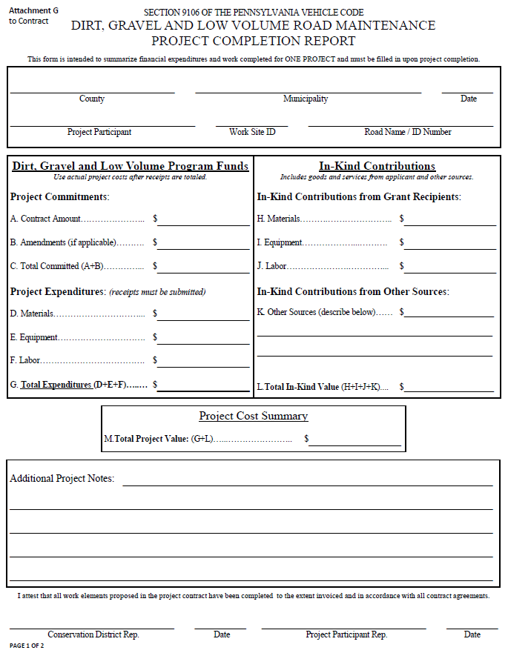
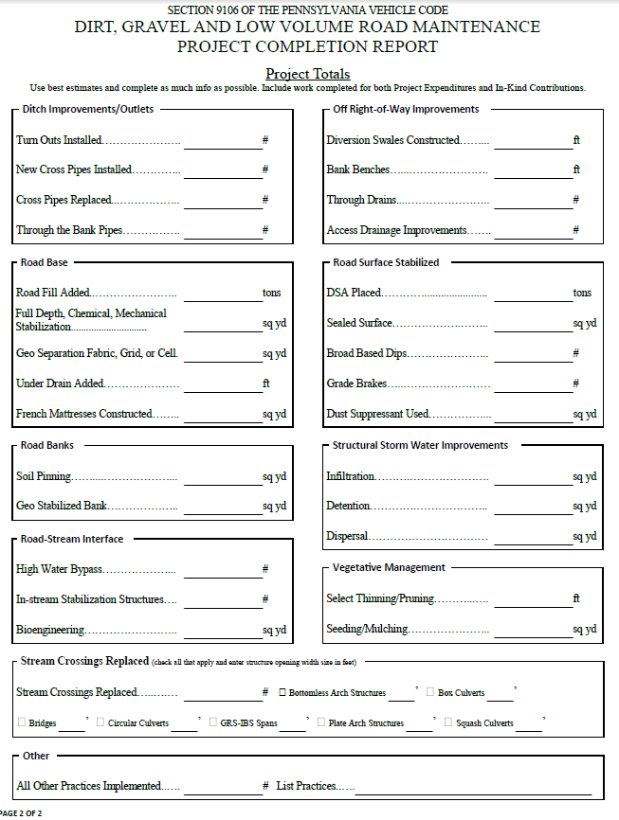
J. Project Completion Report
Forms Update
Expanded to front and back
Project Info
ESM Practice Summary
Financial Summary
Notes and Signatures

Slide 55
J. Project Completion Report
Forms Update
Front Top
No changes to financial data

Slide 56
J. Project Completion Report
Forms Update
Front Back
Space for notes
CD and Grantee Signatures

Slide 57
J. Project Completion Report
Forms Update
Back Top

Slide 58
J. Project Completion Report
Forms Update
Back Bottom

Slide 59
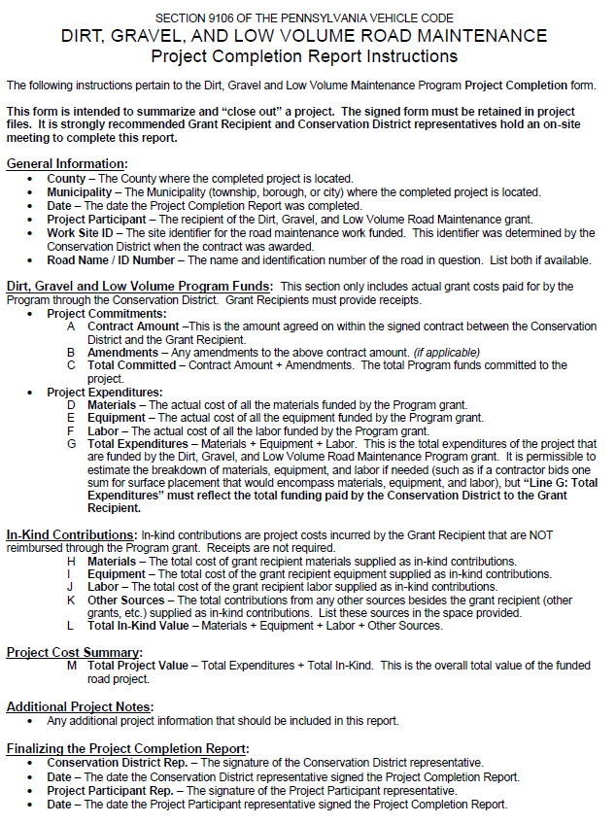
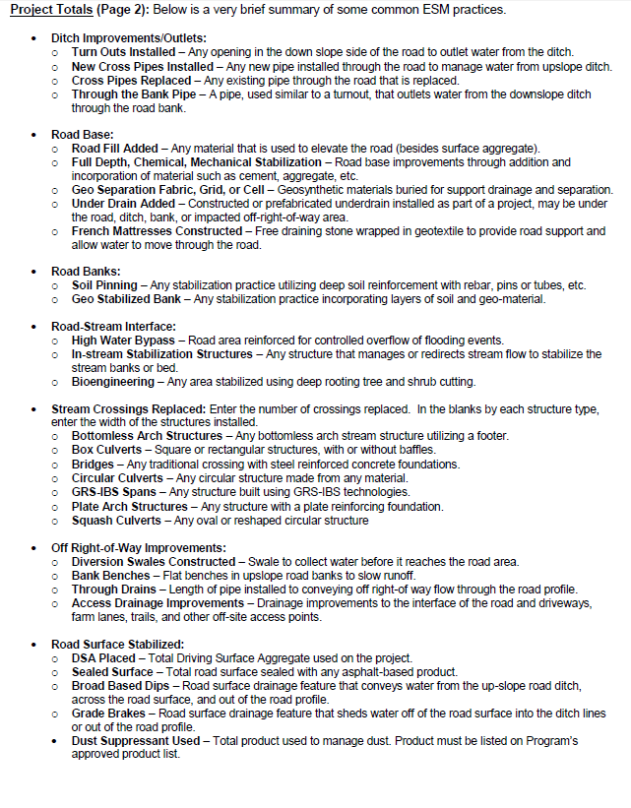
J. Project Completion Report
Forms Update
NEW Project Completion Report Instructions

Slide 60
Appendices
Forms Update
D. New-hire Program Guide revised
E. Grant Application, Work Plan & Instructions revised
F. Contract & Instructions revised
G. General Contract Provisions
H. Contract Amendment & Instructions revised
I. Schedule Of Payments
J. Project Completion Report And Instructions revised
K. Replenishment Request Form revised
L. Traffic Count Validation/Instructions new
M.Stream Crossing Evaluation/Instructions new
O. Off Row Consent Form new
Project
Forms

Slide 61
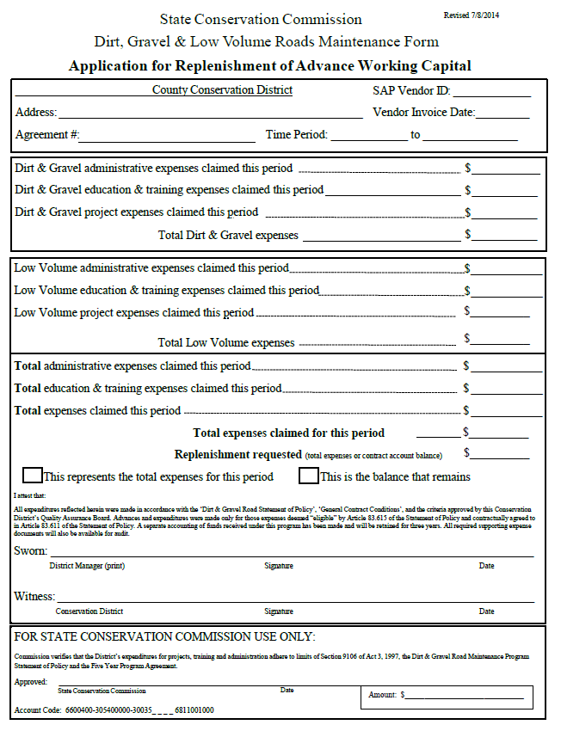
K. Replenishment
Forms Update
Replenishment used by Districts to request remaining funds from SCC
Districts get 50% of allocation up front
Must request replenishment for reminder after funds are spent
Can be all at once, or in several requests

Slide 62
K. Replenishment
Forms Update
NEW form includes D&G and LVR funds
D&G/LVR funds , must be tracked separately
Can request D&G, LVR, or both using one form.

Slide 63
K. Replenishment
Forms Update
Top

Slide 64
K. Replenishment
Forms Update
Bottom
This form goes to Roy Richardson at SCC.

Slide 65
Appendices
Forms Update
D. New-hire Program Guide revised
E. Grant Application, Work Plan & Instructions revised
F. Contract & Instructions revised
G. General Contract Provisions
H. Contract Amendment & Instructions revised
I. Schedule Of Payments
J. Project Completion Report And Instructions revised
K. Replenishment Request Form revised
L. Traffic Count Validation/Instructions new
M.Stream Crossing Evaluation/Instructions new
O. Off Row Consent Form new
Project
Forms

Slide 66
L. Traffic Count Form
Forms Update
LVRs must have less than 500 vehicles per day
Traffic must be validated before a contract can be signed.
More Info:
Details in Manual.
10/23 LVR webinar and presentation on Center website.

Slide 67
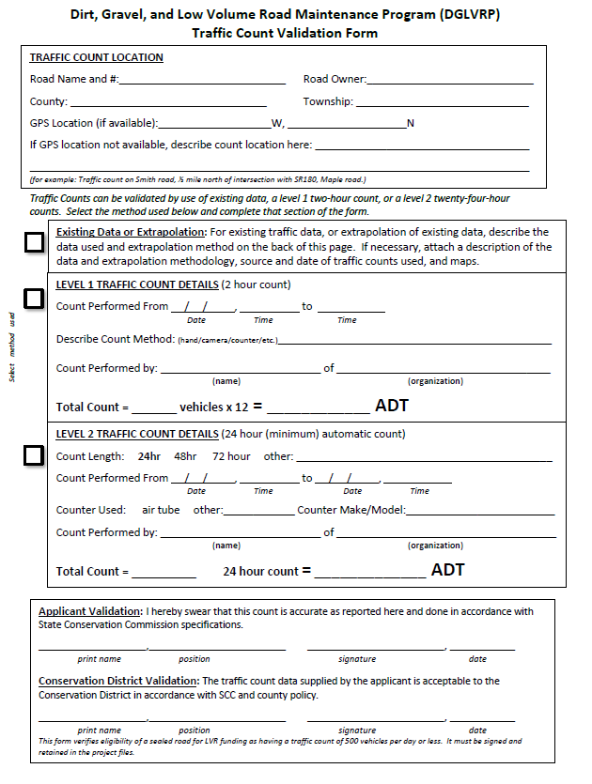
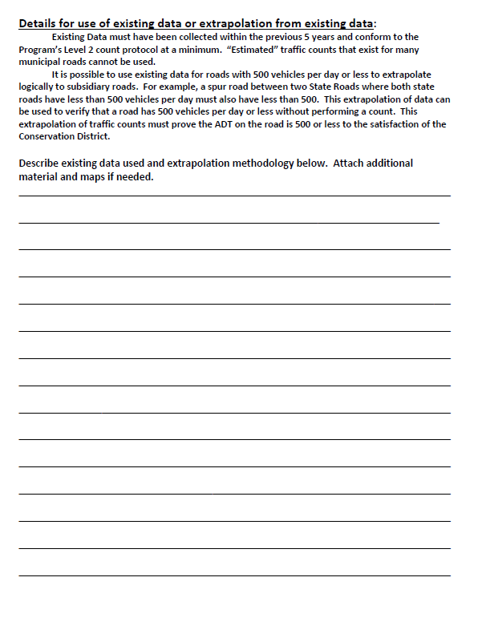
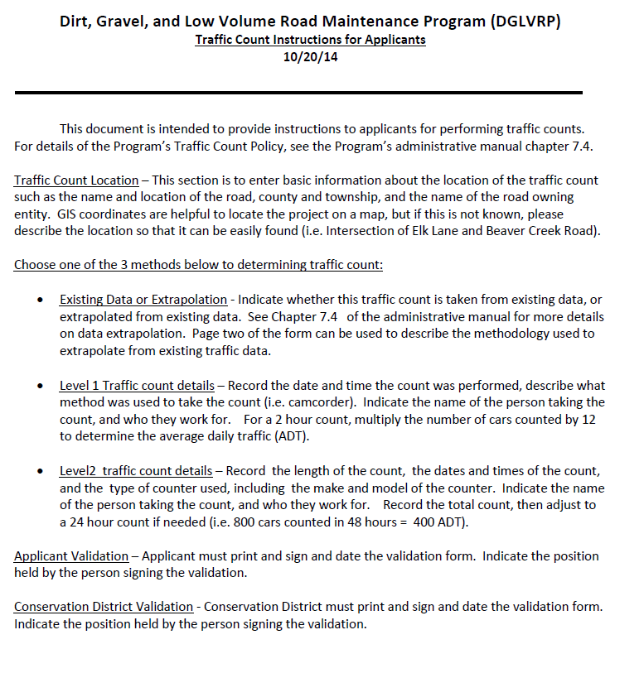
L. Traffic Count Form
Forms Update
Front
Back
Road location
Use Existing counts (back)
Level 1 count: 2-hours
Level 2 count: 24-hours
Instructions
Signatures

Slide 68
Appendices
Forms Update
D. New-hire Program Guide revised
E. Grant Application, Work Plan & Instructions revised
F. Contract & Instructions revised
G. General Contract Provisions
H. Contract Amendment & Instructions revised
I. Schedule Of Payments
J. Project Completion Report And Instructions revised
K. Replenishment Request Form revised
L. Traffic Count Validation/Instructions new
M. Stream Crossing Evaluation/Instructions new
O. Off Row Consent Form new
Project
Forms

Slide 69
M. Stream Crossing Replacement Form
Forms Update
NEW policy for replacing culverts and bridges.
Applies to both D&G and LVR projects.
Limits replacements to areas where structure is causing problem with stream.

Slide 70
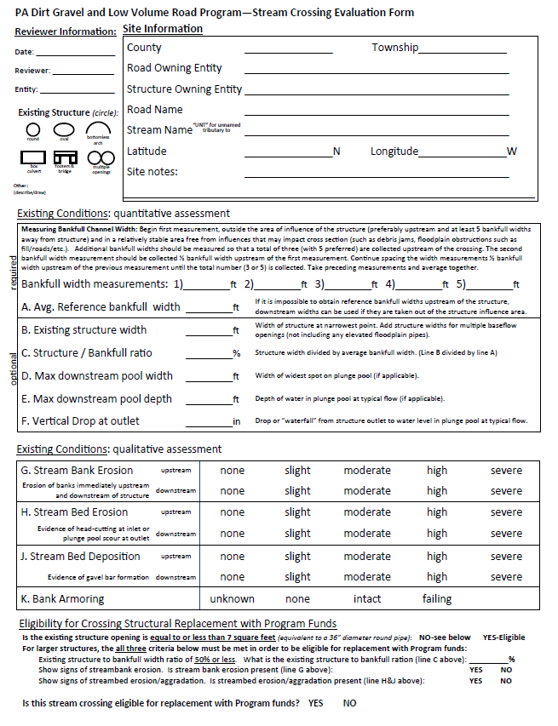
M. Stream Crossing Replacement Form
Forms Update
Details in manual, and likely future Webinar topic.
Site Info
Site Evaluation: width considerations
Site Evaluation: erosion considerations
Eligibility Determination

Slide 71
Appendices
Forms Update
D. New-hire Program Guide revised
E. Grant Application, Work Plan & Instructions revised
F. Contract & Instructions revised
G. General Contract Provisions
H. Contract Amendment & Instructions revised
I. Schedule Of Payments
J. Project Completion Report And Instructions revised
K. Replenishment Request Form revised
L. Traffic Count Validation/Instructions new
M.Stream Crossing Evaluation/Instructions new
O. Off Row Consent Form new
Project
Forms

Slide 72
O. Off Right-of-way Consent Form
Forms Update
Written permission needed when:
Working outside the right-of-way
Impacting landowners (discharging pipe, etc.)
Districts can use their own form, or the example provided here, but must use something!

Slide 73
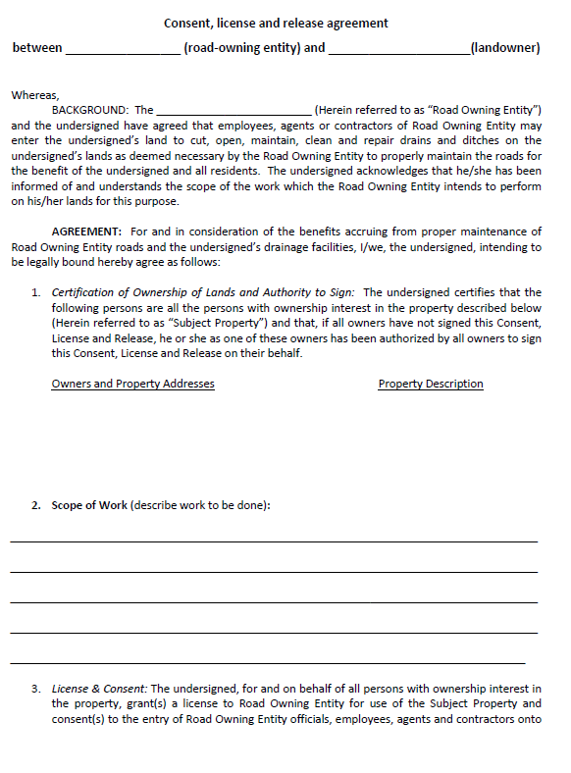
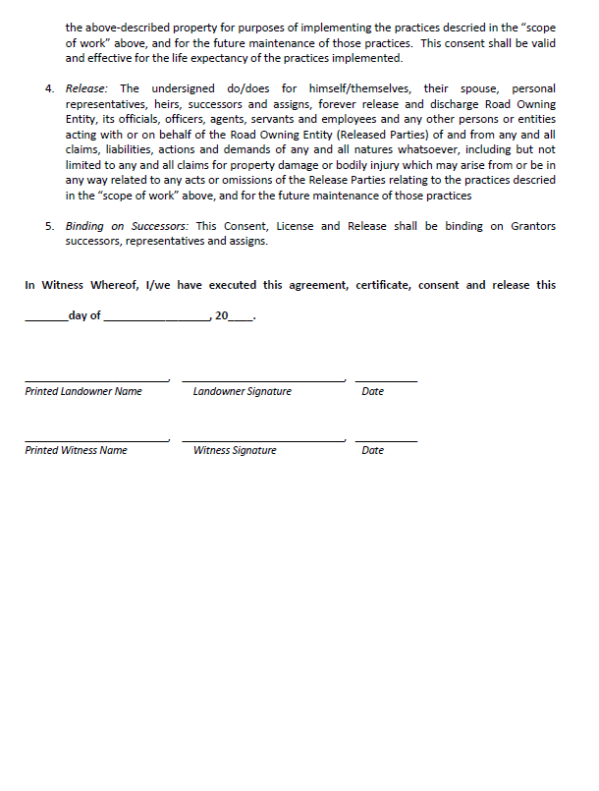
O. Off Right-of-way Consent Form
Forms Update

Slide 74
A. Dirt Gravel, And Low Volume Road Program Law 9106
B. Commission Statement Of Policy
C. 5 Year Agreement Between Districts And Commission
D. New-hire Program Guide revised
E. Grant Application, Work Plan & Instructions revised
F. Contract & Instructions revised
G. General Contract Provisions
H. Contract Amendment & Instructions revised
I. Schedule Of Payments
J. Project Completion Report And Instructions revised
K. Replenishment Request Form revised
L. Traffic Count Validation/Instructions new
M. Stream Crossing Evaluation/Instructions new
N. DSA Specification And Certification
O. Off Row Consent Form new
P. QAQC Documents
Q. Project Ranking Criteria
R. Allocation Formula Details
S. Definitions
T. Contact Information

Slide 75
E. Grant App, Work plan, Instructions
Forms Update
When do I start using the new forms…?
NOW!
Finish out current contracts with old forms, use new forms for 2015 projects.

Slide 76
GIS Update
Forms Update
2014 Summary Report due 1/15/15 using old DGRoads GIS system
New GIS system under development
Web-based
Will include new forms
Expected transition late spring 2015

Slide 77
Poll
Future Webinar Topics?
Stream Crossing Replacement Policy
DSA Clearinghouse
New and updated policies in manual
QAQC process restart
Administrative Issues
GIS Update / Demo
Prevailing Wage
Permit Issues
Project oversight
ESM specifics
Urban LVR BMPs
http://metrocount.com

Slide 78
Poll
Future Webinar Topics?
http://metrocount.com

Slide 79
Links
Admin Manual (w/forms)
Individual Forms
Webinar recordings and presentations
http://metrocount.com

