Slide 1
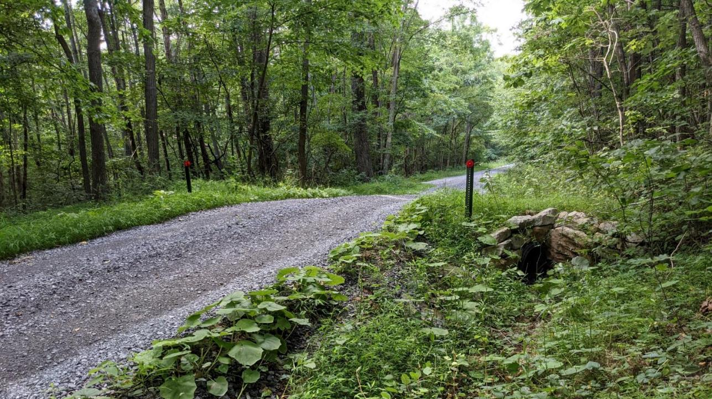
Dirt Gravel and Low Volume Road Program
WEBINAR
2/29/24
Starts 9am
DGLVR New Hire Guide
DGLVR Tech
CDGRS
Steve Bloser
smb201@psu.edu
Tim Ziegler
tmz115@psu.edu
SCC
Sherri Law
shlaw@pa.gov
If you are reading this, then you are successfully seeing the webinar video. Webinar audio should be automatic through your computer (or click “join audio”), and options can be accessed in the “audio options” button on the bottom left. If your computer audio is not working, you can listen on your phone by dialing 312-626-6799.

Slide 2
DGLVR New Hire Guide
Purpose
Provide an overview of the “new” New-hire Guide for DGLVR technicians.
Ask for feedback to improve the guide.
DGLVR Tech

Slide 3
ESM Training
New Hire Guide
Audience: new DGLVR tech at CD
Why:
Turnover is a constant issue.
Trainings not always convenient.
Admin manual and website can be overwhelming.
Goal is to create an “orientation” document with task lists.
www.dirtandgravelroads.org

Slide 4
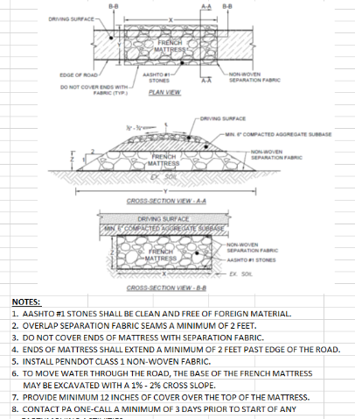
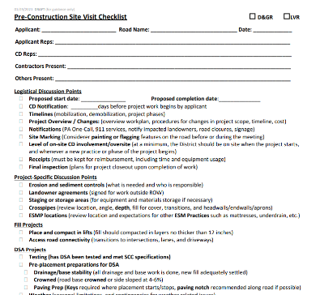
ESM Training
New Hire Guide
Audience: new DGLVR tech at CD
Why:
Turnover is a constant issue.
Trainings not always convenient.
Admin manual and website can be overwhelming.
Goal is to create an “orientation” document with task lists.
French Mattress Standard Detail
www.dirtandgravelroads.org

Slide 5
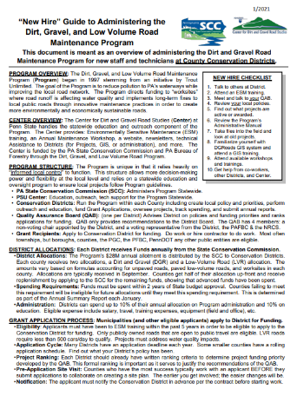
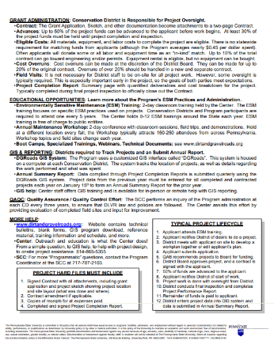
ESM Training
New Hire Guide
Audience: new DGLVR tech at CD
Why:
Turnover is a constant issue.
Trainings not always convenient.
Admin manual and website can be overwhelming.
Goal is to create an “orientation” document with task lists.
Built off:
Old 2-page quick guide
Documents Sherri made when leaving Huntingdon
www.dirtandgravelroads.org

Slide 6
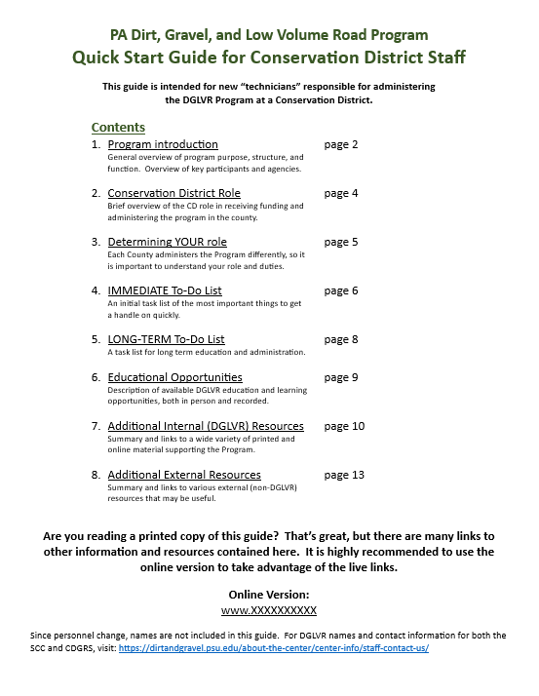
ESM Training
New Hire Guide
Size: goal was~10 pages, currently 12
Major components
Program basics and role of entities.
“To-Do” Lists
Educational opportunities
Where to find resources
Lots of links!
Status:
Initial draft complete.
LOOKING FOR FEEBACK!
www.dirtandgravelroads.org

Slide 7
ESM Training
New Hire Guide
PROVIDING FEEBACK!
PDF sent has line numbers.
Please reference line numbers with comments and suggestions.
Word, excel, or just e-mail is fine.
Looking for content suggestions, not proofreading.
Send comments to smb201@psu.edu by 3/15.
What do you wish you knew sooner about administering the DGLVR Program?
www.dirtandgravelroads.org

Slide 8
ESM Training
New Hire Guide
www.dirtandgravelroads.org

