Slide 1
Dirt Gravel and Low Volume Road Program
WEBINAR
4/13/23, 1pm
PA Direct Deposit of CD Funding
SCC
Sherri Law
shlaw@pa.gov
Roy Richardson
rrichardso@pa.gov
Presenters:
Ashley Jackson Supervisor, Vendor Data Management Unit
Barbara Yessel Assistant Director, Payable Services Call Center
Includes both the Bureau of Payable Services and SCC Presentations.
Notes:
Please note: This presentation is being recorded for future training purposes. By remaining in this session after this point, you are consenting for this session and your participation in this session to be recorded. PAUSE
Welcome to the Payable Services Center presentation. If you have questions during the presentation, please use the Q &A chat feature to ask your question. We will answer as many questions as time permits after the presentation.
My name is Ashley Jackson and I am the VDMU Supervisor and also presenting with me today is the Payable Services Call Center supervisor Christine Acri.

Slide 2
Bureau of Payable Services April 13th, 2023
Welcome to The Payable Services Center
Presenters:
Ashley Jackson Supervisor, Vendor Data Management Unit
Barbara Yessel Assistant Director, Payable Services Call Center
Notes:
Please note: This presentation is being recorded for future training purposes. By remaining in this session after this point, you are consenting for this session and your participation in this session to be recorded. PAUSE
Welcome to the Payable Services Center presentation. If you have questions during the presentation, please use the Q &A chat feature to ask your question. We will answer as many questions as time permits after the presentation.
My name is Ashley Jackson and I am the VDMU Supervisor and also presenting with me today is the Payable Services Call Center supervisor Christine Acri.

Slide 3
Overview
Basic vendor number categories
Non-Procurement vendors (NP)
Procurement vendors
Misconceptions
Contact information
Open questions
Notes:
Today we will be discussing the following

Slide 4
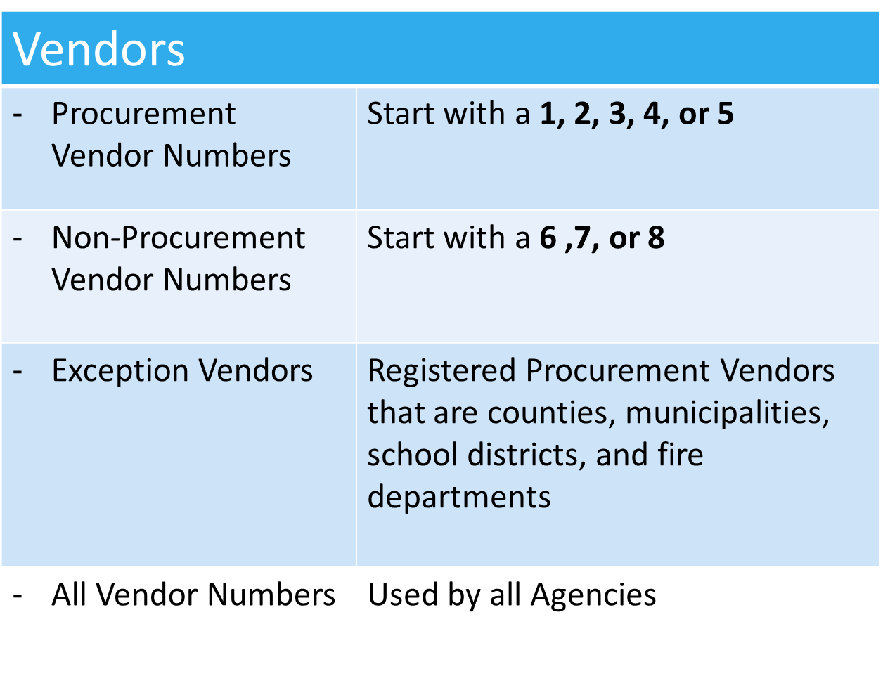
Basic Vendor Categories
Notes:
So let's review the basic vendor categories:
Procurement numbers are created immediately when a vendor registers via the PA Supplier portal. Their vendor numbers begin with either a 1,2,3,4 or 5. Upon completion of the registration, the vendor can bid on job opportunities right away. New registrants are created as bidders and the vendor number is not visible in SAP until a replication request is received by the agency that wishes to utilize the procurement vendor.
Non procurement vendors are established upon successful completion and approval of the registration. Their vendor numbers begin with either a 6,7 or 8 and are assigned within 3-5 business days.
Our exception vendors consists of procurement vendors that are treated as non procurement vendors and those exception vendors are the counties, municipalities (please note: municipal authorities do not fall under the category of municipalities), school districts, and fire departments. Exceptions vendors are to submit all requests for changes/updates in writing to the VDMU resource account ra-psc_supplier_requests@pa.gov.
Last but not least, All vendor numbers procurement and non procurement can be used by all agencies.

Slide 5
3 Points to Remember
Procurement Vendor Numbers | Can be used to pay both Procurement and Non-Procurement invoices Cannot register using a social security number (SSN)
Non-Procurement Vendor Numbers | Can only pay Non-Procurement invoices
Vendor Data Management Unit & Payable Services Call Center | Will not update a vendor record by phone.
Notes:
Now let's review 3 important points to remember.
Procurement- Example of a procurement number: a vendor provides an agency with a vn# that begins with a 1,2,3,4, or 5 as the agency plans to remit a non procurement invoice. Advising the vendor to obtain a NP vendor number is not correct as the procurement number can be used for both purposes. A vendor will not be issued a non procurement vendor number if a procurement number is established.
Non-Procurement- Example of the use of a NP number: An agency is provided a vendor number that begins with a 6,7 or 8 and plan to issue a purchase order via SRM. This would not be possible as only non procurement payments can be issued, and the vendor will need to obtain a procurement number. In this situation, the vendor should be advised to visit the www.budget.pa.gov website to obtain the form to request a procurement number and this is located under Services/ For Vendors/ Non procurement help section. Non procurement vendors do NOT have log on credentials and should not be directed to the PA Supplier portal.
Note: All requests are to be submitted in writing or completed through the vendor managed PA Supplier portal.

Slide 6
Payables Services Call Center
Bureau of Payable Services Call Center staff can assist:
Payment inquiries
Registration
Master Data Changes
Audit Confirmation
Available Mon- Fri 8 a.m. -4:30 p.m. (except holidays)
Toll Free 877-435-7363 / Local 717-346-2676
Notes:
The Payable Services Call center staff can help with payment inquiries, registration, master data changes, and audit confirmation. Their available Mon- Fri 8 a.m. -4:30 p.m. (except holidays). Can be reached Toll Free 877-435-7363 / Local 717-346-2676
Now, Chris will provide an overview of the registration process.

Slide 7
Non-Procurement Vendor Maintenance
Vendor record updates must be submitted in writing for the following:
Change | Requirement
Name | Complete the form located here: https://www.budget.pa.gov/Services/ForVendors/Pages/Non-Procurement-Help.aspx
Address | Complete the form located here: https://www.budget.pa.gov/Services/ForVendors/Pages/Non-Procurement-Help.aspx
Partner Record/Add additional payment address | Thorough explanation must be provided along with create new payment address form located here: https://www.budget.pa.gov/Services/ForVendors/Pages/Non-Procurement-Help.aspx
Notes:
Let’s discuss the non procurement vendor maintenance process.
* All updates must be submitted in writing.
In cases where the vendor would like to update their name, [please direct the vendor to the form located on the budget website under services.> for vendors> Non-Procurement Help section.
To update an address, the vendor can obtain the update/add address form via the budget website under services.> for vendors> Non-Procurement Help section.
Partner record requests are reviewed on a case-by-case basis. To submit a request to add an additional payment address, the vendor can obtain the form to request a new address via the budget website under services.> for vendors> Non-Procurement Help section. A detailed explanation on why an additional address is needed should accompany the form.
Please note that the submission of only a W-9 will not result in an address being updated. A note should be provided along with the W9 if it is in fact an address change. W9’s received are used to update name and or tax classification unless additional details on why the W9 is being sent is provided.
Please keep in mind that SAP is a payment system, therefore the address visible in SAP should only be a payment address and a billing address is not something to be listed.

Slide 8
Non-Procurement Vendor Maintenance
Change | Requirement
Electronic Banking | Pennsylvania Electronic Payment Program Allows vendors to add/change/remove banking to the vendor record
 | Direct Deposit Enrollment Form must be fully completed and signed
 | Voided check to confirm account and routing numbers is required
 | Form located on website > www.budget.pa.gov> SERVICES> FOR VENDORS > Non-Procurement help
Notes:
Signing up for direct deposit is a great benefit for the vendor and the Commonwealth. For NP vendors to receive payments via ACH, the Pennsylvania Electronic payment program form is required to add/change/remove banking.
The form should be fully completed and signed, and a voided check or a letter from the bank signed by a bank official outlining the account number, routing number, and account holder is required along with the form in order for it to be processed. A starter check is not acceptable. Detailed instructions are provided with the form to provide clarity on what information is required in each section of the form. This form is located on budget website: SERVICES> FOR VENDORS > Non-Procurement help

Slide 9
Non-Procurement Vendor Maintenance
Change | Requirement
Email Remittance Electronic Addenda | Email Remittance- allows vendors to receive the remittance information via email.
 | No more paper remittance advice. Form located: https://www.budget.pa.gov/Services/ForVendors/Pages/Direct-Deposit-and-e-Remittance.aspx
 | Electronic Addenda (EA) Vendors receive remittance information with ACH deposit through on-line banking.
 | Form located on website > www.budget.pa.gov> Services> For Vendors > Direct Deposit & E-Remittance
Notes:
Another benefit for the vendor and the Commonwealth is the new email remittance. This allows vendors to receive the remittance information via email. Emails are sent 24- 48 hours prior to pay date and outline the payment amount and the invoice or invoices associated with the payment. This reduces use of paper and provides a timely notification on when to expect payment.
In addition to the e-remittance, the electronic addenda is another item of paperless remittance. The electronic addenda allow vendors to view the invoice number and amount which is displayed via the online banking aspect. The vendor can log on to their banking website and see the remittance information listed in association with the ACH payment received.
Both forms can be accessed via www.budget.pa.gov > Services> For Vendors > Direct deposit and E- remittance section.

Slide 10
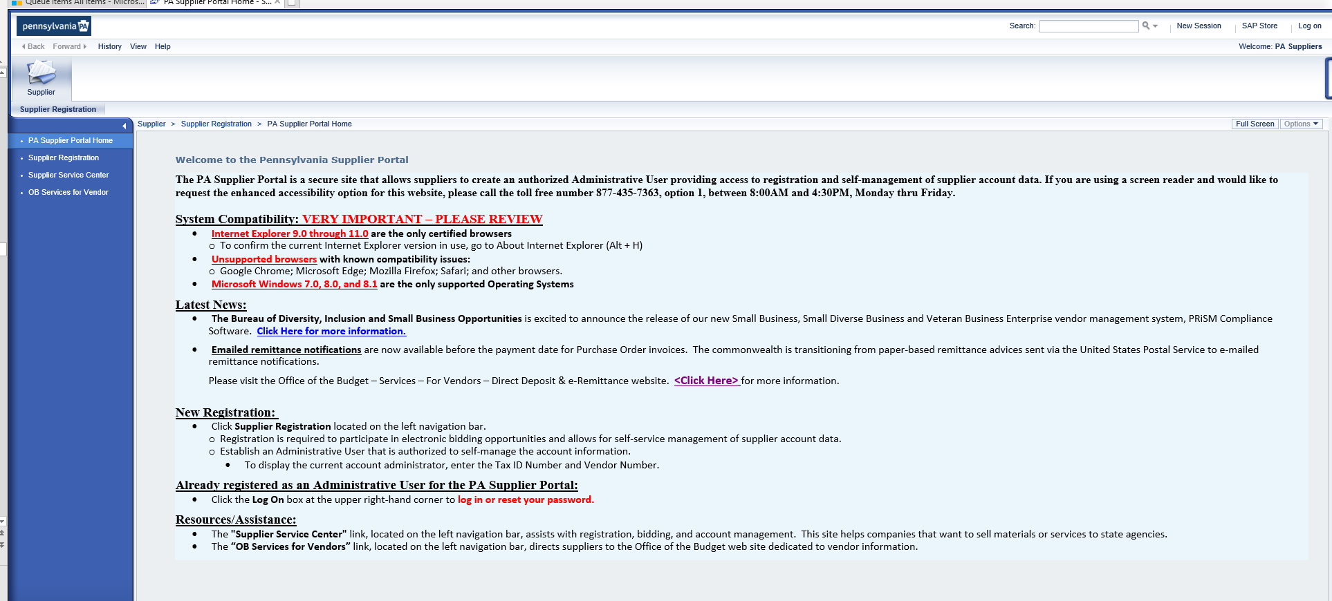
Procurement Vendor Maintenance
Registration completed via the PA Supplier Portal
www.pasupplierportal.state.pa.us
Notes:
Now, let’s review the maintenance process for procurement vendors. Vendors register and gain access to their account via the PA Supplier portal at www.pasupplierportal.state.pa.us.
The main screen provides an overview of system compatibility which is only Internet Explorer. This site also provides the latest news as well as additional resources.
To register, supplier registration should be selected on the left-hand side in the blue column. It is recommended that the company have their tax id number, company name, address, contacts all available prior to registering. Registration process takes about 15 mins to complete.
If the vendor is already registered, the log on area to access the site is in the upper right-hand corner of the website.

Slide 11
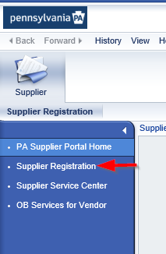
Procurement Vendor Maintenance
Registered Vendors can:
Bid on job opportunities with the Commonwealth of PA
Apply for Invitations to Qualify (ITQ)
Participate in COSTARS
Register for Jaggaer/ Small Business/WBE opportunities
Supplier Service Center
OB Services for Vendor
Notes:
Vendors that register via the PA Supplier portal can bid on job opportunities with the Commonwealth of PA, apply for Invitations to Qualify, participate in COSTARs as well as register for Jaggaer, Small business and WBE. Additional information of the various opportunities can be viewed by selecting Supplier Service Center. Vendors can obtain assistance with navigating the PA Supplier portal by selecting OB Services for vendor
Chris will now provide details on the Multifactor Authentication feature.

Slide 12
Fraud - Identity Theft - Email Hacking
Fraud Prevention and Personally Identifiable Information (PII)
PII =
-tax identification numbers
-bank account numbers and information
Helpful Tips:
Minimize potential for fraud by removing PII from screen shots or vendor communications.
Pay close attention to email for email hacking.
Note: Hacker can possibly create an email that is only one letter or digit off from the actual.
Notes:
Chris
Fraud prevention and personally identifiable information also known as PII should be removed from screen shots or vendor communications. PII consists of Tax identification numbers, bank account numbers and information. Pay close attention to the email address for email hacking. Hackers can possibly create a fraudulent email that is only one letter or digit off from the actual email. This can allow hackers to fool the email recipient into thinking they are really interacting with the vendor when actually, they are interacting with the email hacker.
Now I’ll turn it over to Ashley to talk about the replication process.

Slide 13
VDMU Processes
Due Diligence | IRS Verification/(W-9) Review as potential for fines
 | Bank Validation < banking is required before approval of Replication>
 | Validation of request by authorized official (fraud)
 | Address validation
Management Directives | County names cannot be changed due to Management Directive 305.4 http://www.oa.pa.gov/Policies/md/Documents/305_4.pdf
Notes:
The Vendor Data Management Unit serves as the gatekeeper of any vendor related activity. Due diligence is practiced on all vendors and consists of IRS verification of the name and tax id number, ensuring a valid W-9 is provided and completed correctly and accurately as potential fines may occur for incorrect/falsified information. The address is also validated with the United States Postal Service website to ensure a valid address is on file and reduce the possibility of items being returned.
In addition, VDMU also adheres to several Management Directives. A commonly used directive is the Mgmt Directive 305.4 which outlines the approved names for counties. The names listed in this directive cannot be changed and VDMU must adhere to the name as listed however, we work with the vendor/agency if any issues arise with the name. Mgmt Directive 505.9 is another commonly used directive which outlines the approved abbreviations. This directive is used to ensure the vendor records follow acceptable abbreviations.
Chris will now provide contact information for Payable Services.

Slide 14
VDMU Contact Information for PSCC
Phone :
Toll free: 877-435-7363/Local:717-346-2676
Fax: 717-214-0140
Phone Options:
Vendor Number
Payment Inquiry
Master Data Changes
1099/B notice
PA Supplier Portal Administrative Support
Open: Mon-Fri 8 a.m. – 4:30 p.m. EST except holidays
Email:
VDMU or W9s: ra-psc_supplier_requests@pa.gov
Audit Confirmations: ra-auditconfirmation@pa.gov
Payment Inquiries: ra-pscpaymentinquire@pa.gov
Notes:
Chris
VDMU and PSCC contact information: For assistance, please call 877-435-7363 (local) 717-346-2676. Our fax number is: 717-214-0140. Our phone system is broken down into five sections, 1. SAP vendor number 2. Payment inquiry 3. Master data changes or updates 4. 1099 or B notice assistance and Option 5. PA Supplier Portal administrative help. We are open Monday through Friday 8 a.m. – 4:30 p.m. To reach us by email: For registration issues: email: ra-pscsrmportal@pa.gov for VDMU or W9s email: ra-psc_supplier_requests@pa.gov for audit confirmations email: ra-auditconfirmation@pa.gov. for payment inquiries: Email: ra-pscpaymentinquire@pa.gov .

Slide 15
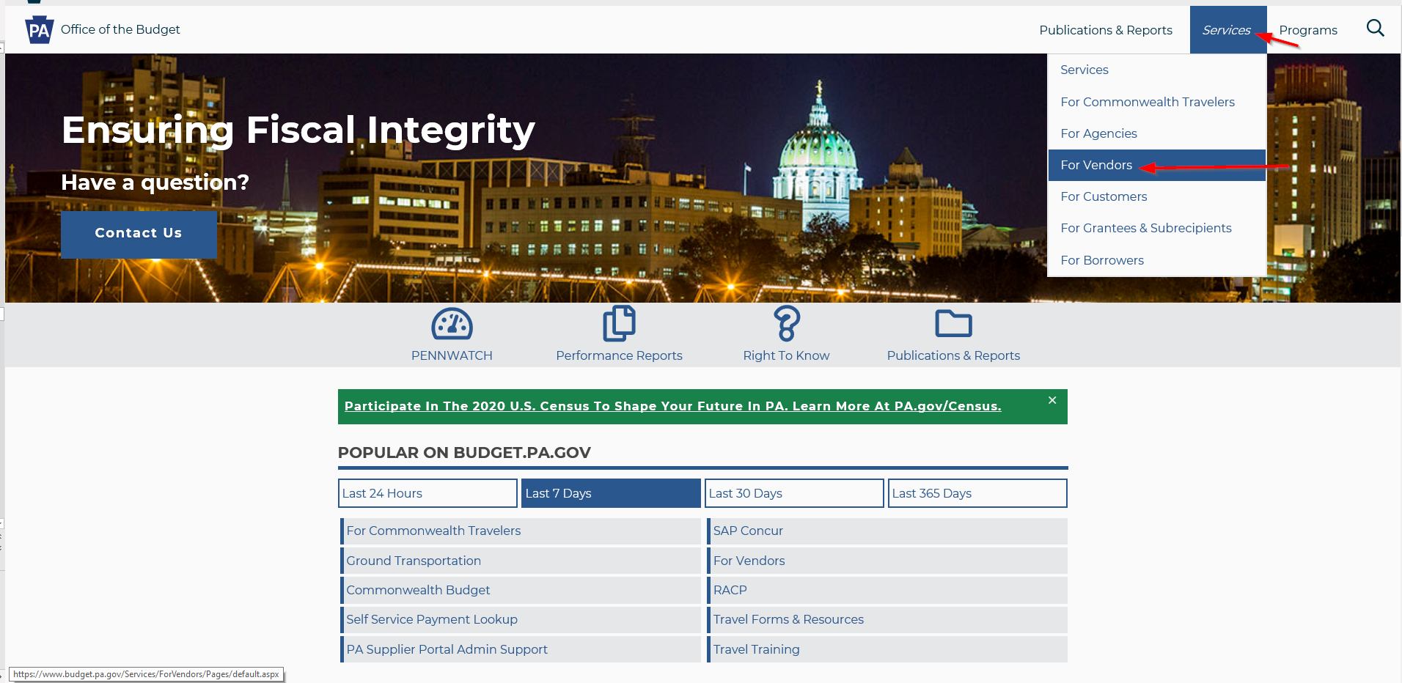
Other Resources And Information
The OB Website Homepage www.budget.pa.gov
Notes:
Chris
The services for vendors section of the budget website has self-service tools and guides for vendors. Once at the budget website, hover over services and select for vendors. Vendors can choose from:

Slide 16
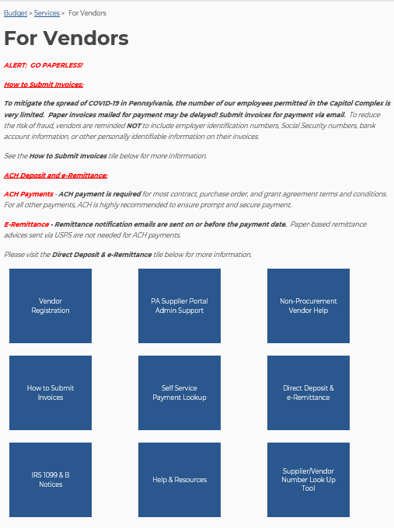
Other Resources And Information
The OB Website for VENDORS www.budget.pa.gov/services/forvendors
Notes:
Chris

Slide 17
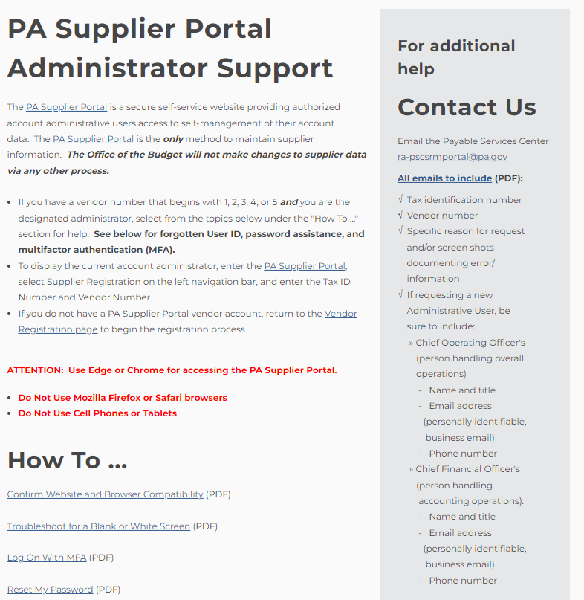
Other Resources And Information
The OB Website for VENDORS www.budget.pa.gov/services/forvendors
Notes:
Chris
The next option for vendors is: The PA Supplier Portal Admin Support option here vendors will be able to see the how tos for procurement vendors. Examples include: how to create additional users, how to add banking and receive direct deposits, change my user information and how to add a new admin to an account – please note, due to security and fraud, specific information is required in order to add an admin to an account. For these requests, all emails should include the specific information outlined on the contact us box after clicking on the PA supplier portal admin support link.

Slide 18
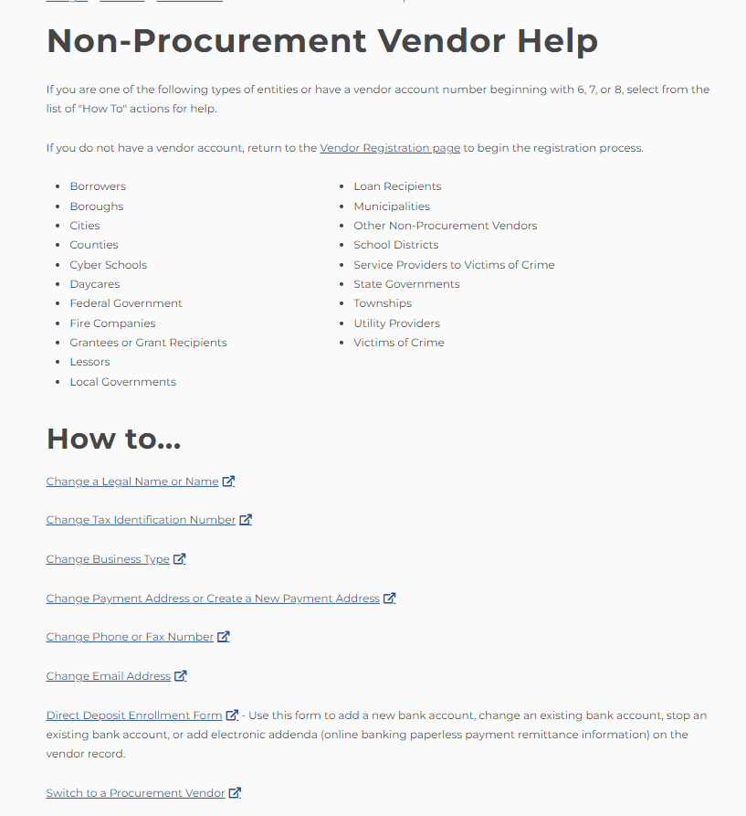
Other Resources And Information
The OB Website for VENDORS www.budget.pa.gov/services/forvendors
Notes:
Chris
the next option on the services for vendors page is: Non-procurement vendor help in this section, non-procurement vendors will fill out forms for any changes to their vendor record. Example of changes include: Change legal name, change payment address, or create new payment address, add a new bank account, change existing bank account, unblock or re-open a vendor record, and find a location code.

Slide 19
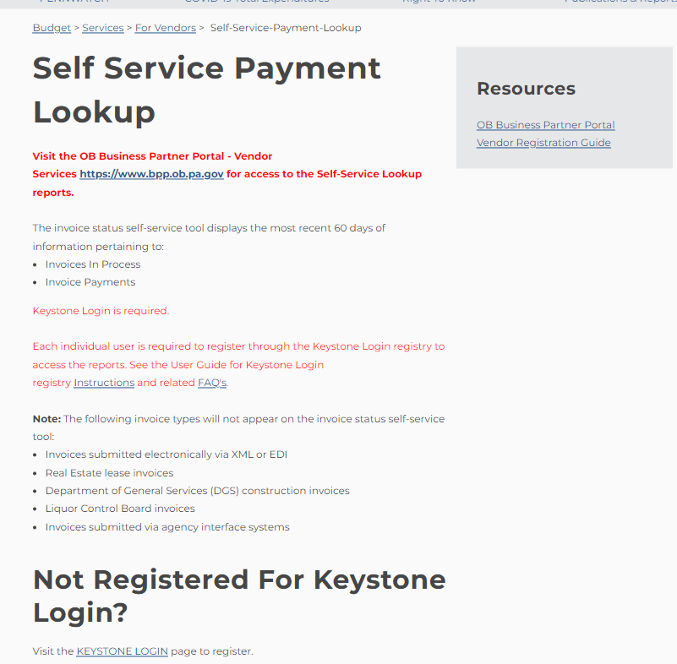
Other Resources And Information
The OB Website for VENDORS www.budget.pa.gov/services/forvendors
Notes:
Chris
We also have a self-service payment-lookup section vendors can register to be able to see their payment information for the last 60 days

Slide 20
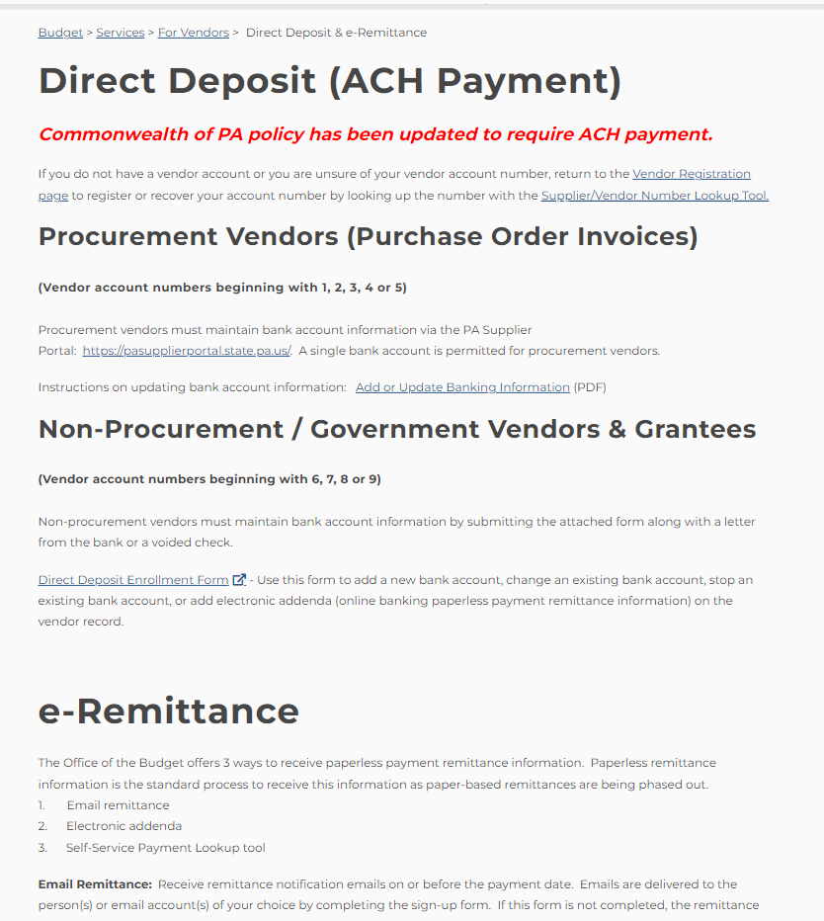
Other Resources And Information
The OB Website for VENDORS www.budget.pa.gov/services/forvendors
Notes:
Chris
The direct deposit and e-remittance option allows vendors to complete the electronic addenda form, the e-remittance sign up form as well as see instructions on how to add or update banking.

Slide 21
Other Resources And Information
The OB Website for VENDORS www.budget.pa.gov/services/forvendors
Notes:
Chris
and lastly, the supplier/vendor number look up tool gives vendors and agency personnel the ability to look up a company’s vendor number. In this example I used the City of Philadelphia to locate their vendor number of 177575.

Slide 22
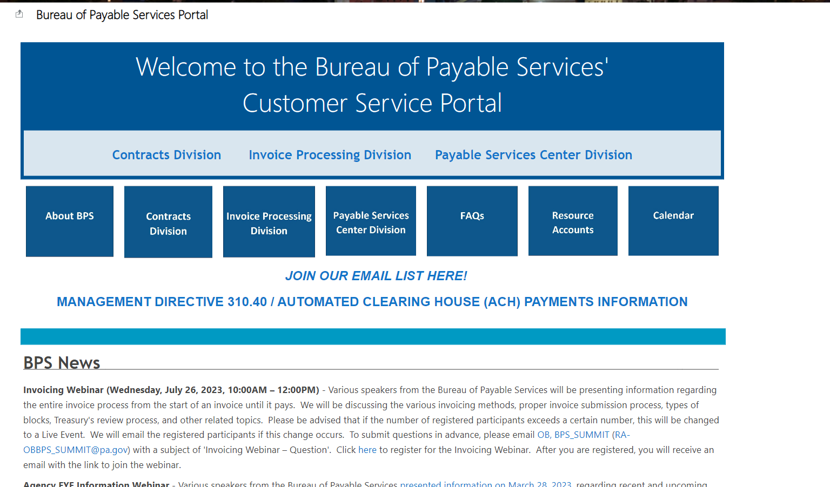
Other Resources And Information
The OB Website for AGENCIES: https://collab.pa.gov/ob/intranet/ComptrollerOperations/BPSPORTAL/Pages/Home.aspx
Notes:
Chris
Agency personnel also have a section on the budget website called the Bureau of Payable Services’ Customer Service Portal. Here you will find information on contracts, invoice processing and payable services center information. You can get answers to many of your questions by visiting this customer service portal. The Bureau of payable Services provides accounts payable services including: Registering suppliers, grantees, customers, and loan recipients to do business with the commonwealth, reviewing and processing purchase orders, contracts, grant agreements, and other procurement documents, advising agencies on financial and service contracting policies and procedures, reviewing and processing supplier and grantee invoices and distributing IRS 1099 forms and other tax-related documentation to entities receiving payments from the commonwealth. We also conduct payment issue resolution through our Payable Services Call Center.
The Bureau is organized into three divisions: Contracts, invoice processing and Payable Services Center.

Slide 23
Questions
Registration
Payable Service Call Center
Budget Website
Bureau of Payable Services portal
Other
Notes:
Chris
Thank you for attending the Payable Service Center ’s presentation. At this time, please use the Q&A chat feature to ask a question, if you have not already done so. We will now answer as many questions as time permits.
Replication – Add banking requests
As of January 1, 2020, in accordance with standard terms and conditions, all payments are to be made through Automated Clearing House (ACH). As Administrative User on the account: Log onto the PA Supplier Portal using Internet Explorer only and click “Manage Company Data” along the left-hand margin. Step by step instructions are located on the www.budget.pa.gov website.
Why can't procurement vendors have more than two addresses?
The PA Supplier Portal contains fields to set up multiple location addresses as ordering and delivery addresses. There is no limit on the number of these addresses an Administrative User can list. These addresses will not appear in the SAP payment system.
The PA Supplier Portal terms and conditions allow for one default remit-to address (listed as default invoicing party under Maintain Addresses in the PA Supplier Portal) where the vendor is determining the payments would be sent if paid via check. This address appears in the SAP payment system as the -901 vendor partner record.
The address that appears in SAP under the main vendor record is controlled by the vendor through the PA Supplier Portal Manage Company Data and is known as the Standard Address.
Does your office have an IRS W9 for my agency?
Each agency is responsible for managing and maintaining the Employer Identification Number (EIN) and an IRS W9 specifically for their agency. Please refer to Management Directive 310.15 for additional information.
Why can't a procurement vendor have more than one bank or address?
Procurement vendors agree to Terms and Conditions upon registration for one bank account and one remittance address.

Slide 25
Updating Vendor Info for the DGLVR Program
PA State Conservation Commission
Sherri Law
Conservation Program Specialist 1

Slide 26
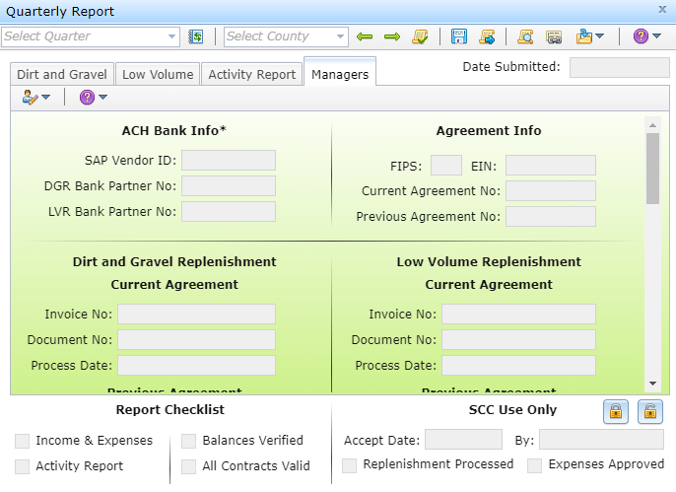
GIS hosts quarterly reporting and generates replenishment requests

Slide 27
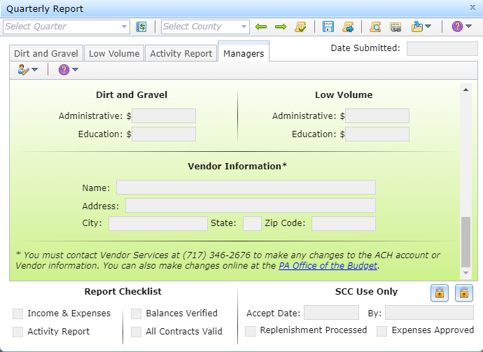
GIS hosts quarterly reporting and generates replenishment requests

Slide 28
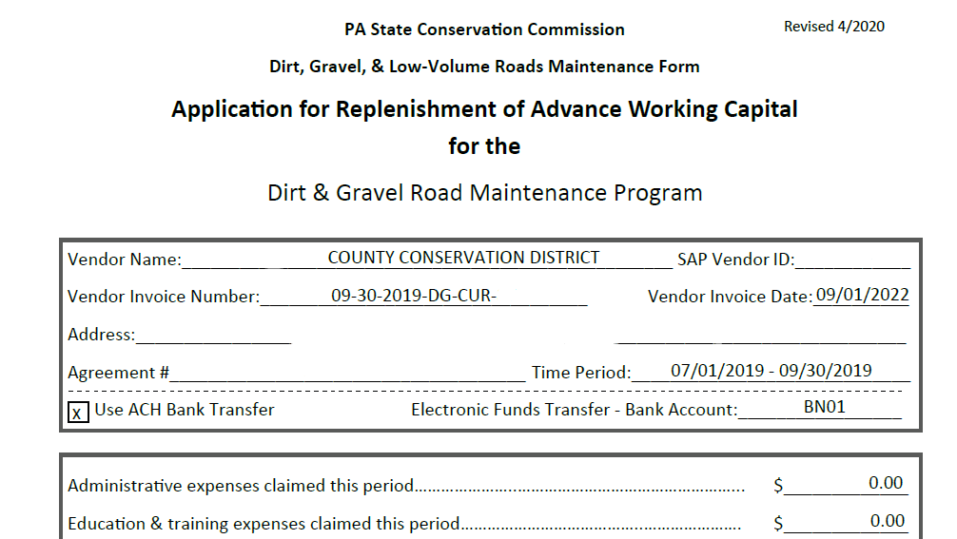
GIS hosts quarterly reporting and generates replenishment requests

Slide 29
Who to Contact
Roy Richardson and Sherri Law
To verify that new information has been updated in state system
rrichardso@pa.gov
shlaw@pa.gov
Ken Corradini
will update GIS accordingly
kjc139@psu.edu
Information to include
Let us know you recently updated information with Vendor Services
Let us know what the new info is

Slide 30
Who to Contact - ACAP
Amy Ewing
amewing@pa.gov
Eric Cromer
ecromer@pa.gov
Justin Challenger
jchallenge@pa.gov
Information to include
Let us know you recently updated information with Vendor Services
Let us know what the new info is

Slide 31
Updating Vendor Info for the CDFAP Program
Department of Environmental Protection
Karen Books
Environmental Group Manager

Slide 32
Who to Contact
Karen Books and Jaci Kerstetter
To verify that new information has been updated in state system
kbooks@pa.gov
jackerstet@pa.gov
Information to include
Let us know you recently updated information with Vendor Services
Exact address provided to Vendor Services
Updated Bank Partner Number
Applies to CDFAP Manager/ Tech, ACT and Administrative Assistance

