Slide 1
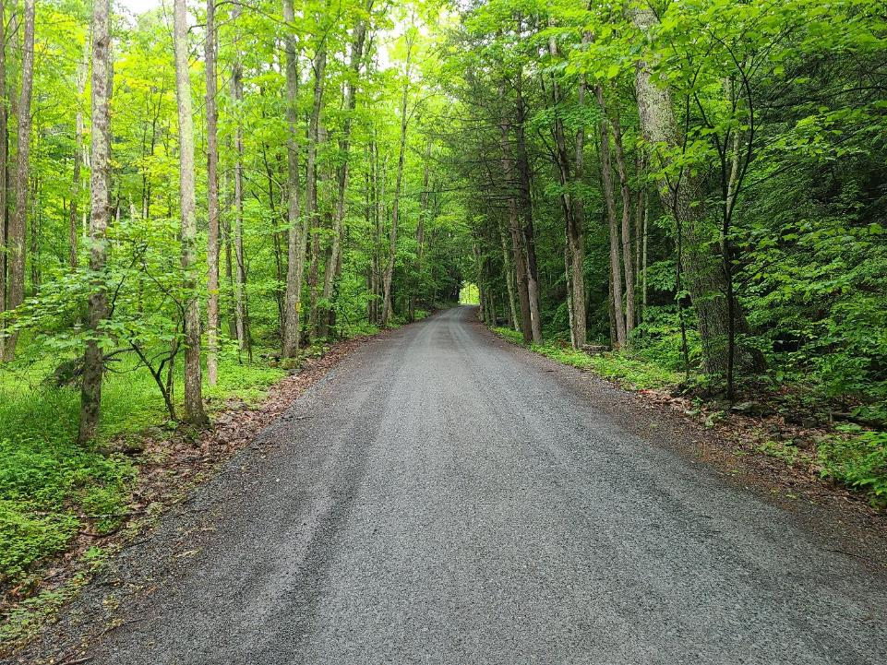



Dirt Gravel and Low Volume Road Program
WEBINAR
Prevailing Wage and the DGLVR Program
1/27/22 Starts at 9am
If you are reading this, then you are successfully seeing the webinar video. Webinar audio should be automatic through your computer (or click “join audio”), and options can be accessed in the “audio options” button on the bottom left. If your computer audio is not working, you can listen on your phone by dialing 312-626-6799.

Slide 2
Dirt, Gravel and Low Volume Roads Program
Prevailing Wage
January 27th, 2022
9:00 AM
Notes:
Good Morning!

Slide 3
DGLVR
Prevailing Wage
Sherri Law
  Dirt, Gravel, and Low Volume Road Program
  State Conservation Commission
  shlaw@pa.gov
  Office: 223-666-2567 / cell – 717-480-2303
Justin Challenger
  Dirt, Gravel, and Low Volume Road Program
  State Conservation Commission
  jchallenge@pa.gov
  Office: 717-772-4187
  717-787-2013

Slide 4
DGLVR
Prevailing Wage
Purpose:
Review Q&A Form on Prevailing Wage
  Document available online at: www.dirtandgravelroads.org , Program Resources, Reference Material
Review District Record Keeping Requirements
Answer District Questions on Prevailing Wage

Slide 5
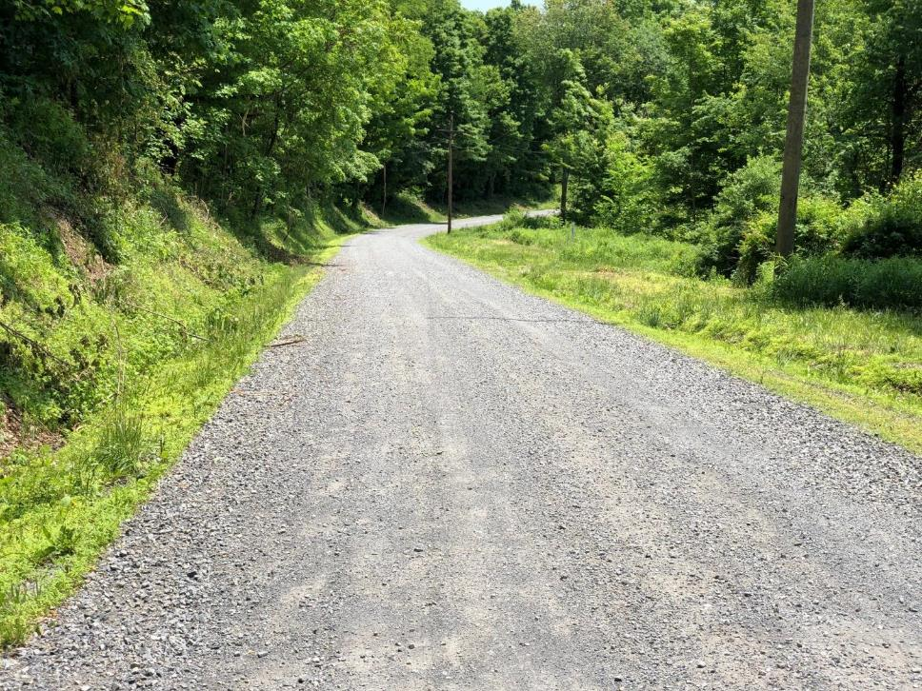
DGLVR
Prevailing Wage

Slide 6
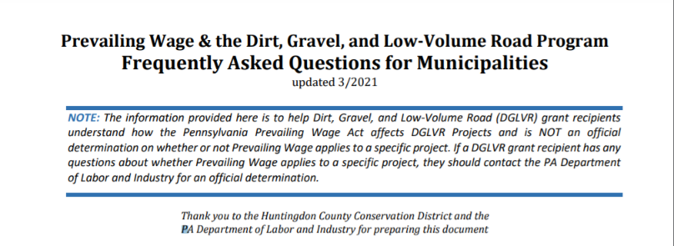
DGLVR Program
Prevailing Wage
Most of this document written by HCCD with help from Labor and Industry
SCC & Center added and clarified a few items
This version was OK’d by Labor and Industry 3/21

Slide 7
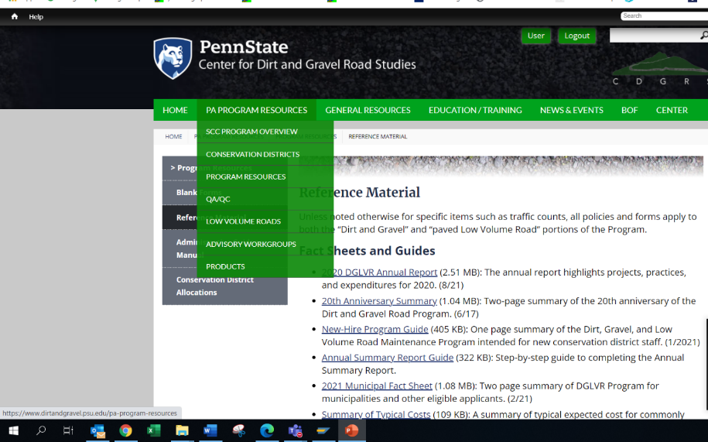
DGLVR Program
Prevailing Wage

Slide 8
DGLVR Program
Prevailing Wage
(1) What is the Pennsylvania Prevailing Wage Act?
This piece of legislation requires the “prevailing wage” rate to be paid to contracted labor for construction projects with an estimated cost of $25,000.00 or more when public funds are involved.
(2) Who determines prevailing wage rates?
The Bureau of Labor Law Compliance, which is part of the PA Department of Labor and Industry

Slide 9
DGLVR Program
Prevailing Wage
(3) When does the PA Prevailing Wage Act apply to Dirt, Gravel, and Low-Volume Road (DGLVR) projects?
When the estimated or total cost of a project funded in part or in whole by the DGLVR program is $25,000 or more, any contracted labor must be paid prevailing wage. “In-kind” in the chart below for PW refers to cash or materials only, non-reimbursed municipal equipment or labor does not count toward the in-kind or total project cost for determining Prevailing Wage, as long as those in-kind costs are clearly identified in the grant application and final project paperwork. In-kind equipment and labor should still be reported as in-kind expenses for Program reporting purposes.

Slide 10
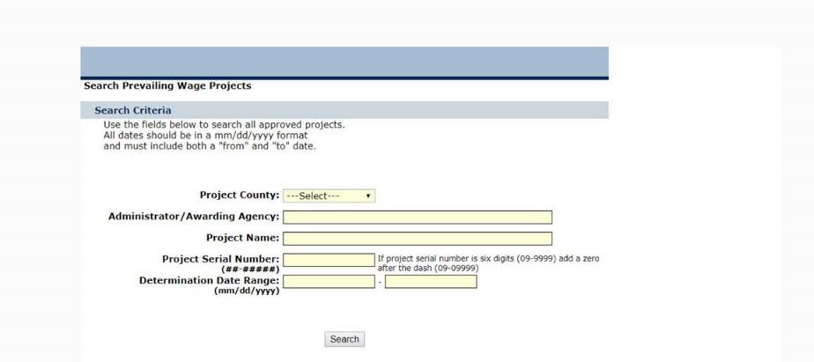
DGLVR Program
Prevailing Wage
(4) How do I get a prevailing wage rate determination?
Contact the Bureau of Labor Law Compliance for a prevailing wage rate determination at (717)-705-5969
This determination can also be initiated online at https://www.dlisecureweb.pa.gov/PrevWage/Pages/DetermRequest.aspx?ID=&PageType=

Slide 11
DGLVR Program
Prevailing Wage
(4) How do I get a prevailing wage rate determination?
Contact the Bureau of Labor Law Compliance for a prevailing wage rate determination at (717)-705-5969
This determination can also be initiated online at https://www.dlisecureweb.pa.gov/PrevWage/Pages/DetermRequest.aspx?ID=&PageType=
Solicitors and DGLVR program staff can give their opinion on the Prevailing Wage Act, but ONLY the Bureau of Labor Law Compliance can make determinations.
  If you have any doubt about whether or not prevailing wage applies to your project, contact the Bureau of Labor Law Compliance!

Slide 12
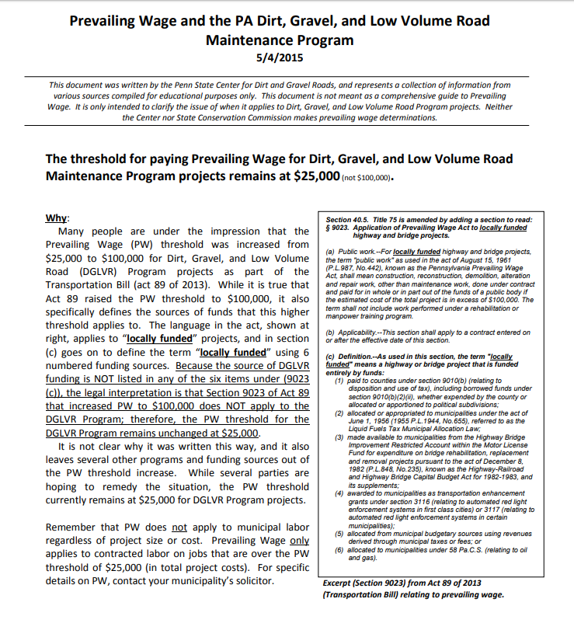
DGLVR Program
Prevailing Wage
(5) Why is the prevailing wage threshold for DGLVR projects $25,000 instead of $100,000?
In 2013, Act 89 raised the prevailing wage threshold to $100,000 for certain funding sources, but did not include the DGLVR program as one of those funding sources. The Penn State Center for Dirt and Gravel Road Studies provides a more detailed explanation of this.

Slide 13
DGLVR Program
Prevailing Wage
(6) Can I split my project into different phases to avoid paying prevailing wage?
If you complete work for your DGLVR-funded project in multiple phases over the life of one DGLVR grant, the work is still considered one project and prevailing wage applies if the total project cost is $25,000 or more
If you receive two different DGLVR grants for the same road in different years, prevailing wage is determined for each project separately

Slide 14
DGLVR Program
Prevailing Wage
(7) My DGLVR grant is over $25,000. What if the municipal road crew completes part of the project and a contractor completes part of the project?
The portion of work completed by municipal employees is not subject to prevailing wage because it is not contracted labor, but it does count towards the total cost of the project if those costs are reimbursed as part of the grant. Non-reimbursed labor and equipment provided by the municipality do not count toward the total cost of the project, as long as those costs are clearly identified in the grant application and final project paperwork.
Since the total cost of the project is over $25,000, prevailing wage must be paid to any contracted labor, regardless of how much of the project the contractor works on.

Slide 15
DGLVR Program
Prevailing Wage
(8) My DGLVR grant is over $25,000, but two contractors each complete part of the project and each part costs less than $25,000. Do the contractors still need to be paid prevailing wage?
Yes, the total cost of the project is still over the prevailing wage threshold of $25,000, so the contractors must be paid prevailing wage

Slide 16
DGLVR Program
Prevailing Wage
(9) Prevailing Wage applies to construction projects, but not maintenance projects. How do I know whether my project is construction or maintenance?
For the Prevailing Wage Act, maintenance work is defined as “the repair of existing facilities when the size, type or extent of such facilities is not thereby changed or increased” 43 P.S. § 165-2(3).
The Bureau of Labor Law Compliance provides guidance on which PennDOT Treatments are considered construction and maintenance (see attached pages from the PA Department of Labor and Industry’s website). NOTE: This list is only guidance and the Bureau retains the authority to determine PA prevailing wage requirements.
DGLVR projects are required to provide an improvement to the road and therefore are almost always considered construction for the purpose of prevailing wages.

Slide 17
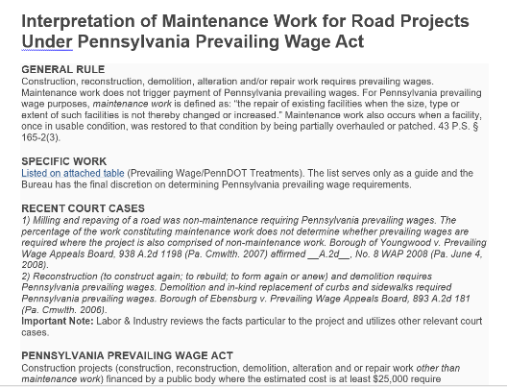
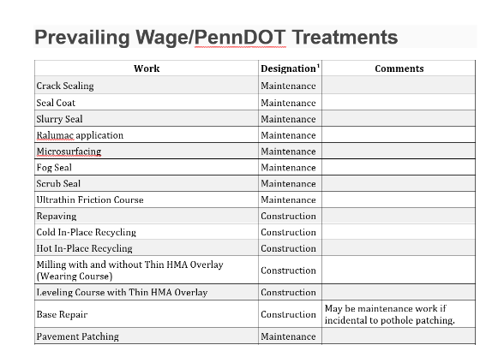
DGLVR Program
Prevailing Wage
(9) Prevailing Wage applies to construction projects, but not maintenance projects. How do I know whether my project is construction or maintenance?
DGLVR projects are required to provide an improvement to the road and therefore are almost always considered construction for the purpose of prevailing wages.

Slide 18
DGLVR Program
Prevailing Wage
(10) How much more does prevailing wage cost than other labor rates?
Prevailing wage rates vary by location and project. The rates for your project are not set until you receive your rate determination from the Bureau of Labor Law Compliance.
To estimate how much prevailing wage might cost when planning your DGLVR project, you can use past prevailing wage rates from similar projects.
  talk to your neighboring municipalities about how much their prevailing wage rates were
  you can search for registered prevailing wage projects and view their rates on the Department of Labor and Industry’s website here: https://www.dli.pa.gov/Individuals/Labor-Management-Relations/llc/prevailing-wage/Pages/Prevailing-Wage-App.aspx

Slide 19
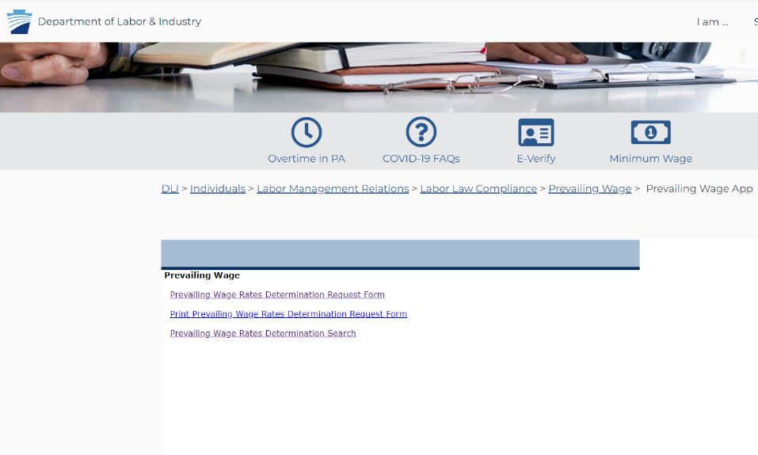
DGLVR Program
Prevailing Wage

Slide 20
DGLVR Program
Prevailing Wage
(11) If the Prevailing Wage Act applies to my project, who gets paid prevailing wage?
Municipal employees are not contractors and therefore do not need to be paid prevailing wage
All contracted labor actively involved in construction, including owner/operators of a contracting business, must be paid prevailing wage
Supervisory personnel do NOT need to be paid prevailing wage
  Supervisory personnel inspect/provide guidance on site. If they actively participate in the construction, such as by picking up a shovel to help spread aggregate, they should be paid prevailing wage for the hours they spend actually doing road construction
Vendors whose sole involvement in the project is delivering materials on site, including truck drivers delivering aggregate, do NOT need to be paid prevailing wage
  Trucks delivering aggregate/pavement into a paver are vendors
  If a truck delivers aggregate and then stays on site, is loaded with debris, and hauls it off site, the truck is no longer considered a vendor and the driver should be paid prevailing wage for the time spend participating in project work

Slide 21
DGLVR Program
Prevailing Wage
(12) As a DGLVR grant recipient, what are my responsibilities in regards to the Prevailing Wage Act?
It is the grant recipient’s responsibility to contact the Bureau of Labor Law Compliance for a prevailing wage rate determination on your DGLVR project
If prevailing wage applies to your project, you (grant recipient) must bid the project as a prevailing wage project and include the prevailing wage rates in the contract with your contractor
The prevailing wage determination is valid for 120 days from the date of issue. If there is no signed contract within 120 days, you will need to request a new project serial number

Slide 22
DGLVR Program
Prevailing Wage
(13) What if the Prevailing Wage Act applies to my DGLVR project and I (grant recipient) didn’t know?
You (grant recipient) are still required to pay prevailing wage and can do so without additional fees or consequences
Notify the contractor, contact the Bureau of Labor Law Compliance to obtain a rate determination, and provide a copy of the certified payroll to the Conservation District to verify that you have followed the provisions of the Prevailing Wage Act

Slide 23
DGLVR Program
Prevailing Wage
(14) What happens if I (a municipality/public entity) don’t pay prevailing wage when required?
If a municipality/public entity does not pay its contracted labor the prevailing wages legally required, that is a civil matter between the municipality/public entity and the contractor
You (grant recipient) can rectify the situation by paying the difference in wages due to the contractor
If the municipality/public entity refuses to pay prevailing wages when required, it may be considered an administrative matter that could equal a “potential debarment proceeding and legal proceeding against a contractor.”

Slide 24
DGLVR Program
Prevailing Wage
(14) What happens if I (a municipality/public entity) don’t pay prevailing wage when required?
If the municipality/public entity refuses to pay prevailing wages, the District can not use DGLVR funds to pay for the project

Slide 25
DGLVR Program
Prevailing Wage
(15) What if my contractor doesn’t want to pay prevailing wage to themselves and/or their employees?
If the contractor is working on a DGLVR project that totals $25,000 or more, they are required by law to comply with the Pennsylvania Prevailing Wage Act.
Small “owner/operator” contractors where the owner performs all the work are still required to pay themselves prevailing wage.
If the contractor does not pay prevailing wage (even to themselves) when required by law, they can be debarred from working on publicly funded projects for up to 3 years. The company’s name and owner’s name are published on a debarment list so that municipalities and other public entities know that the contractor is ineligible to work on their public projects.

Slide 26
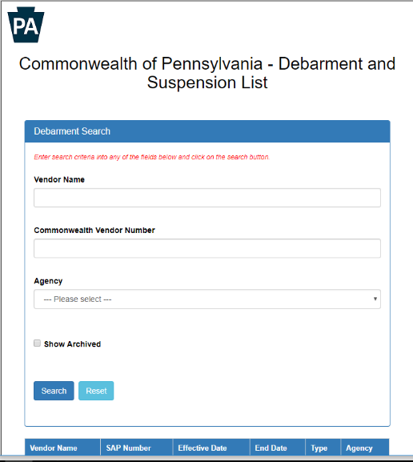
DGLVR Program
Prevailing Wage
Debarment Search:
https://www.dgs.internet.state.pa.us/debarmentsearch/debarment/index

Slide 27
DGLVR Program
Prevailing Wage
(15) What if my contractor doesn’t want to pay prevailing wage to themselves and/or their employees?
If the contractor refuses to pay prevailing wages, the District can not use DGLVR funds to pay for the project

Slide 28
DGLVR Program
Prevailing Wage
(16) What if my project also includes federal funding and falls under Davis-Bacon requirements?
If the requirement to use Davis-Bacon wages is in writing, the Department of Labor and Industry will accept their guidelines for wages. Therefore, PA prevailing wage rates are not required.

Slide 29
DGLVR Program
Prevailing Wage
Additional Pages
DGLVR projects are required to provide an improvement to the road and therefore are almost always considered construction for the purpose of prevailing wages.

Slide 30
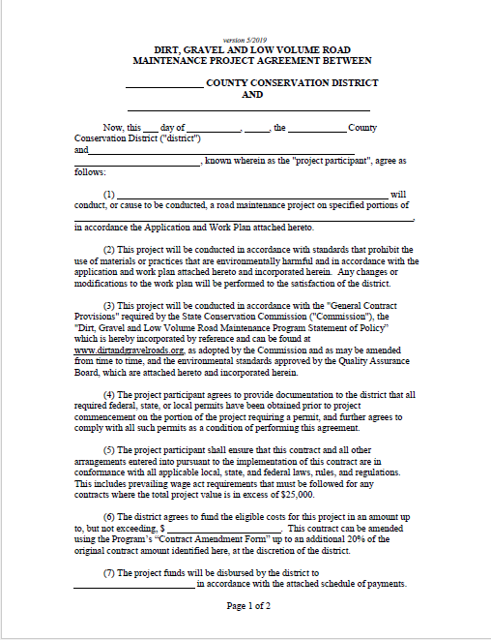
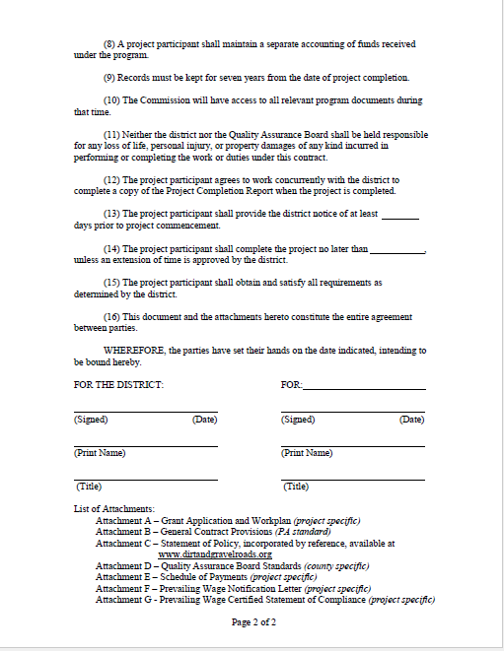

Slide 31
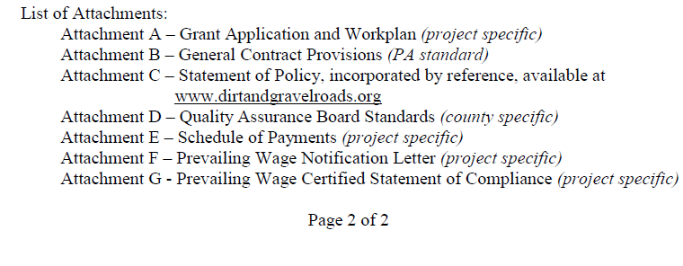

Slide 32
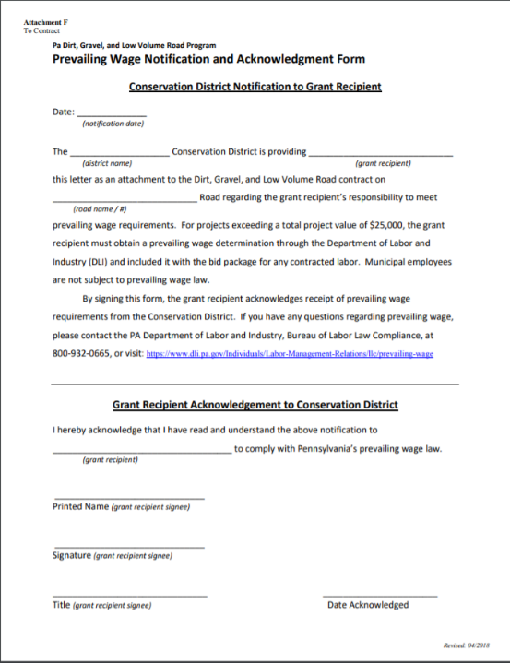
Project Hard File Webinar
Attachment F - Prevailing Wage Notification Letter

Slide 33
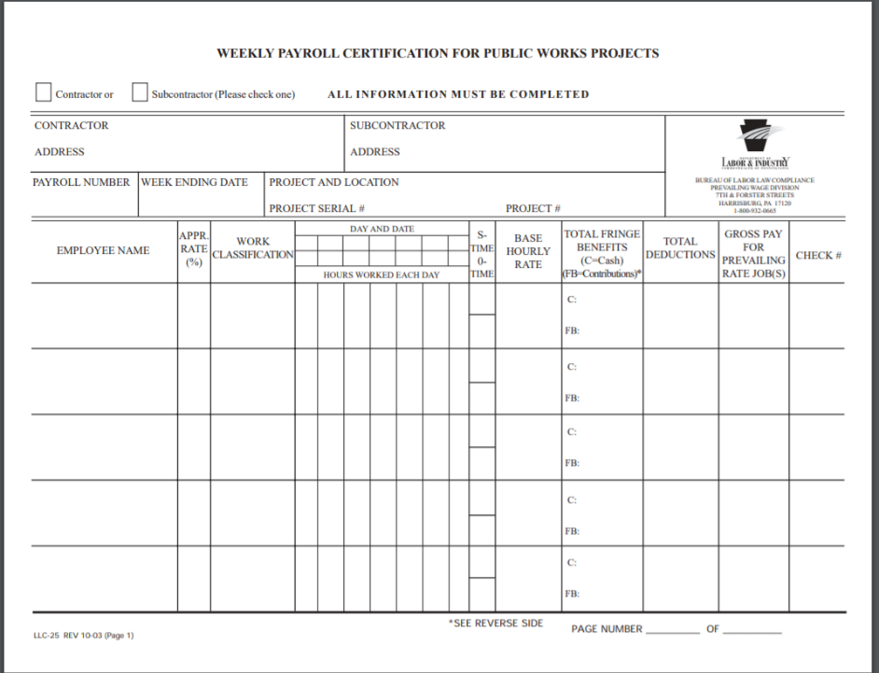
Project Hard File Webinar
Attachment G – Weekly Payroll Certification

Slide 34
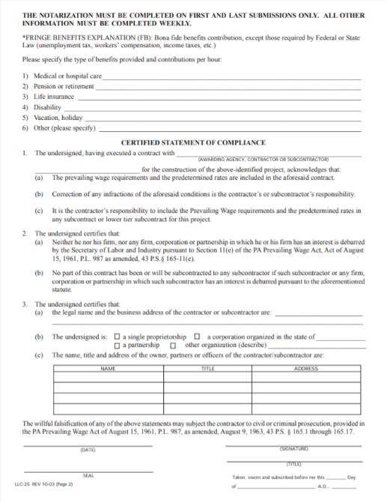
Project Hard File Webinar
Attachment G – Prevailing Wage Certification of Compliance
Note: Must be notarized

Slide 35
DGLVR Program
Prevailing Wage
Additional questions or clarifications?
Another municipality offered to do the project for a neighboring municipality. Do they have to pay prevailing wage.
  No.
Is Davis-Bacon documentation acceptable for DGLVR Program documentation in the hard file?
  Yes.
Project was subject to prevailing wage but was not prevailing wage was not paid, and the District has not made final payment. Now what?
  Prevailing wage must be paid. District can cover the additional expense.

Slide 36

DGLVR Program
Prevailing Wage
PA Department of Labor and Industry
Phone : (717)-705-5969
E-Mail: RA-LI-SLMR-LLC@pa.gov
Web: https://www.dli.pa.gov/Individuals/Labor-Management-Relations/llc/prevailing-wage
Regional Offices:
Altoona District Office Harrisburg District Office
1130 12th Ave. , Suite 200 1301 Labor & Industry Building , 651 Boas St.
Altoona, PA 16601 Harrisburg, PA 17121
814-940-6224 or 1-877-792-8198 717-787-4671 or 1-800-932-0665
Philadelphia District Office Pittsburgh District Office
110 North 8th St., Suite 203 301 5th Ave., Suite 330
Philadelphia, PA 19107 Pittsburgh, PA 15222
215-560-1858 or 1-877-817-9497 412-565-5300 or 1-877-504-8354
Scranton District Office
201 B State Office Building, 100 Lackawanna Ave., Scranton, PA 18503
570-963-4577 or 1-877-214-3962

Slide 37
Prevailing Wage Webinar
  Additional Information:
  Brian Smolock,
  Labor Law Investigator
  PA Department of Labor and Industry
  717-787-0606
  bsmolock@pa.gov

Slide 38
DGLVR
Prevailing Wage
Thank You! Please reach out with any additional questions you may have.
Sherri Law
  Dirt, Gravel, and Low Volume Road Program
  State Conservation Commission
  shlaw@pa.gov
  Office: 223-666-2567 / cell – 717-480-2303
Justin Challenger
  Dirt, Gravel, and Low Volume Road Program
  State Conservation Commission
  jchallenge@pa.gov
  Office: 717-772-4187
  717-787-2013

