Slide 1
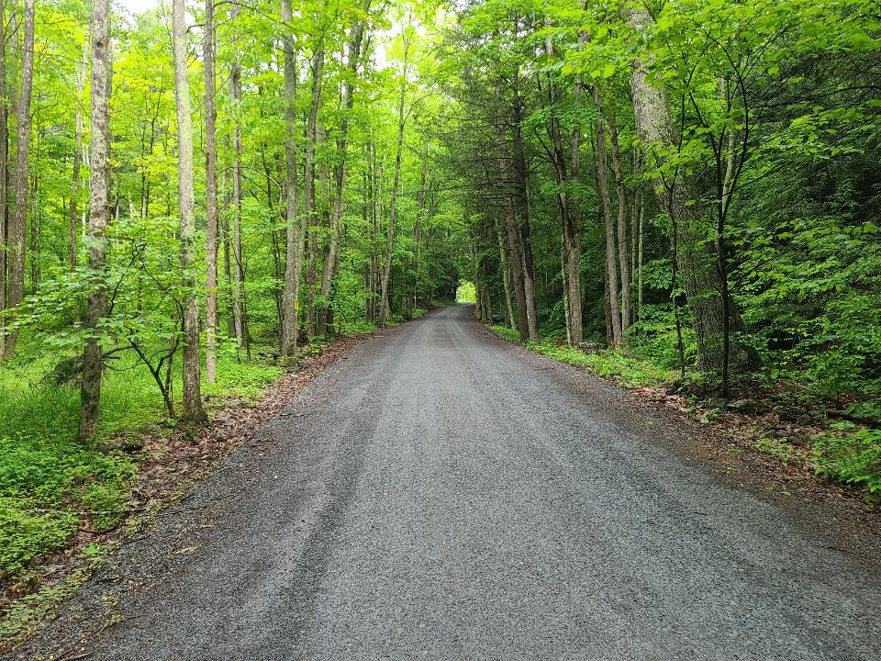
Dirt Gravel and Low Volume Road Program
WEBINAR
Prevailing Wage and the DGLVR Program PART II
4/7/22 Starts at 9am
If you are reading this, then you are successfully seeing the webinar video. Webinar audio should be automatic through your computer (or click “join audio”), and options can be accessed in the “audio options” button on the bottom left. If your computer audio is not working, you can listen on your phone by dialing 312-626-6799.

Slide 2
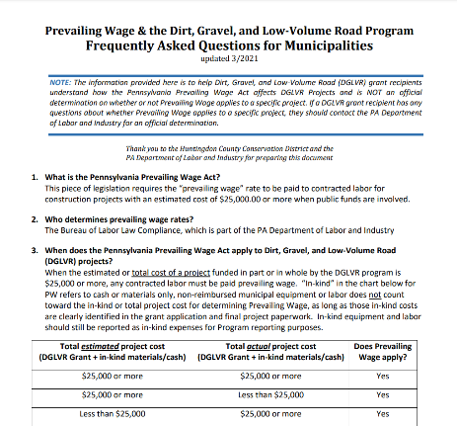
DGLVR
Prevailing Wage
Reminder:
1/27/22 Prevailing Wage Webinar
Done by SCC staff
Reviewed Q&A Form on Prevailing Wage
Recording and PPT available online: https://www.dirtandgravel.psu.edu/education-and-training/webinars/past-webinars

Slide 3
DGLVR
Prevailing Wage
Reminder:
1/27/22 Prevailing Wage Webinar
Done by SCC staff
Reviewed Q&A Form on Prevailing Wage
Recording and PPT available online: https://www.dirtandgravel.psu.edu/education-and-training/webinars/past-webinars
We asked if you would like more PW info and a chance to talk to some “real” experts”.
- Response was an overwhelming “yes”.

Slide 4
DGLVR
Prevailing Wage
Purpose:
Hear about PW from the experts and allow you to ask questions.
Discuss federal Davis Bacon and how it relates to PA PW.
Provide update on DGLVR PW document additions.

Slide 5
DGLVR
Prevailing Wage
DGLVR-----------------------------------------------------------------------------------------------
Sherri Law
DGLVR Program
State Conservation Commission
shlaw@pa.gov
Office: 223-666-25673
Justin Challenger
DGLVR Program
State Conservation Commission
jchallenge@pa.gov
Office: 717-772-4187
PA Prevailing Wage (State)----------------------------------------------------------------------
Bryan M. Smolock
Director, Bureau of Labor Law Compliance
Department of Labor & Industry
bsmolock@pa.gov
Bryan M Smolock |Director
Bureau of Labor Law Compliance
Department of Labor & Industry
U.S. Davis Bacon (Federal)----------------------------------------------------------------------
Ben Searle
U.S. Department of Labor
Regional Enforcement Coordinator, Government Contracts
Wage and Hour Division
searle.ben@dol.gov
Francesca de Roca
U.S. Department of Labor
Community Outreach and Resource Planning Specialist
Wage and Hour Division
deroca.francesca@dol.gov

Slide 7
DGLVR Program
Prevailing Wage
Q&A Update and Closing

Slide 8
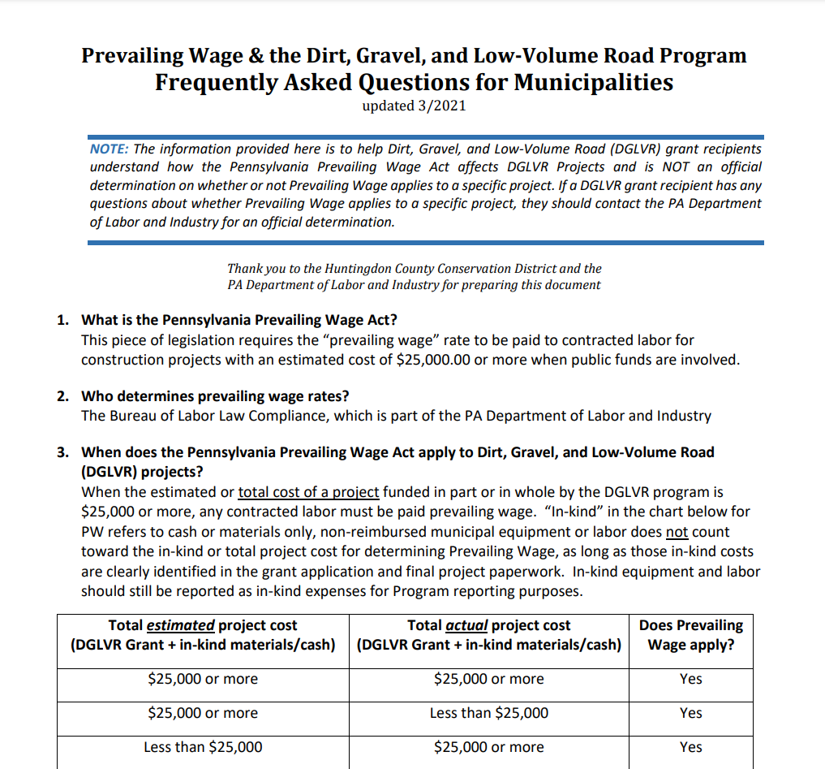
DGLVR Program
Prevailing Wage
Some Updates to the DGLVR PW Question and Answer:

Slide 9
DGLVR Program
Prevailing Wage
(12) As a DGLVR grant recipient, what are my responsibilities in regards to the Prevailing Wage Act?
This part of Answer 12 is unchanged
It is the grant recipient’s responsibility to contact the Bureau of Labor Law Compliance for a prevailing wage rate determination on your DGLVR project
If prevailing wage applies to your project, you (grant recipient) must bid the project as a prevailing wage project and include the prevailing wage rates in the contract with your contractor
The prevailing wage determination is valid for 120 days from the date of issue. If there is no signed contract within 120 days, you will need to request a new project serial number

Slide 10
DGLVR Program
Prevailing Wage
(12) As a DGLVR grant recipient, what are my responsibilities in regards to the Prevailing Wage Act?
UPDATE in red text below.
This requirement has been in the DGLVR Administrative Manual for several years but is now being added to the FAQ.
DGLVR Grant contracts include a “Prevailing Wage Notification Letter” (attachment F) that grant recipients must sign and return to the county conservation district with the signed contract. DGLVR Grant recipients must also provide the conservation district with a copy of a notarized “Certified Statement of Compliance” (attachment G to the DGLVR Contract) for each contractor involved in your DGLVR Project before final grant payment can be made to the grant recipient.

Slide 11
DGLVR Program
Prevailing Wage
(16) What if my project also includes federal funding and falls under Davis-Bacon requirements?
This question is being updated
If the requirement to use Davis-Bacon wages is in writing, the Department of Labor and Industry will accept their guidelines for wages. Therefore, PA prevailing wage rates are not required.

Slide 12
DGLVR Program
Prevailing Wage
(16) What if my project also includes federal funding and falls under Davis-Bacon requirements?
If the requirement to use Davis-Bacon wages is in writing, the Department of Labor and Industry will accept their guidelines for wages. Therefore, PA prevailing wage rates are not required.

Slide 13
DGLVR Program
Prevailing Wage
(16) What if my (the municipality’s) DGLVR project also includes federal funding?
Different types of federal funding have different prevailing wage requirements.
Often, federal funding will require the Davis-Bacon Act to be followed.
If the requirement to use Davis-Bacon wages is in writing, the PA Department of Labor and Industry will accept their guidelines for wages.
For questions about Davis-Bacon applicability to a federally funded construction project contact the federal agency from which any federal funding was obtained.

Slide 14
The following
Questions & Answers
are new

Slide 15
DGLVR Program
Prevailing Wage
(17) What is the Davis-Bacon Act?
The Davis-Bacon and Related Acts apply to contractors and subcontractors performing on federally funded or assisted contracts in excess of $2,000 for the construction, alteration, or repair (including painting and decorating) of public buildings or public works.
The Davis-Bacon Act and Related Acts require contractors and subcontractors to pay their laborers and mechanics the locally prevailing wages and fringe benefits as determined by the U.S. Department of Labor.
See Wage and Hours’ Davis-Bacon Fact Sheet for additional information:
https://www.dol.gov/sites/dolgov/files/WHD/legacy/files/whdfs66.pdf

Slide 16
DGLVR Program
Prevailing Wage
(18) What are my (municipal) requirements under the Davis-Bacon Act?
When hiring a contractor, the Davis-Bacon Labor Standards Clauses must be included in the bid documents and contract with the contractor.
These are available online at: https://www.ecfr.gov/current/title-29/subtitle-A/part-5/subpart-A/section-5.5
Obtain a wage determination from https://sam.gov/content/wage-determinations and include this in the bid documents and contract with your contractor. These wage and fringe benefit rates must then be paid to contracted labor.

Slide 17
DGLVR Program
Prevailing Wage
(18) What are my (municipal) requirements under the Davis-Bacon Act? CONTINUED
All contractors and subcontractors must use the WH-347 or equivalent paperwork to certify that the wages and fringe benefits were paid to mechanics and laborers as required.
See Revised WH-347 Form: https://www.dol.gov/sites/dolgov/files/WHD/legacy/files/wh347.pdf
Instructions for Revised WH-347 Form: https://www.dol.gov/agencies/whd/forms/wh347

Slide 18
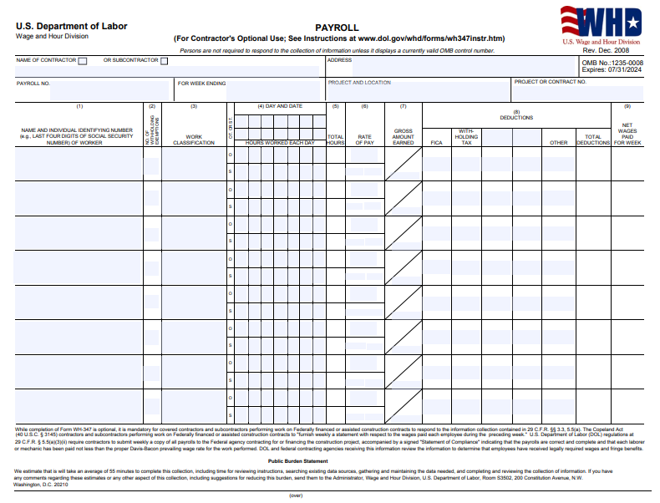
DGLVR Program
Prevailing Wage
https://www.dol.gov/sites/dolgov/files/WHD/legacy/files/wh347.pdf

Slide 19
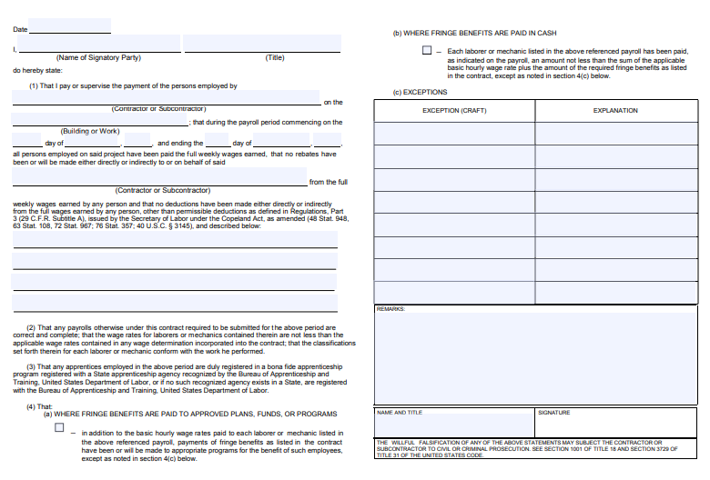
DGLVR Program
Prevailing Wage
https://www.dol.gov/sites/dolgov/files/WHD/legacy/files/wh347.pdf

Slide 20
DGLVR Program
Prevailing Wage
(18) What are my (municipal) requirements under the Davis-Bacon Act? CONTINUED
All contractors and subcontractors must use the WH-347 or equivalent paperwork to certify that the wages and fringe benefits were paid to mechanics and laborers as required.
See Revised WH-347 Form: https://www.dol.gov/sites/dolgov/files/WHD/legacy/files/wh347.pdf
Instructions for Revised WH-347 Form: https://www.dol.gov/agencies/whd/forms/wh347
DGLVR Grant contracts include a “Prevailing Wage Notification Letter” (attachment F) that grant recipients must sign and return to the county conservation district with the signed contract. DGLVR Grant recipients must also provide the conservation district with a copy of a “WH-347 Certified Payroll form” or equivalent approved by the US Department of Labor for each contractor involved in your DGLVR Project before final grant payment can be made to the grant recipient.

Slide 21
DGLVR Program
Prevailing Wage
(19) Where can I find more information about the Davis-Bacon Act?
Davis-Bacon learning portal: https://www.dol.gov/agencies/whd/government-contracts/construction
For basic Davis-Bacon Act compliance questions, contact your local U.S. Wage and Hour office: 1-866-4-US-WAGE or 1-866-487-9243.
https://www.dol.gov/agencies/whd/contact

Slide 22
DGLVR
Prevailing Wage
DGLVR-----------------------------------------------------------------------------------------------
Sherri Law
DGLVR Program
State Conservation Commission
shlaw@pa.gov
Office: 223-666-25673
Justin Challenger
DGLVR Program
State Conservation Commission
jchallenge@pa.gov
Office: 717-772-4187
PA Prevailing Wage (State)----------------------------------------------------------------------
Bryan M. Smolock
Director, Bureau of Labor Law Compliance
Department of Labor & Industry
bsmolock@pa.gov
Thank you, guest speakers!
QUESTIONS?
Bryan M Smolock |Director
Bureau of Labor Law Compliance
Department of Labor & Industry
U.S. Davis Bacon (Federal)----------------------------------------------------------------------
Ben Searle
U.S. Department of Labor
Regional Enforcement Coordinator, Government Contracts
Wage and Hour Division
searle.ben@dol.gov
Francesca de Roca
U.S. Department of Labor
Community Outreach and Resource Planning Specialist
Wage and Hour Division
deroca.francesca@dol.gov

