Slide 1
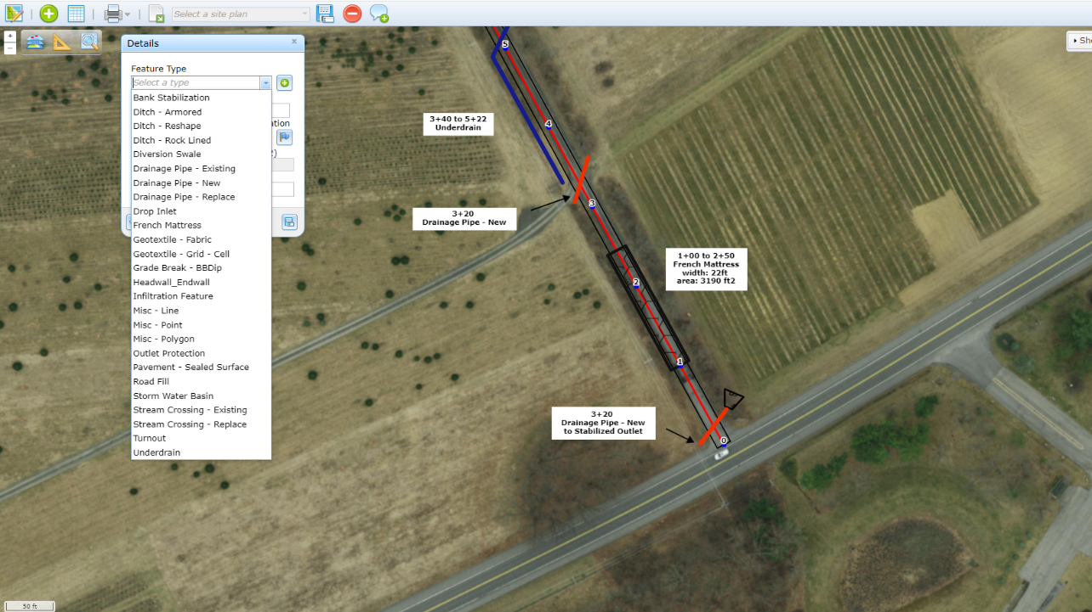
GIS Project Sketcher Application
Dirt Gravel and Low Volume Road Program
WEBINAR
6/13/23
Starts 9am
CDGRS
Steve Bloser
smb201@psu.edu
Ken Corradini
kjc139@psu.edu
Mike Anderson: Spatial IT
If you are reading this, then you are successfully seeing the webinar video. Webinar audio should be automatic through your computer (or click “join audio”), and options can be accessed in the “audio options” button on the bottom left. If your computer audio is not working, you can listen on your phone by dialing 312-626-6799.

Slide 2
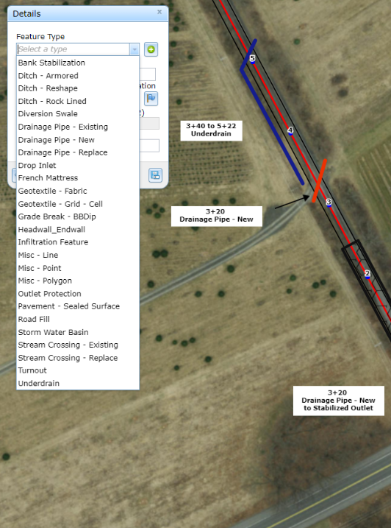
GIS Project Sketches
Purpose
Mini-training and walkthrough of Project Sketcher App
Sketcher is now available to CDs
Still want feedback

Slide 3
GIS Project Sketches
Background and Status
Demonstration
Moving Forward

Slide 4
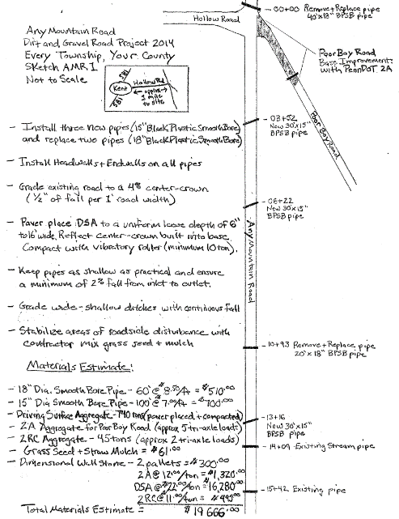
GIS Project Sketches
Project Sketches
Show location of project deliverables such as pipes, turnouts, DSA, etc.
Required as part of workplan, become part of contract.
Most still done by hand:
Some fancy…
www.dirtandgravelroads.org

Slide 5
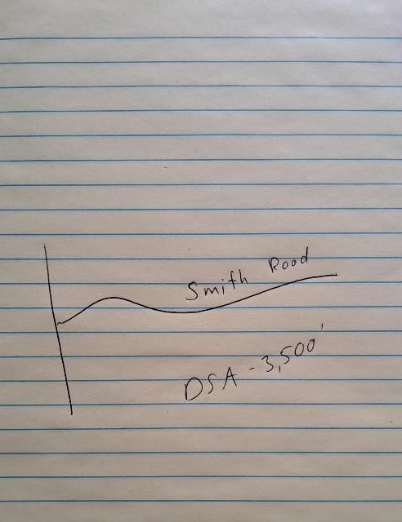
GIS Project Sketches
Project Sketches
Show location of project deliverables such as pipes, turnouts, DSA, etc.
Required as part of workplan, become part of contract.
Most still done by hand:
Some fancy…
Some not…
www.dirtandgravelroads.org

Slide 6
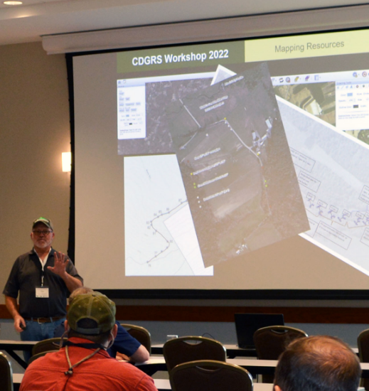
GIS Project Sketches
2022 Workshop Session
Several Counties and CDGRS staff shared tools they use to create workplans
Aerial images, text and graphics in word/ppt
Other software
Good discussion and feedback on possibilities to incorporate into DGLVR GIS system
www.dirtandgravelroads.org

Slide 7
GIS Project Sketches
Since Workshop
CDGRS has been working with programmer to develop application
Small “testing group” established, met several times, given access to program
Today: available for all CDs
www.dirtandgravelroads.org

Slide 8
GIS Project Sketches
Since Workshop
CDGRS has been working with programmer to develop application
Small “testing group” established, met several times, given access to program
Today: available for all CDs
Note: Sketcher is at about 90% complete, we still want feedback
www.dirtandgravelroads.org

Slide 9
GIS Project Sketches
Since Workshop
Separate App from “GIS Mapper”
Login through CDGRS website
Separate App reduces clutter in mapper
Separate App did not risk adding glitches to financial tracking system
www.dirtandgravelroads.org

Slide 10
GIS Project Sketches
Background and Status
Demonstration
Moving Forward

Slide 11
GIS Project Sketches
Background and Status
Demonstration
Moving Forward

Slide 12
GIS Project Sketches
Moving Forward
Use of GIS project sketch will not be required, but available as a tool.
Can print out plans, attach to grant application.
Plans can be saved and “tweaked” to create “as-builts” or reflect project changes.
Will eventually be available to applicants (via public viewer).
www.dirtandgravelroads.org

Slide 13
GIS Project Sketches
Moving Forward
Please start using, but understand we are still refining.
Give us feedback on glitches or suggestions
Thing we are still working on or planning:
Printing: working but we are still refining
Additional “bells and whistles”
Tie sketches back to projects in GIS?
Potentially adding ability to add Tech Bulletins and other info
Public version available once we iron out more kinks.
www.dirtandgravelroads.org

Slide 14
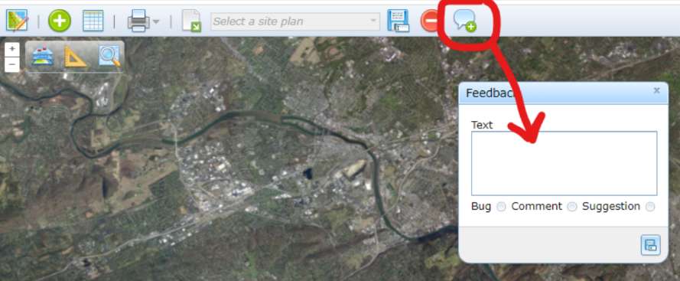
GIS Project Sketches
Don’t forget the feedback button
Happy Mapping!
Don’t just say “I broke it”
Try to repeat the error
Give as much detail as possible
www.dirtandgravelroads.org

