Slide 1
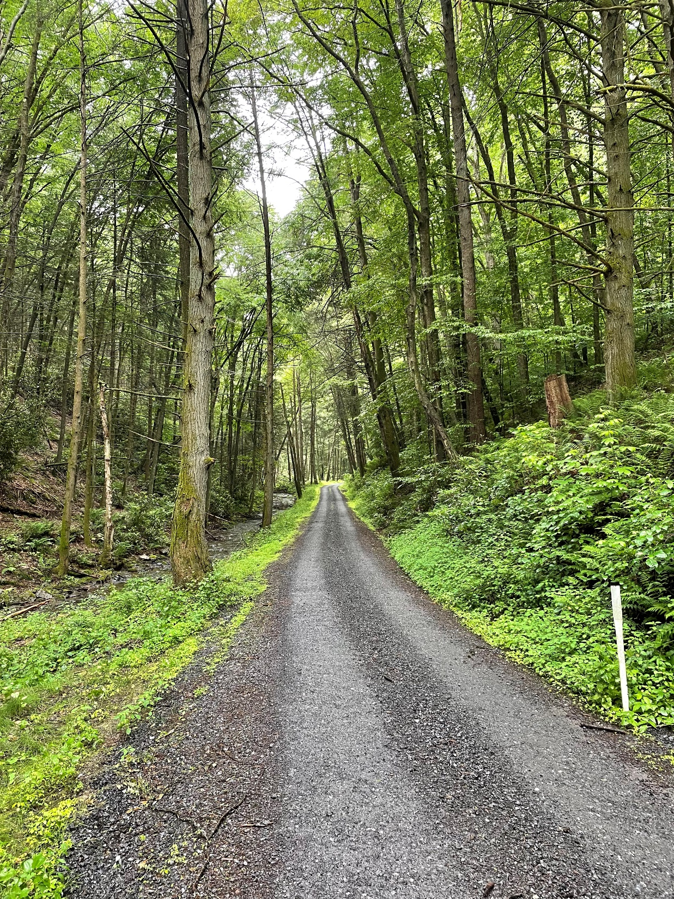


Dirt Gravel and Low Volume Road Program
WEBINAR
4/11/24, 9am
Quality Assurance/Quality Control
2024 Update
SCC
Andy Mickey
Sherri Law
If you are reading this, then you are successfully seeing the webinar video. Webinar audio should be automatic through your computer (or click “join audio”), and options can be accessed in the “audio options” button on the bottom left. If your computer audio is not working, you can listen on your phone by dialing 646-876-9923.

Slide 2

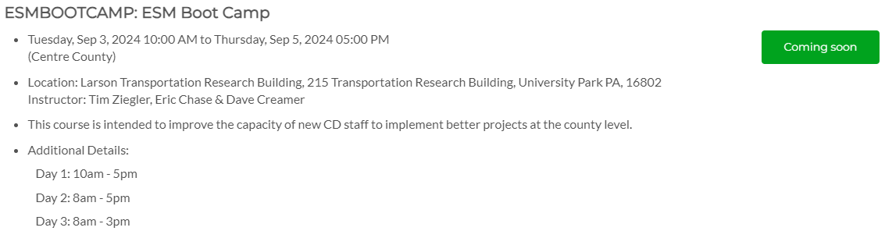
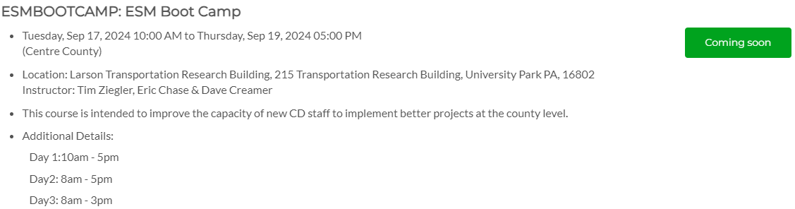
Training Opportunities
Notes:
Discussion: What does “quality” mean?
Why is this an important function of the SCC?
Quality – good, correct, well done, solid/long-lasting
We make sure projects are high-quality because we want to do good work for the environment and community

Slide 3

DSA Notifications
DSA notifications need to be sent to dsatesting@psu.edu
Notes:
Discussion: What does “quality” mean?
Why is this an important function of the SCC?
Quality – good, correct, well done, solid/long-lasting
We make sure projects are high-quality because we want to do good work for the environment and community

Slide 4
QAQC
Quality Assurance/Quality Control (QAQC)
Discussion
  What does “quality” mean?
  Why is this an important function of the SCC?
Notes:
Discussion: What does “quality” mean?
Why is this an important function of the SCC?
Quality – good, correct, well done, solid/long-lasting
We make sure projects are high-quality because we want to do good work for the environment and community

Slide 5
QAQC
Quality Assurance/Quality Control (QAQC)
  The SCC is responsible for making sure funding is spent appropriately
    Funding needs to be properly accounted for
    Funding needs to be spent on eligible expenses
  Educational opportunity:
    Allows SCC to assess district staff understanding of Program goals, policies, technical skills, etc.
    Districts are educated about what they are doing well and areas for improvement
    Districts provide feedback to SCC on how the Program is working

Slide 6
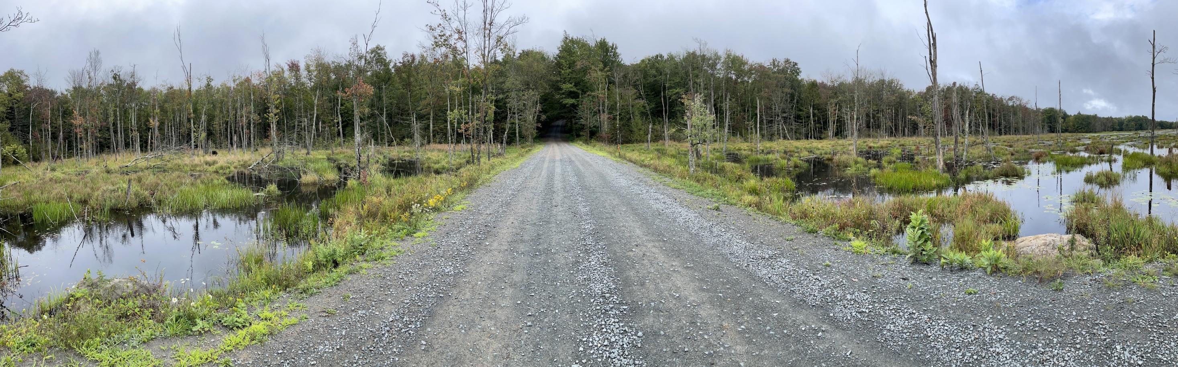
QAQC
Better Roads, Cleaner Streams
Notes:
The purpose of evaluating the DGLVR Program through QAQCs is to help us better meet our Program goals: build better roads and have cleaner streams

Slide 7
Outline
QAQC overview and process
Summary of Round 4 QAQCs (2021-2023)
Updates for Round 5 QAQCs (2024-2027)

Slide 8
Outline
QAQC overview and process
Summary of Round 4 QAQCs (2021-2023)
Updates for Round 5 QAQCs (2024-2027)

Slide 9
DGLVR QAQC Process
Each County Conservation District reviewed once every 3 years
QAQC Round 1: Every County visited 2003-2011
QAQC Round 2: Every County visited 2015-2017
QAQC Round 3: Every County visited 2018-2020
QAQC Round 4: Every County visited 2021-2023
Total QAQCs: 259
QAQC Round 5: Starts 2024

Slide 10
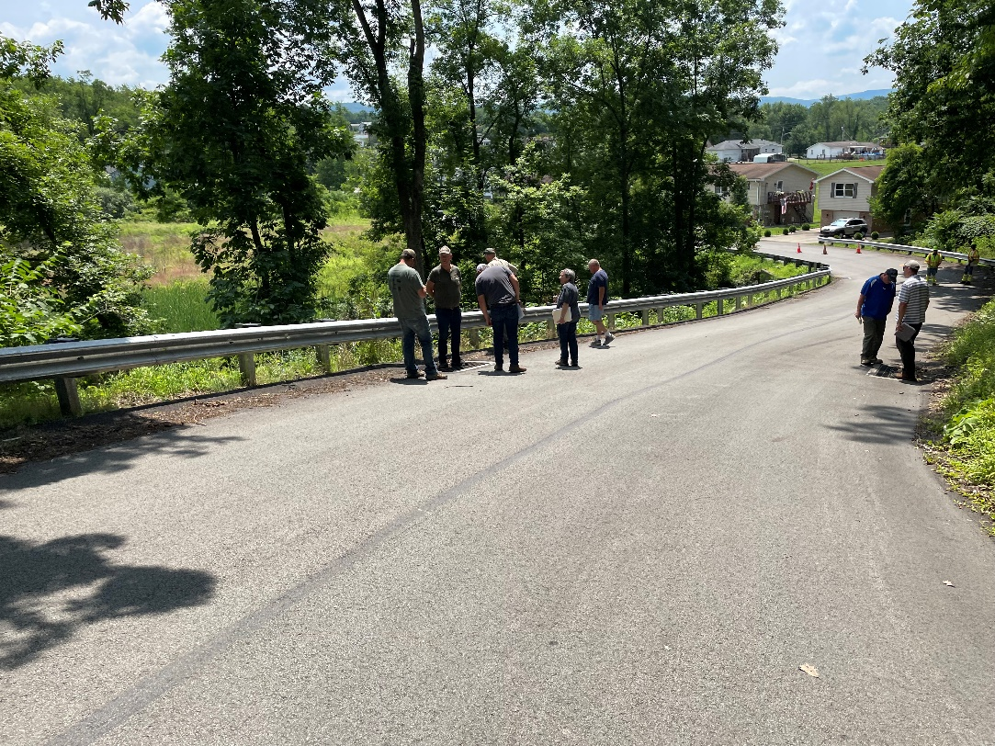
DGLVR QAQC Process
Review is conducted in multiple remote and in person sessions
Review consists of 3 main parts:
  Financial
  Administrative / Functionality
  Projects

Slide 11
DGLVR QAQC Process
Participants:
  District staff responsible for administering the Program
  District manager
  District staff that assist with Program
  State Conservation Commission
  Center for Dirt and Gravel Road Studies
  Quality Assurance Board
  District Board
  DEP Field Representative
  Project participants

Slide 12
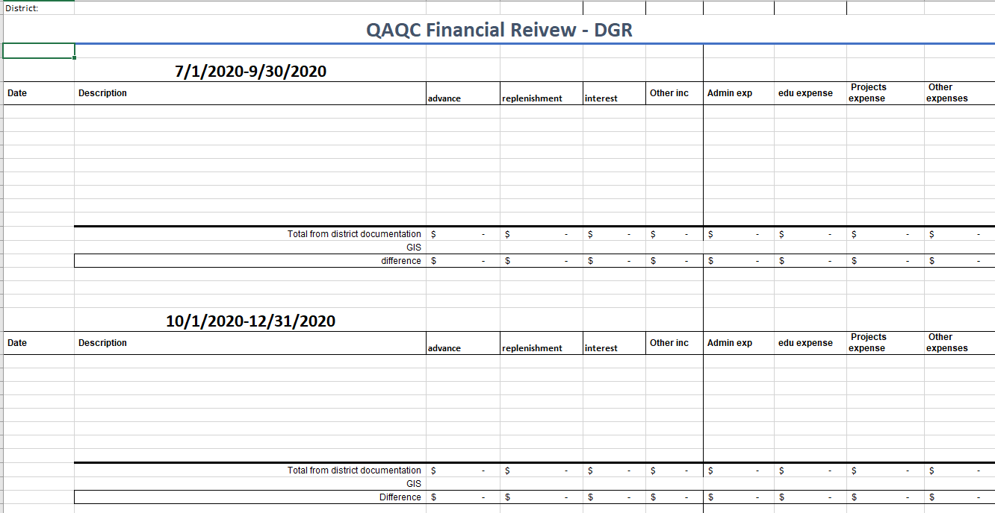
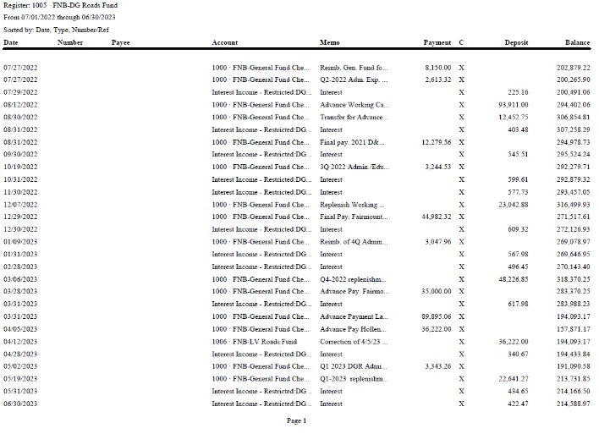
DGLVR QAQC Process
Financial Review
  Primarily conducted remotely
  Financial documentation is provided to SCC electronically
  SCC checks:
    That documentation matches quarterly reports
    That funds were spent on eligible expenses

Slide 13








DGLVR QAQC Process
Administrative/Functionality Review
  Conducted both remotely and in person
  SCC interviews district staff and local Quality Assurance Board (QAB)
  Hard files are reviewed to make sure required documentation is retained
  Review local policy and meeting minutes
  Key points:
    Do district staff understand the Program?
    Are district staff involved enough in projects?
    Are district staff adequately engaging eligible road owners?

Slide 14
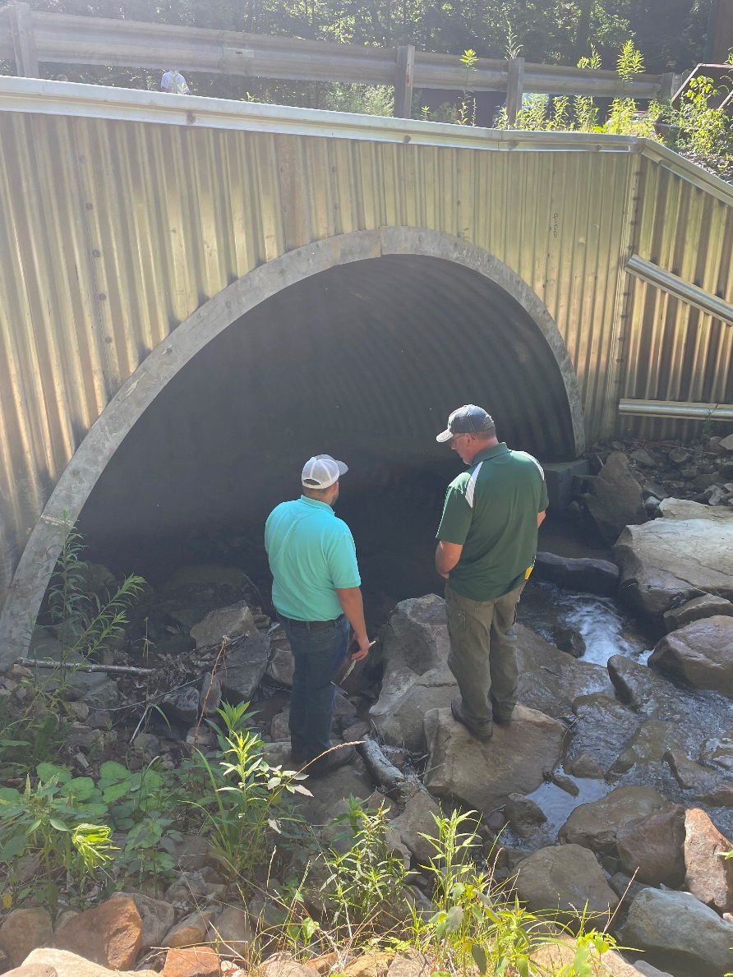
DGLVR QAQC Process
Project Review:
  Most of the in-person visit is spent visiting completed project sites
  Projects chosen from sites in GIS
  District picks some projects and QAQC Team finalizes list
  Review of environmental impact reduction and project success

Slide 15
DGLVR QAQC Process
QAQC Report:
  Written after all remote and in-person visits are complete
  Document how the program is being run locally
  Lists what the district is doing well, if anything is outside of requirements, and suggestions for improvement
  District reviews the preliminary report and provides feedback
  SCC staff determines if any changes are needed prior to sending the final report

Slide 16
DGLVR QAQC Process
Ratings:
  Exceptional - Local program is exceeding expectations in every category and on every project. Saved for the best of the best.
  Exceeds expectations - the local Program goes above and beyond what is required
  Meets expectations - The District is administering the Program well.
  Needs improvement - Self-explanatory and provides a category between Meets Expectations and Doesn’t Meet Expectations for those Districts that are borderline.
  Does not meet expectations - Not meeting the requirements of the Program.

Slide 17
DGLVR QAQC Process
Ratings:
  Meets expectations - The District is administering the Program well.

Slide 18
Outline
QAQC overview and process
Summary of Round 4 QAQCs (2021-2023)
Updates for Round 5 QAQCs (2024-2027)

Slide 19
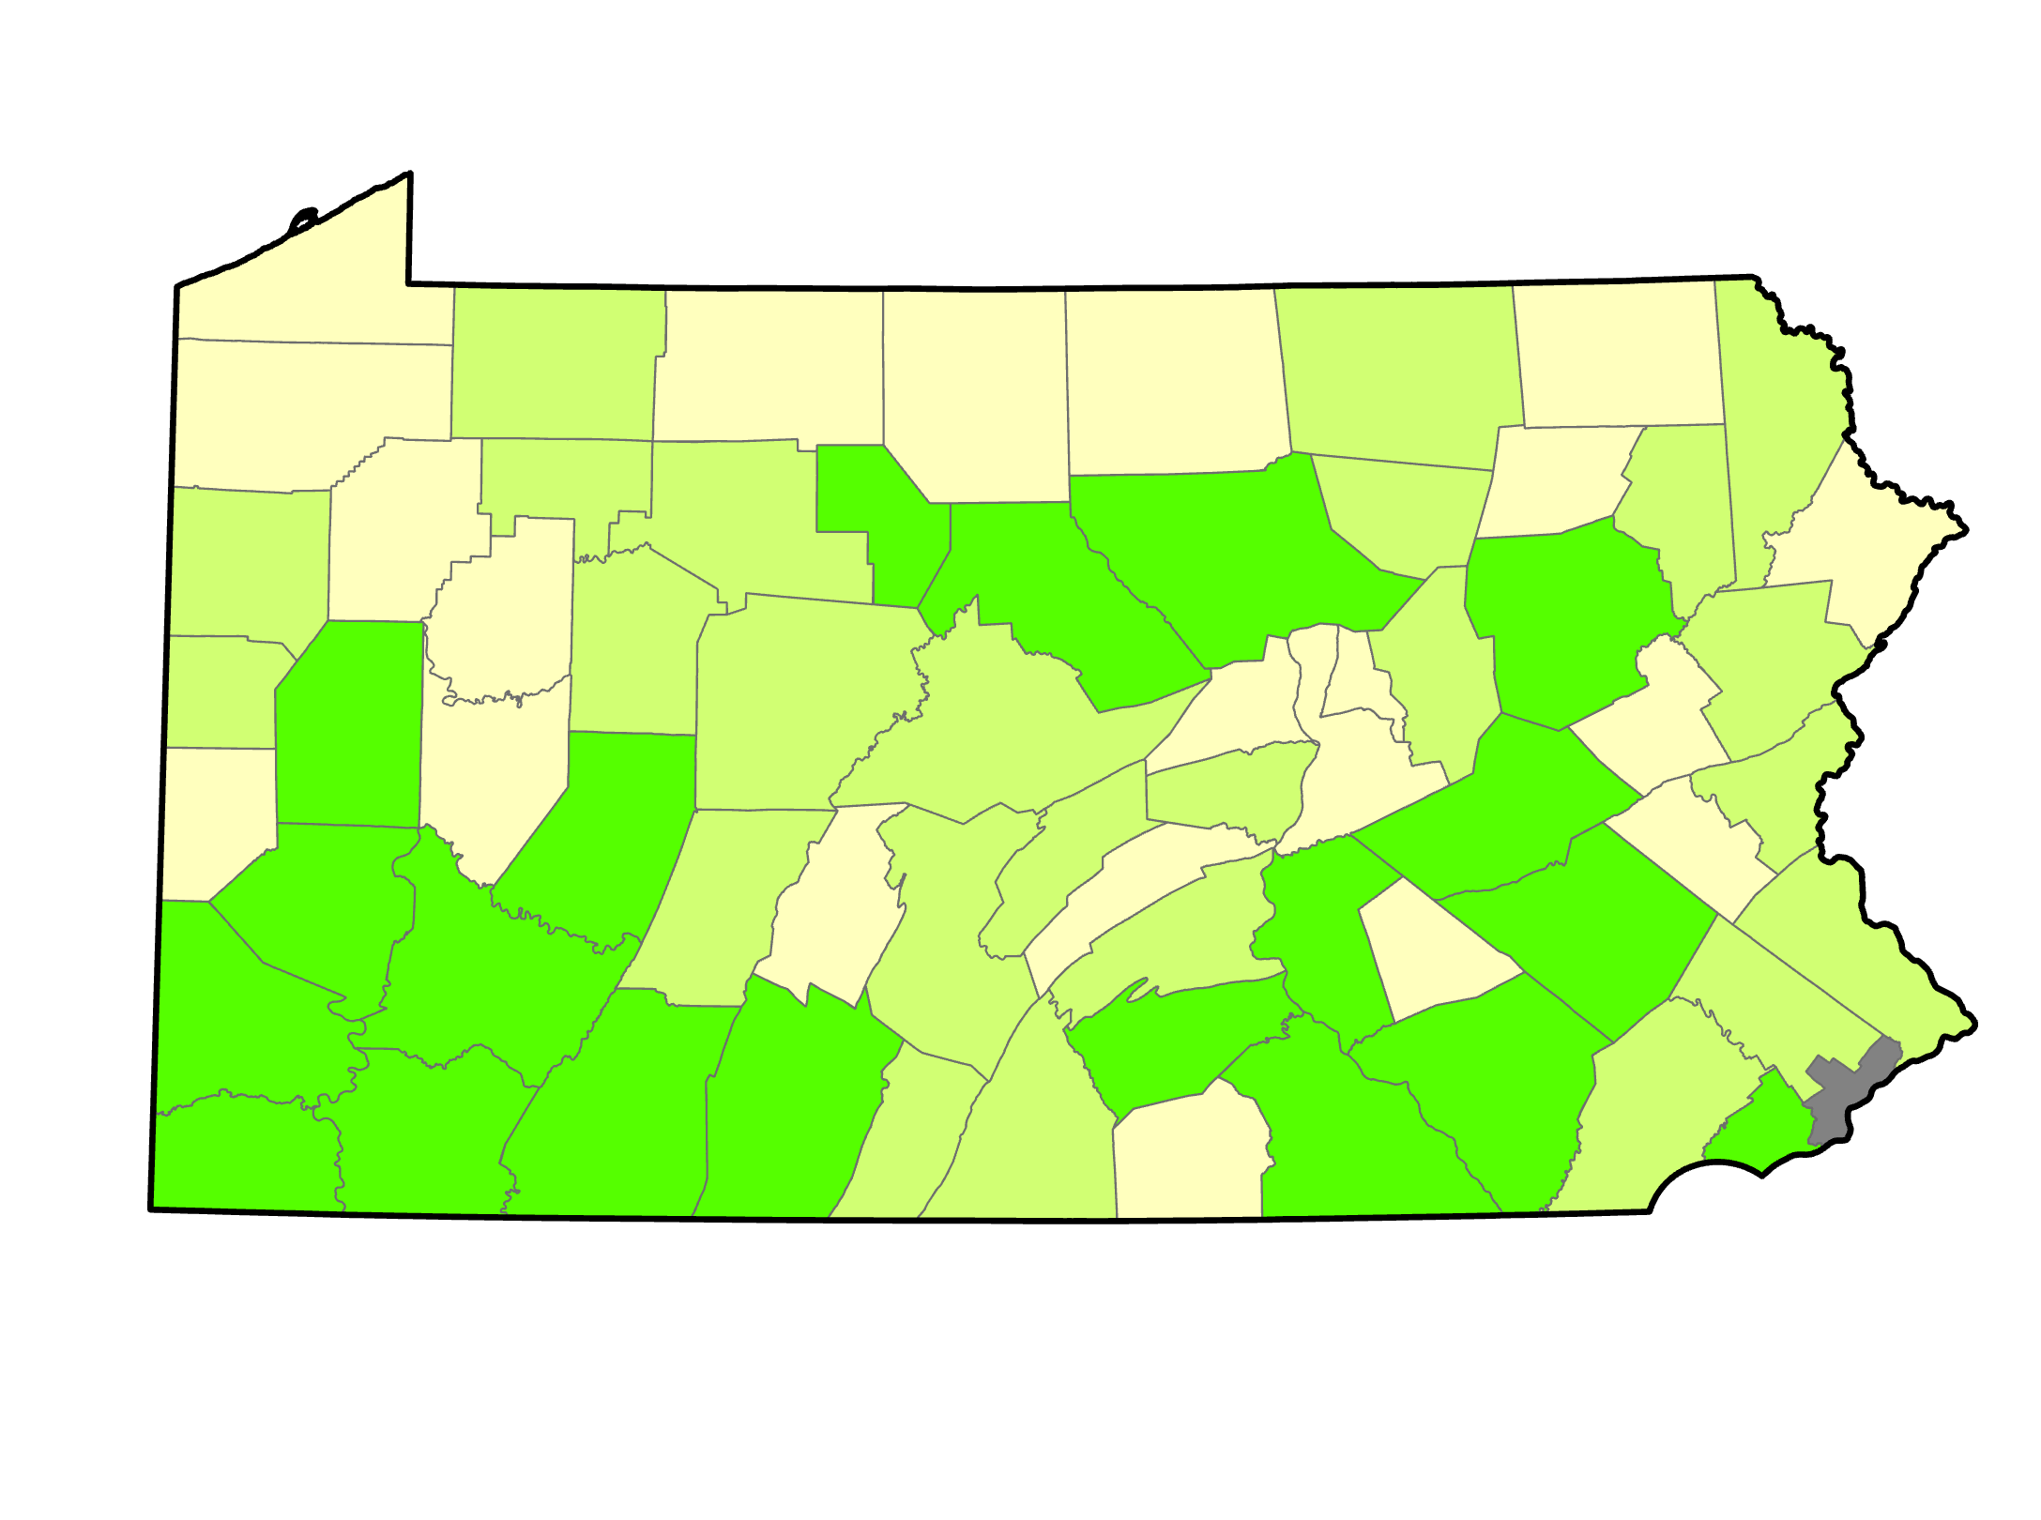
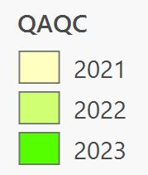
QAQC Round 4 Summary

Slide 20
QAQC Round 4 Summary

Slide 21
QAQC Round 4 Summary

Slide 22
QAQC Round 4 Summary

Slide 23
QAQC Round 4 Summary

Slide 24
QAQC Round 4 Summary
Individualized feedback provided to each conservation district in QAQC report
  CDs should thoroughly review reports
    By staff, management, QAB, and CD Board members
  There are also some recurring themes state-wide: details on following slides

Slide 25
QAQC Round 4 Summary
Recurring Themes: Required Actions
  Follow stream crossing policy
    Especially small streams
  DSA and road fill requirements
  Update local policies
  Update cost allocation methods (CAMs)
  Keep local and GIS account balances reconciled
  Retain PA One-call serial number in project files

Slide 26
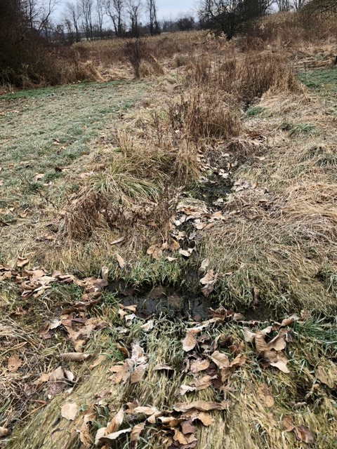
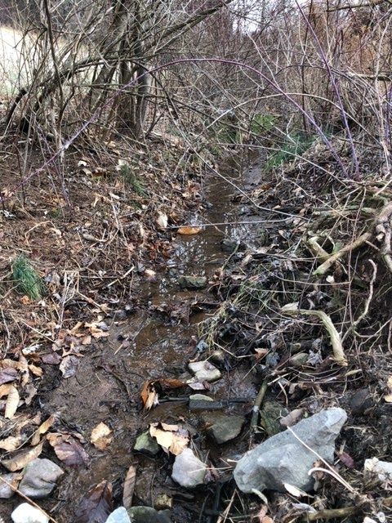
Stream Crossings
Small Streams
  When does the DGLVR stream crossing policy apply?
Admin Manual 7.1.2.3: Where the DGLVR Stream Crossing Policy Applies
The stream crossing policy outlined here applies to situations where streams, including intermittent channels, with identified bed and banks are flowing into the road or the uphill ditch. See section 7.1.3 for more information on Automatic and SCC-requested exemptions from the DGLVR Stream Crossing Standard. Contact the State Conservation Commission in questionable circumstances.
https://dirtandgravel.psu.edu/pa-program-resources/program-specific-resources/administrative-guidance-manual/7-additional-program-policies/#agm_7-1

Slide 27
Stream Crossings
Small Streams
  1.25x bankfull width requirement
  Automatic Exemption
    No SCC approval needed for channels with a bankfull width of 4’ or less and:
      The defined bed and bank coming to the road does not extend more than 500’ upslope of the road ditch, or
      The drainage area of the bed and bank coming to the road is 20 acres or less.
  Complete the “Automatic Exemption from the DGLVR Stream Crossing Standard” form (Appendix I) and keep it in the project file. Automatic exemptions still need to be reported in the SCC notification system.

Slide 28
Stream Crossings
  Written SCC Approval for Exemptions
    Circumstances may exist where a conservation district would like to request an exemption from the DGLVR Stream Crossing Standard from the SCC on a larger stream that does not qualify for an automatic exemption. These situations must be handled individually, and a signed “SCC Exemption from the DGLVR Stream Crossing Standard” form must be obtained from the SCC and kept in the project file.

Slide 29
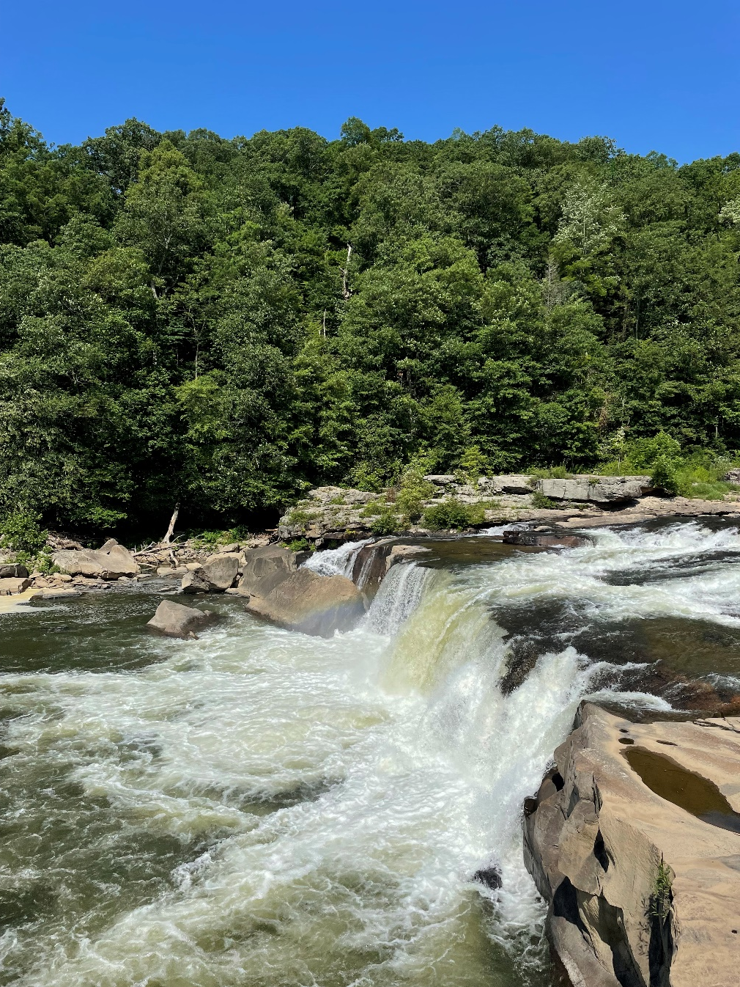
Stream Crossings
  Written SCC Approval for Exemptions
    Examples of some conditions where an exemption from the DGLVR Stream Crossing Standard may be requested:
      Small channels that fall outside the automatic exemptions above.
      Crossings with extensive outlet drops that would make establishing connectivity impossible or prohibitively expensive for the amount of habitat improvement it would provide.
      Other stream crossings with special circumstances. A signed “SCC Approval for Exemption from the DGLVR Stream Crossing Standard Request” form must be kept in the project file.

Slide 30
Stream Crossing Resources
Stream Crossing Page of the Center’s website
  https://dirtandgravel.psu.edu/stream-crossing-replacements/
Policy, Standard, and Technical Manual
Stream Crossing Replacement Certification Training
Recorded webinars:
  https://dirtandgravel.psu.edu/education-training/webinars/past-webinars/
  Please reach out to SCC or Center with any questions and for assistance with ongoing projects!

Slide 31
Stream Crossing Resources
Webinars:
February 8, 2024: Stream Crossings – Status Update and Emerging Issues
  Status update on the implementation of the new stream crossing standard. Included a review of some recent issues encountered on projects and conservation district responsibilities.
January 5, 2023: Stream Crossing Exemptions and Notifications
  This webinar reviewed the notification and exemption process for stream crossings with some examples.
May 27, 2022: Stream Technical Manual: Overview and Q&A on DGLVR Stream Crossing Replacement Technical Manual
May 26, 2022: Stream Standard: Overview and Q&A on DGLVR Stream Crossing Design and Replacement Standard
May 25, 2022: Stream Policy: Overview and Q&A on DGLVR Stream Crossing Replacement Policy

Slide 32
DSA & Road Fill
7.2.3 Exception to using DSA on Fill Projects
Driving surface aggregate meeting the Commission’s Standard and Specification is the only approved road surface material that may be purchased (for DGR projects) with Program funds. The only exception to this is on road fill projects. Road fill projects are defined as projects which install an average compacted thickness of 12-inches or more of fill material, not including the driving surface, to allow for proper drainage and/or strengthen the existing road base. Road fill projects must be capped with DSA or an alternative aggregate at a minimum depth of 6-inches. Shale or bank-run gravel may not be used as the final driving surface. This exception is not meant to replace DSA with fill
Considerations
  Depth of road fill used needs to be sufficient to support drainage
  DSA can still be used to surface road fill projects
  The road fill exception should not be used to avoid DSA placement
  Alternative surface materials should be well-bound
  Project phasing

Slide 33
Financial Resources
NEW Financial Training
Highly recommended for CD staff involved in DGLVR funding: budgeting, bookkeeping, writing checks, spending requirements, etc.
This training covers topics including:
  DGLVR financial policy
  tracking funds
  GIS financial tools
  reconciling the GIS and conservation district DGLVR accounts,
  budgeting and spending requirements
  financial portion of Quality Assurance / Quality Control (QAQC) visits.
Registration: https://dirtandgravel.psu.edu/education-training/program-administration/financial-training-registration/
  May 22 (Westmoreland County)
  July 24 (Centre County)
  October 17 (Luzerne County)
  December 4 (Venango County)

Slide 34
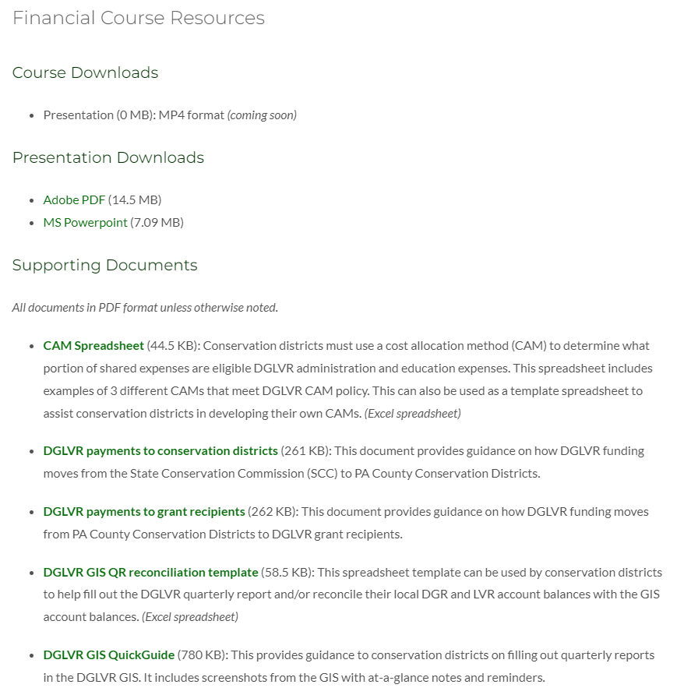
Financial Resources
New templates and financial guidance documents provided in financial training
Available online: https://dirtandgravel.psu.edu/education-training/program-administration/
Reach out to Ken and SCC for financial assistance!

Slide 35
QAQC Round 4 Summary
Recurring Themes: Project Recommendations
  More outlets and drainage disconnection
  Shallow cross pipes with grade breaks
  More road fill
    Achieve sheet flow
  Road crown
  More stable headwalls/endwalls
  Use underdrain, storm sewer, and infiltration practices appropriately
  Stream crossing design/implementation

Slide 36
Project Resources
ESM Spotlight webinars
March 2, 2023: ESM Practice Spotlight: Sectional Fill
  While the Program utilized road fill to correct drainage problems on entrenched roads, sometime a complete fill job is not possible. This webinar covered a “sectional fill” approach that can sometimes be used to raise certain sections of road and obtain drainage outlets.
March 23, 2023: ESM Practice Spotlight: Shallow Crosspipes
  Based on recent QAQCs, the practice of “shallow crosspipes” is still underutilized around the state. This webinar reviewed the topic in detail, providing advantage and instruction for installation.
February 15, 2024: ESM Spotlight – Underdrain, Infiltration, and Storm Sewers
  Building off a presentation done at the 2023 workshop, the Center has developed a new technical bulletin about the use of underdrain, infiltration, and storm sewer systems. This webinar reviewed the new technical bulletin which will be made available.

Slide 37
QAQC Round 4 Summary
Recurring Themes: Administrative Recommendations
  Conservation district should conduct more education and outreach
  More involvement throughout project lifecycle
  Create and file as-built drawings at the end of projects
  Print and include project expense tracker in hard file

Slide 38
Administrative Resources
Recorded webinar: January 17, 2017: CD Education and Outreach Ideas
  Education and outreach ideas and efforts for Conservation Districts to improve interactions with municipalities and other potential applicants.
ESM Bootcamps being scheduled for 2024
  Designed for Conservation Districts staff administering the field portion of the DGLVR Program.
  This multi day training event is held largely in the field to provide basic knowledge in Environmentally Sensitive Road Maintenance.
  Includes training on development and oversight of DGLVR Projects
  https://dirtandgravel.psu.edu/education-training/esm-boot-camp/
Recorded webinar: June 13, 2023: DGLVR Project Work Plan Application
  Since debuting the idea at the 2022 workshop, we have been working with developers to create a “Project Sketch Application” in the DGLVR GIS system. The propose of this application is to allow CDs (and applicants and others) to create simple project layout maps to accompany grant applications for the DGLVR Program. This webinar served as a demonstration/mini-training on the sketcher, and CDs were provided access to the sketcher app immediately after the webinar.
  Can be used for grant applications, updated workplans, and as-built drawings
Upcoming Webinar: April 25th, 9am: Tips for Keeping Up with Spending Requirements: Conservation districts are required to spend each annual allocation of DGR and LVR funds within 2 years to be eligible for future allocations. This webinar will share tips and tricks to help districts establish a local annual grant cycle to get ahead of these spending deadlines.

Slide 39
Administrative Resources
ESM Bootcamps being scheduled for 2024
  Designed for Conservation Districts staff administering the field portion of the DGLVR Program.
  This multi day training event is held largely in the field to provide basic knowledge in Environmentally Sensitive Road Maintenance.
  Includes training on development and oversight of DGLVR Projects
  https://dirtandgravel.psu.edu/education-training/esm-boot-camp/

Slide 40
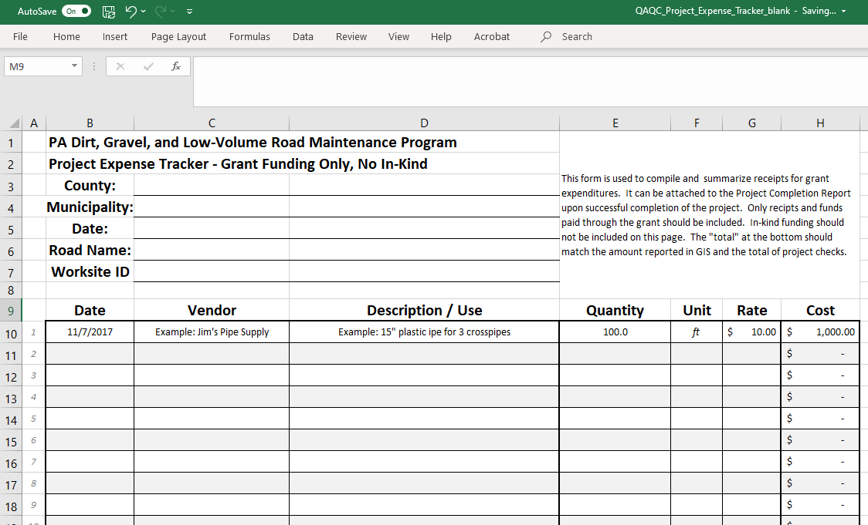
Administrative Resources
Project expense tracker
Template Available as an Excel Document

Slide 41
QAQC Round 4 Summary
Recurring Themes: Commendations
  Dedicated conservation district staff
  Sites with environmental impacts are being funded
  Good basic understanding of and implementation of ESM practices
  Stream crossings incorporating updated guidance

Slide 42
QAQC Round 4 Summary
THANK YOU
to conservation districts
for doing a good job!

Slide 43
Outline
QAQC overview and process
Summary of Round 4 QAQCs (2021-2023)
Updates for Round 5 QAQCs (2024-2027)

Slide 44
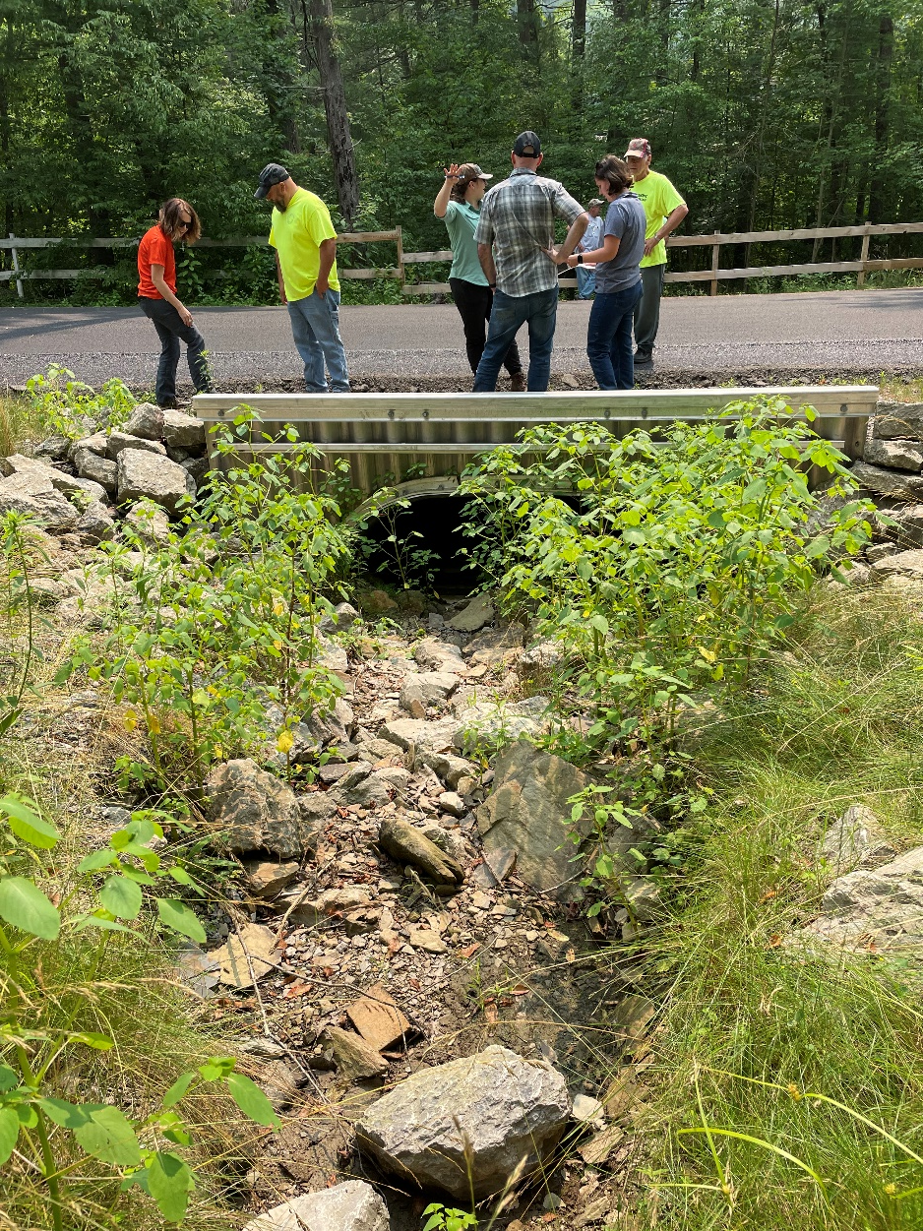
QAQC Round 5 updates
No major changes proposed for Round 5
Review is conducted in multiples remote and in person sessions
Review consists of 3 main parts:
  Financial
  Administrative / Functionality
  Projects

Slide 45
QAQC Round 5 updates
Remote Components
  Financial Review
  Interviews
  Administrative document review
  Project selection
In-person Visit
  1-3 days
  Hard file review
  Focus on site visits

Slide 46
QAQC Round 5 updates
Reviewing Stream Crossings following the Standard
  Visit after completion, before full QAQC visit
    SCC will request documentation ahead of site visit
    Separate report format/criteria for stream crossing projects contracted before the Standard and stream crossing projects following the Standard

Slide 47
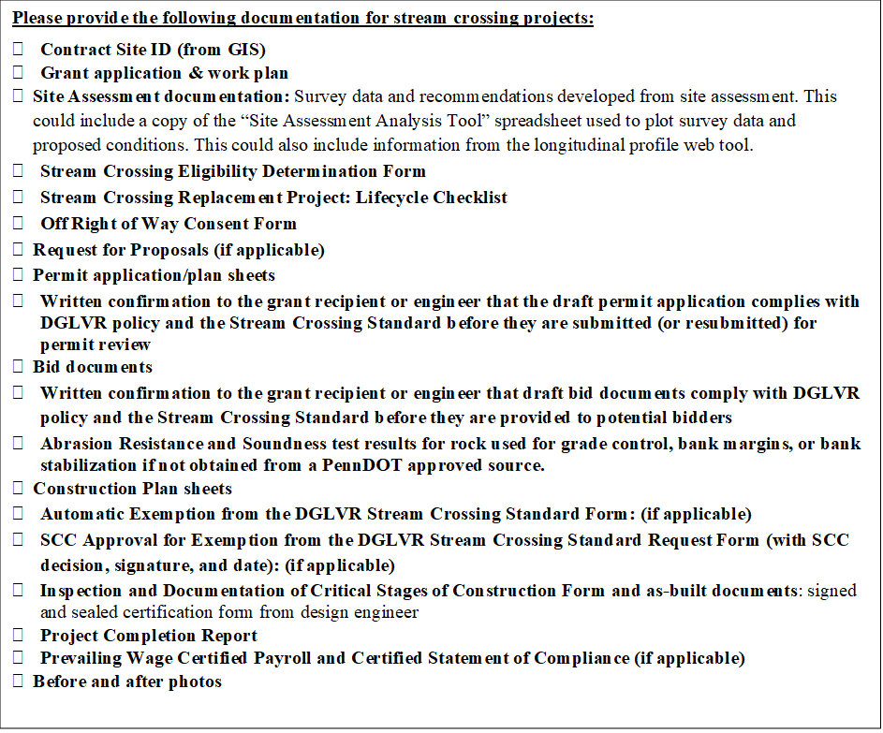
QAQC Round 5 updates

Slide 48
QAQC Round 5 updates
Report
  Ratings
    Unchanged
  Checklist format
    Mostly the same but will be streamlined
  Executive Summary
    First few pages of report
    Include ratings, summary, and commendations, recommendations, and required actions
    unchanged

Slide 49
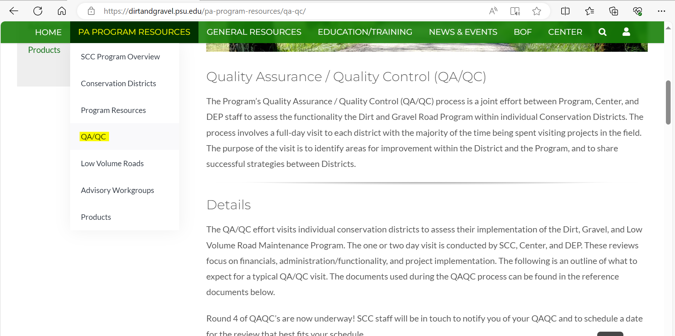
QAQC Round 5 updates
Preparing for a QAQC
  Pre-visit letter (email) includes checklist, overview of ratings, etc. (Attachments A-D)
  All documents available online: https://dirtandgravel.psu.edu/pa-program-resources/qa-qc/

Slide 50
QAQC Round 5 updates
How to do well on a QAQC?
  Attend DGLVR trainings regularly
  Keep up with webinars
  Commit enough time to the DGLVR Program
  Develop ESM practice expertise
  Reach out when you need help
    “You learn more by asking than assuming”

Slide 51

DGLVR Program
Spending Update
  5-Year Spending Update
    All funding from agreement must be spent out by 6/30/2024
    Current CD Status as of 4/11/2024
      Spent everything: 28 DGR, 27 LVR
      Committed everything: 27 DGR, 26 LVR
      Not committed: 9 DGR, 10 LVR

Slide 52
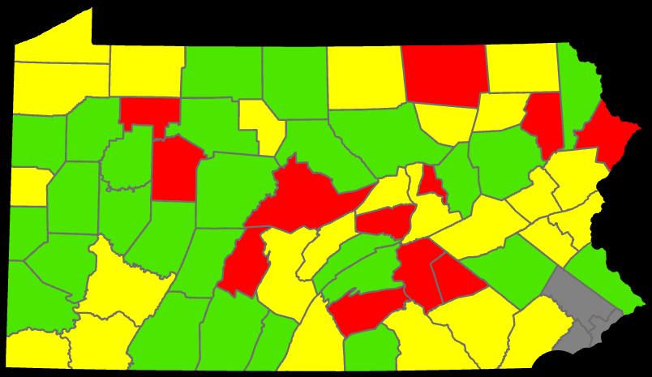
DGR

Slide 53
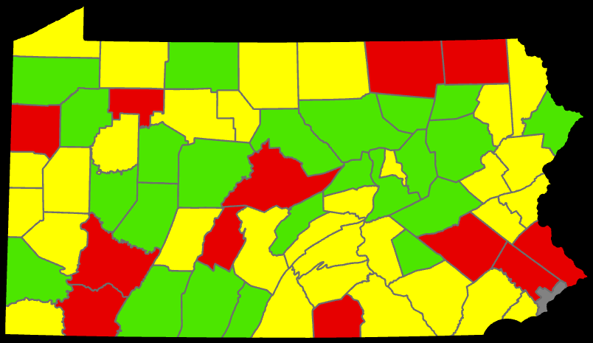
LVR

Slide 54
DGLVR Program
Spending Update
  5-Year Spending Update - Financials
    Dirt and Gravel
      Committed: $3,515,679.81
      Not Committed: $226,924.00
    Low Volume
      Committed: $2,654,177.08
      Not Committed: $380,506.02
    Total
      DGR: $3,742,603.81
      LVR: $3,034,683.10
      Total: $6,777,286.91

Slide 55
DGLVR Program
Spending Update
  Question:
  How do I know how much I need to spend to meet my spending requirements?
    Answer:
  This information is available in the GIS.

Slide 56
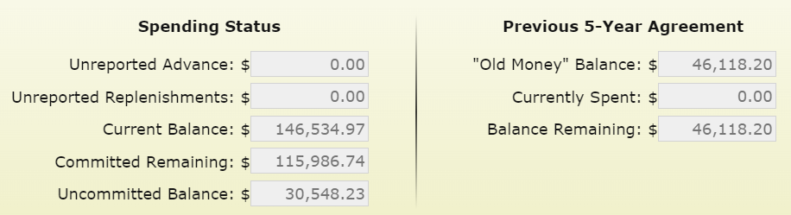
DGLVR Program
Spending Update
  Question:
  How do I know if I have all my “old money” contracted?
    Answer:
  If your Committed Remaining is greater than the Balance Remaining.

Slide 57
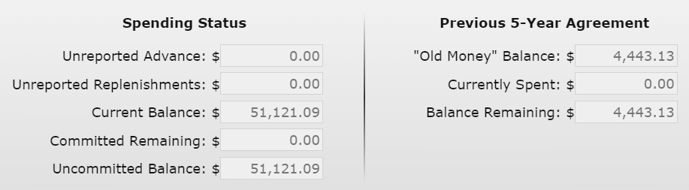
DGLVR Program
Spending Update
  Question:
  How do I know if I still have “old money” to contract?
    Answer:
  If your Committed Remaining is less than the Balance Remaining.

Slide 58
DGLVR Program
Spending Update
  5-Year Spending Update
    If you are Green in both DGR and LVR, great job!
    If you are Yellow or Red in DGR and/or LVR, expect follow-up status calls/emails.

Slide 59
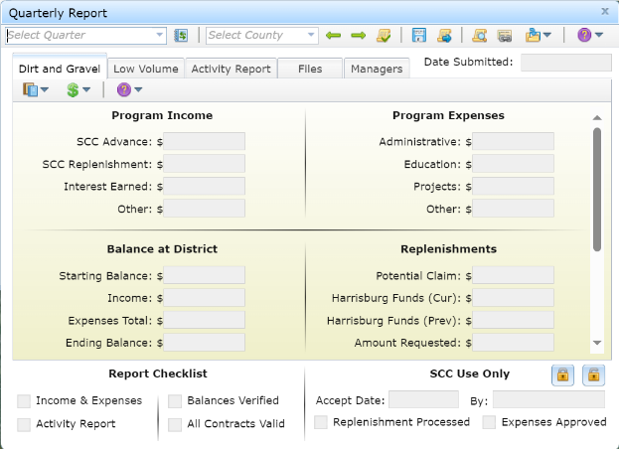
DGLVR Program
Spending Update
  Question:
  How do I make sure my spending is counted towards the spending requirement?
    Answer:
  Enter admin, edu, and project expenses in the GIS by 6/24/2024 (and don’t forget to click save!)

Slide 60
DGLVR Program
Spending Update
  Question:
  What if I don’t know how much money I need to spend or how to spend it?
    Answer:
  Review GIS
  Review past webinars
  Reach out to Ken or the SCC for assistance

Slide 61
DGLVR Program
Spending Update
  Question:
  What if my expenses won’t be ready to enter in GIS by 6/24/2024?
    Answer:
  Contact Ken or the SCC to discuss a plan

Slide 62
DGLVR Program
Spending Update
  Question:
  What if I know I’m not going to meet my spending requirements?
    Answer:
  Reach out to Ken or the SCC to let us know.

Slide 63

QAQC Round 5 updates
I WANT YOU
TO DO WELL ON YOUR QAQC

