Slide 1
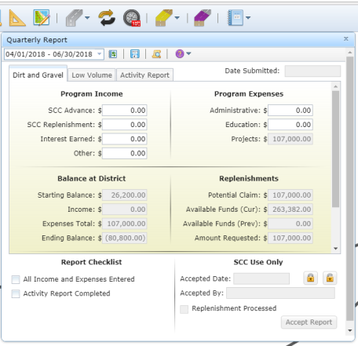
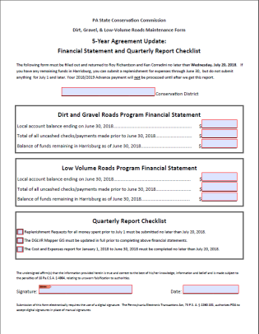
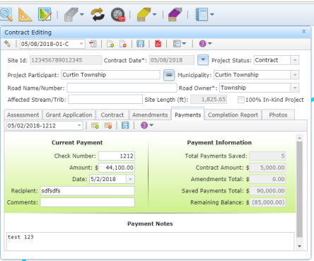
DGLVR Webinar
Quarterly Report
Prep and Overview
6/18/2018
Starts at 9am
If you are reading this, then you are successfully seeing the webinar video. Webinar audio should be automatic through your computer, and options can be accessed in the “audio options” button on the bottom left. If you are having audio issues, or are in a location where listening via phone is preferable, audio is also available on the CDGRS conference line at:
866-823-7699.
For technical assistance, call: 814-865-5355

Slide 2
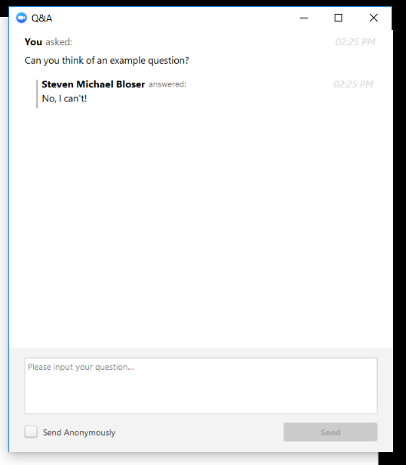
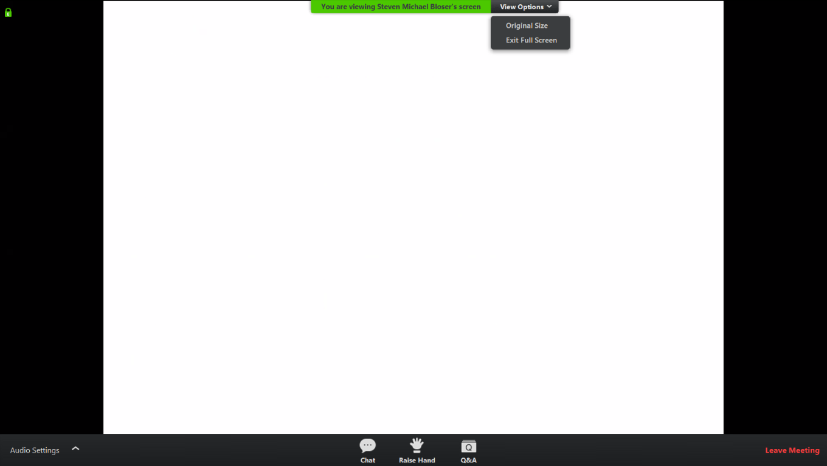
Q&A
Note you can ask a question anonymously
Q&A
For audio via phone: 866-823-7699
For technical assistance: 814-865-5355
Slide #

Slide 3
Quarterly Report Prep and Overview
Major Changes to the DGLVR GIS system:
Required to enter individual project checks: This allows more accurate and timely tracking when projects stay “active” for several months or years.
More detailed financial reporting: The system will now provide complete accounting including allocations, spending, income, and interest for a complete picture of district Program finances at the local level and in Harrisburg.
More frequent financial reporting: The system will move the Program from annual to quarterly reporting.
Automated quarterly replenishments: Replenishments will now be generated automatically each quarter based on spending for that quarter. CD managers will now be required to have a GIS access account in order to approve and submit replenishments.
Audio also available via phone: 866-823-7699
For assistance, call: 814-865-5355

Slide 4
Quarterly Report Prep and Overview
GIS Update Implementation Timeline:
June 18, June 21, June 26: Webinars for all CDS: Will provide a brief overview of the new system and the plan for implementation.
July 1: Project payments tab made available to all CDs in GIS.
July 2, 9, 20: Webinars for all CDs: Training webinar to illustrate how individual project payments (checks) are now tracked.
July 20:
Last date for paper replenishments for “old” money.
Financial Statements needed for both DGR & LVR
GIS Fully Updated
Cost and Expenses report entered for the period of January 1 – June 30
August 6: Quarterly Reporting available to all CDs in GIS
Late July through August: Quarterly Report webinar trainings:
For Technicians: Project Payments and quarterly reports
For Managers and accountants: Financial reporting and replenishments
September 18: Full GIS Training for new hires in Indiana (workshop)
September 19: Four ~45 minute Quarterly Report Trainings in Indiana (workshop)
October 15: First quarterly report due in new system
Audio also available via phone: 866-823-7699
For assistance, call: 814-865-5355

Slide 5
Quarterly Report Prep and Overview
Preparing for the new Quarterly reports
Replenishment Request for spending prior to July 1
Financial Statements needed for both DGR & LVR
GIS Fully Updated
Cost and Expenses report entered for the period of January 1 – June 30
All 4 items due by Friday, July 20
Audio also available via phone: 866-823-7699
For assistance, call: 814-865-5355

Slide 6
Quarterly Report Prep and Overview
Preparing for the new Quarterly reports
Replenishment Request for spending prior to July 1
Financial Statements needed for both DGR & LVR
GIS Fully Updated
Cost and Expenses report entered for the period of January 1 – June 30
All 4 items due by Friday, July 20
Audio also available via phone: 866-823-7699
For assistance, call: 814-865-5355

Slide 7
Quarterly Report Prep and Overview
Replenishment Request
Required for all expenditures prior to July 1
Due Friday, July 20
Do NOT include any expenditures after June 30
These will be handled by the new Quarterly Report
Non-Quarterly Report replenishment requests will NOT be accepted for any expenditures made starting July 1
Audio also available via phone: 866-823-7699
For assistance, call: 814-865-5355

Slide 8
Quarterly Report Prep and Overview
Preparing for the new Quarterly reports
Replenishment Request for spending prior to July 1
Financial Statements needed for both DGR & LVR
GIS Fully Updated
Cost and Expenses report entered for the period of January 1 – June 30
All 4 items due by Friday, July 20
Audio also available via phone: 866-823-7699
For assistance, call: 814-865-5355

Slide 9
Quarterly Report Prep and Overview
Financial Statements
Required for both DGR and LVR accounts
Due Friday, July 20
Required Statements:
Local account balance ending on June 30
Total of all uncashed checks/payments made prior to June 30
Balance of funds remaining in Harrisburg as of June 30
Audio also available via phone: 866-823-7699
For assistance, call: 814-865-5355

Slide 10
Quarterly Report Prep and Overview
Funds Remaining in Harrisburg
These funds do not include the FY 18/19 money.
This balance will be calculated by the remaining funds in Harrisburg minus the replenishment request submitted for all expenditures prior to July
Example:
As of June 30, $20,000 in DGR remains in Harrisburg. On July 20, a request is submitted for $15,000 for expenditures prior to July 1. Therefore, the balance reported for DGR funds remaining in Harrisburg is $5,000.
Audio also available via phone: 866-823-7699
For assistance, call: 814-865-5355

Slide 11
Quarterly Report Prep and Overview
Preparing for the new Quarterly reports
Replenishment Request for spending prior to July 1
Financial Statements needed for both DGR & LVR
GIS Fully Updated
Cost and Expenses report entered for the period of January 1 – June 30
All 4 items due by Friday, July 20
Audio also available via phone: 866-823-7699
For assistance, call: 814-865-5355

Slide 12
Quarterly Report Prep and Overview
GIS Requirements
All contracted projects must be entered
All completed projects must be marked accordingly
Any project payments made starting July 1 MUST be entered into the GIS
Audio also available via phone: 866-823-7699
For assistance, call: 814-865-5355

Slide 13
Quarterly Report Prep and Overview
Project Payments
Any project payments made starting July 1 MUST be entered into the GIS
Required for the new Quarterly Report
Used to generate the replenishment request
Project payments made prior to July 1 will not be entered
These were handled by the “June 30” replenishment request
Audio also available via phone: 866-823-7699
For assistance, call: 814-865-5355

Slide 14
Quarterly Report Prep and Overview
Preparing for the new Quarterly reports
Replenishment Request for spending prior to July 1
Financial Statements needed for both DGR & LVR
GIS Fully Updated
Cost and Expenses report entered for the period of January 1 – June 30
All 4 items due by Friday, July 20
Audio also available via phone: 866-823-7699
For assistance, call: 814-865-5355

Slide 15
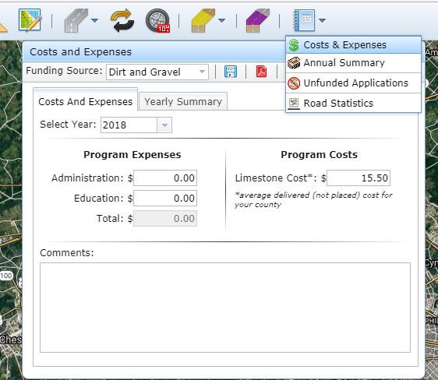
Quarterly Report Prep and Overview
Cost and Expenses Report
This report must be entered for both DGR and LVR for the period of January 1 – June 30
Admin/Edu expenses for both programs
Same report used when completing the ASR
Leave stone cost as the default. This will be appropriately completed for the 2018 ASR.
Audio also available via phone: 866-823-7699
For assistance, call: 814-865-5355

