Slide 1
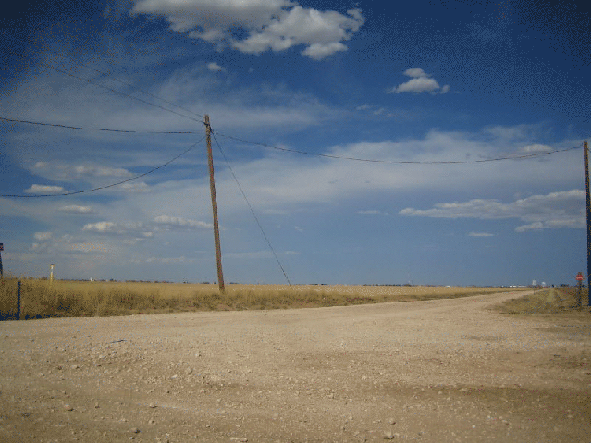
DGLVR Webinar
CDGRS Quarterly Report
Demo w/ Huntingdon CCD
10/5/2018
Starts at 9 AMish
If you are reading this, then you are successfully seeing the webinar video. Webinar audio should be automatic through your computer, and options can be accessed in the “audio options” button on the bottom left. If you are having audio issues, or are in a location where listening via phone is preferable, audio is also available on the CDGRS conference line at: 866-823-7699.
For technical assistance, call: 814-865-5355

Slide 2
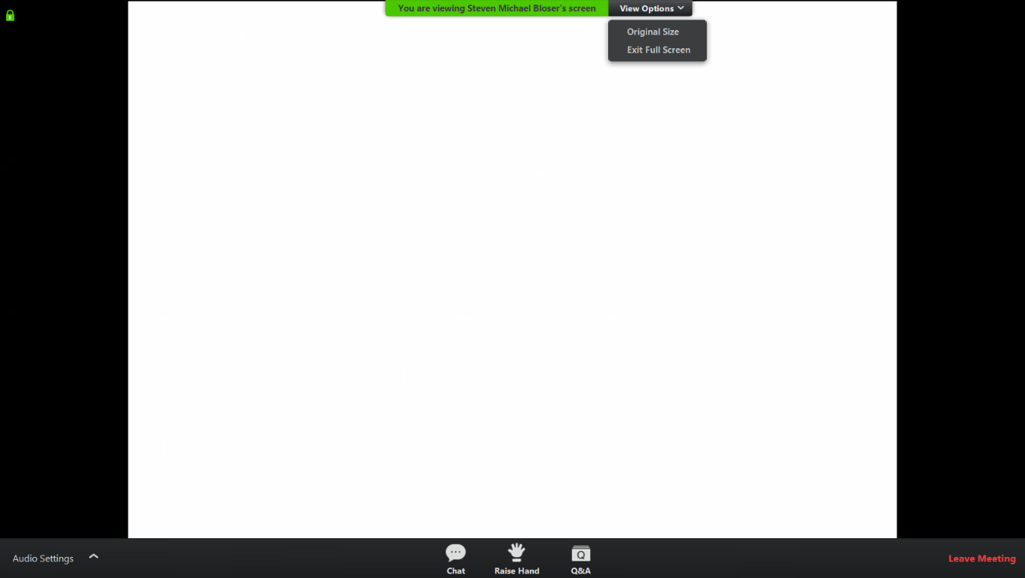
Q&A
Note you can ask a question anonymously
Q&A
For audio via phone: 866-823-7699
For technical assistance: 814-865-5355

Slide 3
Goal
Complete Quarterly Report
Program Tabs
Activity Tab
Submit Report
View email to Roy
Accept Report
View email from Roy

Slide 4
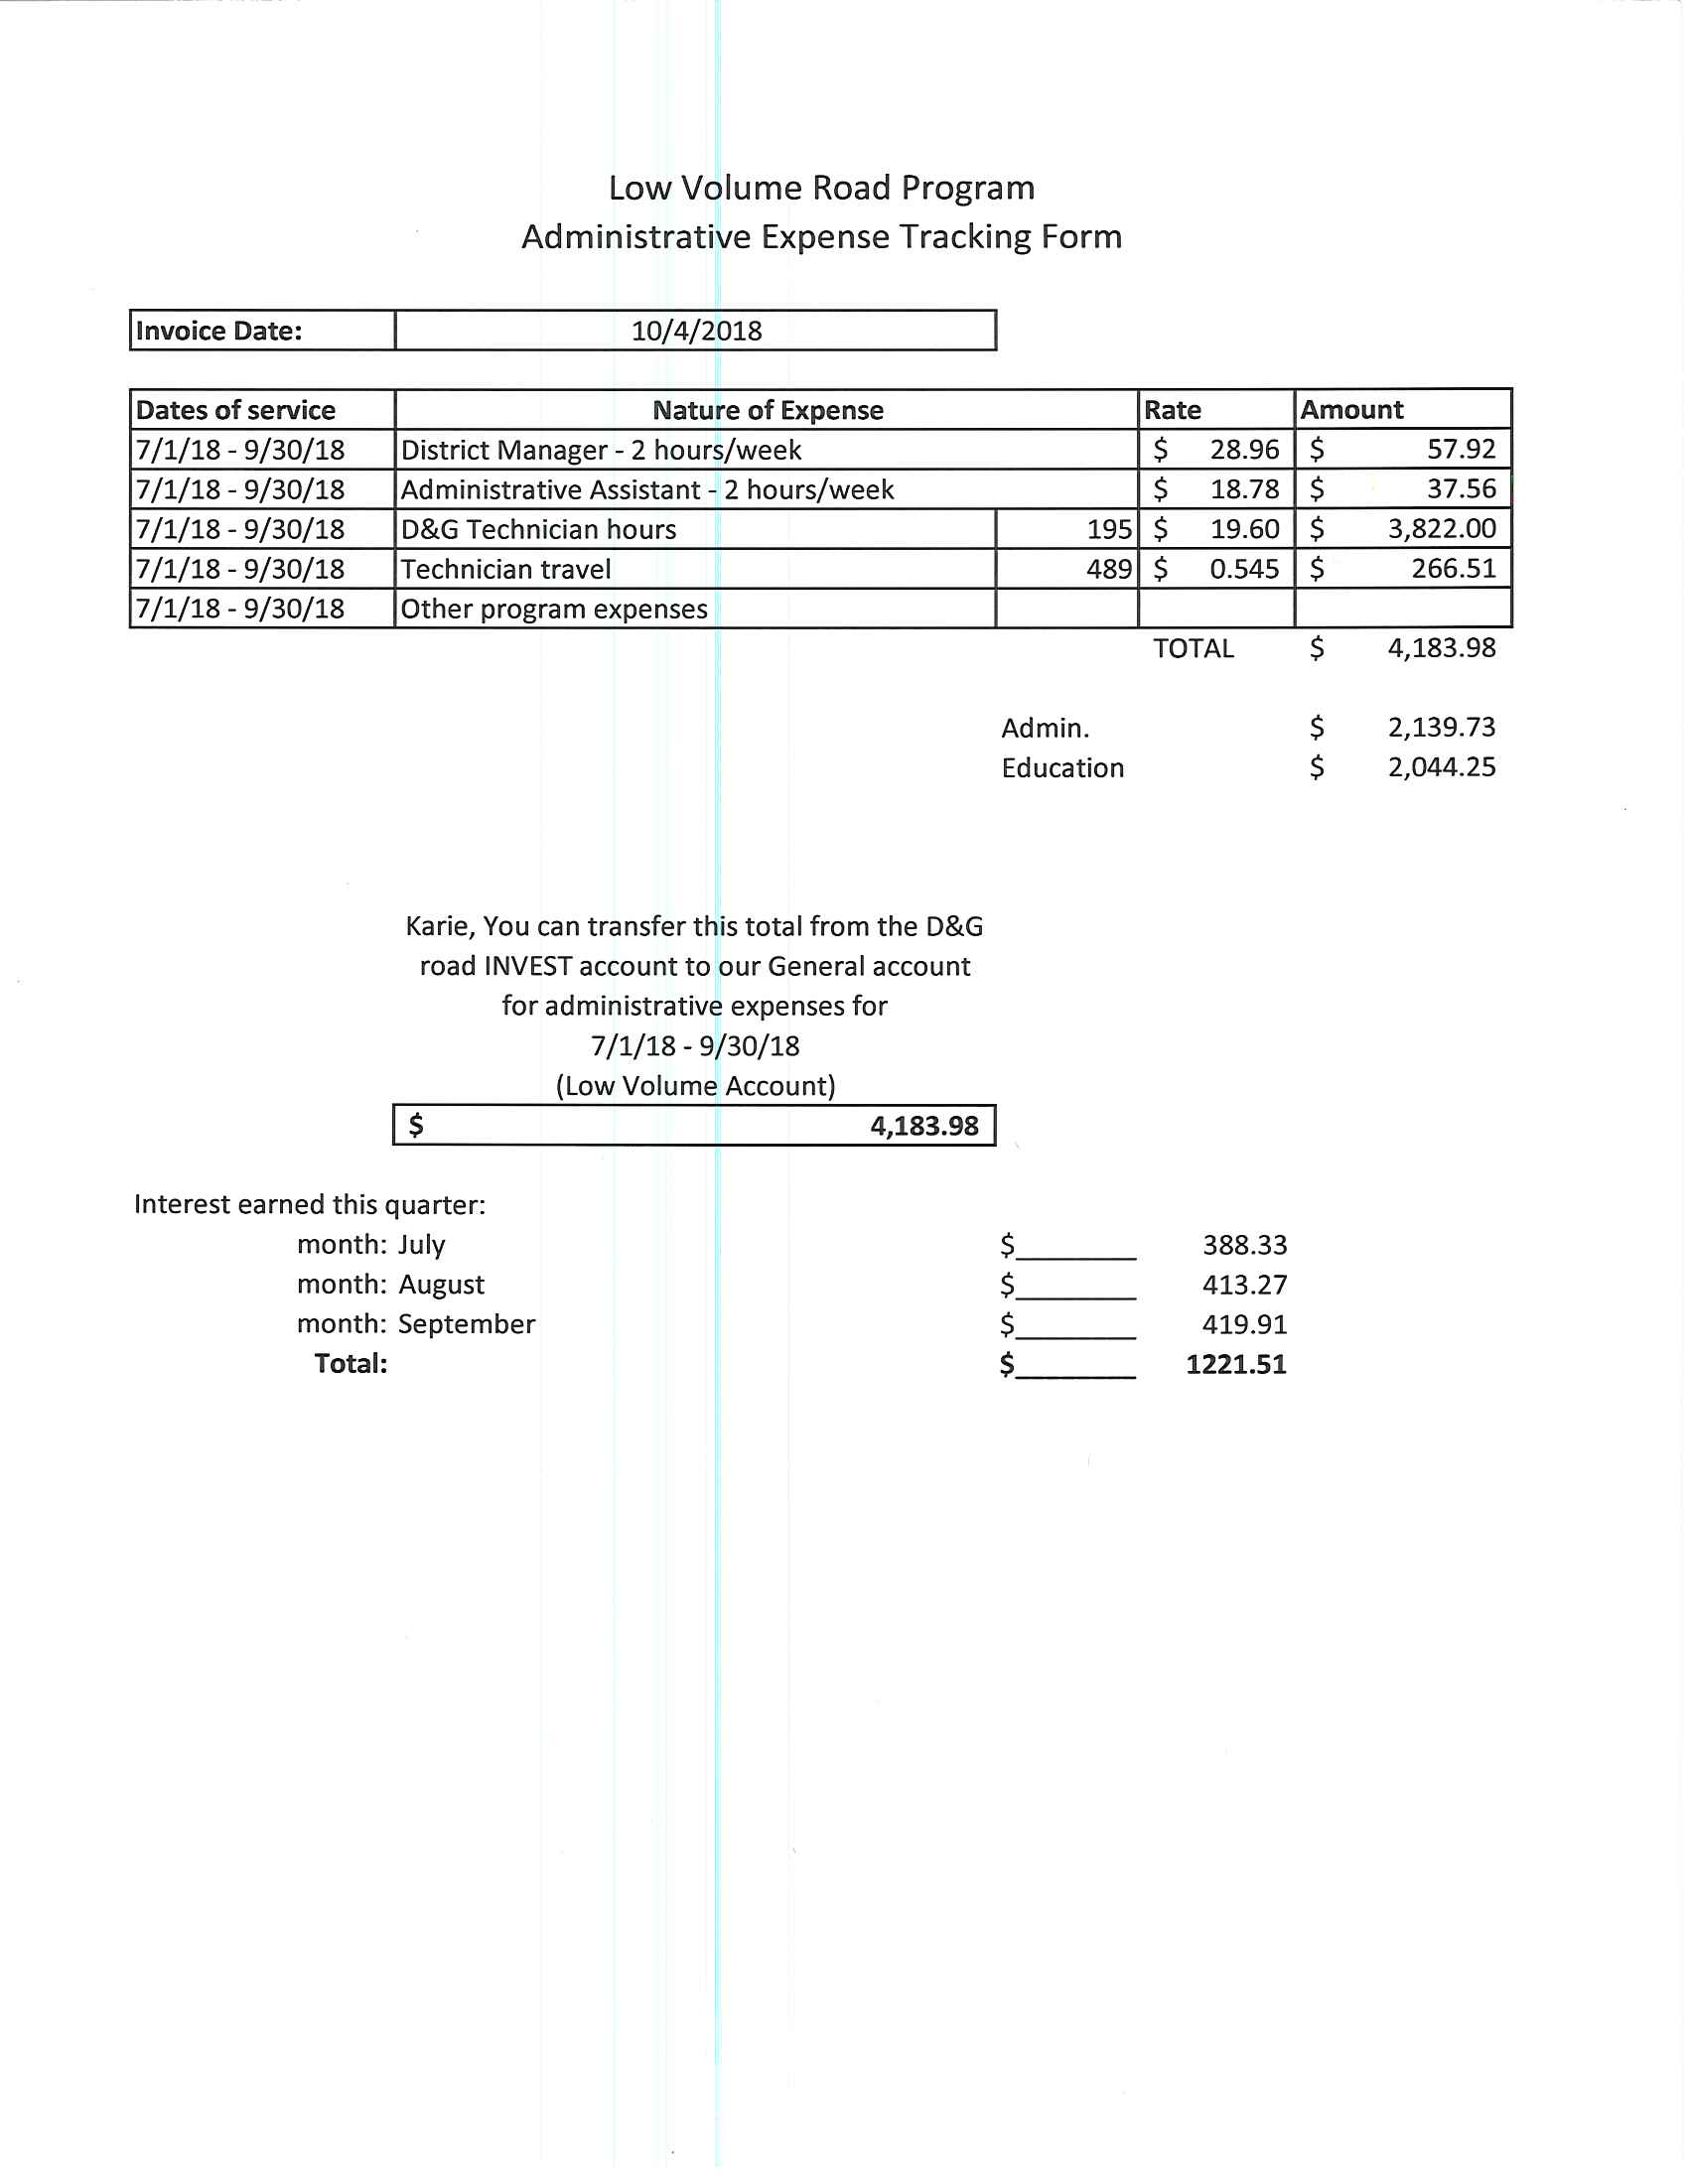
Sample Financial Sheet

Slide 5
Email Tracking
On Submit
On Accept

Slide 6
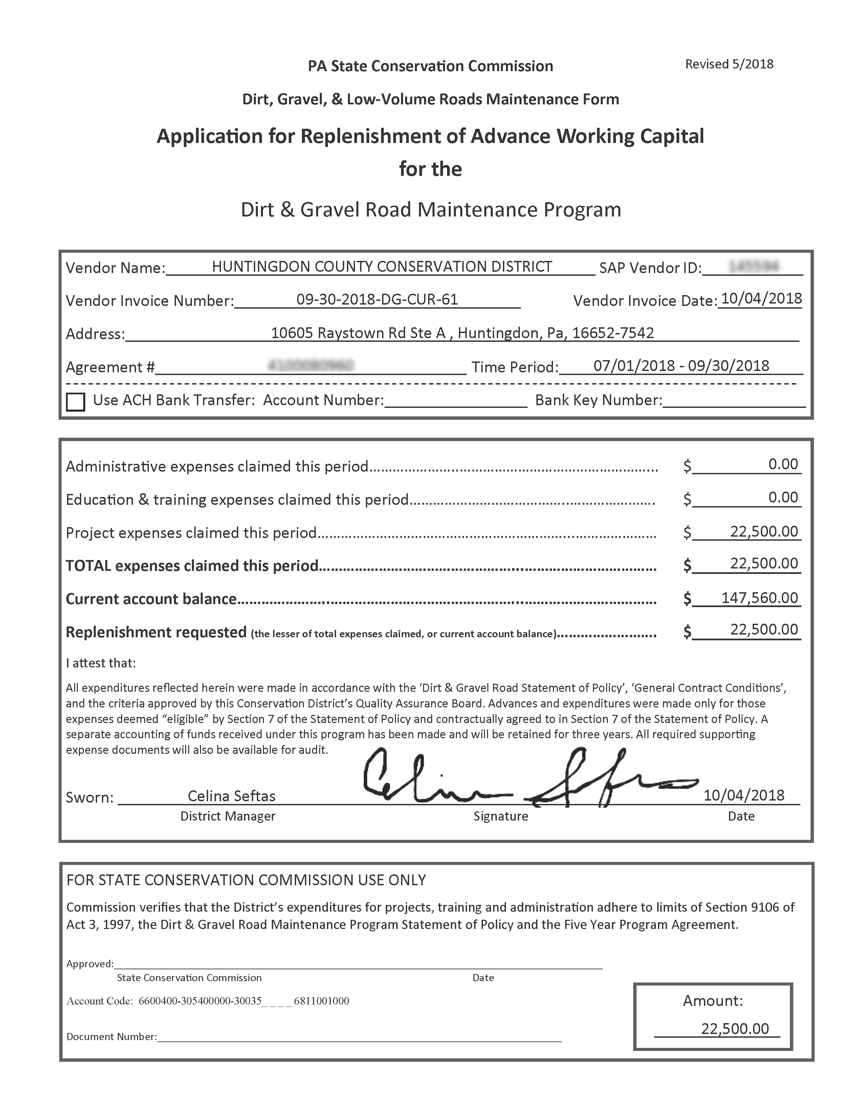
Replenishment Request

Slide 7
Questions
Ken Corradini (CDGRS)
Email: kjc139@psu.edu
Phone: (814) 865-6966
Celina Seftas (Huntingdon CCD)
District Manager
Phone: (814) 627-1626 ext. 3024
Email: manager@huntingdonconservation.org

