Slide 1
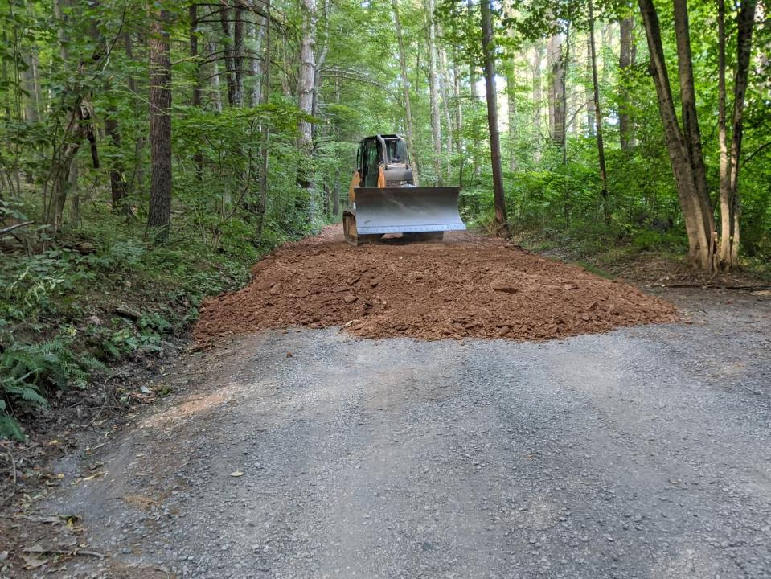
Dirt Gravel and Low Volume Road Program
WEBINAR
3/2/23, 9am
Sectional Fill
CDGRS
Eric Nevel
ern106@psu.edu
Steve Bloser
smb201@psu.edu
If you are reading this, then you are successfully seeing the webinar video. Webinar audio should be automatic through your computer (or click “join audio”), and options can be accessed in the “audio options” button on the bottom left. If your computer audio is not working, you can listen on your phone by dialing 646-876-9923.

Slide 2
Road Fill
Filling Road Cross-Section
Purpose:
Refresher on Road fill and some issues seen on fill projects.
Overview of “Sectional Fill” as an alternative to “Continuous Fill
Notes:
Helps With Drainage On Entrenched Roads
This technique can really help with drainage issues on entrenched roads.

Slide 3
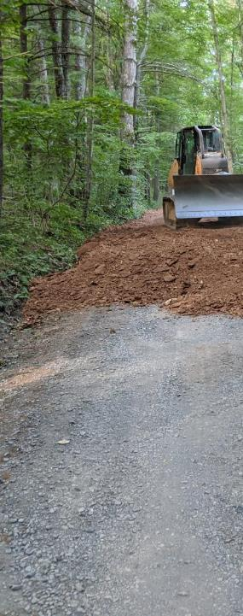
Sectional Fill
Introduction
Continuous Fill
Issues seen with Continuous fill projects
Sectional Fill Alternative
Notes:
Helps With Drainage On Entrenched Roads
This technique can really help with drainage issues on entrenched roads.

Slide 4
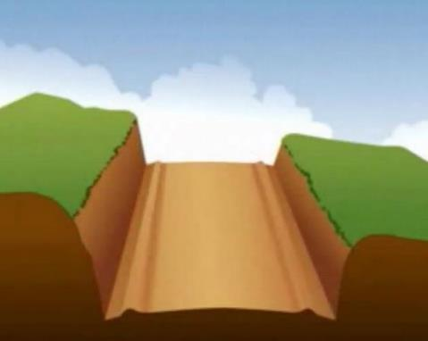
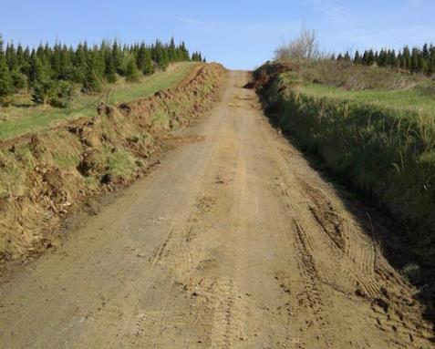
Entrenched Roads
A 100-year-old road that loses 1/2 inch of material that is not replaced each year will be entrenched 4’ today.
Notes:
Helps With Drainage On Entrenched Roads
This technique can really help with drainage issues on entrenched roads.

Slide 5
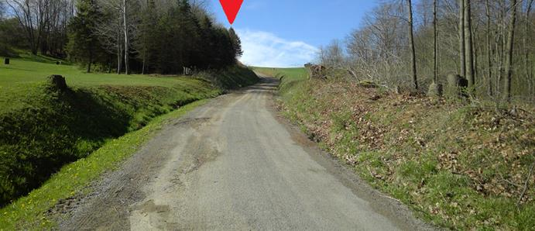
Road Base: ESMPs
Filling Road Cross-Section
Entrenched Roads
Lower than surrounding ground on both sides
Make it impossible to get water off the road
Notes:
Helps With Drainage On Entrenched Roads
This technique can really help with drainage issues on entrenched roads.

Slide 6
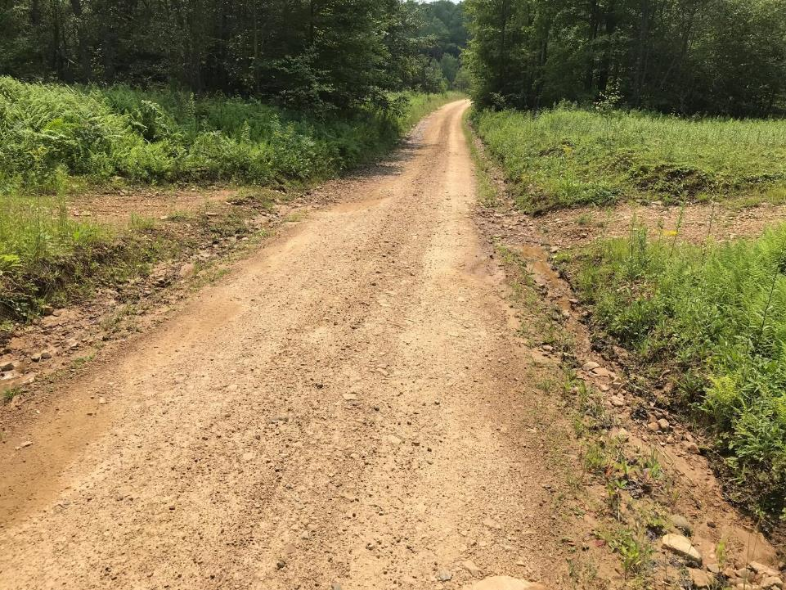
Traditional Practices
Traditional Maintenance:
Clean ditches and regrade, repeat, repeat, repeat
Road gets lower year by year
Ditches drain directly to stream
Notes:
Helps With Drainage On Entrenched Roads
This technique can really help with drainage issues on entrenched roads.

Slide 7
Sectional Fill
Introduction
Continuous Fill
Issues seen with Continuous fill projects
Sectional Fill Alternative
Notes:
Helps With Drainage On Entrenched Roads
This technique can really help with drainage issues on entrenched roads.

Slide 8
Road Fill
This is only a quick refresher
Road Fill:
2 Hour Remote Training recorded 5/2021
Recording and PPT Available
www.dirtandgravelroad.org
Education/Training – Remote Learning Center
Background – example projects - fill types – RFP – more

Slide 9
ESMP
Avoid Concentrating Drainage
Minimize Flow Volumes
Reduce Effects of Concentrated Drainage
Prevent Surface Erosion
Reduce Cost and Frequency of Road Maintenance
These are the goals of ALL of the practices in the DGLVR Program
Notes:
ALL ESMPs have these five goals
These five principles are the goals of ALL of the Environmentally Sensitive Maintenance Practices we will discuss in the next two days.

Slide 10
Continuous Fill
Entrenched Road
110
ditch
flow
ditch
flow
108
106
104
Figures not drawn to scale.
102
100

Slide 11
Continuous Fill
Entrenched Road
Continuous Fill
110
ditch
flow
ditch
flow
108
106
Road
Fill
104
Figures not drawn to scale.
102
100

Slide 12
Continuous Fill
Entrenched Road
Continuous Fill
ditch
flow
ditch
flow
110
New pipes
108
106
Sheet flow
Road
Fill
104
Figures not drawn to scale.
102
100

Slide 13
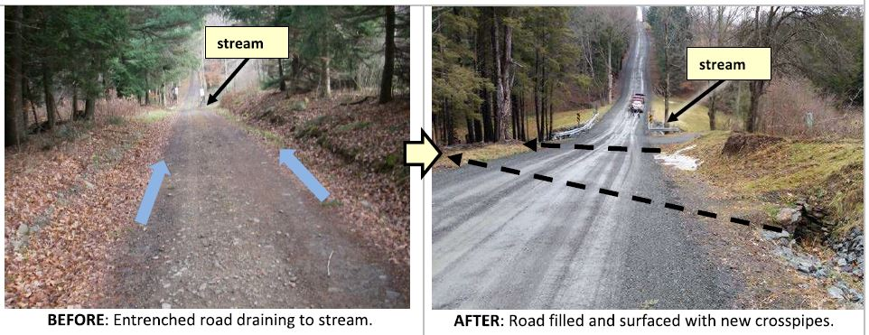
Road Fill
Drainage Disconnection and infiltration are the goals of the DGLVR Program
Hallmarks of the DGLVR program
Keeping sediment & excess runoff out of the stream
Getting water into the ground

Slide 14
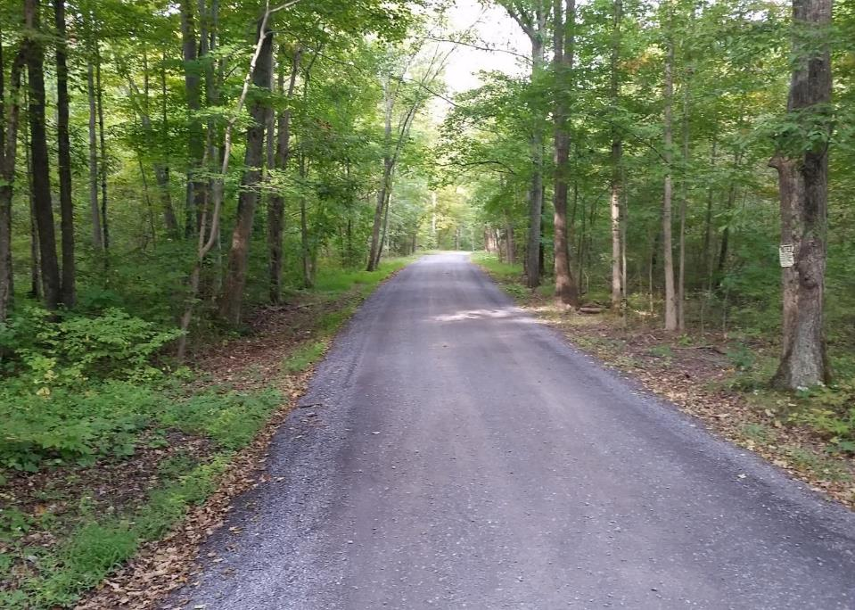
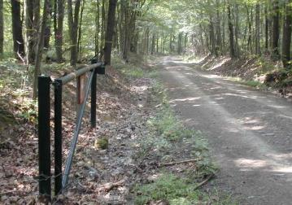
Continuous Fill
2001
2020
long term improvement!
pipes
No ditch!
Huntingdon County – Red Rose Road – 6/6
Notes:
DSA Placed Next Year
A year later the DSA was applied to finish the project.

Slide 15
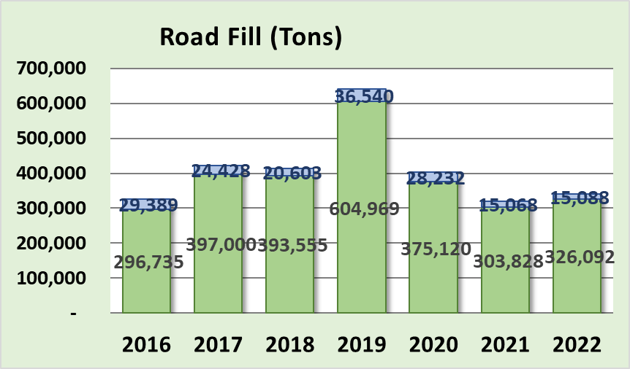
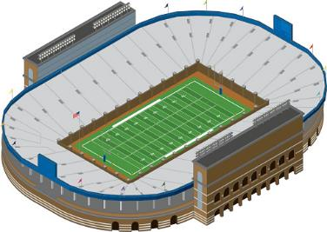
Road Fill
850’ tall
(300’x160’)
Program uses over 300,000 tons annually (13,500+ tri-axles)
Past
5
years
Of
FILL

Slide 16
Road Fill
This is only a quick refresher
Road Fill:
2 Hour Remote Training recorded 5/2021
Recording and PPT Available
www.dirtandgravelroad.org
Education/Training – Remote Learning Center
Background – example projects - fill types – RFP – more

Slide 17
Sectional Fill
Introduction
Continuous Fill
Issues seen with Continuous fill projects
Sectional Fill Alternative
Notes:
Helps With Drainage On Entrenched Roads
This technique can really help with drainage issues on entrenched roads.

Slide 18
Filling the Road
Road Fill
Dollar for Dollar, one of the best drainage improvement practice available when done correctly.
Some issues seen in the field:
Not achieving sheet flow (not enough fill)
Not building above ground elevation
No surface features = water still runs down road even though it is not entrenched
Notes:
Helps With Drainage On Entrenched Roads
This technique can really help with drainage issues on entrenched roads.

Slide 19
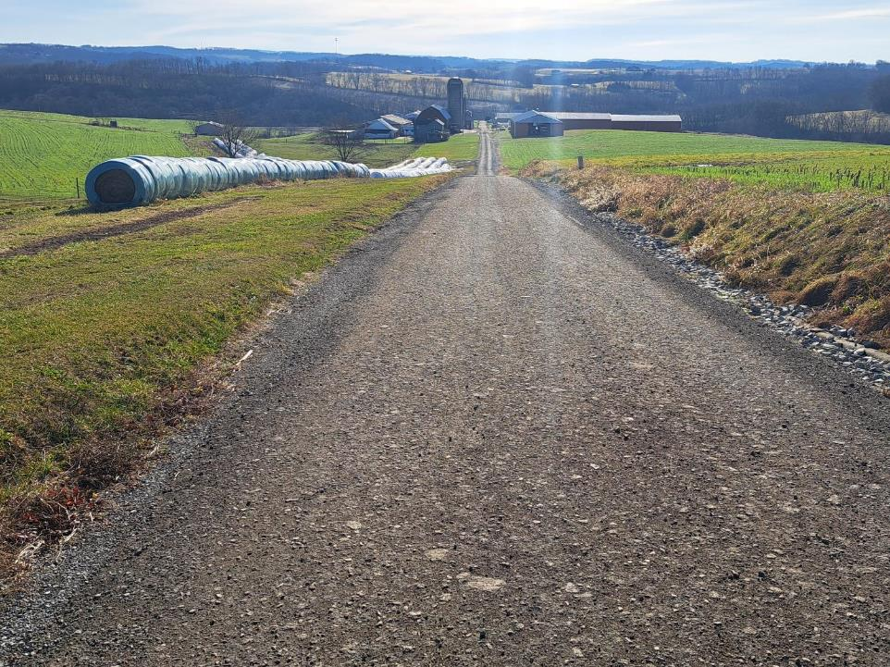
Filling the Road
Completed Project: Road fill & underdrain
Road filled ~18”, but did not achieve sheet flow
Notes:
Entrenched – Both Banks Higher – Water Trapped
An entrenched road is where both banks are higher than the road, and water on the road and ditches can’t escape.

Slide 20
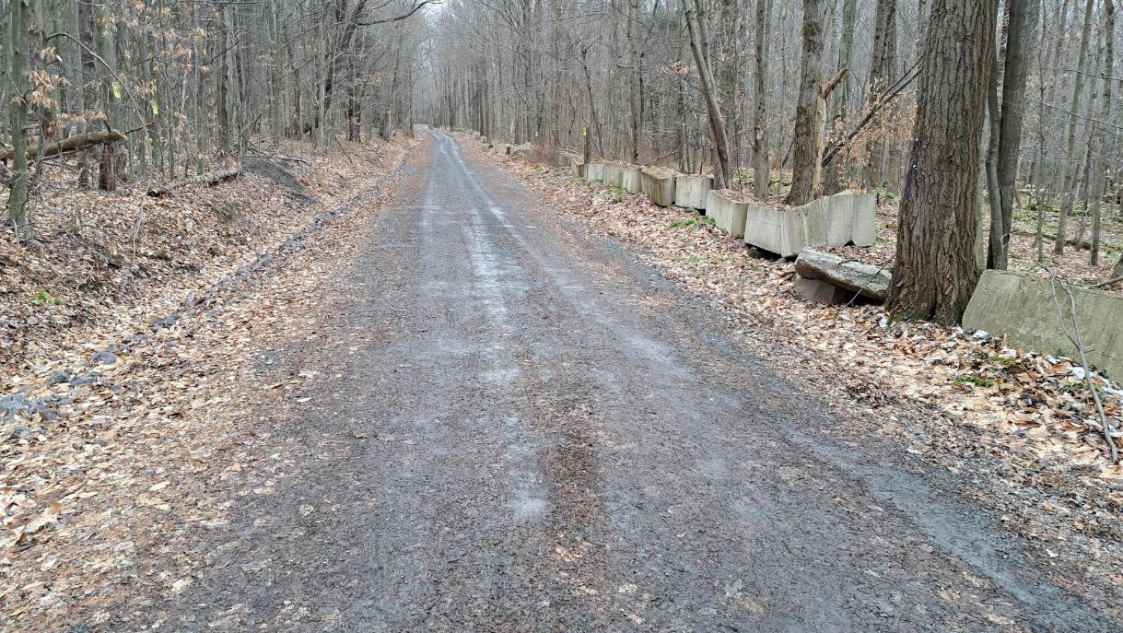
Filling the Road
Completed Project: Road fill & turnouts and ditch stabilization
No grade changes in road to divert runoff
Looks good now (months old), what about in 2 years?
Note this is a dead-end road…likely meaning minimal maintenance to keep crown
Notes:
Entrenched – Both Banks Higher – Water Trapped
An entrenched road is where both banks are higher than the road, and water on the road and ditches can’t escape.

Slide 21
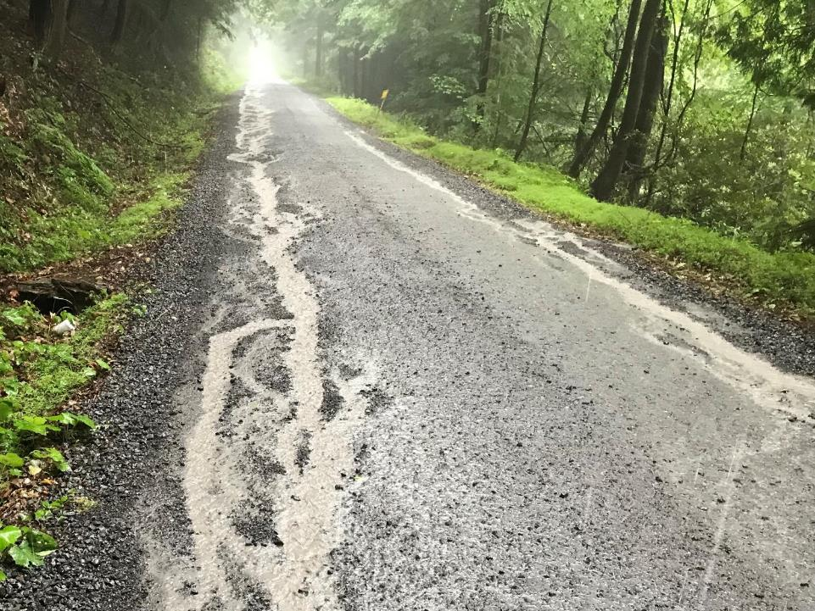
Filling the Road
Lower ground
Pipe is dry
Completed Project (~$100K): Road fill & cross pipes on steep hill
Water is unable to reach ditch or new cross pipes.
Fill higher than lower side of road.
Need grade changes to divert runoff!
Notes:
Entrenched – Both Banks Higher – Water Trapped
An entrenched road is where both banks are higher than the road, and water on the road and ditches can’t escape.

Slide 22
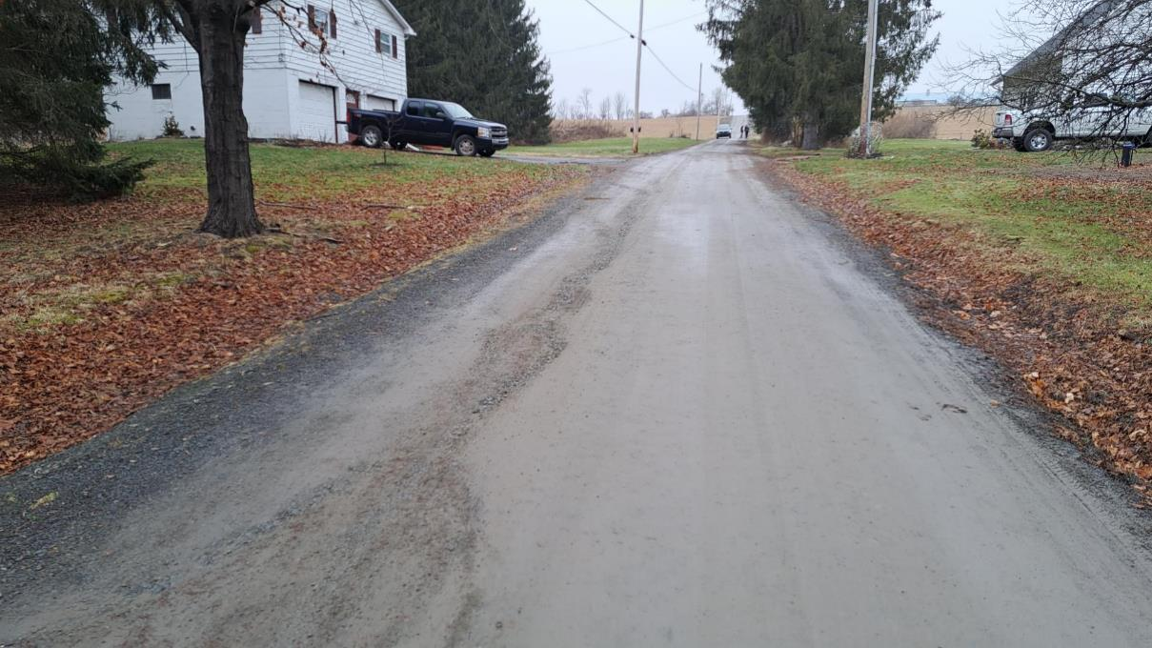
Filling the Road
Completed Project: Road fill & turnouts
After 2 years, water running down road again
Lack of maintenance was again an issue
Notes:
Entrenched – Both Banks Higher – Water Trapped
An entrenched road is where both banks are higher than the road, and water on the road and ditches can’t escape.

Slide 23
Filling the Road
Road Fill
Improvement option 1: Overfill the road
Road Fill settles
Traffic and erosion wear surface away
Ensure sheet flow in year 10, not just year 1
Notes:
Helps With Drainage On Entrenched Roads
This technique can really help with drainage issues on entrenched roads.

Slide 24
Filling the Road
How: Where banks are higher on both sides of the road
Minimum elevation for sheet flow
TOP-SOIL
SUB-SOIL
ROADWAY
Notes:
Entrenched – Both Banks Higher – Water Trapped
An entrenched road is where both banks are higher than the road, and water on the road and ditches can’t escape.

Slide 25
Filling the Road
REDUCED BANK HEIGHT
ELIMINATED BANK
TOP-SOIL
Minimum elevation
FILL
SUB-SOIL
ROADWAY
Notes:
Fill To Eliminate Downslope Bank and Ditch – Can Sheet Flow ½ Road, and Create More Outlet Options For Pipes – Place To Put Snow
By filling the road high enough to eliminate the downslope bank and ditch, water can sheet flow off the downslope side, and pipes from the upslope ditch can be outletted without a high maintenance tail ditch. In addition, you now have some place to put the snow when you plow.

Slide 26
Filling the Road
How: Where banks are higher on both sides of the road
Minor irregularities could still trap water on road surface
TOP-SOIL
SUB-SOIL
ROADWAY
NEW ESM Training Updates for 2023
Notes:
Entrenched – Both Banks Higher – Water Trapped
An entrenched road is where both banks are higher than the road, and water on the road and ditches can’t escape.

Slide 27
Filling the Road
But HIGHER is better!
Better draining & longer lasting.
TOP-SOIL
SUB-SOIL
ROADWAY
NEW ESM Training Updates for 2023
Notes:
Entrenched – Both Banks Higher – Water Trapped
An entrenched road is where both banks are higher than the road, and water on the road and ditches can’t escape.

Slide 28
Filling the Road
REDUCED BANK HEIGHT
ELIMINATED BANK
TOP-SOIL
Higher is better!
FILL
SUB-SOIL
ROADWAY
NEW ESM Training Updates for 2023
Notes:
Fill To Eliminate Downslope Bank and Ditch – Can Sheet Flow ½ Road, and Create More Outlet Options For Pipes – Place To Put Snow
By filling the road high enough to eliminate the downslope bank and ditch, water can sheet flow off the downslope side, and pipes from the upslope ditch can be outletted without a high maintenance tail ditch. In addition, you now have some place to put the snow when you plow.

Slide 29
Filling the Road
Fill Above Existing Terrain:
Goal is to promote long-term sheet flow. Consider settling and future erosion.
Final road elevation should be a foot or more above natural ground for long-term drainage.
Prevents road from eroding below road berms.
Over filling is vital to long-term benefits
Notes:
Helps With Drainage On Entrenched Roads
This technique can really help with drainage issues on entrenched roads.

Slide 30
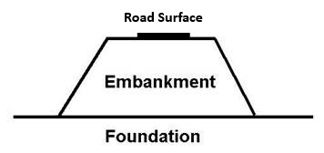
Filling the Road
Fill the hole, build a foundation, and elevate the road surface
Scale exaggerated to show concept
Whenever possible or necessary strive to elevate the road surface by building an embankment
Notes:
Fill To Eliminate Downslope Bank and Ditch – Can Sheet Flow ½ Road, and Create More Outlet Options For Pipes – Place To Put Snow
By filling the road high enough to eliminate the downslope bank and ditch, water can sheet flow off the downslope side, and pipes from the upslope ditch can be outletted without a high maintenance tail ditch. In addition, you now have some place to put the snow when you plow.

Slide 31
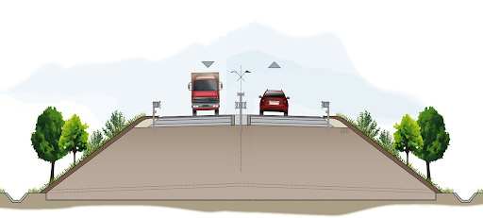
Filling the Road
There is a reason why most major roads are elevated
We can utilize this concept on a smaller scale.
surat-thani-thailand-oct-25-260nw-1095967559
http://www.envicom.eu/en/portfolio-posts/sizing-and-calculation-of-a-supporting-structure-necessary-to-ensure-stability-of-an-embankment-road-infrastructure-2/
Whenever possible or necessary strive to elevate the road surface above the terrain by building an embankment
Notes:
Fill To Eliminate Downslope Bank and Ditch – Can Sheet Flow ½ Road, and Create More Outlet Options For Pipes – Place To Put Snow
By filling the road high enough to eliminate the downslope bank and ditch, water can sheet flow off the downslope side, and pipes from the upslope ditch can be outletted without a high maintenance tail ditch. In addition, you now have some place to put the snow when you plow.

Slide 32
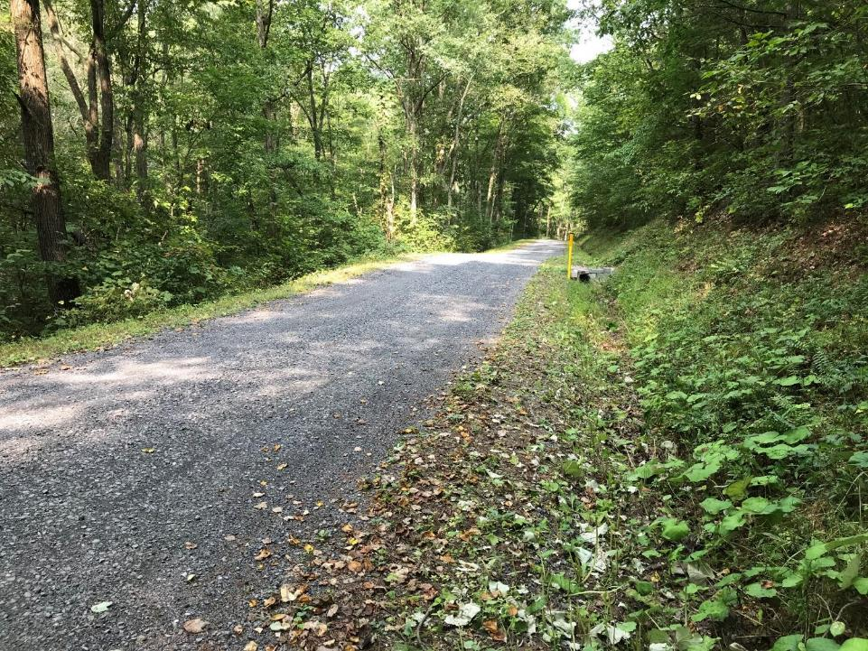
Filling the Road
Strive to elevate the road surface by building an embankment
Often called “turnpiking”
Notes:
Fill To Eliminate Downslope Bank and Ditch – Can Sheet Flow ½ Road, and Create More Outlet Options For Pipes – Place To Put Snow
By filling the road high enough to eliminate the downslope bank and ditch, water can sheet flow off the downslope side, and pipes from the upslope ditch can be outletted without a high maintenance tail ditch. In addition, you now have some place to put the snow when you plow.

Slide 33
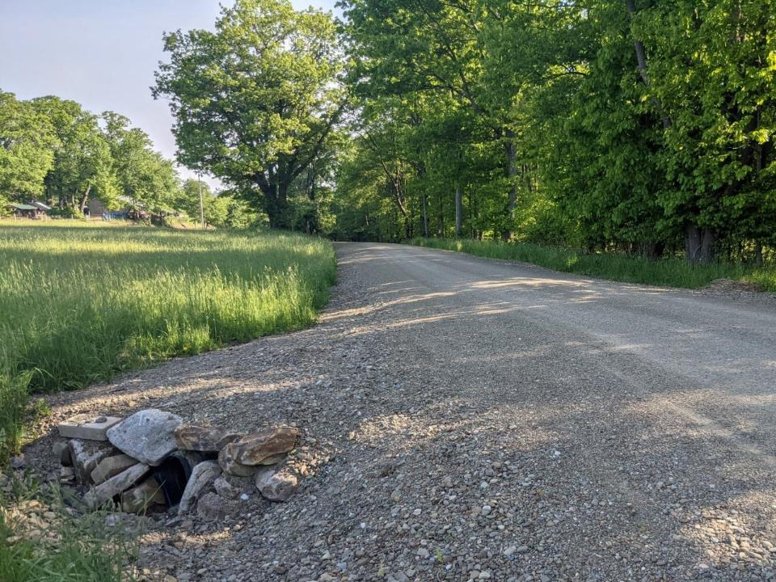
Filling the Road
Strive to elevate the road surface by building an embankment
Often called “turnpiking”
Notes:
Fill To Eliminate Downslope Bank and Ditch – Can Sheet Flow ½ Road, and Create More Outlet Options For Pipes – Place To Put Snow
By filling the road high enough to eliminate the downslope bank and ditch, water can sheet flow off the downslope side, and pipes from the upslope ditch can be outletted without a high maintenance tail ditch. In addition, you now have some place to put the snow when you plow.

Slide 34
Continuous Fill
2001
2020
long term improvement!
pipes
No ditch!
Why does it work 20 years later?
Road Was Overfilled
Included two grade breaks
Maintenance
Notes:
DSA Placed Next Year
A year later the DSA was applied to finish the project.

Slide 35
Filling the Road
Road Fill
Improvement option 2: Sectional Fill
Notes:
Helps With Drainage On Entrenched Roads
This technique can really help with drainage issues on entrenched roads.

Slide 36
Sectional Fill
Introduction
Continuous Fill
Issues seen with Continuous fill projects
Sectional Fill Alternative
Notes:
Helps With Drainage On Entrenched Roads
This technique can really help with drainage issues on entrenched roads.

Slide 37
Sectional Fill
Sectional Fill:
When you can’t fill the entire road due to logistics, lack of material and/or cost
Transition into and out of road fill.
Short section of fill forces ditch turnout and provides cover for a new cross pipe.
Can be more effective and less costly than continuous fill
Notes:
Helps With Drainage On Entrenched Roads
This technique can really help with drainage issues on entrenched roads.

Slide 38
Sectional Fill
Entrenched Road
110
Ditch
Fl ow
D itch
Flow
108
106
104
Figures not drawn to scale.
102
100

Slide 39
Sectional Fill
Entrenched Road
sectional Fill
110
ditch
flow
no fill
ditch
flow
108
106
104
Road
Fill
Figures not drawn to scale.
102
100
no fill

Slide 40
Sectional Fill
110
108
Fill
106
104
No Fill section,
could be 50’, could be 200’
Figures not drawn to scale.
102
Fill
100

Slide 41
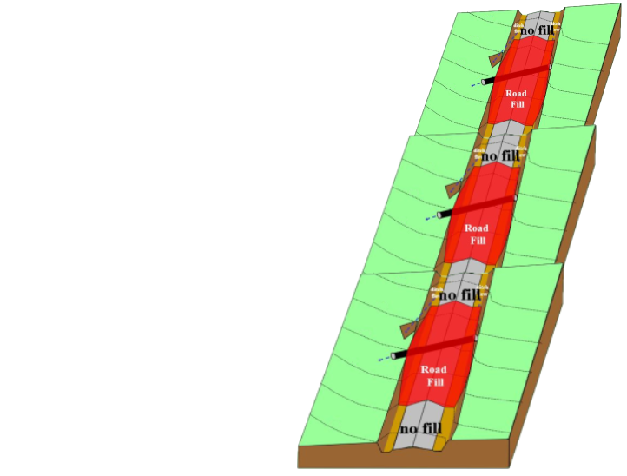
Sectional Fill
Entrenched Road
sectional Fill
On hills, a series of sectional fill sections can be less costly and more effective than filling the full road length
Limitations on steep slopes

Slide 42
Sectional Fill
BEFORE
McKean Cty – Prospect Rd – 1/7

Slide 43
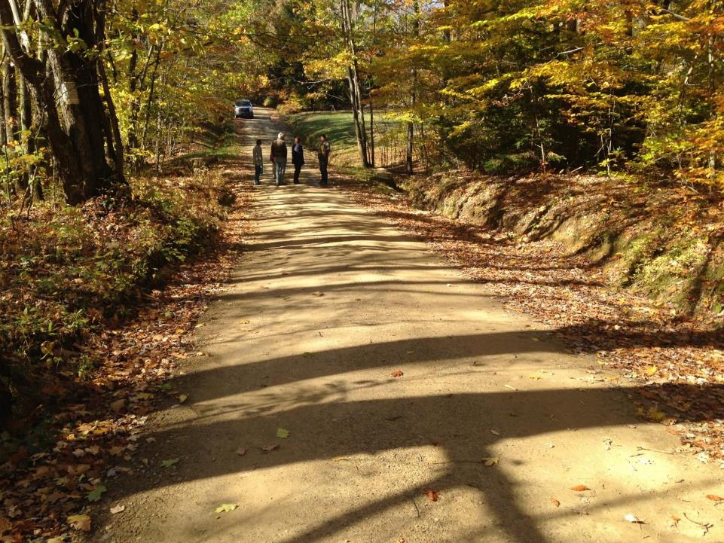
Sectional Fill
McKean Cty – Prospect Rd – 1/7

Slide 44
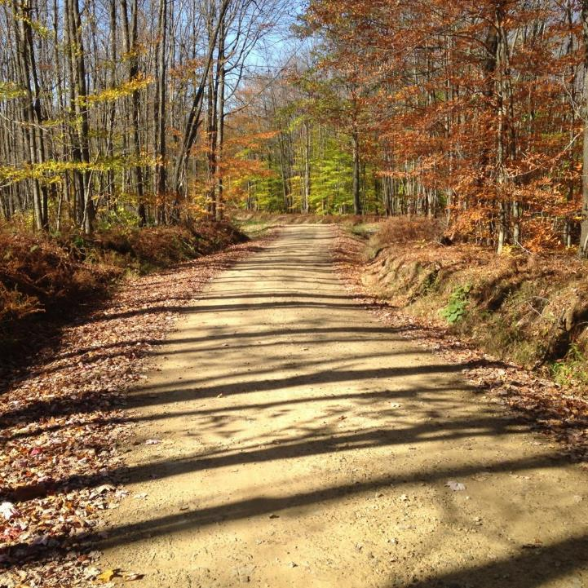
Sectional Fill
BEFORE
McKean Cty – Prospect Rd – 2/7

Slide 45
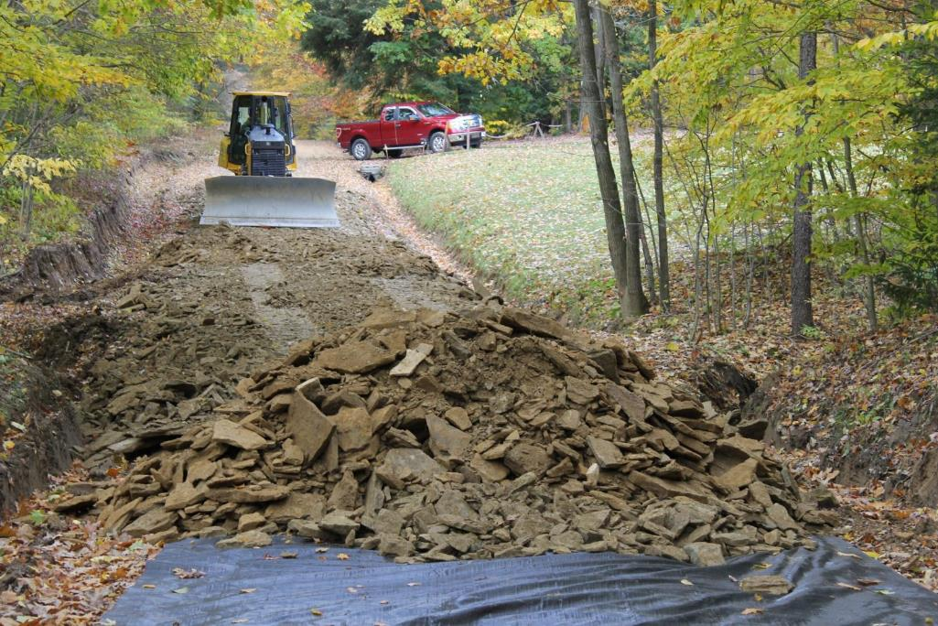
Sectional Fill
Adding Fill
Enough fill used to
build crown
reestablish ditch function
reduce the flow volume reaching stream.
McKean Cty – Prospect Rd – 3/7

Slide 46
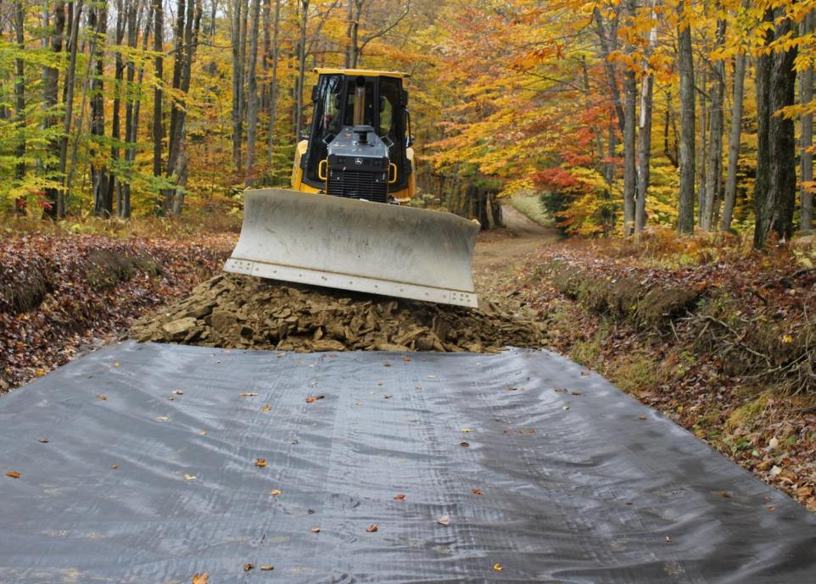
Sectional Fill
At a select location near the project midpoint enough fill is used to create ditch outlets.
McKean Cty – Prospect Rd – 4/7

Slide 47
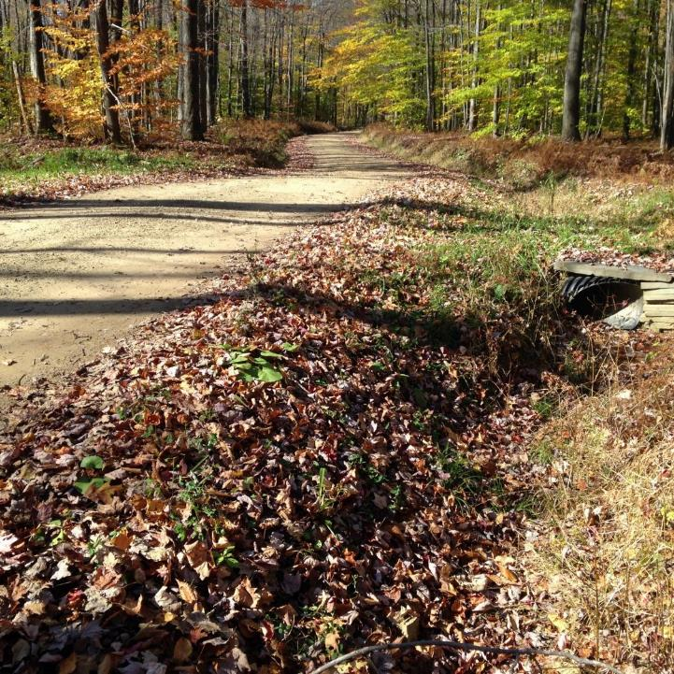
Sectional Fill
A crosspipe and turn-out are installed in the elevated road section.
AFTER
still entrenched here
elevated
Limitations on steep slopes
McKean Cty – Prospect Rd – 5/7

Slide 48
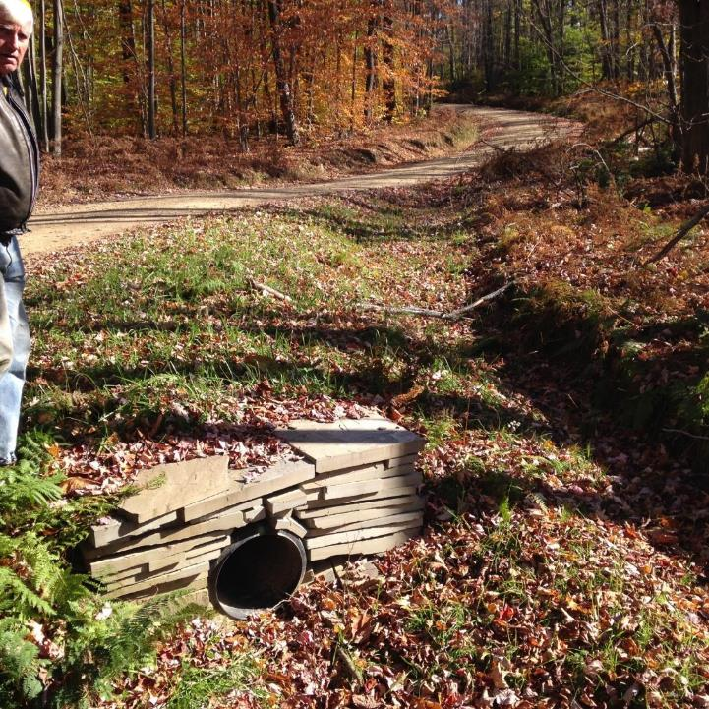
Sectional Fill
Elevated road and ditches relieves ditch flow volumes, reduces erosion and road problems.
AFTER
still entrenched here
elevated
McKean Cty – Prospect Rd – 6/7

Slide 49
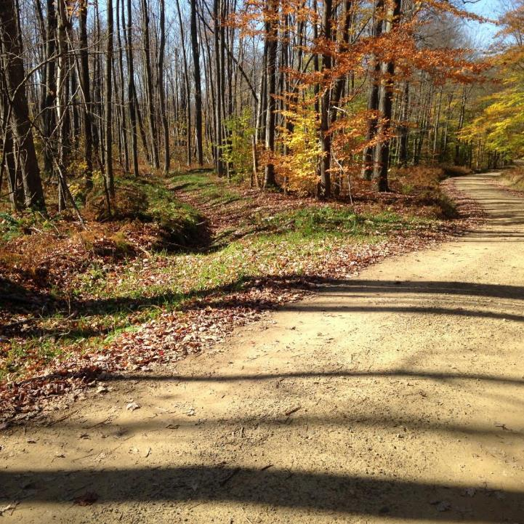
Sectional Fill
Elevated road and ditches relieves ditch flow volumes, reduces erosion and road problems.
AFTER
still entrenched here
elevated
McKean Cty – Prospect Rd – 7/7

Slide 50
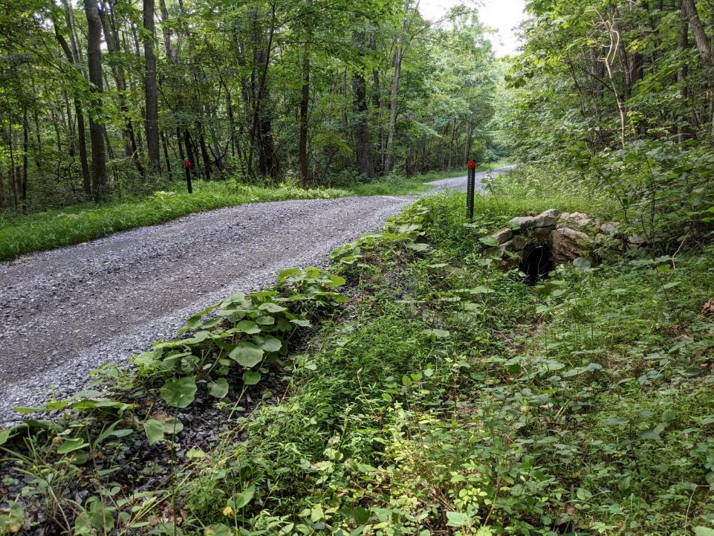
Susquehanna County
Road Fill Overview
No fill
Fill or “extended grade break”
No fill

Slide 51
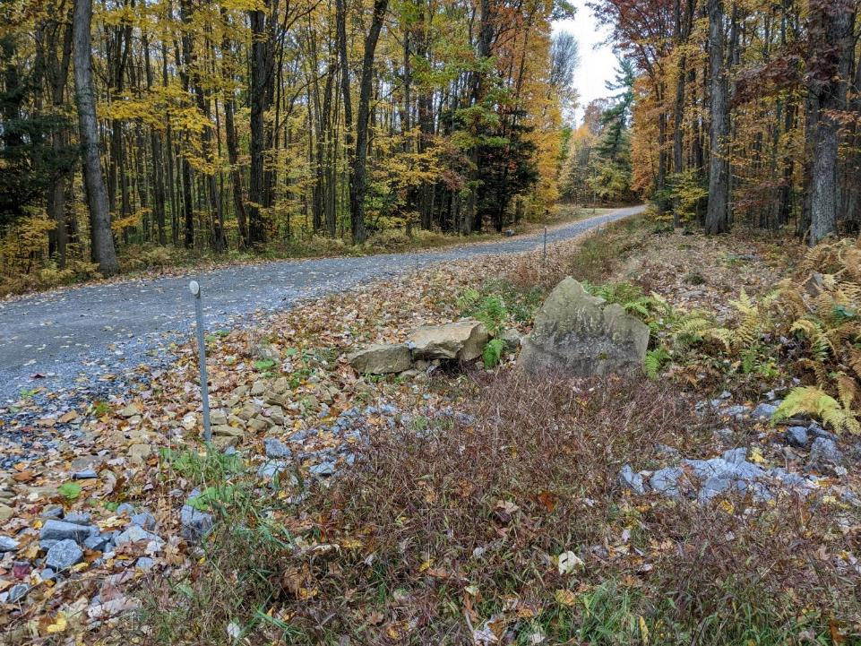
Susquehanna County
Road Fill Overview
No fill
Fill or “extended grade break”
No fill

Slide 52
Sectional Fill
Sectional Fill Advantages:
Less Costly than continuous fill (uses less fill)
Still provides benefits of fill (improves road, allows turnouts and pipes, etc)
More “neglect –proof”: Excellent option in locations where you know maintenance will be limited.
Notes:
Helps With Drainage On Entrenched Roads
This technique can really help with drainage issues on entrenched roads.

Slide 53
Sectional Fill
Sectional Fill Advantages:
Less Costly than continuous fill (uses less fill)
Still provides benefits of fill (improves road, allows turnouts and pipes, etc)
More “neglect –proof”: Excellent option in locations where you know maintenance will be limited.
Continuous Fill Reminders:
Overfill the road (for long term sheet flow)
Use surface drainage features when possible.
Notes:
Helps With Drainage On Entrenched Roads
This technique can really help with drainage issues on entrenched roads.

Slide 54
Questions? Discussion?
Road Fill:
2 Hour Remote Training recorded 5/2021
Recording and PPT Available
www.dirtandgravelroad.org
Education/Training – Remote Learning Center
Background – example projects - fill types – RFP – more
Sectional Fill Advantages:
Less Costly than continuous fill (uses less fill)
Still provides benefits of fill (improves road, allows turnouts and pipes, etc)
More “neglect –proof”: Excellent option in locations where you know maintenance will be limited.
Continuous Fill Reminders:
Overfill the road (for long term sheet flow)
Use surface drainage features when possible.
Notes:
This Section – Bank Management
In this section we will focus on the management of road banks.

