Slide 1
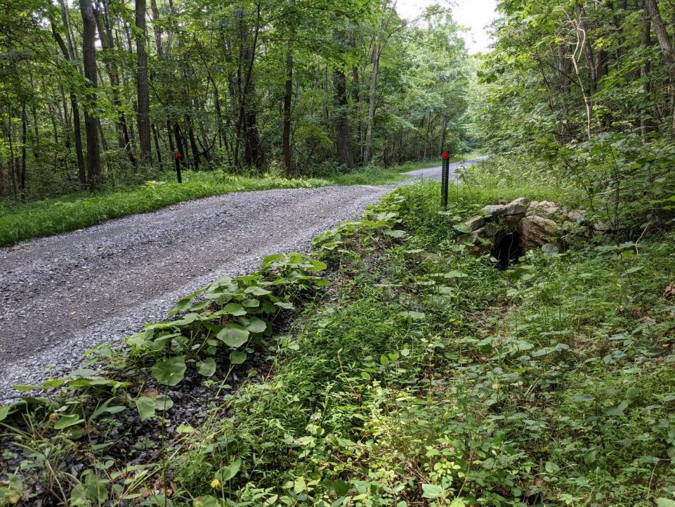
Dirt Gravel and Low Volume Road Program
WEBINAR
3/23/23, 9am
Shallow Crosspipes
CDGRS
Dave Creamer
dmc159@psu.edu
Steve Bloser
smb201@psu.edu
If you are reading this, then you are successfully seeing the webinar video. Webinar audio should be automatic through your computer (or click “join audio”), and options can be accessed in the “audio options” button on the bottom left. If your computer audio is not working, you can listen on your phone by dialing 646-876-9923.

Slide 2
Road Fill
Filling Road Cross-Section
Why Shallow Crosspipes?
Probably one of the most common recommendations on QAQCs:
More and better crosspipes (angle, hw/ew)
Pipes are too deep
Utilize shallow crosspipes
Use grade breaks if possible
Notes:
Helps With Drainage On Entrenched Roads
This technique can really help with drainage issues on entrenched roads.

Slide 3
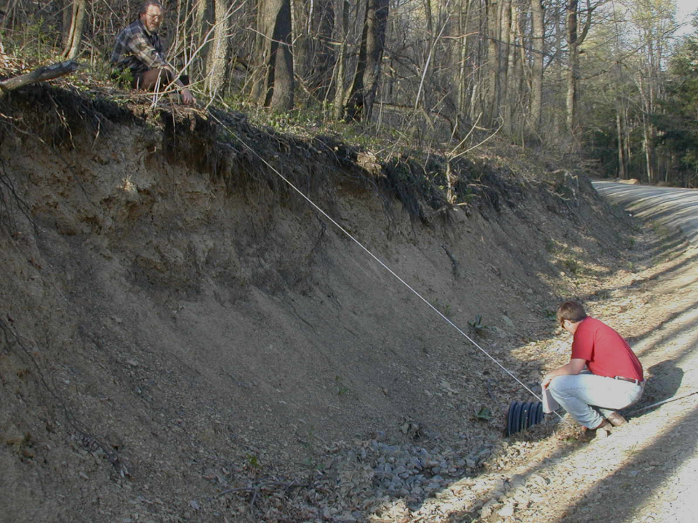
Ditch Outlets: Traditional Practices
Pipes to Deep
Pipe inlet too deep!
Ex 1/5

Slide 4
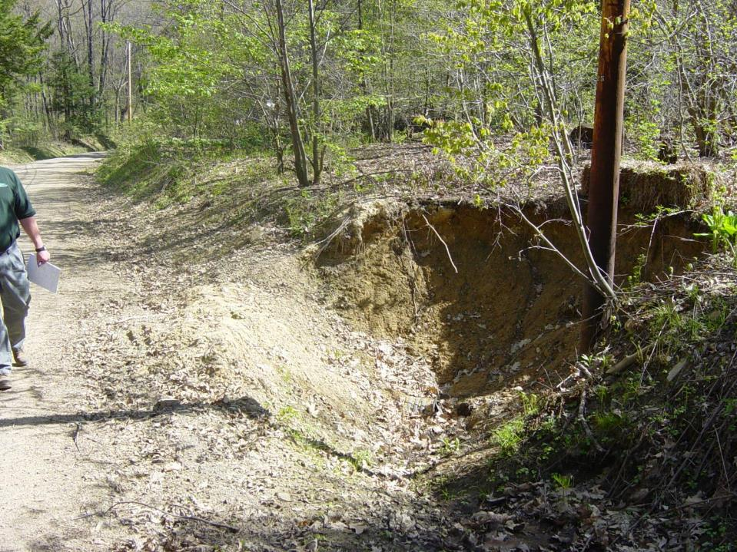
Ditch Outlets: Traditional Practices
Pipes to Deep
Pipe inlet too deep!
Ex 2/5

Slide 5
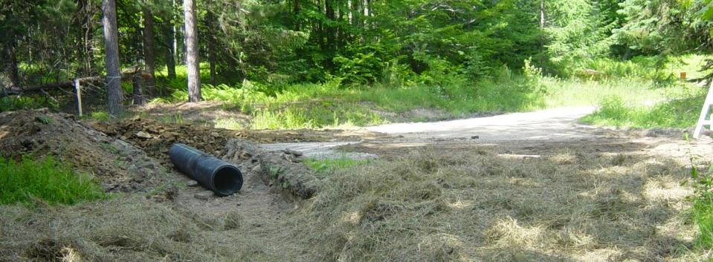
Ditch Outlets: ESMPs
SHALLOW Crosspipes
Shallow Pipe Installation: Installing a crosspipe to outlet at natural ground elevation. This typically involves a shallower trench and additional fill when compared to a traditional installation.
Let’s compare…

Slide 6
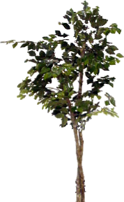
Ditch Outlets: ESMPs
SHALLOW Crosspipes
Traditional “Deep” Installation
Road
Compacted
Pipe
Fill
>12”
31”
31”
15” inside diameter
19”
Natural Ground Elevation
Outlet Trench
Required!

Slide 7
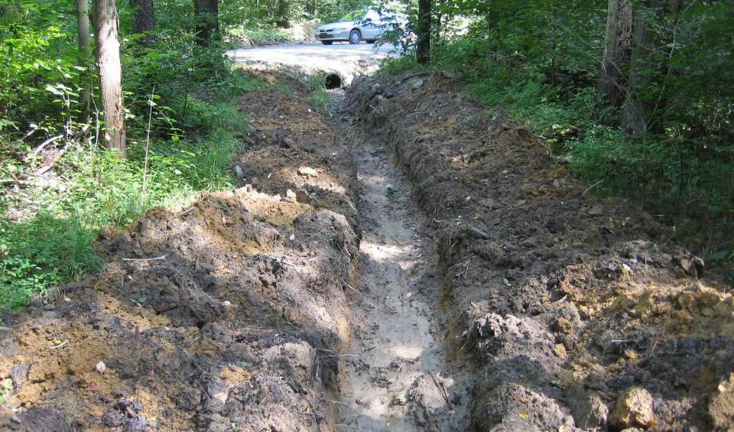
Ditch Outlets: ESMPs
SHALLOW Crosspipes
Traditional “Deep” Installation
Natural Ground Elevation
Outlet Trench
Required!

Slide 8
Ditch Outlets: ESMPs
SHALLOW Crosspipes
Shallow Pipe Installation
Excavate trench

Slide 9
Ditch Outlets: ESMPs
SHALLOW Crosspipes
Shallow Pipe Installation
Compacted
Pipe
Fill
>12”
31”
15” inside diameter
19”
Pipe bottom is at natural ground elevation: No outlet trench!

Slide 10
Ditch Outlets: ESMPs
SHALLOW Crosspipes
Traditional
Shallow
Cover obtained by digging
Cover obtained by filling
new road
Compacted
Pipe Fill
>12”
Road
old road
Compacted
Pipe
Fill
>12”
15” inside diameter
31”
15” inside diameter
Roadbed
Outlet Trench
Required!
Roadbed
Pipe bottom is at natural ground elevation: No outlet trench!

Slide 11
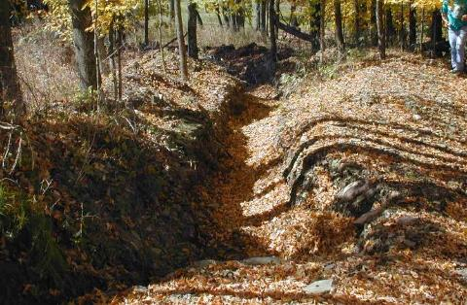
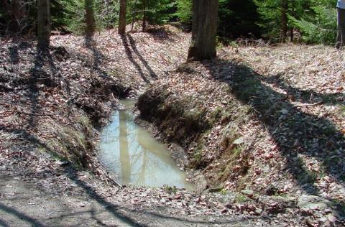
Ditch Outlets: ESMPs
SHALLOW Crosspipes
Why Shallow Pipes?
Outlet water to natural ground instead of into a hole!
Reduce maintenance
Encourage infiltration and recharge
Reduce problems associated with deep pipes

Slide 12
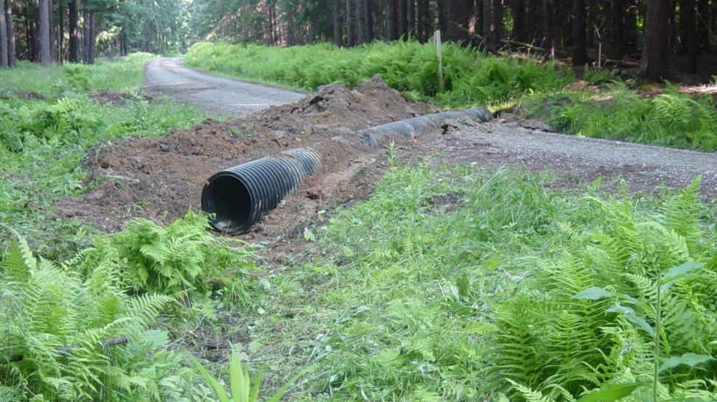
Ditch Outlets: ESMPs
SHALLOW Crosspipes
The Bottom Line:
Don’t use road surface elevation to determine pipe elevation!
Use ground elevation at outlet to determine pipe elevation!

Slide 13
Road Fill
Filling Road Cross-Section
Why Shallow Crosspipes?
This program is all about outlets!
Notes:
Helps With Drainage On Entrenched Roads
This technique can really help with drainage issues on entrenched roads.

Slide 14
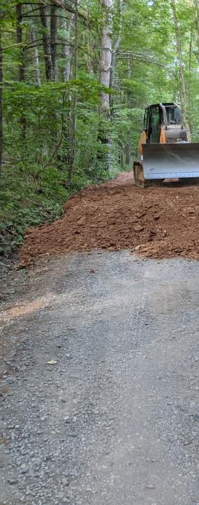
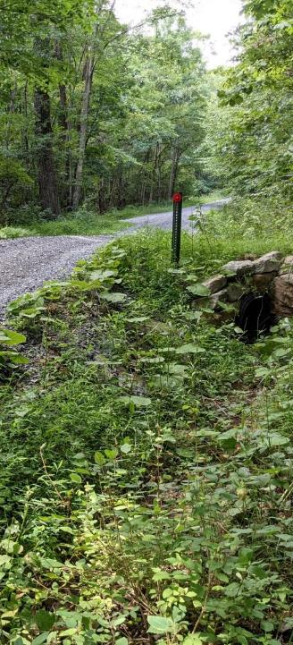
Shallow Crosspipes
Some History
Getting more of them
What do you need in your applications
Tips for a good Installation.
Notes:
Helps With Drainage On Entrenched Roads
This technique can really help with drainage issues on entrenched roads.

Slide 15
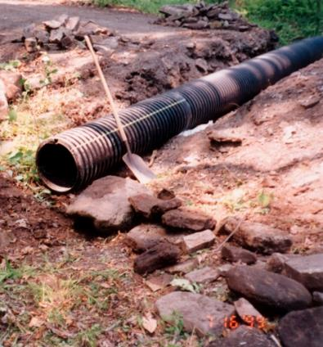
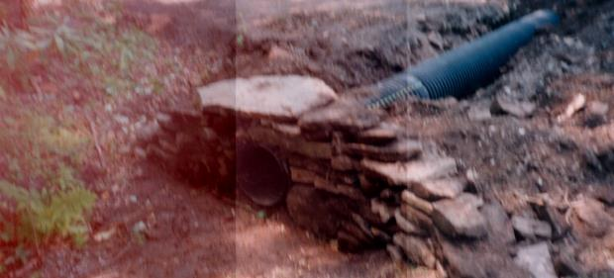
Slide from the 2002 Workshop Orientation

Slide 16
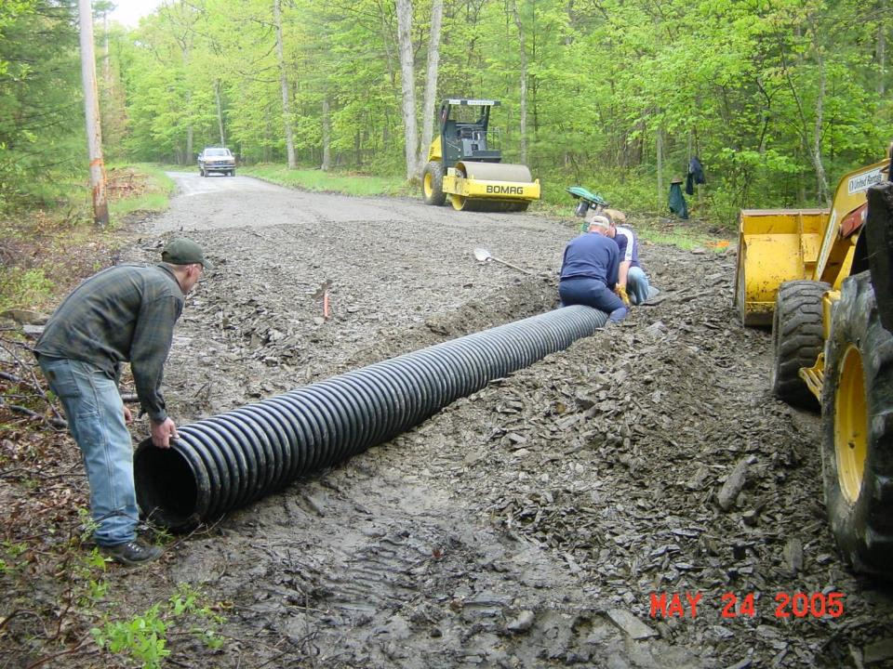
ENVIRONMENTALLY SENSITIVE
MAINTENANCE PRACTICES
SHALLOW Crosspipe Installation

Slide 17
Shallow Crosspipes
Some History
Getting more of them
What do you need in your applications
Tips for a good Installation.
Notes:
Helps With Drainage On Entrenched Roads
This technique can really help with drainage issues on entrenched roads.

Slide 18
Shallow Crosspipes
Give new outlets a lot of points in your ranking.
(Like A lot!)
Talk to landowners yourself.
(It will be insightful and rewarding.)
Notes:
Helps With Drainage On Entrenched Roads
This technique can really help with drainage issues on entrenched roads.

Slide 19
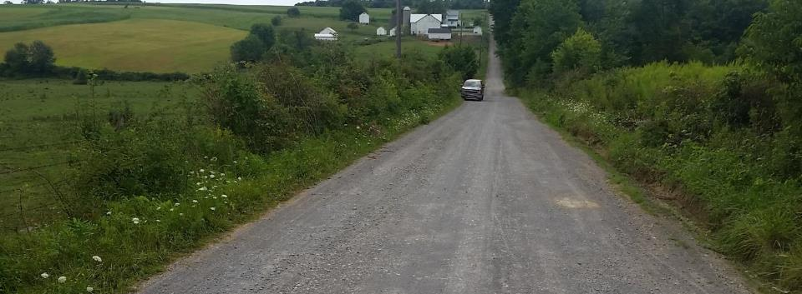
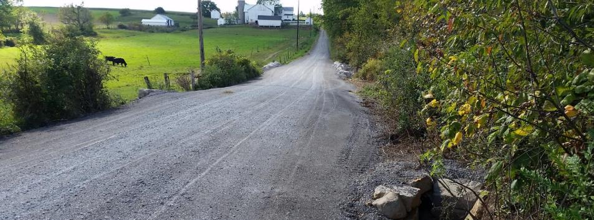
Project from 2015
AFTER
DGR Project in Mercer County: $100K Spent, $6K in kind
Notes:
good

Slide 20
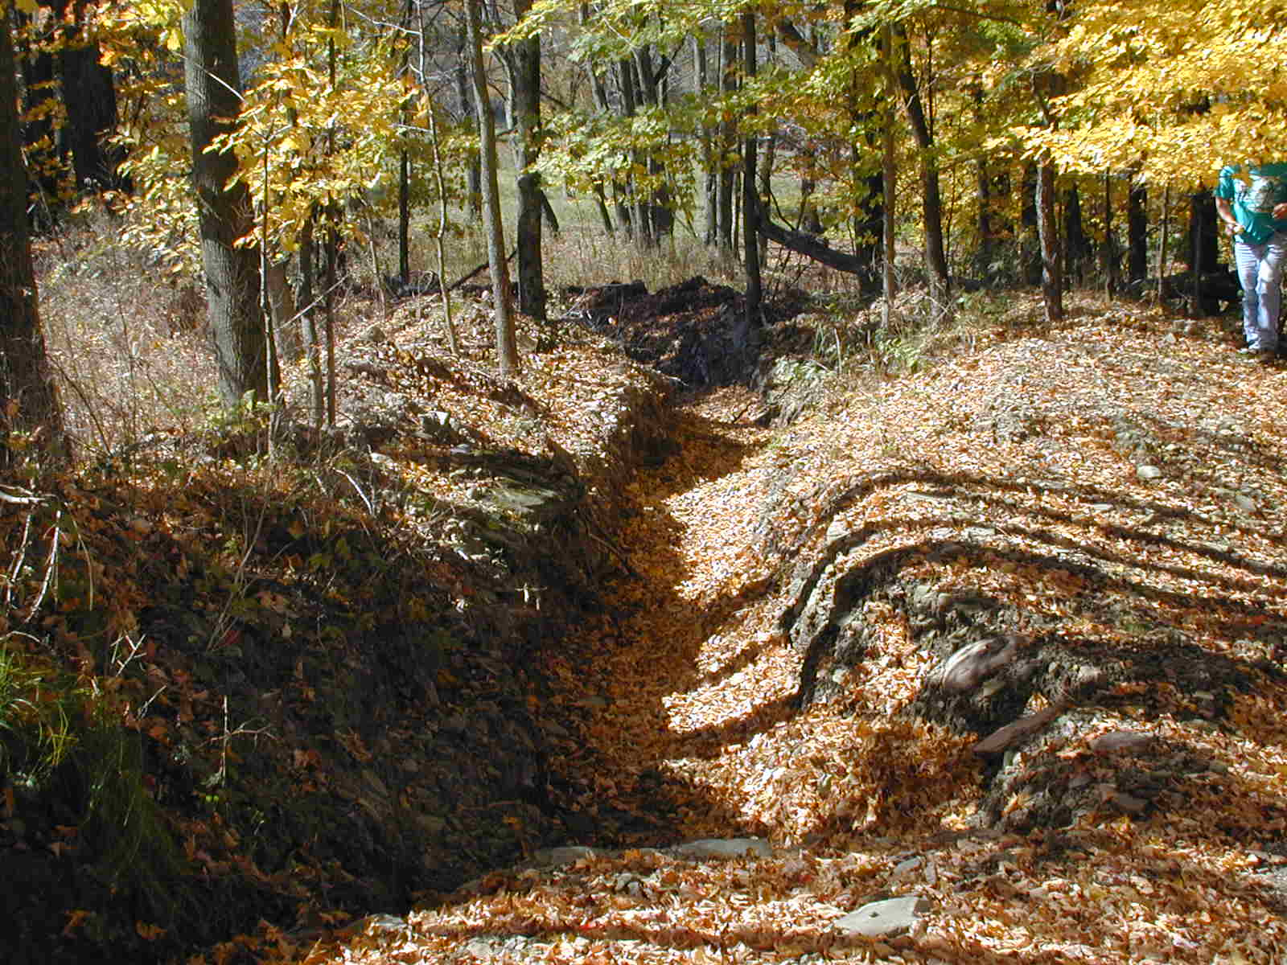
TRADITIONAL ROAD
MAINTENANCE PRACTICES
Pipes too Deep
Pipe outlet too deep!
Ex 3/5

Slide 21
Shallow Crosspipes
Some History
Getting more of them
What do you need in your applications
Tips for a good Installation.
Notes:
Helps With Drainage On Entrenched Roads
This technique can really help with drainage issues on entrenched roads.

Slide 22
Shallow Crosspipes
The Shallow Pipe Requires Cover!
(Think Road Fill)
Notes:
Helps With Drainage On Entrenched Roads
This technique can really help with drainage issues on entrenched roads.

Slide 23
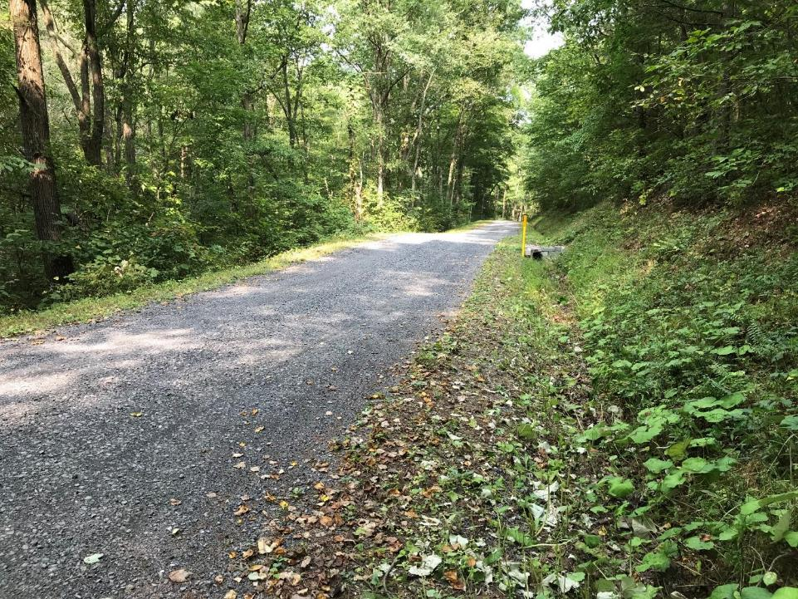
Filling the Road
Pipe outletted at natural ground elevation
Material imported to provide cover
Notes:
Fill To Eliminate Downslope Bank and Ditch – Can Sheet Flow ½ Road, and Create More Outlet Options For Pipes – Place To Put Snow
By filling the road high enough to eliminate the downslope bank and ditch, water can sheet flow off the downslope side, and pipes from the upslope ditch can be outletted without a high maintenance tail ditch. In addition, you now have some place to put the snow when you plow.

Slide 24
Sectional Fill
110
108
Fill
106
104
No Fill section,
could be 50’, could be 200’
Figures not drawn to scale.
102
Fill
100

Slide 25
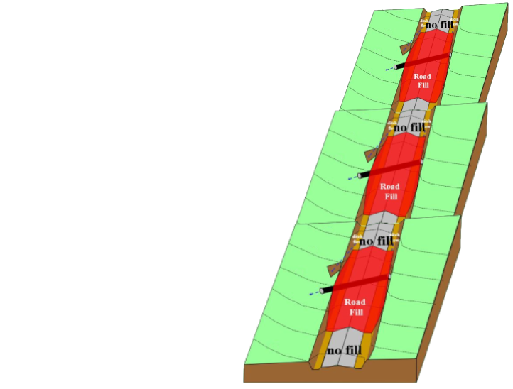
Sectional Fill
Entrenched Road
sectional Fill
On hills, a series of sectional fill sections can be less costly and more effective than filling the full road length
Limitations on steep slopes

Slide 26
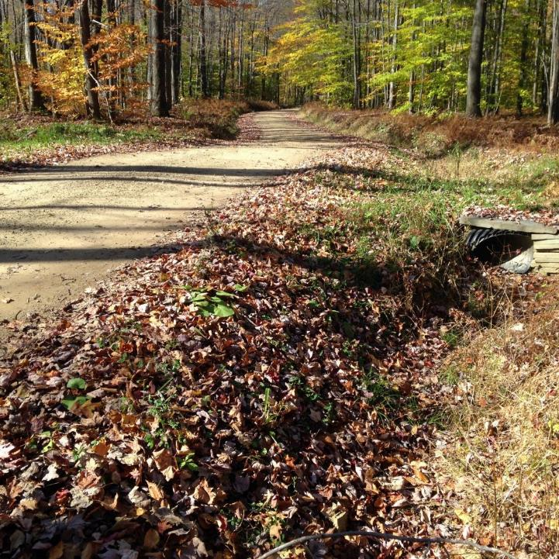
Sectional Fill
A crosspipe and turn-out are installed in the elevated road section.
AFTER
still entrenched here
elevated
Limitations on steep slopes

Slide 27
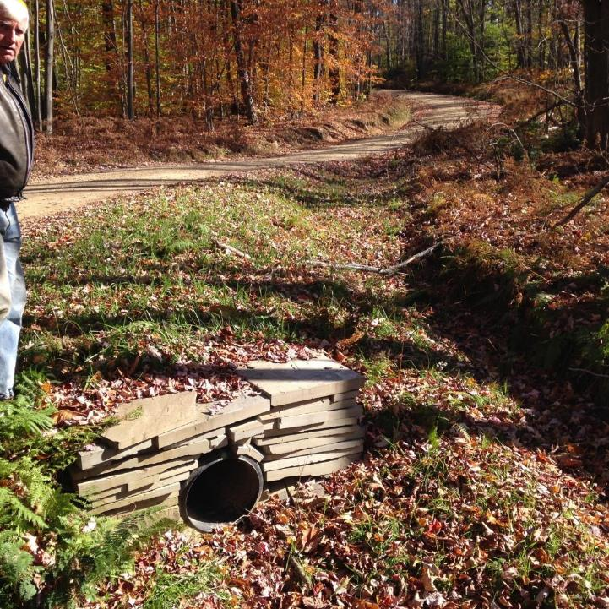
Sectional Fill
Elevated road and ditches relieves ditch flow volumes, reduces erosion and road problems.
AFTER
still entrenched here
elevated

Slide 28
Shallow Crosspipes
The Shallow Pipe Requires Pipe!
Notes:
Helps With Drainage On Entrenched Roads
This technique can really help with drainage issues on entrenched roads.

Slide 29
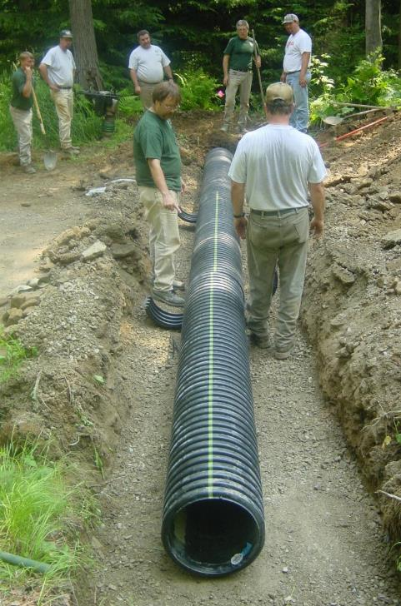
ENVIRONMENTALLY SENSITIVE
MAINTENANCE PRACTICES
12, 15, 18 inch ???
Should always be longer than a traditional pipe.

Slide 30
Shallow Crosspipes
All Pipes Require Head and End Walls!
Notes:
Helps With Drainage On Entrenched Roads
This technique can really help with drainage issues on entrenched roads.

Slide 31
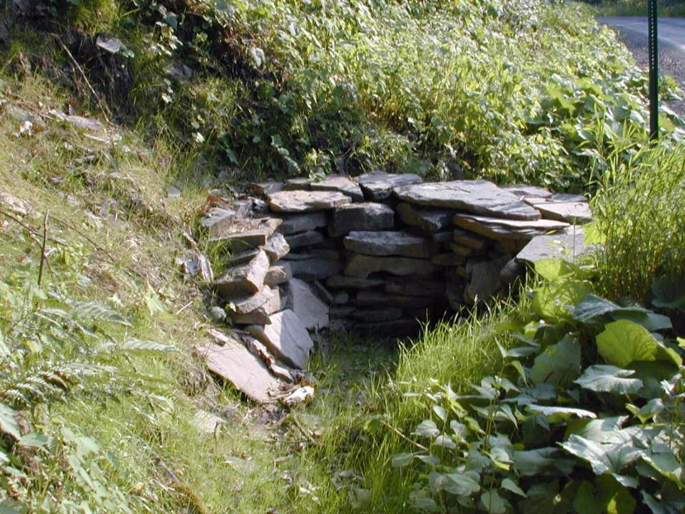
Inlet Protection

Slide 32
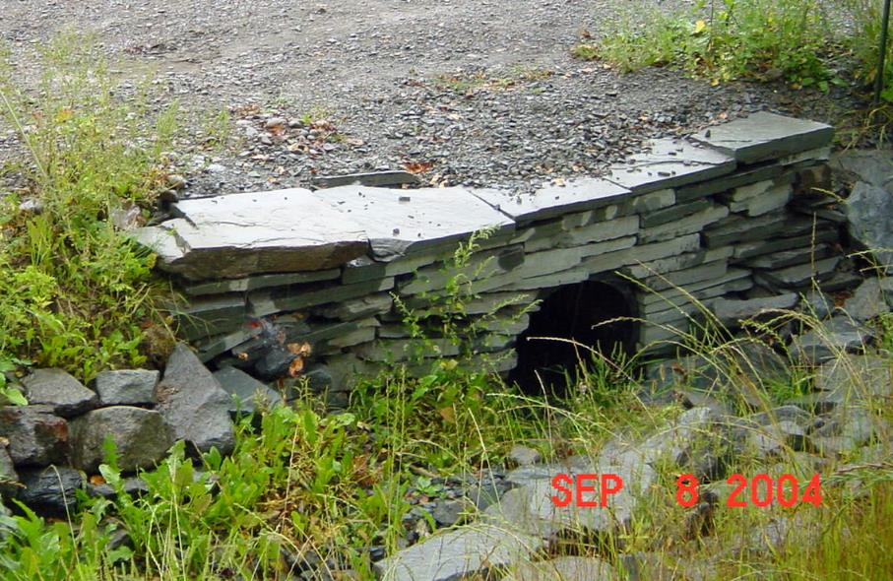
Proper Crosspipe Installation
Inlet and Outlet Protection
Ditch Outlets ESMPs

Slide 33
Shallow Crosspipes
Some History
Getting more of them
What do you need in your applications
Tips for a good Installation.
Notes:
Helps With Drainage On Entrenched Roads
This technique can really help with drainage issues on entrenched roads.

Slide 34
ENVIRONMENTALLY SENSITIVE
MAINTENANCE PRACTICES
Proper Pipe Alignment
Install pipes in direction of flow
Undersized Pipes
bank erosion
ditch flow
road surface
NO
YES
bank erosion
ditch flow

Slide 35
ENVIRONMENTALLY SENSITIVE
MAINTENANCE PRACTICES
Proper Pipe Alignment
ditch flow
road surface
Don’t forget headwalls!
ditch flow

Slide 36
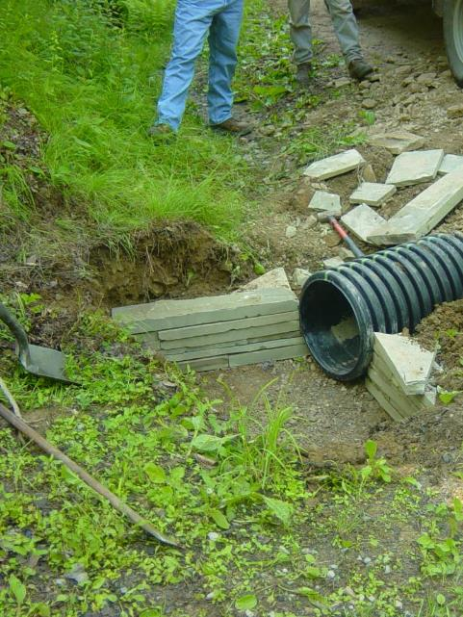
Proper Crosspipe Installation
Place Pipe in Trench
Ditch Outlets ESMPs
Placement:
Inlet should be located in existing ditch line.
Potter

Slide 37
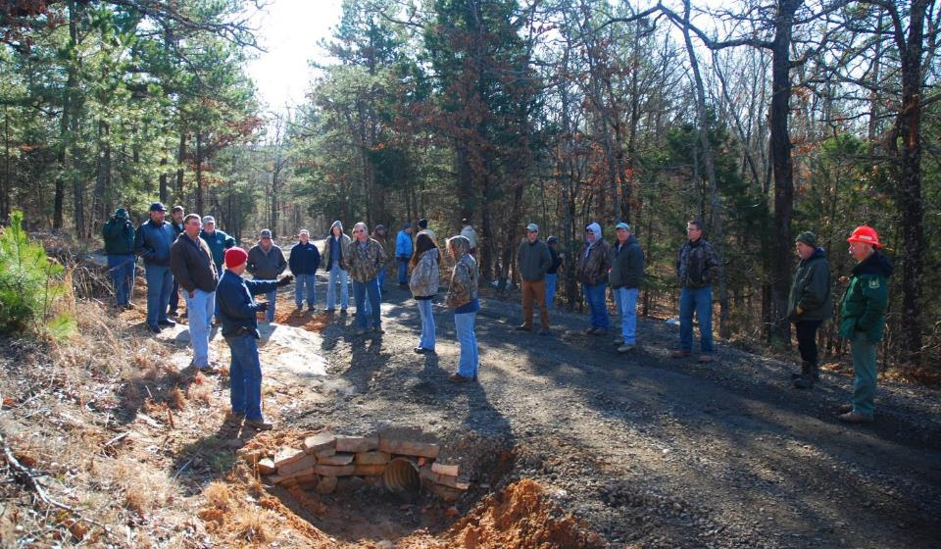
Arkansas Nature Conservancy
“Workshop-like” event sponsored by the Nature Conservancy in Arkansas

Slide 38
Shallow Crosspipes
New Outlets and Road Fill Projects are all ways good Investments.
New outlets need Landowner agreements.
Longer pipes and extra pipe bedding/cover need to included in your grant apps.
Notes:
Helps With Drainage On Entrenched Roads
This technique can really help with drainage issues on entrenched roads.

Slide 39
Shallow Crosspipes
Questions?
Notes:
Helps With Drainage On Entrenched Roads
This technique can really help with drainage issues on entrenched roads.

