Slide 1
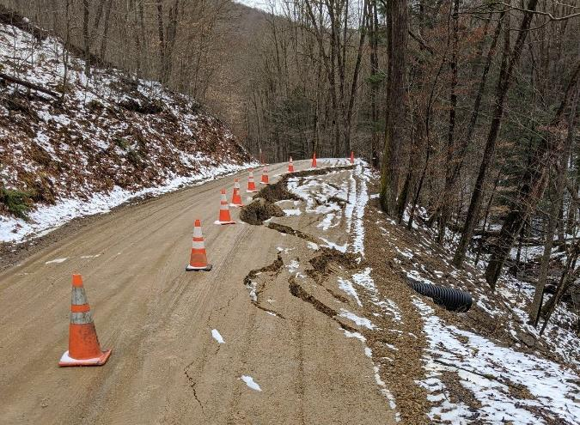
Dirt Gravel and Low Volume Road Program
January 26, 2023
9am
Small Slip and Slide Repair
CDGRS
Tim Ziegler
tmz115@psu.edu
Thanks to Sullivan and Cameron County for example projects
If you are reading this, then you are successfully seeing the webinar video. Webinar audio should be automatic through your computer (or click “join audio”), and options can be accessed in the “audio options” button on the bottom left. If your computer audio is not working, you can listen on your phone by dialing 312-626-6799.

Slide 2
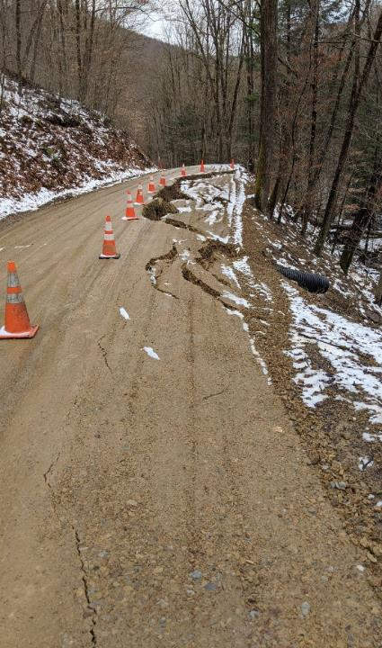
Small Slip and Slide Repair
The Basics
A Plan of Attack
Example 1: Sizer Run Rd & Hunts Run Rd, Cameron County
Example 2: Lick Creek Rd, Schrader Creek Rd, South Black Creek Rd Sullivan County
Credit: Cameron County CD

Slide 3
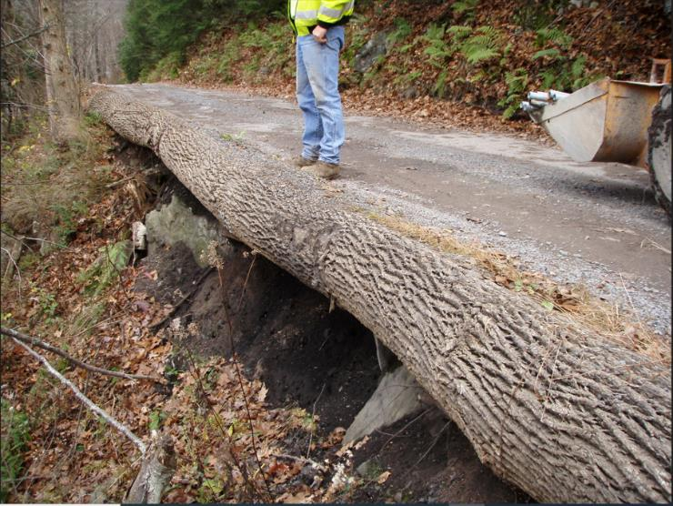
Small Slide and Slip Repair
Diagnosing types and causes of roadside slope instability
and simple, cost-effective techniques for road bank repair
Credit: Pike County CD

Slide 4
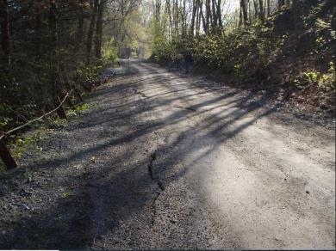
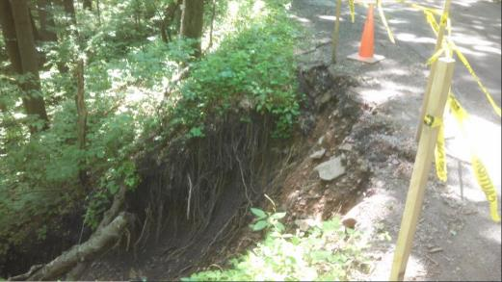
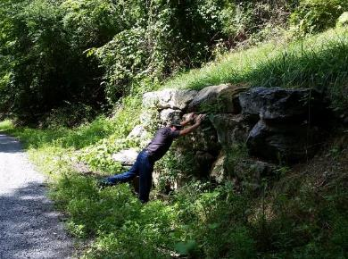
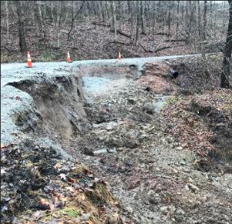
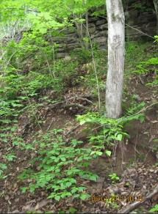
Small Slide and Slip Repair
Don’t let your most valuable assets slip away from you!

Slide 5
Small Slide and Slip Repair
A User Guide to Diagnosing and Repairing Failing Road Banks
This guide describes common slope failures, the conditions that contribute to the failures and stabilization techniques that can be used to repair damaged slopes.
The guide reviews common causes of slope failure and methods of stabilizing slopes based on local site conditions, such as type of slope failure, type of soil, and drainage.
Scenarios for eight common slope failures are presented based on combinations of the site conditions.
As you will see, the recommended remedy for most all small slope failures is the same or similar in all the scenarios.
https://dot.state.mn.us/research/reports/2017/201717G.pdf

Slide 6
Small Slide and Slip Repair
A User Guide to Diagnosing and Repairing Failing Road Banks
Slopes can be stabilized by adding a surface cover to the slope, excavating, and changing (or regrading) the slope geometry, adding support structures to reinforce the slope, or using drainage to control the groundwater in slope material.
Three site conditions should be considered when choosing an appropriate method for stabilizing a slope:
• Type of slope failure
• Type of soil
• Presence of groundwater (poor drainage)

Slide 7
Small Slide and Slip Repair
Type of Slope Failure:
Slope failure is generally classified as either a rotational slide or a surficial soil creep.
Rotational slide failures
circular pattern
leave behind exposed soil
Creep failures
slow‐moving
material gradually moves downhill
Surface cracking can indicate the slope is nearing a rotational slide failure.
Common causes of creep failure are seasonal freeze‐thaw cycles and inadequate shear strength properties in soil. Bent trees or signs can indicate creep failure.

Slide 8
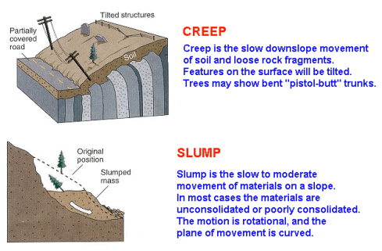
Small Slide and Slip Repair
Type of Slope Failure:
(Rotational Slide)

Slide 9
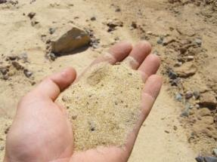
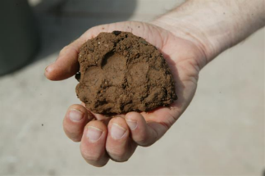
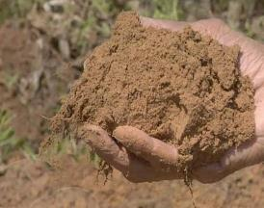
Small Slide and Slip Repair
Type of Soil:
Two soil types to consider:
Cohesive soils (such as silt and clay)
Granular soils (sand)
Soil types can often be distinguished by a visual inspection, but sometimes laboratory testing is required.
Slopes made of granular or sandy soil are less likely to experience deep rotational slides.
Slopes made of cohesive soils like clay and silt usually have more drainage concerns and are more susceptible to seasonal frost heave.

Slide 10
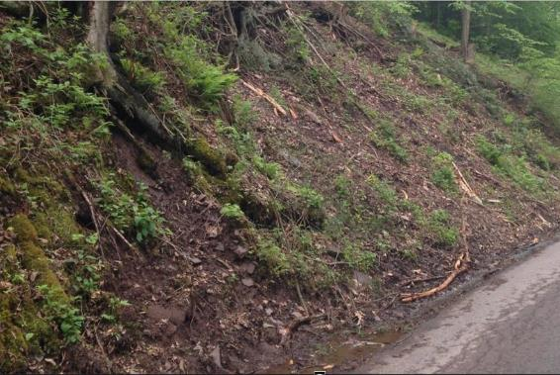
Small Slide and Slip Repair
Presence of Groundwater (poor drainage):
The third major site condition that affects a slope is poor drainage. Drainage is considered poor if groundwater lowers soil shear strength and leads to failure.
Groundwater has a significant effect on shear strength. In the research study, removing groundwater provided the greatest difference in the output factor of safety.

Slide 11
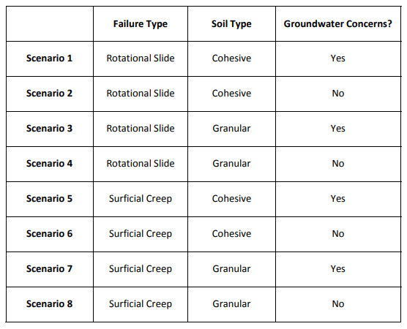
Small Slide and Slip Repair
Diagnosing the Cure:
Determining the site conditions that most closely match the type of slope failure, type of soil, and presence of groundwater will guide you to one of eight practical repair methods to use.

Slide 12
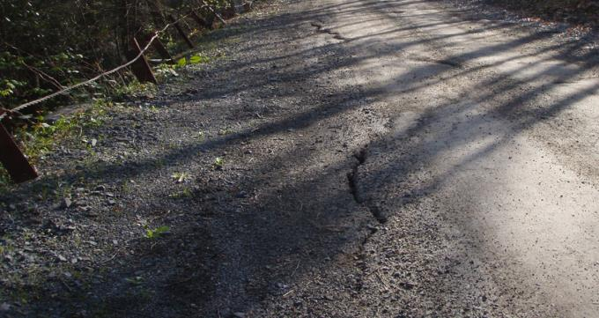
Small Slide and Slip Repair
Diagnosing the Cure:
To determine the appropriate scenario:
First, determine the failure type (rotational or creep).
Next, choose the soil type of the slope material (cohesive or granular).
Then determine whether groundwater is present at the site.
*Note: “Poor drainage” is interchangeable with “groundwater concerns.”
Credit: Pike County CD

Slide 13
Small Slip and Slide Repair
The Basics
A Plan of Attack
Example 1: Sizer Run Rd & Hunts Run Rd, Cameron County
Example 2: Lick Creek Rd, Schrader Creek Rd, South Black Creek Rd Sullivan County
Credit: Cameron County CD

Slide 14
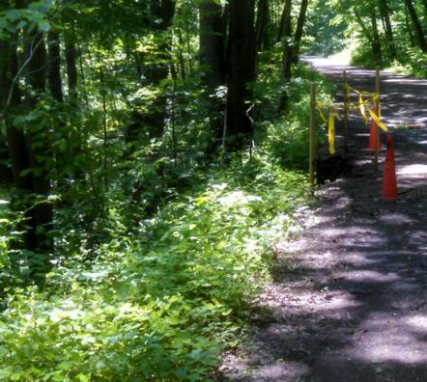
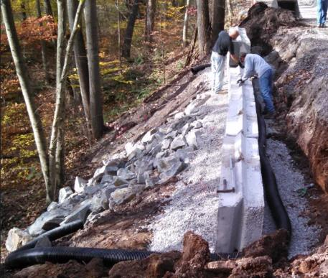
Small Slide and Slip Repair
Plan of Attack:
Scenarios 1 through 4-
Site Conditions:
Rotational failure
Cohesive or sandy soil
With or without groundwater concerns
Recommended Stabilization Approach for all small rotational failures:
Remove and replace poor soils
Add drainage features
Add vegetative cover, hard armoring or both (hard armor sandy soils to prevent erosion)

Slide 15
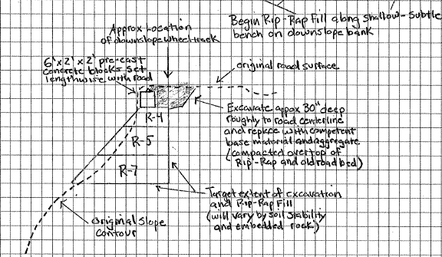
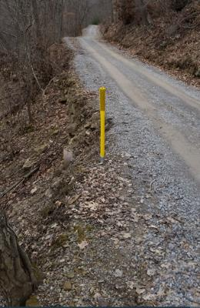
Small Slide and Slip Repair
Plan of Attack:
Drainage features remove groundwater
Fill‐and‐regrade work adds stability
Place drains near the toe of the slope
If significant rotational failure has already occurred, rebuild the slope with as low of a slope angle as possible.

Slide 16
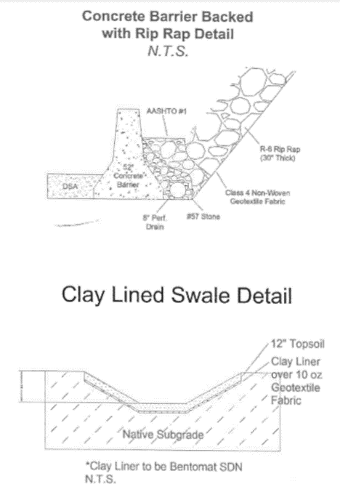
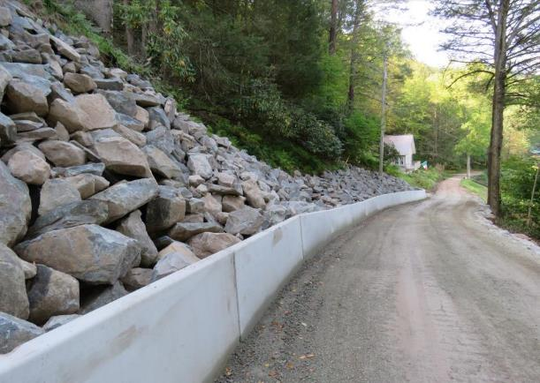
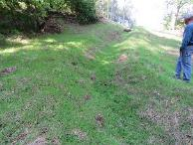
Small Slide and Slip Repair
Plan of Attack:
Specific to Sandy Soils:
Surface cover is very important for slopes with granular soil because erosion is a concern. Surface erosion can cause geometric inconsistencies that lead to failure. Erosion can often cause washout failure. Use a hard armor surface cover (riprap or coarse gravel).
Credit: Wayne County CD

Slide 17
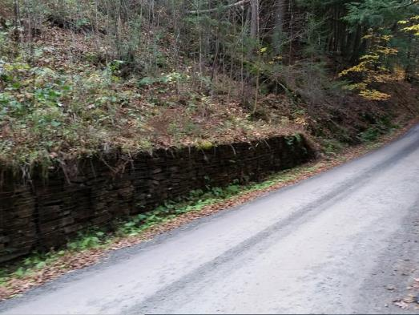
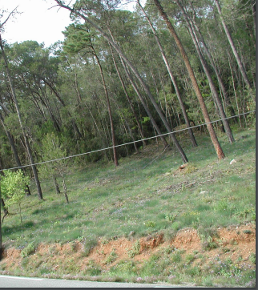
Small Slide and Slip Repair
Plan of Attack:
Scenarios 5 through 8-
Site Conditions:
Creep failure
Cohesive or sandy soil
With or without groundwater concerns
Recommended Stabilization Approach for all small creep failures:
Remove and replace poor soils
Add drainage features
Add vegetative cover, hard armoring or both (hard armor sandy soils to prevent erosion)
Credit: Wayne County CD

Slide 18
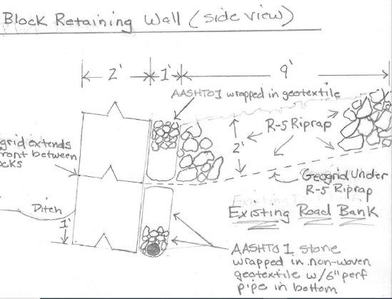
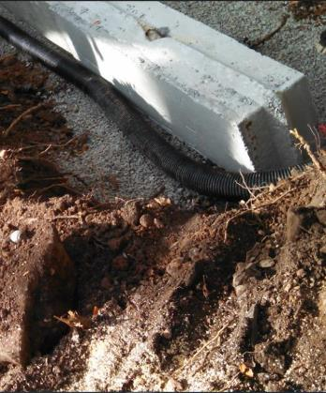
Small Slide and Slip Repair
Plan of Attack:
Drainage features remove groundwater
Fill‐and‐regrade work adds stability
Place drains near the toe of the slope
For creep failures, if soil cannot be removed and replaced, use a buttress at toe of the slope to stabilize the bank.

Slide 19
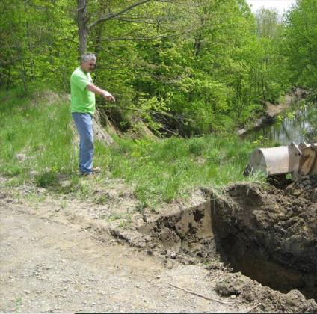
Small Slide and Slip Repair
Plan of Attack:
Repair for Rotational Failures (Slumps)
With blocks, geosynthetics, competent fill, drainage, and cover (to control erosion)
Must excavate below slip plane

Slide 20
Small Slide and Slip Repair
Plan of Attack:
Repair for Rotational Failures (Slumps)
With Riprap, geosynthetics, drainage
Must excavate below slip plane

Slide 21
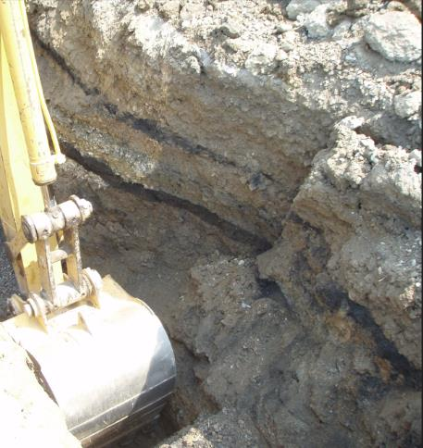
Small Slide and Slip Repair
Plan of Attack:
Repair for Creep Failures (Ooze)
With block, riprap, geosynthetics, drainage
Must excavate below slip plane
Buttress

Slide 22
Small Slide and Slip Repair
Plan of Attack:
Repair concerns for all slope failures:
Bank instability caused by over-steepening can often be corrected by “laying the bank back” (shaping to a lesser grade). Most common on upslope road banks.
Loss of a stable toe from aggressive ditch cleaning, streambank erosion, etc. can trigger slope failure.
Adding drainage features to your stabilization plan is cheap insurance against unforeseen problems.
Don’t underestimate the value of vegetation (or lack of) in maintaining bank stability, especially woody vegetation.
Don’t forget the benefits of fill to address bank instability…..

Slide 23
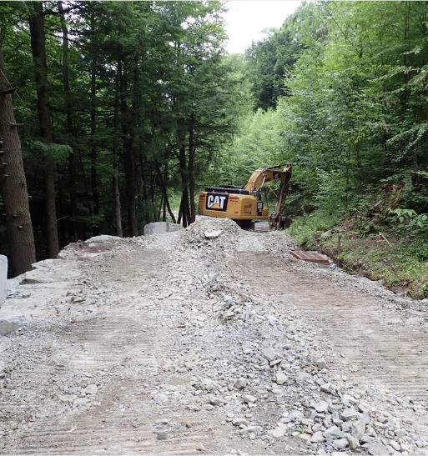
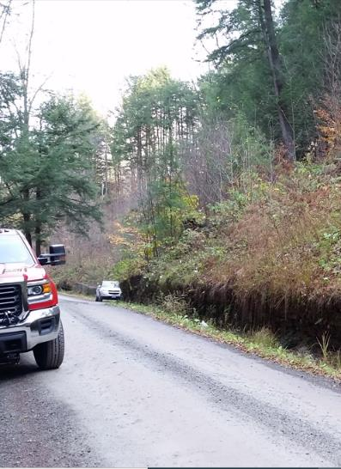
Small Slide and Slip Repair
Fall Brook Road Fill Slope Stabilization Project
Credit: Wayne County CD

Slide 24
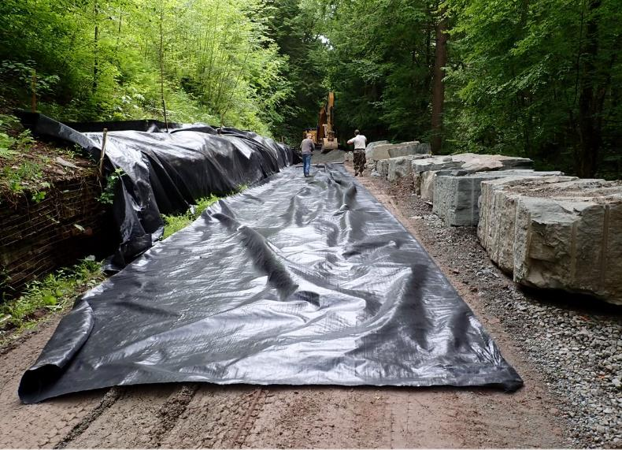
Small Slide and Slip Repair
Fall Brook Road Fill Slope Stabilization Project
Credit: Wayne County CD

Slide 25
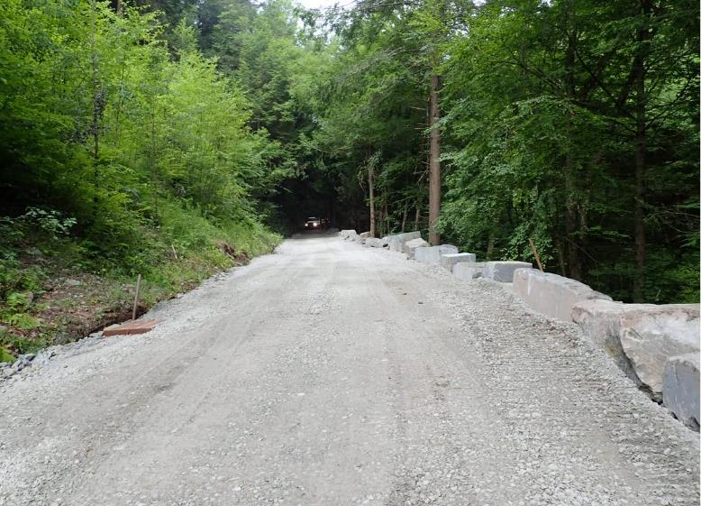
Small Slide and Slip Repair
Fall Brook Road Fill Slope Stabilization Project
Knee replacement, hip replacement, toe replacement…
Credit: Wayne County CD

Slide 26
Small Slip and Slide Repair
The Basics
A Plan of Attack
Example 1: Sizer Run Rd & Hunts Run Rd, Cameron County
Example 2: Lick Creek Rd, Schrader Creek Rd, South Black Creek Rd Sullivan County

Slide 27
Geosynthetic Reinforced Soil (GRS) Slide Repair
Credit: Cameron County CD

Slide 28
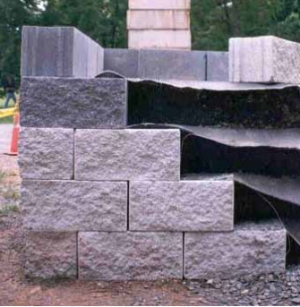
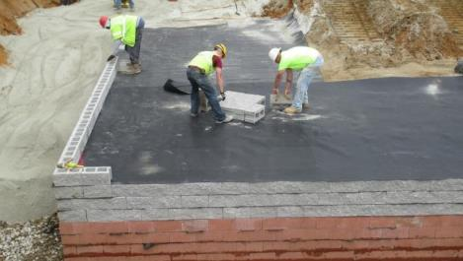
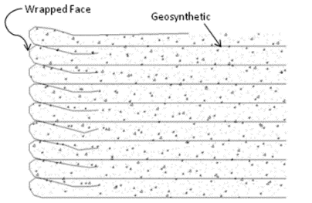
Geosynthetic can be wrapped or pinched between facing block/rock
Credit: Cameron County CD

Slide 29
Benefits of GRS
Cost $$$
Traditional fixes are pricey
Significant resources
Specialized equipment
Done with readily available materials
Can typically be done with township labor
Can be completed in few days
GRS repairs are not applicable to all sites
Credit: Cameron County CD

Slide 30
Sizer Run – Shippen Township
200’ long 8’ high
Used Contractor for implementation
90 concrete blocks
2 new pipes
24 loads of 2RC
4 Days to complete
$23,200.00
Credit: Cameron County CD

Slide 31
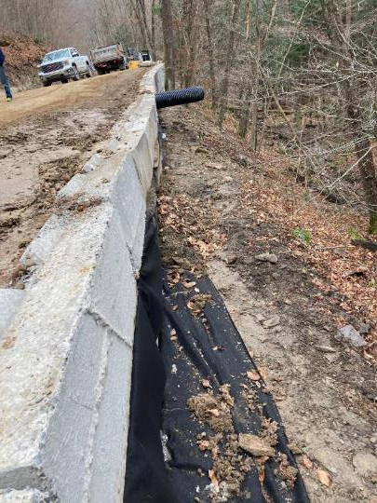
Sizer Run
GRS stabilization method used block wall extends to slip plane
Credit: Cameron County CD

Slide 32
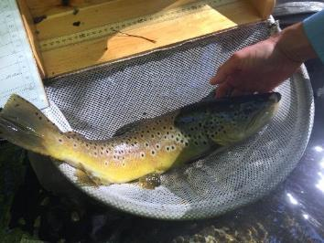
Hunts Run Road – Lumber Township
2 different slides along road
Hunts Run Class A Wild Trout
Completed with Township Labor
Both approximately 140’ x 6’
100 mafia block
30 loads of 2RC
Approximately $29,000.00
Credit: Cameron County CD

Slide 33
Hunts Run Road
Stabilized both upslope
and downslope banks
Credit: Cameron County CD

Slide 34
Hunts Run Road
Lower bank repair used GRS method with block wall
Credit: Cameron County CD

Slide 35
Small Slip and Slide Repair
The Basics
A Plan of Attack
Example 1: Sizer Run Rd & Hunts Run Rd, Cameron County
Example 2: Lick Creek Rd, Schrader Creek Rd, South Black Creek Rd Sullivan County
Credit: Cameron County CD

Slide 36
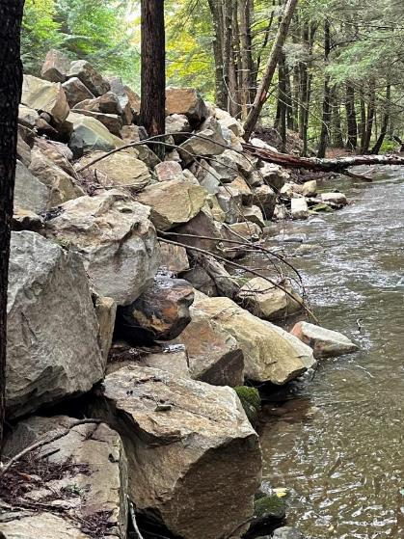
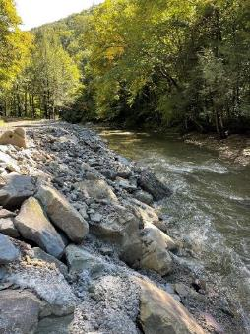
AVOID THIS….
AND MAKE A PLAN
Credit: Sullivan County CD

Slide 37
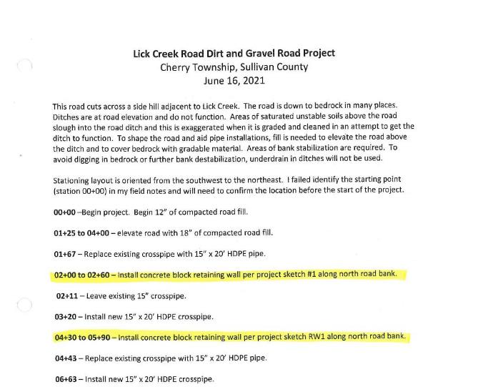
Lick Creek Road Sullivan County, PA
Credit: Sullivan County CD

Slide 38
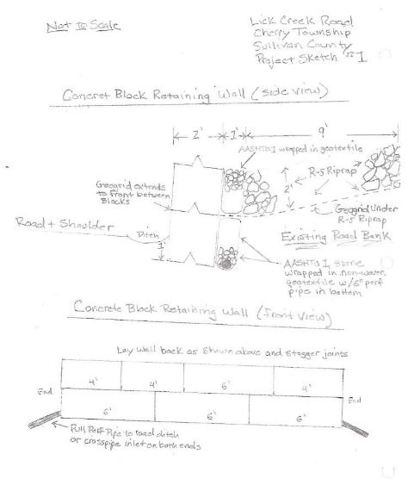
Lick Creek Road Bank Stabilization Plan
Credit:
Sullivan County CD

Slide 39
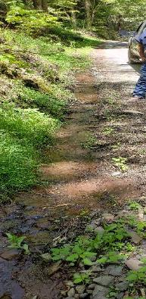
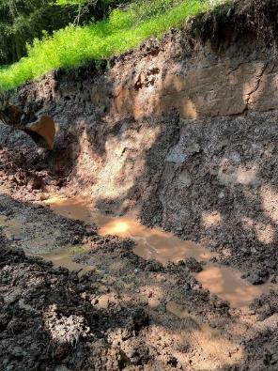
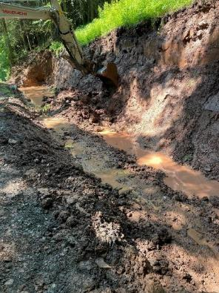
Lick Creek Road Before Stacked Concrete Wall
Bank sloughing onto roadway
Excavating for drain and rock overlay
Credit: Sullivan County CD

Slide 40
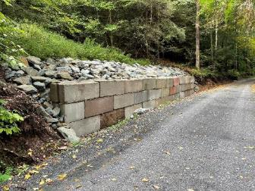
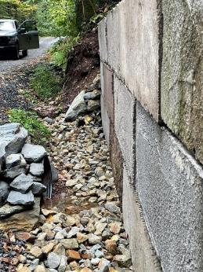
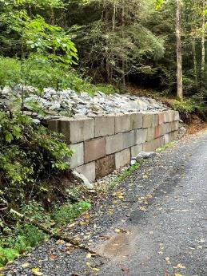
Stacked Concrete Wall #1 Completed
Lick Creek Road
Credit: Sullivan County CD

Slide 41
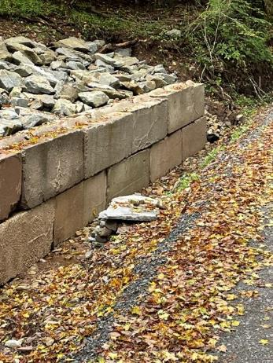
Lick Creek Road
Stacked Concrete Wall #2 Completed
Rock overlay replaces poor soils
Footer drain and pipe remove water
Credit: Sullivan County CD

Slide 42
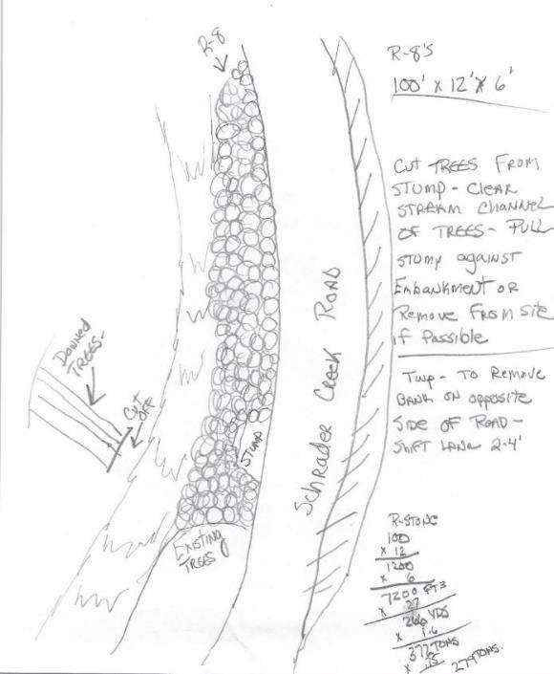
Schrader Creek Road Sullivan County, PA
Credit: Sullivan County CD

Slide 43
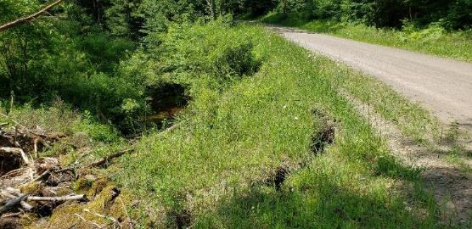
Schrader Creek Road Before Stacked Rock Wall
Slip Encroaching on Road
Road Bank / Stream Bank Failing
Credit: Sullivan County CD

Slide 44
Schrader Creek Road Coompleted Stacked Rock Wall
Large Rock embedded into channel make stable toe
Road shifted for stable bank angle without stream encroachment
Credit: Sullivan County CD

Slide 45
South Black Creek Road Sullivan County, PA
Credit: Sullivan County CD

Slide 46
South Black Creek Road Bank Failure Due To Surface Erosion Before Outfall Pipe Stabilization
Credit: Sullivan County CD

Slide 47
South Black Creek Road Outfall Pipe Stabilization
Reconstructed bank at pipe outfall
Rock at stable angle with large rock at toe
Credit: Sullivan County CD

Slide 48
Questions?
Or let us know your experiences.
CDGRS
Tim Ziegler
tmz115@psu.edu
Thanks to Sullivan and Cameron County for example projects

