Slide 1
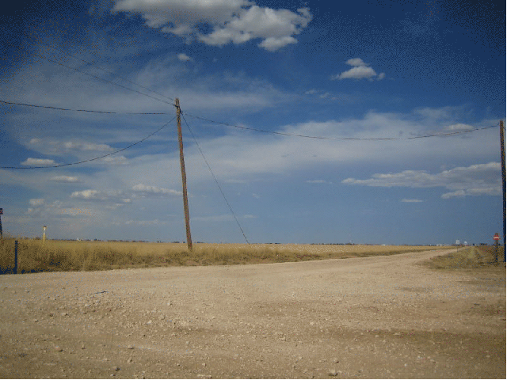


DGLVR Webinar
DGLVR Spending Update and Annual Summary Report Refresher
12/14/23
Starts at 9am
If you are reading this, then you are successfully seeing the webinar video. Webinar audio should be automatic through your computer, and options can be accessed in the “audio options” button on the bottom left. If you are having audio issues, or are in a location where listening via phone is preferable, audio is also available on the CDGRS conference line at: 312-626-6799
For technical assistance, call: 814-865-5355

Slide 2
DGLVR Program
Spending Update/ASR Refresher
Agenda
  Spending requirement update
  Quarterly Report updates
  Annual Summary Report Refresher (including looking up spending status)

Slide 3
DGLVR Program
Spending Update/ASR Refresher
DGLVR 5-Year Agreements (between SCC and CDs)
  Agreement that establishes DGLVR Program in individual CDs, allowing funding transfer to CDs.
  66 CDs currently have agreement
  Previous Agreement ended 6/30/23
  All funding from agreement must be spent out by 6/30/24

Slide 4

DGLVR Program
Spending Update/ASR Refresher
  Conservation District DGLVR Allocations
    Current CD Status as of 12/14/2023:
      Spent everything: 15 DGR, 11 LVR
      Committed everything: 25 DGR, 25 LVR
      Not committed: 24 DGR, 30 LVR

Slide 5
DGLVR Program
Spending Update/ASR Refresher
  Question:
  What if funds are not spent by 6/30/24?
    Answer:
  Per conditions of the existing 5-year agreement (section 1.3): “…the funds will revert back to the control of the Commission for future apportionments, or the District may, at the discretion of the Commission, be ineligible for future allocations, or the amount of such funds may be deducted from any future apportionment to the District.”

Slide 6
DGLVR Program
Spending Update/ASR Refresher
  Question:
  How do I know how much I need to spend to meet my spending requirements?
    Answer:
  This information is available in the GIS.

Slide 7
DGLVR Program
Spending Update/ASR Refresher
Annual Summary Report Spending Difference VS Previous 5-Year Balance Remaining?
In a Normal Year:
CDs have 2 years to spend funds to be eligible for next FY allocations
Spending Requirement does not include two most recent allocation Fiscal Year’s
  FY 22/23 not included
CD Status reflected in GIS “ASR Overview”:
  Green = OK
  Red = Short of spending
From Annual Report

Slide 8
DGLVR Program
Spending Update/ASR Refresher
Annual Summary Report Spending Difference VS Previous 5-Year Balance Remaining?
This Year Only: Green/Red Status does not matter!
Why?
Since old 5-year contract funds must be spent by June 30, 2024, that requirement is stricter than the traditional Green/Red for 2-year spending.
So what does matter?
In a Normal Year:
CDs have 2 years to spend funds to be eligible for next FY allocations
CD Status reflected in GIS “ASR Overview”:
  Green = OK
  Red = Short of spending

Slide 9
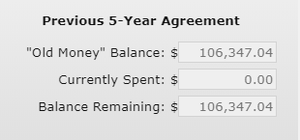
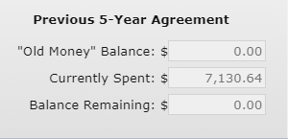
DGLVR Program
Spending Update/ASR Refresher
Annual Summary Report Spending Difference VS Previous 5-Year Balance Remaining?
This Year:
Must “zero out” balance remaining in old 5-year contract funds
Balance Remaining includes FY 22/23
Don’t forget to check BOTH DGR and LVR – tracked separately!
From Quarterly Report
County A: still $106K left to spend
County B: old money spent!

Slide 10
DGLVR Program
Spending Update/ASR Refresher
Take Home
Be concerned with ONLY the Previous 5-Year Balance Remaining!!!!!
This is the only balance that includes FY 22/23!
Through June 30, 2024, IGNORE the ASR Spending Difference!!

Slide 11
DGLVR Program
Spending Update/ASR Refresher
  When is the best time to start planning and asking for assistance?
  NOW!
  Winter is easier to get technical assistance quickly

Slide 12

DGLVR Program
Spending Update/ASR Refresher
  The Ken Show!

Slide 13
DGLVR Program
Spending Update/ASR Refresher
Agenda
  Spending Requirement update
  Quarterly Report updates
  Annual Summary Report Refresher (including looking up spending status)

Slide 14
DGLVR Program
Spending Update/ASR Refresher
Quarterly Report Updates
File Manager (replaces Receipt Invoice tools)
SCC Information Export tool (only available to Financial and District Manager roles)
Both will be available on Monday, December 18

Slide 15
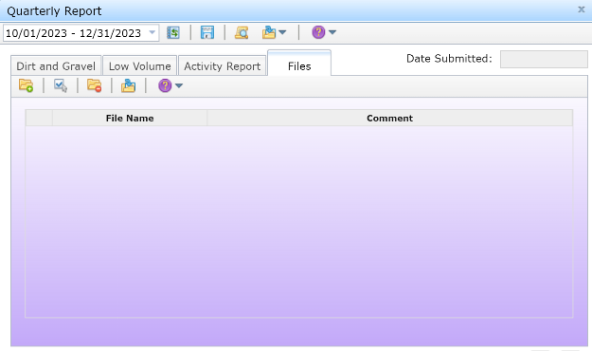
DGLVR Program
Spending Update/ASR Refresher
Quarterly Report File Manager
Available to everyone
No restrictions on upload file types
Can add/remove files and provide file comments

Slide 16
DGLVR Program
Spending Update/ASR Refresher
Quarterly Report File Manager
Click “Upload File” to launch the file browser then choose a file to upload
Once uploaded, provide comments
Select any files to delete or download
  Downloaded files are in a zipped folder and contain a csv of any entered file comments

Slide 17

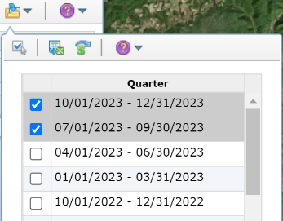
DGLVR Program
Spending Update/ASR Refresher
Exporting SCC Information
Only available to Financial and District Manager roles
Exports all Advance and Replenishment Information for the selected quarters (i.e., amounts, document numbers, process dates, etc)
Located in the Export Quarters drop-down
To use, select the desired
quarters to export then click
the Export SCC Information
button

Slide 18
DGLVR Program
Spending Update/ASR Refresher
Agenda
  Spending Requirement update
  Quarterly Report updates
  Annual Summary Report Refresher (including looking up spending status)

Slide 19
DGLVR Program
Spending Update/ASR Refresher
Annual Summary Report
Due January 15th
Any CD employee with a GIS login can submit
Can be viewed at any point throughout the year to help keep track of spending requirements
Budgeting tool to help meet spending requirements
5 Required Steps to submit
  All quarters for the previous calendar year submitted and accepted
  Enter the Limestone Cost for the previous year
  Check and fix any contract errors
  Verify all financial and project information in the ASR
  Check all boxes and submit the report

Slide 20
DGLVR Program
Spending Update/ASR Refresher
Required Steps
Submit the October – December Quarter
  Verify that balances match
  Address any expired contracts
  SCC must accept the report before the ASR can be submitted

Slide 21
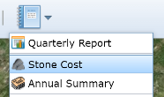
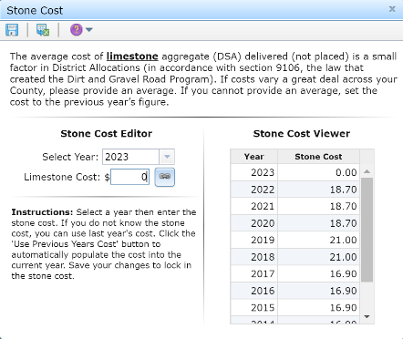
DGLVR Program
Spending Update/ASR Refresher
Required Steps
Enter the Limestone Cost for 2023
  The average cost of limestone aggregate (DSA) delivered (not placed)

Slide 22
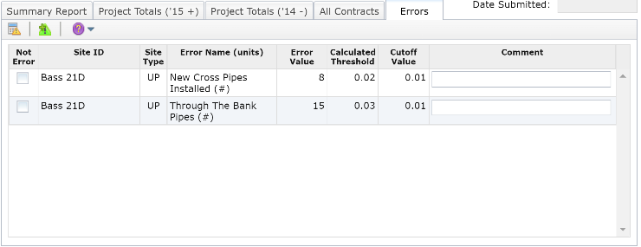
DGLVR Program
Spending Update/ASR Refresher
Required Steps
Check and fix any contract Errors
  Review errors and, if valid, fix each within their respective contract to permanently remove the error from the list.
  If a marked error is not an error, check the respective box, enter comments, then click the "Save Changes" button.
Note that all errors must be fixed before the ASR can be submitted.

Slide 23
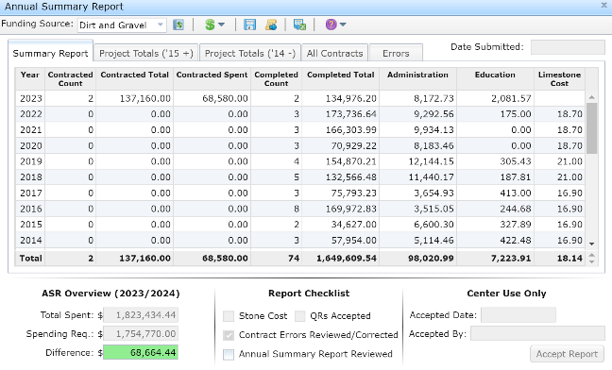
DGLVR Program
Spending Update/ASR Refresher
Required Steps
Verify the information present in the ASR
  Financials for each Program
  Project totals for each completed Funded Site

Slide 24
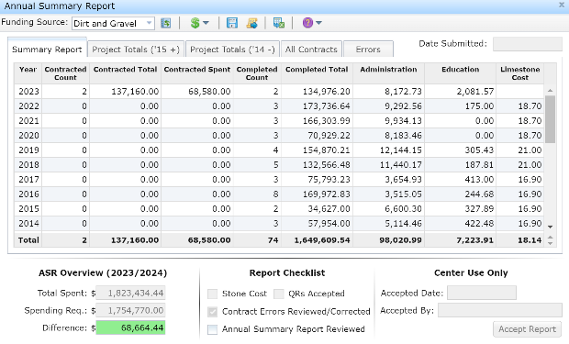
DGLVR Program
Spending Update/ASR Refresher
Required Steps
Submit the Annual Summary Report
  All check boxes need to be checked before you can submit
  Emails will be sent upon Submit and Accept

Slide 25
DGLVR Program
Spending Update/ASR Refresher
Am I eligible for an allocation?
Depends on your Spending Requirement Status
Spending Requirement is the total of all allocations received minus the most recent 2 fiscal years
  If Total Spent >= Spending Requirement, then you are eligible for an allocation. The difference will be green.
  If Total Spent < Spending Requirement, then you are not eligible for an allocation. The difference will be red. That amount must be spent by the time the next allocation is determined. This is typically March 31 for a normal allocation year

Slide 26
DGLVR Program
Spending Update/ASR Refresher
ASR Budgeting Tool
Useful to help meet Spending Requirements
Be sure that all income and expenses are up to date
The information saved in the ASR budget tool is reset when the next allocation has been entered into the GIS

Slide 27
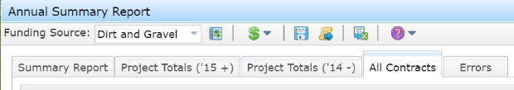
DGLVR Program
Spending Update/ASR Refresher
Downloadable Data
Each of the five tabs in the ASR can be downloaded in a comma delimited format.
To download data for a particular tab, choose the appropriate tab and then click the Export Reports button.
Select the “Combined” funding source for both DGR and LVR data.

Slide 28
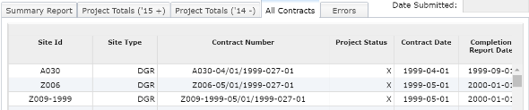
DGLVR Program
Spending Update/ASR Refresher
Downloadable Data
The “All Contracts” tab is useful to view data for individual contracts.
The March 29, 2019 webinar “Detailed GIS Data Analysis Demo in Excel” provides a comprehensive GIS data analysis focusing on sorts, summarizations, formulas, and graphs, and other functions in excel. (located in Past Webinars)

Slide 29
DGLVR Program
Spending Update/ASR Refresher
Report Due January 15

