Slide 1
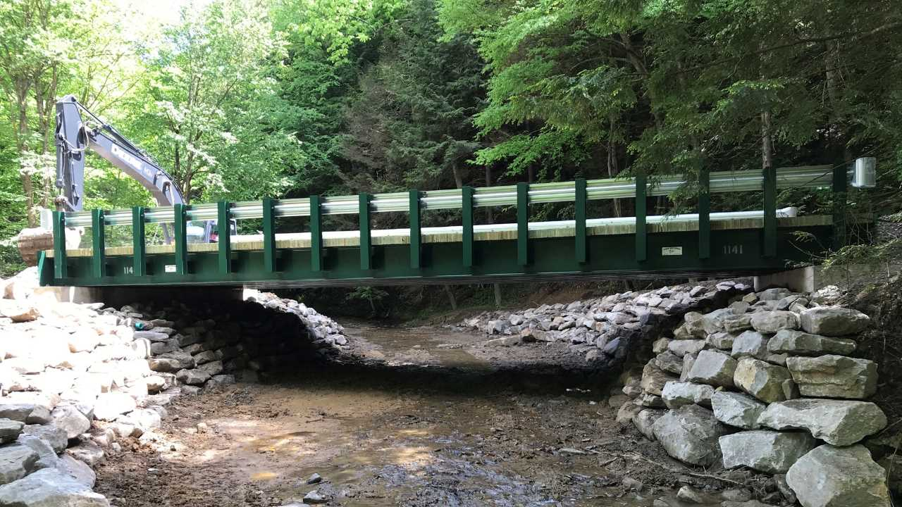
Dirt Gravel and Low Volume Road Program
January 19, 2023
SPREAD FOOTER BRIDGES
CDGRS
Maria Dreese
maa241@psu.edu
Clarion Conservation District
Alicia Ramsey
ramseyccd@gmail.com
Warren County Conservation District
Heather Wilcox
hwilcox@wcconservation.net

Slide 2
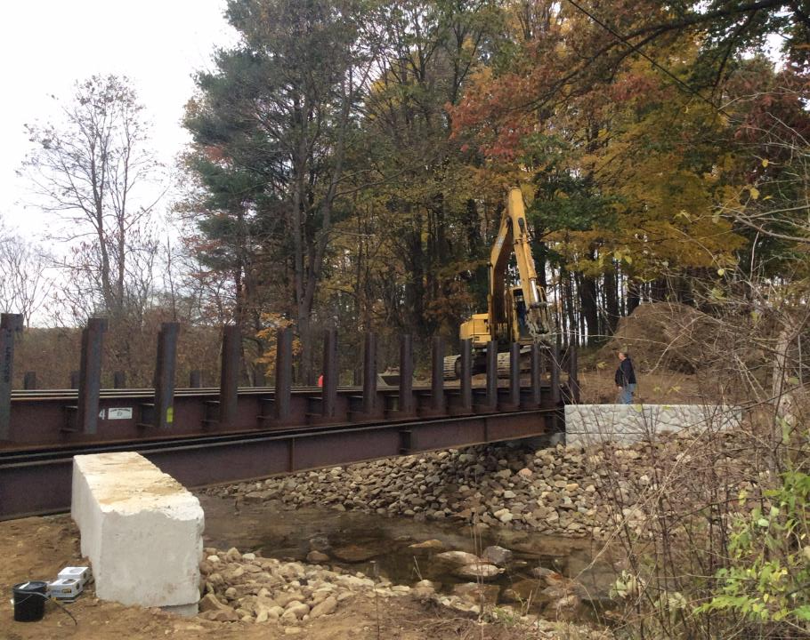
SPREAD FOOTER BRIDGES
Spread Footer vs. Traditional Abutments
When to Consider a Spread Footer
Pros & Cons
Spread Footer Project Installation Sequence - Barr Road, Indiana County
Clarion County Gowdy Road Project
Warren County Stoddard Road Project

Slide 3
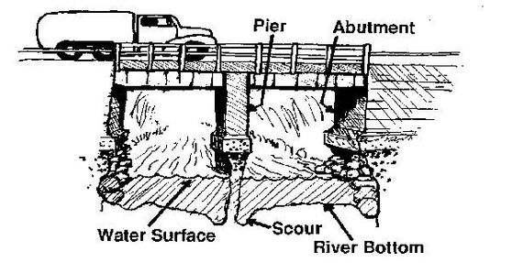
Traditional Bridge Abutments
McCormick Taylor
www.dirtandgravelroads.org

Slide 4
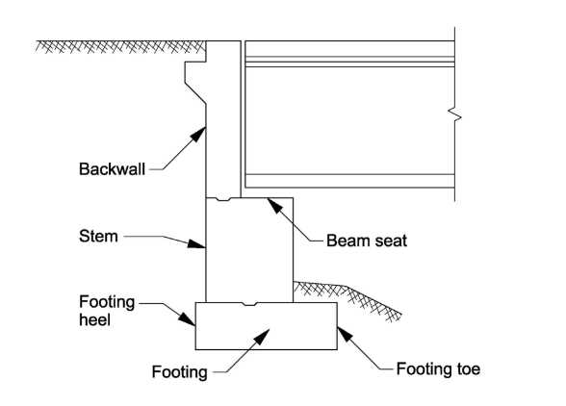
Traditional Bridge Abutments
Low Flow Channel
Wisconsin DOT
www.dirtandgravelroads.org

Slide 5
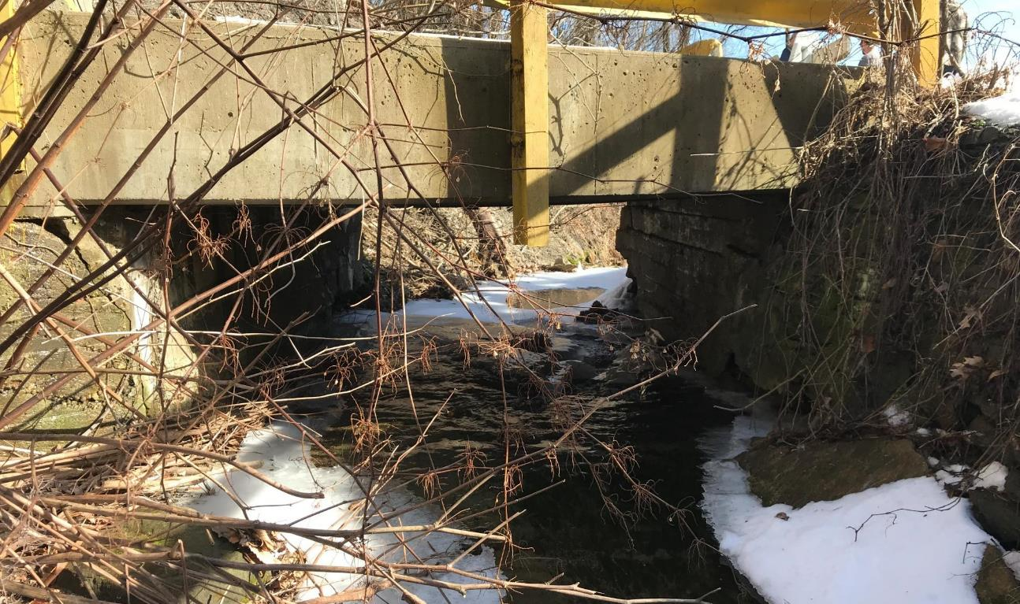
Traditional Bridge Abutments
Beaver County
www.dirtandgravelroads.org

Slide 6
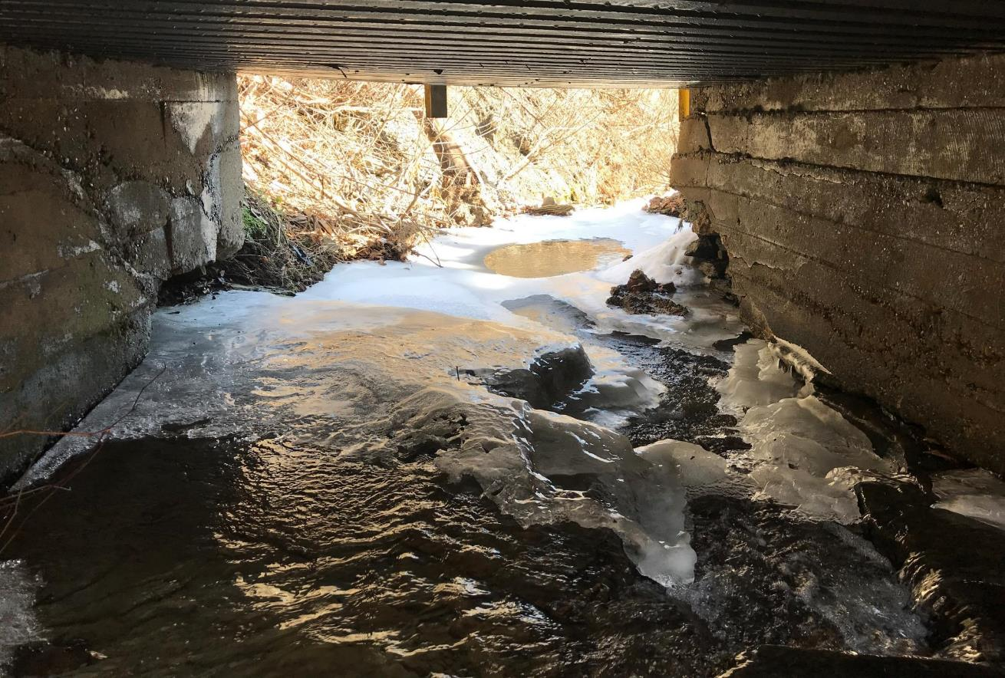
Traditional Bridge Abutments
Beaver County
www.dirtandgravelroads.org

Slide 7
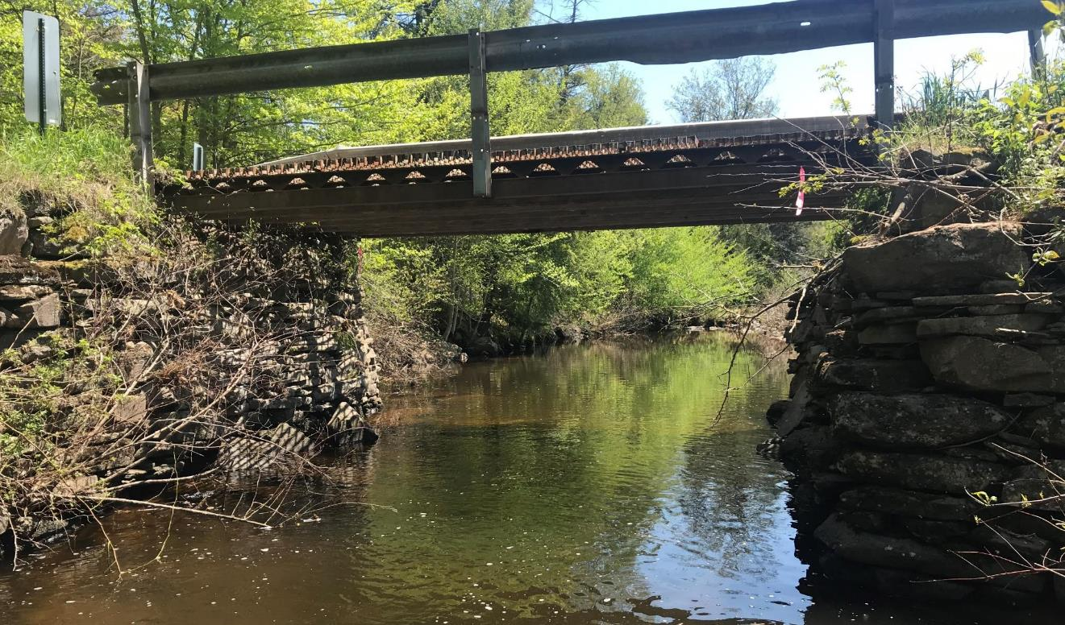
Traditional Bridge Abutments
Wayne County
www.dirtandgravelroads.org

Slide 8
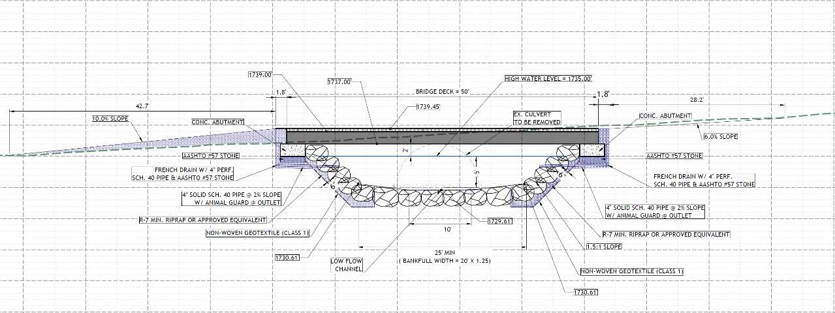
Spread Footer Foundations
Traditional Footer
Spread Footer
www.dirtandgravelroads.org

Slide 9
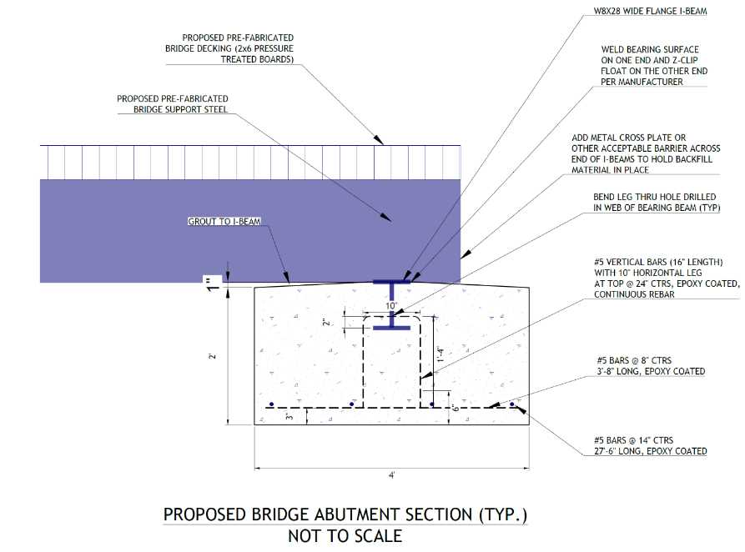
Spread Footer Foundations
www.dirtandgravelroads.org

Slide 10
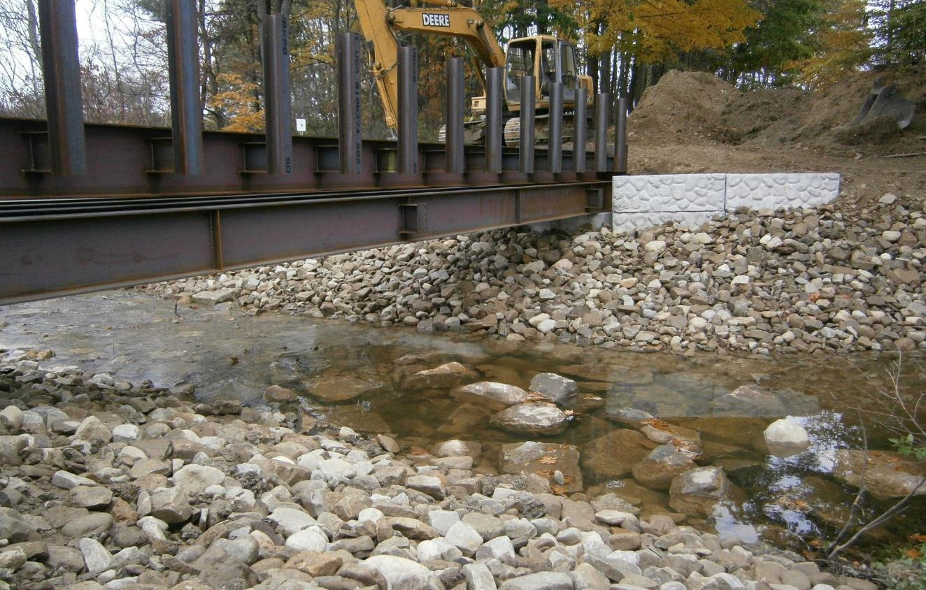
Spread Footer Foundations
Existing Road Surface Elevation
Existing Road Base
www.dirtandgravelroads.org

Slide 11
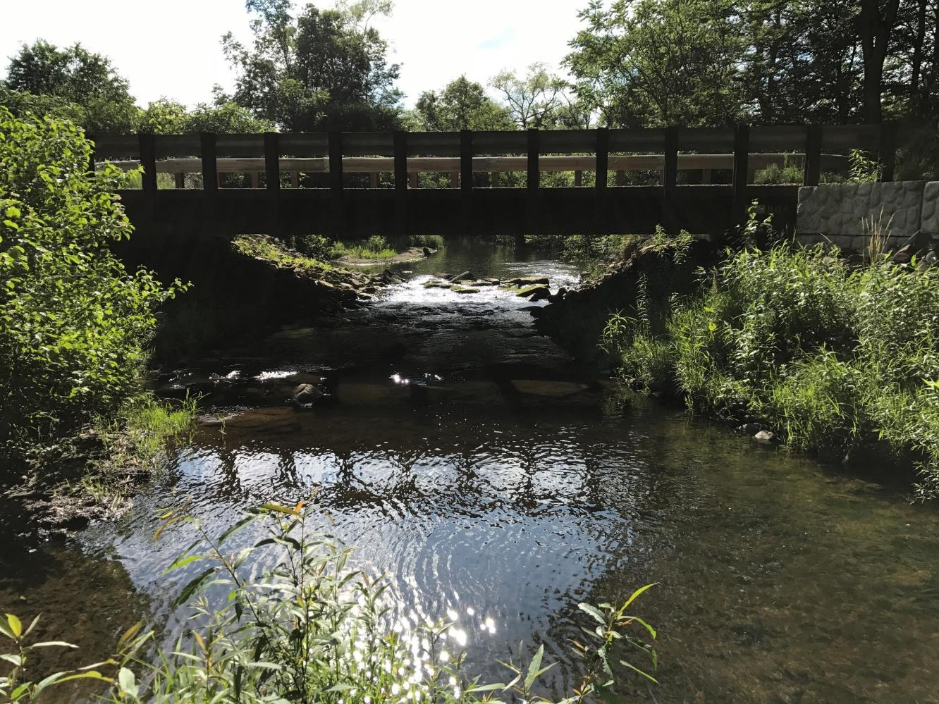
Spread Footer Foundations
Spread Footer Foundation
Traditional Bridge Abutment
www.dirtandgravelroads.org

Slide 12
When to Consider A Spread Footer
Bankfull measurements that require structures 20’ span or greater
*~16.25 Bankfull Width
Areas that require additional opening area to meet the Q100 at 80% of the structure capacity
Areas where the vertical rise is limited for roadway elevation but additional span (width) is necessary
Stream channels that exceed 4% continuity slope and require a bottomless structure
www.dirtandgravelroads.org

Slide 13
Pros & Cons
Pros
Reduced depth of excavation
Less concrete and sequential concrete pours = less concrete cure time
Expedited installation schedule = less environmental and community impact
Increase structure capacity, better flood resiliency, lower maintenance requirements
Cons
Longer bridge spans required
Cost analysis to determine if reduction in abutment costs offsets additional structure length expense
Alternative design approach from Penn DOT Standard – may require additional discussion and coordination with design engineer and bridge inspectors.
www.dirtandgravelroads.org

Slide 14
SPREAD FOOTER BRIDGES
Spread Footer vs. Traditional Abutments
When to Consider a Spread Footer
Pros & Cons
Spread Footer Project Installation Sequence - Barr Road, Indiana County
Clarion County Gowdy Road Project
Warren County Stoddard Road Project

Slide 15
Indiana County
Green Township Barr Road
Spring 2020

Slide 16
Existing Inlet 5’ Round Plastic Pipe

Slide 17
Existing Inlet 5’ Round Plastic Pipe

Slide 18
Existing Inlet

Slide 19
Upstream Conditions

Slide 20
Existing Structure Downstream Outlet

Slide 21
Existing Structure Outlet Downstream Conditions

Slide 22
Existing Conditions Roadway Approach

Slide 23
Existing Conditions Roadway Approach

Slide 24
Proposed Plan

Slide 25
Proposed Plan

Slide 26
Proposed Plan

Slide 27
River Left Spread Footer Foundation Excavation

Slide 28
River Left Spread Footer Foundation Excavation & Drainage

Slide 29
River Left Spread Footer Foundation Excavation & Drainage

Slide 30
River Left Spread Footer Foundation Base Compaction

Slide 31
River Left Spread Footer Foundation Based Prepared

Slide 32
River Left Spread Footer Rebar Reinforcement

Slide 33
River Left Spread Footer Form and Rebar Reinforcement

Slide 34
River Left Spread Footer

Slide 35
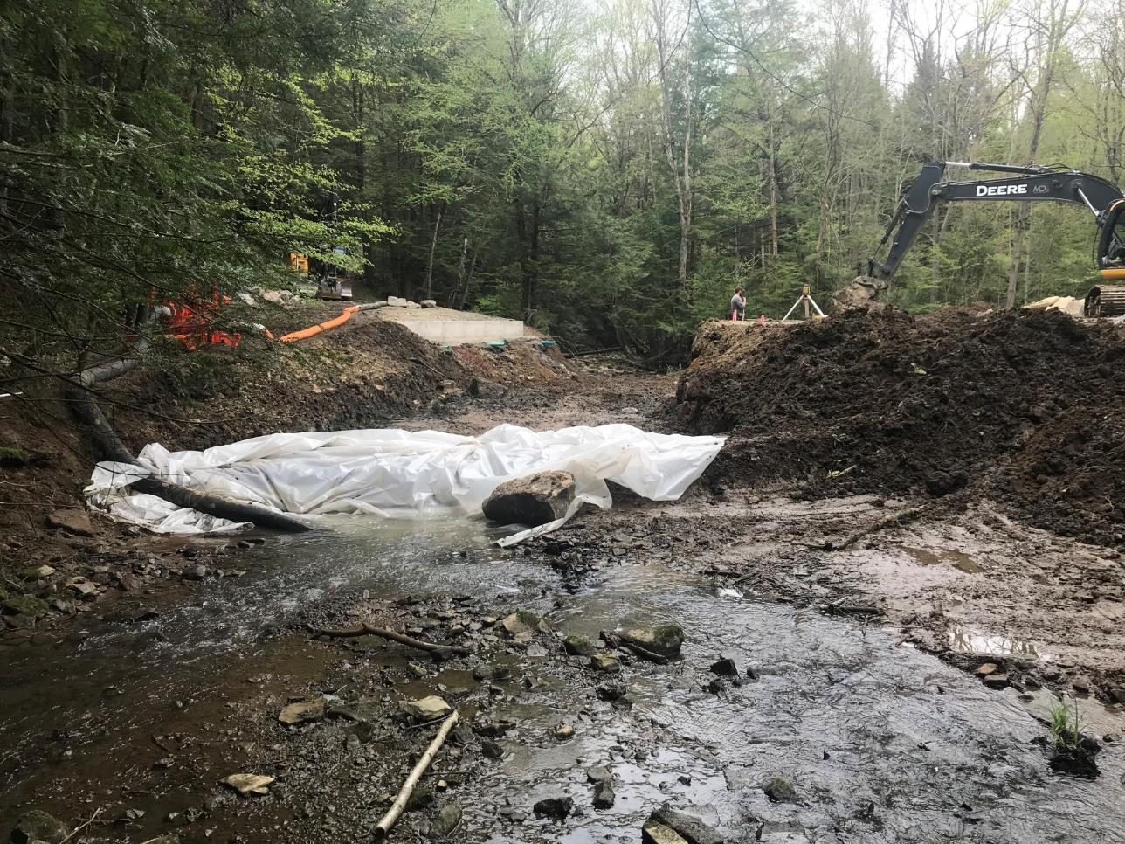
Temporary Stream Bypass Stream Channel Restoration

Slide 36
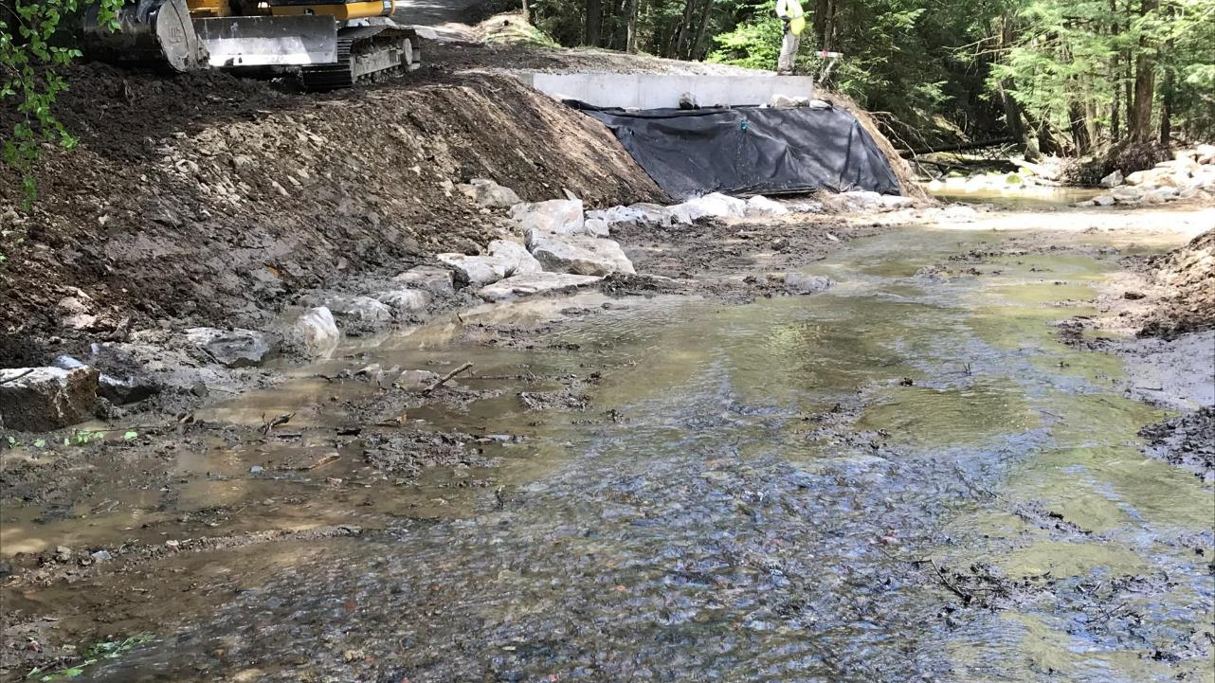
Stream Channel Restoration and Streambank Stabilization

Slide 37
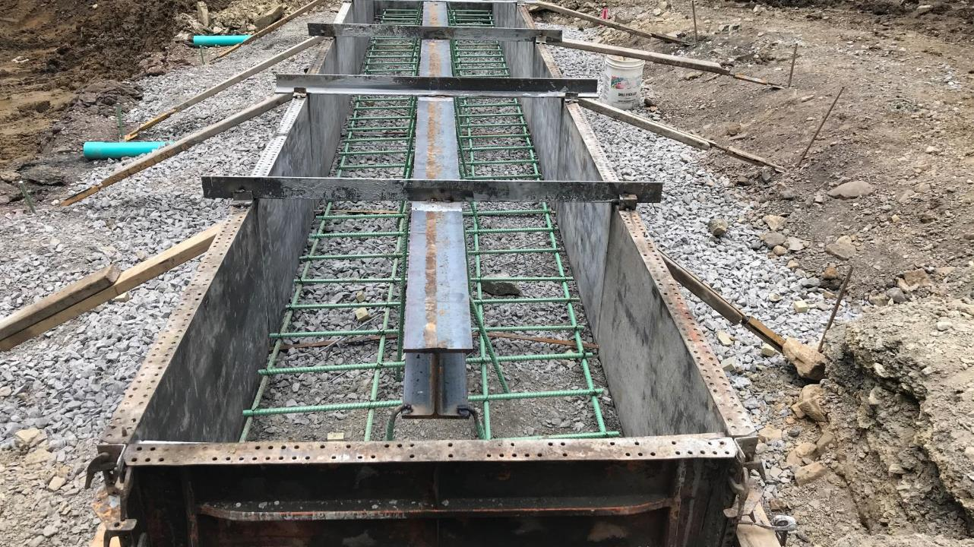
River Right Spread Footer Framing

Slide 38
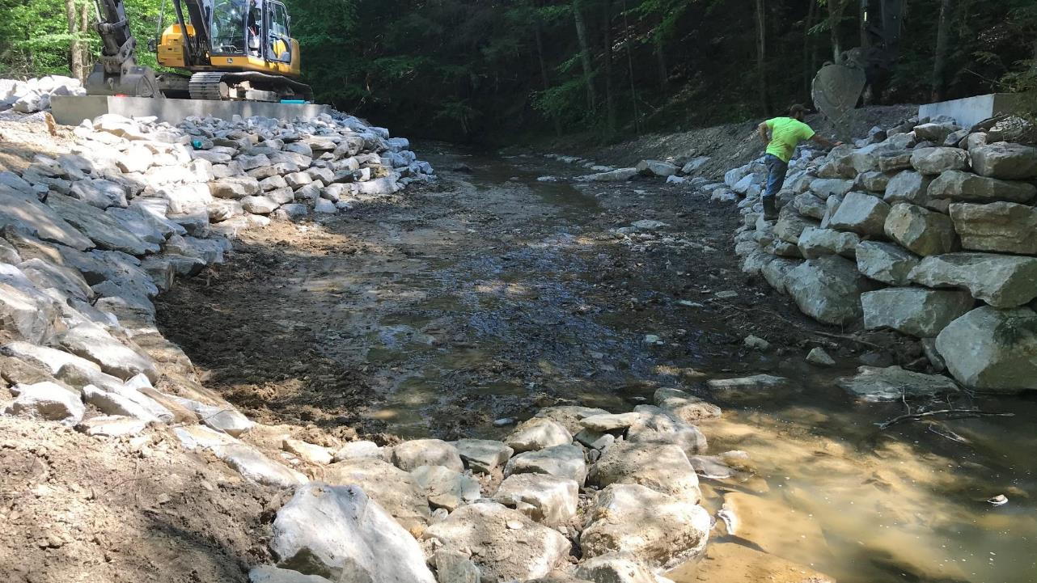
Completed Stream Channel Restoration & Streambank Stabilization

Slide 39
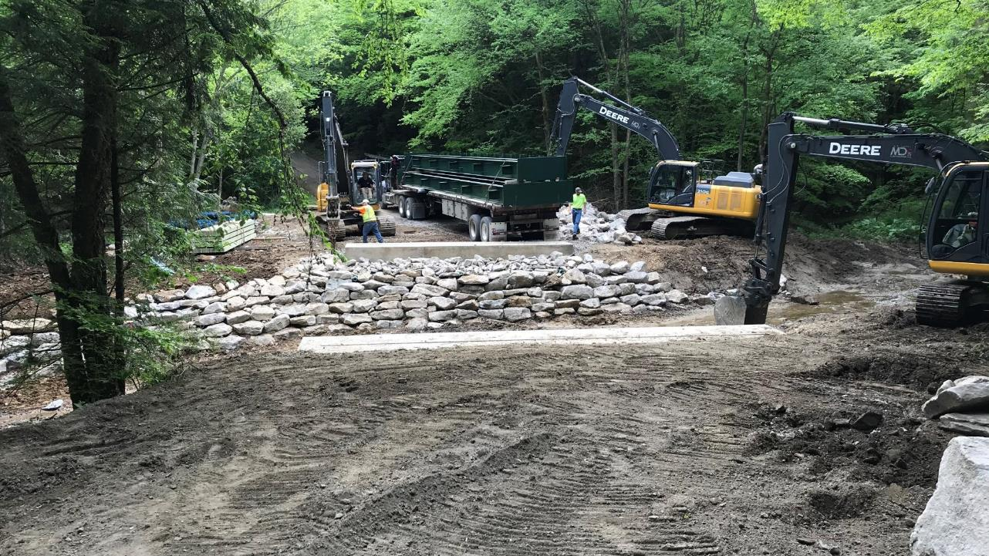
Delivery of Pre-Fabricated Modular Bridge ~9:00 am

Slide 40
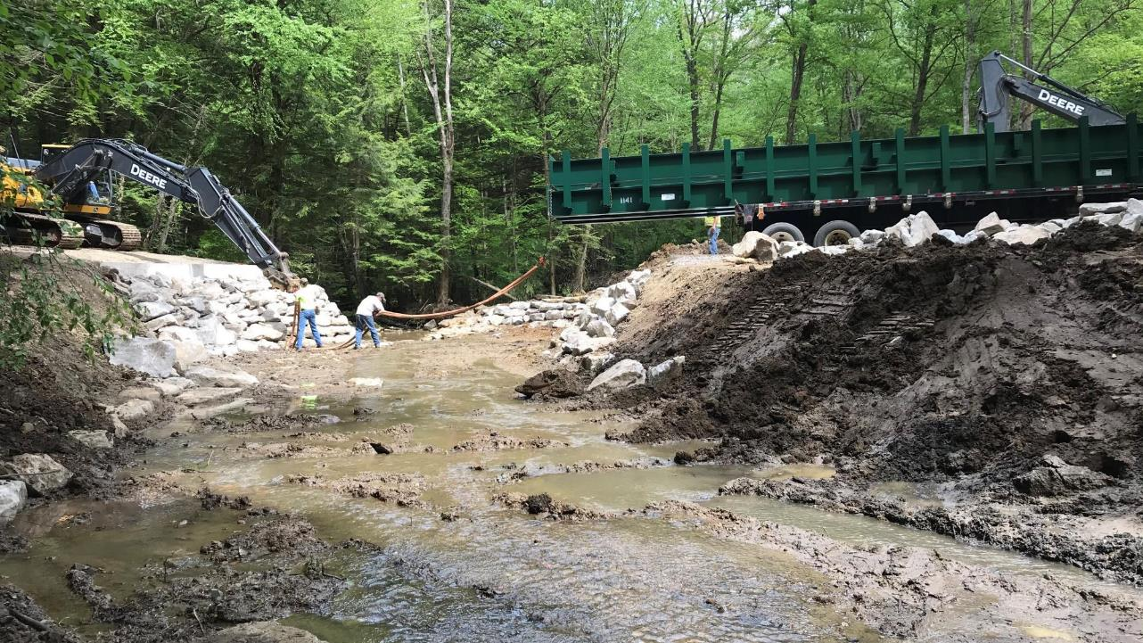
Placement of Bridge on Spread Footers

Slide 41
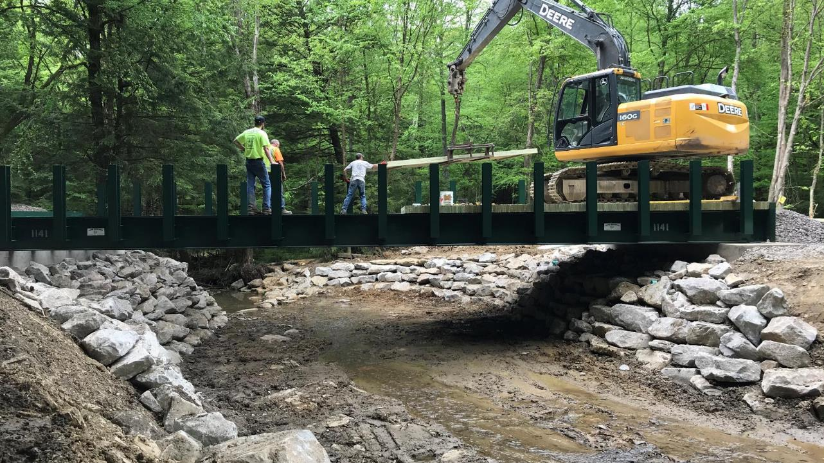
Installation of Wood Deck

Slide 42
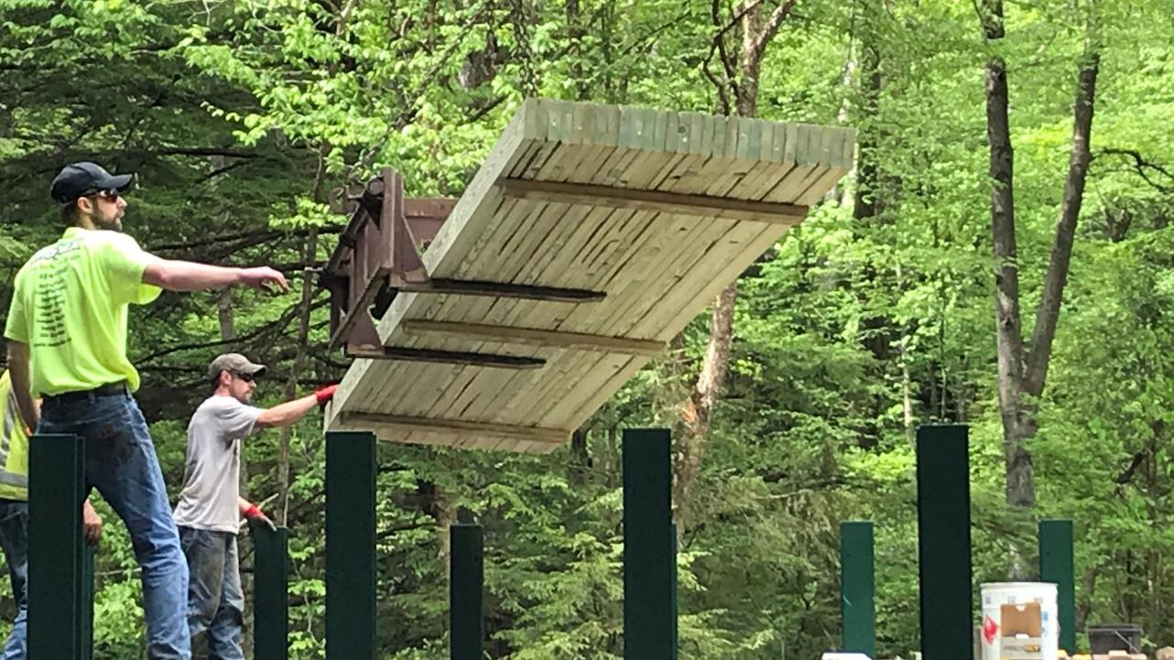
Installation of Wood Deck Panels

Slide 43
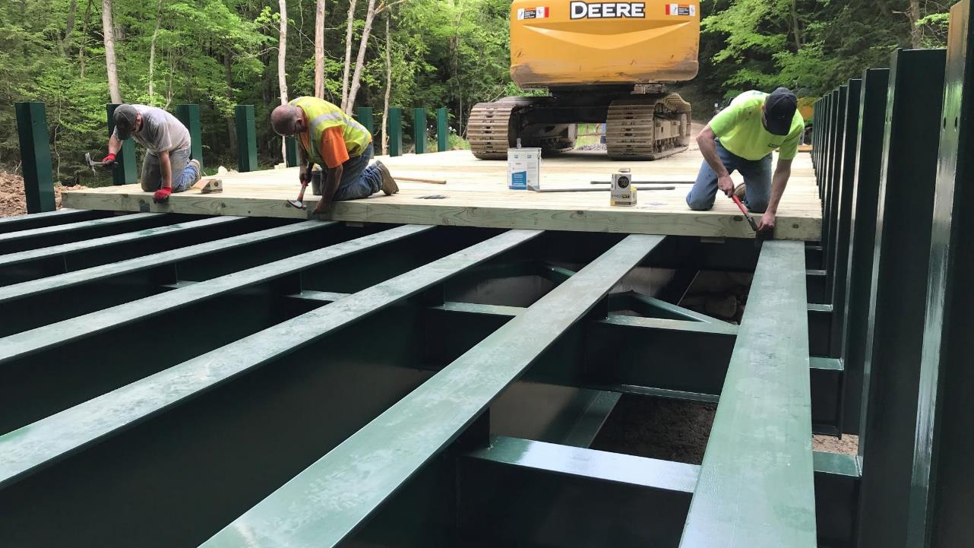
Securing of Wood Deck Panels to Superstructure

Slide 44
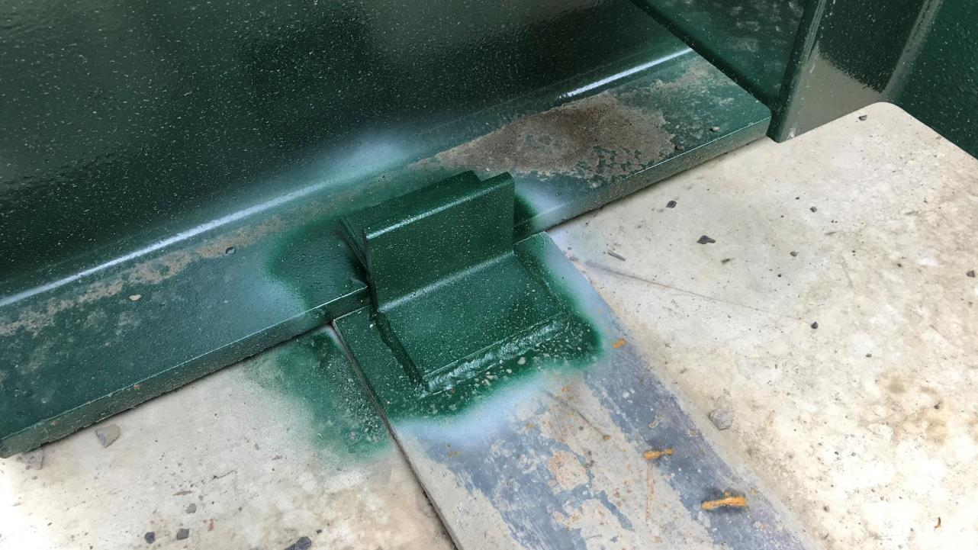
Expansion Anchor of Bridge to Spread Footers

Slide 45
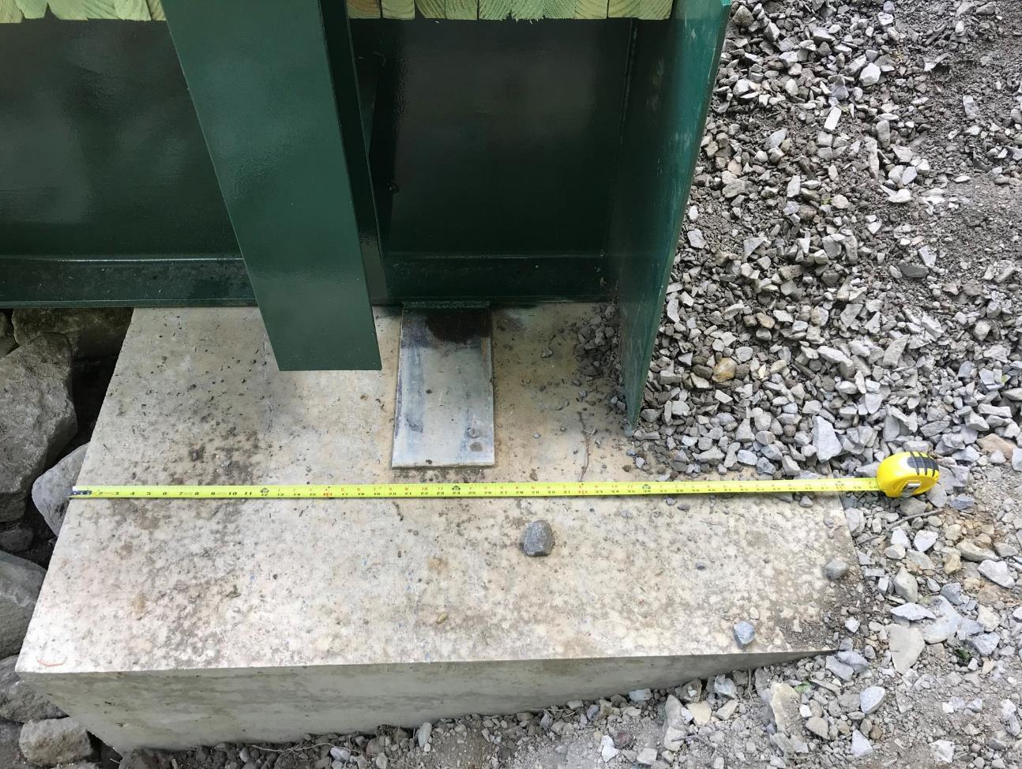
Fixed Attachment of Bridge Superstructure to Spread Footer

Slide 46
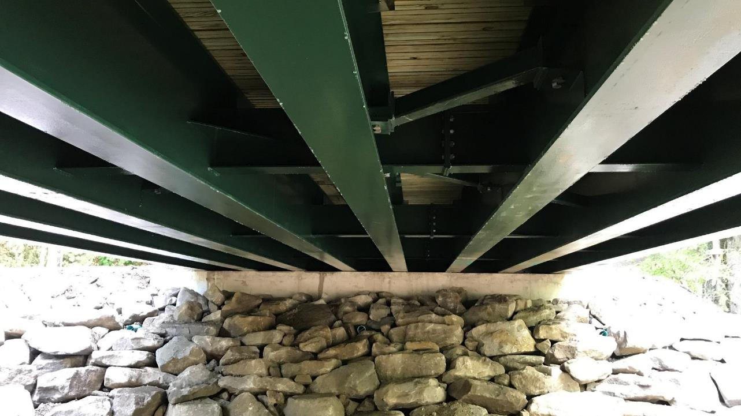
Bridge Superstructure

Slide 47
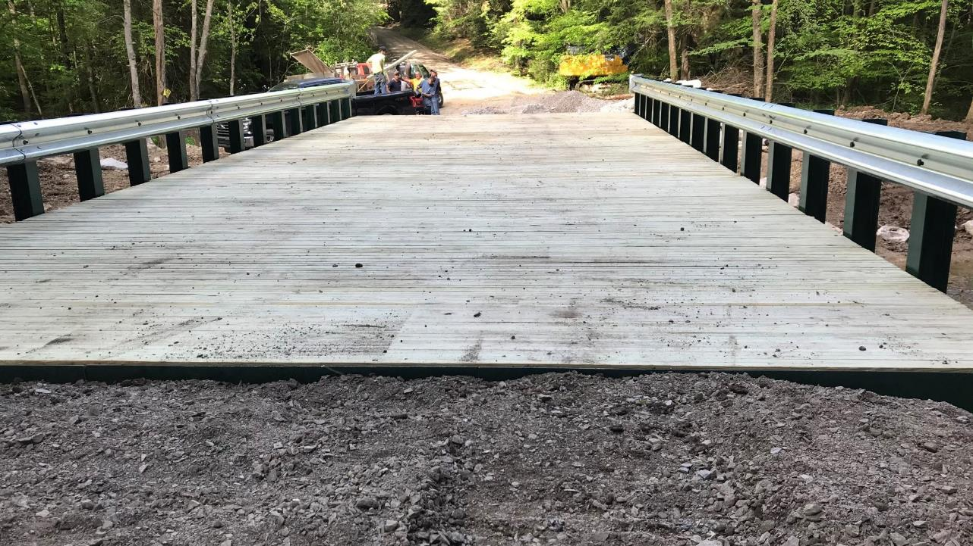
Bridge Deck & Guide Rail Installation ~7:00 pm

Slide 48
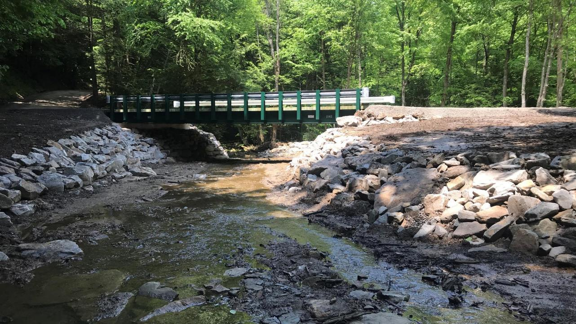
Grading and Site Restoration Work

Slide 49
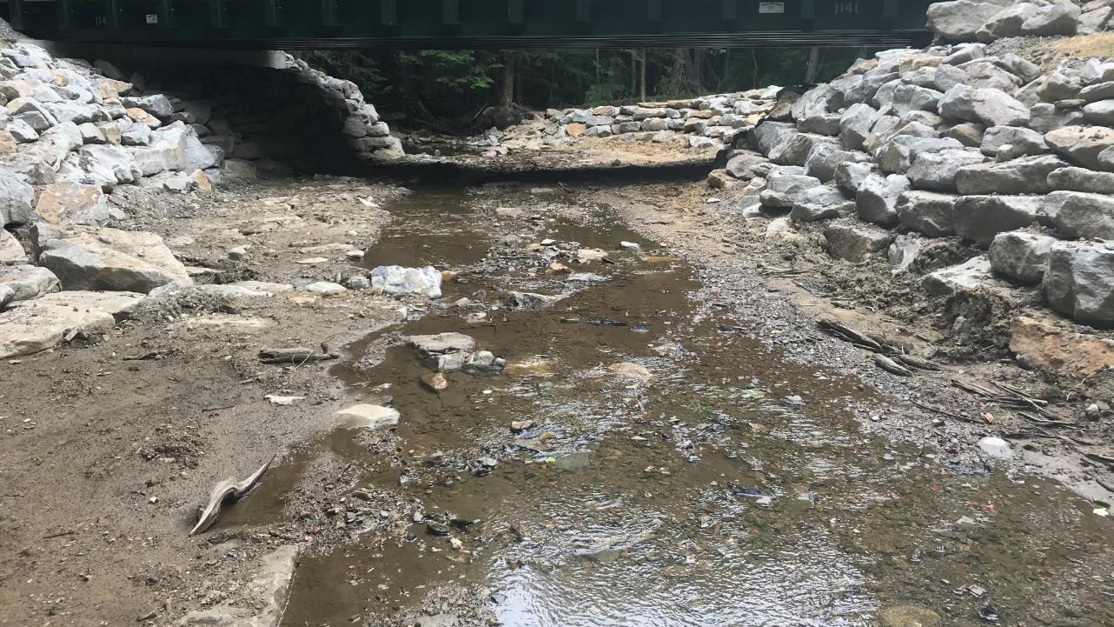
Stream Restoration Low Water Level

Slide 50
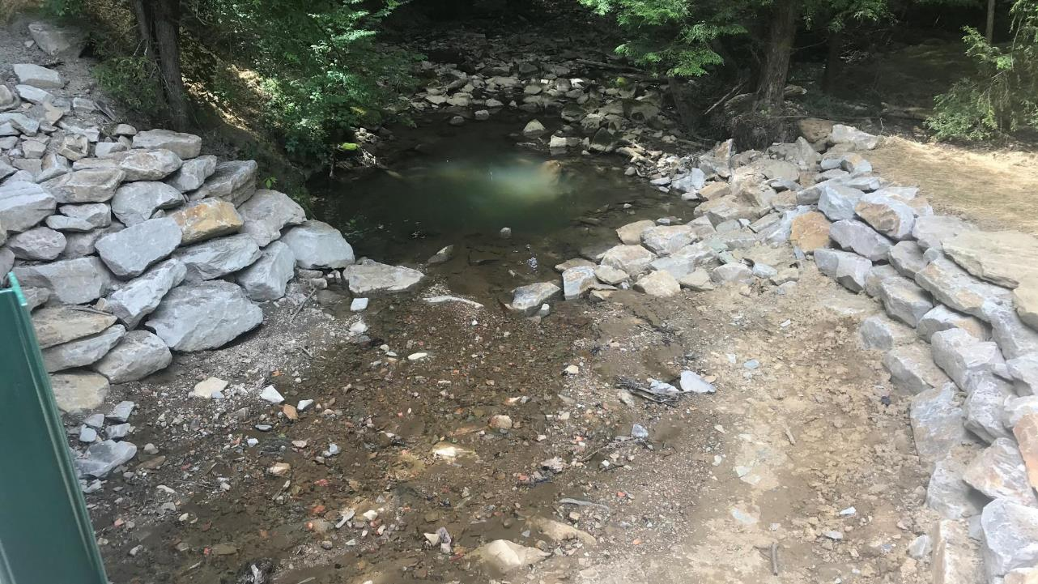
Downstream Condition Post Construction

Slide 51
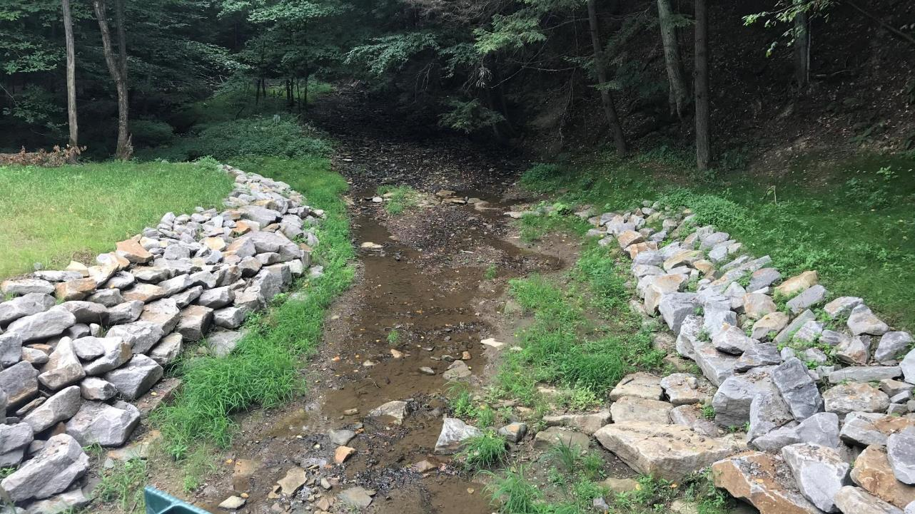
Upstream Condition Post Construction

Slide 52
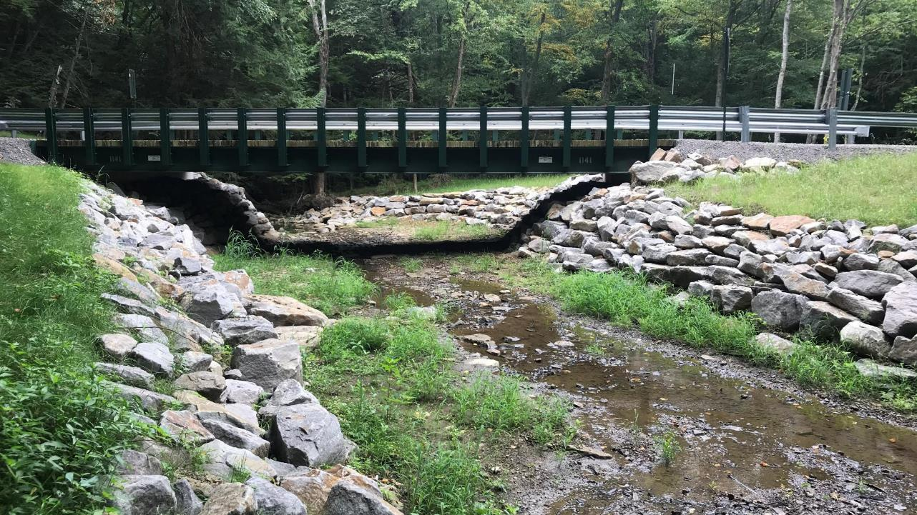
Final Project

Slide 53
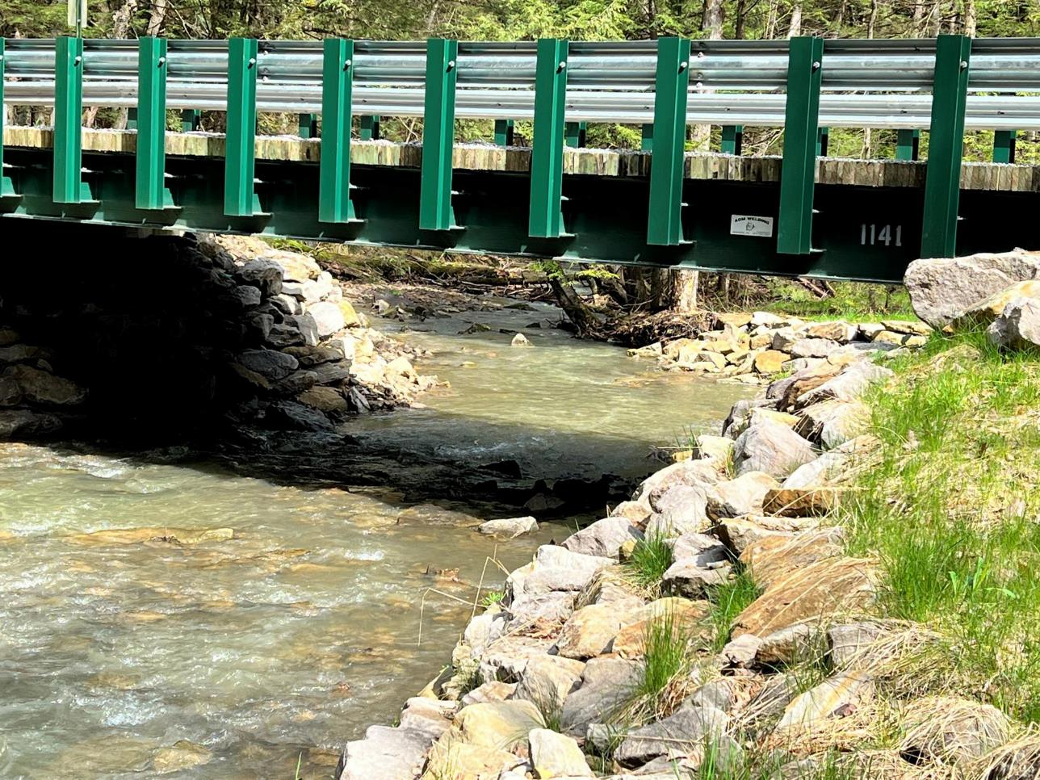
May 5, 2022 ~ 2 years post construction

Slide 54
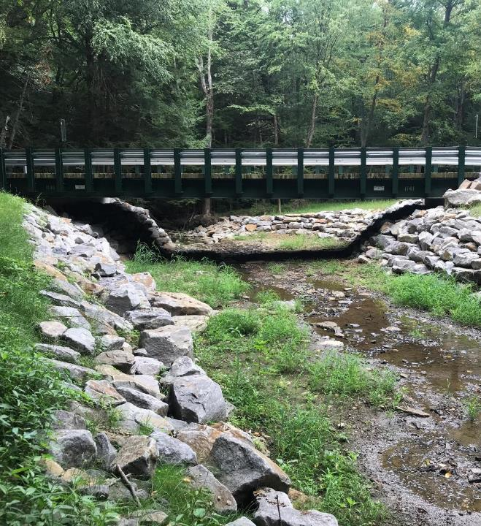
Scope of Work Included: Removal of Existing Structure Installation (2) Spread Footer Abutments Stream Channel and Bank Restoration 50’ x 20’ Pre-Fab Modular Bridge & Installation (4) New Cross Pipes Roadway Bridge Approach Work Completed in 4 Weeks Due to Weather and COVID 19 Delays Total Project Value $186,402.22

Slide 55
SPREAD FOOTER BRIDGES
Spread Footer vs. Traditional Abutments
When to Consider a Spread Footer
Pros & Cons
Spread Footer Project Installation Sequence - Barr Road, Indiana County
Clarion County Gowdy Road Project
Warren County Stoddard Road Project

Slide 56
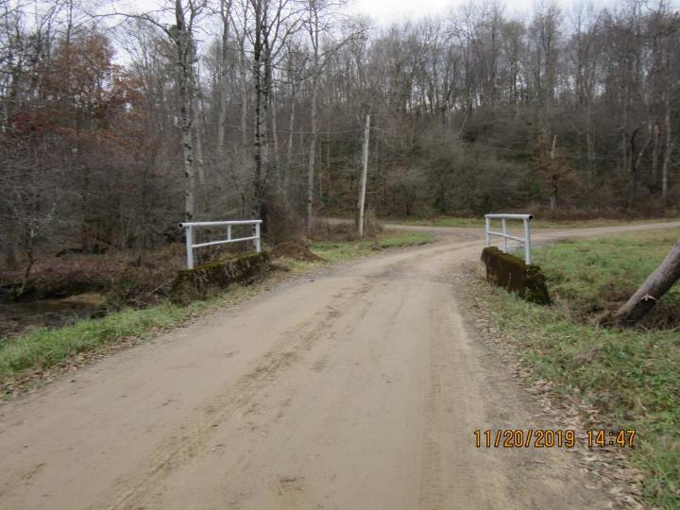
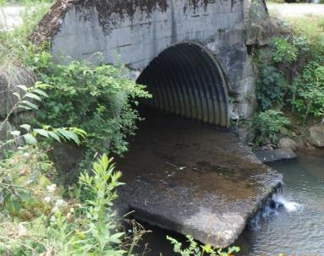
Clarion County Gowdy Road - BEFORE
Gowdy Road, Washington Township, Clarion County
McCauley Run, EV stream
www.dirtandgravelroads.org
Notes:
Where, when, why it need replacement..

Slide 57
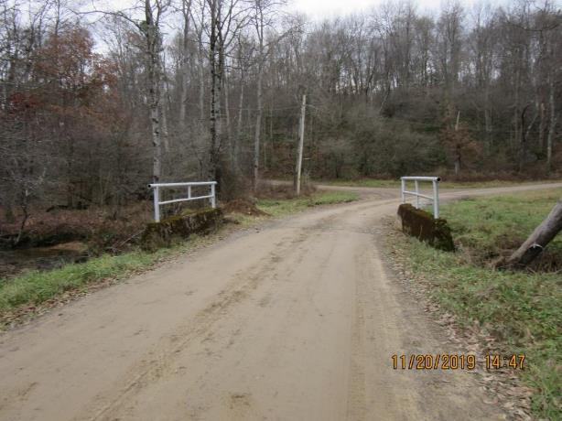
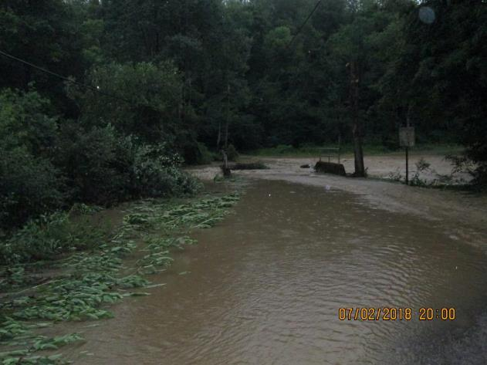
Clarion County Gowdy Road - BEFORE
www.dirtandgravelroads.org
Notes:
Where, when, why it needed replacement..

Slide 58
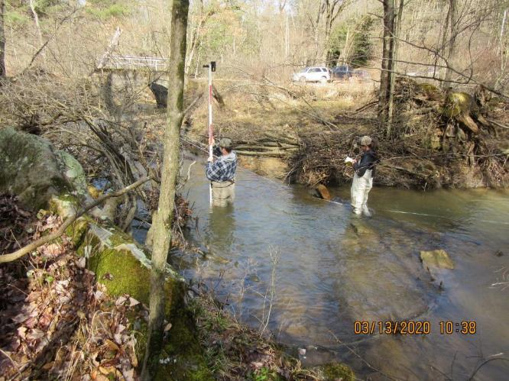
PLANNING PROCESS
Applicant requested tech assist
‘Pre-app’ meeting: applicant, CDGRS, District, and District engineer
TU and CDGRS survey
RFP process to select engineer (including on site meeting)
‘Pre-design’ mtg.: applicant, chosen engineer, CDGRS, District
Design and GP
Pre-bid meeting (x2): applicant, CDGRS, District, potential contractors
Construction
YEAR
www.dirtandgravelroads.org
Notes:
Process: steps 1-8 over the timespan of Nov 2019- Aug-2022 (covid in between)

Slide 59
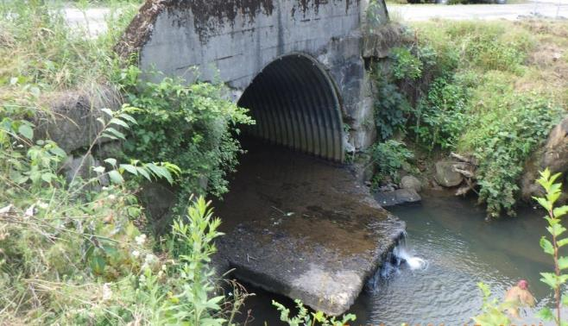
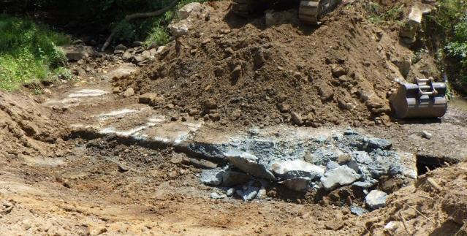
DURING CONSTRUCTION
Before- Outlet
Ex. concrete
During
Ex. concrete
www.dirtandgravelroads.org
Notes:
Staged, laid things out, demo, install of each practice, structure, remaining items, with some hiccups in between.
Specific items that paid off to be on site practically the entire project: E&S controls, footer placement, riprap/geo placement for bank layback (under structure), etc.

Slide 60
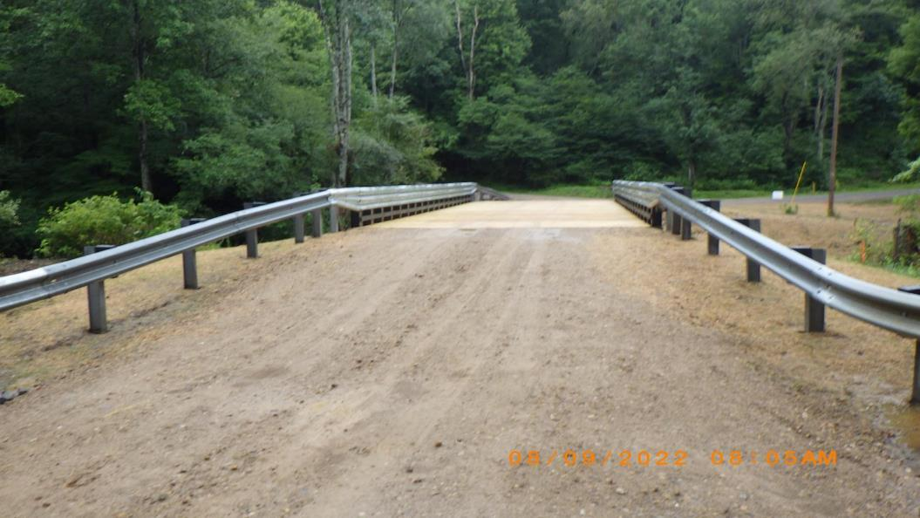
COMPLETED PROJECT
20’ x 60’ bridge,
Instream grade controls (4), modified mud sill, & root wad revetment
Overall project cost: $312,000
www.dirtandgravelroads.org
Notes:
Standing/ Facing same direction as 1st photo. Note elevation change lends to positive drainage away from the structure

Slide 61
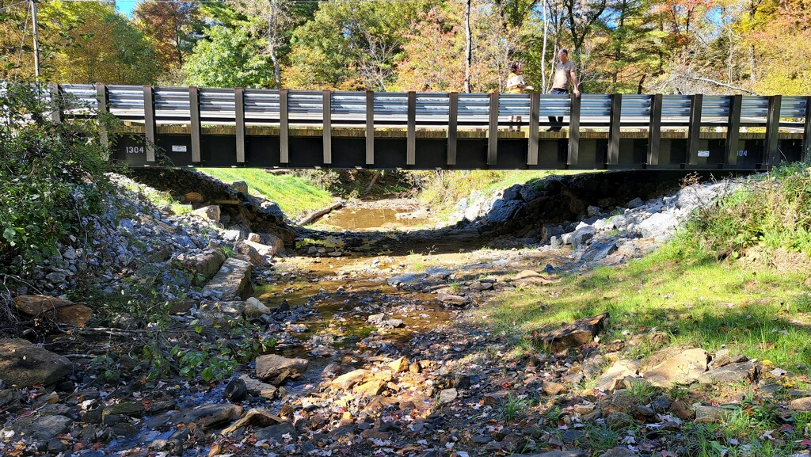
COMPLETED PROJECT
www.dirtandgravelroads.org
Notes:
Standing/ Facing same direction as 1st photo. Note elevation change lends to positive drainage away from the structure

Slide 62
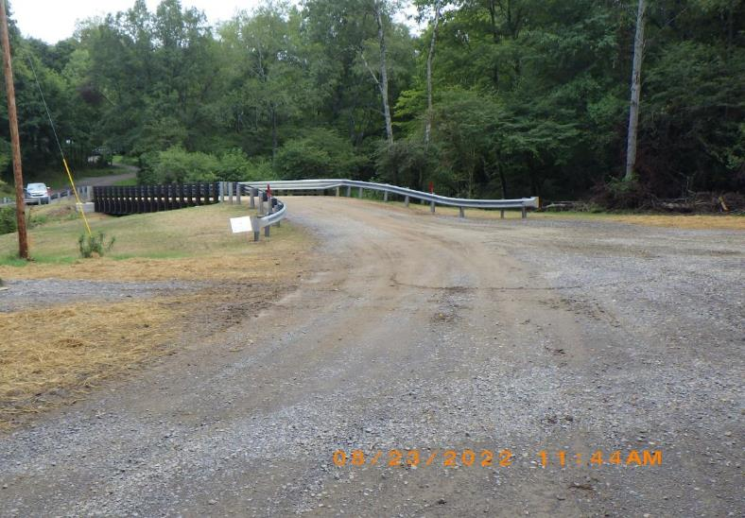
SUMMARY OF EXPERIENCE
Lessons learned
Advantages to this type of structure
Time investment
www.dirtandgravelroads.org
Notes:
Lessons learned- and there are many- lots of coordination. More details and improvement on the planning side may make for easier construction and oversight during.

Slide 63
SPREAD FOOTER BRIDGES
Spread Footer vs. Traditional Abutments
When to Consider a Spread Footer
Pros & Cons
Spread Footer Project Installation Sequence - Barr Road, Indiana County
Clarion County Gowdy Road Project
Warren County Stoddard Road Project

Slide 64
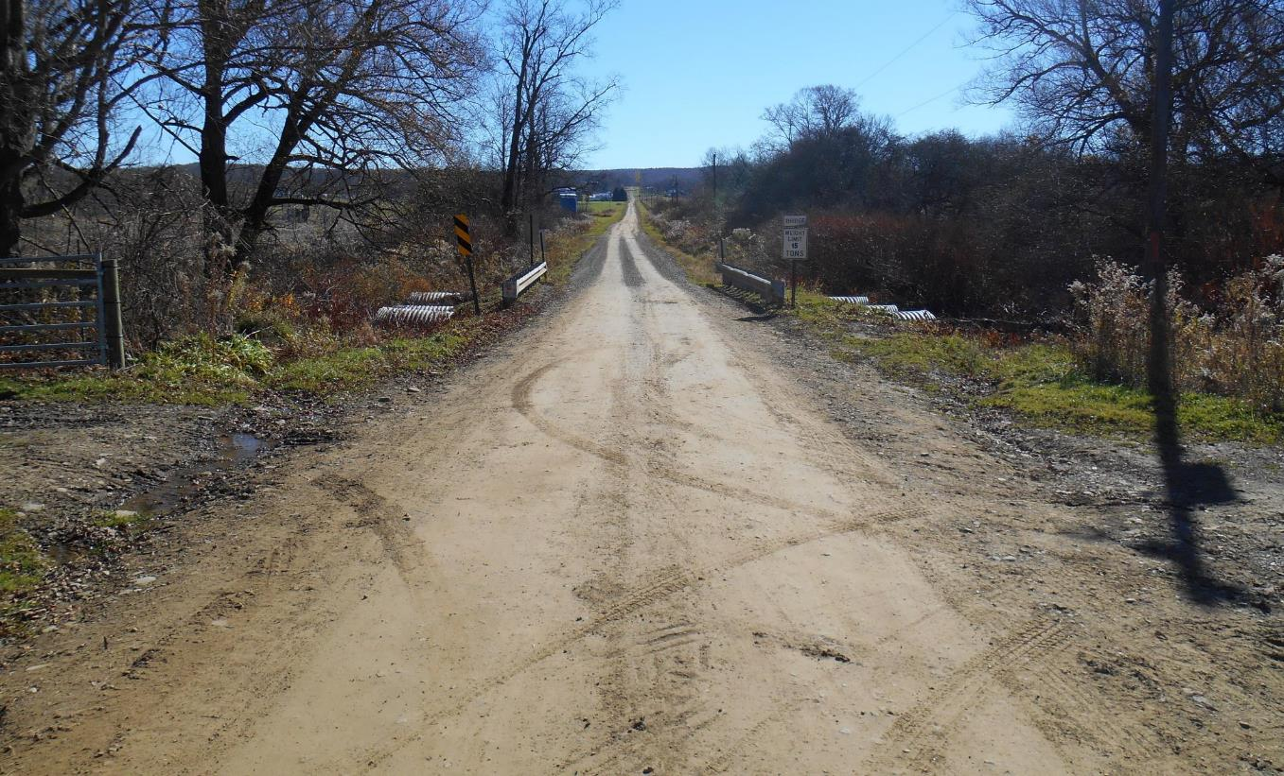
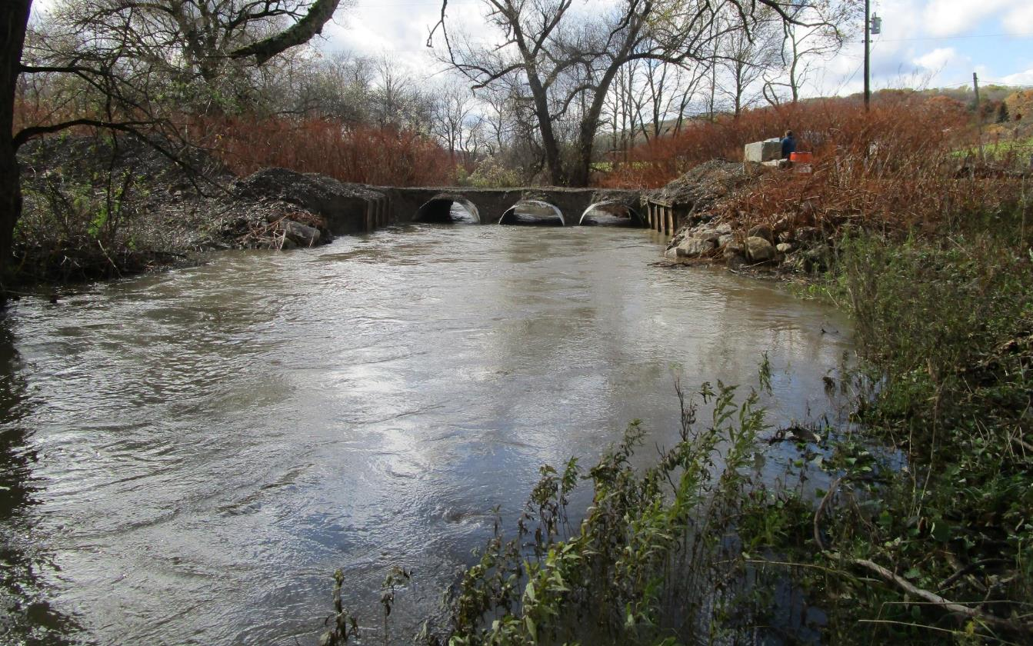
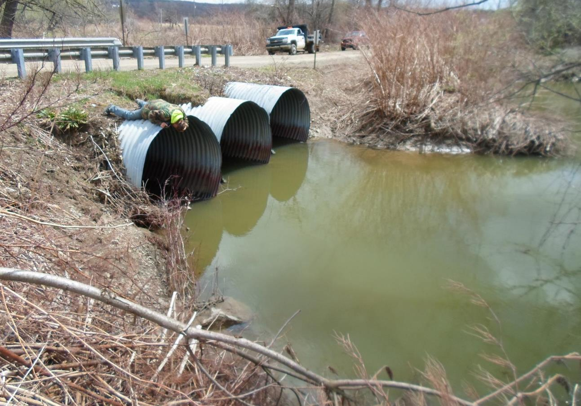
Warren County Stoddard Road - BEFORE
Inlet End of Multiple Pipes
Outlet Looking Upstream
www.dirtandgravelroads.org

Slide 65
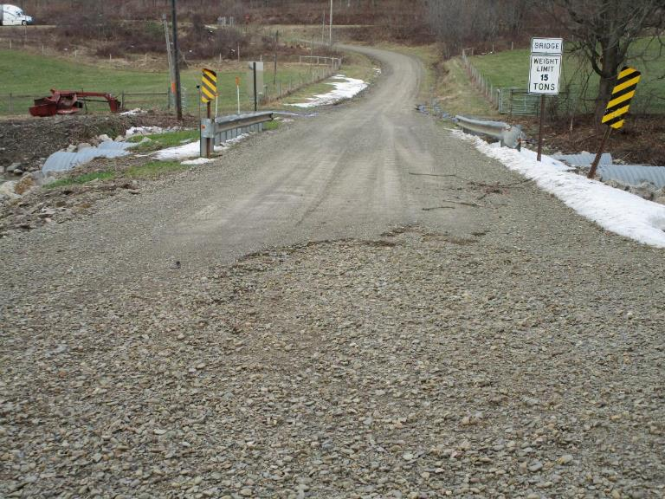
PLANNING PROCESS
Multiple Pre-Application site visits and project planning - Feb. through Oct. 2018
Application Received Nov. 2, 2018 & approved for funding by CD Board on Dec. 18, 2018
Held Contract signing meeting March 2019
Multiple conversations and site visits with Engineer to develop site plans, GP11 permit package, and Bid Package – March 2019 through June 2020
Public Ad in local newspaper June 29 and July 6, 2020
Mandatory site showing held July 10, 2020
Bid opening July 21, 2020
Construction began August 31, 2020 and ended November 2020
www.dirtandgravelroads.org

Slide 66
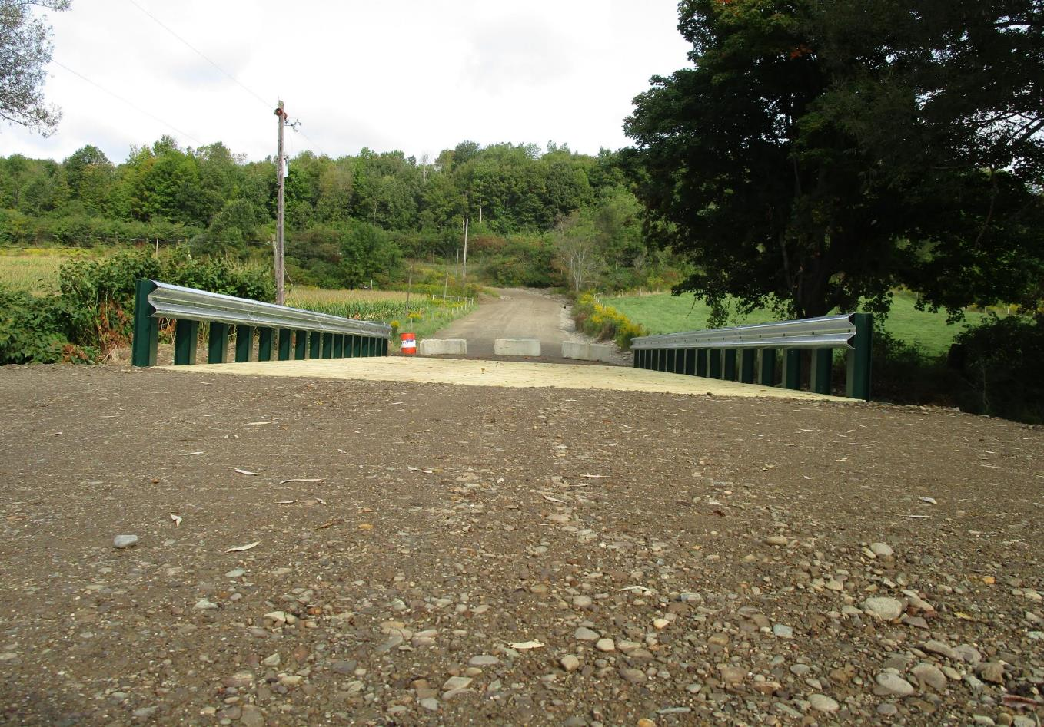
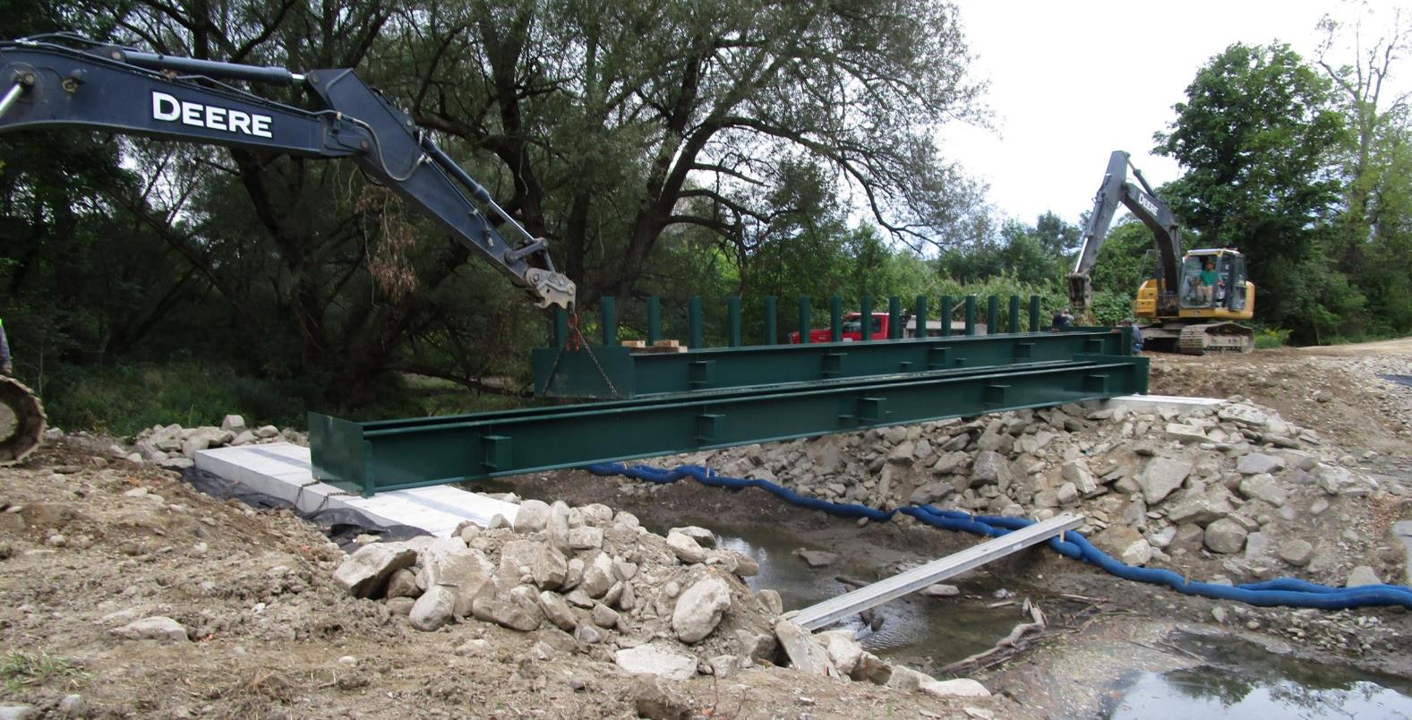
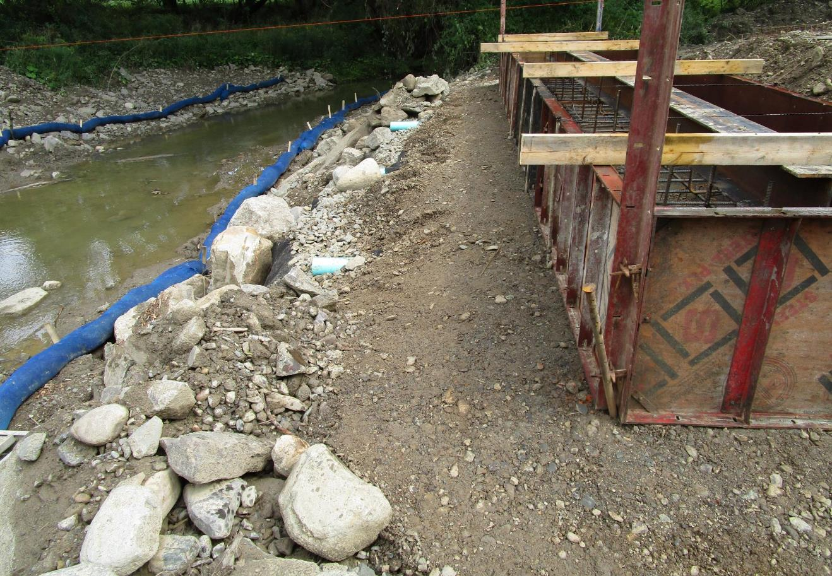
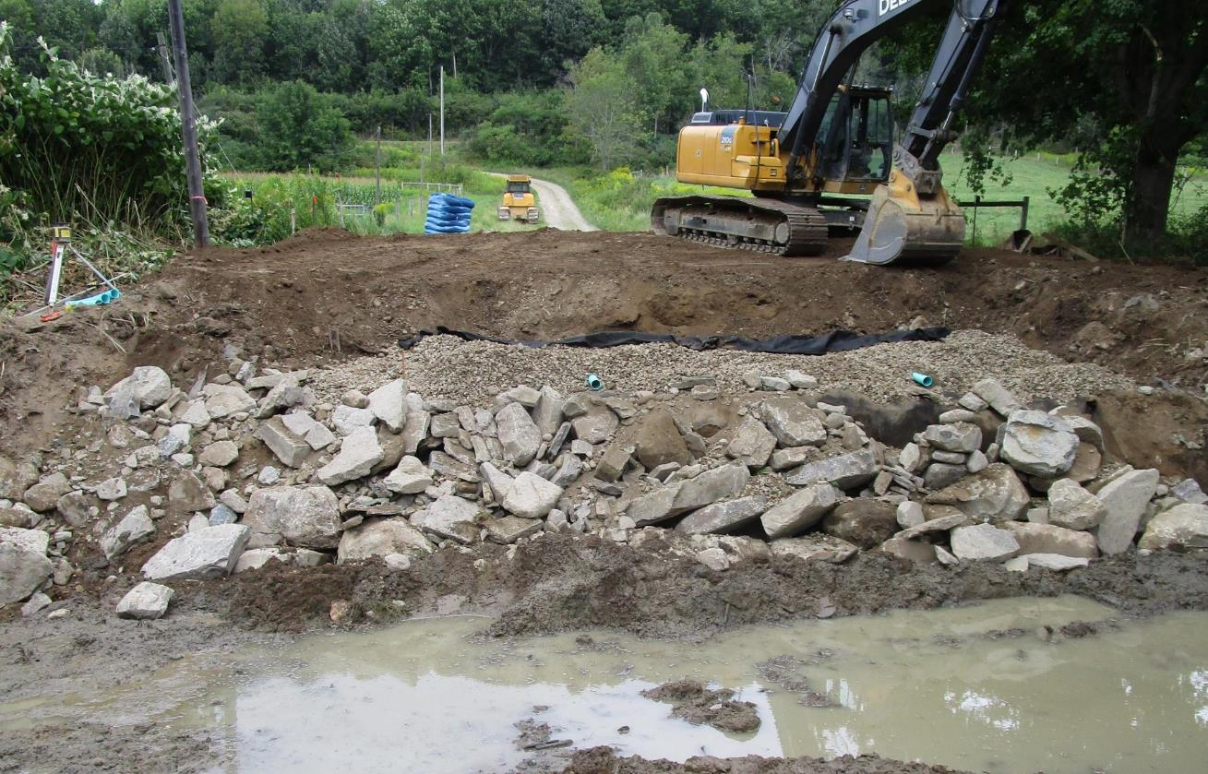
DURING CONSTRUCTION
www.dirtandgravelroads.org

Slide 67
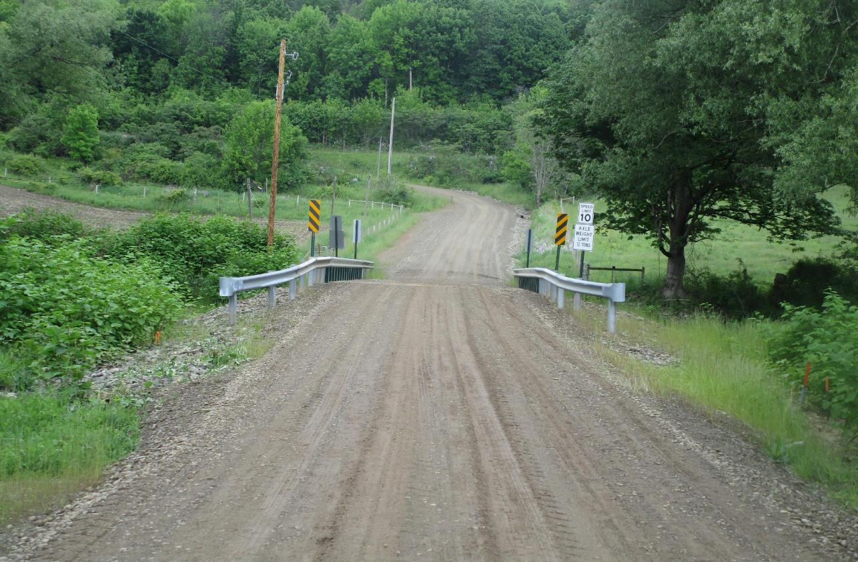
COMPLETED PROJECT
www.dirtandgravelroads.org

Slide 68
SUMMARY OF EXPERIENCE
Final Project Value: $217,775
In addition to the stream crossing this included 16 cross pipes, 2,905 tons road fill, seeding, mulching and instream restoration work.
No Road Closures Due to Flooding Since Project Completion
Better high-water flow under the new bridge
Series of (15) - 12 inch pipes provide flood relief through the road profile.
Township has another LVR project to replace a multiple pipe crossing on a tributary to this stream
Lessons Learned
Compaction of material right up to structure
Streams are going to flood - Plan for it!
Be as detailed as possible in your plan drawings and bid package.
www.dirtandgravelroads.org

Slide 69
SPREAD FOOTER BRIDGES
QUESTIONS?
Special Thank You to:
Clarion Conservation District
Warren County Conservation District
Indiana County Conservation District

