Slide 1
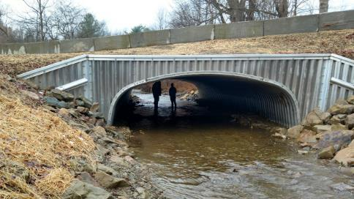
Dirt Gravel and Low Volume Road Program
WEBINAR
2/24/22
Starts 9am
Stream Crossing Comments
If you are reading this, then you are successfully seeing the webinar video. Webinar audio should be automatic through your computer (or click “join audio”), and options can be accessed in the “audio options” button on the bottom left. If your computer audio is not working, you can listen on your phone by dialing 312-626-6799.

Slide 2
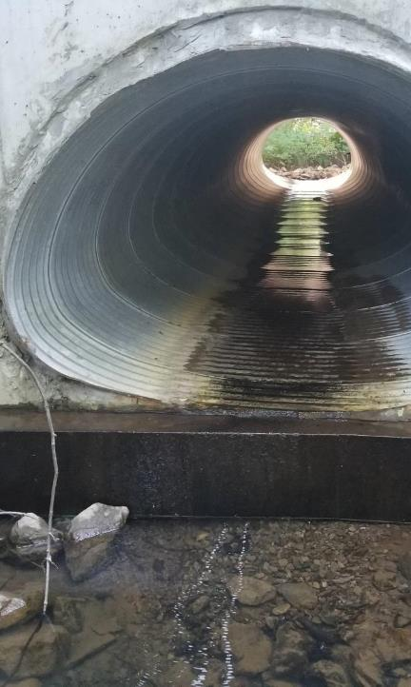
OUTLINE
Summary of Comments and Response Status
Discussion of “major themes” in responses
Long-pro confusion
Engineering cost concerns
CDs don’t have the time or funding
CDs may not fund or twps not apply for stream crossings
Slow the process down

Slide 3
Stream Crossing Discussion
Update on Comments Received:
CDGRS received:
~500 individual comments, not including corrections/editing
2 sets of comments from USFS
3 sets of comments from engineers
1 set of comments from PAFBC
1 set of comments from DEP
1 set of comments from NRCS
20 sets of comments from Conservation Districts
www.dirtandgravelroads.org

Slide 4
Stream Crossing Discussion
Update on Comments Received:
CDGRS received:
~500 individual comments, not including corrections/editing
2 sets of comments from USFS
3 sets of comments from engineers
1 set of comments from PAFBC
1 set of comments from DEP
1 set of comments from NRCS
20 sets of comments from Conservation Districts
PACD collected comments:
18 sets of comments from CDs (13 duplicate, 5 to PACD only)
CDGRS only: 7 CDs
PACD only: 5 CDs
PACD and CDGRS: 13 CDs
Total: 25 CDs
www.dirtandgravelroads.org

Slide 5
Stream Crossing Discussion
Moving Forward:
Responses:
Response to PACD letter: ~90% complete
Compiling of individual CD comments: 100% complete
“Distillation” of comments into manageable comment list: 90% complete
Creating response to comment list: 75% complete
Individual calls to discuss with CDs who provided comment: plan to start next week
www.dirtandgravelroads.org

Slide 6
Stream Crossing Discussion
Moving Forward:
Next Steps:
Finish comment responses
Advisory workgroup meeting(s)
Draft changes in documents
PDA legal and administrative review
Presentation to SCC for potential approval
www.dirtandgravelroads.org

Slide 7
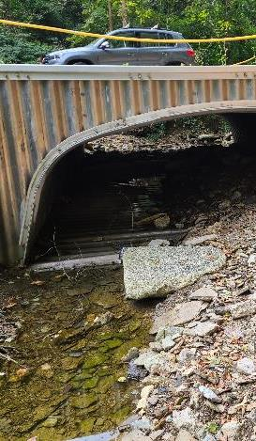
OUTLINE
Summary of Comments and Response Status
Discussion of “major themes” in responses
Long-pro confusion
Engineering cost concerns
CDs don’t have the time or funding
CDs may not fund or twps not apply for stream crossings
Slow the process down

Slide 8
Stream Crossing Discussion
Longitudinal Profile Confusion
Sample Comments:
Please explain the purpose of the preliminary long-pro vs. the final long-pro. It seems counterintuitive to designate staff time to conduct a prelim long-pro when the licensed professional will be responsible for the final long-pro.
Requiring the Conservation District to be on-site during field surveys could be a large expense for them.
just require the engineer to conduct the Longitudinal profile
Concern with CD technician needing to be on site for long pro survey. Engineers should be responsible for acquiring survey data
Engineering is not eligible to be paid unless there is a contract signed for the project, but we do need to have an accurate application for the project that we act on and approve.
www.dirtandgravelroads.org

Slide 9
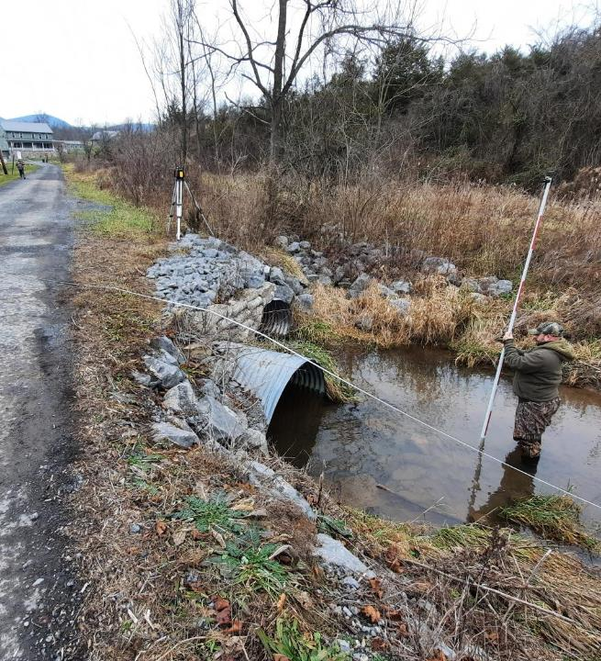
Stream Crossing Discussion
Preliminary Long Pro
Purpose: to measure site conditions to create a better application cost estimate.
Done by CD (help available)
Done before contracting
2 people, 2 hours, and $700 of equipment is all that is needed
NOT a design survey
Design Long Pro
Done by Engineer (or survey crew)
Done after contracting, before design
CD required to be on site
Purpose: to obtain final design measurements
www.dirtandgravelroads.org

Slide 10
Stream Crossing Discussion
Preliminary Long Pro
Purpose: to measure site conditions to create a better application cost estimate.
Done by CD (help available)
Done before contracting
2 people, 2 hours, and $700 of equipment is all that is needed
NOT a design survey
Design Long Pro
Purpose: to inform the project design
Done by Engineer (or survey crew)
Done after contracting, before design
CD required to be on site
www.dirtandgravelroads.org

Slide 11
Stream Crossing Discussion
Why does CD need to go out with engineer for the design survey?
Engineer often sends survey crew out
Survey crews are surveying experts, but not stream experts
Surveys are often inadequate
Too short (focus on structure only)
Miss key stream features (grade control, etc)
Results in inadequate design, or additional cost to re-survey
Long Pro is just part of an engineering survey, CD does not need to be there for rest of survey
www.dirtandgravelroads.org

Slide 12
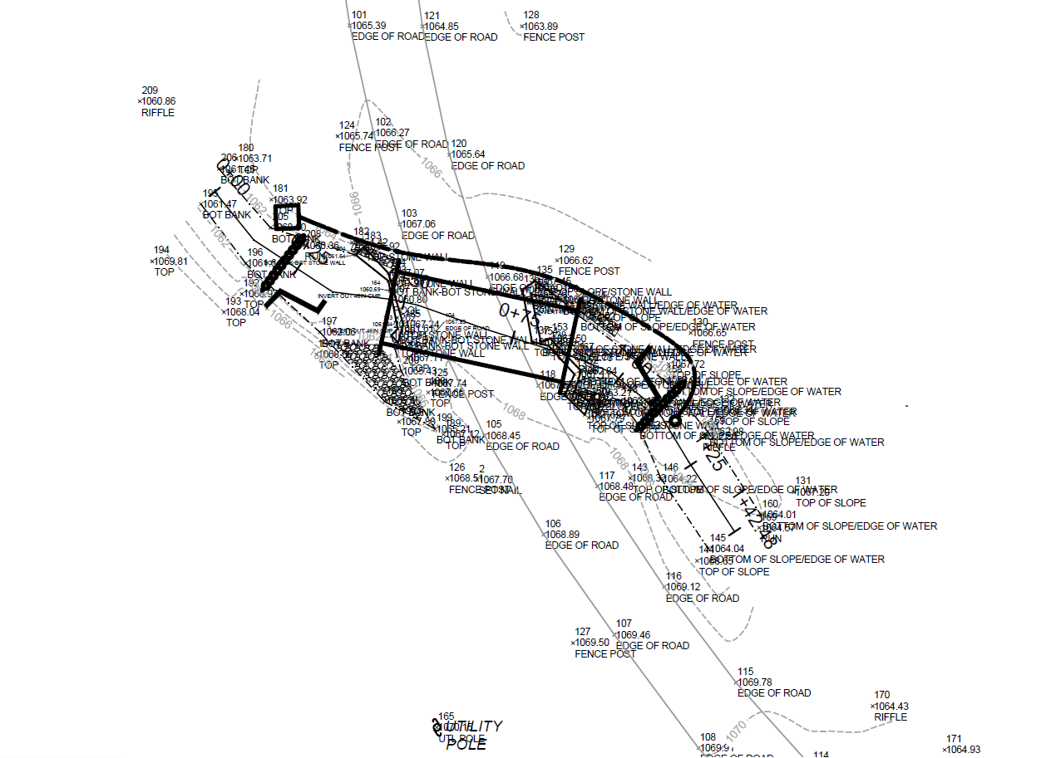
Stream Crossing Discussion
Example actual engineering survey
www.dirtandgravelroads.org

Slide 13
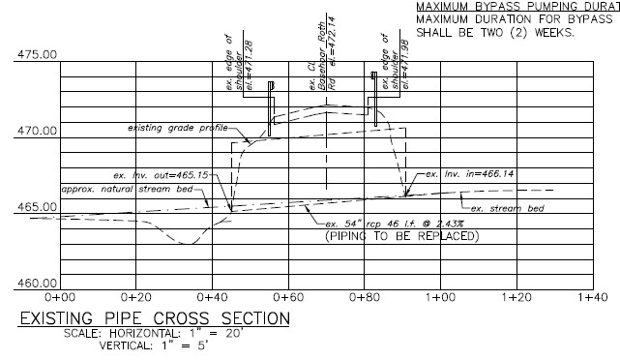
Stream Crossing Discussion
Example actual engineering survey
www.dirtandgravelroads.org

Slide 14
Stream Crossing Discussion
Longitudinal Profile Confusion
Sample Comments (Pro):
Reflecting on this more, I do not think an engineer will collect the riffle-run-pool features without District guidance. In my experience, I have not had an engineer/surveyor take a sufficiently detailed long pro.”
We feel that requiring district staff to know how to conduct surveys is not feasable. We do agree however that a representative of the program should be onsite for when the professional engineers/surveyors are conducting their work.
www.dirtandgravelroads.org

Slide 15
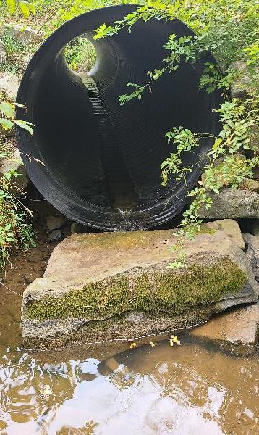
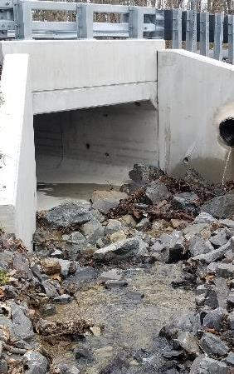
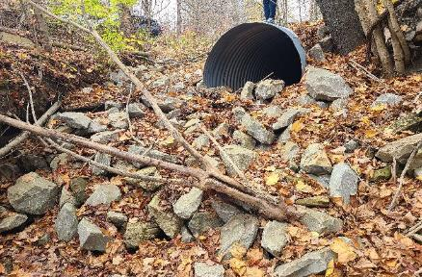
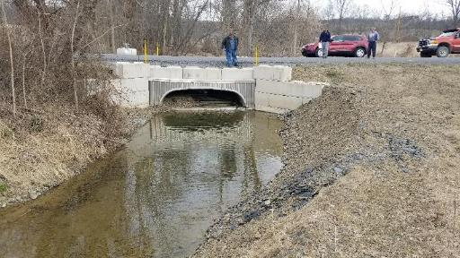
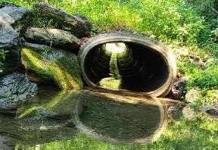
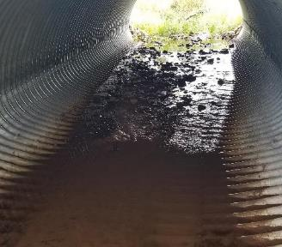
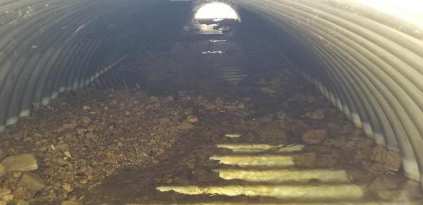
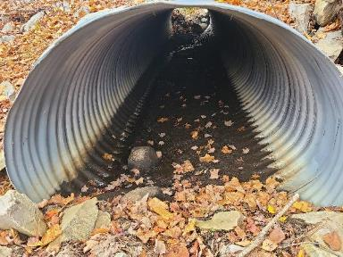
OUTLINE
Summary of Comments and Response Status
Discussion of “major themes” in responses
Long-pro confusion
Engineering cost concerns
CDs don’t have the time or funding
CDs may not fund or twps not apply for stream crossings
Slow the process down
www.dirtandgravelroads.org

Slide 16
Stream Crossing Discussion
Engineering Costs: example of “distilling” comments
64 comments receive on engineering cost
A lot of repetition, both within and between counties
Comments categorized and “distilled” to 4 questions / concerns
Requirements will drive up engineering cost, especially inspections and certification (8 CDs)
Increase the currently proposed (10%, 15% with bidding) engineering limit further, and do not require receiving bids for engineering. (12 CDs)
A training is needed specific to engineers, possibly required or incentivized. (8 CDs)
Program needs to find a way to pay engineers for design work before a contract is signed. (7 CDs)
www.dirtandgravelroads.org

Slide 17
Stream Crossing Discussion
Engineering Costs:
Requirements will drive up engineering cost, especially inspections and certification (8 CDs).
Yes, engineering costs will likely increase, but needed to address current shortcomings
Inadequate designs
Poor construction plans
Lack of involvement in inspection
Liability questions and issues
Will likely see initial increase, then gradual reduction.
Currently there is no design or construction standard
Standard gives engineer something to design to
www.dirtandgravelroads.org

Slide 18
Stream Crossing Discussion
Engineering Costs:
Increase the currently proposed (10%, 15% with bidding) engineering limit further, and do not require receiving bids for engineering. (12 CDs)
Understood, will consider alternatives and discuss with advisory workgroup
Potential changes:
Perhaps increase percentage and add maximum dollar value cap?
Not requiring bidding? Incentivize bidding?
Other suggestions?
In an example of the varying prices of engineering, in one case quotes were submitted by three engineering firms based on the new standard at $19,000, $50,000, and $69,000 for the same project.
www.dirtandgravelroads.org

Slide 19
Stream Crossing Discussion
Engineering Costs:
A training is needed specific to engineers, possibly required or incentivized. (8 CDs)
SCC/CDGRS agree
Current focus is on creating training for CDs.
Training for Engineers is under discussion, questions remain:
Length of training we can expect them to take?
Required versus incentivized.
Could reduce pool of engineers if required and a significant time investment
How to incentivize attendance
www.dirtandgravelroads.org

Slide 20
Stream Crossing Discussion
Engineering Costs:
Program needs to find a way to pay engineers for design work before a contract is signed. (7 CDs)
Costs incurred before contract is signed are not eligible for reimbursement.
Engineer should not be needed to:
Conduct preliminary long pro.
Complete an application.
Prepare a preliminary cost estimate.
Use of engineer before a contract is signed is at discretion of applicant (and can be counted as in-kind)
www.dirtandgravelroads.org

Slide 21
OUTLINE
Summary of Comments and Response Status
Discussion of “major themes” in responses
Long-pro confusion
Engineering cost concerns
CDs don’t have the time or funding
CDs may not fund or twps not apply for stream crossings
Slow the process down
www.dirtandgravelroads.org

Slide 22
Stream Crossing Discussion
CDs don’t have the time or funding to implement these projects.
Sample Comments:
Many Districts employ technicians to administer multiple programs. These technicians do not have adequate time to be "project managers“
CCD staffing may be an issue especially if more than one crossing in one construction season
Technicians that split time between the DGLVR program and other programs are going to have issues splitting time.
If the District Technicians have multiple programs that they oversee there will be little chance that they would be able to spend the time on these projects that will be required.
The increase in the time ….will most likely cause us to go over the hours that can be paid through the program.
Administrative allowances should be increased to 15%
www.dirtandgravelroads.org

Slide 23
Stream Crossing Discussion
CDs don’t have the TIME to implement these projects.
Stream crossing replacements are inherently more complex than typical drainage improvements done by the Program
The current lack of time investment is one of many factors impacting project success.
www.dirtandgravelroads.org

Slide 24
Stream Crossing Discussion
CDs don’t have the FUNDING to implement these projects.
CD administrative limits set by law, not policy.
CDs spending 7.5% on admin and 3.2% on education statewide (‘17-’21)
If a district cannot devote the time or commit to training staff on how to properly implement a stream crossing, it may be better for that district to focus on the types of projects they have capacity to properly oversee. Districts can decide locally what projects they are able to implement, which could include the decision to not fund or limit the number of stream crossing replacements.
www.dirtandgravelroads.org

Slide 25
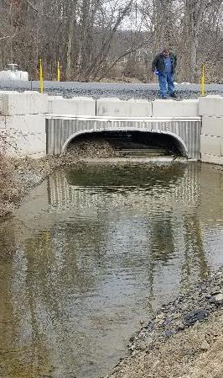
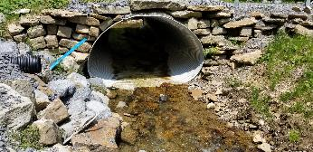
OUTLINE
Summary of Comments and Response Status
Discussion of “major themes” in responses
Long-pro confusion
Engineering cost concerns
CDs don’t have the time or funding
CDs may not fund or twps not apply for stream crossings
Slow the process down
www.dirtandgravelroads.org

Slide 26
Stream Crossing Discussion
These changes will lead to CDs not funding stream crossing or twps not applying for them
Sample Comments:
The proposed changes, could lead to the elimination of stream crossing work in our County and thus jeopardize our funding allocation, and the District's ability to offer the program.
My fear after reading all of this is that it will detract municipalities from participating in DGLVR projects at all.
…the reluctance of Township or Municipality participation due to the complexity of the new requirements.
I would envision doing fewer, if not zero, stream crossing projects through the program once I share these new requirements with the municipality.
A general comment on the policy change would be that it would limit the number of stream crossing projects a District can do because of how time consuming and involved the project would be
As currently proposed, however, I feel that fewer projects will be submitted for consideration and ultimately funded for replacement.
www.dirtandgravelroads.org

Slide 27
Stream Crossing Discussion
These changes will lead to CDs not funding stream crossing or twps not applying for them
With life expectancies of 50-75 years, it is more important to install stream crossings correctly compared to drainage projects.
An initial decline in stream crossing projects is expected until new standard becomes more familiar to everyone.
It is more important for DGLVR funding to install quality projects that meet Program goals than to install a greater number of projects that do not meet Program goals.
www.dirtandgravelroads.org

Slide 28
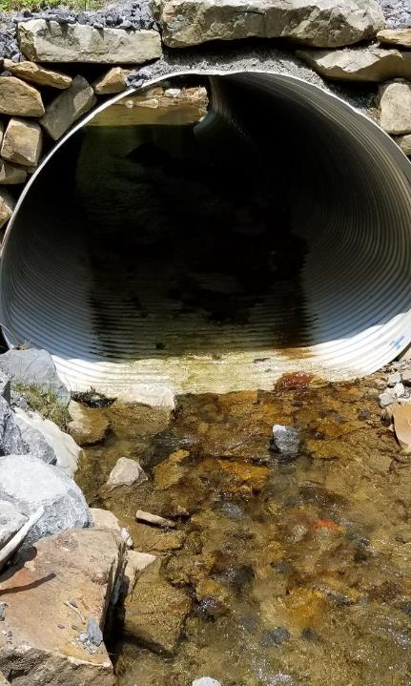
OUTLINE
Summary of Comments and Response Status
Discussion of “major themes” in responses
Long-pro confusion
Engineering cost concerns
CDs don’t have the time or funding
CDs may not fund or twps not apply for stream crossings
Slow the process down
www.dirtandgravelroads.org

Slide 29
Stream Crossing Discussion
This is a lot at once. Can the process be slowed down, guidance at first, demo projects, etc., eventually leading to policy
Sample Comments:
Rather than following the current timeline, perhaps it would be better to release the Standard and Manual with a one year transition period.
The majority of issues could be addressed through more education and training
Are there aspects that can be just guidance …versus a requirement?
www.dirtandgravelroads.org

Slide 30
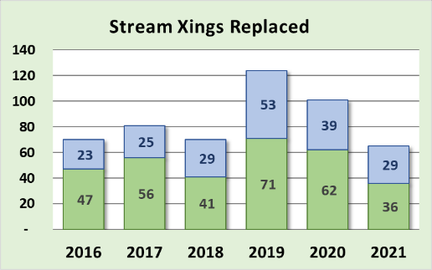
Stream Crossing Discussion
This is a lot at once. Can the process be slowed down, guidance at first, demo projects, etc., eventually leading to policy
We have a lot of “Demo” projects. Program is currently funding ~85 crossing a year
What are the options for “slowing the process down”, without putting an additional 150+ “inadequate” crossing in over the next two years?
Comment: If the concern is that stream crossings will be implemented improperly until the process is completed, then the program needs to temporarily stop contracting stream crossings until the due diligence process has been completed. We are of the opinion that the standard should be done right, not necessarily right now.
www.dirtandgravelroads.org

Slide 31
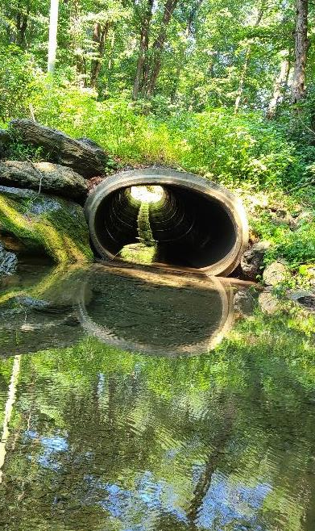
OUTLINE
Summary of Comments and Response Status
Discussion of “major themes” in responses
Long-pro confusion
Engineering cost concerns
CDs don’t have the time or funding
CDs may not fund or twps not apply for stream crossings
Slow the process down
www.dirtandgravelroads.org

Slide 32
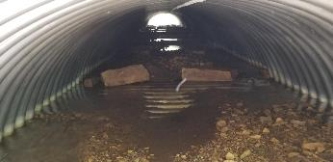
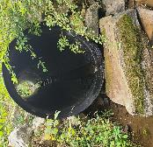
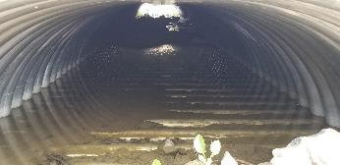
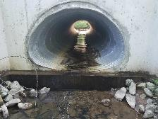
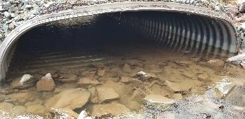
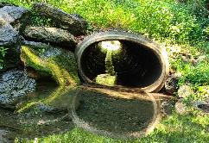
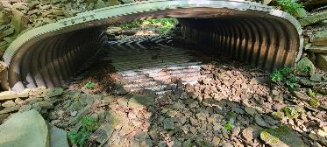
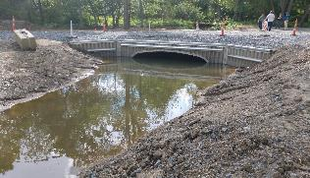
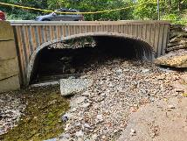
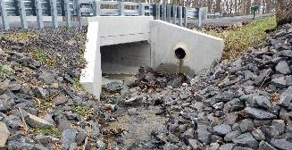
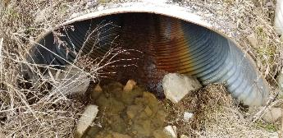
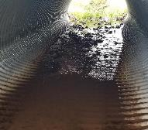
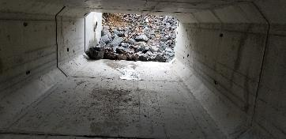
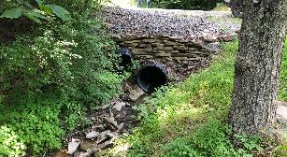
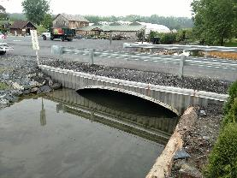
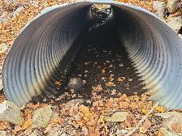
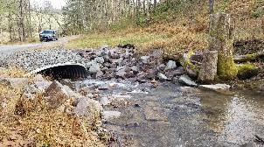
We can do better.
We need to do better
www.dirtandgravelroads.org

Slide 33
Thank you for your time and concern to provide feedback
Many comments were positive:
The District appreciates the inclusion of this section(Construction Specification withing Standard) within the document. During a recent bottomless arch culvert installation, the contractor over excavated the stream channel for footer installation and at this time (post project), the stream runs subsurface through the bottomless arch. This is being investigated by DEP but hopefully, this design standard will prevent this situation from occurring on a DGLVR project.
The construction design specs will make it much easier to oversee a project installation
(Increase in engineering cost) is a big improvement
The Automatic Exemption form seems like a very good idea. We have plenty of crossings which haven't been addressed due their cost/ benefit scenarios. It’s been a prohibitive factor for us to not fix issues with smaller pipes with no AOP or value.
Good, Conservation District Staff should always attend these meetings (pre contract, site showing, etc.) . As the funding flows through our hands, it’s important to have every detail throughout the process.
Pre-Design meeting is a great idea….Anything of this nature CD staff should be included on. Many CD staff members are new to DGLVR and engineering designs, so the more exposure the better.
We like and appreciate the concept of utilizing a technical manual along with standards and specifications - this was a lot of work, well done.
There are a lot of extra steps that are going to be added for stream crossing projects, but I think they are good contributions that will result in better project outcomes. A lot of the changes are things we have already adopted because of the feedback received from our QAQC Review.
I love the exemption request. This will be a big impact in our county where we have a lot of “stormwater drainage ways” that end up counting as “streams” under the current definition.

Slide 34
Thank you for your time and concern to provide feedback
Some external agency feedback:
PA Department of Conservation and Natural Resources (DCNR) feedback on DGLVR documents (2/21/22): “DCNR also supports the combined efforts of the State Conservation Commission and Center for Dirt and Gravel Road Studies in regard to the development of the technical guidance documents for stream crossings….While the SCC/DGR guidance documents include much more technical based guidance, both of our agencies are aiming to achieve the same goals for aquatic organism passage.”
PA Department of Environmental Protection (DEP) feedback on DGLVR documents from DEP (2/17/22): “Overall, the proposed changes are positive and in keeping with resource protections and generally consistent with DEP’s regulations under Chapter 105. The proposed stream crossing replacement changes are positive both for stewardship of funds and the environment because it promotes and funds projects which are resilient to flood damage by being designed to withstand higher intensity storm events, thereby decreasing maintenance and replacement costs and promoting aquatic connectivity and reduced erosion… The implementation of these policies and guides places the DGLVR program as a leader in promoting stream continuity design within Pennsylvania.”
PA Fish and Boat Commission (PFBC) feedback on DGLVR documents from DEP (2/1/22): “The PFBC certainly appreciates the hard work that went into developing the new policy, standard and technical manual. We are optimistic that this effort will result in improved stream continuity at road stream crossings and hope that the practices outlined in the technical manual can be a model for non DGLVR projects state wide.”
US Forest Service (USFS) feedback on DGLVR documents from DEP (1/19/22): “Your group did a really nice job of pulling all these pieces together to guide what happens within your sphere of influence. Well done.”

Slide 35
Stream Crossing Discussion
Thanks for joining us and being patient.
This was just a “big picture” comment overview.
More discussion to come.
Next Steps
Finish comment responses
Advisory workgroup meeting(s)
Draft changes in documents
PDA legal and administrative review
Presentation to SCC
QUESTIONS?
www.dirtandgravelroads.org

