Slide 1
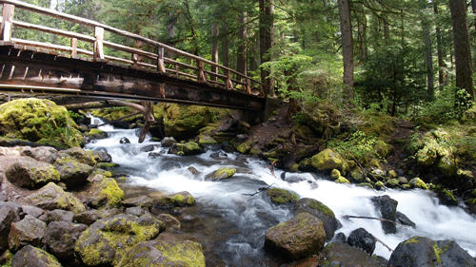
DGLVR Webinar
Stream Crossing Notifications
7/24/20
Starts at 9am
If you are reading this, then you are successfully seeing the webinar video. Webinar audio should be automatic through your computer, and options can be accessed in the “audio options” button on the bottom left. If your computer audio is not working, you can listen on your phone by dialing 312-626-6799.
Audio via Phone: 312-626-6799

Slide 2
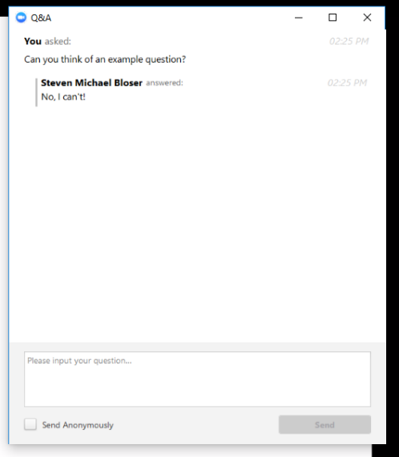
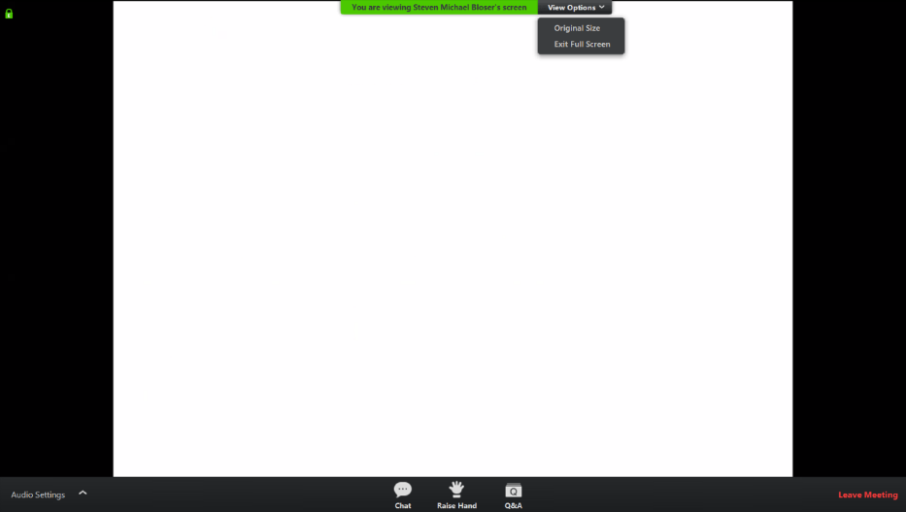
Q&A
Note you can ask a question anonymously
Q&A
Audio via Phone: 312-626-6799
Slide #

Slide 3
DGLVR Webinar
Policy, DSA, and more
Purpose:
Provide overview of Stream Crossing Notification process built into CDGRS website
Allow CDs to ask questions
Audio via Phone: 312-626-6799

Slide 4
DGLVR Educational Efforts Update
Reminder: what is the policy?
Conservation Districts are required to notify the SCC of proposed stream crossing replacements as soon as practical before a contract is signed”.
Details: Stream crossing replacements are more expensive, complicated, and have a longer life expectancy than many of the other “standard” DGLVR practices. Many of these projects are designed with little or no consideration for aquatic organism passage and maintaining substrate through the new structure. This notification system is intended to allow SCC/CDGRS/TU to have earlier input into project designs to avoid problems in project implementation. An online notification will be created for CDs to use as part of the CDGRS website. Note this is requirement for SCC notification, not approval.

Slide 5
DGLVR Educational Efforts Update
Conservation Districts are required to notify the SCC of proposed stream crossing replacements as soon as practical before a contract is signed”.
Why are notifications required?
To many projects not going in correctly
Earlier involvement is key to getting projects off on the right foot.

Slide 6
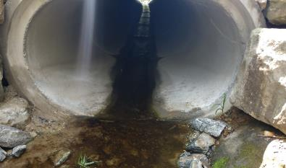
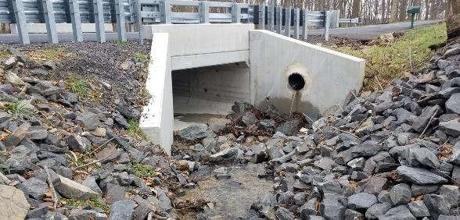
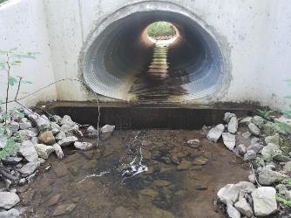
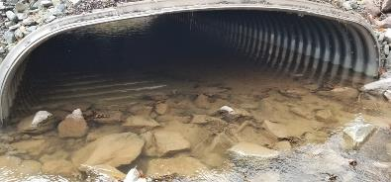
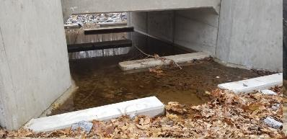
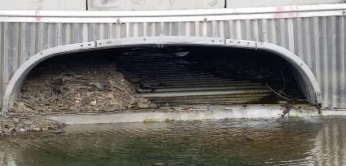
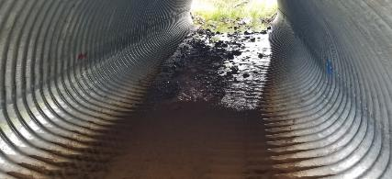
DGLVR Educational Efforts Update
Conservation Districts are required to notify the SCC of proposed stream crossing replacements as soon as practical before a contract is signed”.
Why are notifications required?

Slide 7
DGLVR Educational Efforts Update
Conservation Districts are required to notify the SCC of proposed stream crossing replacements as soon as practical before a contract is signed.
Q: Is this a notification or approval?
A: This is a notification. Once you submit, you can proceed with project. SCC/CDGRS/TU will contact you with any questions or concerns.

Slide 8
DGLVR Educational Efforts Update
Conservation Districts are required to notify the SCC of proposed stream crossing replacements as soon as practical before a contract is signed.
Q: Do I have to notify of 100% in-kind stream crossing replacements?
A:
If you are not counting it as in-kind for DGLVR: NO.
If you are counting it as in-kind for DGLVR: Yes. Remember that anything counted as in-kind for DGLVR projects must meet Program standards.

Slide 9
DGLVR Educational Efforts Update
Conservation Districts are required to notify the SCC of proposed stream crossing replacements as soon as practical before a contract is signed.
Q: When should I submit a notification?
A:
At a minimum, before a contract is signed.
The earlier the better once you are ~75% sure a project is likely to be funded.

Slide 10
DGLVR Educational Efforts Update
Conservation Districts are required to notify the SCC of proposed stream crossing replacements as soon as practical before a contract is signed.
Q: DO I have to submit notifications for projects that are already under contract?
A:
Optional, notification only required for contracts signed after 7/22/20.
Although, we would be happy to provide feedback and assistance on current contracts if you have questions or concerns

Slide 11
DGLVR Educational Efforts Update
Conservation Districts are required to notify the SCC of proposed stream crossing replacements as soon as practical before a contract is signed.
Q: Who submits the notification?
A:
CD manager / technician.
Must have CDGRS website login (same as GIS)

Slide 12
DGLVR Educational Efforts Update
Conservation Districts are required to notify the SCC of proposed stream crossing replacements as soon as practical before a contract is signed.
Q: What if one project involves multiple stream crossing replacements?
A:
Each notification is for a single crossing
Submit multiple notifications for multiple crossings

Slide 13
DGLVR Educational Efforts Update
Conservation Districts are required to notify the SCC of proposed stream crossing replacements as soon as practical before a contract is signed.
Q: Where do the notifications go?
A:
For now, the go to Roy, Steve, Justin, and TU and we will discuss them weekly as we expect a flush to come in all at once.
Long term procedure is TBD

Slide 14
DGLVR Educational Efforts Update
Conservation Districts are required to notify the SCC of proposed stream crossing replacements as soon as practical before a contract is signed.
Q: What are possible outcomes of notifications?
Maybe nothing
Maybe an e-mail asking if everything is OK
Maybe a phone call to discuss
Maybe a field visit
Maybe an intervention

Slide 15
DGLVR Educational Efforts Update
Conservation Districts are required to notify the SCC of proposed stream crossing replacements as soon as practical before a contract is signed.
Questions?
Next: Live demo of notification process

