Slide 1
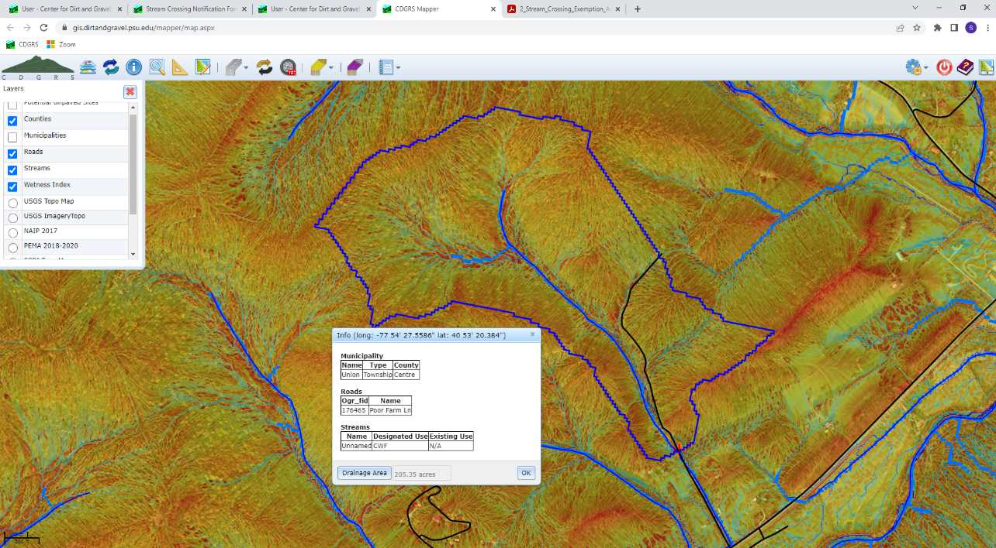
Dirt Gravel and Low Volume Road Program
WEBINAR
1/5/22
Starts 9am
Stream Notification and Exemptions
CDGRS
Steve Bloser
smb201@psu.edu
SCC
Roy Richardson
rrichardso@pa.gov
SCC
Sherri Law
shlaw@pa.gov
If you are reading this, then you are successfully seeing the webinar video. Webinar audio should be automatic through your computer (or click “join audio”), and options can be accessed in the “audio options” button on the bottom left. If your computer audio is not working, you can listen on your phone by dialing 312-626-6799.

Slide 2
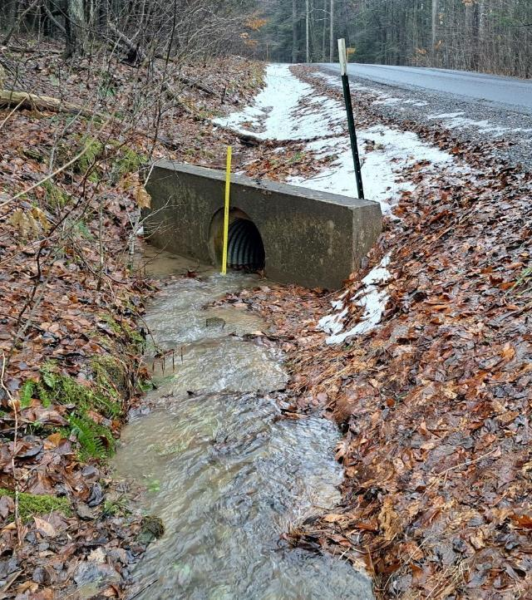
Stream Notification and Exemptions
Notifications:
Reminder and review of process
Added input for exemptions
Exemptions:
Review process
A few examples

Slide 3
Stream Notifications and Exemptions
Where the DGLVR Stream Crossing Policy Applies
where streams, including intermittent channels, with identified bed and banks are flowing into the road or the uphill ditch.
All stream crossing replacements funded in whole or in part with DGLVR funds, or listed as in-kind on a DGLVR Project, must follow the DGLVR Stream Crossing Design & Installation Standard
unless an “Exemption from DGLVR Stream Crossing Standard” is applicable
www.dirtandgravelroads.org

Slide 4
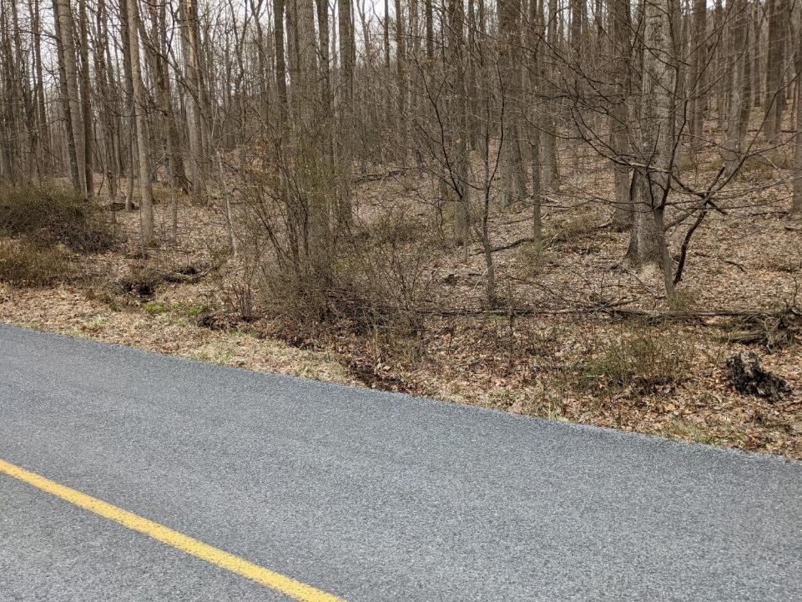
Stream Notifications and Exemptions
Where the
DGLVR Stream
Crossing Policy
Applies
Example 1
Looking upslope from road
www.dirtandgravelroads.org

Slide 5
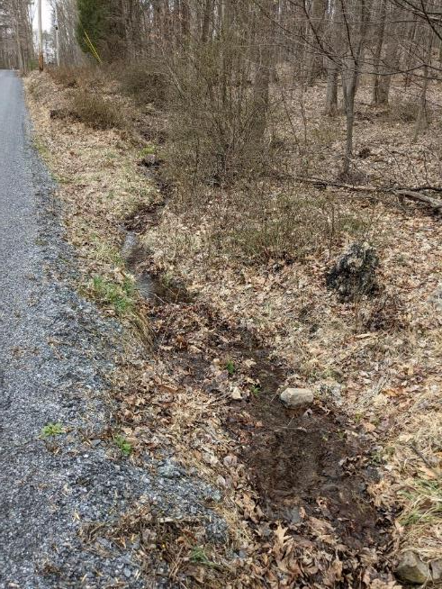
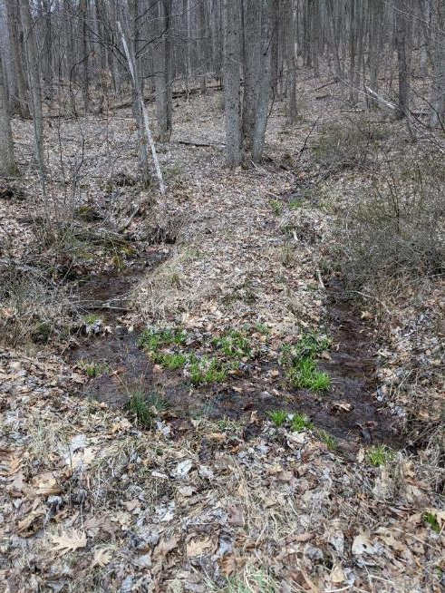
Stream Notifications and Exemptions
Where the
DGLVR Stream
Crossing Policy
Applies
Example 1
Looking upslope from road
www.dirtandgravelroads.org

Slide 6
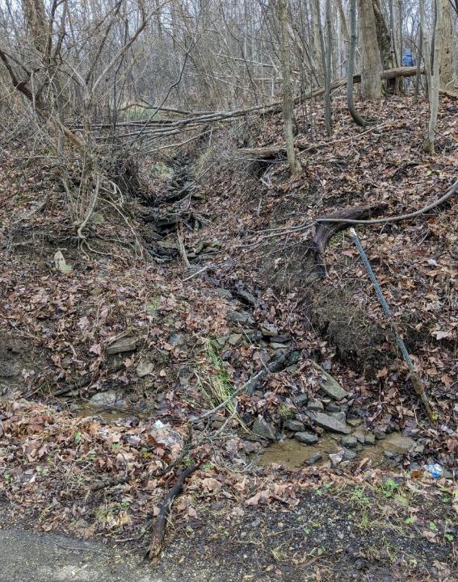
Stream Notifications and Exemptions
Where the
DGLVR Stream
Crossing Policy
Applies
Example 2
Looking upslope from road
www.dirtandgravelroads.org

Slide 7
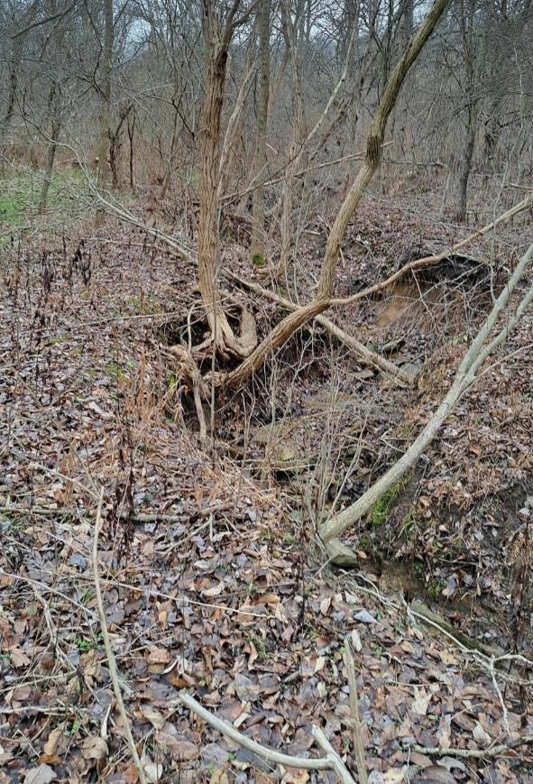
Stream Notifications and Exemptions
Where the
DGLVR Stream
Crossing Policy
Applies
Example 3
Looking upslope from road
www.dirtandgravelroads.org

Slide 8
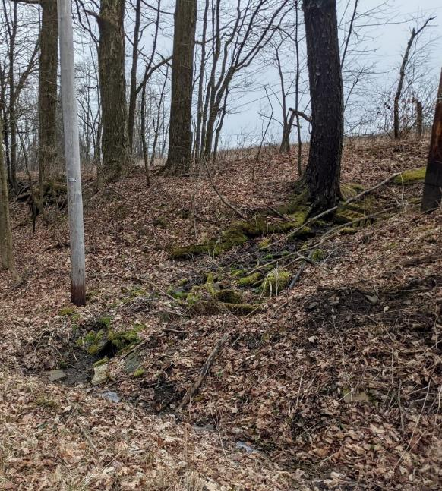
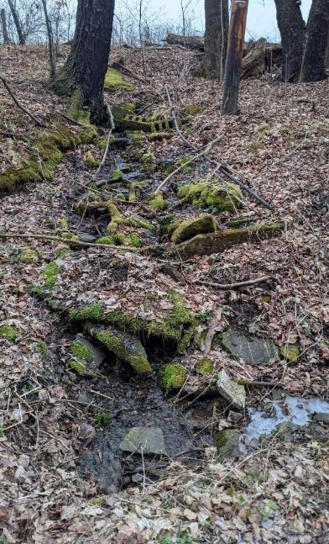
Stream Notifications and Exemptions
Where the
DGLVR Stream
Crossing Policy
Applies
Example 4
Looking upslope from road
www.dirtandgravelroads.org

Slide 9
Stream Notifications and Exemptions
Stream Crossing Notifications
With the new standard in place, are stream crossing replacement notifications still required?
www.dirtandgravelroads.org

Slide 10
Stream Notifications and Exemptions
Stream Crossing Notifications
With the new standard in place, are stream crossing replacement notifications still required?
Yes: (DGLVR Administrative Manual 7.1.2.2)
SCC Notification: Conservation districts are required to notify the State Conservation Commission (SCC) of proposed stream crossing replacements as soon as practical before a contract is signed. An online notification system is available by logging in to the Center for Dirt and Gravel Road Studies website (same log-in as accessing the GIS system) at www.dirtandgravelroads.org.
www.dirtandgravelroads.org

Slide 11
Stream Notifications and Exemptions
Stream Crossing Notifications
Why are notifications still required?
www.dirtandgravelroads.org

Slide 12
Stream Notifications and Exemptions
Stream Crossing Notifications
Why are notifications still required?
To get ahead of potential issues
To gauge upcoming workload
To ensure adequate TA is available
www.dirtandgravelroads.org

Slide 13
Stream Notifications and Exemptions
Stream Crossing Notifications
Are notifications required for exempt crossings?
www.dirtandgravelroads.org

Slide 14
Stream Notifications and Exemptions
Stream Crossing Notifications
Are notifications required for exempt crossings?
Yes: (DGLVR Administrative Manual 7.1.3)
Complete the “Automatic Exemption from the DGLVR Stream Crossing Standard” form (Appendix I) and keep it in the project file. Automatic exemptions still need to be reported in the SCC notification system.
New input selections for exempt crossings in notification system – will review
www.dirtandgravelroads.org

Slide 15
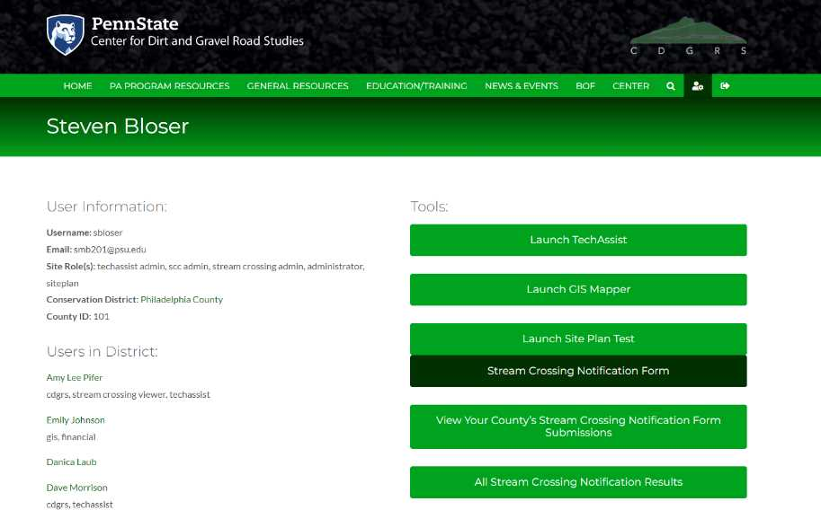
Stream Notifications and Exemptions
Stream Crossing Notifications
Where:
www.dirtandgravelroads.org

Slide 16
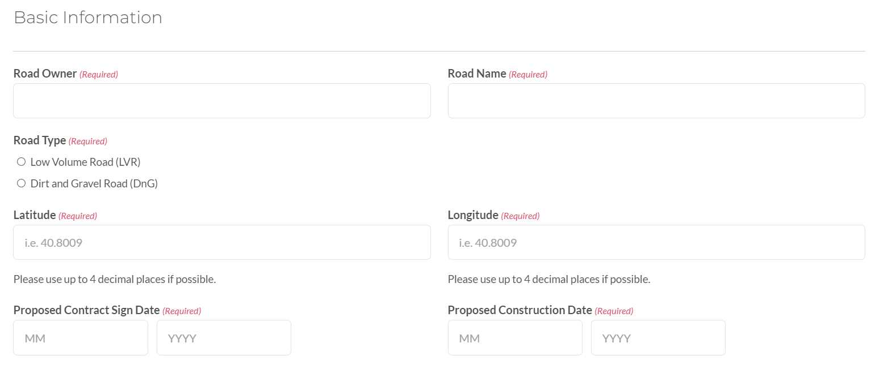
Stream Notifications and Exemptions
Basic Information: who, what, where, when
www.dirtandgravelroads.org

Slide 17
Stream Notifications and Exemptions
Existing Conditions: bankfull and existing structure
www.dirtandgravelroads.org

Slide 18
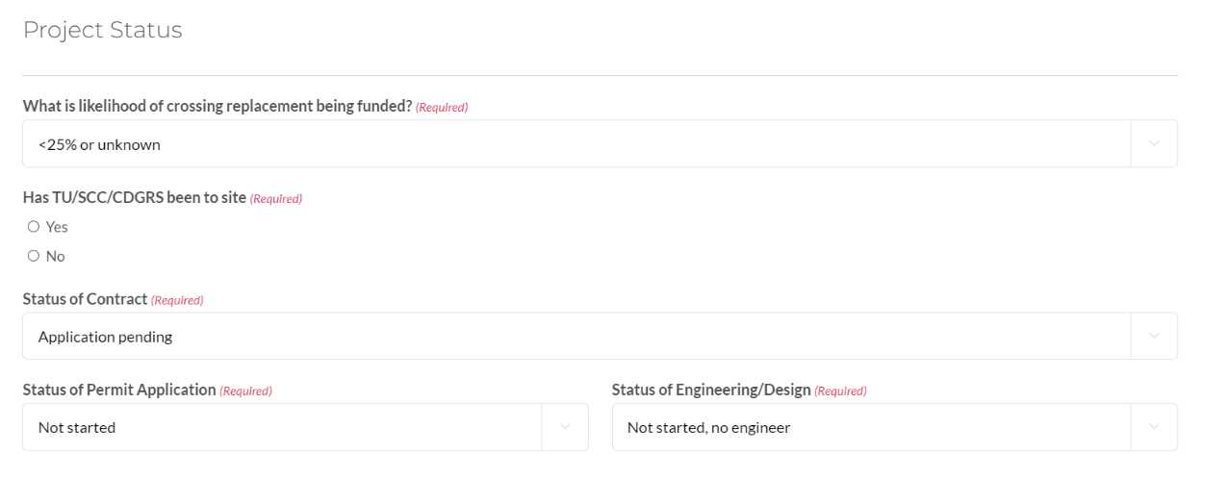
Stream Notifications and Exemptions
Project Status
www.dirtandgravelroads.org

Slide 19
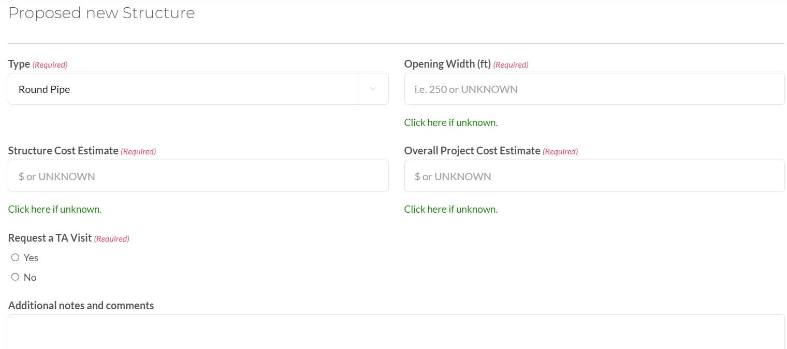
Stream Notifications and Exemptions
Proposed New Structure: if known, what will likely be installed
www.dirtandgravelroads.org

Slide 20
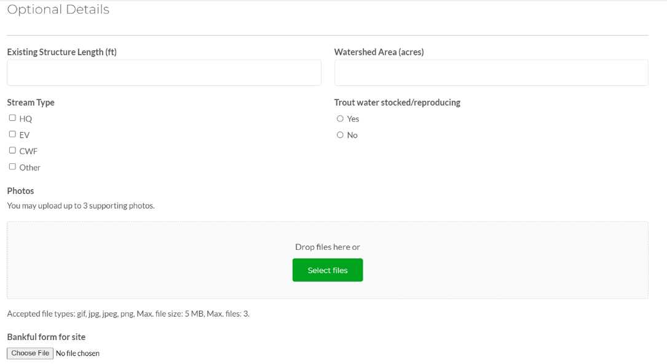
Stream Notifications and Exemptions
Optional Details: other information and pictures
www.dirtandgravelroads.org

Slide 21
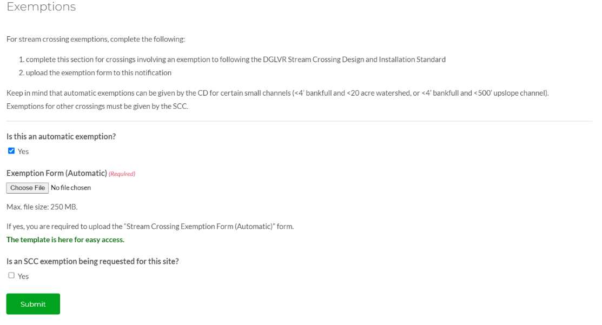
Stream Notifications and Exemptions
NEW SECTION: Exemptions: must upload either automatic or SCC approve exemption form
Automatic
SCC Approved
www.dirtandgravelroads.org

Slide 22
Stream Notification and Exemptions
Notifications:
Reminder and review of process
Added input for exemptions
Exemptions:
Review process
A few examples

Slide 23
Stream Notifications and Exemptions
Two types of exemptions
Automatic Exemption
for small channels
CD may grant without SCC approval
SCC Approved
For any circumstance not covered by automatic exemption
Reminder: All Exemptions
are only exempt from following DGLVR standard, not any permit or other requirements
Are still required to be 1.25 BF and ensure stability above and below new structure
www.dirtandgravelroads.org

Slide 24
Stream Notifications and Exemptions
Automatic Exemptions
Two scenarios where CD may exempt a crossing:
< 4’ Bankfull and < 20-acre watershed
< 4’ Bankfull and < 500’ of “bed and banks” channel
Must fill out “automatic exemption” form and keep in file.
Must complete SCC “stream crossing notification” online, including uploading automatic exemption form.
No SCC approval required.
Reminder: All Exemptions
are only exempt from following DGLVR standard, not any permit or other requirements
Are still required to be 1.25 BF and ensure stability above and below new structure
www.dirtandgravelroads.org

Slide 25
Stream Notifications and Exemptions
Automatic Exemptions
Two scenarios where CD may exempt a crossing:
< 4’ Bankfull and < 20-acre watershed
Easier, can be done “remotely”
DGLVR GIS is a good tool, especially with wetness index
< 4’ Bankfull and < 500’ of “bed and banks” channel
More difficult, requires field determination
Reminder: All Exemptions
are only exempt from following DGLVR standard, not any permit or other requirements
Are still required to be 1.25 BF and ensure stability above and below new structure
www.dirtandgravelroads.org

Slide 26
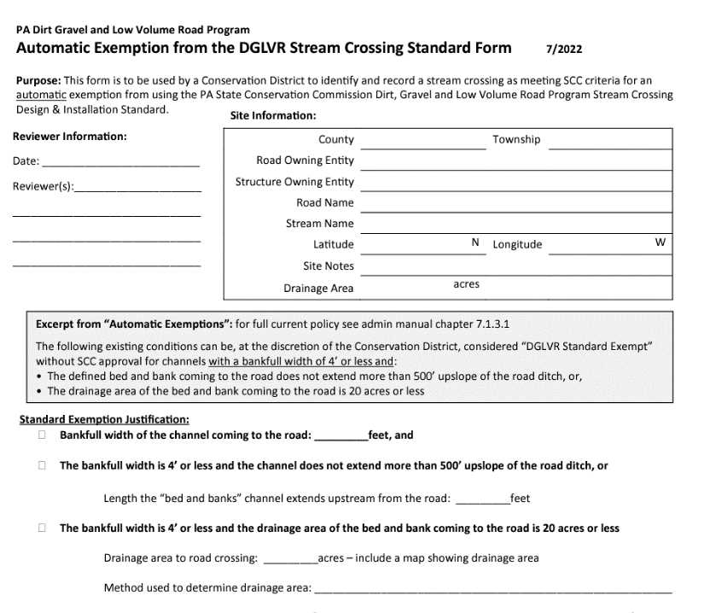
Stream Notifications and Exemptions
Automatic Exemption
Form
1-page
Keep in project file
Upload to notification
Site
Info
Justification
Reminder: All Exemptions
are only exempt from following DGLVR standard, not any permit or other requirements
Are still required to be 1.25 BF and ensure stability above and below new structure
www.dirtandgravelroads.org

Slide 27
Stream Notifications and Exemptions
BONUS:
Stream stats now available directly in DGLVR GIS
to get watershed areas
DEMO
www.dirtandgravelroads.org

Slide 28
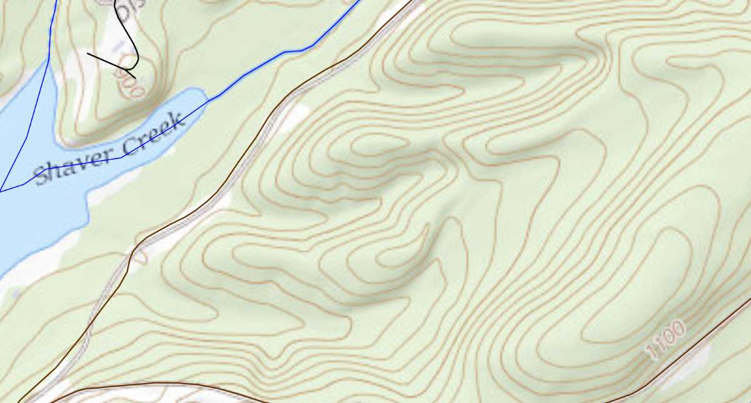
Stream Notifications and Exemptions
2
3
1
www.dirtandgravelroads.org

Slide 29
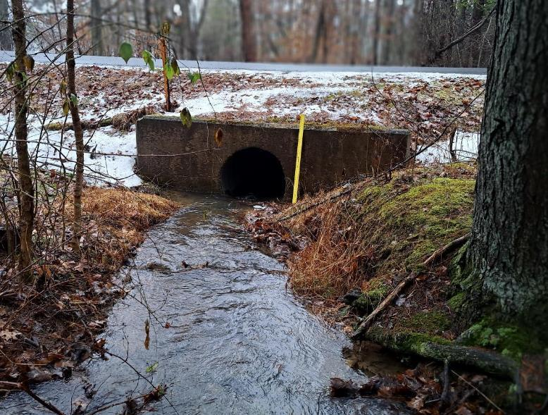
Stream Notifications and Exemptions
Crossing 1: 36” pipe inlet
2
Site 1 picture
3
1
www.dirtandgravelroads.org

Slide 30
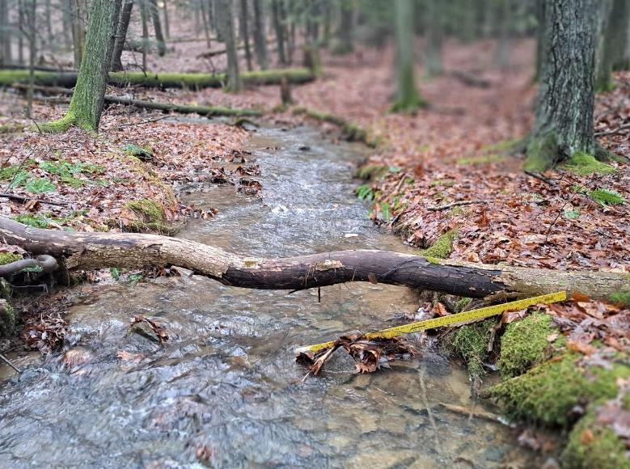
Stream Notifications and Exemptions
Crossing 1: 9’ Bankfull
2
Site 1 picture
3
1
www.dirtandgravelroads.org

Slide 31
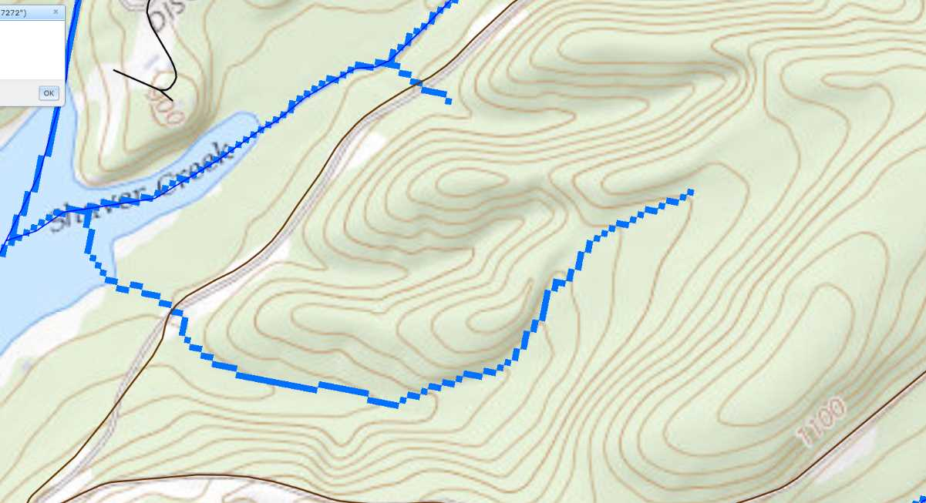
Stream Notifications and Exemptions
Crossing 1:
No USGS blueline
9’ Bankfull
Has streamstats blueline
2
2
3
3
1
1
www.dirtandgravelroads.org

Slide 32
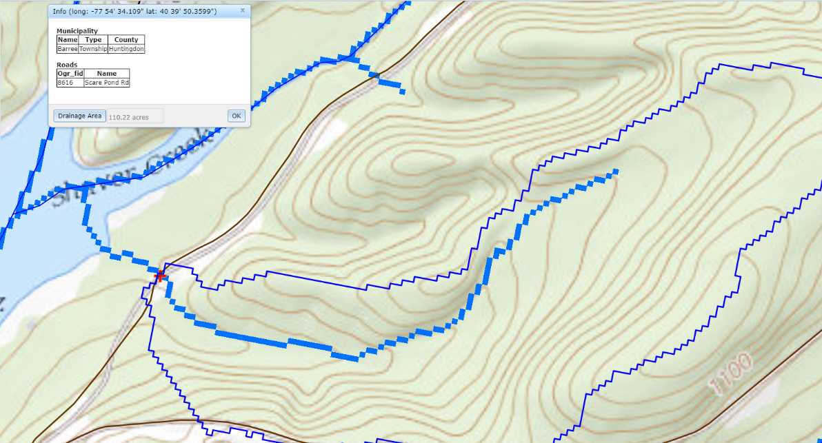
Stream Notifications and Exemptions
Crossing 1:
No USGS blueline
9’ Bankfull
Has streamstats blueline
Streamstats returns 110 Acre Watershed
Not eligible for automatic waiver
Bankfull over 4’
Watershed over 20 acres
2
3
1
www.dirtandgravelroads.org

Slide 33
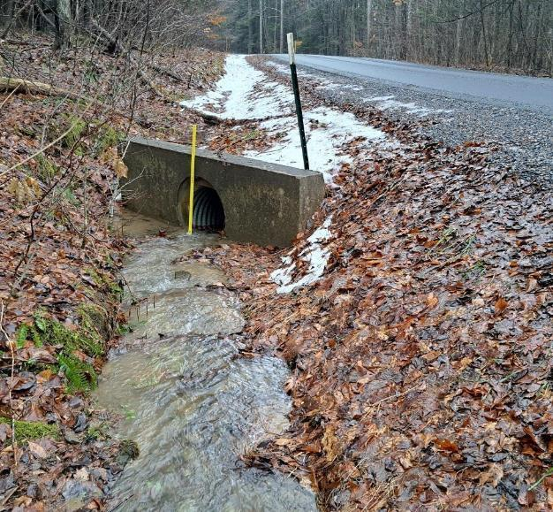
Stream Notifications and Exemptions
Crossing 2: 24” pipe inlet
2
Site 2 picture
3
1
www.dirtandgravelroads.org

Slide 34
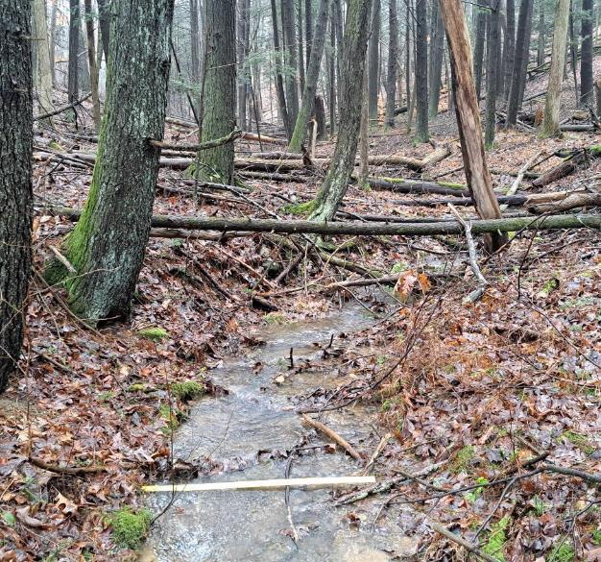
Stream Notifications and Exemptions
Crossing 2: 5’ bankfull
2
Site 2 picture
3
1
www.dirtandgravelroads.org

Slide 35
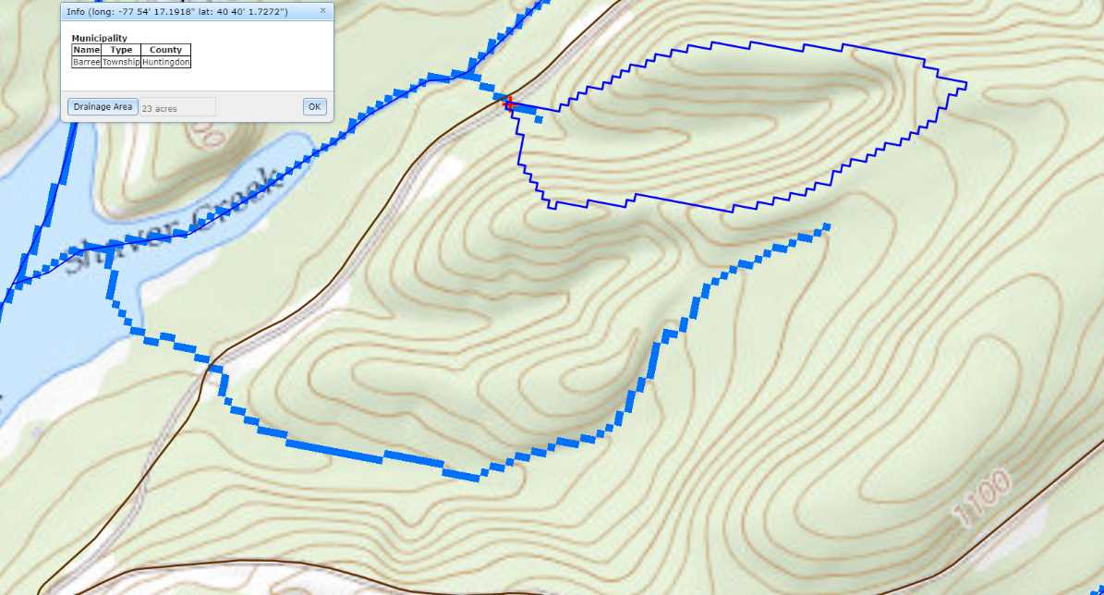
Stream Notifications and Exemptions
2
Crossing 2:
No USGS blueline
5’ Bankfull
Has streamstats blueline
Streamstats returns 23 acre watershed
3
1
www.dirtandgravelroads.org

Slide 36
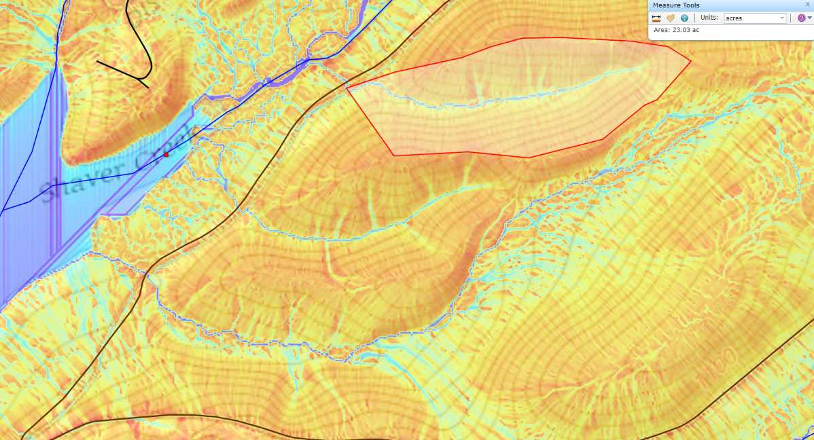
Stream Notifications and Exemptions
2
Crossing 2:
No USGS blueline
5’ Bankfull
Has streamstats blueline
Streamstats returns 23 acre watershed
Manual Double check = 23 acre watershed
3
1
www.dirtandgravelroads.org

Slide 37
Stream Notifications and Exemptions
2
Crossing 2:
No USGS blueline
5’ Bankfull
Has streamstats blueline
Streamstats returns 23 acre watershed
Manual Double check = 23 acre watershed
Not Eligible: bankfull >4’
3
1
www.dirtandgravelroads.org

Slide 38
Stream Notifications and Exemptions
2
Crossing 2:
No USGS blueline
3’ Bankfull
Has streamstats blueline
Streamstats returns 23 acre watershed
Manual Double check = 23 acre watershed
Let’s pretend bankfull is 3’.
Is it eligible?
3
1
www.dirtandgravelroads.org

Slide 39
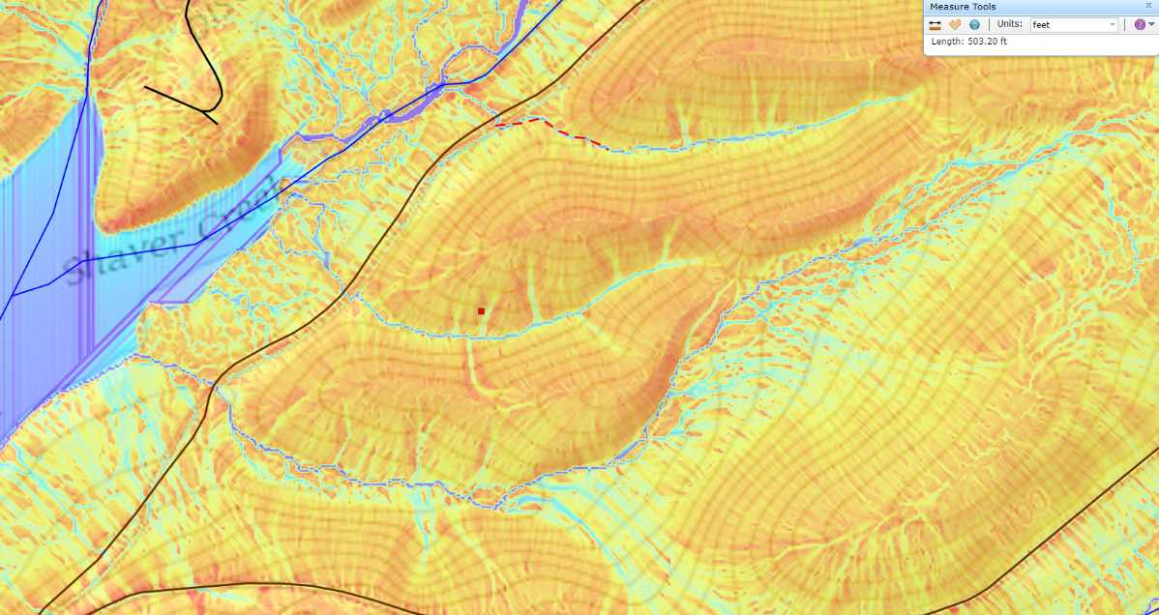
Stream Notifications and Exemptions
2
? 500’ ?
Crossing 2:
No USGS blueline
3’ Bankfull
Has streamstats blueline
Streamstats returns 23 acre watershed
Manual Double check = 23 acre watershed
Not automatically eligible based on watershed. Need to see if bed and banks channels ends within 500’ upslope of road
Let’s pretend bankfull is 3’.
Is it eligible?
3
1
www.dirtandgravelroads.org

Slide 40
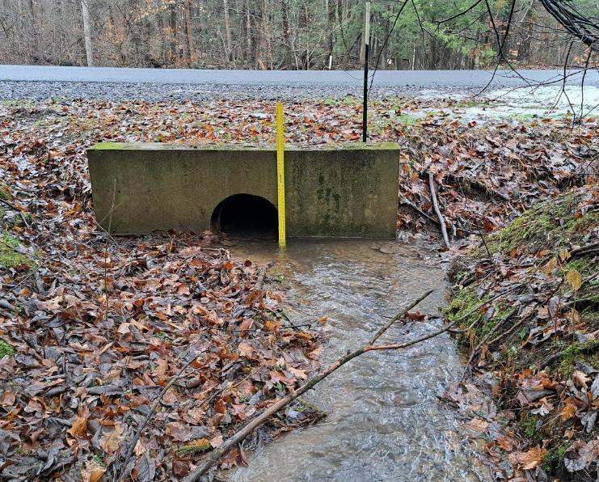
Stream Notifications and Exemptions
Crossing 3: 24” inlet
2
Site 3 picture
3
1
www.dirtandgravelroads.org

Slide 41
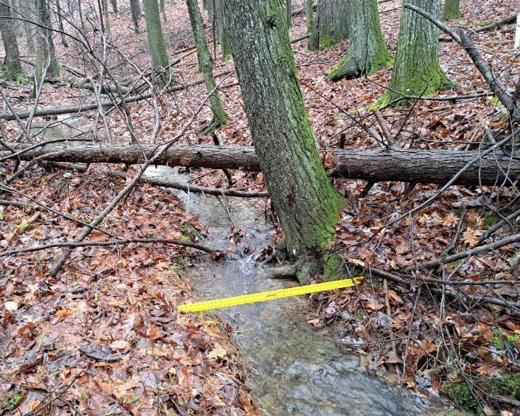
Stream Notifications and Exemptions
Crossing 3: 3.5’ bankfull
2
Site 3 picture
3
1
www.dirtandgravelroads.org

Slide 42
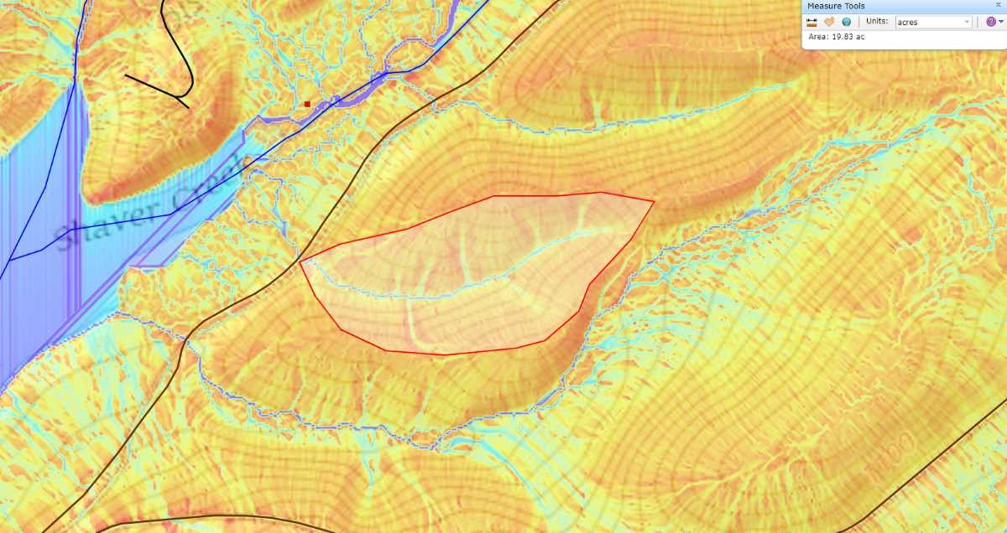
Stream Notifications and Exemptions
Crossing 3:
No USGS blueline
No streamstats blueline
3.5’ BF
Manual measurement = 17.3 acre watershed
Eligible for Automatic Waiver
2
3
1
www.dirtandgravelroads.org

Slide 43
Stream Notifications and Exemptions
Where the
DGLVR Stream
Crossing Policy
Applies
Example 4
Looking upslope from road
www.dirtandgravelroads.org

Slide 44
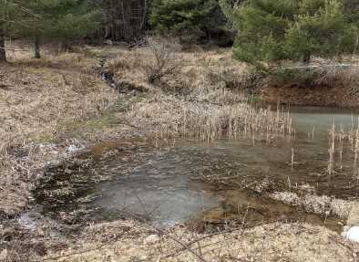
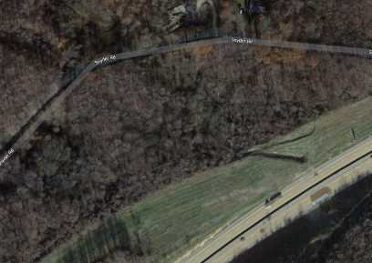
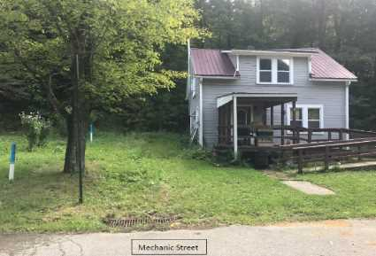
Stream Notifications and Exemptions
What if…what if…what if…
There will always be odd circumstances
Let not make policy for every possible situation
For odd circumstance, call the SCC!
Pond or wetland upstream, how do I measure channel length?
My watershed starts as
turnpike drainage?
Channel comes off, hill, to grass swale, to drop inlet.
www.dirtandgravelroads.org

Slide 45
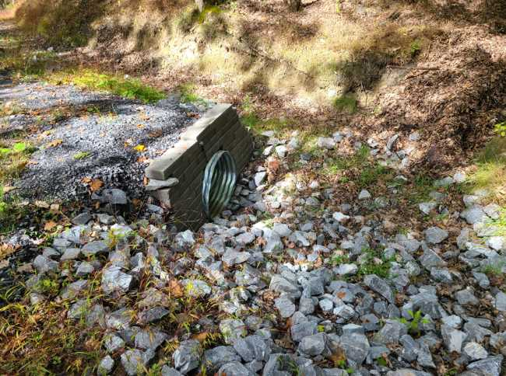
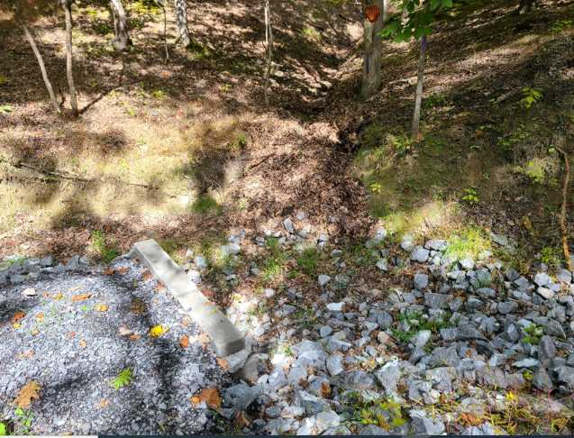
Stream Notifications and Exemptions
Automatic Exemptions: Example 2
Numers Hollow Rd, Henderson Twp, Huntingdon Co
Example 2
www.dirtandgravelroads.org

Slide 46
Stream Notifications and Exemptions
SCC Approved Exemptions
On any other crossing not meeting criterial for automatic exemptions.
Could be for any variety of reasons, for example:
Impossible to achieve continuity due to extreme drop or other manmade limitations.
Channel is urban area is actually a large stormwater channel.
Other?????
SCC Exemption form must be submitted to SCC
Reminder: All Exemptions
are only exempt from following DGLVR standard, not any permit or other requirements
Are still required to be 1.25 BF and ensure stability above and below new structure
www.dirtandgravelroads.org

Slide 47
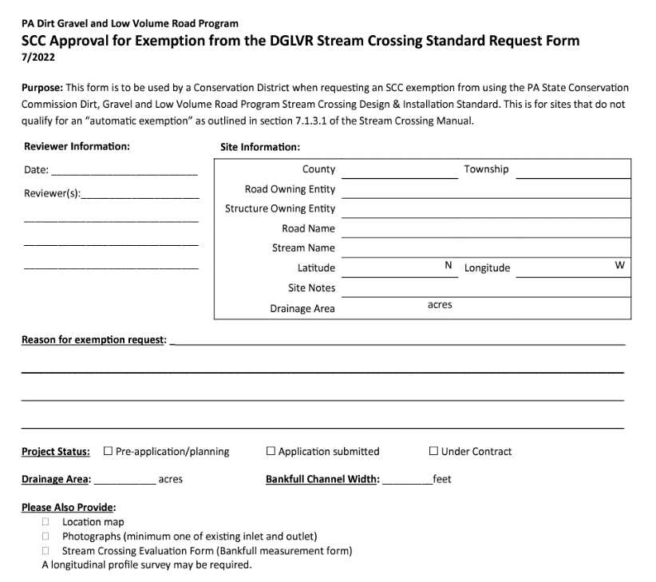
Stream Notifications and Exemptions
SCC Approval Exemption
Form
1-page
Keep in project file
Upload to notification
Site
Info
Justification
Reminder: All Exemptions
are only exempt from following DGLVR standard, not any permit or other requirements
Are still required to be 1.25 BF and ensure stability above and below new structure
www.dirtandgravelroads.org

Slide 48
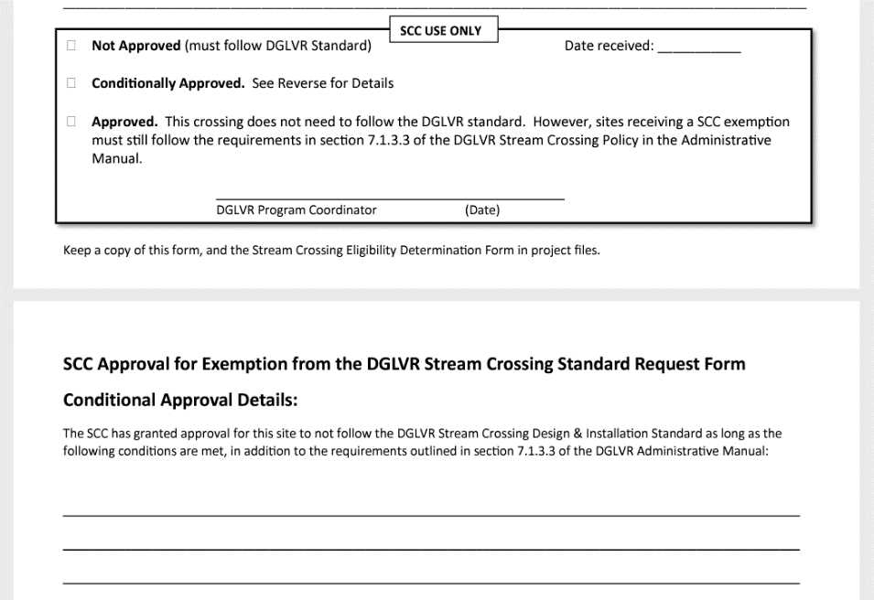
Stream Notifications and Exemptions
SCC Approval
Exemption
Form
Keep in project file
Upload to notification
SCC Use: Approval
Site
Info
Justification
Reminder: All Exemptions
are only exempt from following DGLVR standard, not any permit or other requirements
Are still required to be 1.25 BF and ensure stability above and below new structure
SCC Use: additional conditions
www.dirtandgravelroads.org

Slide 49
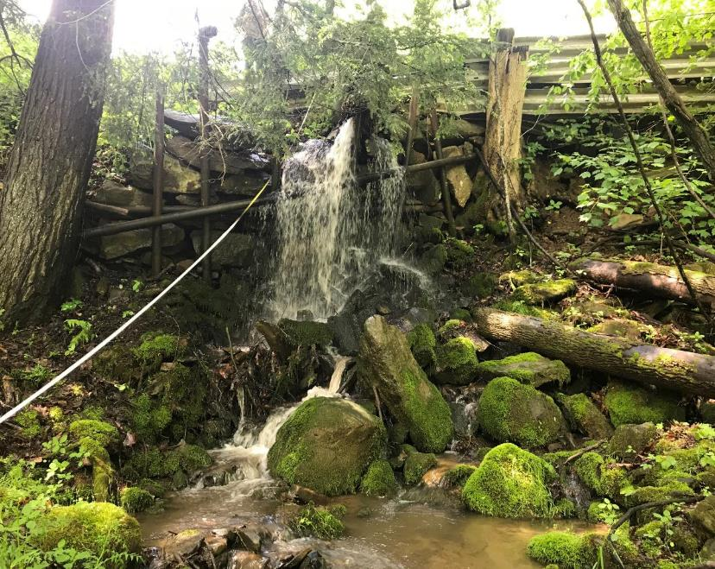
Stream Notifications and Exemptions
SCC Approved Exemptions: Example 1
12’ vertical offset
Railroad bridge upstream preventing stream modification
Meets larger stream downstream preventing stream modification
12’ drop in 15’
www.dirtandgravelroads.org

Slide 50
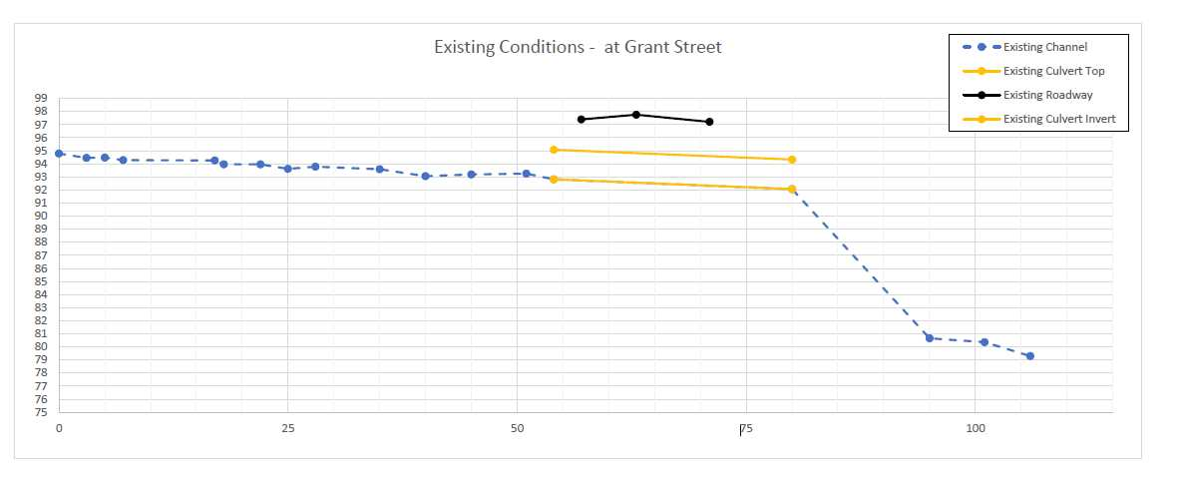
Stream Notifications and Exemptions
SCC Approved Exemptions: Example 1
www.dirtandgravelroads.org

Slide 51
Stream Notifications and Exemptions
SCC Approved Exemptions: Example 1
Railroad bridge
upstream
12’ drop in 15’
www.dirtandgravelroads.org

Slide 52
Stream Notifications and Exemptions
SCC Approved Exemptions: Example 2
Example 2
www.dirtandgravelroads.org

Slide 53
Stream Notifications and Exemptions
Reminder of Exemption Requirements
New structures must still be a single span at a minimum of 1.25 times or 125% of the bankfull channel width unless otherwise approved by the SCC.
Ensure the stability of the channel upstream and downstream. Grade controls must be shown on plan drawings if drawings are required.
Upstream: Grade control(s) are required immediately (between one and two bankfull widths) upstream of the inlet of the new structure to prevent headcutting (headward erosion lowering channel elevation that moves upstream over time). These grade controls are typically installed at the existing streambed elevation. If a larger structure is installed in a channel with road height limitations, installing a larger structure below the existing streambed elevation without grade control(s) will likely cause a headcut.
Downstream: Outlet stabilization is required in the form of grade controls, bank armoring, and/or filling in scour holes. Any grade controls are typically installed at the existing streambed elevation. Pipes may need to be extended further off the road, and the erosion potential caused by any elevation drops must be considered.
Reminder: All Exemptions
are only exempt from following DGLVR standard, not any permit or other requirements
Are still required to be 1.25 BF and ensure stability above and below new structure
www.dirtandgravelroads.org

Slide 54
Stream Notifications and Exemptions
Reminder of Exemption Requirements
New structures must still be a single span at a minimum of 1.25 times or 125% of the bankfull channel width unless otherwise approved by the SCC.
Ensure the stability of the channel upstream and downstream. Grade controls must be shown on plan drawings if drawings are required.
Upstream: Grade control(s) are required immediately (between one and two bankfull widths) upstream of the inlet of the new structure to prevent headcutting (headward erosion lowering channel elevation that moves upstream over time). These grade controls are typically installed at the existing streambed elevation. If a larger structure is installed in a channel with road height limitations, installing a larger structure below the existing streambed elevation without grade control(s) will likely cause a headcut.
Downstream: Outlet stabilization is required in the form of grade controls, bank armoring, and/or filling in scour holes. Any grade controls are typically installed at the existing streambed elevation. Pipes may need to be extended further off the road, and the erosion potential caused by any elevation drops must be considered.
WHY?
Still want to accommodate larger flows.
Putting a larger structure in without addressing stability could actually make the situation WORSE
Potential headcut upstream by lowering inlet elevation.
Potential increase erosion / road stability issue downstream.
Reminder: All Exemptions
are only exempt from following DGLVR standard, not any permit or other requirements
Are still required to be 1.25 BF and ensure stability above and below new structure
www.dirtandgravelroads.org

