Slide 1
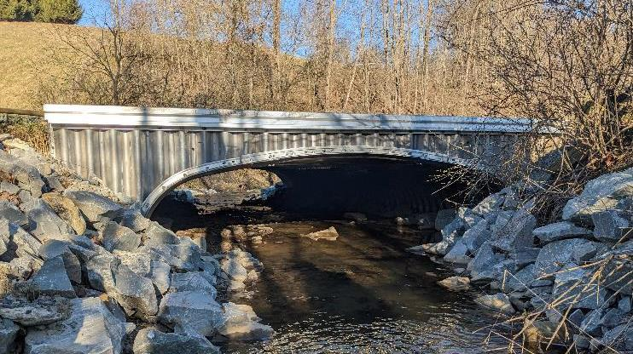


Dirt Gravel and Low Volume Road Program
WEBINAR
2/8/24
Starts 9am
Stream Crossings:
Update, Reminders, and Emerging Issues
CDGRS
Steve Bloser
smb201@psu.edu
SCC
Roy Richardson
rrichardso@pa.gov
Sherri Law
shlaw@pa.gov
Andy Mickey
anmickey@pa.gov
If you are reading this, then you are successfully seeing the webinar video. Webinar audio should be automatic through your computer (or click “join audio”), and options can be accessed in the “audio options” button on the bottom left. If your computer audio is not working, you can listen on your phone by dialing 312-626-6799.

Slide 2
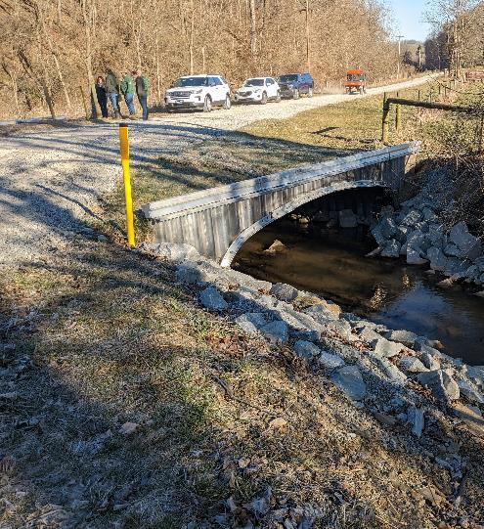



Stream Crossing Update
Purpose
Update on implementation of stream crossing standard, including issues and reminders for CDs

Slide 3
Stream Crossing Update
Implementation Update
Emerging Issues
CD Responsibilities
Other Considerations

Slide 4


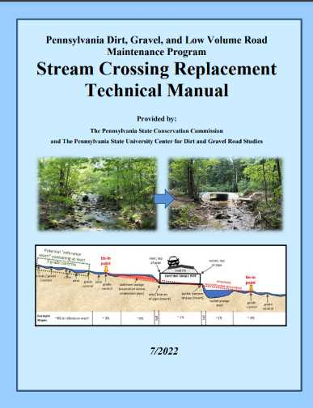
Stream Crossing Standard Update
DGLVR Stream Crossing Replacement Standard required for contracts signed after 6/30/22
Standard has NOT changed since initial approval
Status
  Projects completed under standard: 0
  Projects in progress under standard: ~30?
2023-24: a lot of “almost standard” projects…
www.dirtandgravelroads.org

Slide 5
Stream Crossing Standard Update
2023-24: a lot of “almost standard” projects…
  Large number of projects contracted before 6/30/22
  Do not have to follow standard
  Many CDs went above and beyond, working with CDGRS/SCC to get them as close to the standard as possible
    Some examples:
www.dirtandgravelroads.org

Slide 6
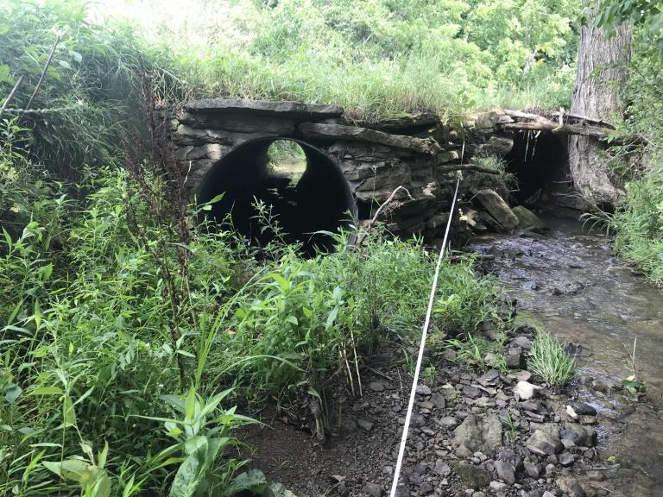
Stream Crossing Standard Update
“Almost standard” projects… WASHINGTON COUNTY
DGR funds: $106,600.00
In-kind: $19,405.79
Problem being addressed:
The existing stream crossing was multiple pipes
the stream’s bankfull width is 12.9 ft
www.dirtandgravelroads.org

Slide 7
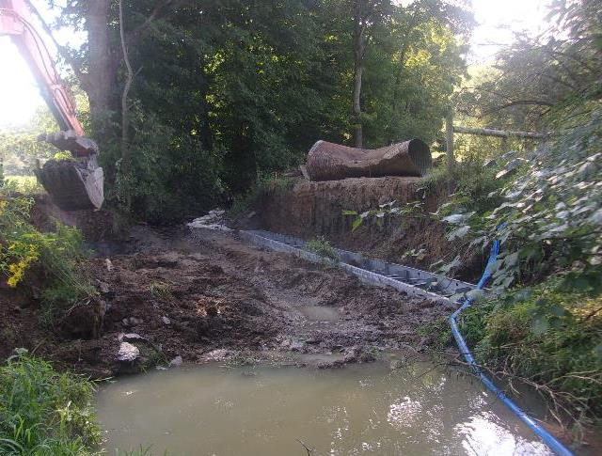
Stream Crossing Standard Update
“Almost standard” projects… WASHINGTON COUNTY
During
Project details:
The district worked closely with the CDGRS to incorporate updated guidance into the stream crossing design.
Bank margins, a low flow channel, and 3 riffles were constructed to establish a stable, continuous stream channel upstream, through, and downstream of the road crossing.
www.dirtandgravelroads.org

Slide 8
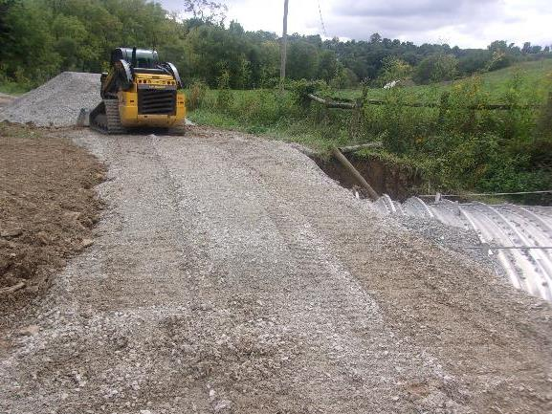
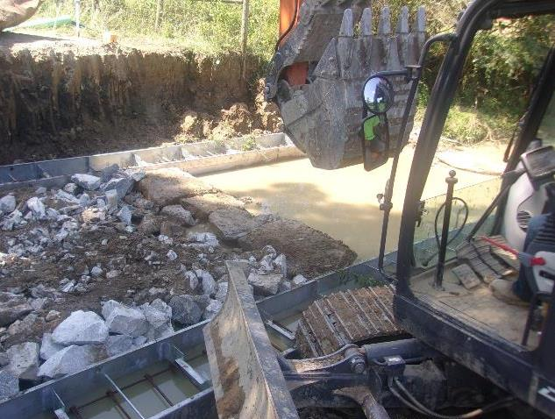
Stream Crossing Standard Update
“Almost standard” projects… WASHINGTON COUNTY
Project details:
The district worked closely with the CDGRS to incorporate updated guidance into the stream crossing design.
Bank margins, a low flow channel, and 3 riffles were constructed to establish a stable, continuous stream channel upstream, through, and downstream of the road crossing.
www.dirtandgravelroads.org

Slide 9
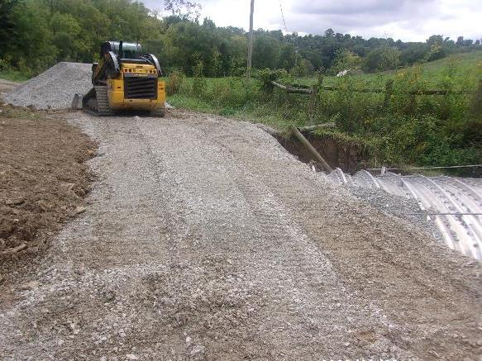
Stream Crossing Standard Update
“Almost standard” projects… WASHINGTON COUNTY
During
Project details:
The district worked closely with the CDGRS to incorporate updated guidance into the stream crossing design.
Bank margins, a low flow channel, and 3 riffles were constructed to establish a stable, continuous stream channel upstream, through, and downstream of the road crossing.
www.dirtandgravelroads.org

Slide 10
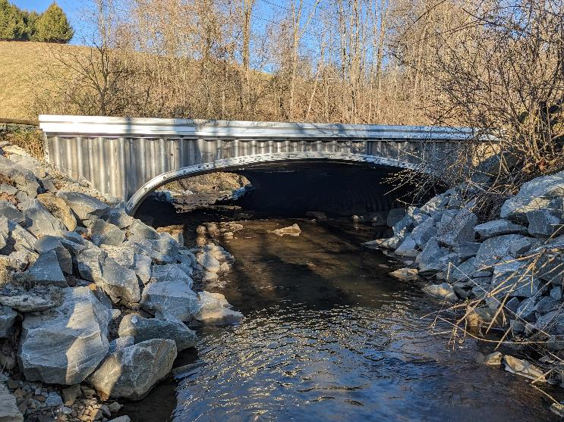
Stream Crossing Standard Update
“Almost standard” projects… WASHINGTON COUNTY
After
Project details:
A 16’ W x 4’3” H aluminum bottomless box culvert on express foundations was installed.
Road ditch turnouts were also installed to disconnect road drainage from the stream crossing.
www.dirtandgravelroads.org

Slide 11
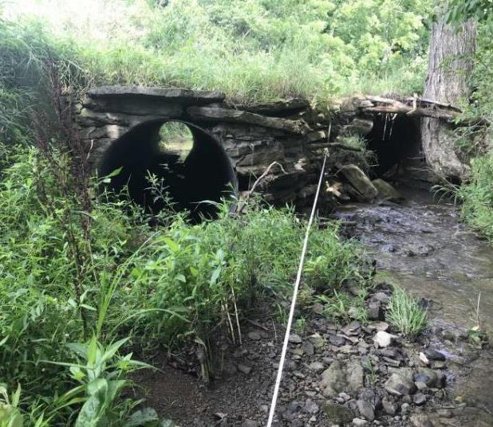
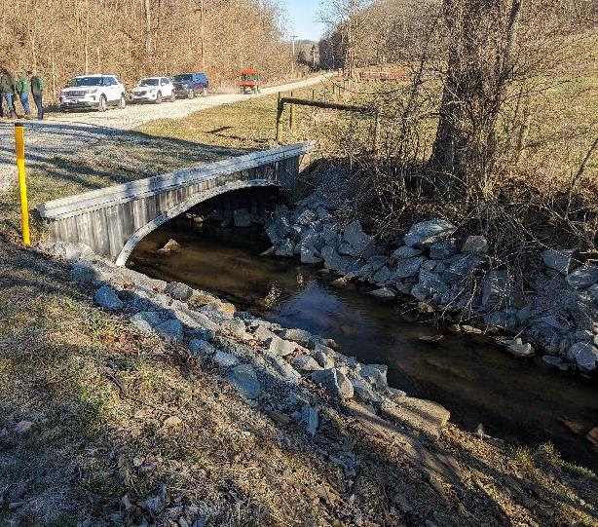
Stream Crossing Standard Update
“Almost standard” projects… WASHINGTON COUNTY
Before
After
www.dirtandgravelroads.org

Slide 12
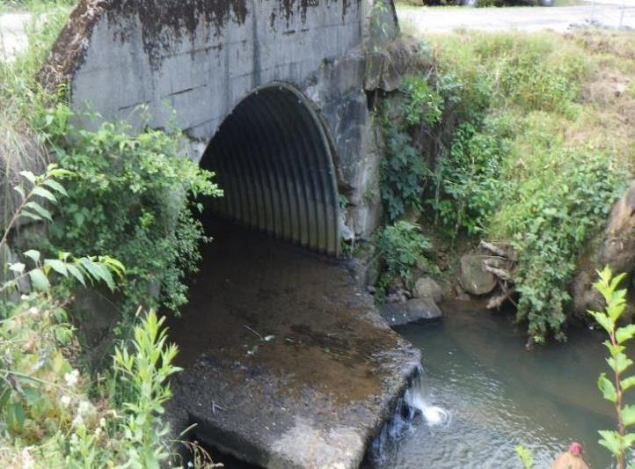
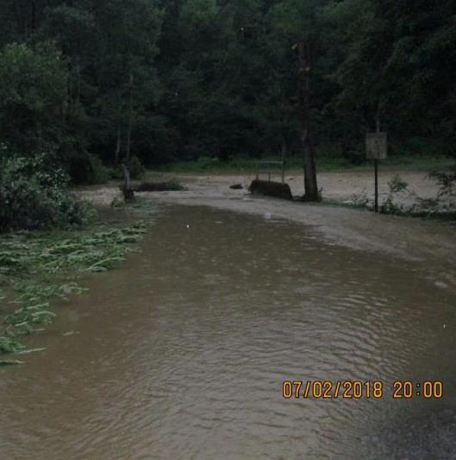
Stream Crossing Standard Update
“Almost standard” projects… CLARION COUNTY
Before
www.dirtandgravelroads.org

Slide 13
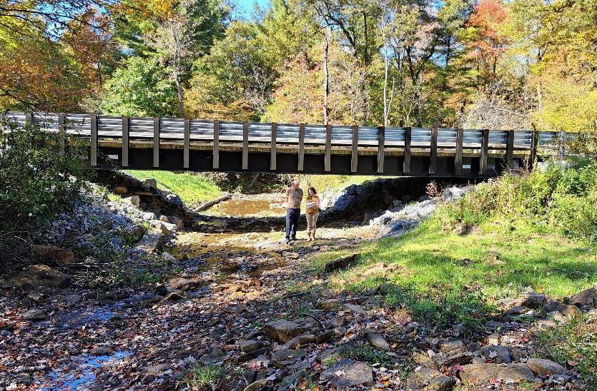
Stream Crossing Standard Update
“Almost standard” projects… CLARION COUNTY
Existing was pipe stuck into an old bridge opening
Frequent flooding
Installed Spread Footer Bridge
Significant channel work
After
www.dirtandgravelroads.org

Slide 14
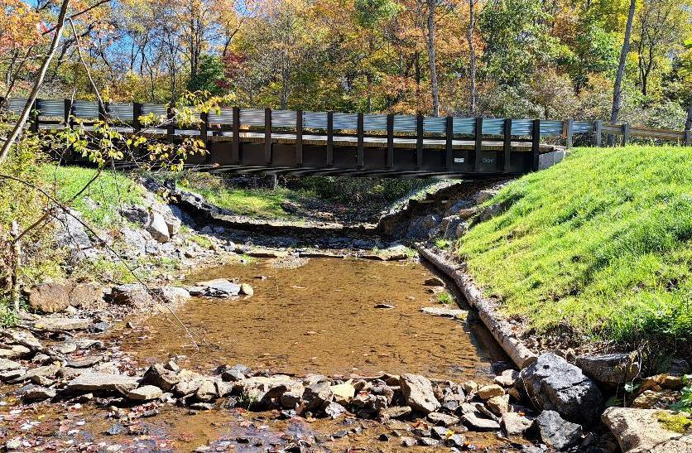
Stream Crossing Standard Update
“Almost standard” projects… CLARION COUNTY
Existing was pipe stuck into an old bridge opening
Frequent flooding
Installed Spread Footer Bridge
Significant channel work
After
Mud sill and bank stabilization
Grade Controls
Scour Hole Filled
www.dirtandgravelroads.org

Slide 15
Stream Crossing Standard Update
2023-24: a lot of “almost standard” projects…
  Still many “pre-standard” crossings to be installed in 2024
  Recommend to use elements from the Standard to try to make them as functional and resilient as possible
  SCC/CDGRS staff available for assistance
  First project designed to full DGLVR Standard will go in this Spring.
    Stay Tuned!
www.dirtandgravelroads.org

Slide 16
Andy

Slide 17
Stream Crossing Update
Implementation Update
Emerging Issues
CD Responsibilities
Other Considerations

Slide 18
Emerging Issues
Problem: A few significant issues have come up early in 2024
Wanted to share them as examples and reminders for other districts.
Counties will be kept anonymous
www.dirtandgravelroads.org

Slide 19
Emerging Issues
Example 1
Contracted after 7/1/22
Standard not followed
Structure already installed
www.dirtandgravelroads.org

Slide 20
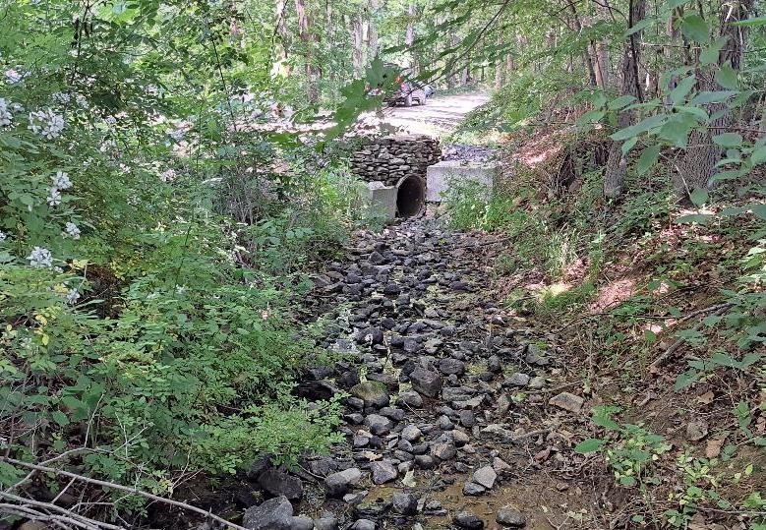
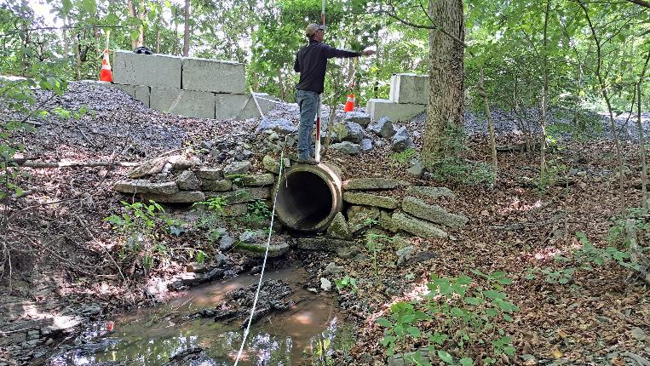
Emerging Issues
Example 1 County
CENSORED
Before
www.dirtandgravelroads.org

Slide 21
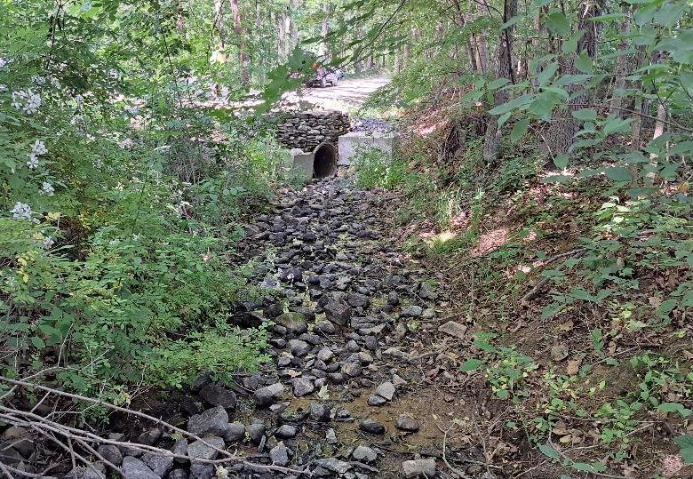
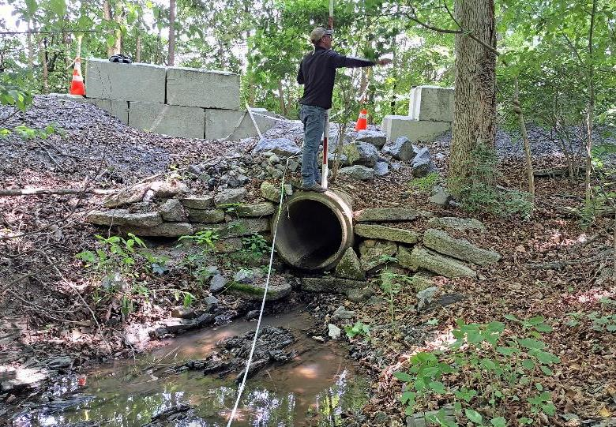
Emerging Issues
Example 1 County
CENSORED
Before
www.dirtandgravelroads.org

Slide 22
Emerging Issues
District attended stream training, but did not ensure Standard was followed.
  Proper long pro survey not completed
  No review of plan to meet Standard (grade controls, slope, channel shape and composition, etc.)
CDGRS assisted with long pro June 2023 – not used in design
Installation mostly complete (by twp) in December 2023 when SCC/CDGRS learned it was in progress.
Engineer fell short on design requirements, especially stream channel reconstruction
Example 1 County
CENSORED
www.dirtandgravelroads.org

Slide 23
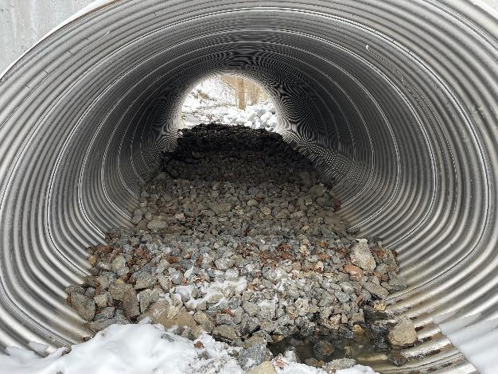
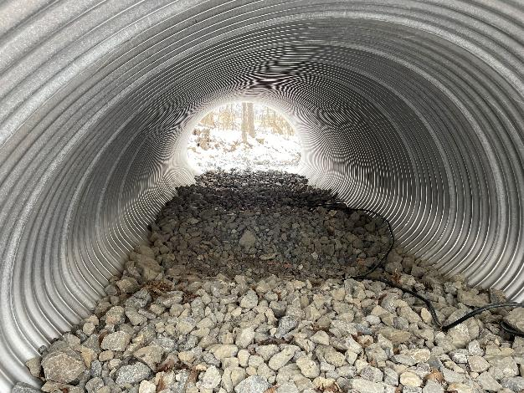
Emerging Issues
Example 1
After
Inside Culvert (DS View)
Inside Culvert (US View)
MISSING:
Channel Shape
Bank Margins
Grade control
Proper substrate
Embedment depth
Slope and elevation
www.dirtandgravelroads.org

Slide 24
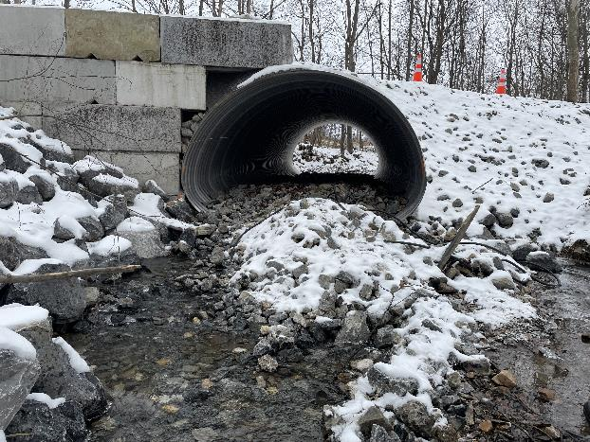
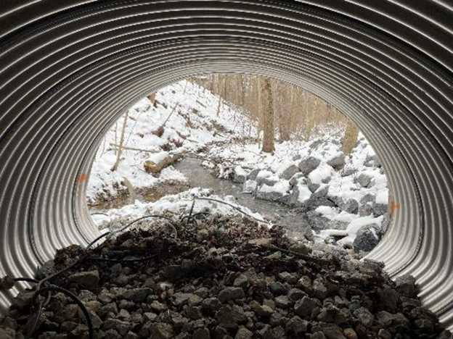
Emerging Issues
Example 1
After
Outlet
Downstream
Pipe installed high
18-24” drop at outlet
www.dirtandgravelroads.org

Slide 25
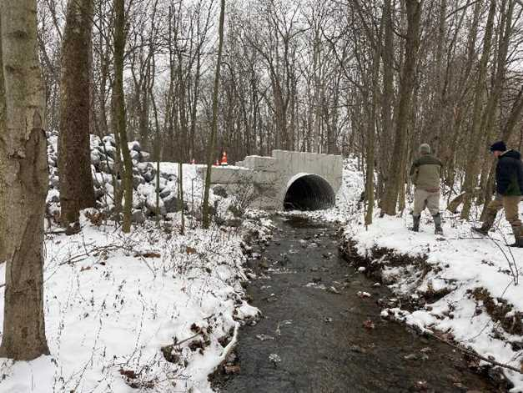
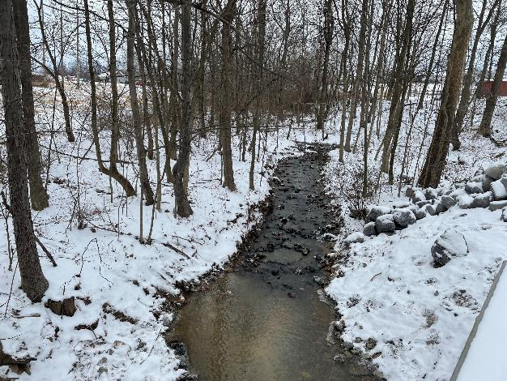
Emerging Issues
Example 1
After
Inlet
Upstream
www.dirtandgravelroads.org

Slide 26
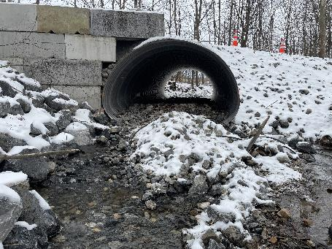
Emerging Issues
Update:
  Standard cannot be met: pipe installed too high.
  As is, this site would not even meet the old policy (pre-standard).
  CDGRS working with CD, twp, and engineer on remediation plan to make the site as stable and continuous as possible.
  Meetings planned, still active site as of today 2/8/23.
Example 1 County
CENSORED
www.dirtandgravelroads.org

Slide 27
Emerging Issues
Example 2
Contracted after 7/1/22
Standard not followed
Structure already purchased
www.dirtandgravelroads.org

Slide 28
Emerging Issues
Example 2 County
CENSORED
District completed site assessment with CDGRS staff and provided recommendations to engineer
  District did not complete satisfactory review of draft plan set before submittal
  Insufficient design in permit plan set
CD DGLVR Staff changed twice (so far) in life of project.
Replacement structure purchased prior to permit approval
  (Permit not reviewed or approved currently)
  Structure chosen exceeds 1.25x bankfull (12’ bkfll, 16’ box culvert)
    However, structure will likely not meet Q100 requirements
      80% structure rise & key pieces stability
www.dirtandgravelroads.org

Slide 29
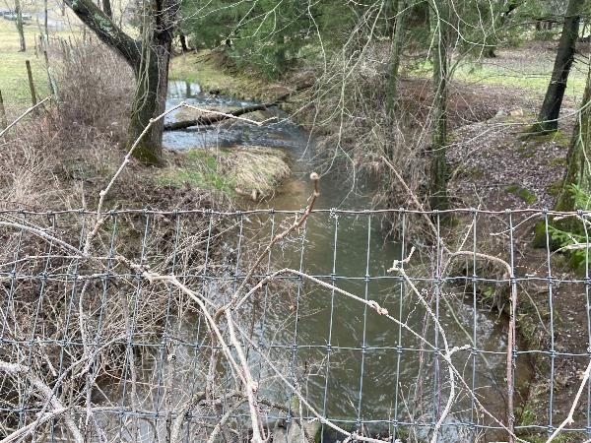
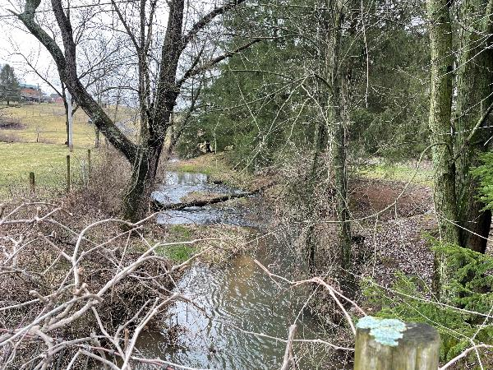
Emerging Issues
Example 2
Before
Upstream
Upstream
www.dirtandgravelroads.org

Slide 30
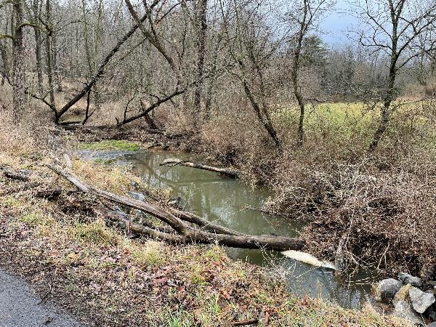
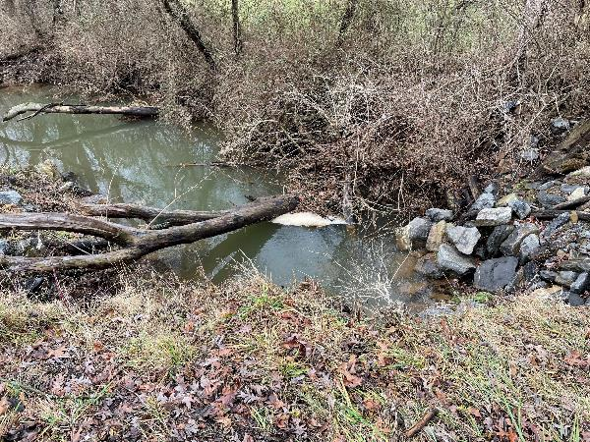
Emerging Issues
Example 2
Before
Downstream
Downstream Scour
www.dirtandgravelroads.org

Slide 31
Emerging Issues
Example 2 County
CENSORED
Update:
  H&H analysis being conducted by engineer
    Will determine if structure can be used as purchased (unlikely)
  Potential Options
    Scrap invert, place structure on footers and raise elevation
      Inside of footer will encroach beyond inside of culvert wall
      Leaves insufficient room to place stable bank margins while maintaining bankfull width channel through structure
      Concrete footers will need to serve as bank margins
      Purchase new structure
      Significant additions/changes to plan details need to be made regarding stream channel reconstruction
www.dirtandgravelroads.org

Slide 32
Sherri

Slide 33
Emerging Issues
Example 3
Contracted before 7/1/22
Old Policy Applies
Bidding Issues
www.dirtandgravelroads.org

Slide 34
Emerging Issues
Example 3: Bidding difficulties
  Township bidding a stream crossing replacement
    14 ft wide bottomless structure
    Est $250,000 - $300,000 budget
  First time the project was bid: no bidders
  Second time it was bid: one bid: $610,000
  What to do?
  How to get a reasonable bid?
www.dirtandgravelroads.org

Slide 35
Emerging Issues
Example 3: Resolution???
  Options:
    Accept the high bid
    Reject the bid and cancel the project
    Reject the bid and rebid to get a more reasonable cost
      Tips on the following slides
  Considerations:
    Is additional funding available?
      Program funds or in-kind
    Timeline
      Contract expiration, spending deadlines, seasonal restrictions, etc.
    SCC and Center are available to discuss options
www.dirtandgravelroads.org

Slide 36
Emerging Issues
Example 3: How to get a reasonable bid?
  Review the bid package
  Longer / complicated bid package often mean higher bids.
    Potential issues:
      Difficult to find important DGLVR information
      Bidders may not read the whole package
      Bidders may submit a higher bid due to the extra work of understanding and following a large bid package
    Suggestions:
      Shorten the bid package
      Ensure grant requirements are clear (include a short narrative, etc.)
    Note: reviewing stream crossing bid packages is now required
www.dirtandgravelroads.org

Slide 37
Emerging Issues
Example 3: How to get a reasonable bid?
  Better advertising
  Don’t just meet the bare minimum advertising requirements
    Suggestions:
      Advertise in multiple places
      Ask contractors where they typically find projects, and advertise there
      Invite bidders
        Many conservation districts have lists of contractors who have completed or expressed interest in DGLVR projects
        Road owner can send bid packages directly to contractors and invite them to bid on the project
www.dirtandgravelroads.org

Slide 38
Emerging Issues
Example 3: How to get a reasonable bid?
Other considerations
Project participant can buy the structure through CoStars
Consider mandatory onsite pre-bid meeting/site showing
  Ensures all parties understand the plan and what the project entails.
  Note: if only one bidder participates, could lead to an artificially inflated bid.
www.dirtandgravelroads.org
Notes:
COSTARS program, a cooperative purchasing program designed to make purchasing both easier and price competitive for public entities

Slide 39
Emerging Issues
For more guidance on bidding: Recorded DGLVR webinars
April 14, 2020: Municipal Bidding
  This webinar reviewed various aspects of the municipal bidding process as it relates to municipal projects funded through the DGLVR Program. It covered an overview of the bidding process and provided additional resources.
  Webinar Download (66.3 MB): MP4 format (~ 1 hour 8 minutes)
  Presentation Downloads: Adobe PDF (8.81 MB) MS Powerpoint (16.9 MB)
June 9, 2020: COSTARS and Purchasing
  As part of the 4/14/20 “Municipal Bidding” webinar, there was some discussion and a request for more information about the COSTARS program, a cooperative purchasing program designed to make purchasing both easier and price competitive for public entities. Felicia Campbell & Kim Bullivant, two representatives from COSTARS, presented information and answered available for questions.
  Webinar Download (178 MB): MP4 format (~ 1 hour 19 minutes)
  Presentation Downloads: Adobe PDF (7.3 MB) MS Powerpoint (8.72 MB)
www.dirtandgravelroads.org

Slide 40
Emerging Issues
Example 4
Contracted after 7/1/22
Small “that’s not a stream” site
Completed 2023
www.dirtandgravelroads.org

Slide 41
Emerging Issues
Example 4 County : Small Streams
CENSORED
Small Streams
  When does the DGLVR stream crossing policy apply?
Admin Manual 7.1.2.3: Where the DGLVR Stream Crossing Policy Applies
The stream crossing policy outlined here applies to situations where streams, including intermittent channels, with identified bed and banks are flowing into the road or the uphill ditch. See section 7.1.3 for more information on Automatic and SCC-requested exemptions from the DGLVR Stream Crossing Standard. Contact the State Conservation Commission in questionable circumstances.
www.dirtandgravelroads.org

Slide 42
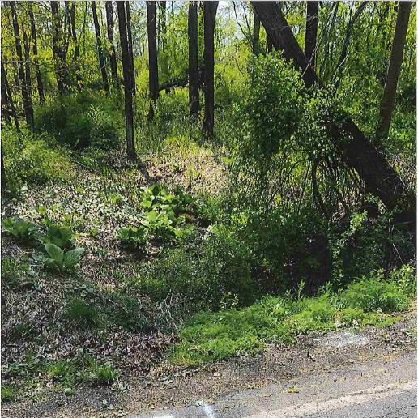
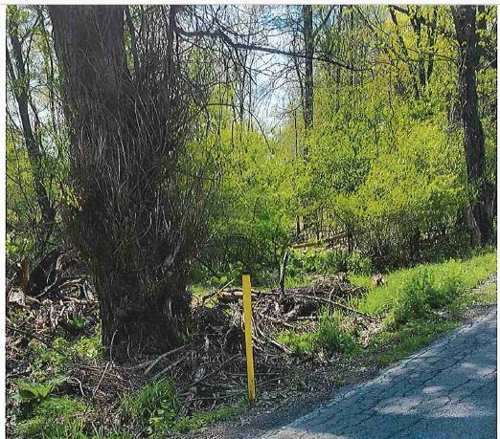
Emerging Issues
Site during pre-app meeting (summer) – looking upslope of pipe locations
2023-24 Project: County
CENSORED
www.dirtandgravelroads.org

Slide 43
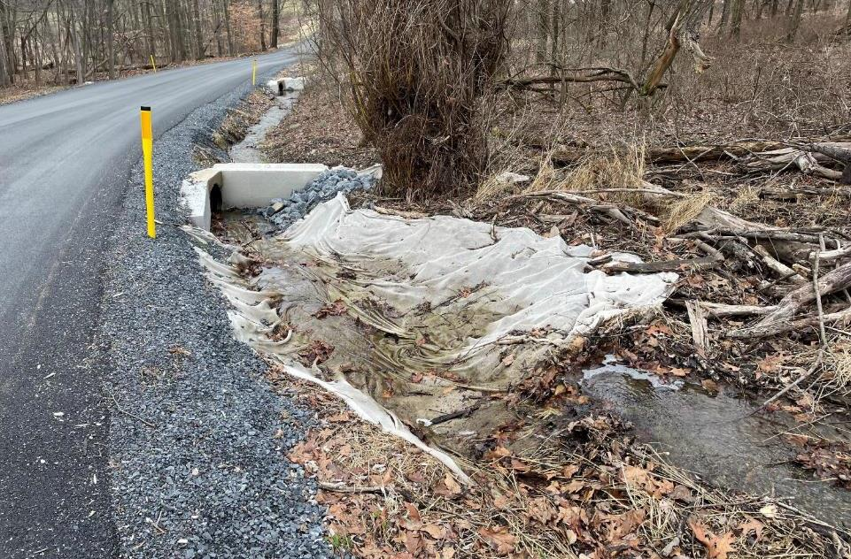
Emerging Issues
Same site after construction (winter)
2023-24 Project: County
CENSORED
www.dirtandgravelroads.org

Slide 44
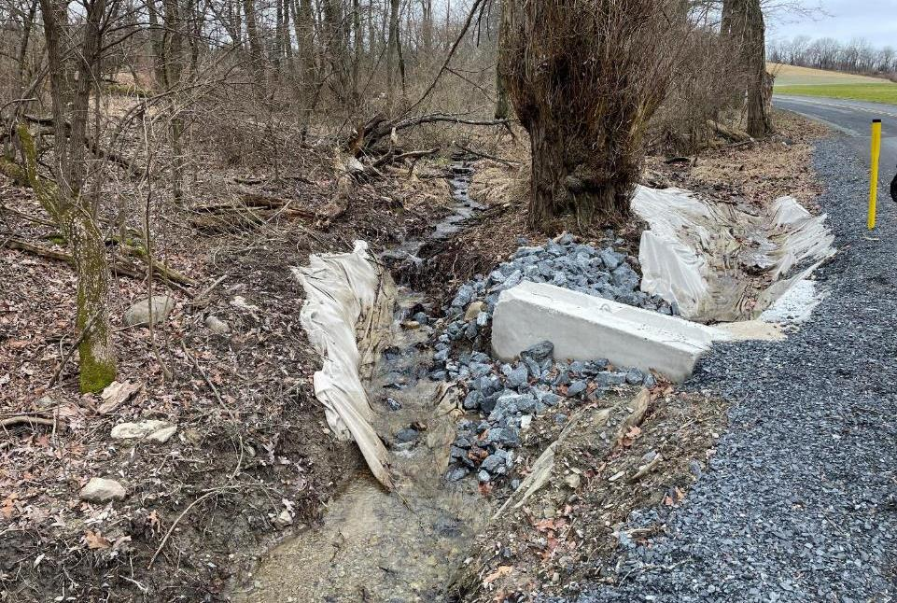
Emerging Issues
Same site after construction (winter)
2023-24 Project: County
CENSORED
www.dirtandgravelroads.org

Slide 45
Emerging Issues
  Need to determine if the water coming to a pipe:
    Is groundwater seeping up to the surface?
    Is storm runoff being collected and carried in the roadside ditch?
    Is a channel or stream?
      If surface or groundwater channelizes before it reaches the road, the DGLVR stream crossing policy may apply
      Look for bed and bank
      Why? Because channelized flows require different environmentally sensitive practices than typical groundwater or stormwater issues
Example 4 County : Small Streams
CENSORED
www.dirtandgravelroads.org

Slide 46
Emerging Issues
How to find out if there are bed and banks:
Field assessment: walk upslope
Consider time of year:
  Summer is difficult: dry weather and leafy vegetation
  Revisit the site during other times of year if possible
  Talk to the road owner about whether there is ever running water entering any of the cross pipes
  Dry channels may have indicators of stream flow (riffles, pools, etc.)
Wet site indicators:
  If the area is known to have roadside springs, saturated road base, wetland conditions, is in the headwaters to larger streams, etc.
  These are all indicators you should investigate for small channels
Maps
Example 4 County : Small Streams
CENSORED
www.dirtandgravelroads.org

Slide 47
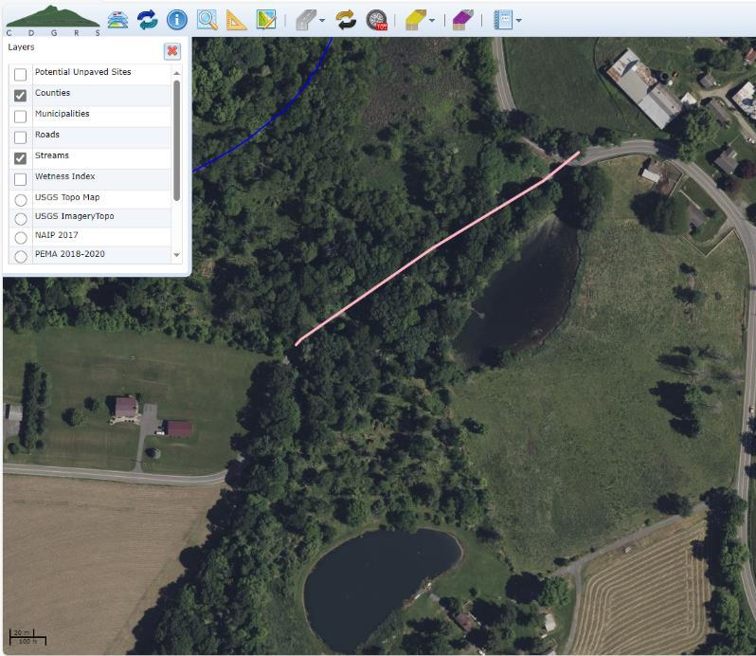
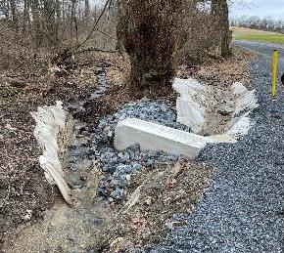
Emerging Issues
Maps:
DGLVR GIS includes a stream layer
  Only shows larger streams
  Other tools available to help identify smaller channels
Stream layer
DGLVR worksite
www.dirtandgravelroads.org

Slide 48
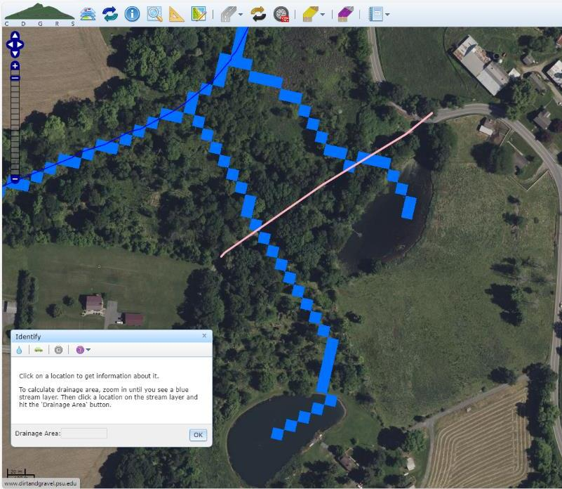
Emerging Issues
Maps: StreamStats
USGS web tool
https://www.usgs.gov/streamstats
DGLVR GIS references StreamStats when identifying drainage area
Shows more detail than typical stream maps
Check out these spots to see if there’s bed and bank coming to the road
www.dirtandgravelroads.org

Slide 49
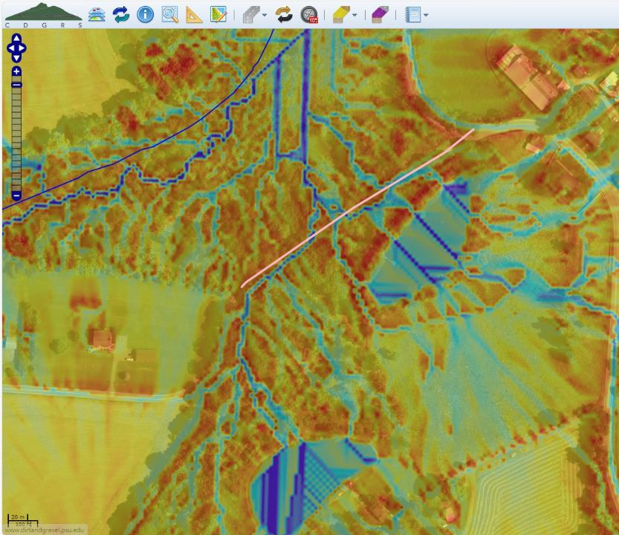
Emerging Issues
Maps: wetness index
Specific to DGLVR GIS
Shows low spots in the landscape where water is expected to flow
Check out these spots to see if there’s bed and bank coming to the road
www.dirtandgravelroads.org

Slide 50
Emerging Issues
Recorded webinars
December 17, 2020: GIS Updates: Topographic Wetness Index, Project Error Checker, Financial Updates
  Some of you may have noticed a new “topographic wetness index” layer has been added to the GIS. CD staff will likely find this layer useful in many of the programs they administer. This webinar introduced that layer and go over some basics of how it was made and how it can be of use. It also demonstrated a new “Project Error Checker” tool designed to catch data entry errors for completed projects, along with a brief discussion on Administrative and Education spending.
  Webinar Download (200 MB): MP4 format (~ 55 minutes)
  Presentation Downloads:
    Adobe PDF (2.34 MB)
    MS Powerpoint (1.5 MB)
January 5, 2023: Stream Crossing Exemptions and Notifications
  This webinar reviewed the notification and exemption process for stream crossings with some examples. Includes info about StreamStats in DGLVR GIS.
  Webinar Download (112 MB): MP4 format (~41 minutes)
  Presentation Downloads:
    Adobe PDF (6.88 MB)
    MS Powerpoint (3.54 MB)
www.dirtandgravelroads.org

Slide 51
Steve

Slide 52
Emerging Issues
Example 5
Contracted after 7/1/22
Standard followed
Q100 sizing and design issues
www.dirtandgravelroads.org

Slide 53
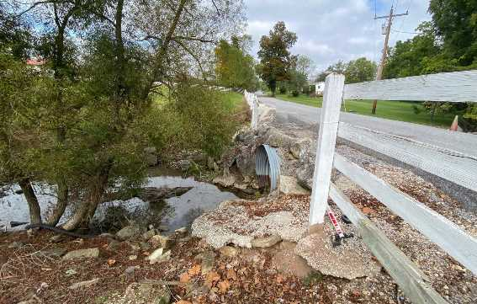
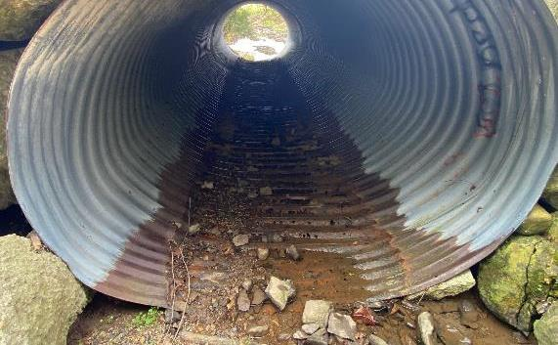
Emerging Issues
Example 5 County
CENSORED
  Existing 6’ metal pipe
  Bankfull of 9’
  Proposed 24’ bottomless box culvert to meet Q100 in the Standard.
  District is working through the Standard
  with CDGRS assistance
www.dirtandgravelroads.org

Slide 54
Emerging Issues
Example 5 County
CENSORED
  Existing 6’ metal pipe
  Bankfull of 9’
  Proposed 24’ bottomless box culvert to meet Q100 in the Standard.
  District is working through the Standard
  with CDGRS assistance
  Initial calculations show that the new
  24’ structure will not accommodate
  Q100 (100-year) flow as required.
  STRAMSTATS Caution
www.dirtandgravelroads.org

Slide 55
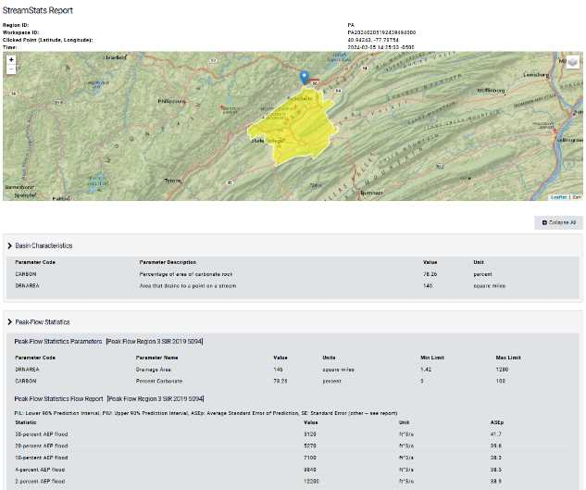
6 ft. wide CMP Crossin
Bankfull = 8.67’
Proposed 24’ Wide Bottomless Aluminum Box Culvert
Hydraulic Modeling shows Q100 is overtopping the roadway.
Floodplain relief not accounted for in model.
StreamStats Peak Flow for Q100 is very high.
StreamStats may not be best for small watersheds
(ask Eric C. for size)
Proposed structure is big enough based on bankfull measurements.
Engineer is working on revising H&H Report to meet standard.
Emerging Issues
STREAMSTATS
  Extremely useful USGS watershed model
  Estimates watershed size, bankfull width, flow probabilities and more
  Useful, but it is a model.
  Have seen repeated overestimations of flows, specifically Q100, for small drainages.
  Limited “resolution”:
    The smaller the watershed the bigger the potential error
www.dirtandgravelroads.org

Slide 56
6 ft. wide CMP Crossin
Bankfull = 8.67’
Proposed 24’ Wide Bottomless Aluminum Box Culvert
Hydraulic Modeling shows Q100 is overtopping the roadway.
Floodplain relief not accounted for in model.
StreamStats Peak Flow for Q100 is very high.
StreamStats may not be best for small watersheds
(ask Eric C. for size)
Proposed structure is big enough based on bankfull measurements.
Engineer is working on revising H&H Report to meet standard.
Emerging Issues
STREAMSTATS
Error Warning is built into streamstats, but often ignored
  Extremely useful USGS watershed model
  Estimates watershed size, bankfull width, flow probabilities ana more
  Useful, but it is a model.
  Have seen repeated overestimations of flows, specifically Q100
  Limited “resolution”:
    The smaller the watershed the bigger the potential error
www.dirtandgravelroads.org

Slide 57
Emerging Issues
STREAMSTATS
Main stem
  Limited “resolution”:
    The smaller the watershed the bigger the potential error
Road
Crossing to be replaced.
Tributary
www.dirtandgravelroads.org

Slide 58
Emerging Issues
STREAMSTATS
Main stem
  Limited “resolution”:
    The smaller the watershed the bigger the potential error
    ACTUAL STREAMSTATS DATA:
Road
Warning Flag Given
Streamstats
Area = 1.05 SqMi
Q100 =1,210 CFS
Tributary
www.dirtandgravelroads.org

Slide 59
Emerging Issues
STREAMSTATS
Main stem
  Limited “resolution”:
    The smaller the watershed the bigger the potential error
    ACTUAL STREAMSTATS DATA:
Streamstats
Area = 18.1 sq mi
Q100 = 7,280
Road
Streamstats
Area = 19.2 sq mi
Q100 = 7,560 CFS
Warning Flag Given
Streamstats
Area = 1.05 SqMi
Q100 =1,210 CFS
Tributary
www.dirtandgravelroads.org

Slide 60
Emerging Issues
STREAMSTATS
Main stem
  Limited “resolution”:
    The smaller the watershed the bigger the potential error
    ACTUAL STREAMSTATS DATA:
Streamstats
Area = 18.1 sq mi
Q100 = 7,280
Road
Streamstats
Area = 19.2 sq mi
Q100 = 7,560 CFS
Warning Flag Given
Streamstats
Area = 1.05 SqMi
Q100 =1,210 CFS
What is the Q100 flow?
1,210 CFS with a warning?
7,560 CFS – 7,280 CFS = 280 CFS with no warnings?
A 4X increase in Q100 CFS will drive up structure size!
Nearby HAS gauge estimates 420 CFS per square mile,
so even this estimates ~450 CFS, not 1,210.
Streamstats estimates a 14.6’ BF, actually 9’.
Tributary
www.dirtandgravelroads.org

Slide 61
Emerging Issues
STREAMSTATS
  Very Valuable Modeling Tool
  Limited “resolution” for determining flow (Q100):
    The smaller the watershed the bigger the potential error
    ALTERNATIVES
  USDA TR-55
  USACE HEC-RAS
  HY 8 Culvert Hydraulic Analysis Program
  Gage data if on a gaged Stream – Can be gage regression or per sq mile estimations.
www.dirtandgravelroads.org
Explain what each of these alternatives is and/or where to find more info about them?

Slide 62
Andy

Slide 63
Stream Crossing Update
Implementation Update
Emerging Issues
CD Responsibilities
Other Considerations

Slide 64
CD Responsibilities
CDs have certain defined responsibilities for stream crossing projects
  Listed in Admin Manual section 7.1.2.6 Conservation District Requirements
  Telling the engineer there is a standard and giving them a copy of it does NOT meet these requirements
www.dirtandgravelroads.org

Slide 65
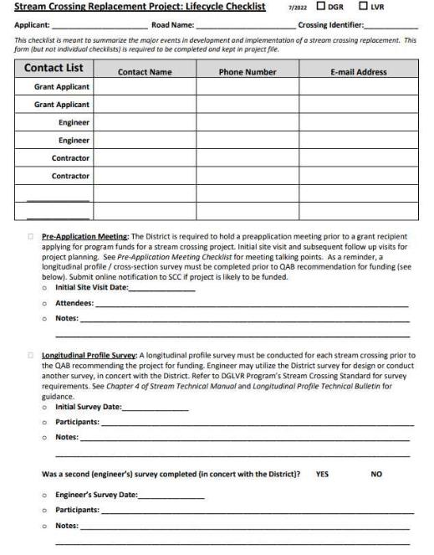
CD Responsibilities
Project Lifecycle Checklist
Required to complete and retain
Helps ensure all required administrative and technical aspects of the project are met
Covers project from pre-application stage to completion
  Pre-app meeting
  Long-pro survey
  Contract
  Engineer selection
  Design Review
  Bid Package Review
  Bid Site Showing (recommended)
  Construction Notice
  Pre-Con
  Project Inspection
  Project Completion
www.dirtandgravelroads.org

Slide 66
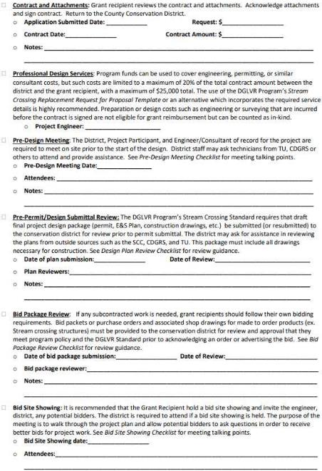
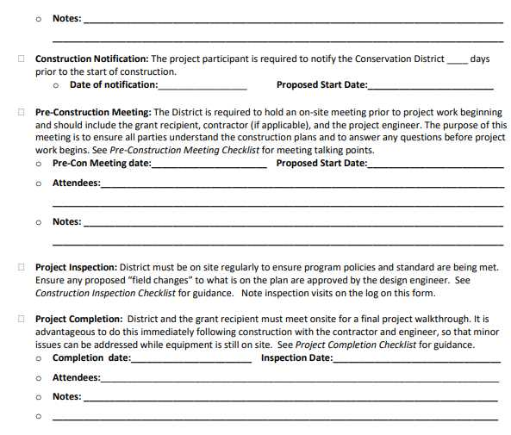
CD Responsibilities
Project Lifecycle Checklist
www.dirtandgravelroads.org

Slide 67
CD Responsibilities
Project Timeline (Example)
Pre-Application Meeting (June-October 2024)
Longitudinal Profile Survey (June 2024-April 2025)*
Ranking (March-April 2025)
QAB Recommendation/Board Approval (June 2025)*
Engineer RFP/Pre-Design Meeting (June-August 2025)
Plan Review/Approval (October-December 2025)
Permit Application Submission (December 2025 – January 2026)
Bid Package Review/Approval (March-April 2026)
Permit Authorization (April-May 2026)
Pre-Bid Site Showing (April 2026)
Bid Award (May 2026)
Pre-Construction Meeting (June-July 2026)
Construction/Construction Oversight (June-September 2026)*
Inspection (June-September 2026)
Project Closeout (July-December 2026)
www.dirtandgravelroads.org

Slide 68
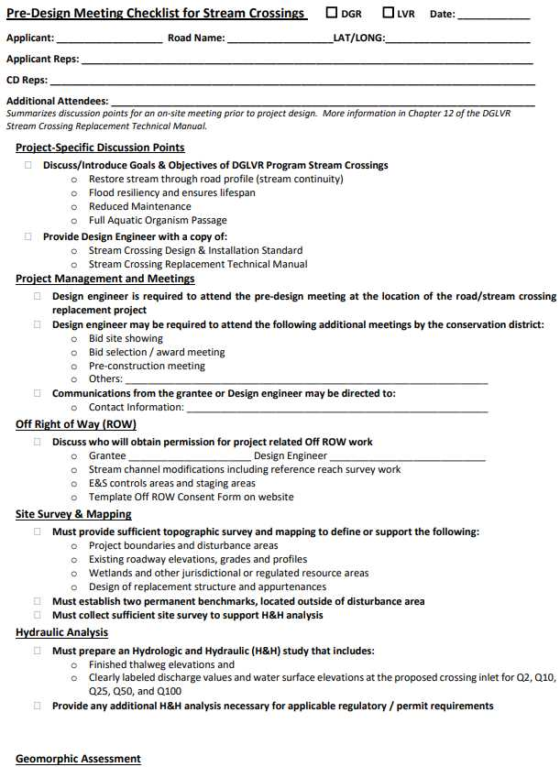
CD Responsibilities
Pre-Design Checklist
Discuss goals of the project
Project scope
Engineer scope of work/requirements
  Meetings
  Design
  Permit
  Bid Docs.
  Construction Inspection
Provide engineer with Standard and Technical Manual
www.dirtandgravelroads.org

Slide 69
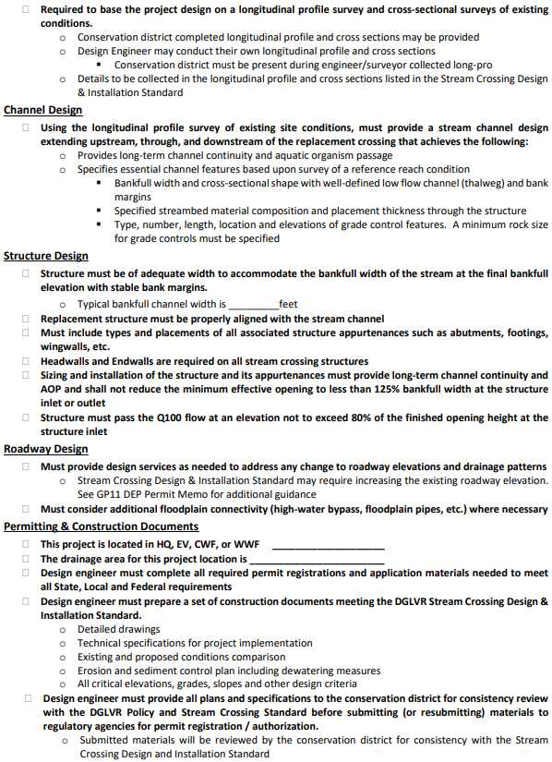
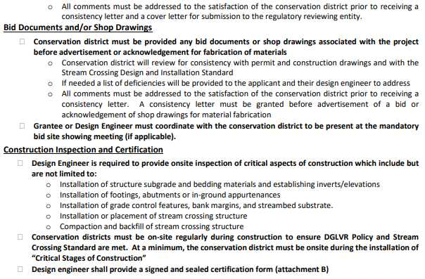
CD Responsibilities
Pre-Design Checklist
www.dirtandgravelroads.org

Slide 70
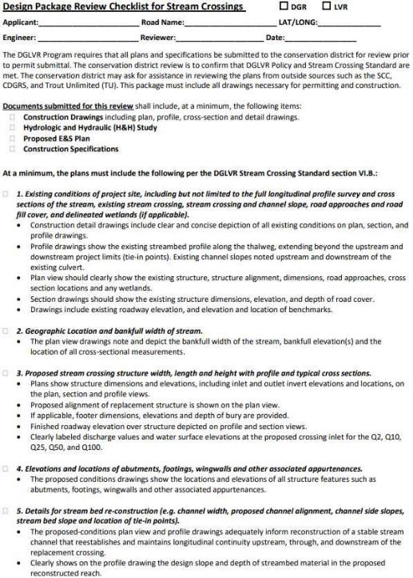
CD Responsibilities
Design Package (Plan) Review Checklist
Confirm necessary elements are present
Consistent with the Design Standard
  Required documents
  Existing conditions
  Location and bankfull width
  Structure width, length, & height with profile and cross sections
  Elevation and location of structure features
  Details for streambed reconstruction
  Details for low flow channel
  Details for rock-sizing and structures
  Material details for streambed restoration
  Compaction specification
  Scour hole restoration
  Structure manufacturer's details/instructions
www.dirtandgravelroads.org

Slide 71
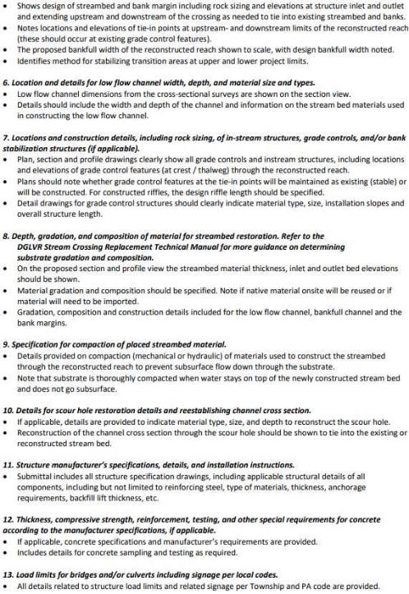
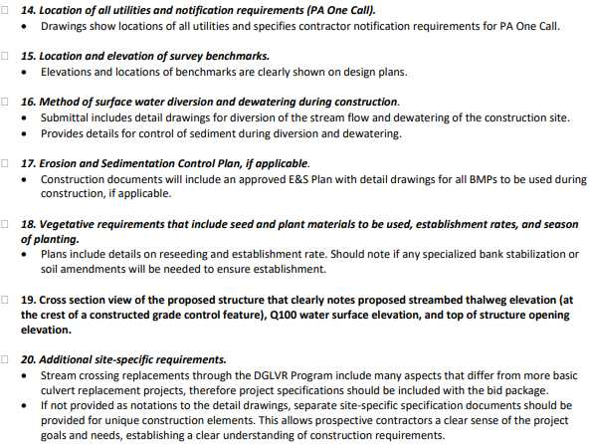
CD Responsibilities
Design Package (Plan) Review Checklist
www.dirtandgravelroads.org

Slide 72
CD Responsibilities
Other Documents
Pre-Application Meeting Checklist
Stream Crossing Exemption Forms (required if applicable)
Engineer Request for Proposal Template
Consistency/Deficiency Letters (required, but don't have to use template)
GP-11 Memo (use it)
GP-7/GP-11 Cover Letter (use it)
Bid Package Review Checklist
Bid Site Showing Checklist
Pre-Construction Meeting Checklist
Construction Inspections Checklist
Completion/Final Inspection Checklist
Inspection and Documentation of Critical Stages of Construction Form (required for engineer)
https://dirtandgravel.psu.edu/stream-crossing-replacements/
www.dirtandgravelroads.org

Slide 73
Stream Crossing Update
Implementation Update
Emerging Issues
CD Responsibilities
Other Considerations

Slide 74
Stream Crossings: Other Considerations
The Program would like to get ahead of any other potential issue out there.
SCC/CDGRS working to catalog crossings going in under standard
  E-mail survey to come
SCC/CDGRS will reach out to see if assistance is needed
We also want to monitor how the first ones go using the Standard…what works, what doesn’t, for future Standard changes.
www.dirtandgravelroads.org

Slide 75

Stream Crossings: Other Considerations
Stream Notification System update: Add site ID once the project is contracted
www.dirtandgravelroads.org

Slide 76
Steve and
Roy

Slide 77

Stream Crossings: Other Considerations
Stream Crossing Replacements:
are more complex.
are more time-consuming.
take longer to implement.
(compared to “normal DGLVR projects”)
www.dirtandgravelroads.org

Slide 78
Stream Crossings: Other Considerations
Stream Crossing Replacements:
are more complex.
are more time-consuming.
take longer to implement.
(compared to “normal DGLVR projects”)
Does your CD have available staff time to implement stream crossings?
More meetings, more planning, more plan review, more on-site time.
A CD with one 25% DGLVR tech might not have to capacity to do even one!
A few CDs have several (3-4) in the pipeline at once (in addition to drainage projects). That may overwhelm even a full time DGLVR tech.
www.dirtandgravelroads.org

Slide 79
Stream Crossings: Other Considerations
Stream Crossing Replacements:
are more complex.
are more time-consuming.
take longer to implement.
(compared to “normal DGLVR projects”)
Does your CD have knowledge and capacity to implement stream crossings?
The Center’s stream training is a great start, but if you implement one every few years, it is a lot to remember
Do you have a laser and know how to use it?
CD is the “keystone” in the process. Can you effectively communicate and discuss with engineer and applicant, and know when to ask for help.
www.dirtandgravelroads.org

Slide 80
Stream Crossings: Other Considerations
Stream Crossing Replacements:
are more complex.
are more time-consuming.
take longer to implement.
(compared to “normal DGLVR projects”)
What happens when the DGVLR technician leaves?
The average stream crossing, start to finish, might be about as long as the average new technician lasts!
Manager needs to have some knowledge and needs to ensure someone at the CD can pick up the project.
How do you move forward with new technician?
www.dirtandgravelroads.org

Slide 81

Stream crossing projects require more CD involvement/time
First 100% “to Standard” projects going in this Spring.
The Standard only works if the CD ensures it is being met!
Don’t be shy if you have questions!
www.dirtandgravelroads.org

