Slide 1
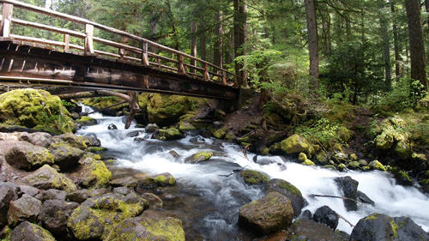
DGLVR Webinar
Stream Crossing Guidance: Structure Selection
5/7/20
Starts at 9am
If you are reading this, then you are successfully seeing the webinar video. Webinar audio should be automatic through your computer, and options can be accessed in the “audio options” button on the bottom left. If your computer audio is not working, you can listen on your phone by dialing 312-626-6799.
Audio via Phone: 312-626-6799

Slide 2
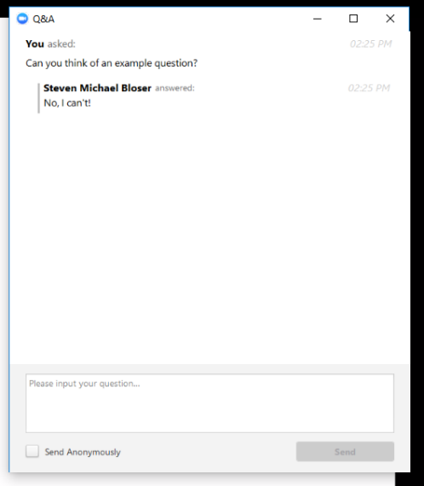
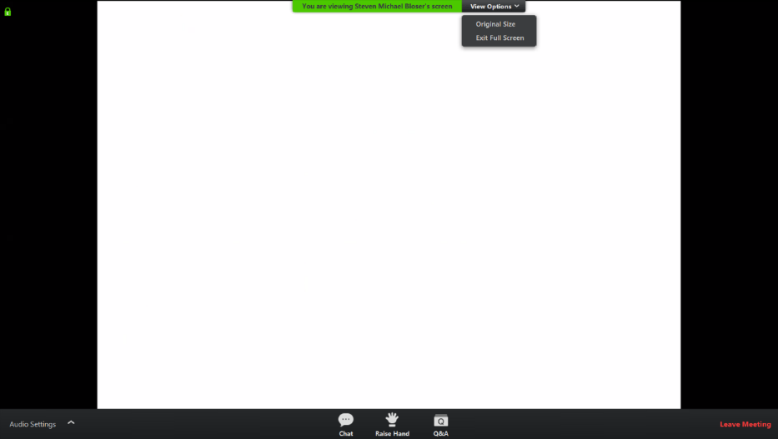
Q&A
Note you can ask a question anonymously
Q&A
Audio via Phone: 312-626-6799
Slide #

Slide 3
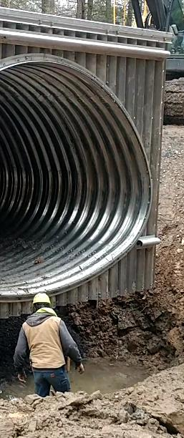
DGLVR Assessment Update
Purpose:
Review the “nearly final” Structure Selection technical bulletin
Allow for questions, comments, and clarifications
Audio via Phone: 312-626-6799

Slide 4
DGLVR Unpaved Road Assessment Update
Big Picture:
CDGRS working with SCC and TU on new stream crossing related guidance:
Determining Bankfull
Structure Selection
Continuity and Longitudinal Profile in progress
Streambed Material in progress
Contracting, engineering, cost estimates in progress
Grade Control
Design requirements (related to DEP memo)
Construction Oversight
Audio via Phone: 312-626-6799

Slide 5
DGLVR Unpaved Road Assessment Update
Big Picture:
CDGRS working with SCC and TU on new stream crossing related guidance:
Will likely make separate page on website for stream crossing reference material (like DSA is now).
One stop shop for stream crossing guidance, policy, videos, trainings, outside references, etc.
Audio via Phone: 312-626-6799

