Slide 1
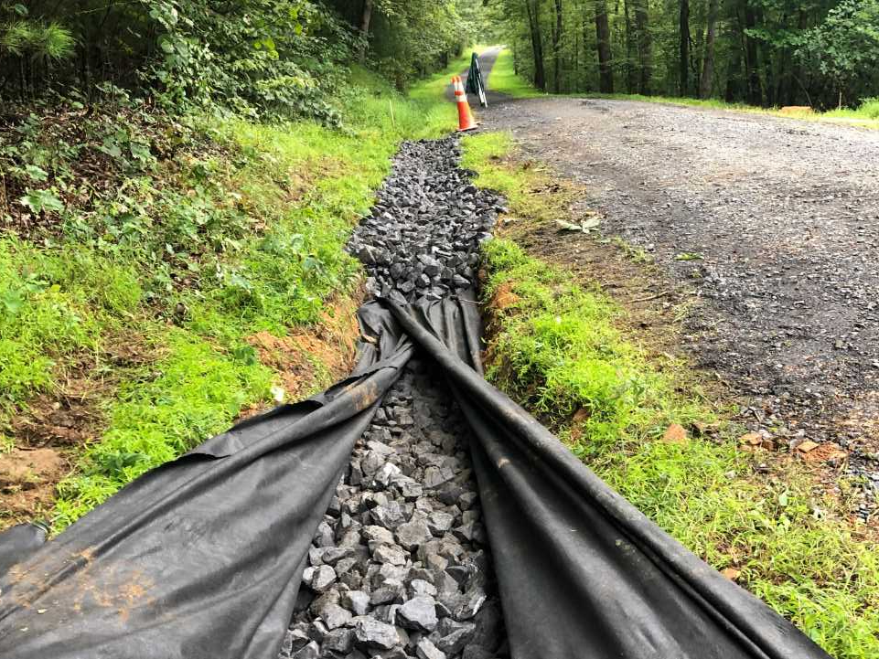
Underdrain, Storm Sewer
& Infiltration
Notes:
Show Quickly

Slide 2
Introduction
Underdrain
  Carries: groundwater
  Requires: slope/fall to carry water
  Outlets: on the surface
Storm sewer
  Carries: surface water underground
  Requires: slope/fall to carry water
  Outlets: on the surface
Infiltration practices
  Carries: surface water underground
  Requires: flat bottom and correct site conditions to achieve infiltration
  Outlets: underground via infiltration
    With a surface overflow
Notes:
Project C

Slide 3
Underdrain, Storm Sewer
& Infiltration
LVR Overview
Underdrains
Storm Sewer
Infiltration – Structural BMPs

Slide 4
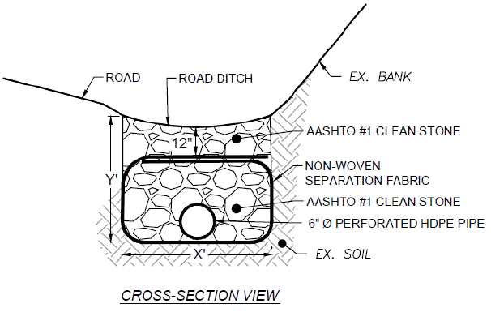
Underdrains
Notes:
Consider Underdrains When:
Wet Ditches, Banks, Spots in Road
Dry Bank and Remove Lubrication
Consider an Underdrain when you see perpetually wet ditches and banks along the road. They can even be installed under the cartway to dry out problem wet spots. When you dry out wet ditches and drain wet banks, you remove lubrication from the equation and make your banks more stable.

Slide 5
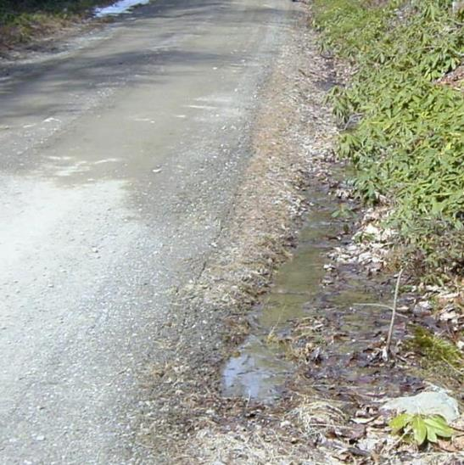
Underdrains
When TO USE:
Groundwater!!!!!
  Saturated road bases
  Perpetually wet
  ditches and banks
WHERE ROADS ARE CONSISTENTLY
WET FROM GROUNDWATER WATER.
Notes:
Consider Underdrains When:
Wet Ditches, Banks, Spots in Road
Dry Bank and Remove Lubrication
Consider an Underdrain when you see perpetually wet ditches and banks along the road. They can even be installed under the cartway to dry out problem wet spots. When you dry out wet ditches and drain wet banks, you remove lubrication from the equation and make your banks more stable.

Slide 6
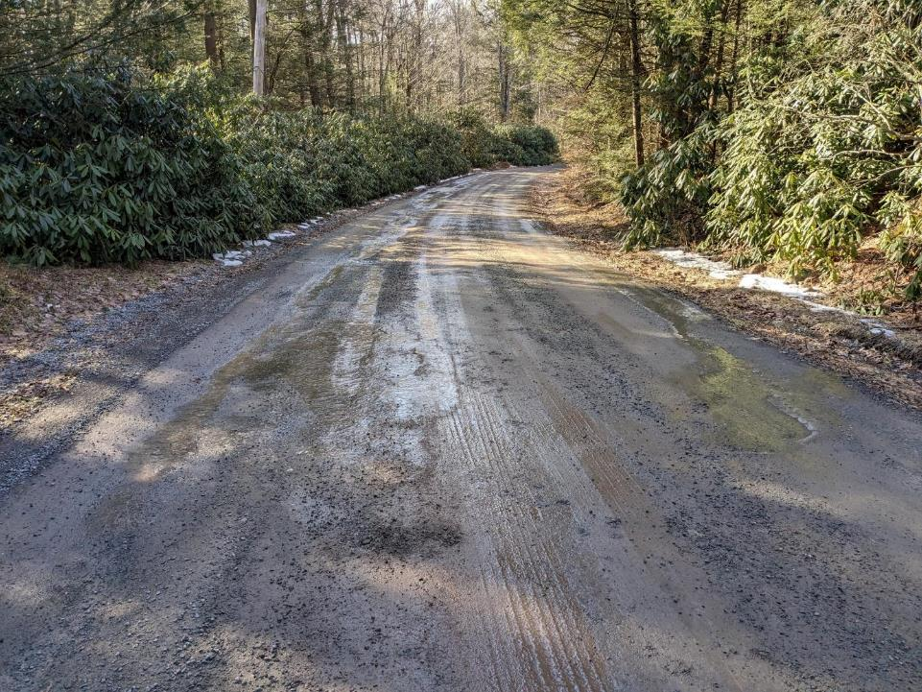
Underdrains
Use where ground water issues are affecting the road.

Slide 7
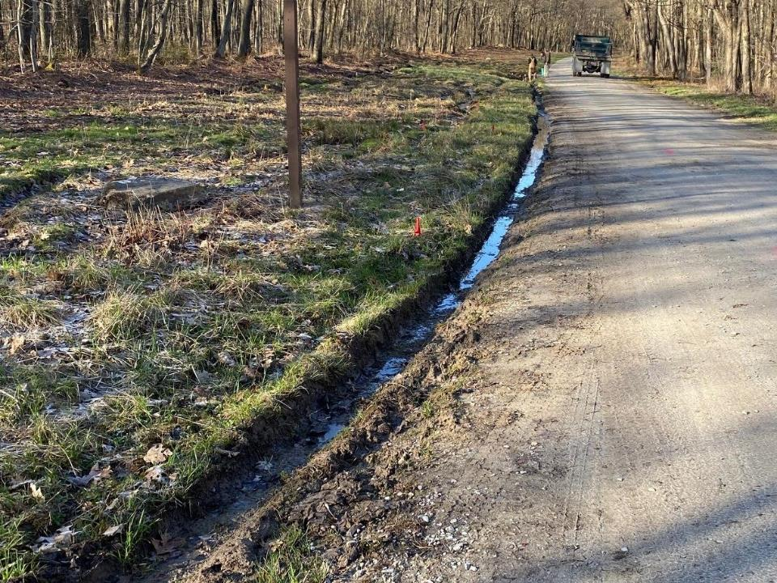
Underdrains
Example Project #1: Exposed Underdrain
Notes:
Discussed in “Banks”
We talked about these buried drains in the “Banks” section.

Slide 8
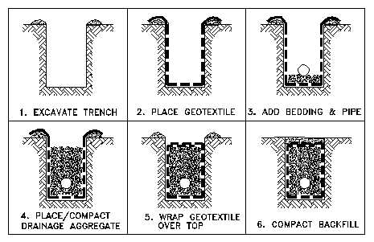
Underdrains
Constructed Stone Underdrain
1. Excavate Trench
2. Place Geo-textile
3. Add pipe and clean fill
4. Add clean fill
5. Wrap and overlap geo-textile
6. Cover geo-textile
FHWA Geosynthetic Design and Construction Guidelines
(Berg, et. al., 1998)
Notes:
Constructed Underdrain:
Built Any Size – For Any Flow
Clean Filter Stone Also Carries Water
Slide of Steps of Construction
A constructed underdrain can be built to any size, to handle any anticipated flow. The clean stone surrounding the drain pipe will carry water as well. I’ve seen a lot of field drains made only of stone. This slide shows the steps of constructing an underdrain.

Slide 9
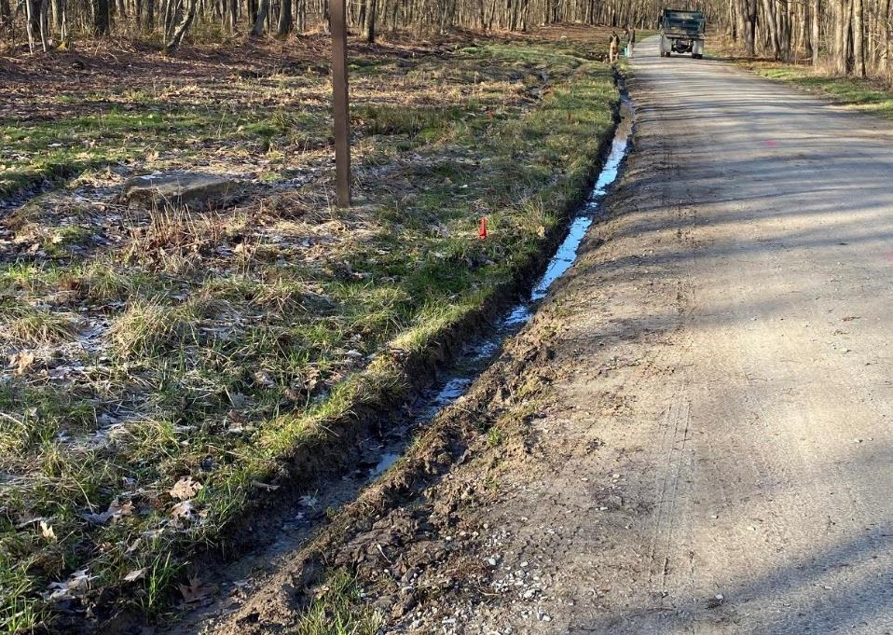
Underdrains
Before
Groundwater from pipeline

Slide 10
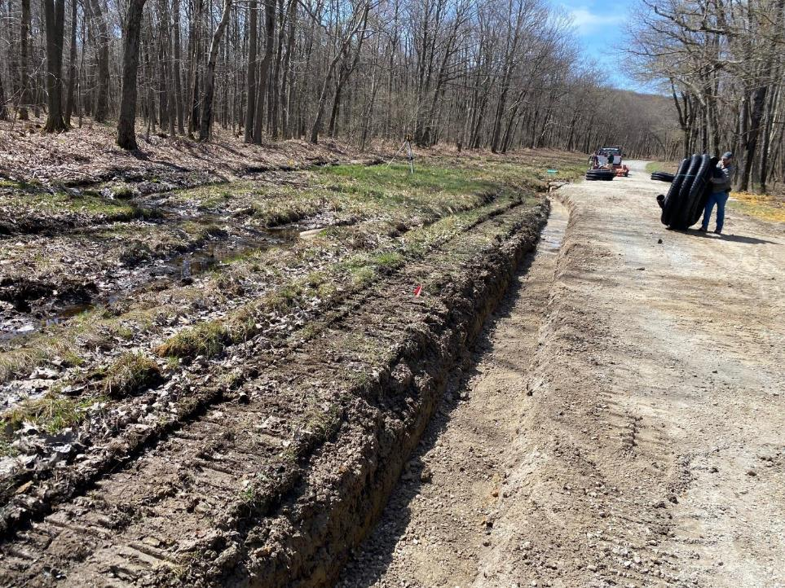
Underdrains
During
Underdrain excavation
Ensure trench has positive drainage. Use Laser Level!

Slide 11
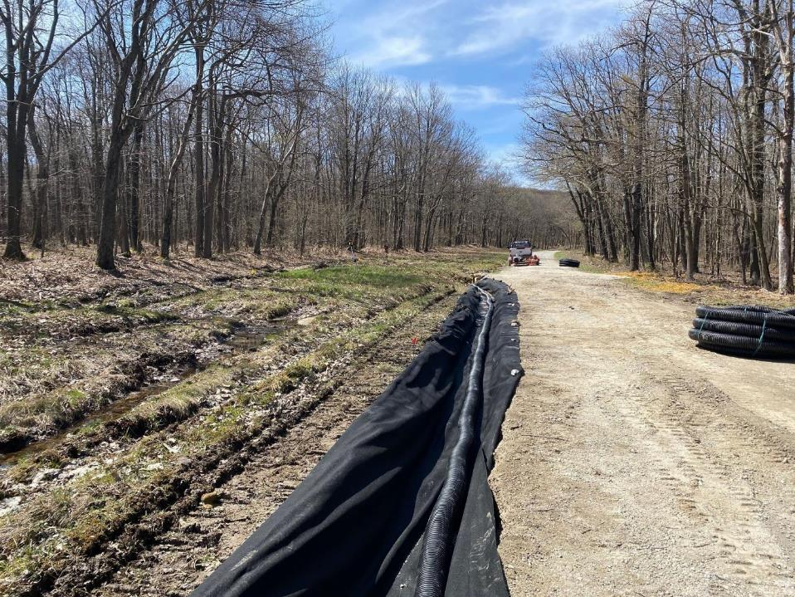
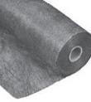
Underdrains
During
Non-Woven Fabric & Perforated Pipe Placement
Non-Woven Fabric
- separates
filters

Slide 12
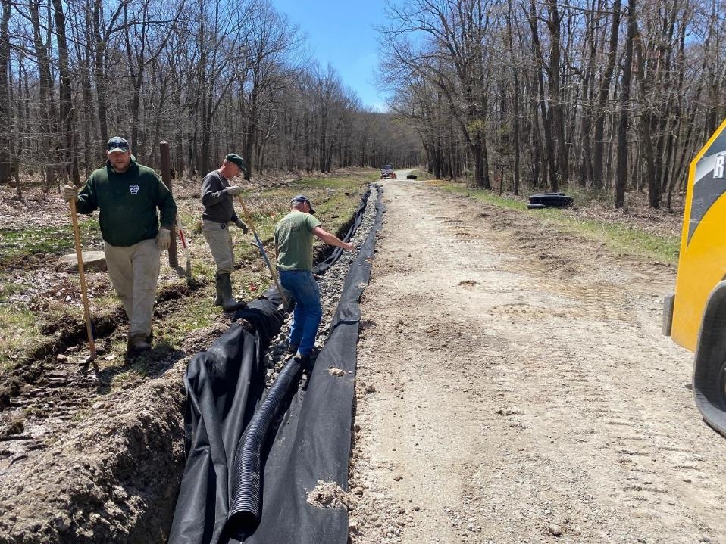
Underdrains
During
AASHTO #1 Stone Backfill

Slide 13
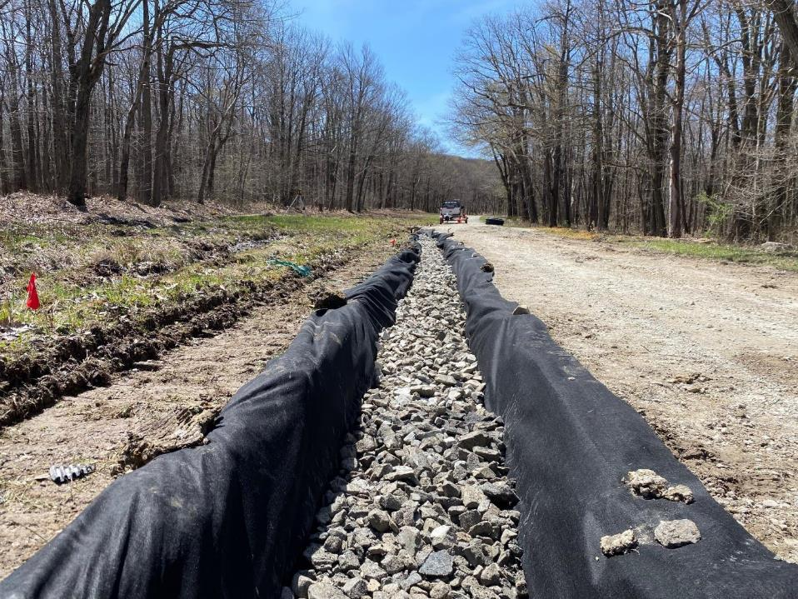
Underdrains
During
AASHTO #1 Stone Backfill

Slide 14
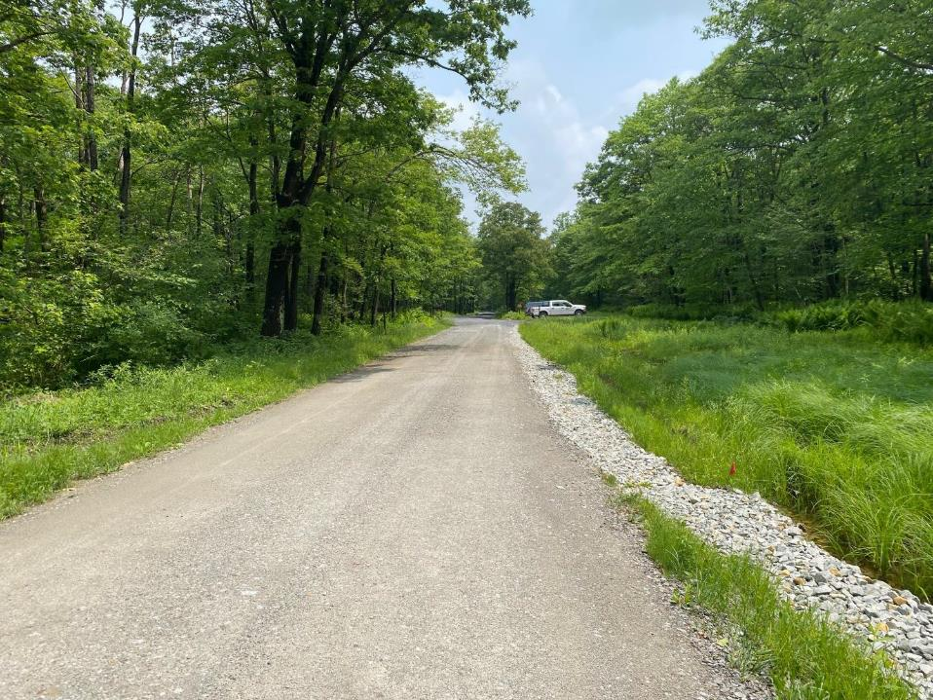
Underdrains
After

Slide 15
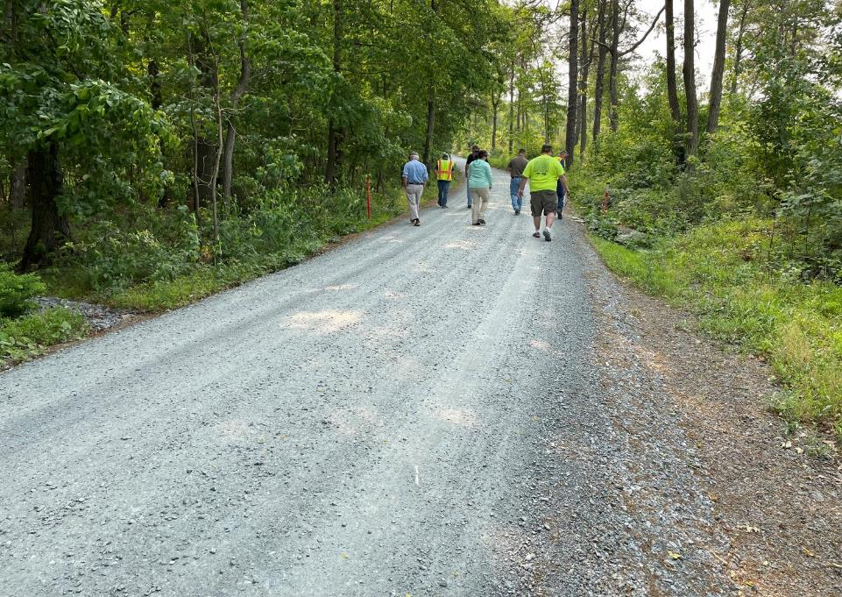
Underdrains
Separate underdrain outlet
Pipe outlet

Slide 16
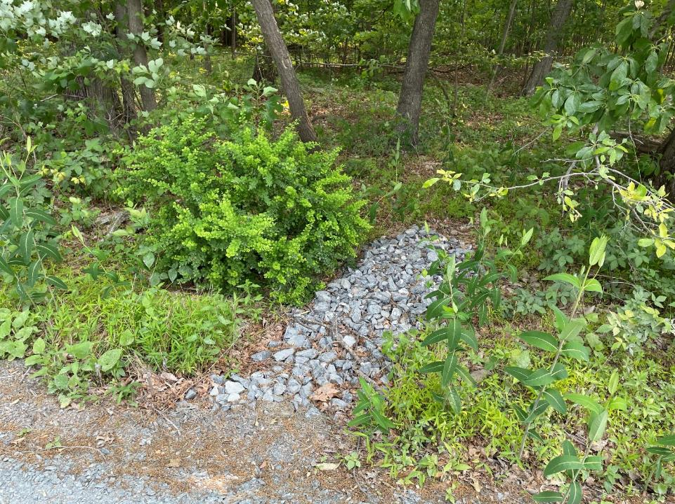
Underdrains
Close up of separate underdrain outlet
Looking from road

Slide 17
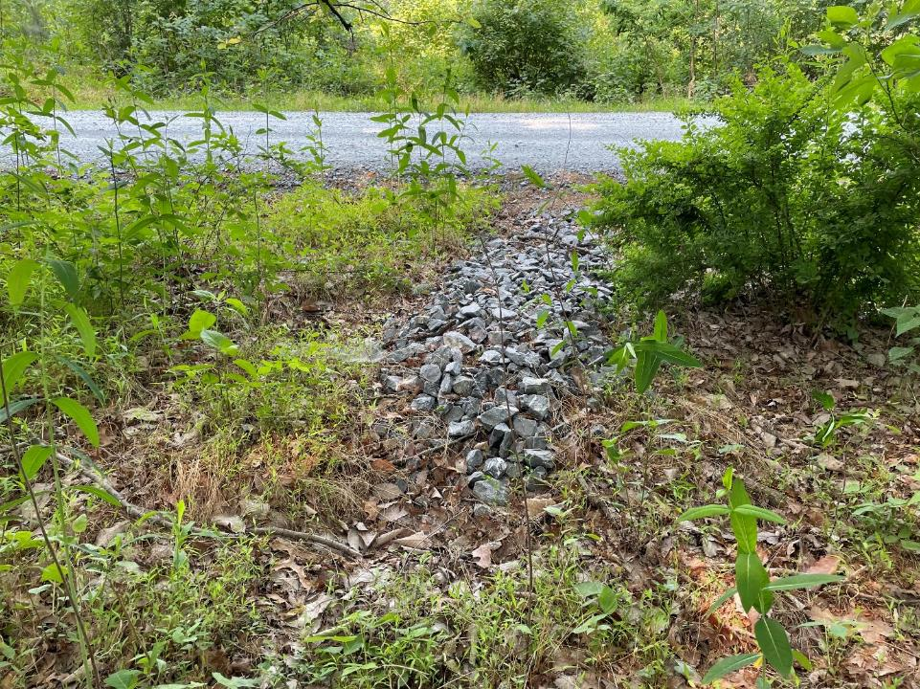
Underdrains
Close up of separate underdrain outlet
Facing road

Slide 18
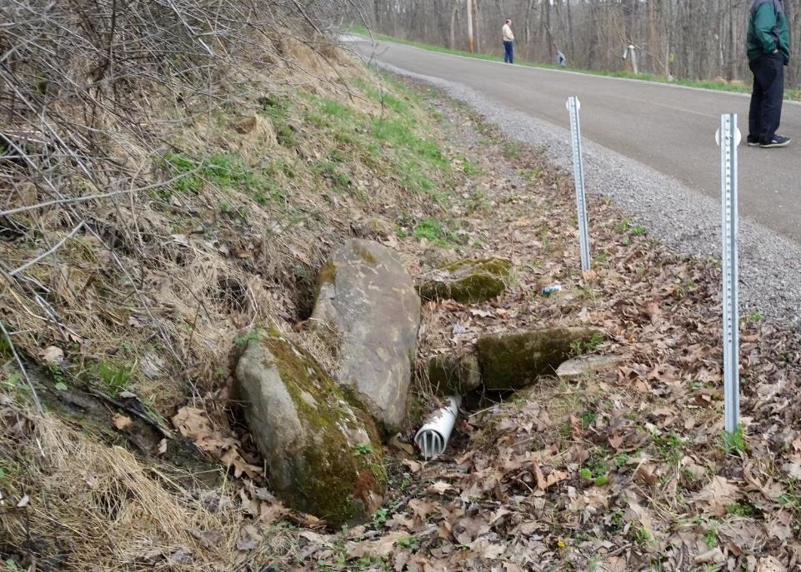
Underdrains
Solid Pipe at Outfall.
Solid pipe prevents crushing
Critter guards
Notes:
Dig to Desired Width and Depth to Allow For Min. 12” Cover
Ensure Minimum 1% Slope
Line With Geo-Fab
Clean Stone Bedding
Lay Pipe
The trench was excavated to the desired width, and deep enough to allow for sufficient cover of the completed underdrain. The backhoe operator made sure their was at least 1% slope, so the drain would drain . The trench was then lined with enough geo-fabric to overlap on top. Clean stone was laid in the bottom as pipe bedding, and the perforated drain pipe was laid on top of the stone.

Slide 19
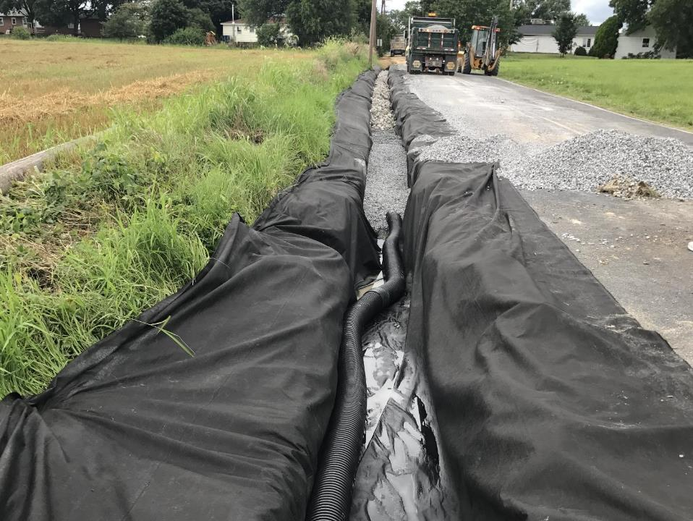
During
Example Project #2: Buried Underdrain
Clean Stone
Perforated Pipe
Wet ditch from seep

Slide 20
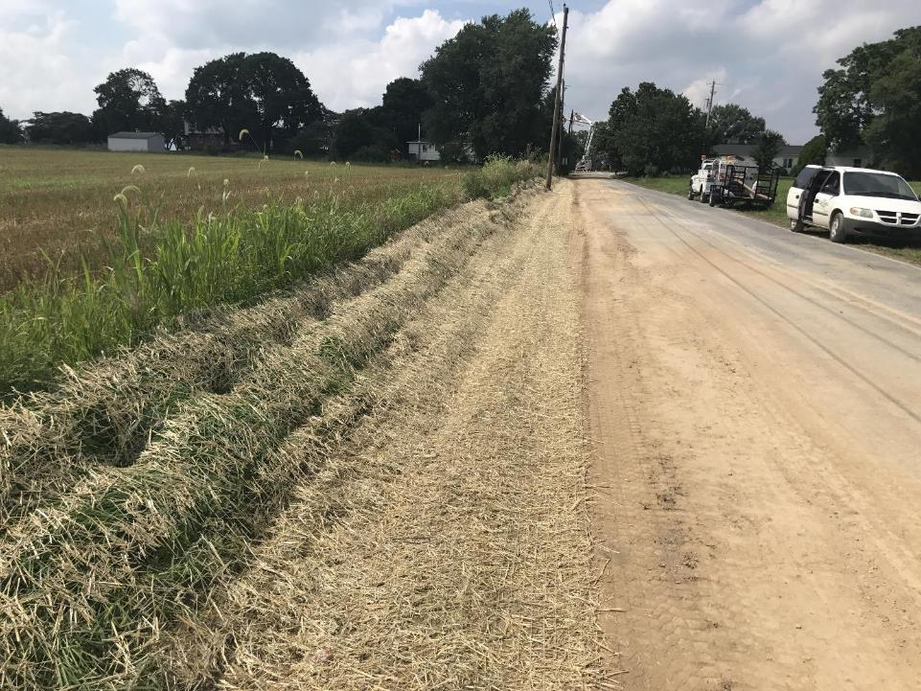
During
Topsoil w/ Seeding & Mulching.
Maintain ditch shape/profile.

Slide 21
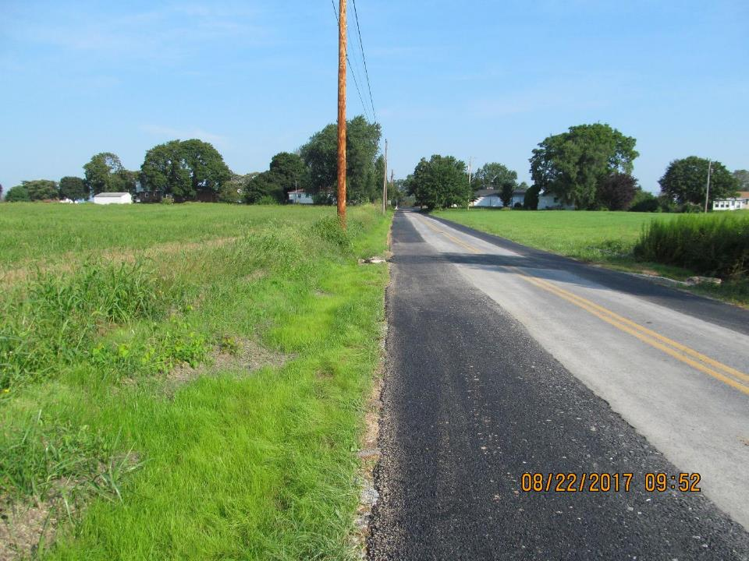
After

Slide 22
Road Base: ESMPs
Underdrains
FROM ESM TRAINING
Considerations:
Use clean stone (with no fines) – AASHTO 1 a good choice
Small stone (such as 2A) that is exposed at surface is prone to washouts and clogging.
Cover with min 1’ material – avoid reusing ditch spoils
Use caution installing on slopes – often not needed here
Use constructed stone underdrains wrapped in non-woven geofabric (use of fabric may be local decision)
Outlet separately from ditch drainage when possible
Easy to add underdrain with little effort in fill jobs
Notes:
Consider Underdrains When:
Wet Ditches, Banks, Spots in Road
Dry Bank and Remove Lubrication
Consider an Underdrain when you see perpetually wet ditches and banks along the road. They can even be installed under the cartway to dry out problem wet spots. When you dry out wet ditches and drain wet banks, you remove lubrication from the equation and make your banks more stable.

Slide 23
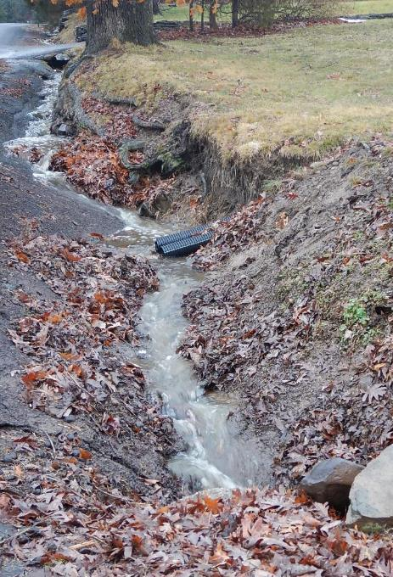
Road Base: ESMPs
Underdrains
FROM ESM TRAINING
When NOT TO USE:
For stormwater runoff.
Where surface runoff has not been addressed.
As storm sewer systems to convey surface runoff.
Notes:
Consider Underdrains When:
Wet Ditches, Banks, Spots in Road
Dry Bank and Remove Lubrication
Consider an Underdrain when you see perpetually wet ditches and banks along the road. They can even be installed under the cartway to dry out problem wet spots. When you dry out wet ditches and drain wet banks, you remove lubrication from the equation and make your banks more stable.

Slide 24
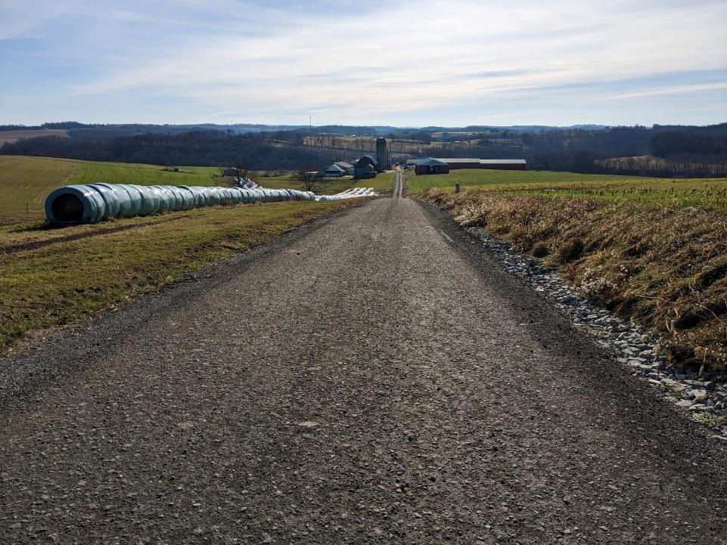
Underdrains
Lack of Outlets / Long Runs
Notes:
Project A

Slide 25
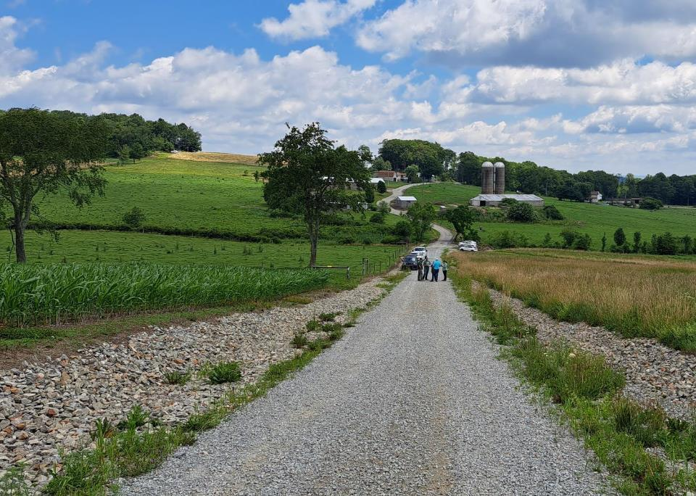
Underdrains
Not for Surface Water Runoff!
Underdrains are not Storm Sewer Systems
Lack of Outlets / Long Runs
If ditch stabilization is needed ensure that rock lining is large enough to stay in place.
Notes:
Consider Underdrains When:
Wet Ditches, Banks, Spots in Road
Dry Bank and Remove Lubrication
Consider an Underdrain when you see perpetually wet ditches and banks along the road. They can even be installed under the cartway to dry out problem wet spots. When you dry out wet ditches and drain wet banks, you remove lubrication from the equation and make your banks more stable.

Slide 26
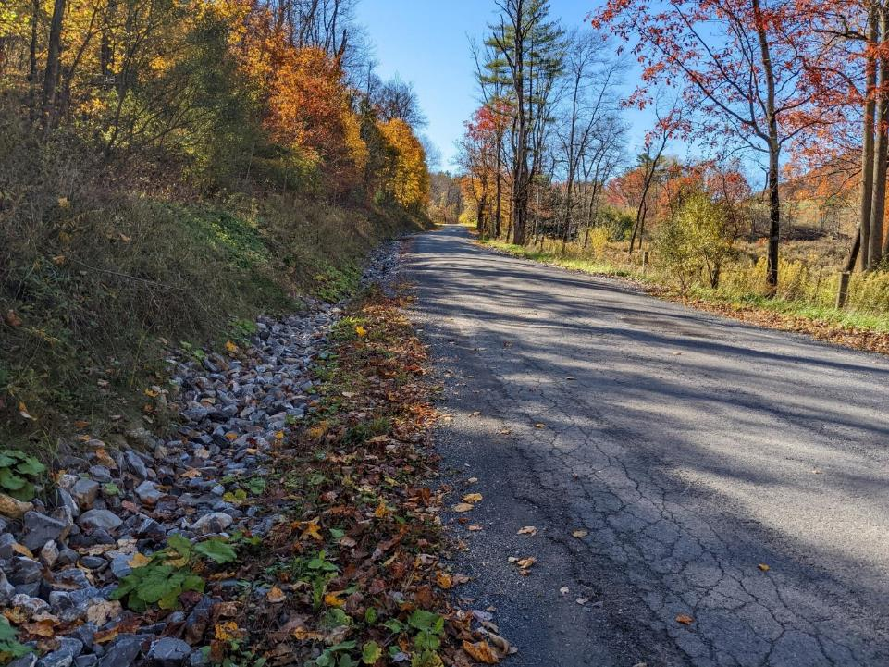
Underdrains
If ditch stabilization is needed ensure that rock lining is large enough to stay in place.
Large rock to prevent erosion.
Ditch shape was maintained.
Notes:
Project D

Slide 27
Underdrains
Why are underdrains not suitable for storm water?
Notes:
Project A

Slide 28
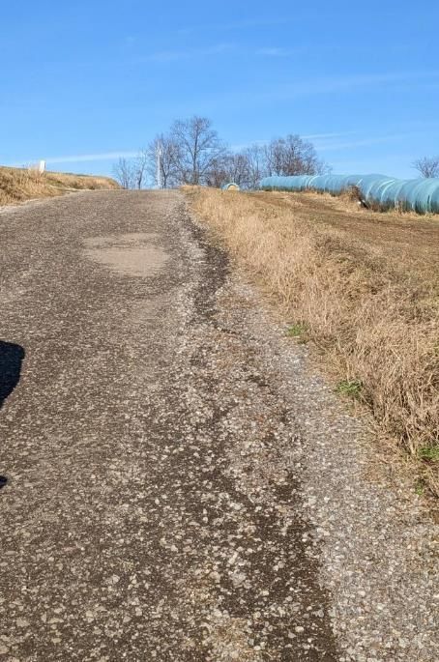
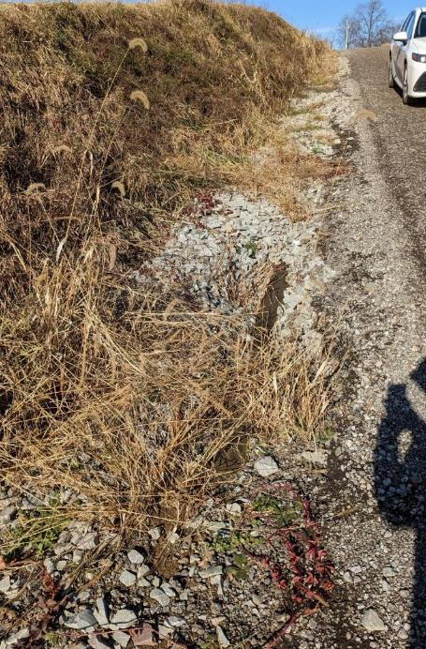
Underdrains
Notes:
Project A

Slide 29
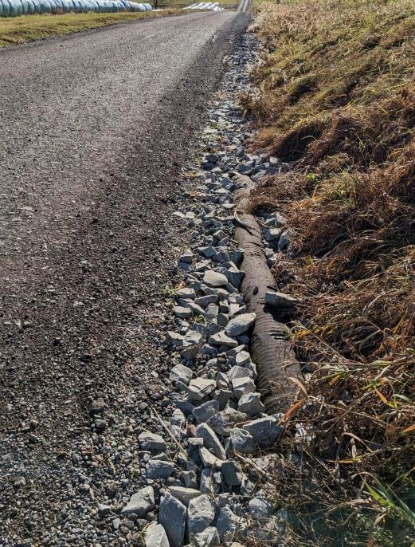
Underdrains
Lack of Ditch Outlets.
AASHTO #1 is not riprap.
Utilize riprap if needed.
Surface runoff can expose underdrains.
Notes:
Project A

Slide 30
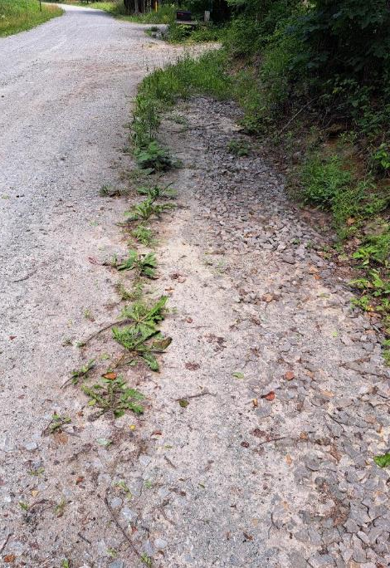
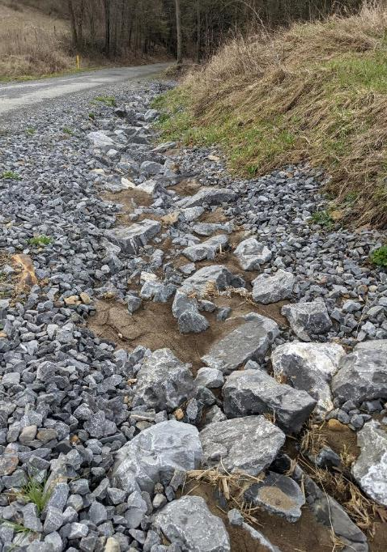
Underdrains
Sediment can close off underdrain & shorten effective life span.
Notes:
Consider Underdrains When:
Wet Ditches, Banks, Spots in Road
Dry Bank and Remove Lubrication
Consider an Underdrain when you see perpetually wet ditches and banks along the road. They can even be installed under the cartway to dry out problem wet spots. When you dry out wet ditches and drain wet banks, you remove lubrication from the equation and make your banks more stable.

Slide 31
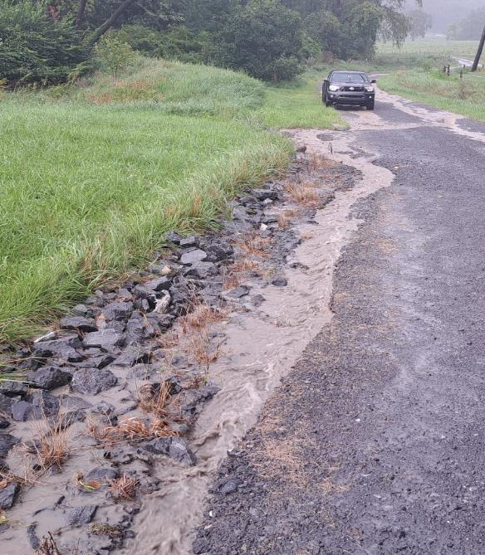
Underdrains
Maintain ditch shape and capacity over underdrains.
Notes:
Consider Underdrains When:
Wet Ditches, Banks, Spots in Road
Dry Bank and Remove Lubrication
Consider an Underdrain when you see perpetually wet ditches and banks along the road. They can even be installed under the cartway to dry out problem wet spots. When you dry out wet ditches and drain wet banks, you remove lubrication from the equation and make your banks more stable.

Slide 32
Underdrains
UNDERDRAINS ARE NOT STORM SEWER SYSTEMS!
Use underdrains to address groundwater.
Use ditch and/or storm sewers to capture and convey storm water runoff.
Maintain ditch shape and capacity to convey stormwater flows.
If adequate outlets are not available, then evaluate use of storm sewer systems and/or rock lined ditches.
Notes:
Consider Underdrains When:
Wet Ditches, Banks, Spots in Road
Dry Bank and Remove Lubrication
Consider an Underdrain when you see perpetually wet ditches and banks along the road. They can even be installed under the cartway to dry out problem wet spots. When you dry out wet ditches and drain wet banks, you remove lubrication from the equation and make your banks more stable.

Slide 33
Underdrain, Storm Sewer
& Infiltration
LVR Overview
Underdrains
Storm Sewer
Infiltration – Structural BMPs

Slide 34










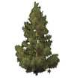


Storm Sewer
Existing Conditions - residential
Surface drainage patterns
Sub-surface drainage patterns
Notes:
Project C

Slide 35
Storm Sewer
Add storm sewer
Surface drainage patterns
Sub-surface drainage patterns
Detention basin or other stable outlet
Notes:
Project C

Slide 36
Storm Sewer
Considerations:
Will the storm sewer reduce sediment impacts?
Consider when:
  Outlet opportunities are limited.
  Ditches are unstable due to excessive runoff.
  Open ditches or cross pipes are not feasible in residential or urban settings.
Consider grass swales over storm sewers.
Where will the system outlet?
How will the outlet location be stabilized?
Notes:
Project C

Slide 37
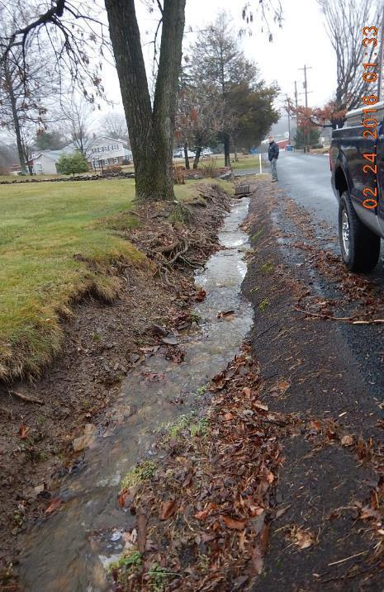
PROJECT SPOTLIGHT
Webber Road, Montgomery County
BEFORE
Montgomery County
Webber Road
$24,000 Grant, $2,000 in kind
Problems:
Excessive surface flow
Nowhere to outlet water
Practices Used:
Small storm sewer
Widened grass-lines swale
37
Notes:
Best example of the three – flows

Slide 38
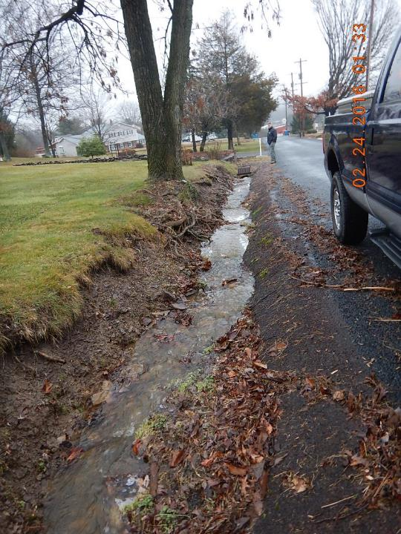
PROJECT SPOTLIGHT
Webber Road, Montgomery County
2016 LVR Project
Montgomery County, Webber Road
$24K Spent, $2K in kind
ESMs Used:
Small storm sewer
Widened grass-lined swale
BEFORE
Constant ditch washouts, erosion into yards

Slide 39
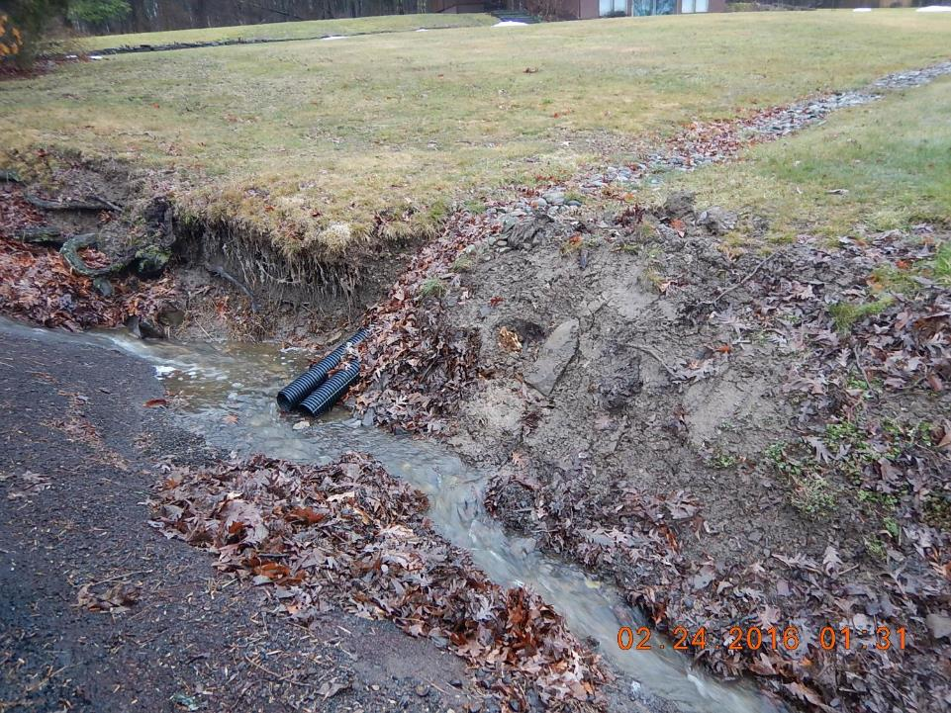
PROJECT SPOTLIGHT
Webber Road, Montgomery County
BEFORE
2016 LVR Project
Montgomery County, Webber Road
$24K Spent, $2K in kind
ESMs Used:
Small storm sewer
Widened grass-lined swale
Yards drain to road.
Nowhere to outlet water

Slide 40
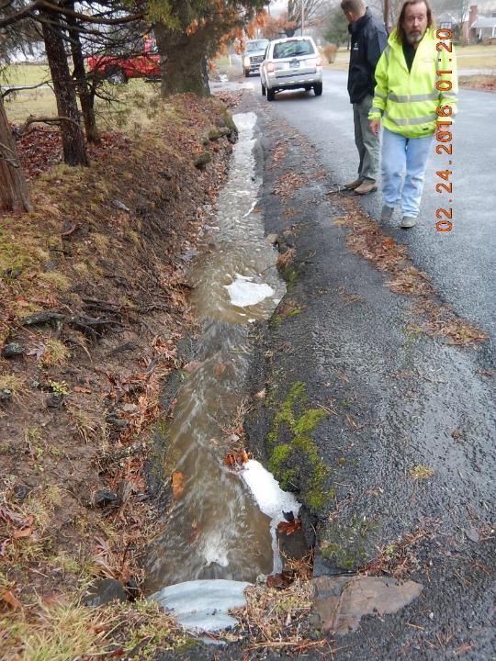
PROJECT SPOTLIGHT
Webber Road, Montgomery County
2016 LVR Project
Montgomery County, Webber Road
$24K Spent, $2K in kind
ESMs Used:
Small storm sewer
Widened grass-lined swale
BEFORE
Constant ditch washouts, erosion into yards

Slide 41
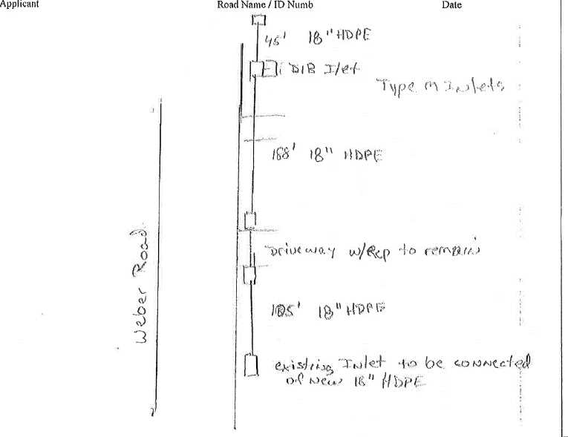
PROJECT SPOTLIGHT
Webber Road, Montgomery County
From Grant Application

Slide 42
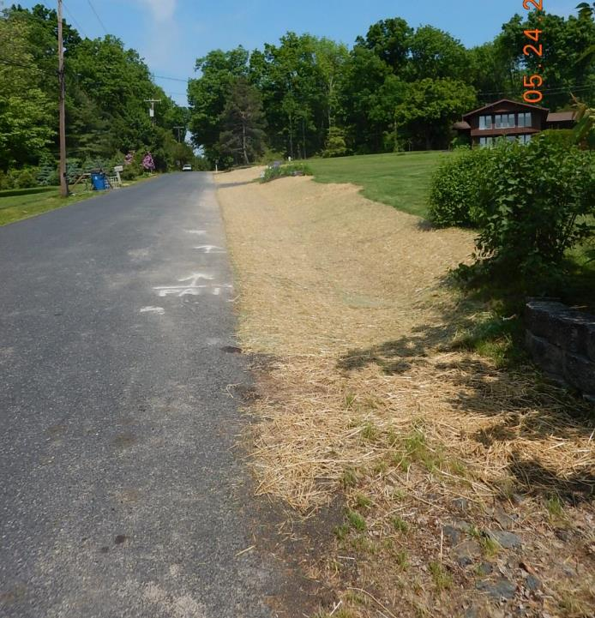
PROJECT SPOTLIGHT
Webber Road, Montgomery County
AFTER
2016 LVR Project
Montgomery County, Webber Road
$24K Spent, $2K in kind
ESMs Used:
Small storm sewer
Widened grass-lined swale
Short storm sewer
Widened grass swale

Slide 43
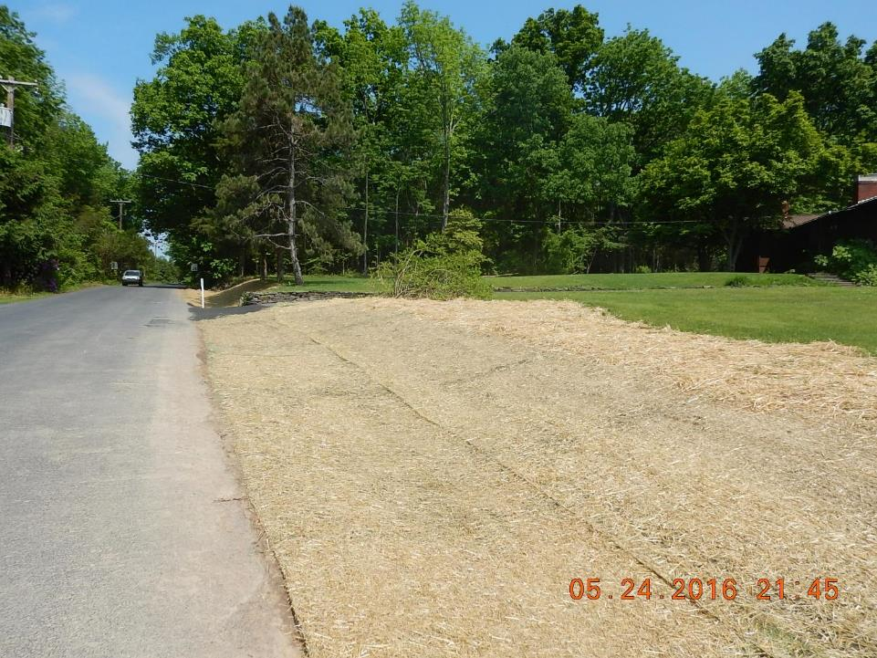
PROJECT SPOTLIGHT
Webber Road, Montgomery County
Webber Road, Montgomery County
AFTER
2016 LVR Project
Montgomery County, Webber Road
$24K Spent, $2K in kind
ESMs Used:
Small storm sewer
Widened grass-lined swale
Short storm sewer
Widened grass swale

Slide 44
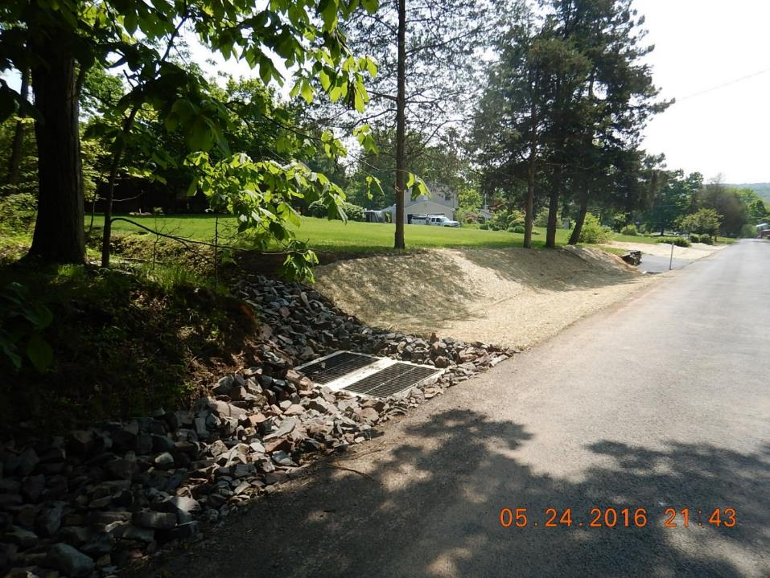
PROJECT SPOTLIGHT
Webber Road, Montgomery County
AFTER
2016 LVR Project
Montgomery County, Webber Road
$24K Spent, $2K in kind
ESMs Used:
Small storm sewer
Widened grass-lined swale
Short storm sewer
Widened grass swale

Slide 45
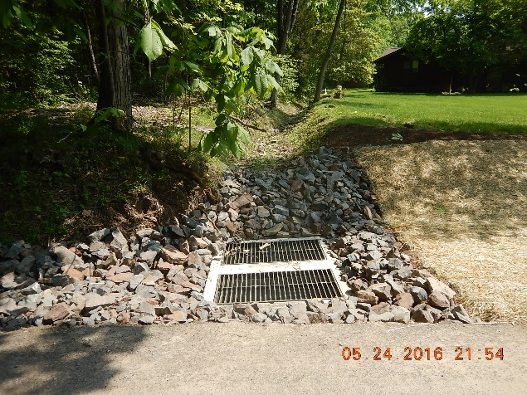
PROJECT SPOTLIGHT
Webber Road, Montgomery County
AFTER
2016 LVR Project
Montgomery County, Webber Road
$24K Spent, $2K in kind
ESMs Used:
Small storm sewer
Widened grass-lined swale
Off-ROW drainage to storm sewer
Widened grass swale

Slide 46
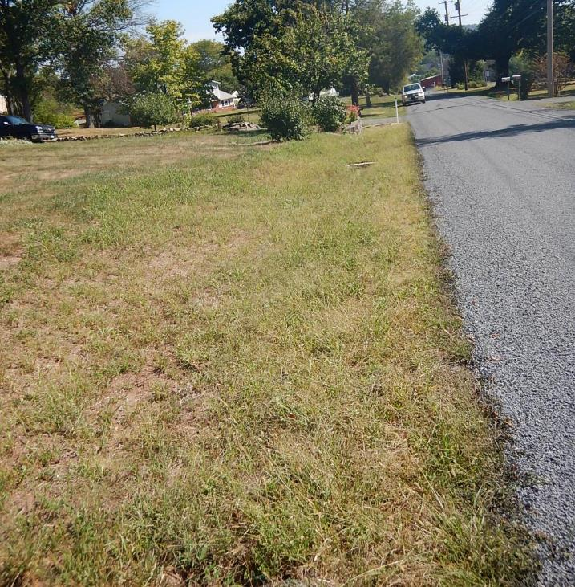
PROJECT SPOTLIGHT
Webber Road, Montgomery County
AFTER
2016 LVR Project
Montgomery County, Webber Road
$24K Spent, $2K in kind
ESMs Used:
Small storm sewer
Widened grass-lined swale
Short storm sewer
Widened grass swale

Slide 47
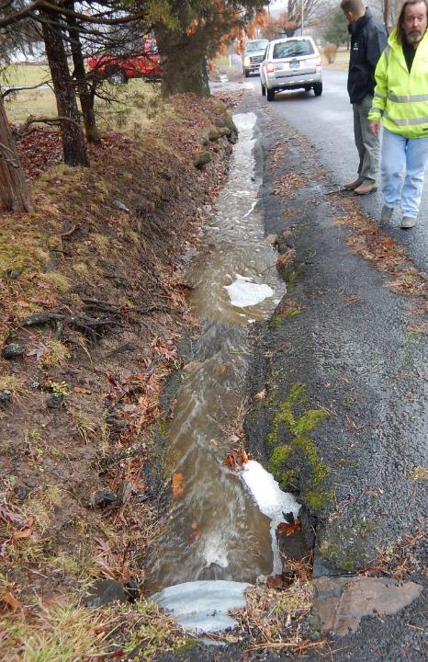
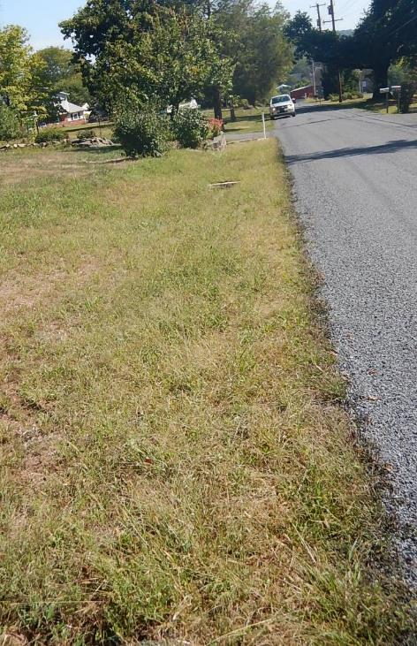
PROJECT SPOTLIGHT
2016 LVR Project
Montgomery County, Webber Road
$24K Spent, $2K in kind
ESMs Used:
Small storm sewer
Widened grass-lined swale
Webber Road, Montgomery County
Constant ditch washouts, erosion into yards
2016 LVR Project
Montgomery County, Webber Road
$24K Spent, $2K in kind
ESMs Used:
Small storm sewer
Widened grass-lined swale
BEFORE
AFTER

Slide 48
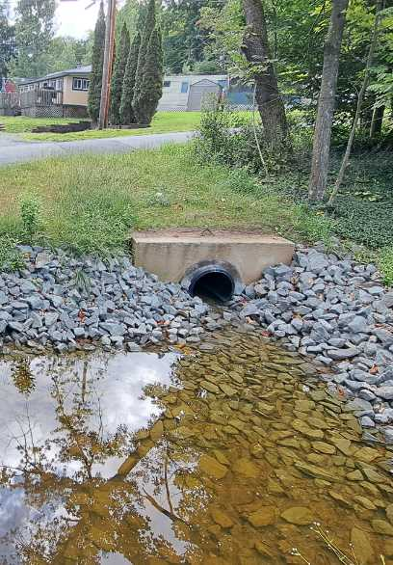
PROJECT SPOTLIGHT
Bartleson Road, Pike County
After
Pike County
Bartleson Road
$99,000 Grant, $17,000 in kind
Problems:
Excessive surface flow from small development
Flow erodes roadside ditch
Flow enters stream at bottom of hill.
Practices Used:
Storm Sewer
Energy Dissipater at Outlets
Reduce Flow Lengths
48
Notes:
Best example of the three – flows

Slide 49
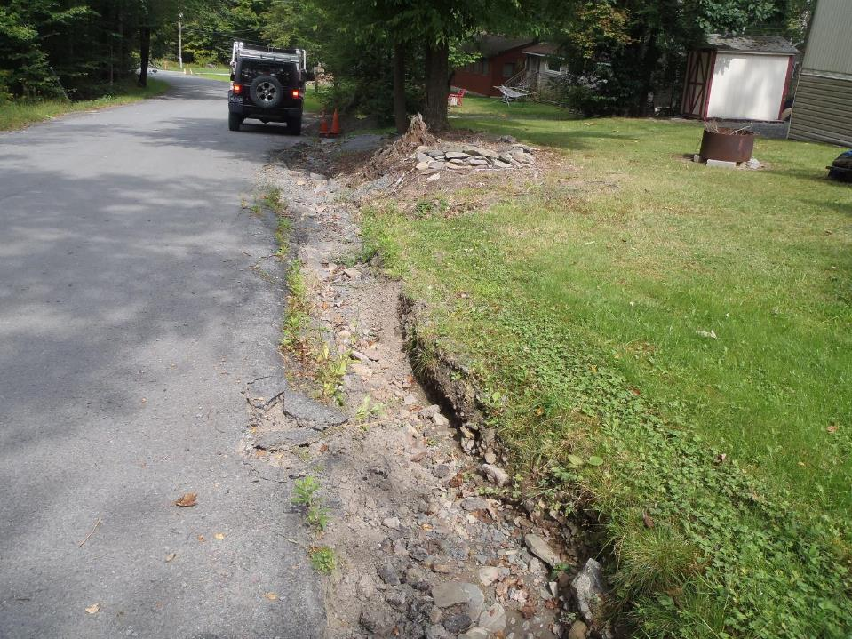
PROJECT SPOTLIGHT
Bartleson Road, Pike County
Before
Constant ditch washouts, erosion into yards
49
Notes:
Best example of the three – flows

Slide 50
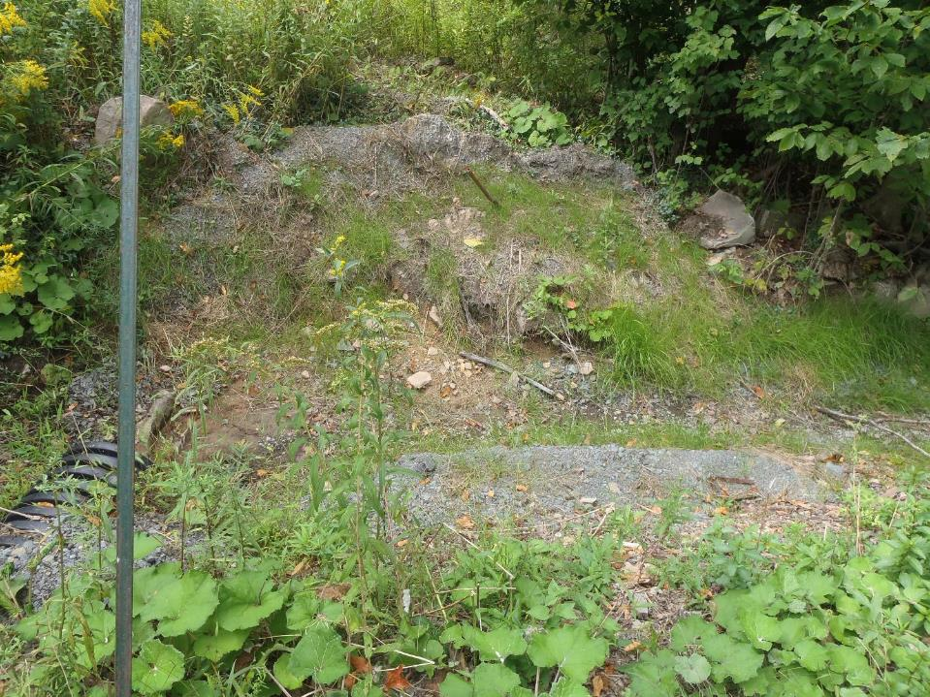
PROJECT SPOTLIGHT
Bartleson Road, Pike County
Before
Existing pipe outlet was unstable and required constant maintenance.
50
Notes:
Best example of the three – flows

Slide 51
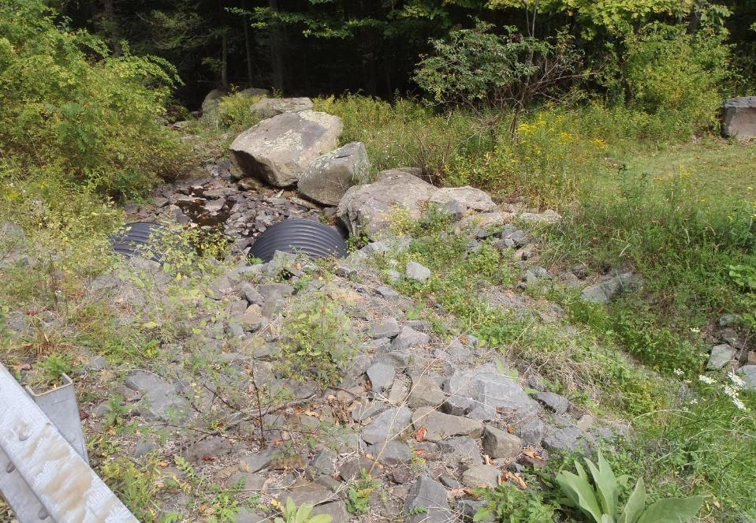
PROJECT SPOTLIGHT
Bartleson Road, Pike County
Before
Ditch drained directly to stream.
51
Notes:
Best example of the three – flows

Slide 52
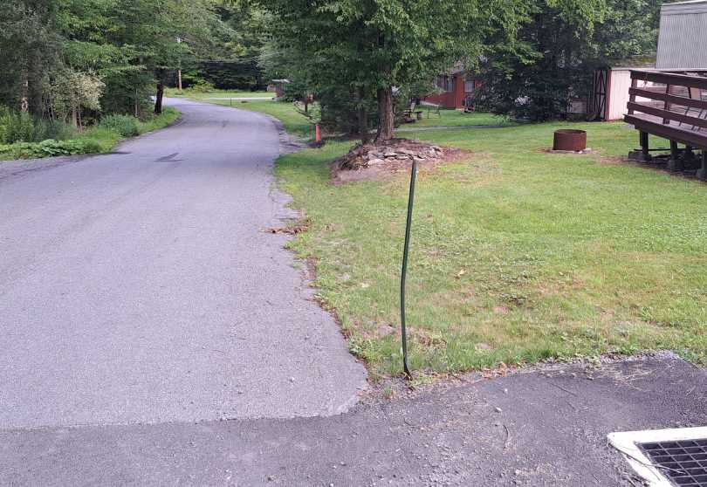
PROJECT SPOTLIGHT
Bartleson Road, Pike County
After
Inlet boxes located at intersection to capture flow.
52
Notes:
Best example of the three – flows

Slide 53
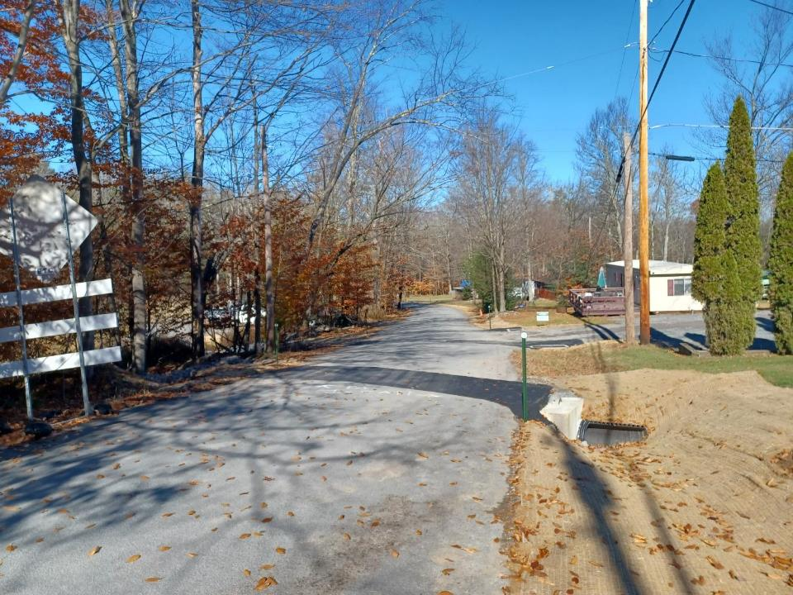
PROJECT SPOTLIGHT
Bartleson Road, Pike County
After
Multiple inlets & cross pipes to reduce flow lengths & break up flow volumes at
53
Notes:
Best example of the three – flows

Slide 54
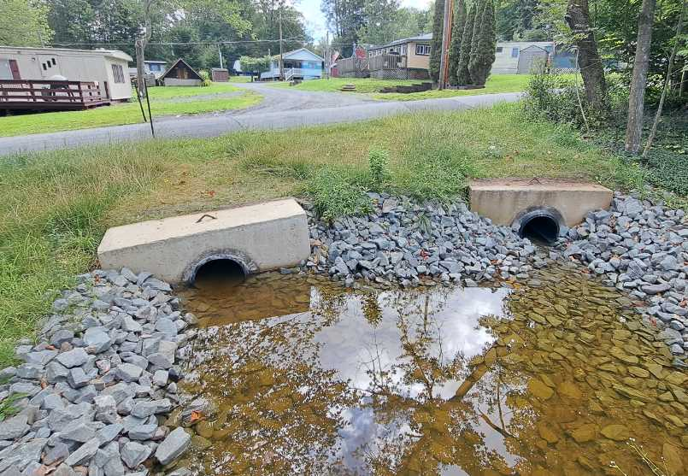
PROJECT SPOTLIGHT
Bartleson Road, Pike County
After
A total of 4 separate “teardrop” basins were constructed for the outlets of 5 different pipes.
54
Notes:
Best example of the three – flows

Slide 55

PROJECT SPOTLIGHT
Bartleson Road, Pike County
After
A total of 4 separate “teardrop” basins were constructed for the outlets of 5 different pipes.
55
Notes:
Best example of the three – flows

Slide 56
Introduction
Underdrain
  Carries groundwater underground
  Outlets on surface
Storm sewer
  Carries surface water underground
  Outlets on surface

Slide 57
Storm Sewer
What if groundwater impacts where you want to install storm sewer?
Can surface and groundwater be separated?
Underdrains can be installed in conjunction with Storm Sewers.
  Install underdrain to address groundwater issues and install storm sewer to convey storm water.
Seek as many outlets as possible and ensure outlets are stabilized.
Perforated storm sewer can collect both surface and groundwater.
  Use and installation based on project goals
    Infiltration vs. Capture

Slide 58
Storm Sewer
CONSIDERATIONS for perforated storm sewer:
  Size appropriately for the volume of water being carried.
  Bed/backfill in clean stone .
  Wrap pipe and stone in non-woven geotextile fabric.
  Consider perforated inlet boxes for infiltration projects.

Slide 59

Storm Sewer
Notes:
Talk to manufacturers about perforated inlet boxes

Slide 60
Underdrain, Storm Sewer
& Infiltration
LVR Overview
Underdrains
Storm Sewer
Infiltration – Structural BMPs

Slide 61

Infiltration
Infiltration - Water moving downward into the space between soil particles.
  Structural infiltration BMPs can be used when storm water is collected and conveyed to a single location.
Notes:
https://eschooltoday.com/learn/infiltration/

Slide 62

Infiltration
Site Evaluation
Soil Type(s) – soil mapping, wetlands, drainage
Slopes
Hydrology, Drainage Patterns
Buildings
Aerial Photographs
  Area evaluation
  Is the site suitable
  for infiltration???
Notes:
Project C

Slide 63
Infiltration
Infiltration Design
Size based upon infiltration rate
Structure design should include the following:
  Level Bottom
  Uncompacted Bottom / Amended Soils
  Limit Water Depth
  Drawdown time
  Positive Overflow
  Flow path:
    Will flow re-concentrate?
    Is permission required for discharge?
Notes:
Project C

Slide 64

Infiltration
Infiltration Basins
Notes:
Project B. infiltration/detention basin designed by engineer

Slide 65

Infiltration
Rain Garden
Notes:
Project C

Slide 66

Infiltration
Rain Garden
Notes:
Project C

Slide 67

Infiltration
Rain Garden Basins
Notes:
Project C

Slide 68

Infiltration
Bioretention Swales
Notes:
Project C

Slide 69

Infiltration
Infiltration Sump
Notes:
Project C

Slide 70

Infiltration
Infiltration Sump
3’ Deep, filled w/ R4 and edged with pallet stone.
Notes:
Project C

Slide 71

PROJECT SPOTLIGHT
Dauphin County
Penbrook Borough
31st Street
$93,019 Spent, $10,126 In-Kind
Problems:
2.8 ac. drainage enters alley
Failed storm inlets
Eroding roadway & outlet
Discharges to Spring Creek
Practices Used:
Infiltration
Retention
Stabilized outlet
BEFORE
71

Slide 72

31st & Charles Street, Penbrook Borough
Project Site

Slide 73



Slide 74



Slide 75



Slide 76



Slide 77


Slide 78



Slide 79



Slide 80


Slide 81
Infiltration
When NOT to use infiltration practices:
  When site conditions limit infiltration:
    Clay soils
    Shallow Bedrock
    Saturated soils – spring seeps, wetlands, etc.
    Houses, septic systems, utilities may be impacted.
    Infiltration in the upslope ditch may saturate road base
  When no one can maintain the practice.
  If the practice will be outside the right-of-way and:
    Written permission is not obtained.
    Off-ROW practices that are 35% or more of the project cost or 500+ ft outside the ROW require SCC permission
Notes:
Project C

Slide 82
Summary
Underdrain
  Carries: groundwater
  Requires: slope/fall to carry water
  Outlets: on the surface
Storm sewer
  Carries: surface water underground
  Requires: slope/fall to carry water
  Outlets: on the surface
Infiltration practices
  Carries: surface water underground
  Requires: flat bottom and correct site conditions to achieve infiltration
  Outlets: underground via infiltration
    With a surface overflow
Notes:
Project C

Slide 83

Summary
Technical Bulletin: Underdrains, Storm Sewers & Infiltration
Compares Underdrain vs. Storm Sewers & Infiltration
https://dirtandgravel.psu.edu/general-resources/technical-bulletins/
Notes:
Project C

Slide 84

Summary
Technical Bulletin: Underdrains
Underdrain construction
https://dirtandgravel.psu.edu/general-resources/technical-bulletins/
Notes:
Project C

Slide 85

Questions? Discussion?

Slide 86

DGLVR Program
Spending Update/ASR Refresher
  5-Year Spending Update
    All funding from agreement must be spent out by 6/30/24
    Current CD Status as of 2/13/2024
      Spent everything: 23 DGR, 20 LVR
      Committed everything: 24 DGR, 29 LVR
      Not committed: 17 DGR, 17 LVR

Slide 87
DGLVR Program
Spending Update/ASR Refresher
  5-Year Spending Update - Financials
    Dirt and Gravel
      Committed: $4,279,904.22
      Not Committed: $484,442.34
    Low Volume
      Committed: $2,842,816.66
      Not Committed: $867,122.70
    Total
      DGR: $4,764,346.56
      LVR: $3,709,939.36
      Total: $8,474,285.92

Slide 88
DGLVR Program
Spending Update/ASR Refresher
  Question:
  How do I know how much I need to spend to meet my spending requirements?
    Answer:
  This information is available in the GIS.

Slide 89

DGLVR Program
Spending Update/ASR Refresher
  Question:
  How do I know if I have all my “old money” contracted?
    Answer:
  If your Committed Remaining is greater than the Balance Remaining.

Slide 90

DGLVR Program
Spending Update/ASR Refresher
  Question:
  How do I know if I still have “old money” to contract?
    Answer:
  If your Committed Remaining is less than the Balance Remaining.

Slide 91
DGLVR Program
Spending Update/ASR Refresher
  5-Year Spending Update
    If you are Green in both DGR and LVR, great job!
    If you are Yellow or Red in DGR and/or LVR, expect follow-up status calls/emails.

