Slide 1
WELCOME
PA Dirt, Gravel, and Low Volume Road Maintenance Program
12:30-1:00 – Intro
1:00-5:00 – Admin training
www.dirtandgravelroads.org
Steve Bloser (Center) - smb201@psu.edu
Roy Richardson (SCC) - rrichardso@pa.gov

Slide 2
PA Dirt and Gravel Road Maintenance Program
www.dirtandgravelroads.org
Steve Bloser (Center) - smb201@psu.edu
Roy Richardson (SCC) - rrichardso@pa.gov

Slide 3
TOPIC OUTLINE
Program Purpose
Program History
Program Structure
PSU Center
Program Future

Slide 4
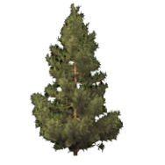
PA Dirt and Gravel Road Program
Program Purpose
Surface drainage patterns
SUBSURFACE DRAINAGE PATTERNS
SUBSURFACE DRAINAGE PATTERNS
Sub-surface drainage patterns
Notes:
The effects of increased erosion are many, but the biggest are increased maintenance problems, as well as excess sediment and chemical runoff to the streams.

Slide 5
PA Dirt and Gravel Road Program
Program Purpose
Surface drainage patterns
SUBSURFACE DRAINAGE PATTERNS
SUBSURFACE DRAINAGE PATTERNS
Sub-surface drainage patterns
Notes:
The effects of increased erosion are many, but the biggest are increased maintenance problems, as well as excess sediment and chemical runoff to the streams.

Slide 6
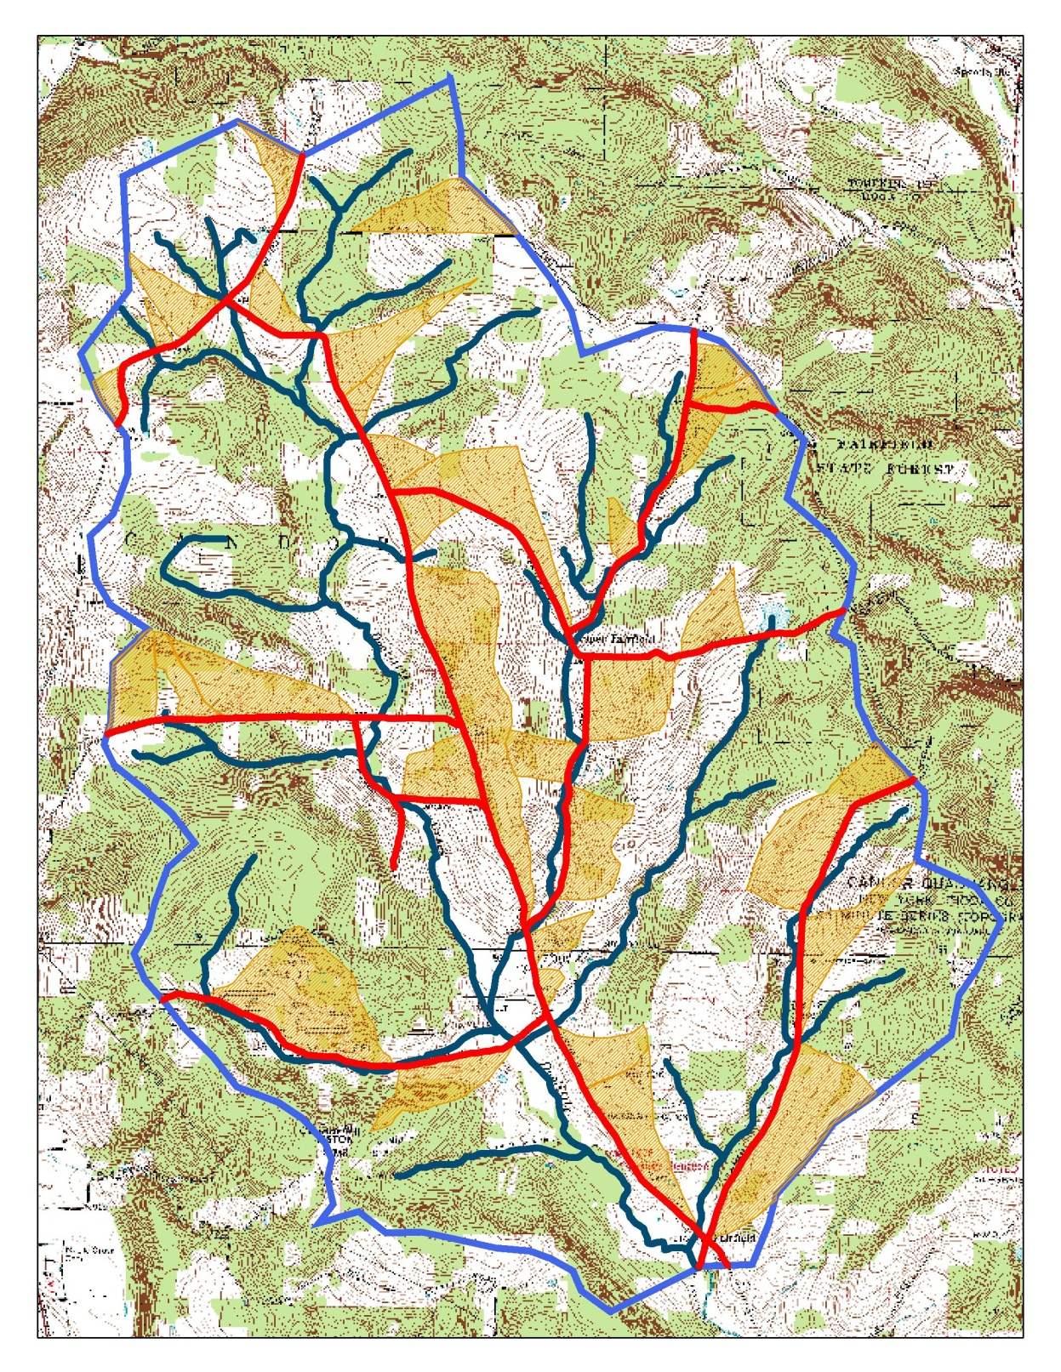
PA Dirt and Gravel Road Program
Program Purpose
Some rural watersheds have > ¼ of their area drained by road ditches into streams
Sediment & pollutants
Increased flood flows
Decreased infiltration
Ditch drainage
basins
Stream
Road ditches
-Cornell University , Dr. Rebecca Schneider

Slide 7
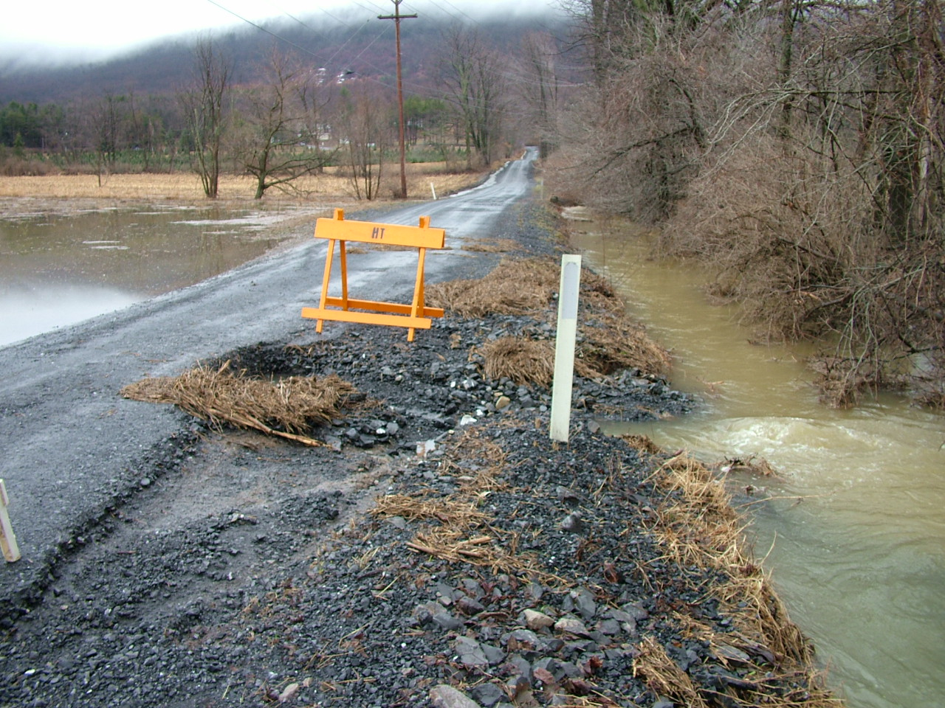
PA Dirt and Gravel Road Program
Program Purpose
Notes:
Since so many of our roads are close to streams, roads have a great deal of impact on the quality of our streams here in PA.
The next dozen slides show how roads affect natural drainage patterns, and how concentrated water and unstable roads can negatively affect nearby streams (and strain valuable municipal road funds).

Slide 8
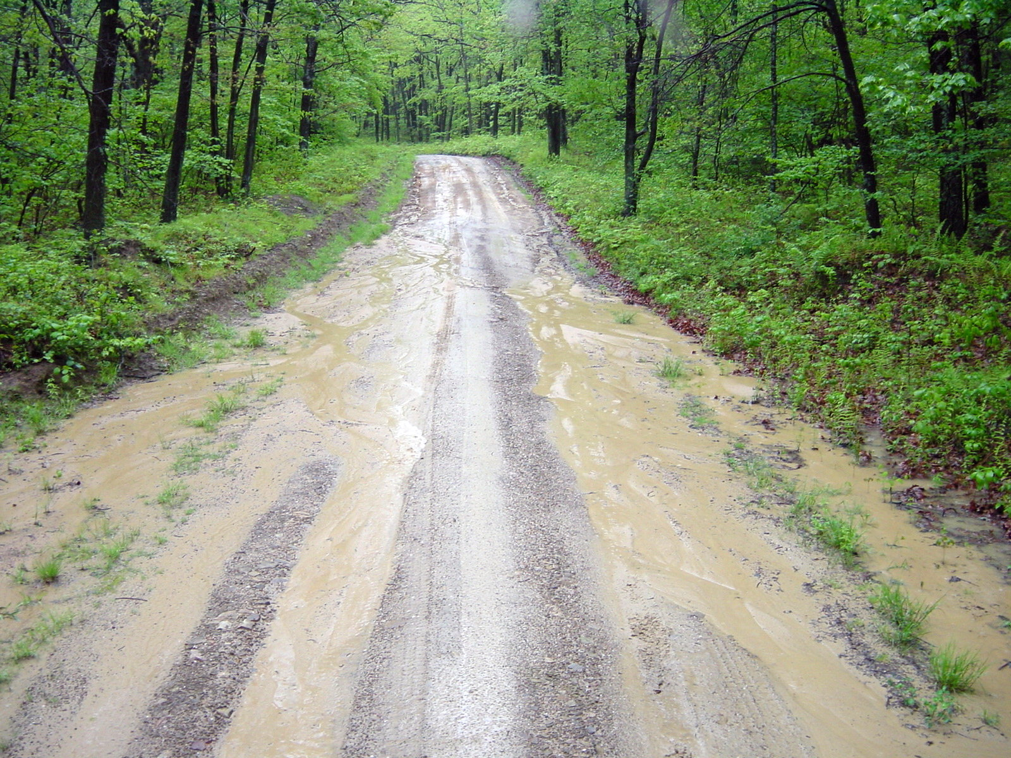
PA Dirt and Gravel Road Program
Program Purpose
Environmental impacts of road runoff
sediment generation & transport

Slide 9
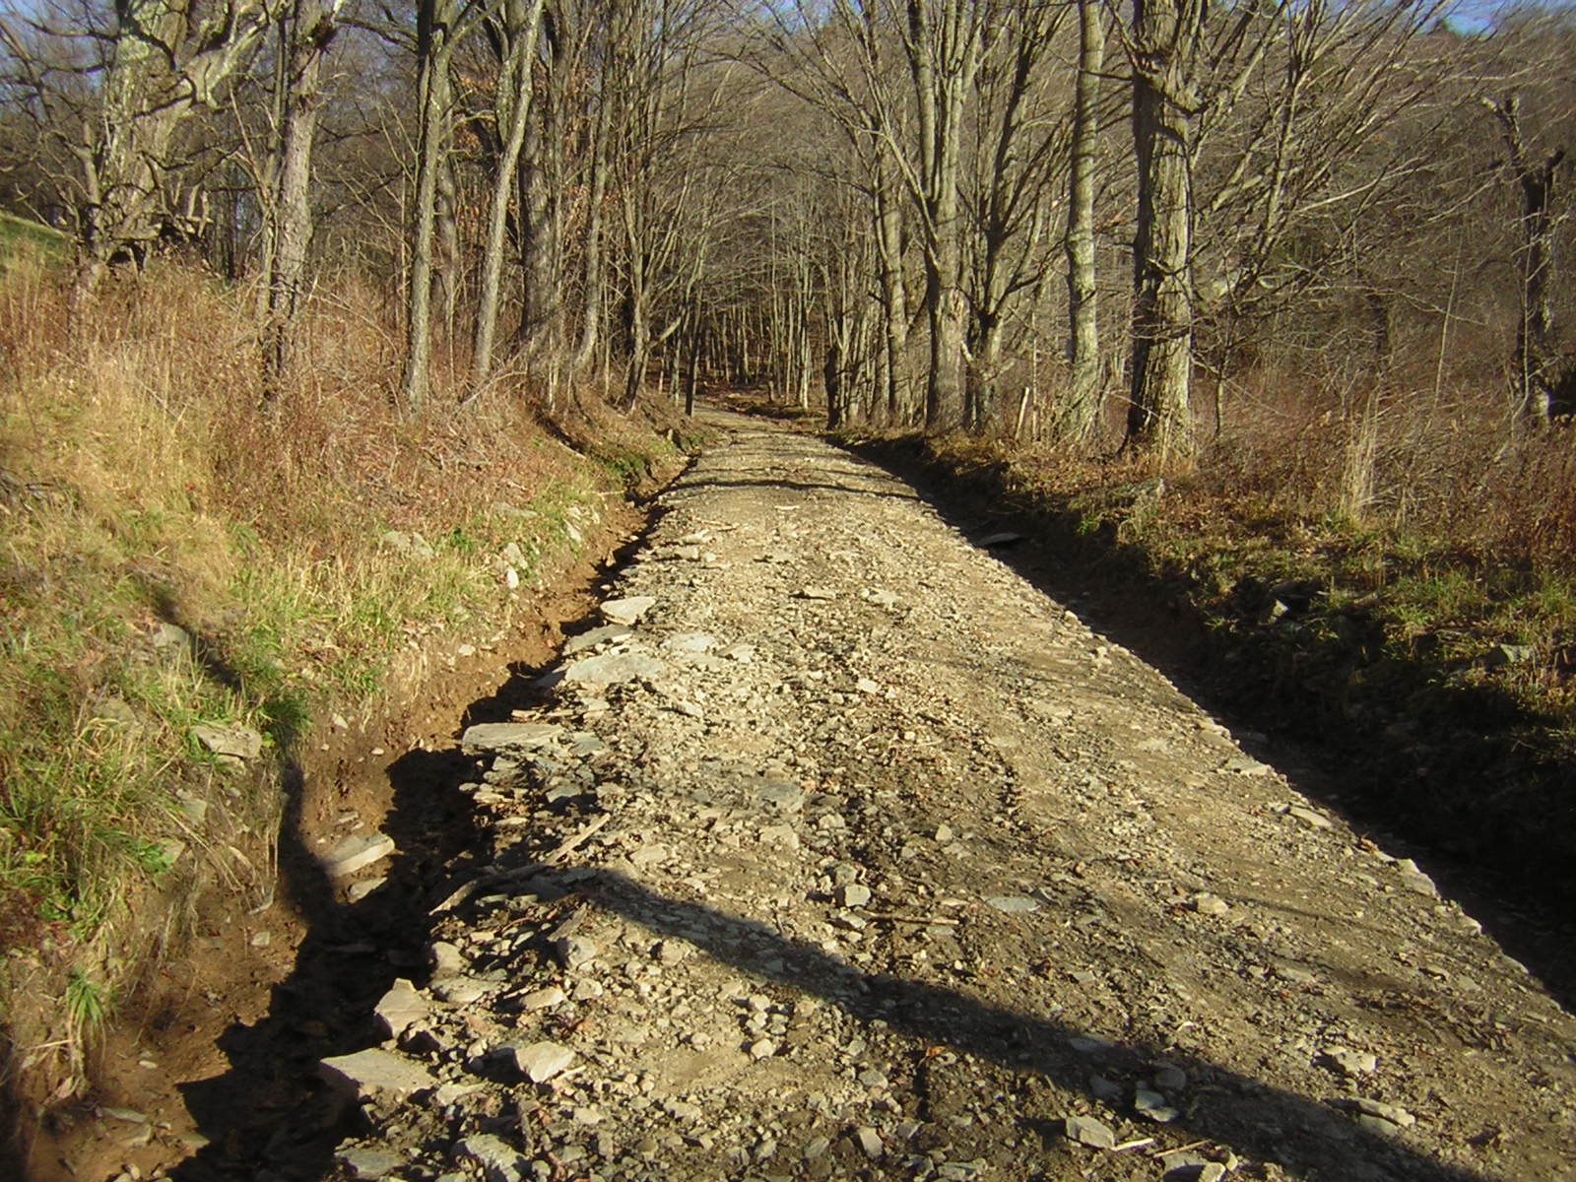
PA Dirt and Gravel Road Program
Program Purpose
Environmental impacts of road runoff
sediment generation & transport

Slide 10
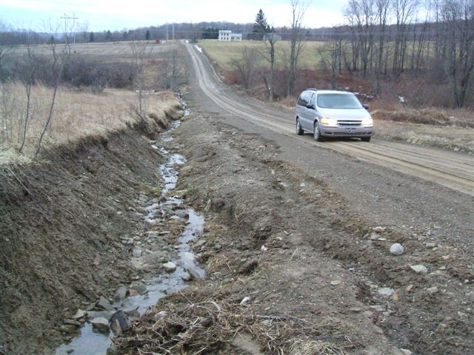
PA Dirt and Gravel Road Program
Program Purpose
Environmental impacts of road runoff
sediment generation & transport

Slide 11
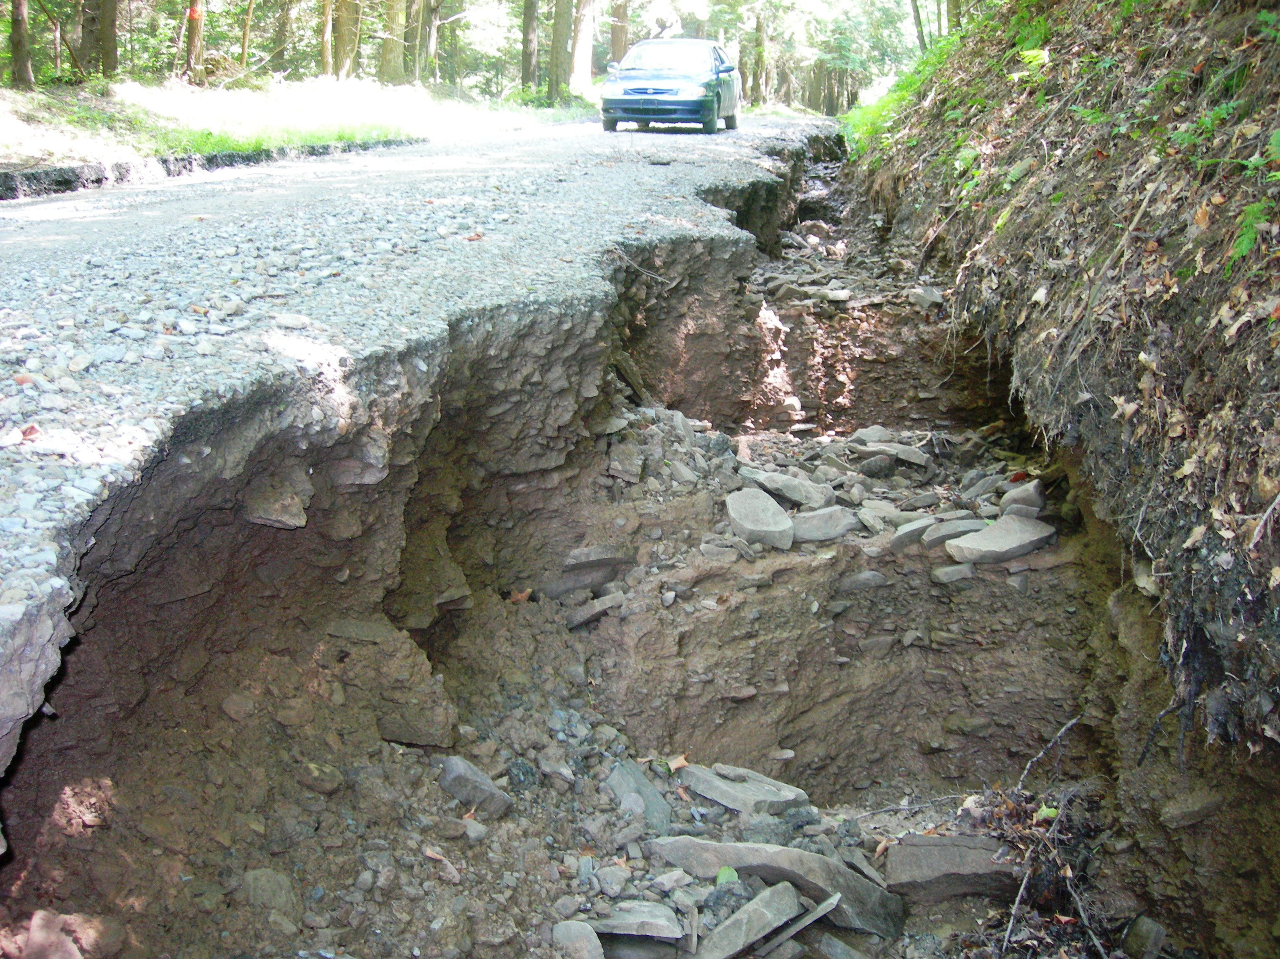
PA Dirt and Gravel Road Program
Program Purpose
Environmental impacts of road runoff
sediment generation & transport

Slide 12
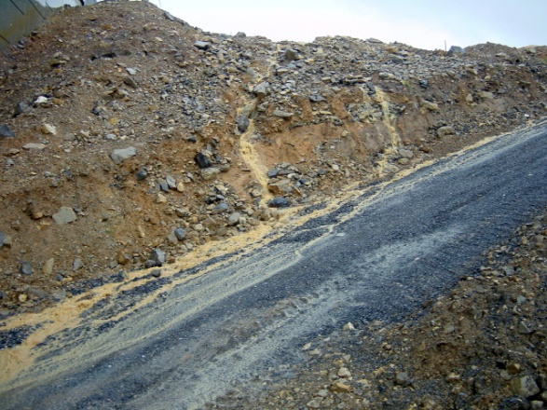
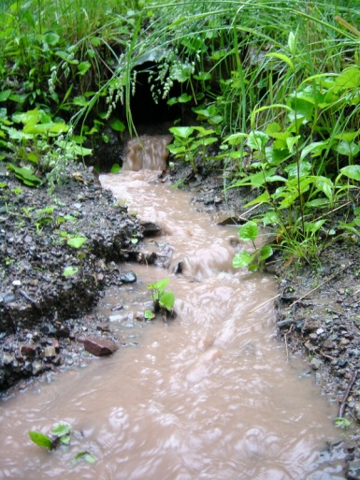
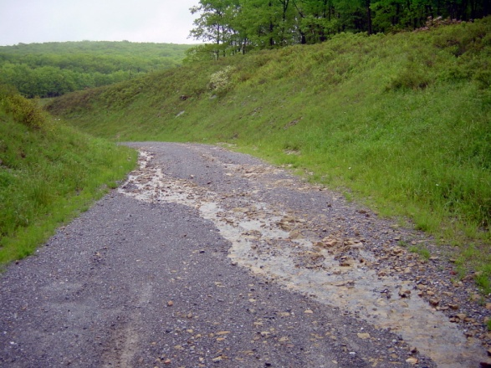
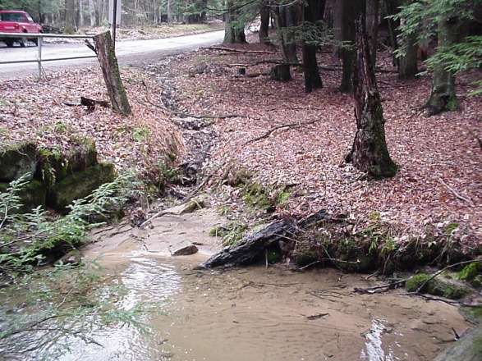
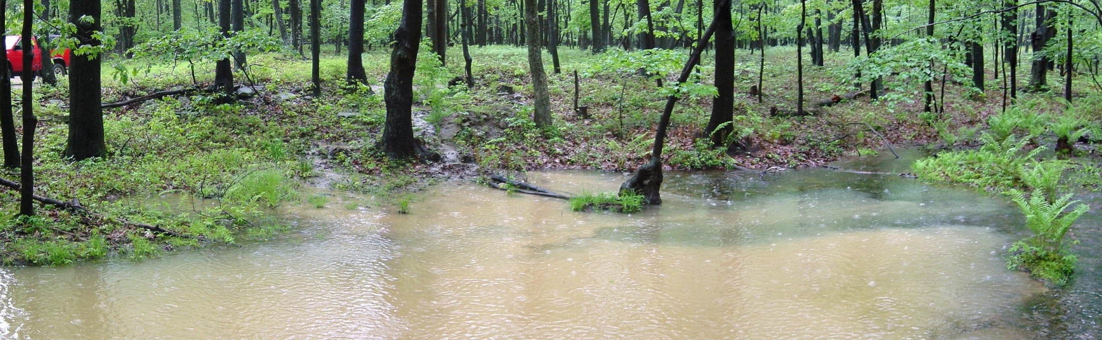
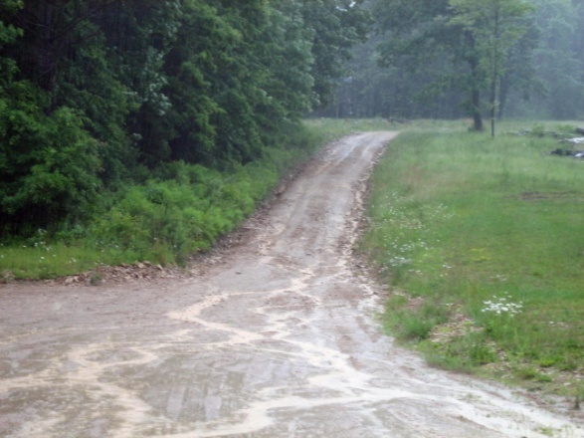
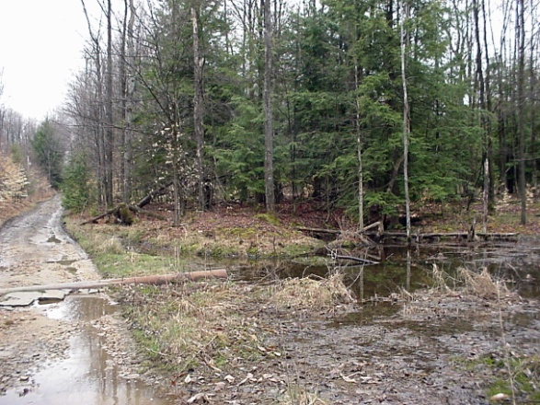
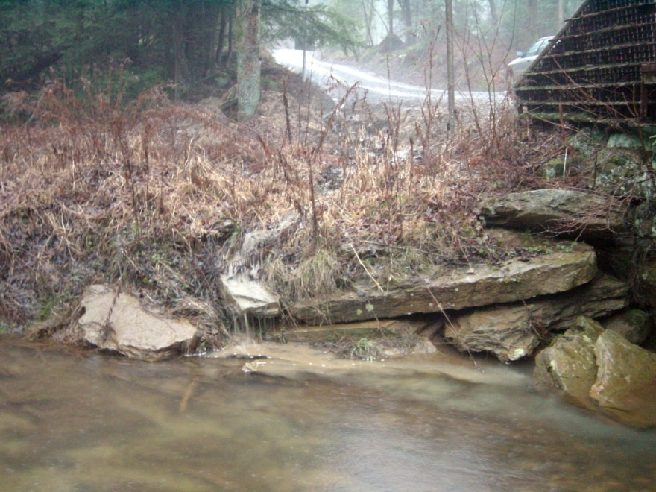
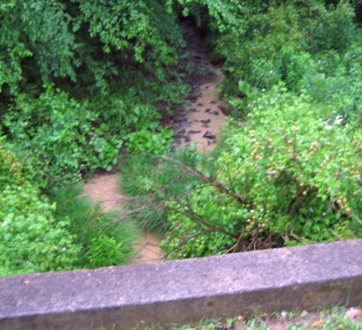
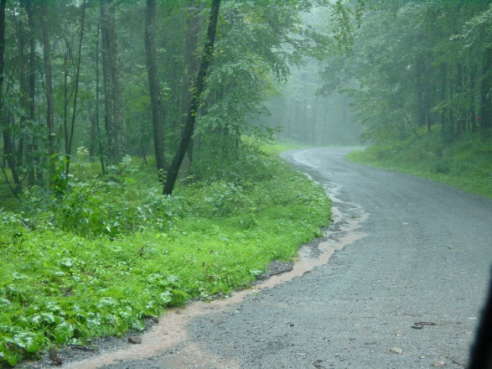
PA Dirt and Gravel Road Program
Program Purpose
Environmental impacts of road runoff
sediment delivery

Slide 13
PA Dirt and Gravel Road Program
Program Purpose
Surface drainage patterns
SUBSURFACE DRAINAGE PATTERNS
SUBSURFACE DRAINAGE PATTERNS
Sub-surface drainage patterns
Notes:
The effects of increased erosion are many, but the biggest are increased maintenance problems, as well as excess sediment and chemical runoff to the streams.

Slide 14
PA Dirt and Gravel Road Program
Program Purpose
Surface drainage patterns
SUBSURFACE DRAINAGE PATTERNS
SUBSURFACE DRAINAGE PATTERNS
Sub-surface drainage patterns
Notes:
The effects of increased erosion are many, but the biggest are increased maintenance problems, as well as excess sediment and chemical runoff to the streams.

Slide 15
Environmentally Sensitive Maintenance for low-volume roads
PA Dirt and Gravel Road Program
Program Purpose
Reduce concentrated drainage.
Reduce sediment pollution.
Reduce impact of road on the land.
Reduce long-term maintenance costs.
“Better Roads,
Cleaner Streams”
Notes:
The effects of increased erosion are many, but the biggest are increased maintenance problems, as well as excess sediment and chemical runoff to the streams.

Slide 16
ESMPs
ESM
ESM vs. Traditional Road Drainage
Ditches and Ditch Outlets
Traditional Drainage Practices: (collect and control)
Collection
Armoring
ESM Drainage Practices: (divide and conquer!)
Dispersal
Sheet Flow
Infiltration
Mimic Natural Drainage
Notes:
ALL ESMPs have these five goals
These five principles are the goals of ALL of the Environmentally Sensitive Maintenance Practices we will discuss in the next two days.

Slide 17
PA Dirt and Gravel Road Program
Program Purpose
SAMPLE PROJECTS
Crosspipe / Culvert Installation
BEFORE AFTER

Slide 18
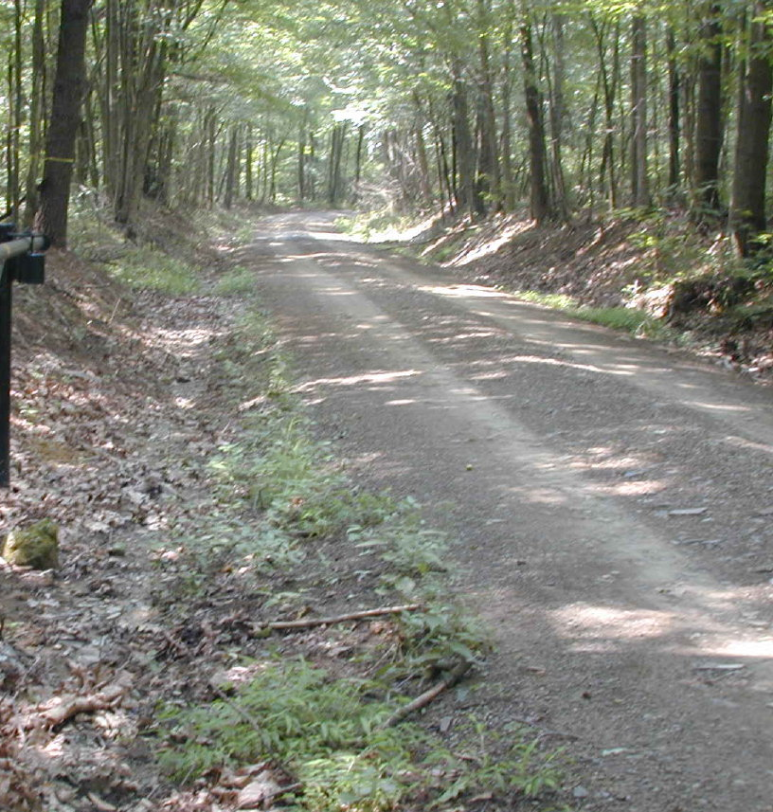
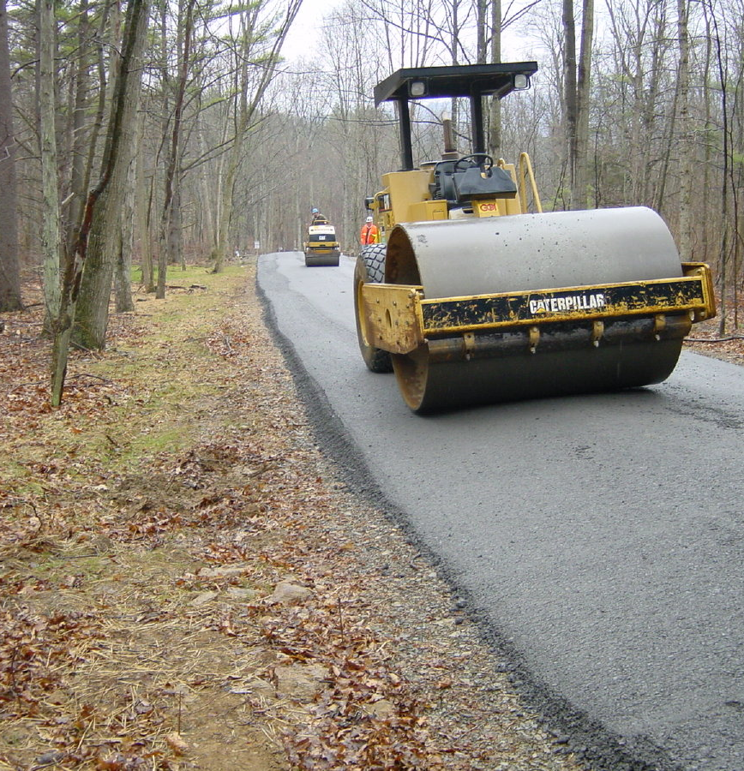
PA Dirt and Gravel Road Program
Program Purpose
SAMPLE PROJECTS
Road Filled to eliminate ditches
BEFORE AFTER

Slide 19
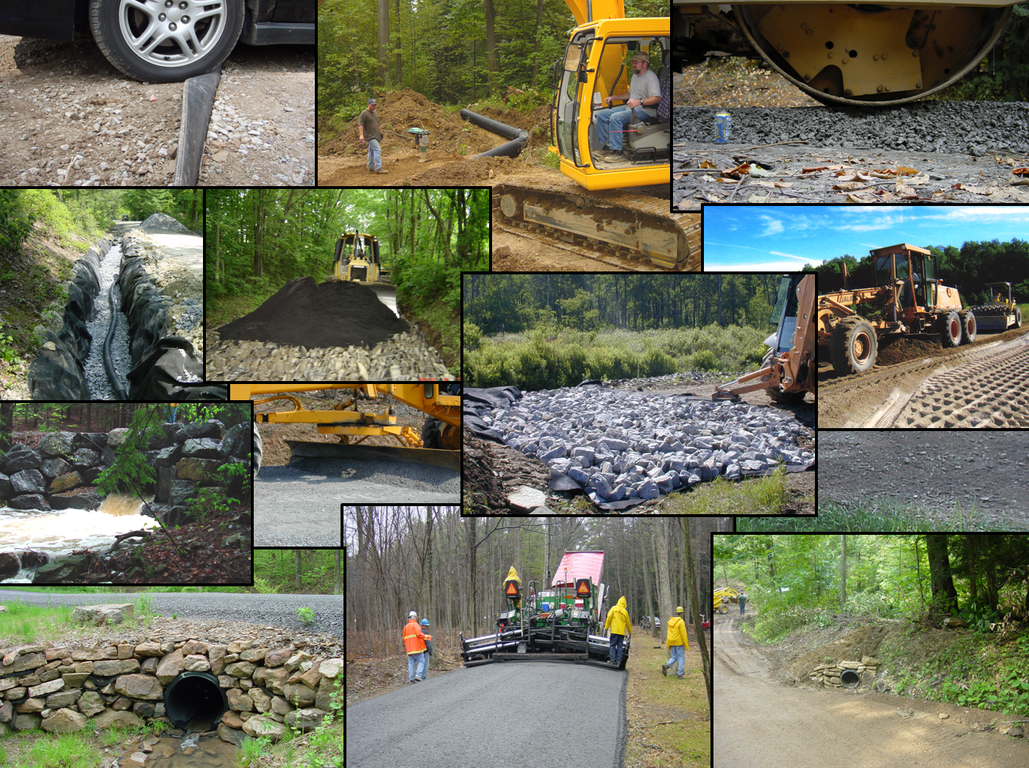
PA Dirt and Gravel Road Program
Program Purpose
SAMPLE PROJECTS

Slide 20
TOPIC OUTLINE
Program Purpose
Program History
Program Structure
PSU Center
Program Future

Slide 21
PA Dirt and Gravel Road Program
Program History
Began in 1997 (TU initiative)
$5 Million per year in grant funding
$1 Million through Bureau of Forestry
$4 Million through State Conservation Commission
Run by County Conservation Districts
Local road owning entities (municipalities, SGL, PAFBC, etc) apply for grant to District
GOAL: Long term solutions to reduce stream pollution and maintenance costs from unpaved roads
Notes:
Flow Chart
Administered at Local Level
Here is a flow chart of how the program is administered. Note that the Program is run by your County Conservation District, at the local level.

Slide 22
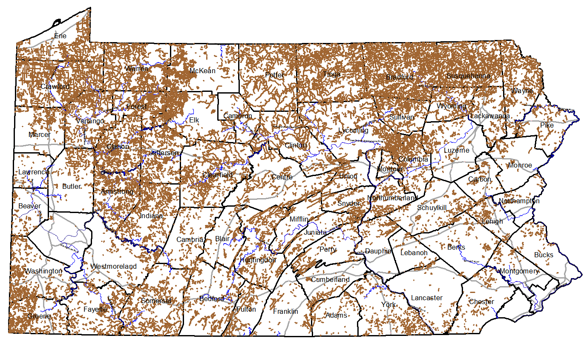
PA Dirt and Gravel Road Program
UNPAVED ROAD NETWORK
Program History
Public Unpaved Roads (20,000+ miles)
(16,500 municipal)

Slide 23
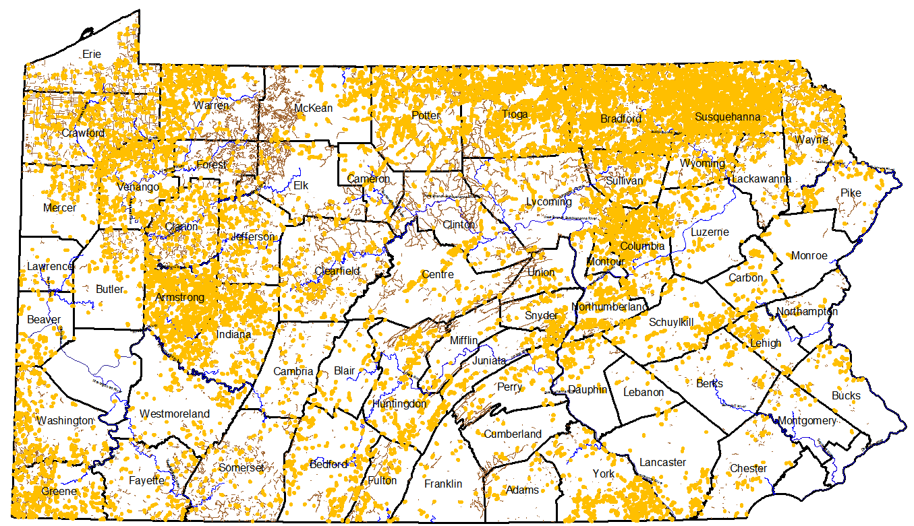
Program Status as of 1/2013
16,626 worksites
Public Unpaved Roads (20,000+ miles)
Unaddressed Pollution Sites (14,199 sites)

Slide 24
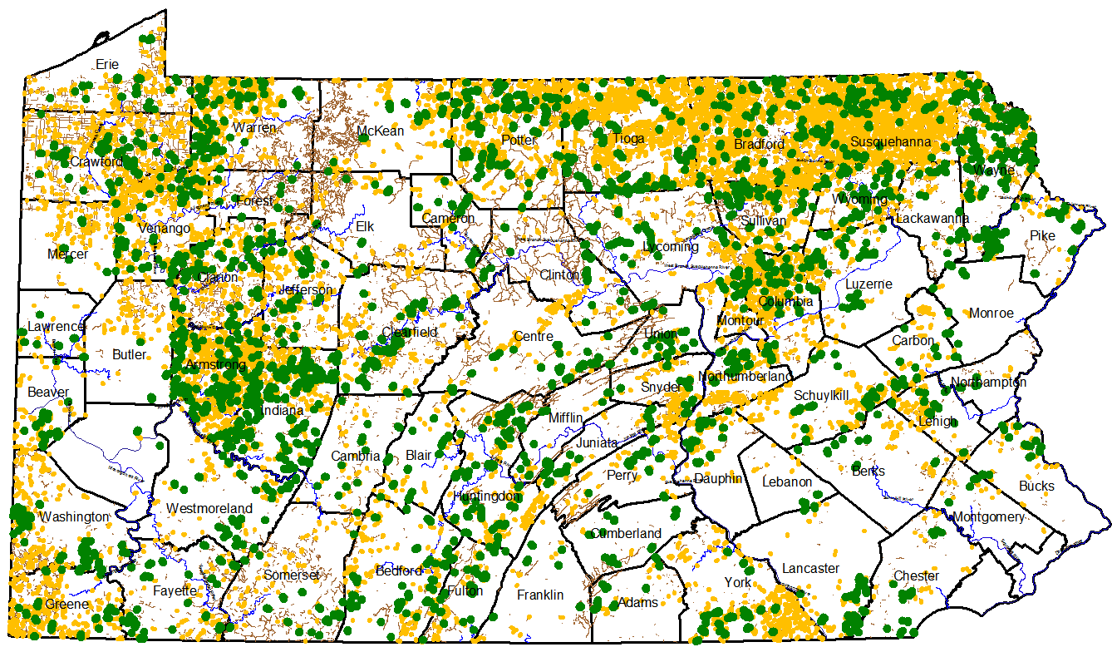
Program Status as of 1/2013
16,626 worksites
Public Unpaved Roads (20,000+ miles)
Unaddressed Pollution Sites (14,199 sites)
All Funded Worksites (2,427 sites)

Slide 25
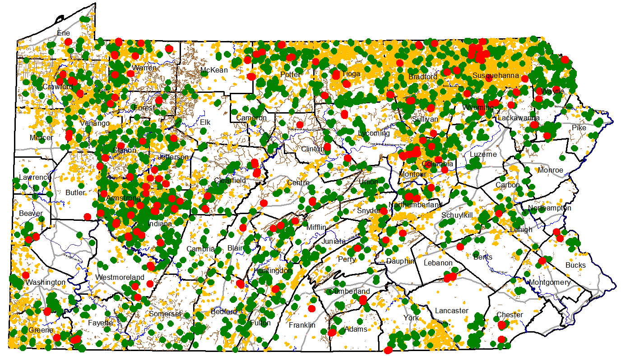
Program Status as of 1/2013
16,626 worksites
65 counties
667 municipalities
Public Unpaved Roads (20,000+ miles)
Unaddressed Pollution Sites (14,199 sites)
All Funded Worksites (2,427 sites)
2012 Funded Worksites (197 sites)

Slide 26
TOPIC OUTLINE
Program Purpose
Program History
Program Structure
PSU Center
Program Future

Slide 27
PA Dirt and Gravel Road Program
Program Structure
Dirt and Gravel Road Maintenance Program
$5 Million annual allocation
PA State Conservation Commission
$4 Million
PA DCNR Bureau of Forestry
$1 Million
Notes:
Flow Chart
Administered at Local Level
Here is a flow chart of how the program is administered. Note that the Program is run by your County Conservation District, at the local level.

Slide 28
PA Dirt and Gravel Road Program
Program Structure
Dirt and Gravel Road Maintenance Program
$5 Million annual allocation
PA State Conservation Commission
$4 Million
PA DCNR Bureau of Forestry
$1 Million
$
PA Conservation Districts
Administer Program in County
$
Townships (& others)
Apply to District for funding
Complete or contract work
Notes:
Flow Chart
Administered at Local Level
Here is a flow chart of how the program is administered. Note that the Program is run by your County Conservation District, at the local level.

Slide 29
PA Dirt and Gravel Road Program
Program Structure
Dirt and Gravel Road Maintenance Program
$5 Million annual allocation
PA State Conservation Commission
$4 Million
PA DCNR Bureau of Forestry
$1 Million
$
$
PA Conservation Districts
Administer Program in County
Forestry Districts
Receive funding and complete work
$
Townships (& others)
Apply to District for funding
Complete or contract work
Notes:
Flow Chart
Administered at Local Level
Here is a flow chart of how the program is administered. Note that the Program is run by your County Conservation District, at the local level.

Slide 30
Program Structure
SCC/District Program
State Conservation Commission
County Conservation District
Quality Assurance Board (QAB)
Grant Recipients
STATE CONSERVATION COMMISSION
- Administers statewide program.
- Quality Assurance Quality Control
- Allocates money to Conservation Districts.
PROGRAM BROCHURE IN
YOUR TAKE-HOME BOOK
Notes:
DGRP Efficient Program
One State Employee Administers and Allocates Funds
The Dirt and Gravel Roads Program is one of the most efficient state programs we have. It’s not a “Pork Barrel” program. There is only one employee at the State Conservation Commission that administers the program statewide, and allocates the money to the individual County Conservation Districts.

Slide 31
Program Structure
SCC/District Program
State Conservation Commission
County Conservation District
Quality Assurance Board (QAB)
Grant Recipients
COUNTY CONSERVATION DISTRICT
Administer program on county level.
Work with applicants on projects and permitting.
Receive money based on verified pollution sites.
Conduct inspection after work is completed.
Keep records and report to State annually.
Notes:
Locally Administered by Conservation District
You Work Directly with Conservation District
District Controls Grant $
District Conducts Site Inspections
Each County Conservation District administers the program at the local level. Municipal groups or public agencies interested in obtaining a grant will work directly with the District to get their project permitted and funded. The Conservation Districts are very knowledgeable about the process - they control the grant money allocated to them, and will conduct site inspections after the work is finished…. and they are also responsible for filing a report to the State Conservation Commission on an annual basis.

Slide 32
Program Structure
SCC/District Program
State Conservation Commission
County Conservation District
Quality Assurance Board (QAB)
Grant Recipients
QUALITY ASSURANCE BOARD
Each County has a QAB.
3 voting members and 1 non-voting chairman.
Members from District, PAFBC, and NRCS.
Develop priority list for worksites in County.
Recommend sites for funding to District Board
Notes:
Explain QAB
Local Folks
QAB Sets Criteria and Decides on Projects
Each participating county has a Quality Assurance Board, or a QAB, consisting of 3 voting members and one non-voting chairman. All of the QAB members are from the local county, and are familiar with the local roadways. This group is made up of members of the Conservation District, the Fish and Boat Commission, and the Natural Resources Conservation Service (which is the federal rep.). The Fish and Boat Commission, and the NRCS can appoint members to the QAB to represent their agencies. The QAB decides which projects get funded, based on a priority list they establish.

Slide 33
Program Structure
SCC/District Program
State Conservation Commission
County Conservation District
Quality Assurance Board (QAB)
Grant Recipients
GRANT RECIPIENTS
Own and maintain roads.
Applicants are usually municipalities, but include:
PA Game Commission, County Parks, PA Fish Commission, PA DOT
Apply to conservation District for project funding.
Complete work themselves or have it contracted.
Must attend ESM training to apply for funding.
Notes:
Grant Recipients – Usually Townships
Can Do Work or Hire a Contractor
The next group is you guys, the ones who own and maintain our dirt and gravel roads. In most cases, the Grant Recipients are the local Townships, who applied to the District for project funding. The Game Commission, the Fish Commission, County Parks, and even PennDOT are also eligible for funding, but this rarely occurs. A Grant Recipient can chose to do the work themselves, or they can hire a private contractor.

Slide 34
TOPIC OUTLINE
Program Purpose
Program History
Program Structure
PSU Center
Program Future

Slide 35
PA Dirt and Gravel Road Program
PSU Center
Dirt and Gravel Road Maintenance Program
$5 Million annual allocation
PA State Conservation Commission
$4 Million
PA DCNR Bureau of Forestry
$1 Million
$
$
$
$
PSU Center for Dirt and Gravel Road Studies
PA Conservation Districts
Administer Program in County
Forestry Districts
Receive funding and complete work
$
Townships (& others)
Apply to District for funding
Complete or contract work
Notes:
Flow Chart
Administered at Local Level
Here is a flow chart of how the program is administered. Note that the Program is run by your County Conservation District, at the local level.

Slide 36
PA Dirt and Gravel Road Program
PSU Center
Dirt and Gravel Road PROGRAM
Education
2 day ESM training
Annual Workshops
Demonstration Days
Outreach
- Technical Documentation
- Website
Newsletter
Interagency cooperation
Program Support
Advisory Groups
Technical Assistance to Districts
Quality Assurance effort
Geographic Information Systems
Funding Support
Guidance
Make Policy
“Administer” Program

Slide 37
PA Dirt and Gravel Road Program
PSU Center
We are here to help the Conservation Districts:
Project layouts
Meeting with applicants
Project implementation help
Admin help
GIS
Driving Surface Aggregate
General questions
CALL US!

Slide 38
TOPIC OUTLINE
Program Purpose
Program History
Program Structure
PSU Center
Program Future

Slide 39
PA Dirt and Gravel Road Program
Program Future
Act 89 of 2013 (transportation bill)
Notes:
Flow Chart
Administered at Local Level
Here is a flow chart of how the program is administered. Note that the Program is run by your County Conservation District, at the local level.

Slide 40
PA Dirt and Gravel Road Program
Program Future
Act 89 of 2013 (transportation bill)
7X Program Funding increase
$5M Annual Funding $35M Annual Funding
$4M to SCC $28M to SCC
$1M to Forestry $7M to Forestry
Notes:
Flow Chart
Administered at Local Level
Here is a flow chart of how the program is administered. Note that the Program is run by your County Conservation District, at the local level.

Slide 41
PA Dirt and Gravel Road Program
Program Future
Act 89 of 2013 (transportation bill)
7X Program Funding increase
$5M Annual Funding $35M Annual Funding
$4M to SCC $28M to SCC
$1M to Forestry $7M to Forestry
Low-volume Paved Roads
Minimum $8M (of SCC $28M) for work on paved roads with less than 500 adt.
Effective FY 2014-15
Notes:
Flow Chart
Administered at Local Level
Here is a flow chart of how the program is administered. Note that the Program is run by your County Conservation District, at the local level.

Slide 42
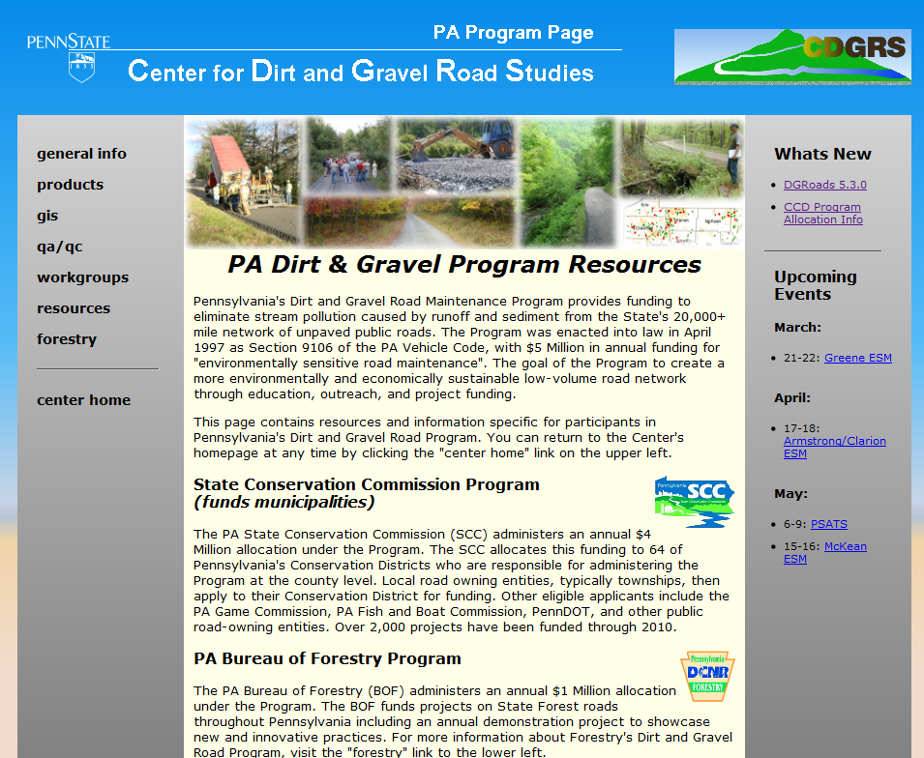
PA Dirt and Gravel Road Program
Program Future
Notes:
Flow Chart
Administered at Local Level
Here is a flow chart of how the program is administered. Note that the Program is run by your County Conservation District, at the local level.

